Slide 1

Machine Learning for Media Technology - exam Haberman's Survival Data Set
BY NICKLAS OLSEN

Slide 3
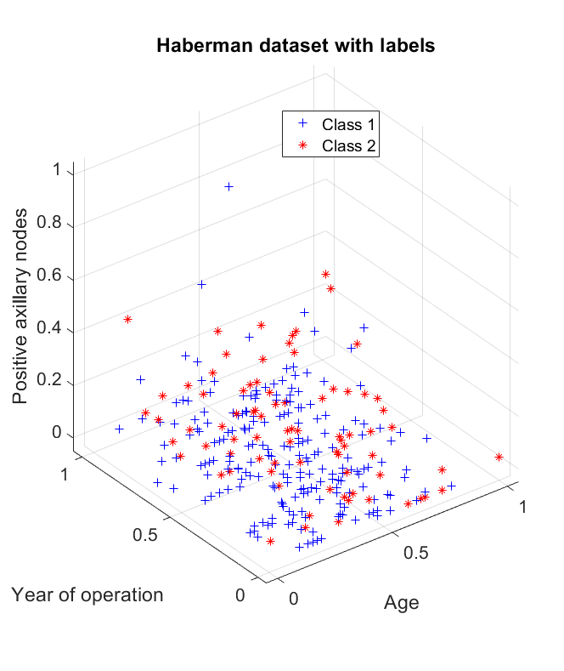
DATA
306 entries
3 Features:
Age
Year of operation
Positive Axillary nodes
2 Classes:
The patient survived 5 years or longer
The patient died within 5 years

Slide 4
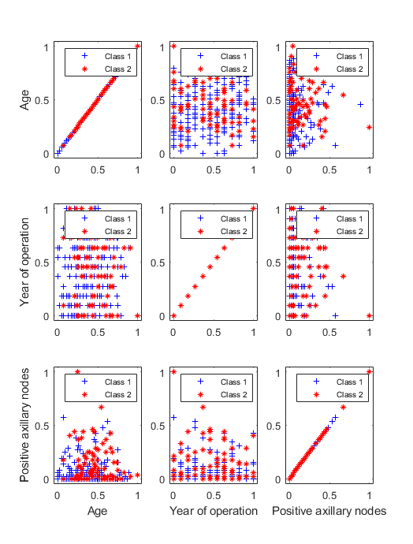
DATA
306 entries
3 Features:
Age
Year of operation
Positive Axillary nodes
2 Classes:
The patient survived 5 years or longer
The patient died within 5 years

Slide 5
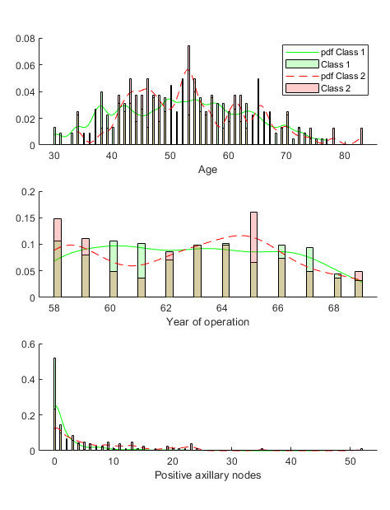
DATA
306 entries
3 Features:
Age
Year of operation
Positive Axillary nodes
2 Classes:
The patient survived 5 years or longer
The patient died within 5 years

Slide 6
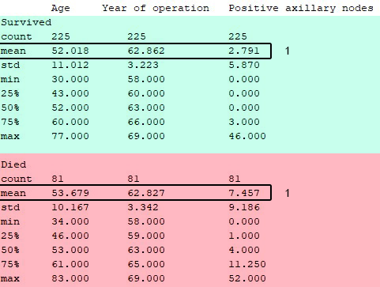
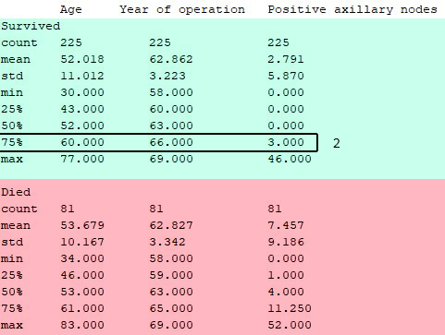
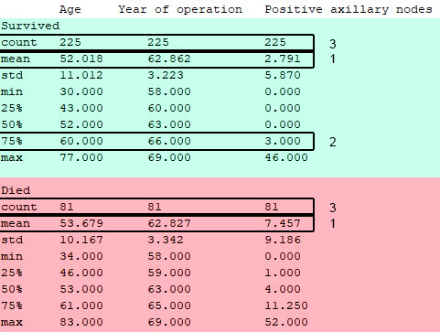
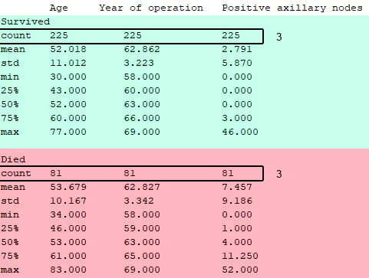
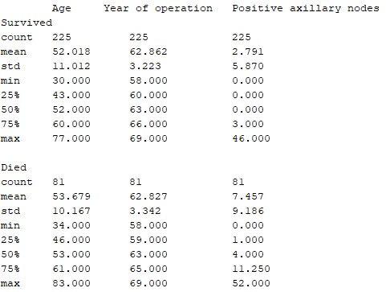
DATA ANALYSIS
Amount
Means
Min/Max
Quantiles
Distributions
Priors
Covariances

Slide 7
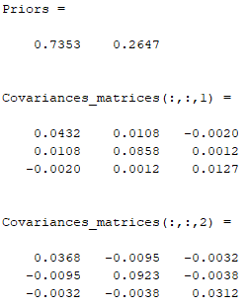
DATA ANALYSIS
Amount
Means
Min/Max
Quantiles
Distributions
Priors
Covariances

Slide 8
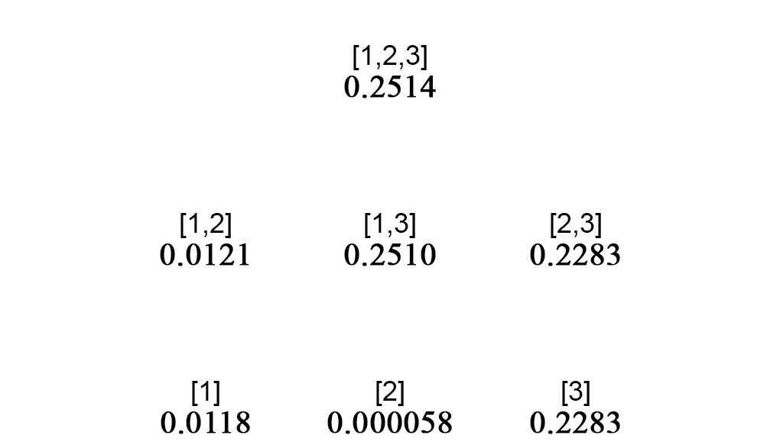
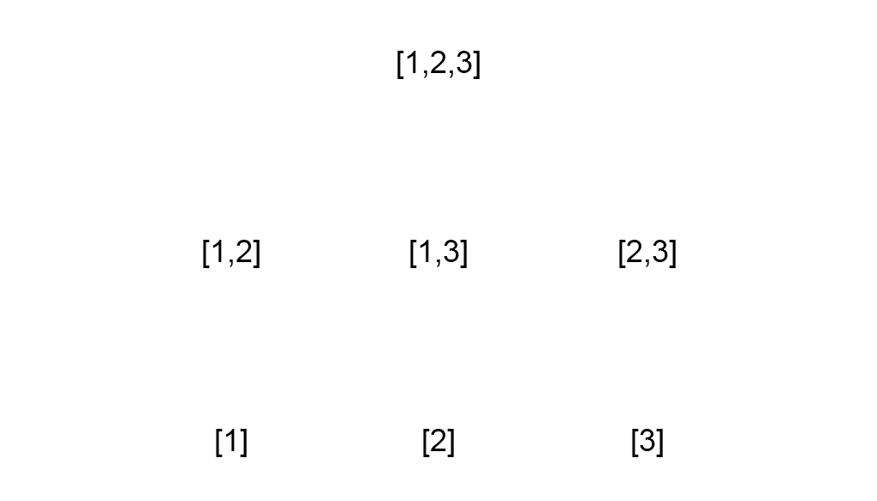

Feature selection
[Age, Year of operation, Positive axillary nodes]
Inter/intra class distance
For each possible subset permutation

Slide 9
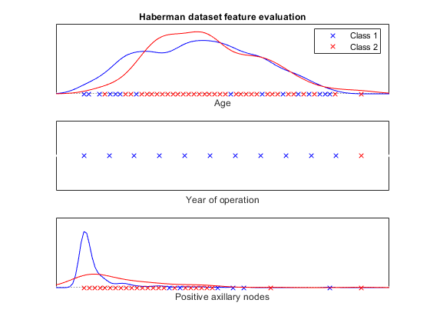
Feature selection (visual inspection)
How do these results correlate with an visual insepection of each feature?

Slide 10
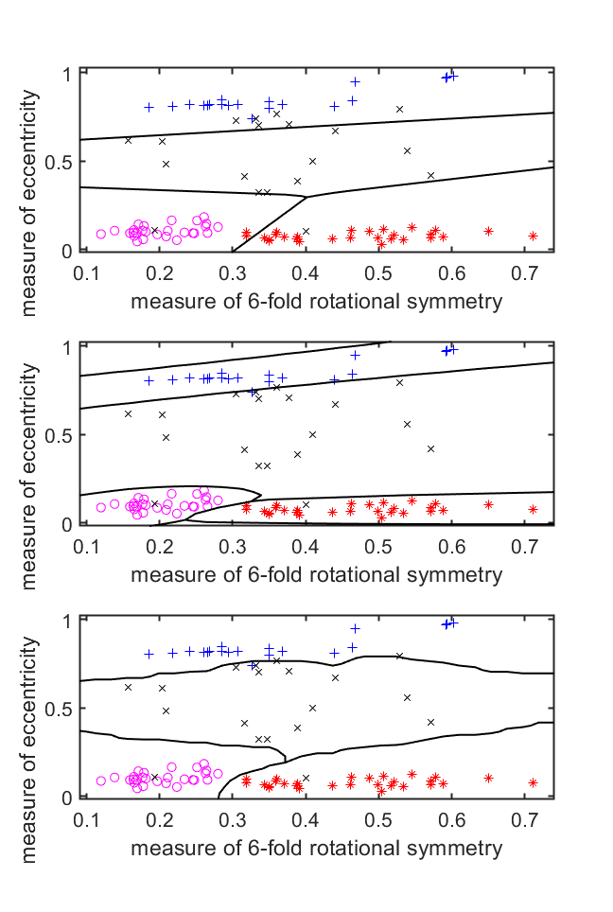
Training
With these results
Hard for any classifier to classify with high precision
Evaluate the following classifiers:
Linear classifier (ldc)
Clearly not cut out for such a task
Quadratic classifier (qdc)
Has potential
Nearest Neighbor Classifier (knnc)
Has potential

Slide 11
[1,2,3]
ldc
Contour plots
Confusion matrix
Cross validation
Performance estimation
qdc
Contour plots
Confusion matrix
Cross validation
Performance estimation
knnc
Contour plots
Confusion matrix
Cross validation
Performance estimation

Slide 12
[1,3]
ldc
Decision boundary plot
Confusion matrix
Cross validation
Performance estimation
qdc
Decision boundary plot
Confusion matrix
Cross validation
Performance estimation
knnc
Decision boundary plot
Confusion matrix
Cross validation
Performance estimation

Slide 13
[2,3]
ldc
Decision boundary plot
Confusion matrix
Cross validation
Performance estimation
qdc
Decision boundary plot
Confusion matrix
Cross validation
Performance estimation
knnc
Decision boundary plot
Confusion matrix
Cross validation
Performance estimation

Slide 14
[3]
ldc
Contour plots
Confusion matrix
Cross validation
Performance estimation
qdc
Contour plots
Confusion matrix
Cross validation
Performance estimation
knnc
Contour plots
Confusion matrix
Cross validation
Performance estimation

