Slide 1

Machine Learning for Media Technology - exam Haberman's Survival Data Set
BY NICKLAS OLSEN

Slide 2
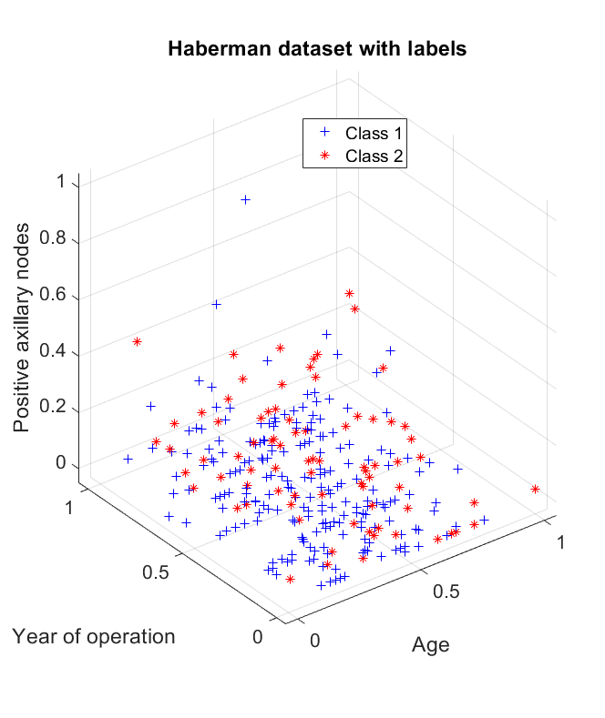
DATA
306 entries
3 Features:
Age
Year of operation
Positive Axillary nodes
2 Classes:
The patient survived 5 years or longer
The patient died within 5 years

Slide 3
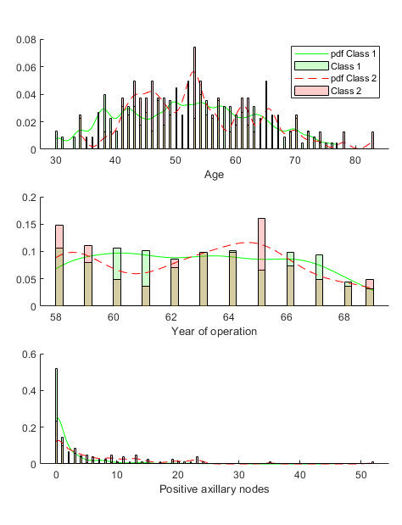
DATA
306 entries
3 Features:
Age
Year of operation
Positive Axillary nodes
2 Classes:
The patient survived 5 years or longer
The patient died within 5 years

Slide 4
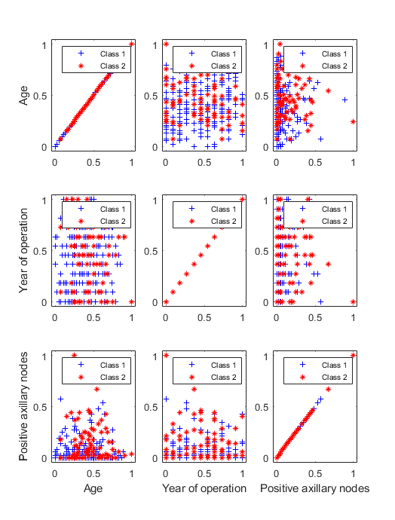
DATA
306 entries
3 Features:
Age
Year of operation
Positive Axillary nodes
2 Classes:
The patient survived 5 years or longer
The patient died within 5 years

Slide 5
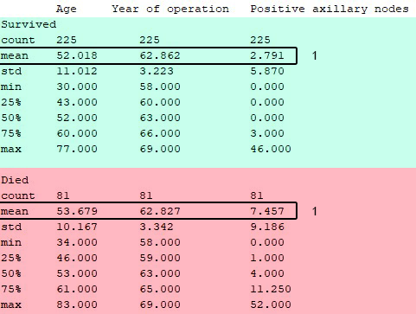
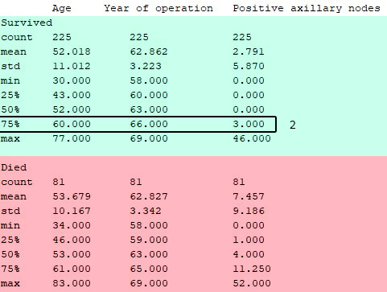
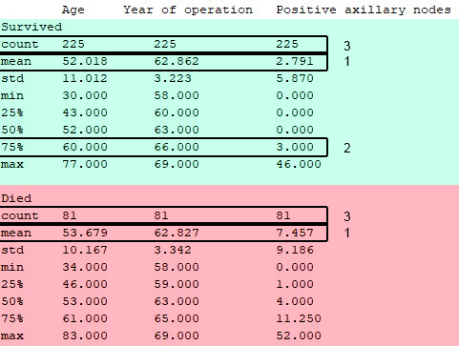
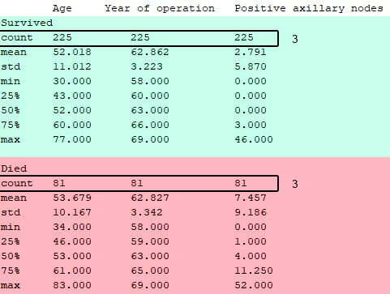
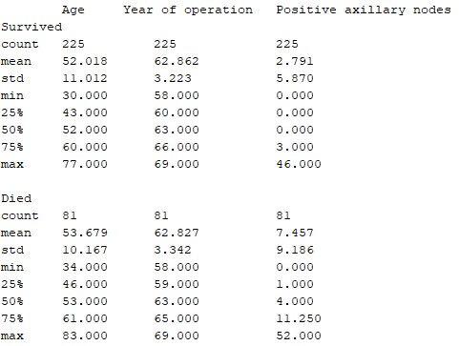
DATA ANALYSIS
Amount
Means
Min/Max
Quantiles
Distributions
Priors
Covariances

Slide 6
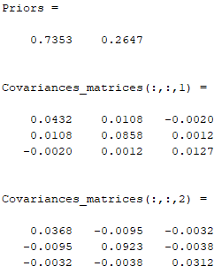
DATA ANALYSIS
Amount
Means
Min/Max
Quantiles
Distributions
Priors
Covariances

Slide 7
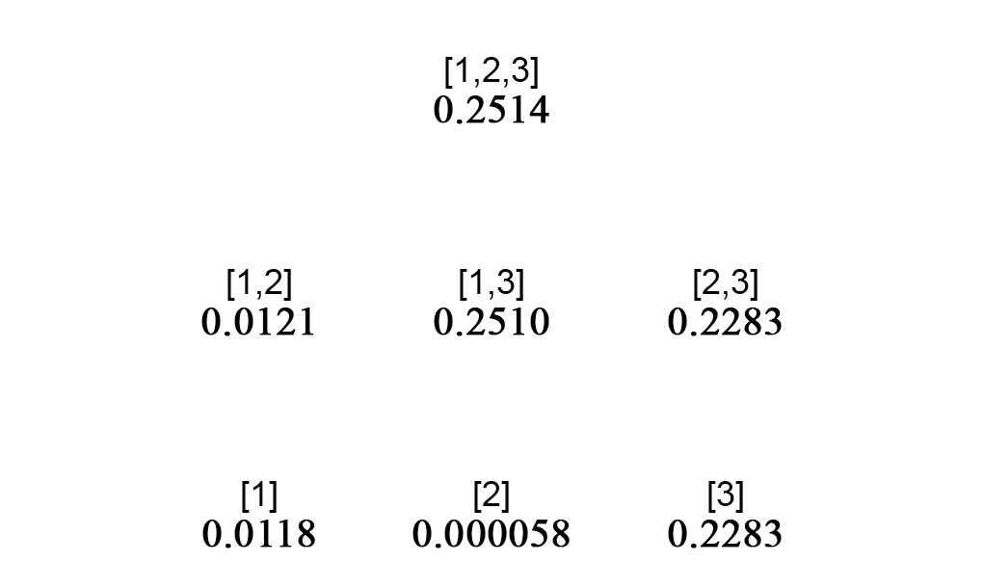
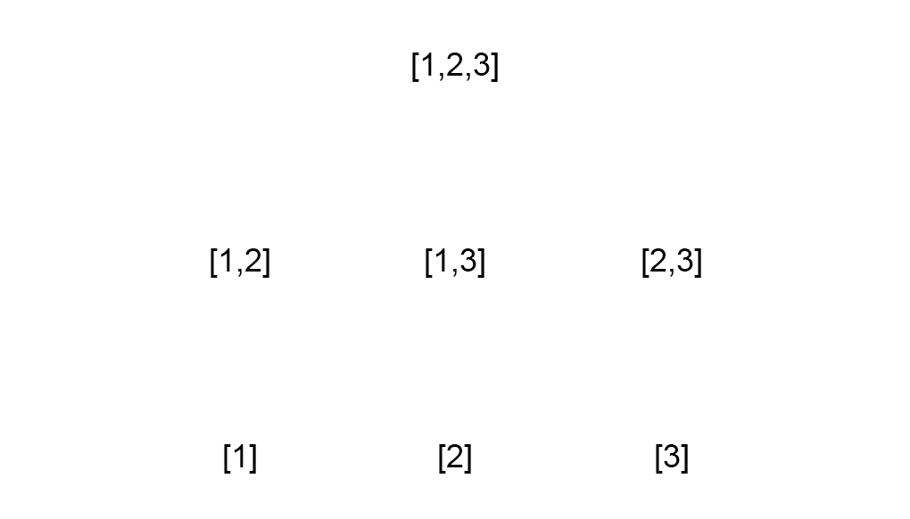

Feature selection
[Age, Year of operation, Positive axillary nodes]
Inter/intra class distance
For each possible subset permutation

Slide 8
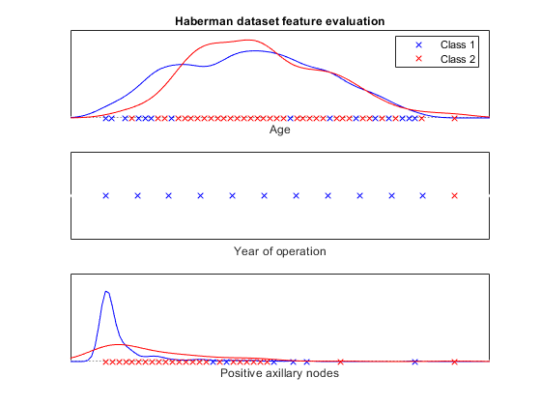
Feature selection (visual inspection)
How do these results correlate with an visual insepection of each feature?

Slide 9
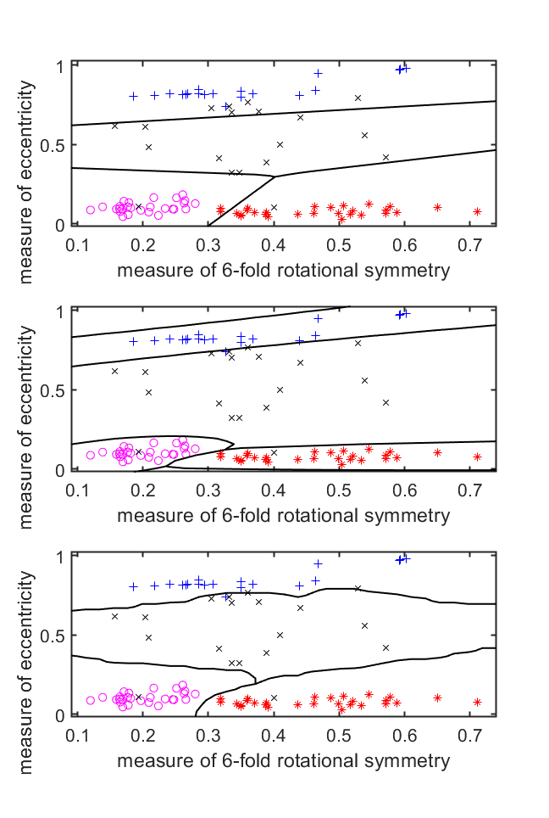
Training
With these results
Hard for any classifier to classify with high precision
Evaluate the following classifiers:
Linear classifier (ldc)
Clearly not cut out for such a task
Quadratic classifier (qdc)
Has potential
Nearest Neighbor Classifier (knnc)
Has potential

Slide 10
Results
Best subset
Cross validation:
qdc: [3] ⟶ 0.236842
ldc: [3] ⟶ 0.233083
knnc:[3] ⟶ 0.221805
Performance estimation (testc):
qdc: [3] ⟶ 0.35
ldc: [3] ⟶ 0.375
knnc: [1,3] ⟶ 0.45

Slide 11
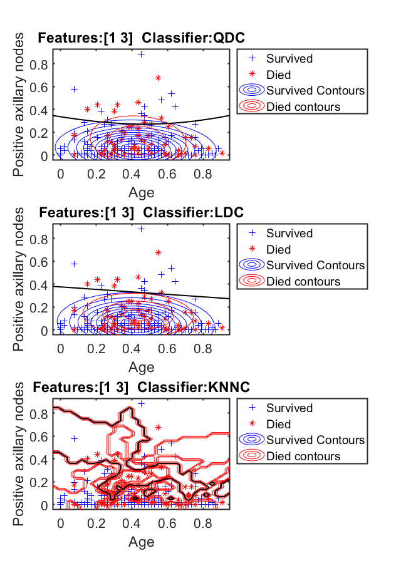
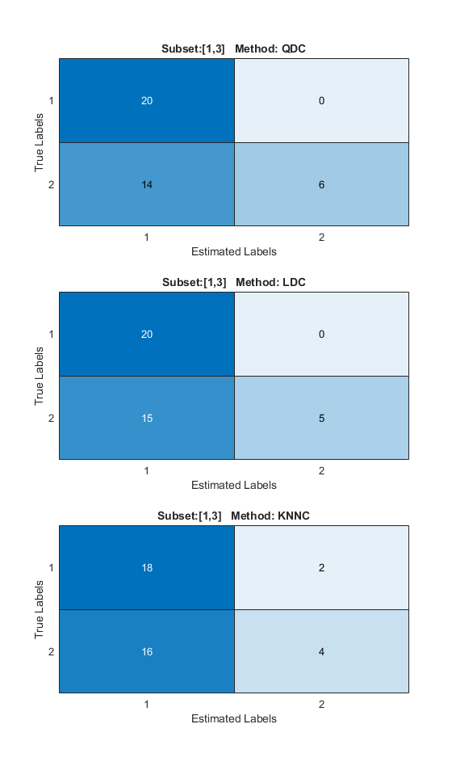
[1,3]
ldc
Decision boundary plot
Confusion matrix
ROC plot
qdc
Decision boundary plot
Confusion matrix
ROC plot
knnc
Decision boundary plot
Confusion matrix
ROC plot

Slide 12
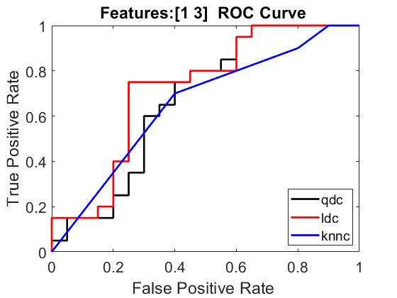
[1,3]
ldc
Decision boundary plot
Confusion matrix
ROC plot
qdc
Decision boundary plot
Confusion matrix
ROC plot
knnc
Decision boundary plot
Confusion matrix
ROC plot

Slide 13
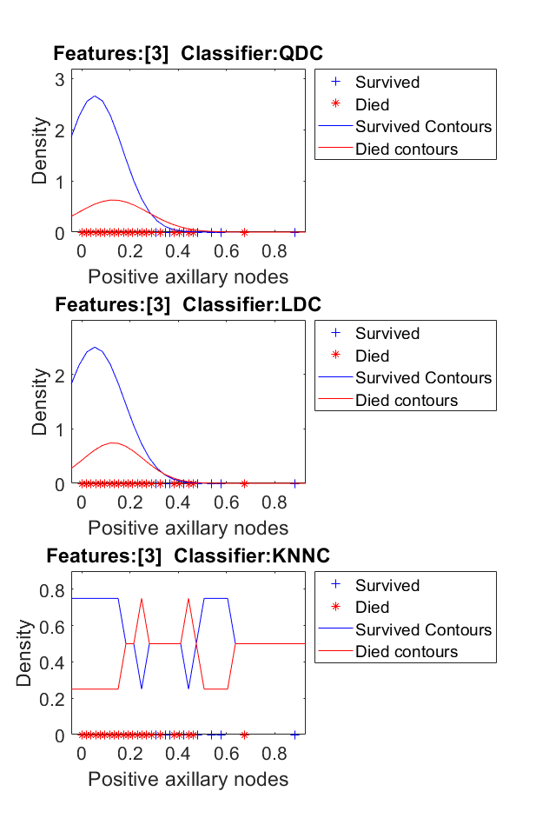
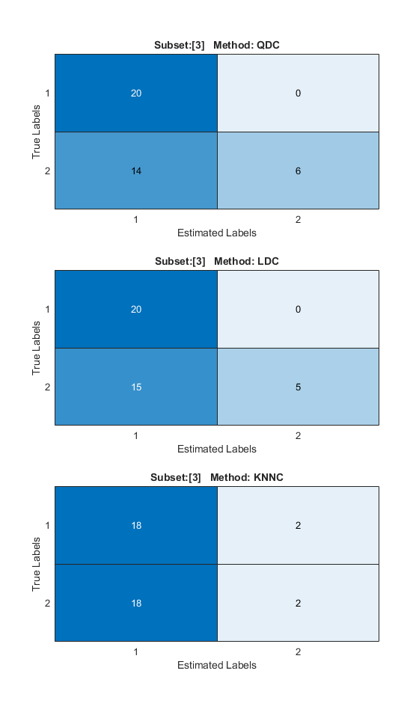
[3]
ldc
Contour plot
Confusion matrix
ROC plot
qdc
Contour plot
Confusion matrix
ROC plot
knnc
Contour plot
Confusion matrix
ROC plot

Slide 14
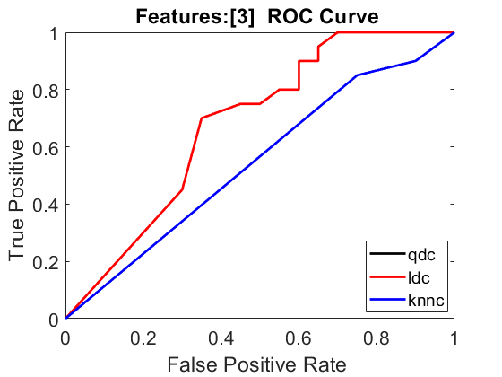
[3]
ldc
Contour plot
Confusion matrix
ROC plot
qdc
Contour plot
Confusion matrix
ROC plot
knnc
Contour plot
Confusion matrix
ROC plot

