Slide 1
Patent and paper prep
EpiTox

Slide 2
Figures mockup for next week
Results
Epitox
Magea3
input
Magea 3 analysis
Ranking
SCORE
Kinetics landscape
Benchmark against tools -> supplementary (CrossDome)
References

Slide 3
Done!
Still in the making!
Story line incomplete
EpiTox
Implementation and features
MAGEA3 off-targets prediction & validation
SNPs-derived peptides
Motif binding
Experimental evidence
Benchmark:
Known off-targets
Other tools
Ranking score

Slide 4









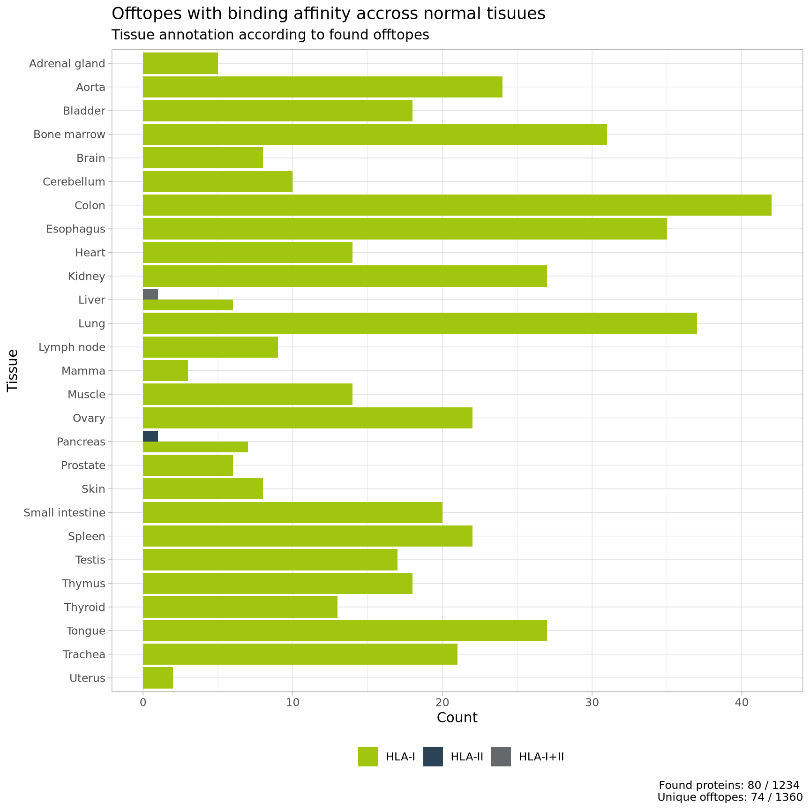
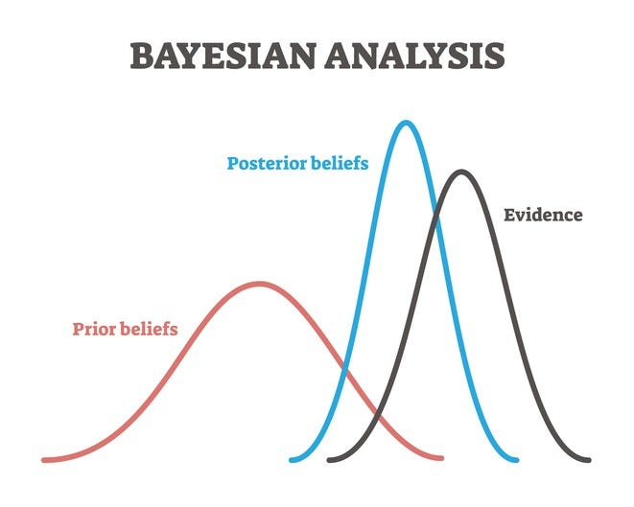
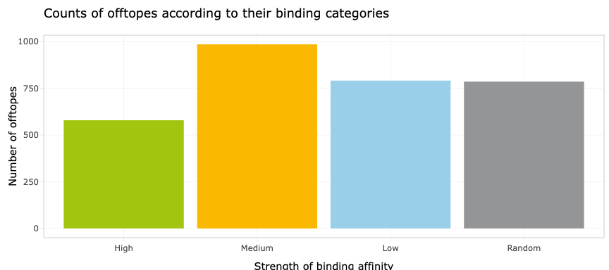
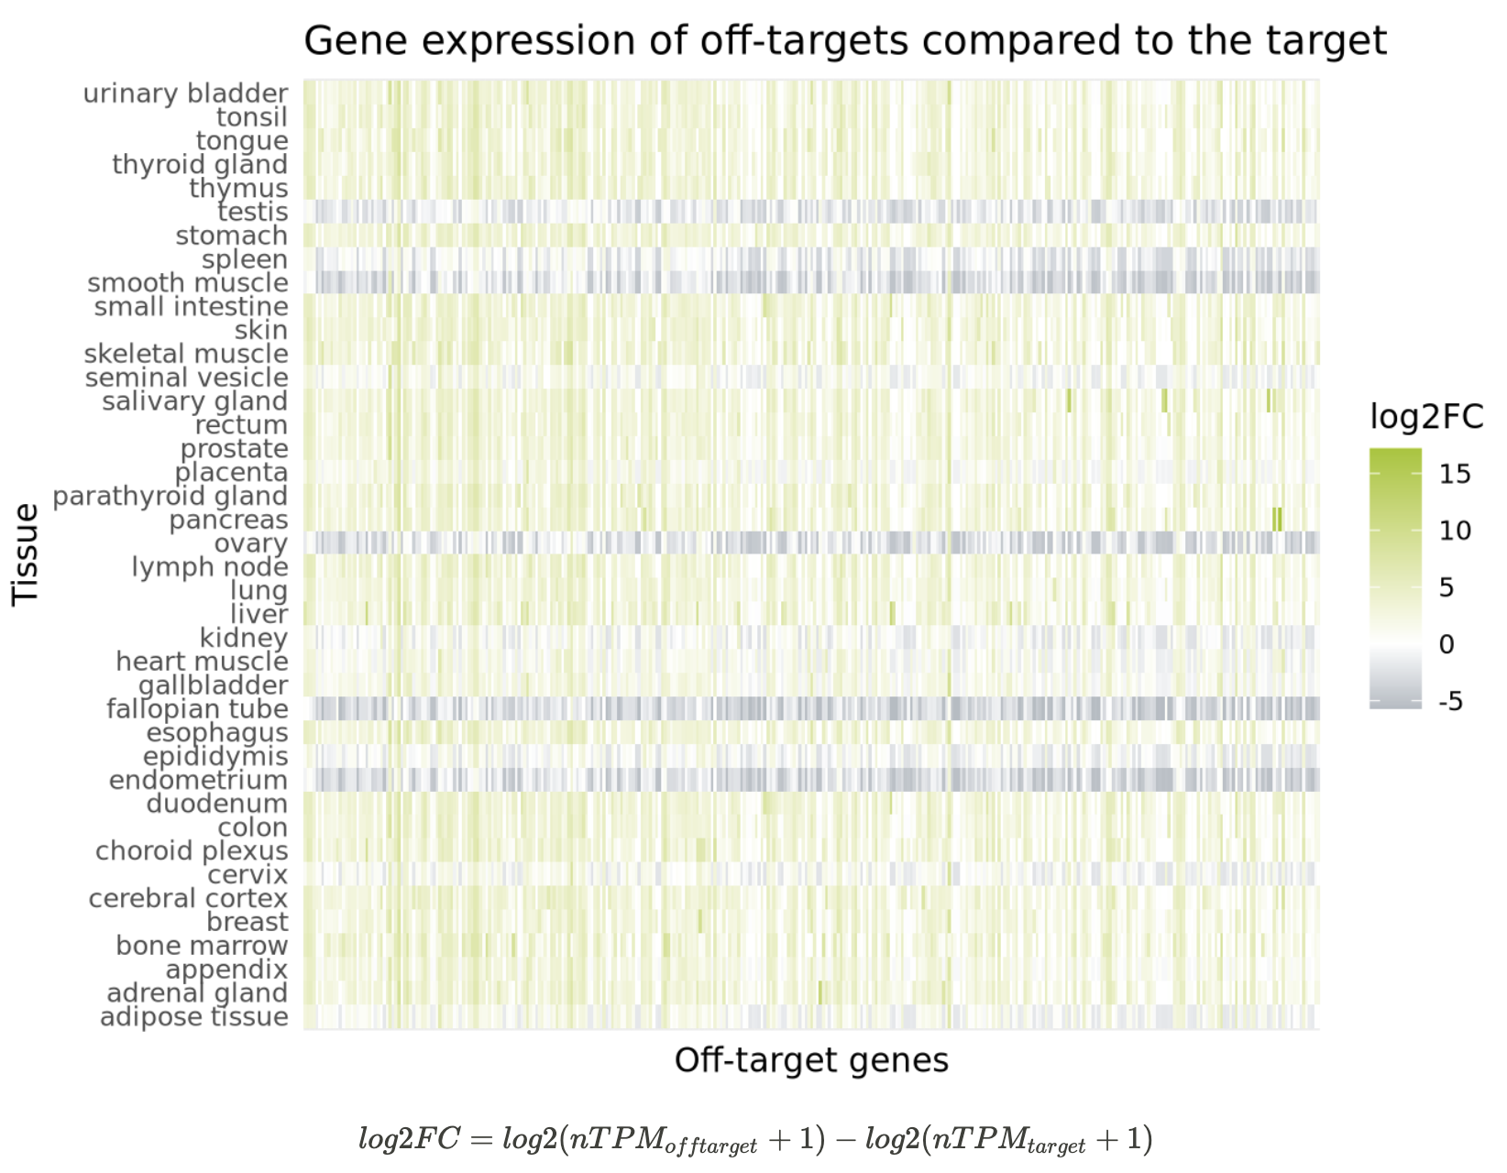

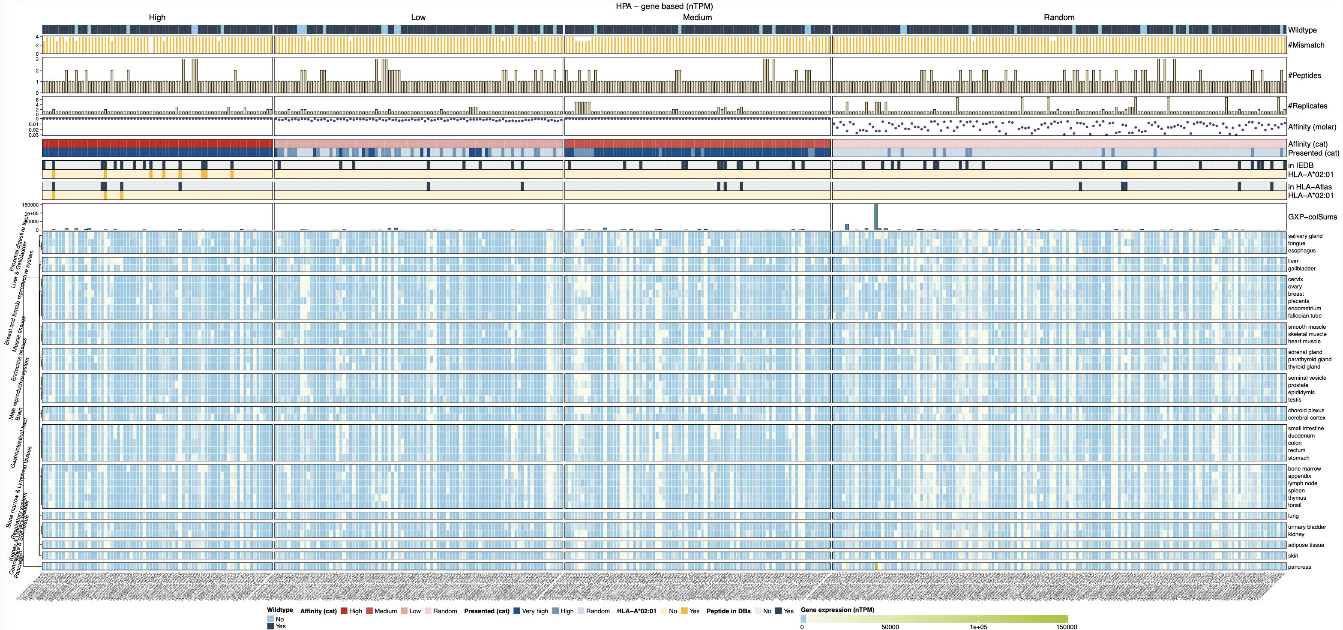

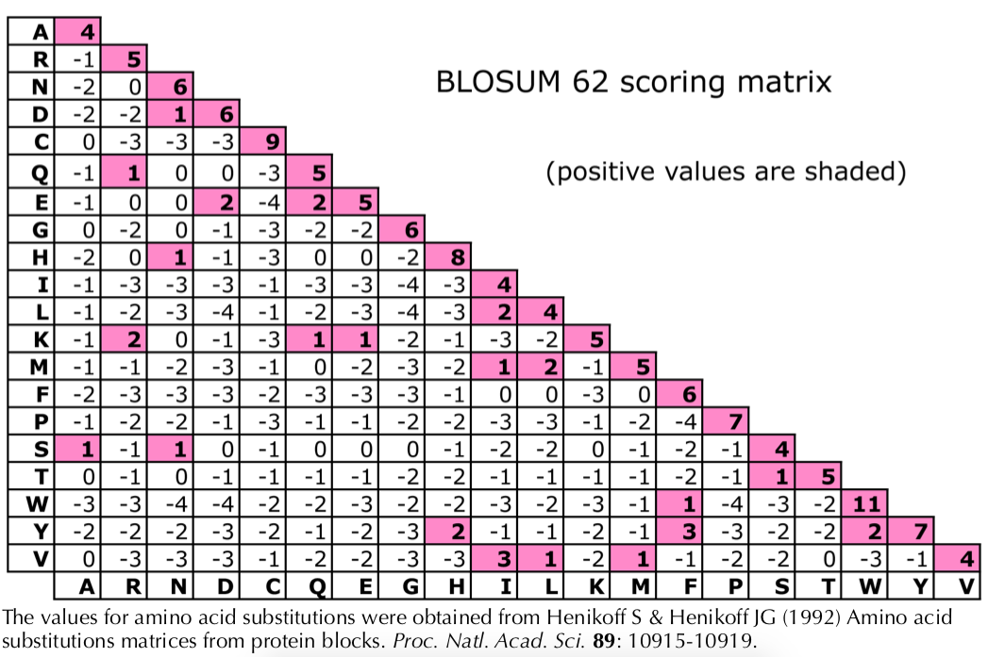
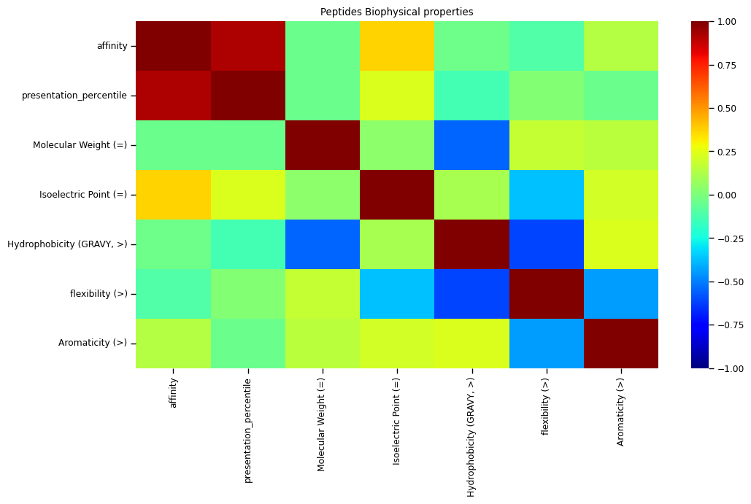
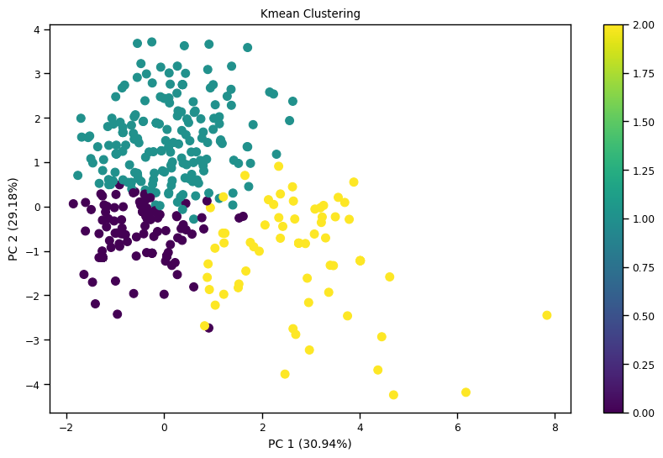
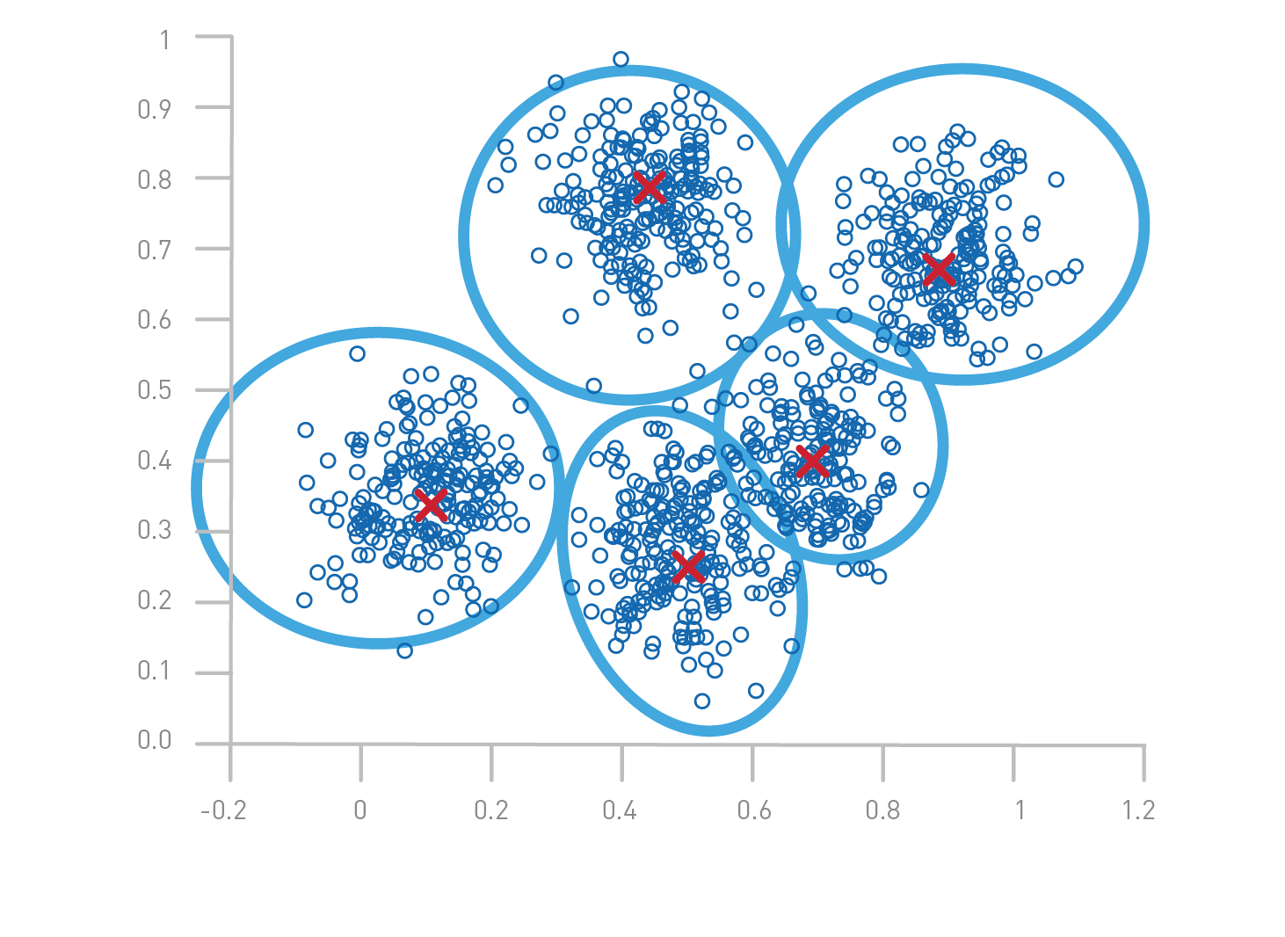
Data acquisition
Target sequence
HLA allele
Patents
Unique MHC knowledge
a
b
c
FindTopes
MutaTopes
PrediTopes
d
e
higher
XScan
AnnoTopes
lower
Targeted features
g
Affinity
BLOSUM62
Features selection
Only relevant or predictive features were considered
High
0 - 50_{nM}
Dimension reduction
PCA/t-SNE/UMAP
Clustering & ranking
K-mean/HDBSCAN
Med
50 - 500_{nM}
Low
500 - 5k_{nM}
Maintaining biological meaning
Indirect biochemical
properties
Bi-Feature formula-based Ranking
Multivariable embedding-based Ranking

Slide 5
FindTopes
ViralTopes
XScan
Target sequence
HLA allele
Patents
FindTopes
MutaTopes
ViralTopes
AnnoTopes
MutaTopes
PrediTopes
XScan
PrediTopes
AnnoTopes
Affinity
BLOSUM62
Features selection
Only relevant or predictive features were considered
High
0 - 50_{nM}
Dimension reduction
PCA/t-SNE/UMAP
higher
Med
50 - 500_{nM}
Low
500 - 5k_{nM}
Clustering & ranking
K-mean/HDBSCAN
lower
Indirect biochemical
properties
Maintaining biological meaning
Bi-Feature formula-based Ranking
Multivariable embedding-based Ranking

Slide 6
FindTopes
ViralTopes
XScan
Target sequence
HLA allele
Patents
FindTopes
MutaTopes
ViralTopes
AnnoTopes
MutaTopes
PrediTopes
XScan
PrediTopes
AnnoTopes
Affinity
BLOSUM62
Features selection
Only relevant or predictive features were considered
High
0 - 50_{nM}
Dimension reduction
PCA/t-SNE/UMAP
higher
Med
50 - 500_{nM}
Low
500 - 5k_{nM}
Clustering & ranking
K-mean/HDBSCAN
lower
Indirect biochemical
properties
Maintaining biological meaning
Bi-Feature formula-based Ranking
Multivariable embedding-based Ranking

Slide 7
b
FindTopes
ViralTopes
XScan
a
MutaTopes
PrediTopes
AnnoTopes
Affinity
BLOSUM62
Features selection
Only relevant or predictive features were considered
High
0 - 50_{nM}
Dimension reduction
PCA/t-SNE/UMAP
higher
Med
50 - 500_{nM}
Low
500 - 5k_{nM}
Clustering & ranking
K-mean/HDBSCAN
lower
Indirect biochemical
properties
Maintaining biological meaning
Bi-Feature formula-based Ranking
Multivariable embedding-based Ranking

Slide 8
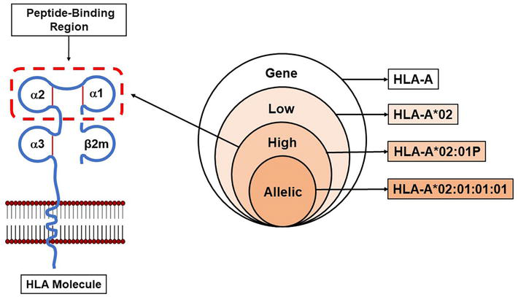
Xscan illustration
Permissive
Flexible
% better than WT
Classical anchor
Neutral
Mean fold change

Slide 9
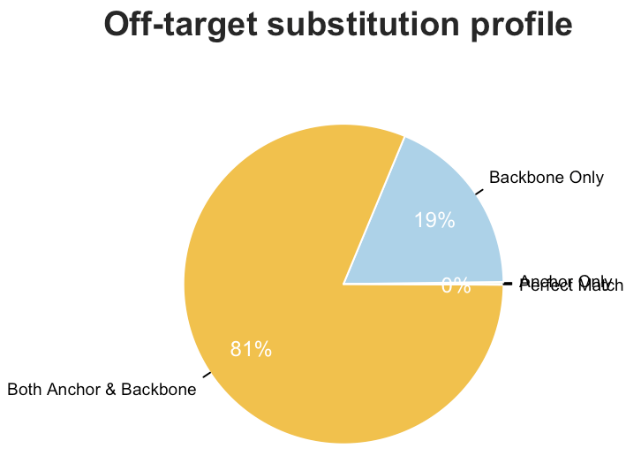
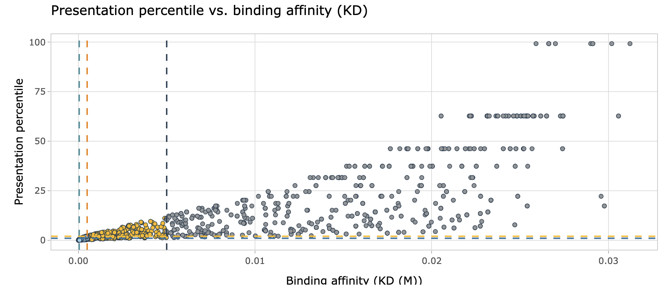
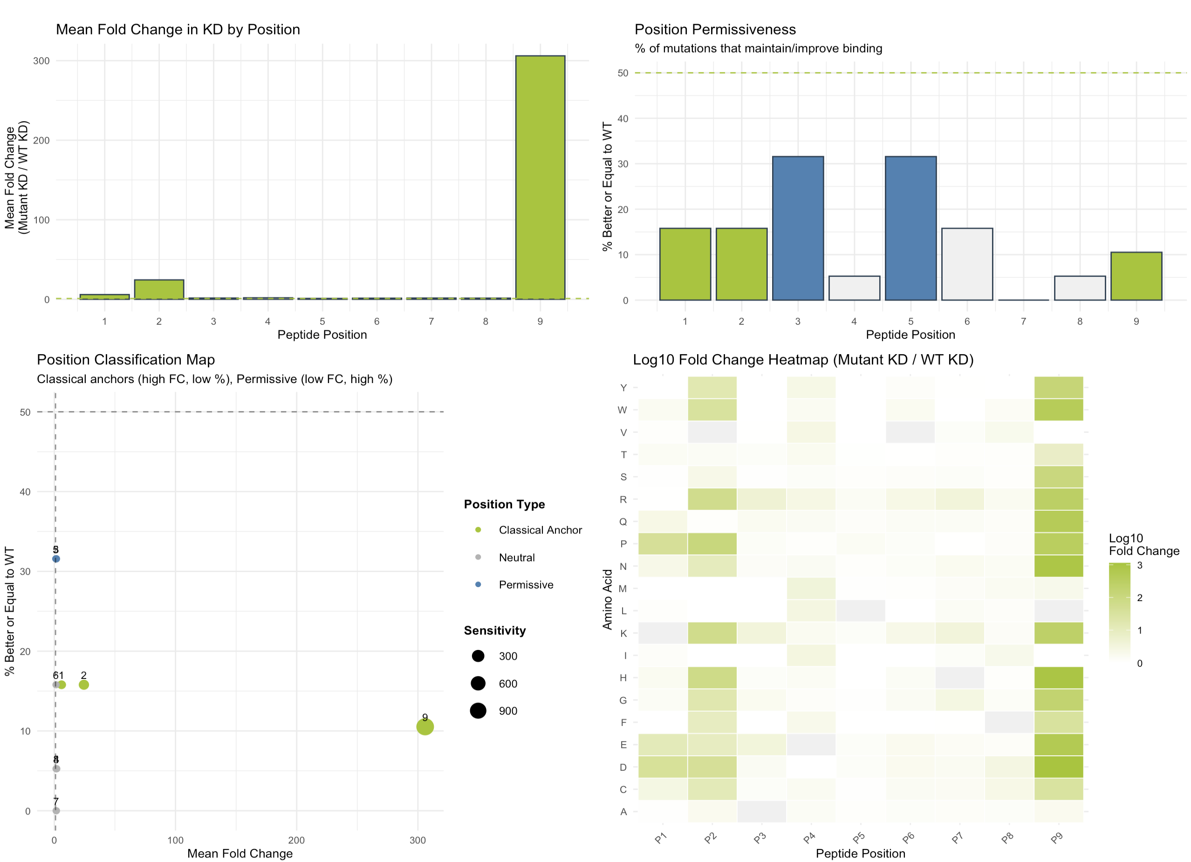
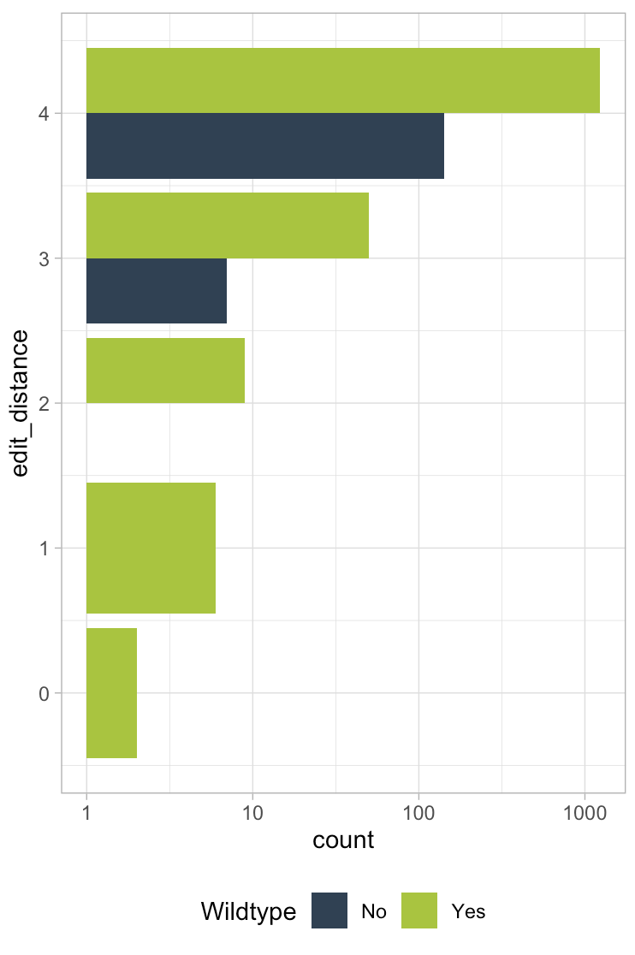
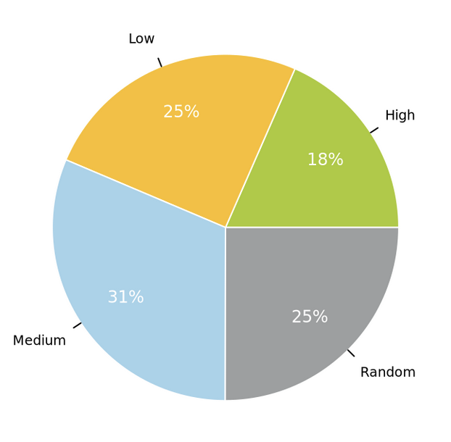
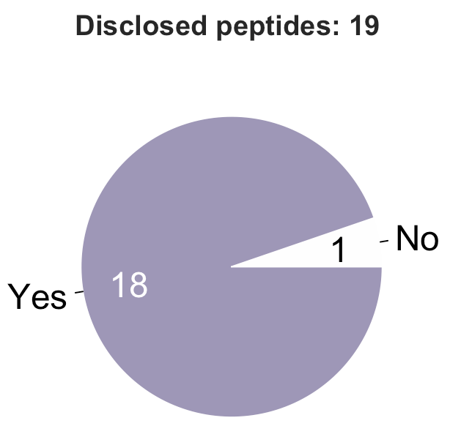
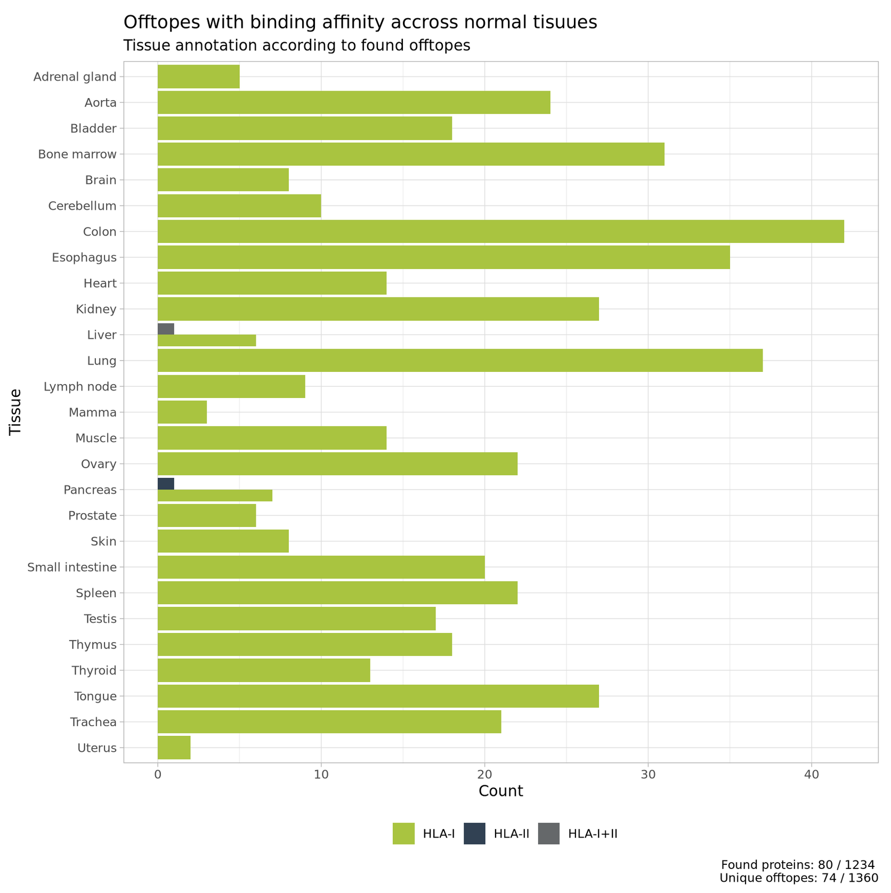
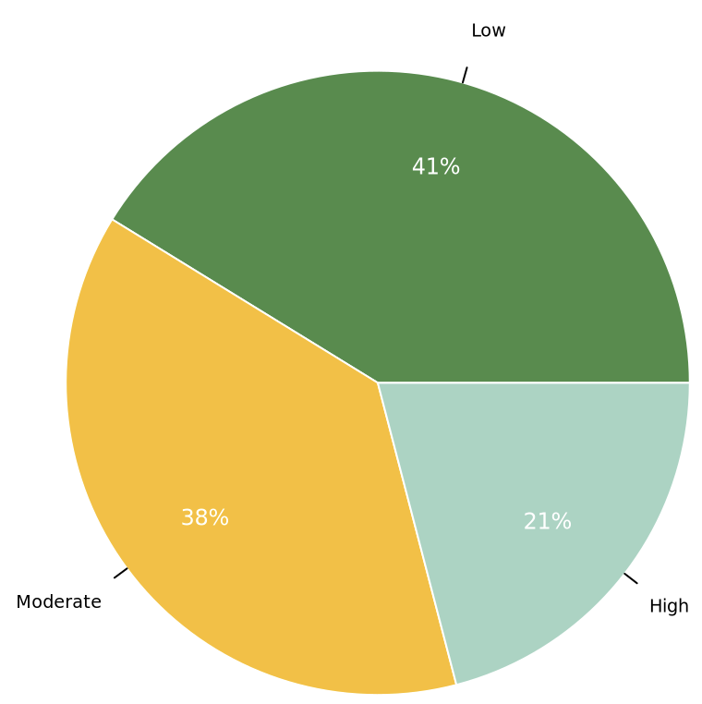
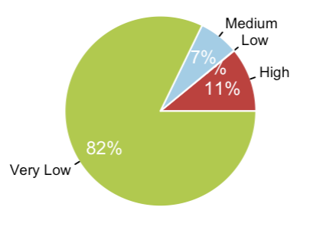
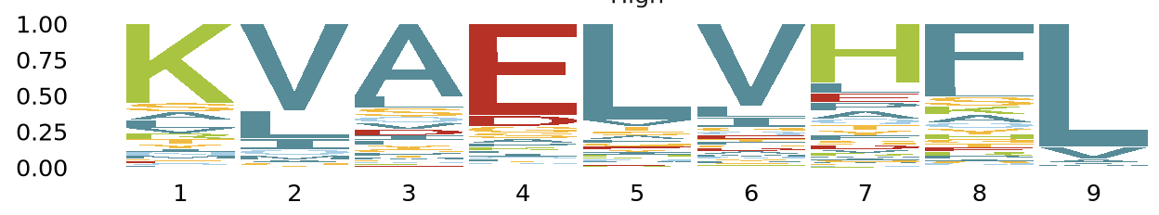
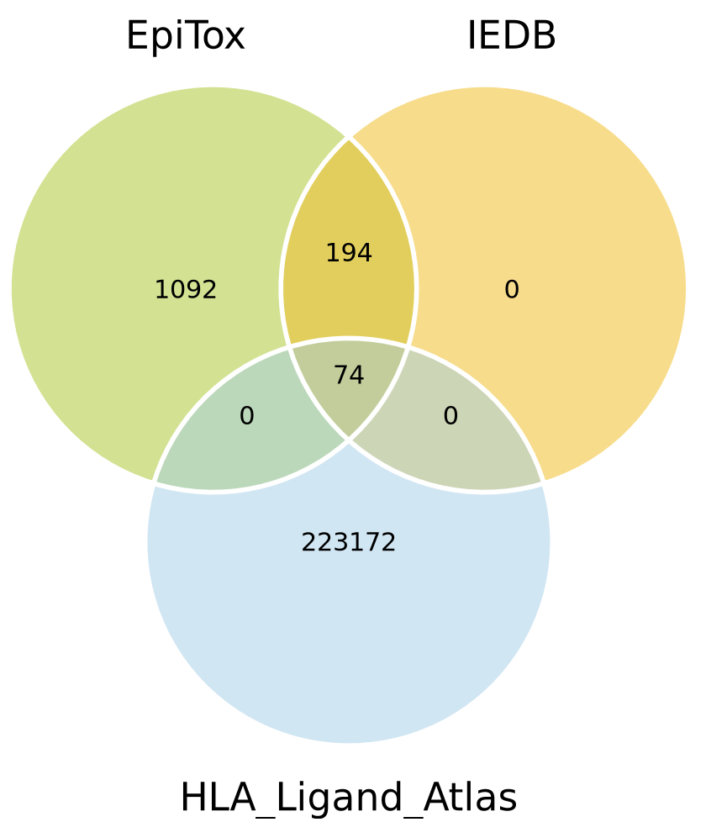
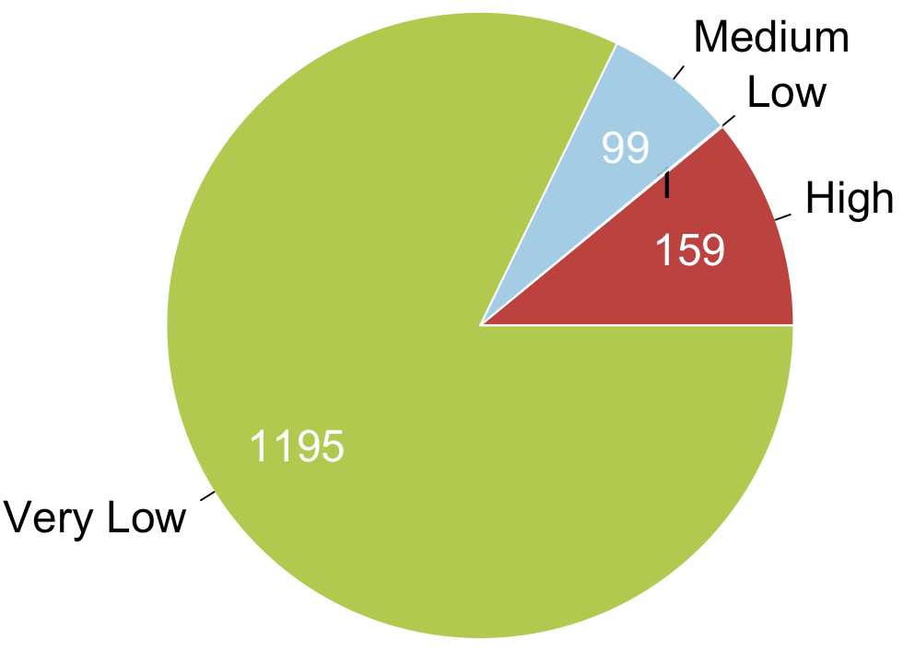
Figure 1
a
b
c
I
II
III
d
e
f
Uniprot | Gene name | peptide | D | W | Affinity | Rank | Known
P43357 | MAGEA3 | KVAELVHFL | 0 | Yes | 14.39613 | High | Yes
P43362 | MAGEA9 | KVAELVHFL | 0 | Yes | 14.39613 | High | Yes
P43365 | MAGEA12 | KMAELVHFL | 1 | Yes | 10.82504 | High | Yes
Q9UBF1 | MAGEC2 HCA587 MAGEE1 | KVAELVEFL | 1 | Yes | 19.86870 | High | Yes
Q9NUL7 | DDX28 MDDX28 | KVAELVHIL | 1 | Yes | 29.73447 | High | Yes
Q8TD91 | MAGEC3 HCA2 | KVAELVQFL | 1 | Yes | 20.49103 | High | Yes
P43361 | MAGEA8 | KVAELVRFL | 1 | Yes | 52.65181 | High | Yes
P43360 | MAGEA6 | KVAKLVHFL | 1 | Yes | 23.75682 | High | Yes
Q9Y6F6 | IRAG1 IRAG JAW1L MRVI1 | KLEELVHFL | 2 | Yes | 18.58793 | High | Yes
P43356 | MAGEA2 | KMVELVHFL | 2 | Yes | 10.88588 | High | Yes
P43355 | MAGEA1 | KVADLVGFL | 2 | Yes | 36.29844 | High | Yes
Q8NCN5 | PDPR KIAA1990 | KVAELHHLL | 2 | Yes | 26.76974 | High | No
Q96MG7 | NSMCE3 HCA4 MAGEG1 NDNL2 | KVCELVQFL | 2 | No | 30.61227 | High | No
P43358 | MAGEA4 | KVDELAHFL | 2 | Yes | 29.96302 | High | Yes
Q96MG7 | NSMCE3 HCA4 MAGEG1 NDNL2 | KVSELVQFL | 2 | Yes | 23.83906 | High | No
Q96M61 | MAGEB18 | KVVSLVHFL | 2 | Yes | 19.25214 | High | Yes
Q9H6S3 | EPS8L2 PP13181 | SAAELVHFL | 2 | Yes | 29.47499 | High | Yes
Q9HAY2 | MAGEF1 | TVAELVQFL | 2 | Yes | 40.02244 | High | No
Q9Y4C4 | MFHAS1 MASL1 | AVAELGHHL | 3 | Yes | 39.39967 | High | No
Q5VTM2 | AGAP9 CTGLF6 | KVADLVLML | 3 | Yes | 35.17263 | High | No

Slide 10
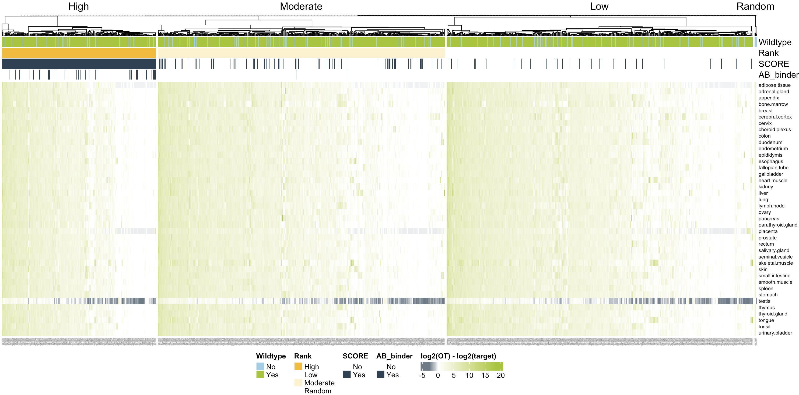
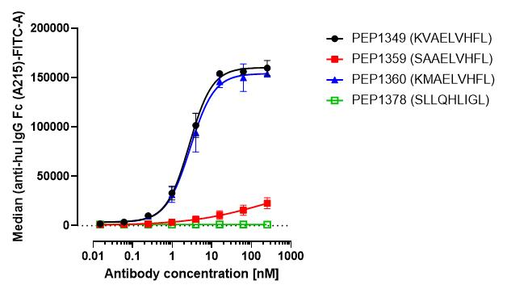
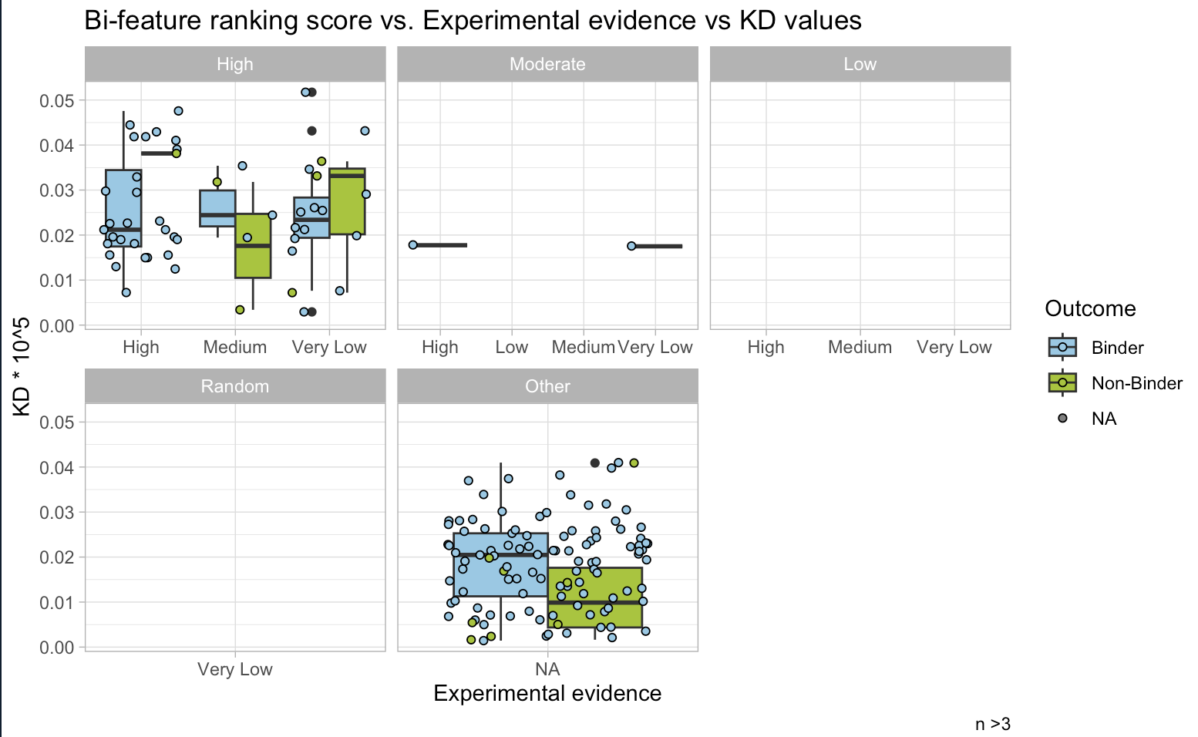
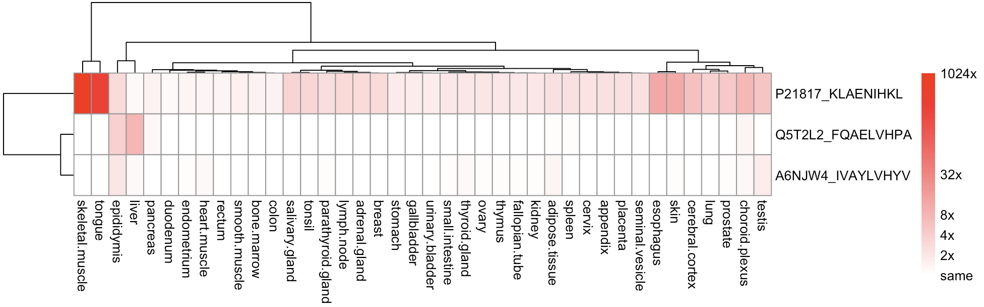
Figure 2
a
b
c
AB position classification
d
e
f
Benchmark against crossdome??

Slide 11
Figure1: SNPs integration
Off-targets
WT only
Off-targets genomic location
Extract SNPs
QC: PASS
AF
Population ID
Mutate off-targets
Edit distance < threshold
Off-targets
WT + MUT
Annotate SNPs
SNPs Exom file
SNPs annotation
Peptide | Found SNPs | Mutated sequence | Notion
KVAELVHFL | - | - | WT
 | SNP₁:A₂ | KAAELVHFL | MUT
 | SNP₂:A₈ | KVAELVHAL | MUT
 | SNP₁:A₁ | AVAELVHFL | MUT

Slide 12
Figure1: SNPs integration
Peptide | Lab guru | KD | n | mismatch | Binder | Log2_FC | Pass | B | Rank
FQAELVHPA | PEP1842 | 3.463011e-07 | 24 | 4 | Binder | -0.9383164 | 3 | 15 | High
IVAYLVHYV | PEP1678 | 1.644378e-07 | 24 | 4 | Binder | 0.1361684 | 3 | 23 | High
KLAENIHKL | PEP1661 | 2.933844e-08 | 24 | 4 | Binder | 2.6228463 | 3 | 24 | High
Off-targets
WT only
Off-targets genomic location
Extract SNPs
QC: PASS
AF
Population ID
Mutate off-targets
Edit distance < threshold
Off-targets
WT + MUT
Annotate SNPs
SNPs Exom file
SNPs annotation

Slide 13
Gene | Ensembl gene | Ensembl trans | uniprot | isoform | peptide | D | Position | SNP info
RYR1 | ENSG00000196218 | ENST00000355481 | P21817 | P21817-2 | KLAENIHKL | 4 | 19:872-880 | rs746904839; K;879; MODERATE; missense_variant
LRRC3C | ENSG00000204913 | ENST00000377924 | A6NJW4 | A6NJW4 | IVAYLVHYV | 4 | 17:236-244 | rs140521451; I;236; MODERATE; missense_variant
AKR1C8 | ENSG00000264006 | ENST00000650030 | Q5T2L2 | Q5T2L2 | FQAELVHPA | 4 | 10:93-101 | rs376200113; Q;94; MODERATE; missense_variant
AKR1C8 | ENSG00000264006 | ENST00000584929 | Q5T2L2 | Q5T2L2 | FQAELVHPA | 4 | 10:93-101 | rs376200113; Q;94; MODERATE; missense_variant; NMD_transcript_variant

Slide 14
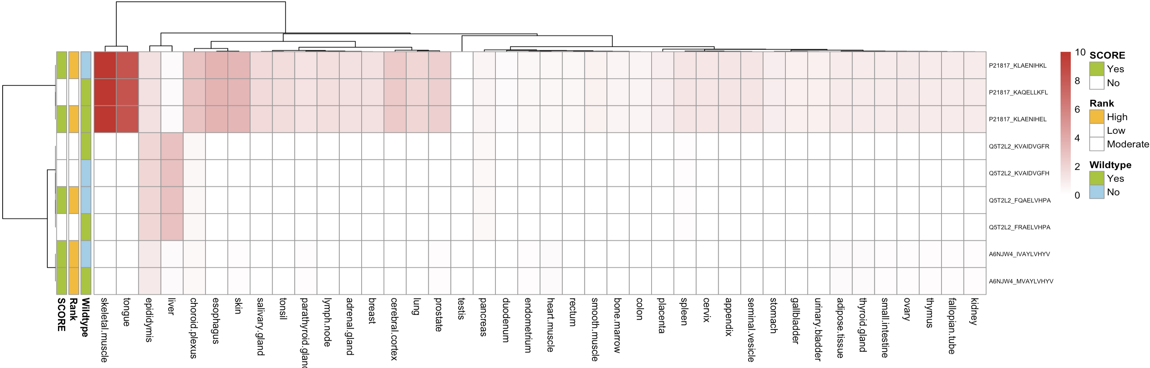
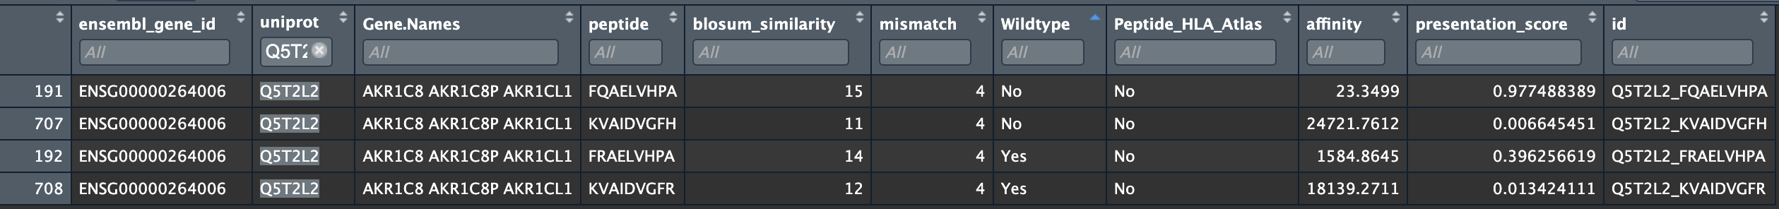
Figure1: SNPs integration
a
b
Peptide | Lab guru | KD | n | mismatch | Binder | Log2_FC | Pass | B | Rank
FQAELVHPA | PEP1842 | 3.463011e-07 | 24 | 4 | Binder | -0.9383164 | 3 | 15 | High
IVAYLVHYV | PEP1678 | 1.644378e-07 | 24 | 4 | Binder | 0.1361684 | 3 | 23 | High
KLAENIHKL | PEP1661 | 2.933844e-08 | 24 | 4 | Binder | 2.6228463 | 3 | 24 | High

Slide 15
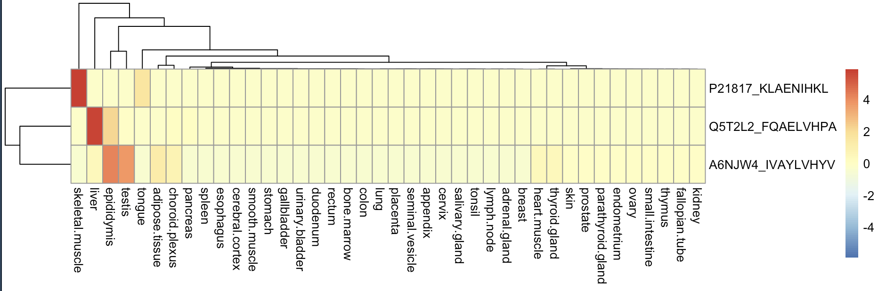
SNPs in peptides with high risk
Peptide | Lab guru | KD | n | mismatch | Binder | Log2_FC | Pass | B | Rank
FQAELVHPA | PEP1842 | 3.463011e-07 | 24 | 4 | Binder | -0.9383164 | 3 | 15 | High
IVAYLVHYV | PEP1678 | 1.644378e-07 | 24 | 4 | Binder | 0.1361684 | 3 | 23 | High
KLAENIHKL | PEP1661 | 2.933844e-08 | 24 | 4 | Binder | 2.6228463 | 3 | 24 | High

Slide 16
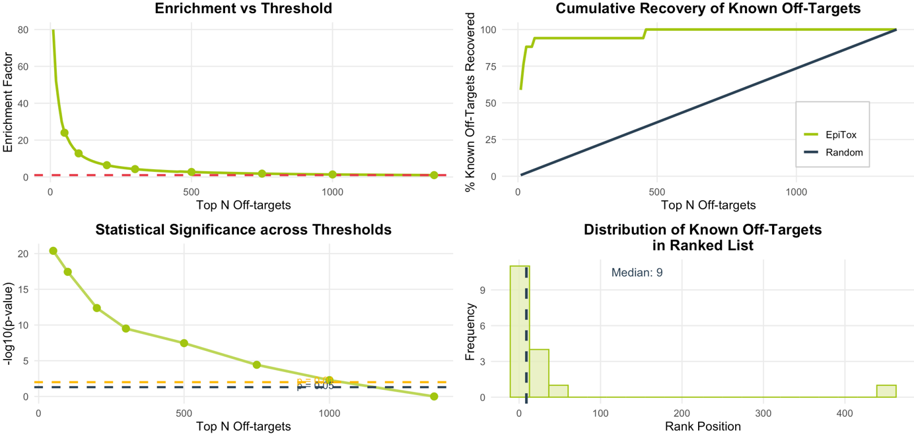
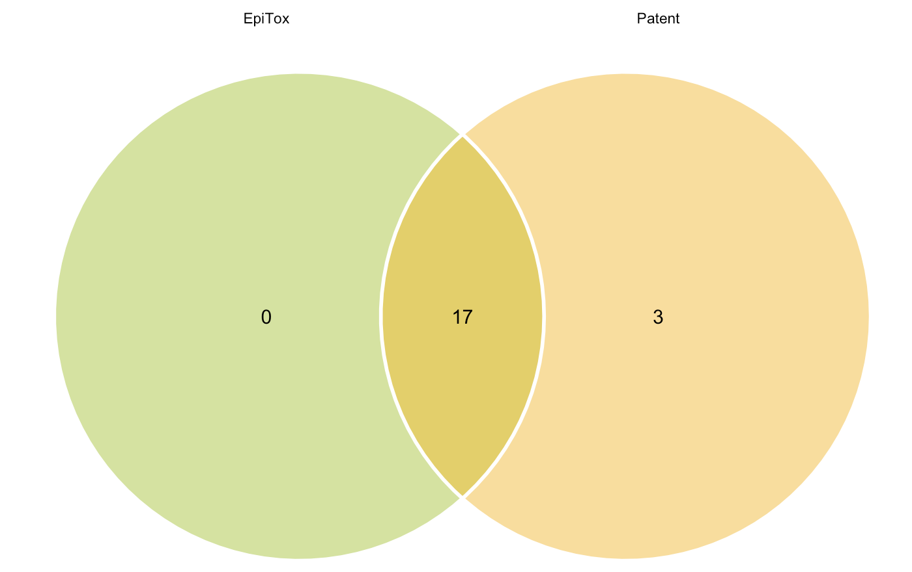

Slide 17
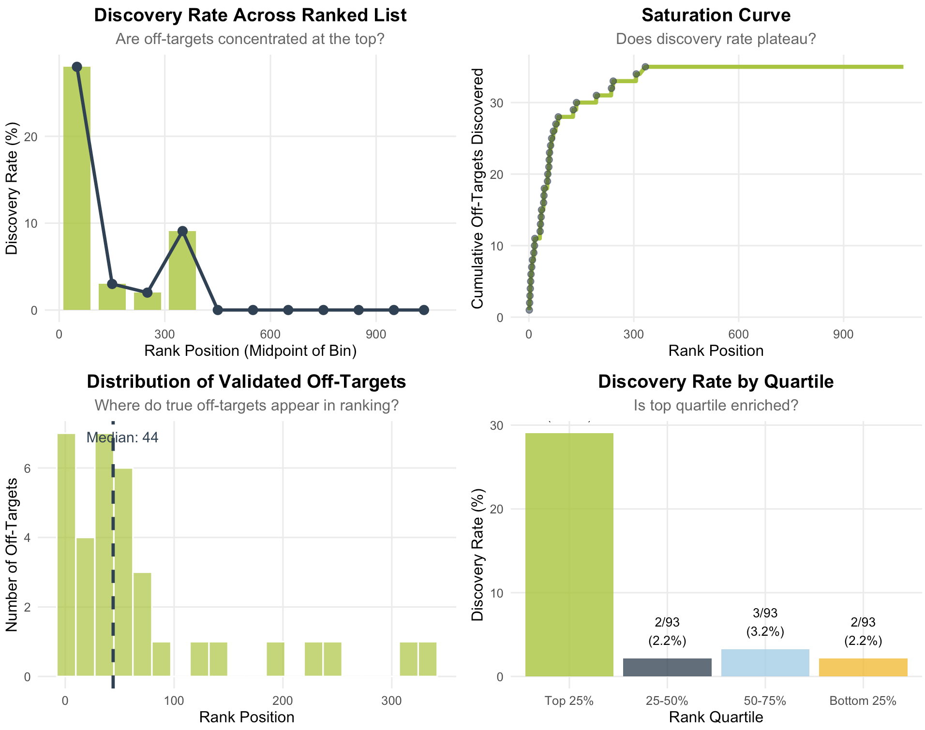
Score results with reference AB

Slide 18
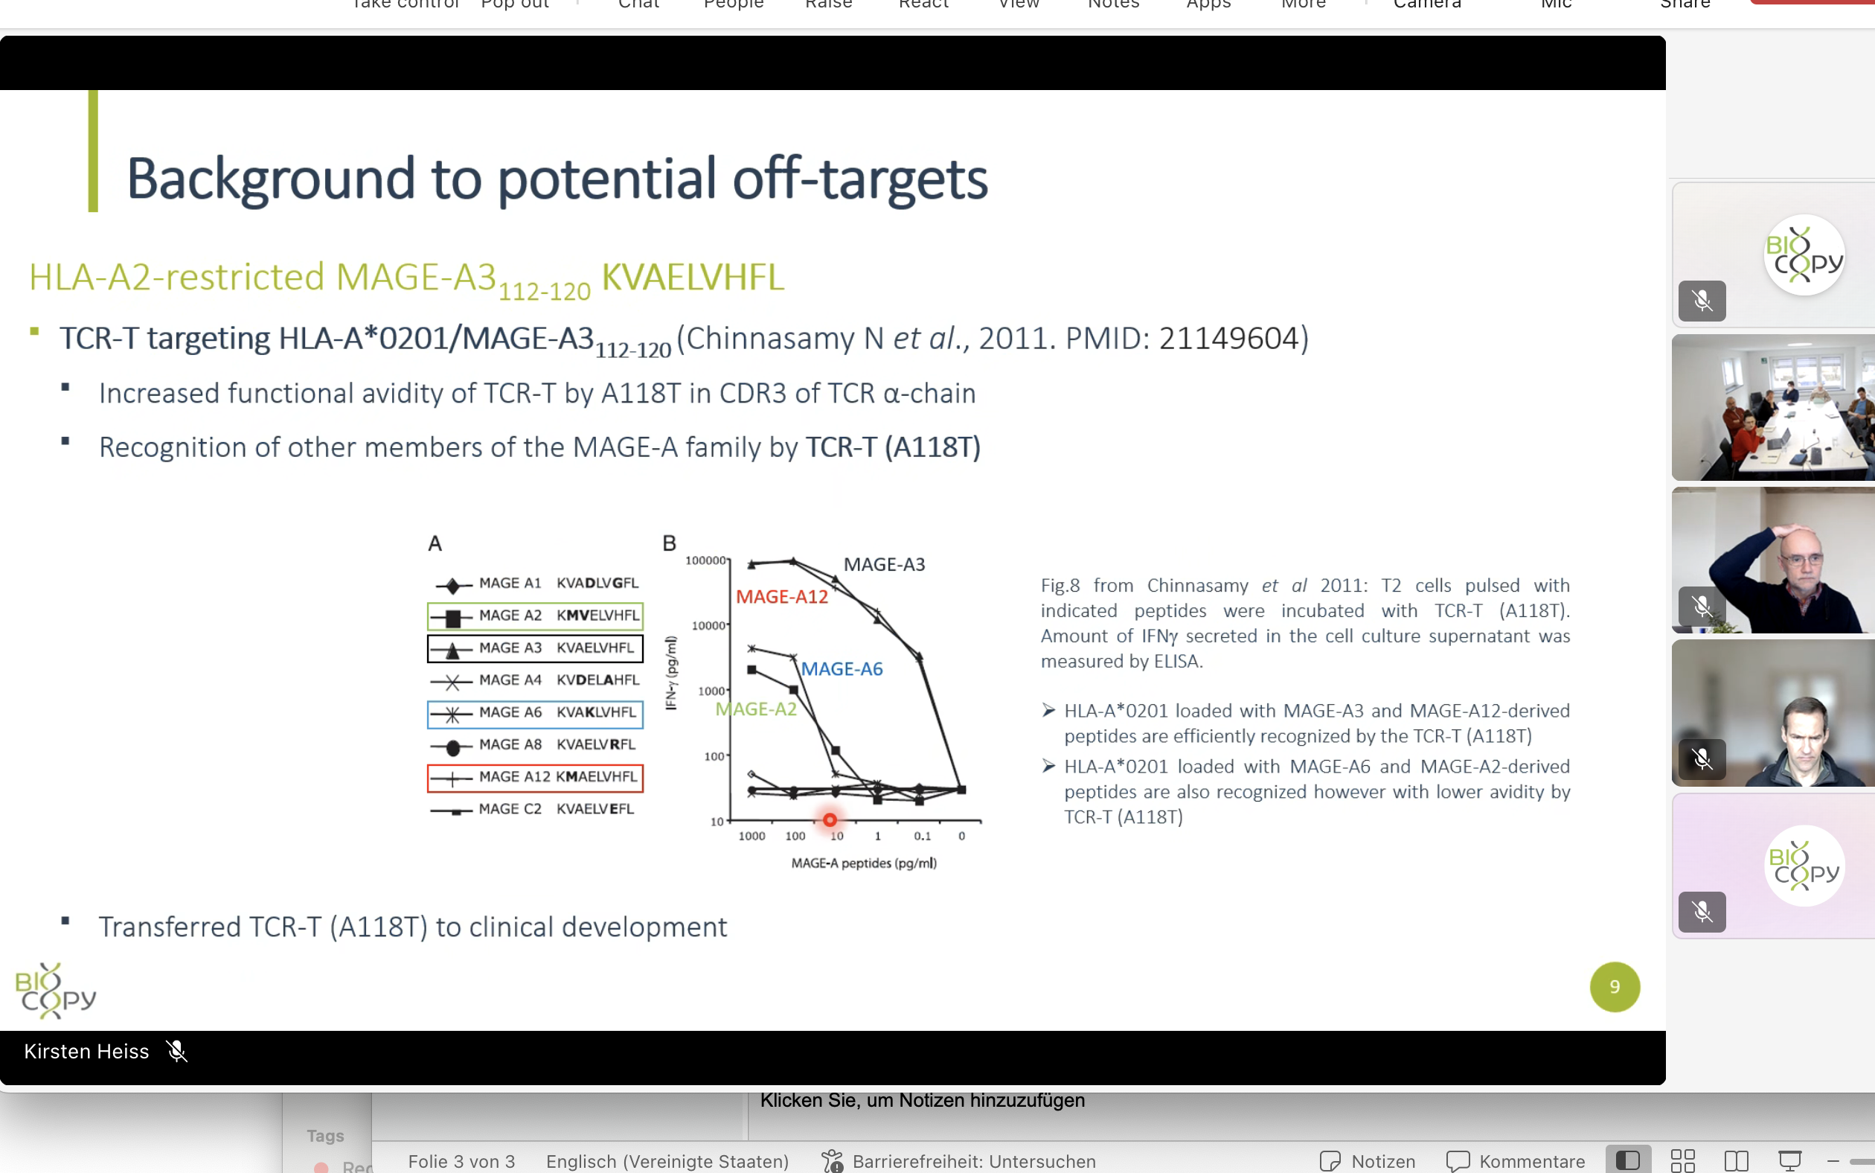
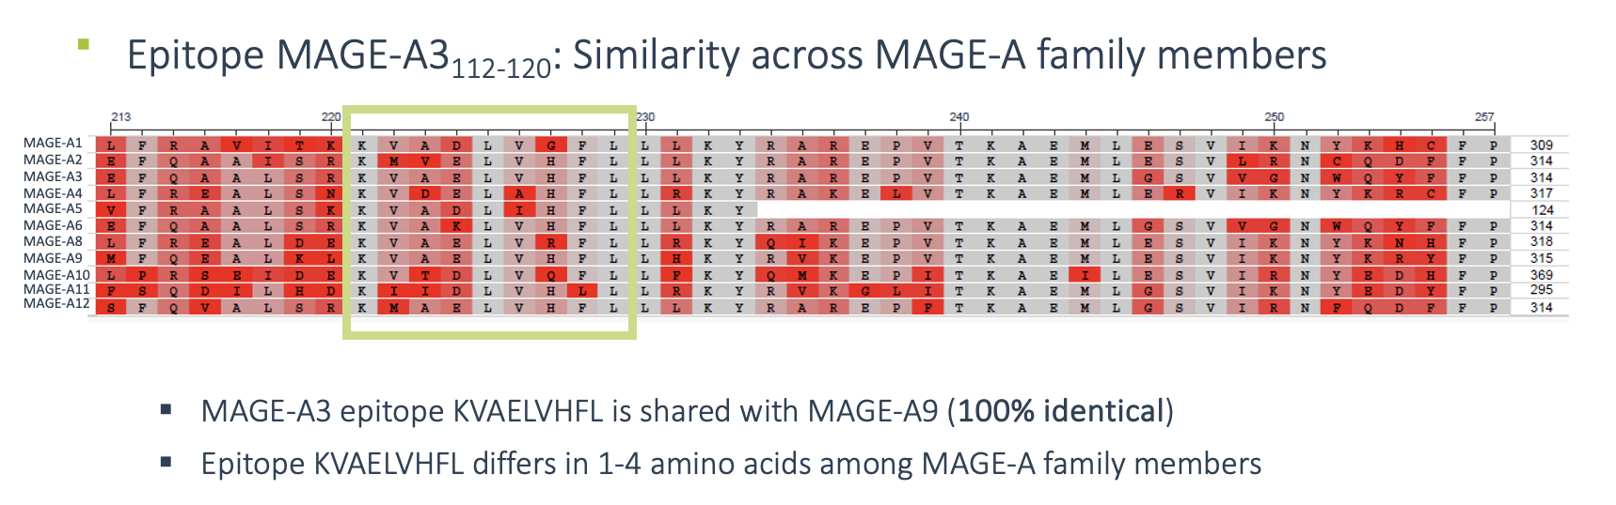

Slide 19
Score Interpretation Framework:
High similarity (35-44): Very strong matches, likely functionally similar regions
Moderate similarity (20-34): Good matches, worth investigating further
Weak similarity (10-19): Marginal matches, may be meaningful in context
Low similarity (1-9): Poor matches, likely not biologically significant
No similarity (≤0): Random or worse alignment quality
For initial filtering: Score ≥ 20 (roughly 45% of your max score) For detailed analysis: Score ≥ 15 (about 35% of max) For exploratory work: Score ≥ 10 (about 25% of max)

Slide 20
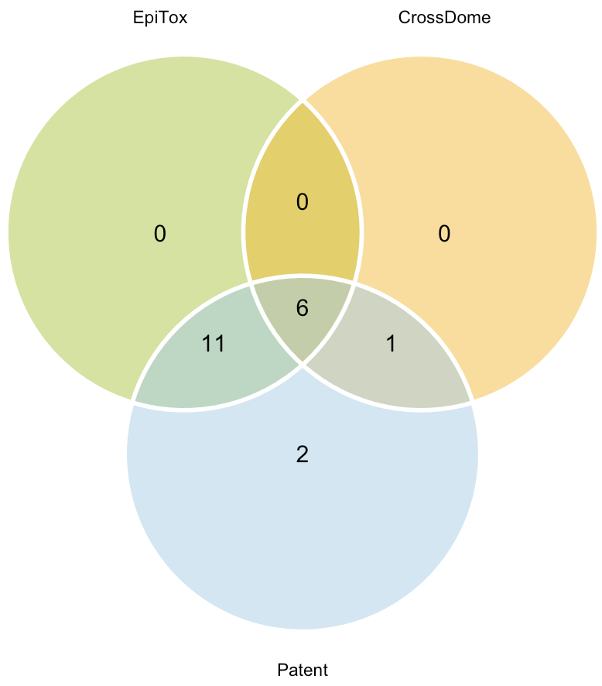
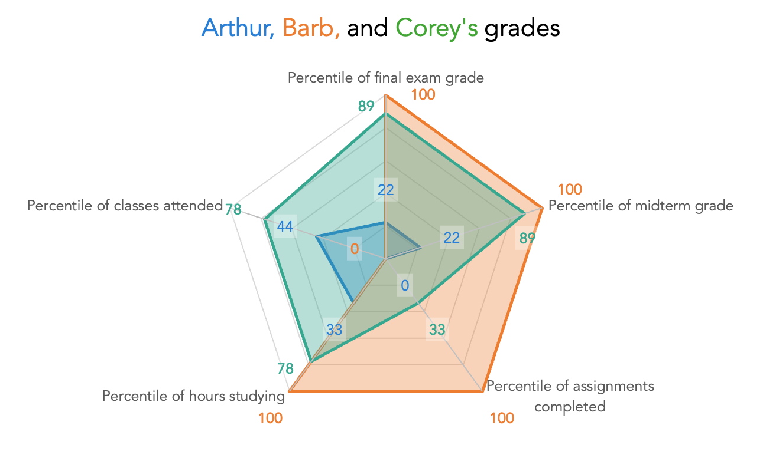
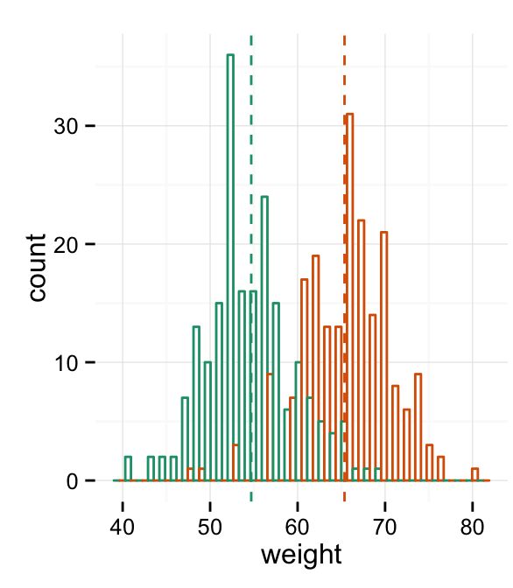
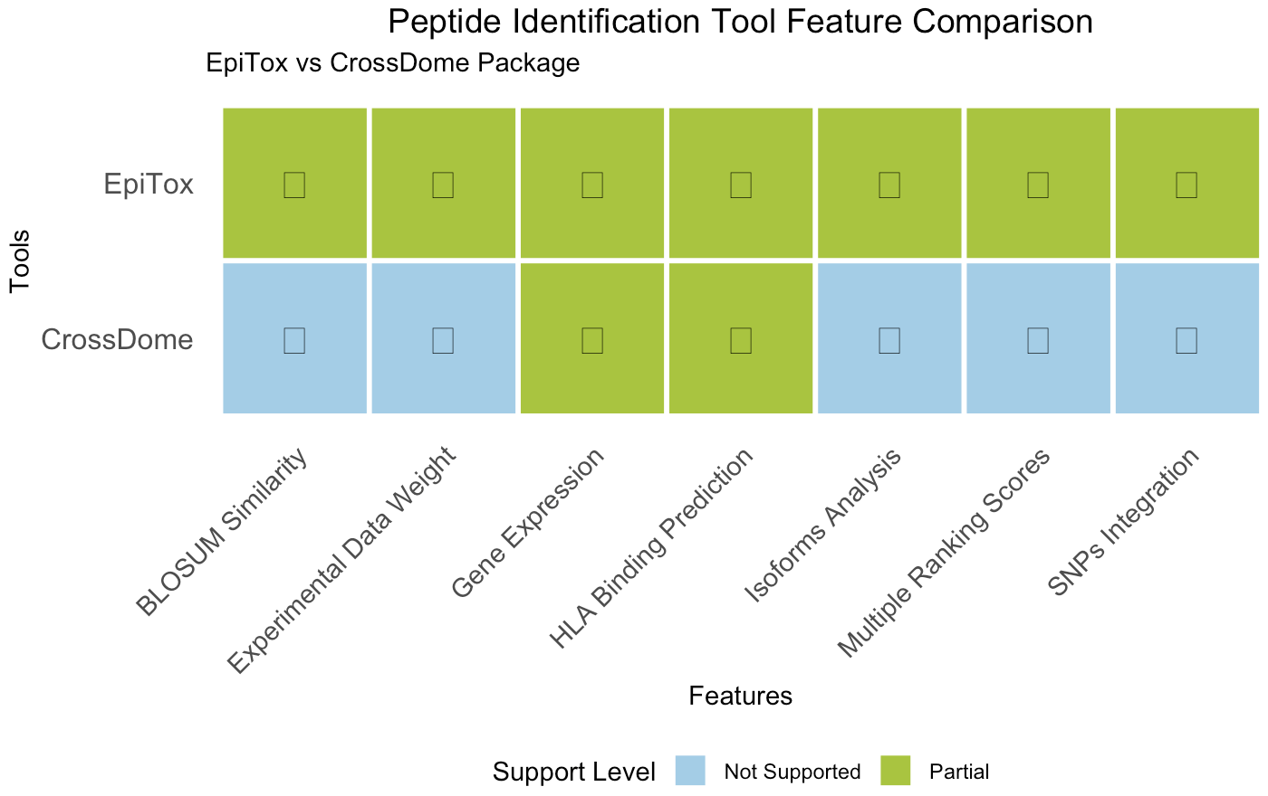
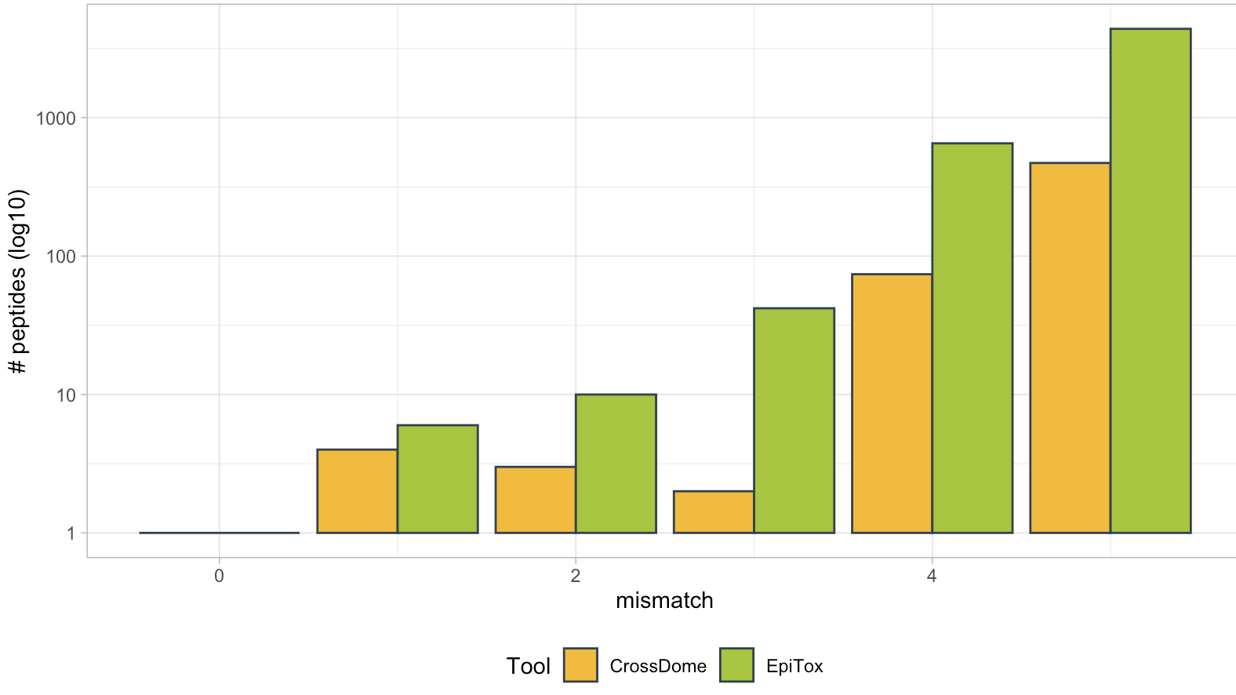
Benchmark & Validation
Radar plot for multiple parameters:
Genetics
Features
Peptide counts
HLA-context
Peptide counts per tools
crossDome
scrap
Similarity scores distribution

Slide 21



Figure 1: EpiTox overall
Target sequence
HLA allele
Peptides list
ViralTopes
1) Off-targets identification mode
2) Peptides annotation mode
FindTopes
MutaTopes
Annotator
Non-Human mode
xscan
PrediTopes
AnnoTopes
DBfetch
Human mode

Slide 22
Figure 2: pepmatch vs. blastp

Slide 23
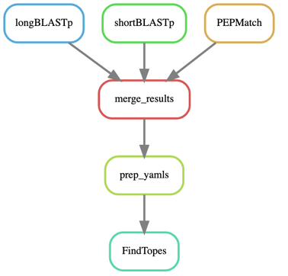
Figure 3: findtopes

Slide 24
Figure 4: mutation logic
Gene
Exon 1
Exon 2
Exon 3
Exon 4
Exon 5
Isoform A
(Exons 1-2-3-4-5)
Protein coordinates
SNP₁
SNP₂
1
100
AA 130 - 160
200
300
Peptide
Isoform B
(Exons 1-3-4-5)
Protein coordinates
SNP₁: AA 155
SNP₂: AA 200
1
100
200
300
AA 70 - 110
Peptide
SNP₁: AA 90
SNP₂: AA 120

Slide 25
Figure 4: mutation logic

Slide 26
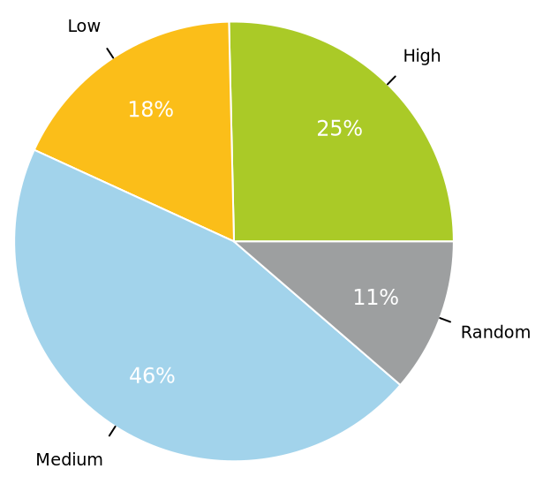
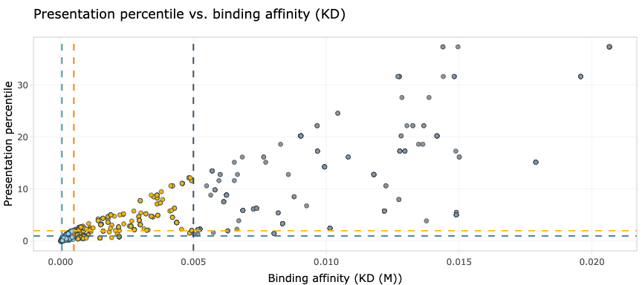
Figure 5: PrediTopes affinity vs. presentation

Slide 27
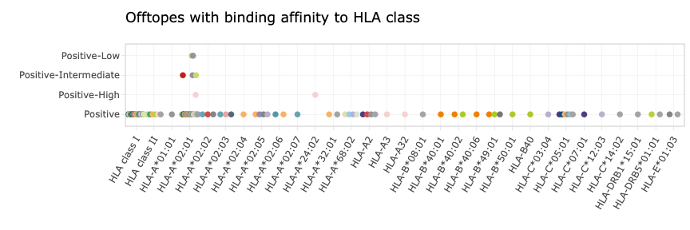
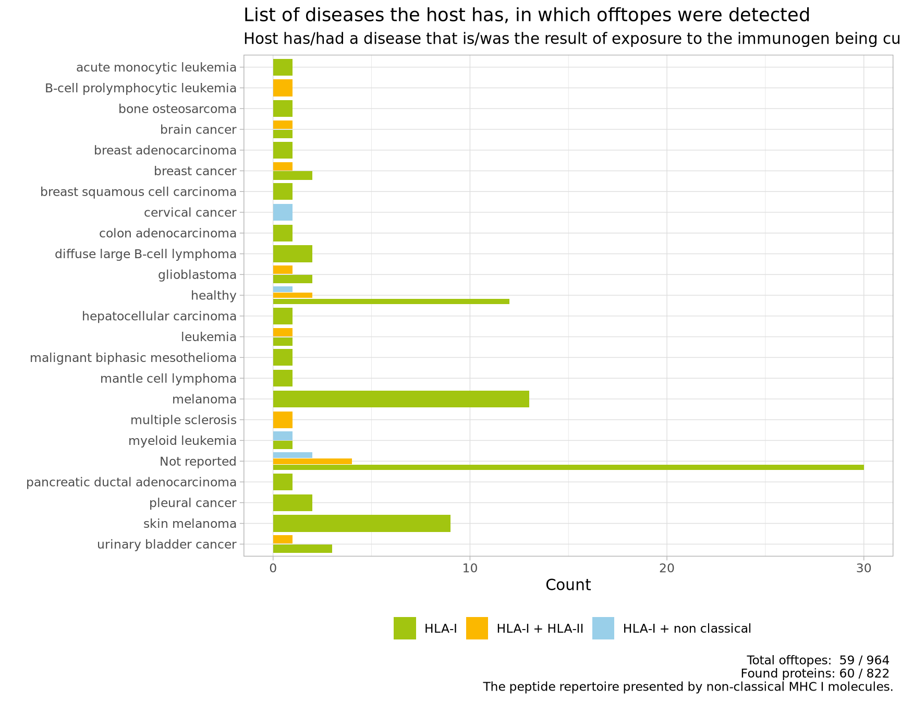
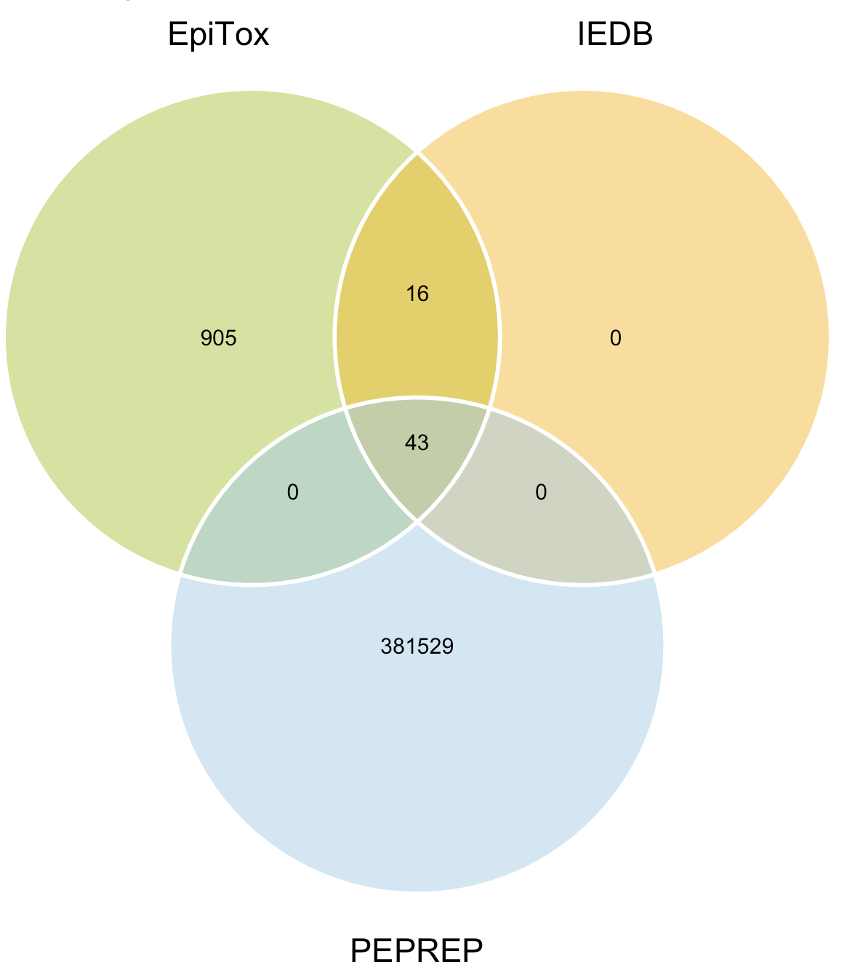
Figure 6: PrediTopes annotation

Slide 28
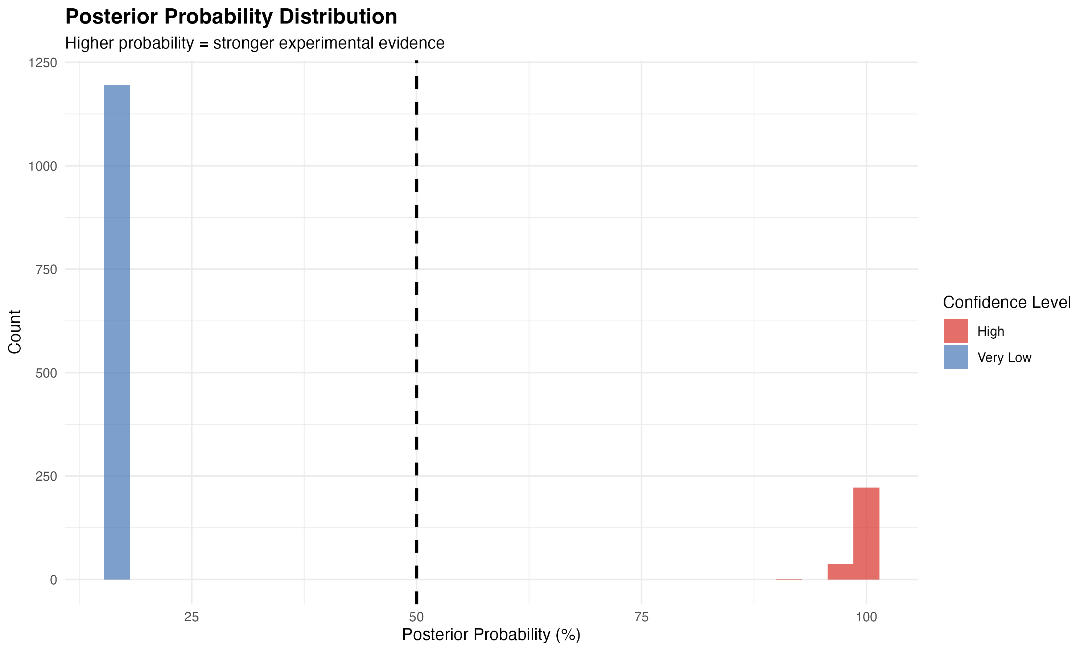
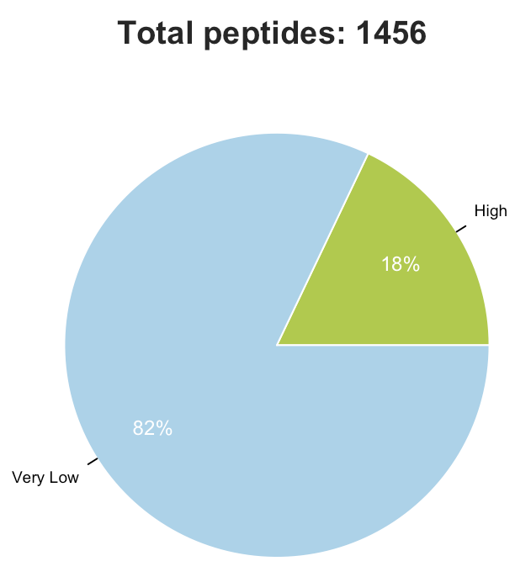
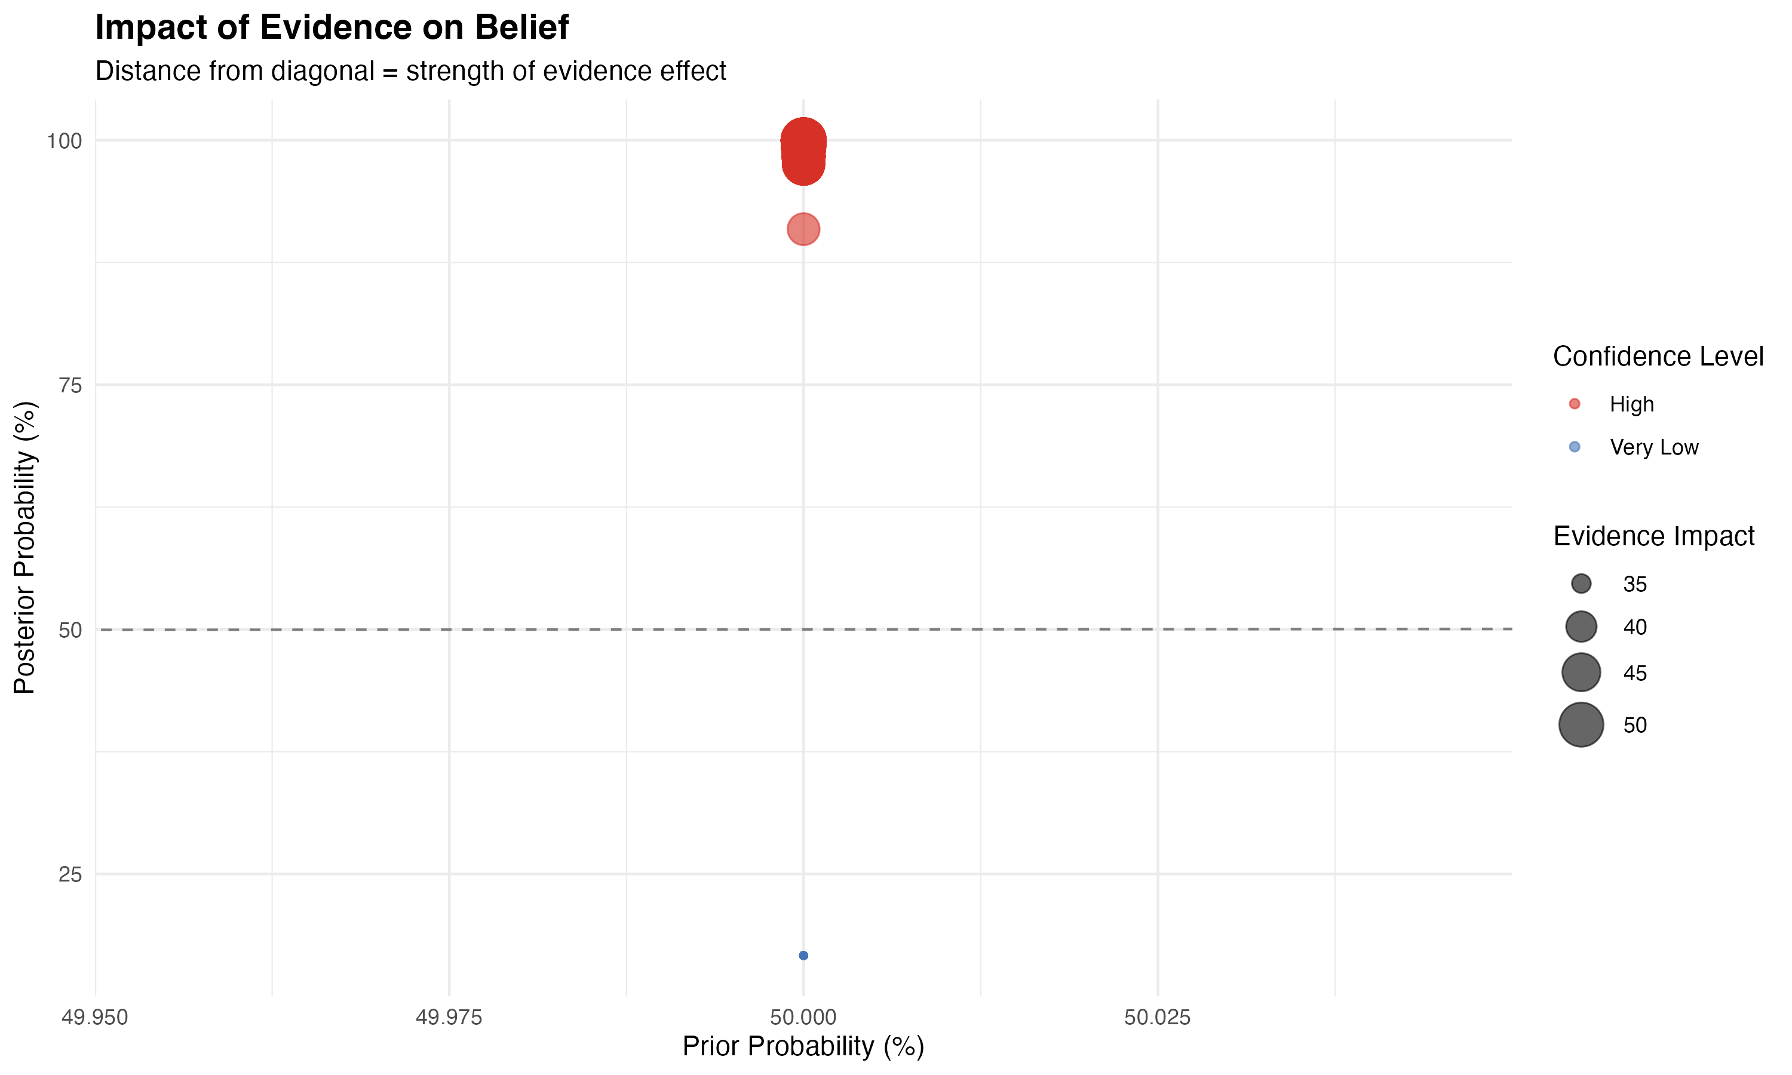
Figure 6: Bayesian prediction

Slide 29
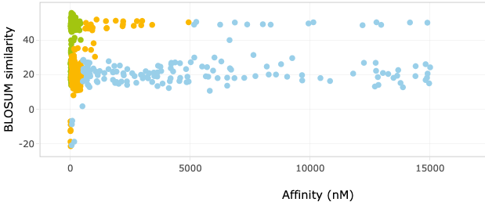
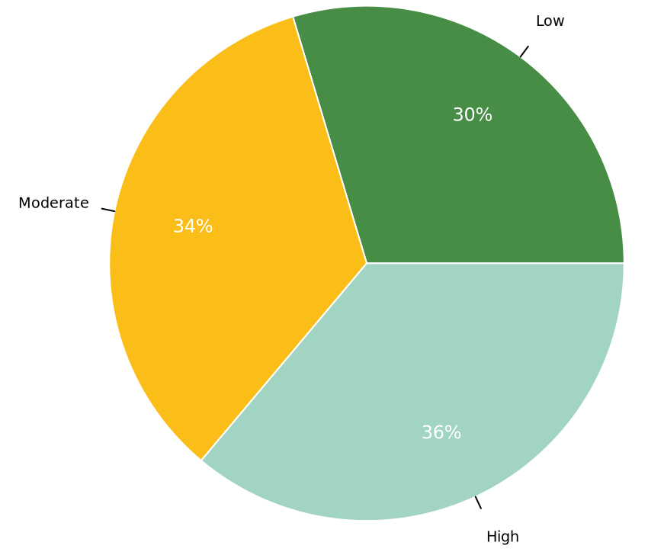
Figure 7: bi-features score
Kmean clustering
Affinity
Similarity
High affinity
0 - 50_{nM}
Med affinity
50 - 500_{nM}
KVAELVHFL |0| 44
KMAELVHFL |1| 41
KMAECAHFH |4| 25
KMAEEVGKL |4| 15
…
Low affinity
500 - 5k_{nM}
Random affinity
Supervised machine learning
Maintaining biological meaning
Indirectly reflects biochemical properties

Slide 30



Biophysical properties correlation
Features | Expectation
Aromaticity - affinity | Negative correlation
Gravy* - affinity | Depends on the allele
MW* - presentation | Positive
Flexibility* – immune resp | Yet to come!
Isoelectric* - affinity
* Compared to the target

Slide 31
Biophysical properties – clustering
PCA 2 - Clusters 3: Silhouette Score = 0.510
✔ Affects solubility, protein interactions, & stability in biological fluids
✔ pI affects peptide charge, which in turn influences HLA binding affinity. ✔ Charge complementarity between peptide and HLA binding pockets plays a role in binding stability. ✔ TCR recognition may be affected by solvent-exposed charged residues, impacting immune activation.

Slide 32




Figure 8: multi-features score
Multiple feature
Dimension reduction
Unsupervised clustering
$$x_{norm}(m×n)$$
$$z (m×k)$$
Affinity to HLA
BLOSUM similarity
…
PCA / t-SNE / UMAP
…
High
Stability score
Z $=DR(X_{norm})$
Medium
Immunogenicity
Normalize
Cluster
Rank
Low
.. (n features)
Final score:
S = f(cluster, distance)
Reduced feature space
$$x∈ℝ^{m×n}$$
High-dimensional (many features)
Low-dimensional (k < n)
…
Methods:
PCA: linear projection
t-SNE: non-linear embedding
UMAP: Topology preserving
Methods:
K-means
Hierarchical
DBSCAN
…
…

Slide 33

Figure 9: xscan motif binding

Slide 34
Figure1: SNPs integration
Off-targets
WT only
Off-targets genomic location
Extract SNPs
QC: PASS
AF > 0.1
Population ID
Mutate off-targets
Edit distance < threshold
Off-targets
WT + MUT
Annotate SNPs
SNPs Exom file
SNPs annotation
Peptide | Found SNPs | Mutated sequence | Notion
KVAELVHFL | - | - | WT
 | SNP₁:A₂ | KAAELVHFL | MUT
 | SNP₂:A₈ | KVAELVHAL | MUT
 | SNP₁:A₁ | AVAELVHFL | MUT

Slide 35
Figure 4

