Slide 1
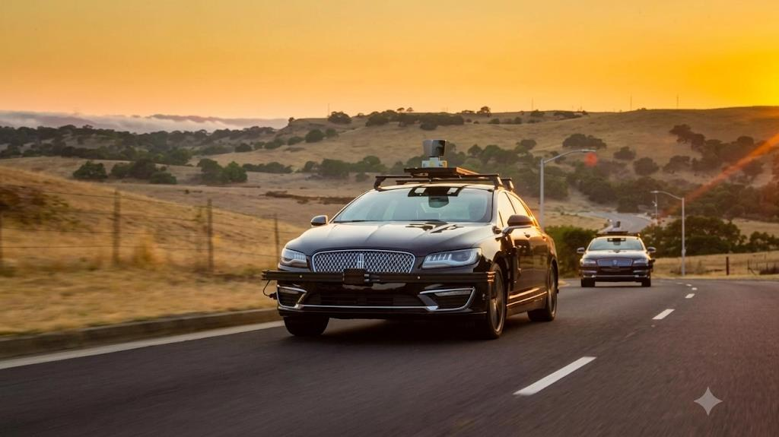
AutoDrive
Autonomous Driving Research Prototype
Computer vision, lane segmentation and steering prediction
AutoDrive Research Team
github.com/HA2345567/Autodrive
Notes:
PRESENTATION NOTES
Good morning everyone. I am Harsh Bhardwaj, with Shrishti Singh and Rajat Kandpal. AutoDrive explores how a camera frame can support object detection, lane segmentation and steering prediction. Aaj hum architecture, measured results aur limitations explain karenge.
SOURCE
Supplied synopsis, page 1. Research paper, page 1.
C:/Users/Harsh/Documents/AutoDrive_Research_Paper.pdf
Cover image is conceptual artwork from the supplied presentation, not a photograph of an AutoDrive vehicle trial.

Slide 2
Project team and academic guidance
Department of Electronics and Communication Engineering
Maharaja Surajmal Institute of Technology, New Delhi, India
Team member | Enrolment number | Email
Harsh Bhardwaj | 03696302823 | bhardwajharsh0312@gmail.com
Shrishti Singh | 03996302823 | shrisht2723@gmail.com
Rajat Kandpal | 04496302823 | rajatkandpal12@gmail.com
Mentor: Ms. Jasmine, Assistant Professor
2
Notes:
PRESENTATION NOTES
Our team has three members. Ms. Jasmine is the mentor listed in our synopsis. Department aur college ka naam briefly introduce karo, phir project ki story par move karo.
SOURCE
Supplied synopsis, page 2. Research paper author block, page 1.
C:/Users/Harsh/Documents/AutoDrive_Research_Paper.pdf

Slide 3
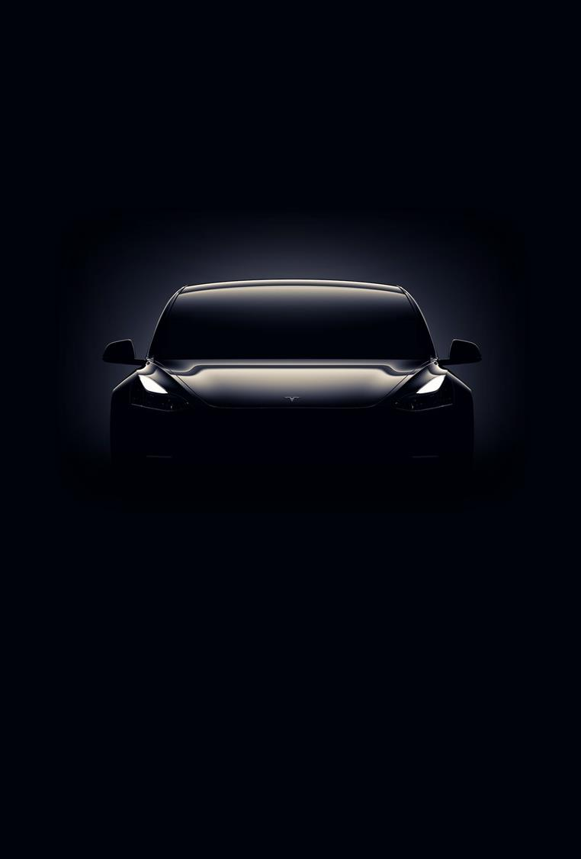
Presentation outline
01
Problem and project objectives
02
Architecture, data and training
03
Detection, lane and steering results
04
Limitations, applications and next steps
3
Notes:
PRESENTATION NOTES
We will first explain the problem, then the implementation and measured results. Detailed numerical tables are in the appendix for questions. Outline ko sirf 15 seconds mein cover karo.
SOURCE
Presentation structure adapted from supplied synopsis, page 3.
C:/Users/Harsh/Documents/AutoDrive_Research_Paper.pdf

Slide 4
Introduction
One front-camera frame supports three separately evaluated tasks
01
Object detection identifies road users and traffic infrastructure.
02
Lane segmentation estimates the pixels belonging to lane markings.
03
Steering regression estimates a continuous steering angle.
04
A visual display combines the outputs for inspection.
4
Notes:
PRESENTATION NOTES
Driving ke time hum objects dekhte hain, lane samajhte hain, aur steering choose karte hain. Our pipeline explores the same perception tasks. Detection gives boxes and labels, segmentation gives masks, and regression gives an angle. Outputs visual display mein combine hote hain.
SOURCE
Research paper, Sections I and IV.
C:/Users/Harsh/Documents/AutoDrive_Research_Paper.pdf

Slide 5
Project objectives
01
Train a compact detector for ten road-relevant COCO categories.
02
Convert TuSimple lane points into polygons for YOLO segmentation.
03
Audit the steering checkpoint and evaluate a new frozen-CNN readout.
04
Document each module’s accuracy, timing and evaluation limits.
5
Notes:
PRESENTATION NOTES
Our objective is a reproducible engineering prototype. Lane annotation conversion is an important part of the work because sparse points cannot directly supervise instance masks. We also evaluate steering honestly and compare it with simple baselines.
SOURCE
Research paper, Section I, Objectives and Contributions.
C:/Users/Harsh/Documents/AutoDrive_Research_Paper.pdf

Slide 6
Literature review
Work | Contribution | Relevance to AutoDrive
DAVE-2, Bojarski et al. (2016) | Camera images to steering angle | Reference architecture for steering regression
SCNN and LaneNet (2018) | Lane structure and instance segmentation | Context for learning lane markings
Ultralytics YOLO11 (2024) | Object detection and instance segmentation | Implemented perception models
TuSimple benchmark (2017) | Lane annotations and evaluation protocol | Lane dataset and metric caveats
Contribution: integration, annotation conversion and component evaluation
6
Notes:
PRESENTATION NOTES
DAVE-2 inspired our steering branch. Lane research shows why thin structures need careful supervision. We implement YOLO11s and YOLO11s-seg. We do not claim a new neural architecture. Earlier synopsis drawings used YOLOv4 and ConvLSTM, while this deck describes the actual implementation.
SOURCE
Research paper, Section II and references [4], [8], [11], [21], [22].
C:/Users/Harsh/Documents/AutoDrive_Research_Paper.pdf

Slide 7
Integrated AutoDrive architecture
Parallel branches process the same camera frame
YOLO11s
Object detection
Bounding boxes
and class labels
Front camera
RGB frame
YOLO11s-seg
Lane segmentation
Lane masks
and geometry cues
Visual
display
CNN
Steering regression
Estimated
steering angle
Research prototype. No validated closed-loop vehicle control.
7
Notes:
PRESENTATION NOTES
Diagram ko left to right explain karo. A camera frame feeds three branches. Detection returns boxes and classes, lane segmentation returns masks, and steering returns an angle. The display brings the outputs together. This diagram represents visual integration, not a validated planner or vehicle controller.
SOURCE
Research paper, Fig. 1 and Section IV.
C:/Users/Harsh/Documents/AutoDrive_Research_Paper.pdf

Slide 8
Datasets and preprocessing
Module | Training data | Evaluation data | Preprocessing
Detection | 8,080 COCO-10 images | 975 validation + 525 test | 640 × 640 input, ten classes
Lane segmentation | 2,900 TuSimple frames | 726 validation frames | Lane points converted to narrow polygons
Steering | 36,324 ordered training rows | 9,082 validation rows | Bottom 150-row crop, 200 × 66 resize
Lane annotations: 3,626 valid frames and 2,732 validation lane instances
The existing steering split is not an independent test drive.
8
Notes:
PRESENTATION NOTES
Detection has a held-out test split. Lanes use a random 80/20 split with seed 42, while steering uses the existing ordered 80/20 split. Steering collection provenance is not established. We should not attribute it to a named public dataset without evidence.
SOURCE
Research paper, Section III and Tables II(a), II(b).
C:/Users/Harsh/Documents/AutoDrive_Research_Paper.pdf

Slide 9
Perception models
Model | Task | Parameters | Fused compute
YOLO11s | 10-class object detection | 9,416,670 | 21.4 GFLOPs
YOLO11s-seg | 1-class lane masks | 10,067,203 | 32.9 GFLOPs
640 × 640
image
Backbone
feature extraction
Neck
feature aggregation
Prediction
head
Detection: boxes and classes. Segmentation: boxes, masks and confidence.
9
Notes:
PRESENTATION NOTES
YOLO models use a backbone to extract features, a neck to aggregate them, and a task-specific prediction head. Both perception modules use 640-pixel inputs. The object model has ten classes, while the lane model has one lane class.
SOURCE
Research paper, Table III and Section IV.
C:/Users/Harsh/Documents/AutoDrive_Research_Paper.pdf

Slide 10
Steering model and new readout
RGB frame
Crop and resize
Frozen CNN
5 convolutions
1,152
features
Linear readout
Angle in degrees
01
The saved CNN contains 1,595,511 parameters, including a 1,164-unit dense layer.
02
The new experiment freezes the backbone and fits a Huber-loss readout.
03
The canonical 252,219-parameter DAVE-2 remains a reference configuration.
10
Notes:
PRESENTATION NOTES
The reference DAVE-2 and the saved checkpoint have different parameter counts. Our local saved CNN includes an extra dense layer. In the new experiment, convolutional weights stay fixed and a regularized linear readout learns the angle in degrees. Explain this distinction clearly if faculty asks about the diagram.
SOURCE
Research paper, Sections IV and XVII, Table III and Fig. 11.
C:/Users/Harsh/Documents/AutoDrive_Research_Paper.pdf

Slide 11
Training setup and requirements
Run | Epochs | Batch | Input | Hardware / time
Detection | 50 | 16 | 640 × 640 | Colab Tesla T4 / 2.14 h
Lane segmentation | 60 | 16 | 640 × 640 | Colab Tesla T4 / 2.31 h
Original steering setup | 30 | 100 | 66 × 200 | Historical training time not recorded
Software: Python, PyTorch, Ultralytics, TensorFlow, OpenCV and NumPy
New steering readout: local Intel Pentium 4415U CPU
11
Notes:
PRESENTATION NOTES
The perception runs use a T4. The new steering readout experiment runs locally on a CPU, so do not describe it as a GPU training run. We use PyTorch and TensorFlow, not Torch 7. We do not claim use of NVIDIA DRIVE PX hardware.
SOURCE
Research paper, Sections III, V and XVII, Table IV.
C:/Users/Harsh/Documents/AutoDrive_Research_Paper.pdf

Slide 12
Object detection results
Held-out test: 525 images and 3,116 annotated instances
71.2%
precision
61.4%
recall
mAP is a detection metric. It is not classification accuracy.
12
Notes:
PRESENTATION NOTES
On the held-out test split, precision is 71.2 percent and recall is 61.4 percent. mAP50 is 67.2 percent and mAP50-95 is 47.1 percent. Precision tells us how often detections are correct. Recall tells us how many true objects we find. mAP ko accuracy mat bolo.
SOURCE
Research paper, Table VI(a), page 13.
C:/Users/Harsh/Documents/AutoDrive_Research_Paper.pdf

Slide 13
Lane segmentation results
Validation: 726 frames and 2,732 annotated lane instances
99.2%
box mAP50
38.9%
mask mAP50–95
Thin lane masks make IoU sensitive to small offsets. These are not official TuSimple leaderboard scores.
13
Notes:
PRESENTATION NOTES
Lane boxes achieve high scores, but thin masks are sensitive to one- or two-pixel offsets. Standalone re-evaluation gives mask mAP50-95 of 0.389, while end-of-training gives 0.363. These scores evaluate synthetic lane ribbons, not the official TuSimple point-wise metric.
SOURCE
Research paper, Table VI(b), Section VIII and Eq. 6.
C:/Users/Harsh/Documents/AutoDrive_Research_Paper.pdf

Slide 14
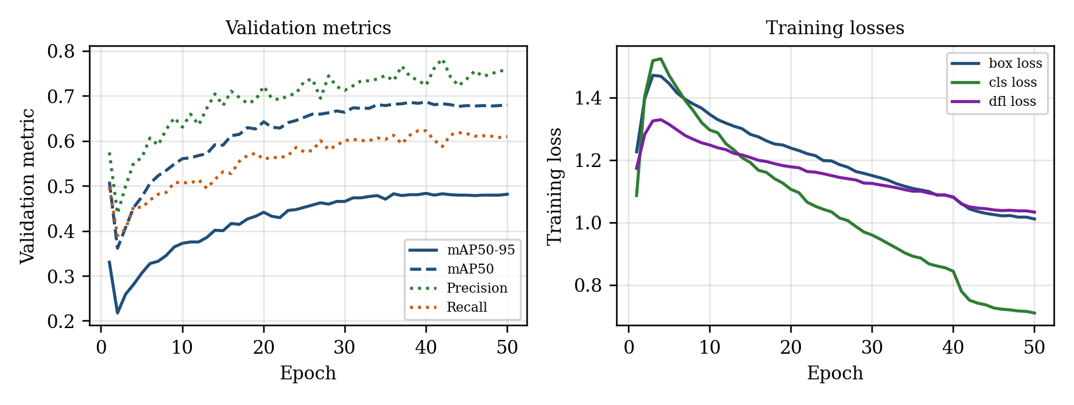
Detection training progress
50 recorded epochs on the perception training run
Validation mAP50–95: 0.331 at epoch 1, 0.482 at epoch 50
14
Notes:
PRESENTATION NOTES
The validation curve improves from 0.331 after the first epoch to 0.482 at epoch 50. The losses decrease. These are recorded training outputs. This is a progress comparison and does not isolate the effect of one architecture or augmentation choice.
SOURCE
Research paper, Fig. 5 and Table V.
C:/Users/Harsh/Documents/AutoDrive_Research_Paper.pdf

Slide 15
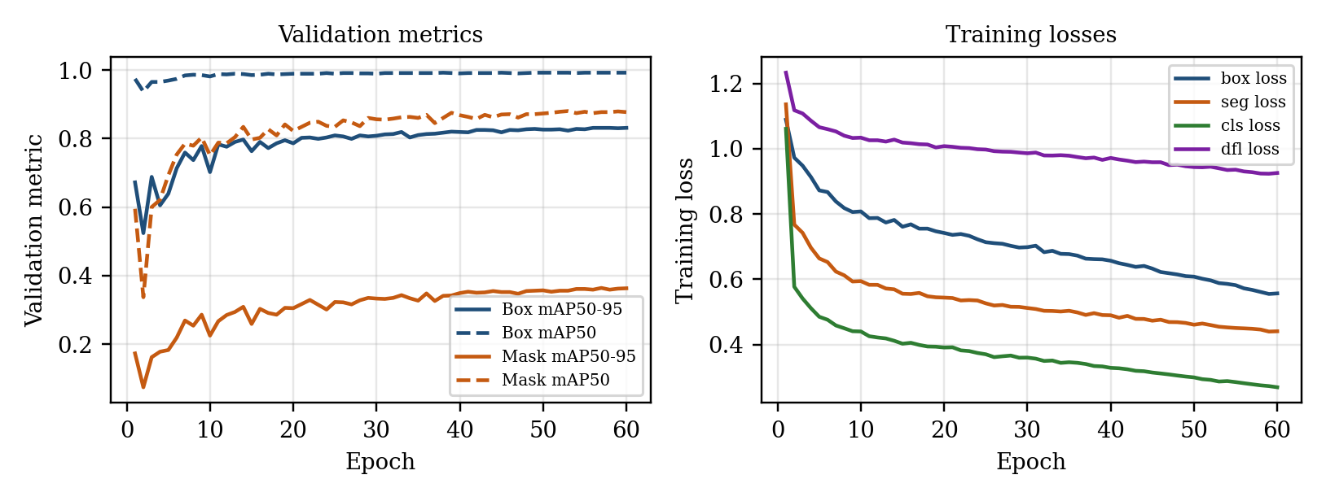
Lane training progress
60 recorded epochs on the perception training run
Mask mAP50–95: 0.173 at epoch 1, 0.363 at epoch 60
15
Notes:
PRESENTATION NOTES
The lane model improves across training. Box metrics converge early, while mask metrics remain lower because lane ribbons are thin. End-of-training mask mAP50-95 reaches 0.363. Re-evaluation of the same checkpoint gives 0.389.
SOURCE
Research paper, Fig. 6 and Table V.
C:/Users/Harsh/Documents/AutoDrive_Research_Paper.pdf

Slide 16
Steering results and baselines
Same 9,082 validation frames for all four models
36.9%
lower MAE than
the original RGB CNN
14.6822° MAE
R² = −0.1336
Constant baselines remain stronger. Reliable image-conditioned steering is not established.
16
Notes:
PRESENTATION NOTES
All four models use the same 9,082 frames. The new readout reduces MAE from 23.2570 to 14.6822 degrees, a 36.9 percent reduction. But training-mean and training-median constants still give lower MAE, and R-squared remains negative. Improvement ko strong or reliable steering ka proof mat bolo.
SOURCE
Research paper, Table IX and Section XVII, page 20.
C:/Users/Harsh/Documents/AutoDrive_Research_Paper.pdf

Slide 17
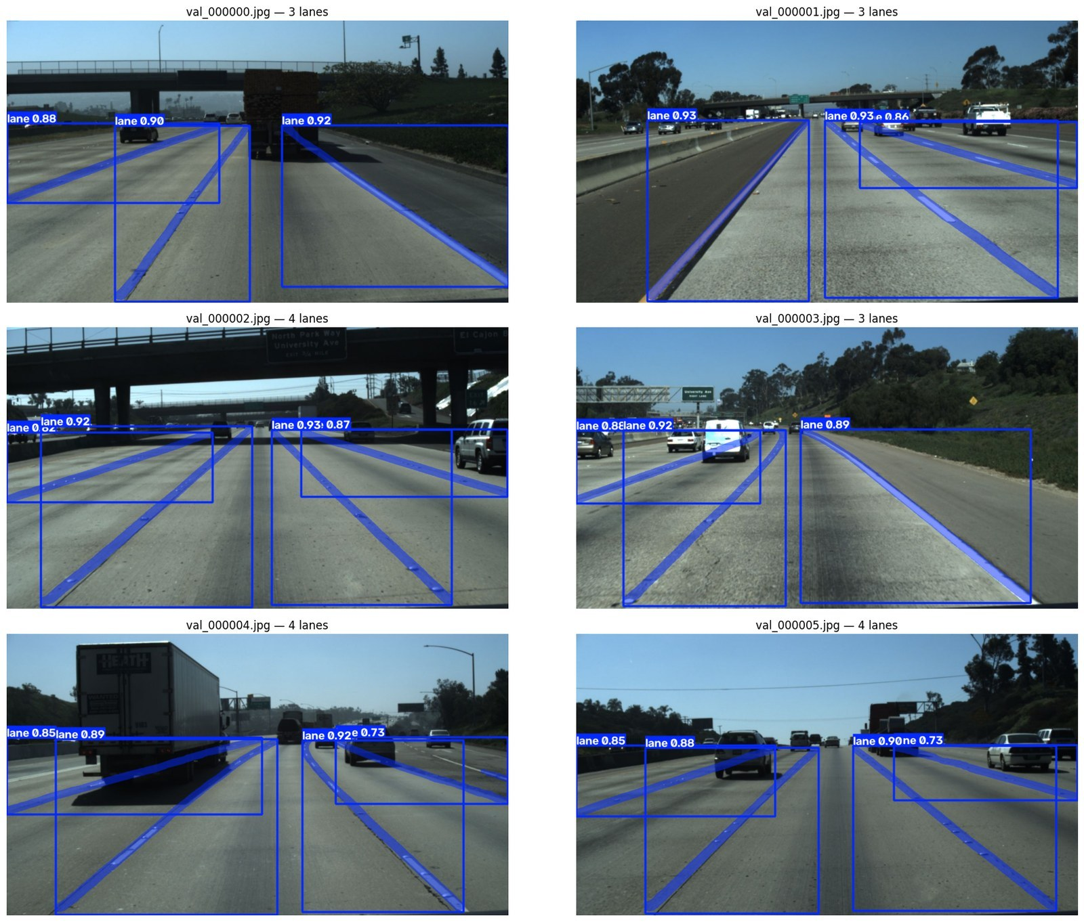
Lane prediction examples
What the image shows
Predicted lane boxes and masks on six validation frames.
Examples include shadows, underpasses and a truck occlusion.
Qualitative evidence complements the numerical metrics.
17
Notes:
PRESENTATION NOTES
Point to the predicted lane masks and explain how they follow painted markings. Some boxes are large because diagonal lanes create large bounding rectangles. These are examples, so do not generalize from six images alone.
SOURCE
Research paper, Fig. 9.
C:/Users/Harsh/Documents/AutoDrive_Research_Paper.pdf

Slide 18
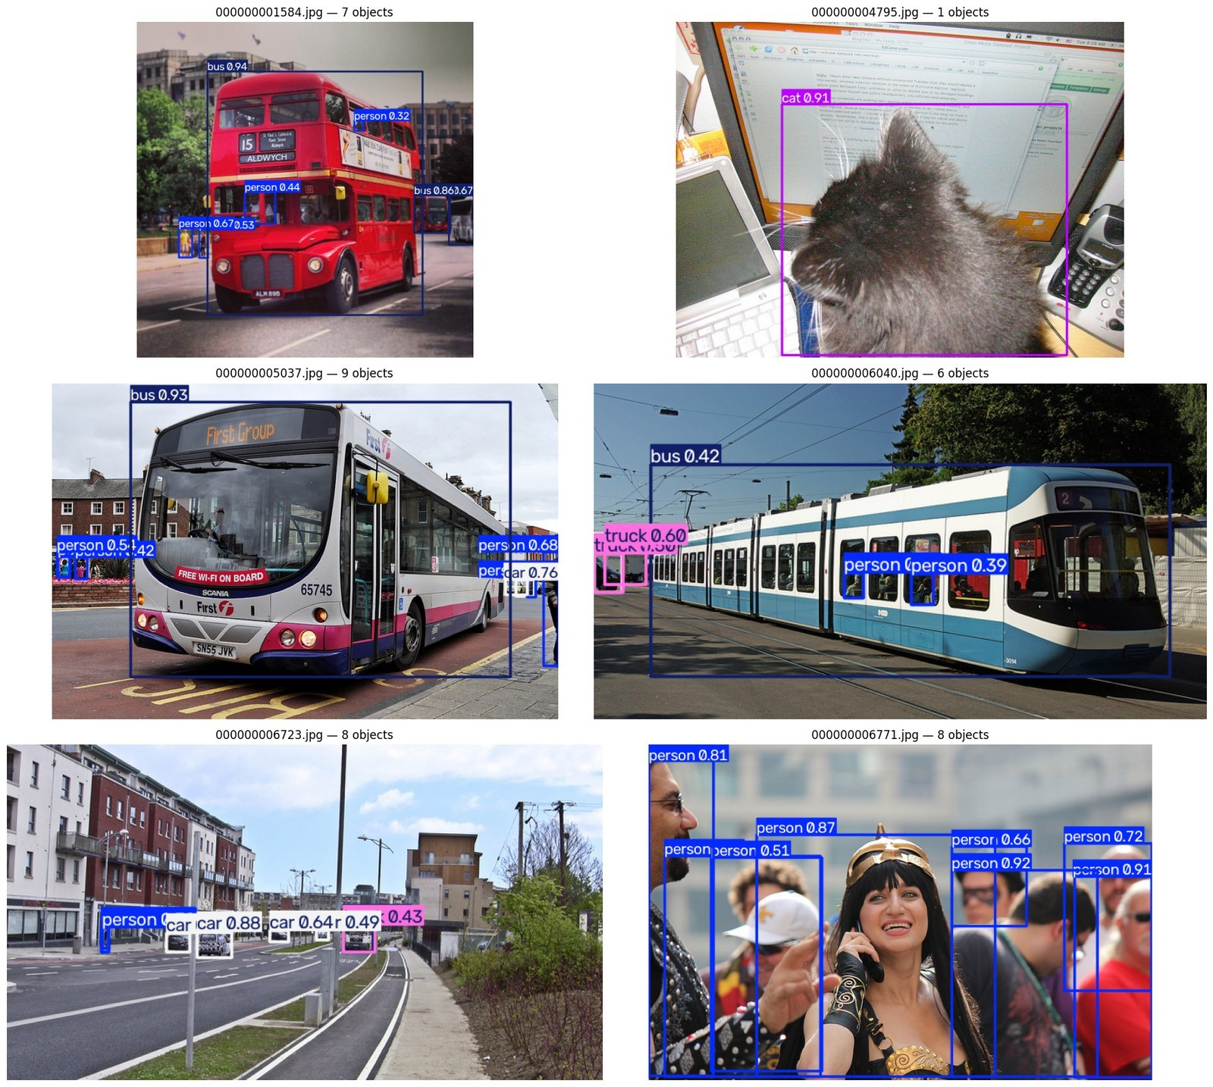
Object prediction examples
What the image shows
Bounding boxes, class names and confidence scores.
The detector finds large objects well, but small objects and recall remain challenges.
Test images remain separate from training.
18
Notes:
PRESENTATION NOTES
Explain boxes, labels and confidence. The test metrics show that recall remains limited even when selected images look good. These examples include six held-out test frames.
SOURCE
Research paper, Fig. 10.
C:/Users/Harsh/Documents/AutoDrive_Research_Paper.pdf

Slide 19
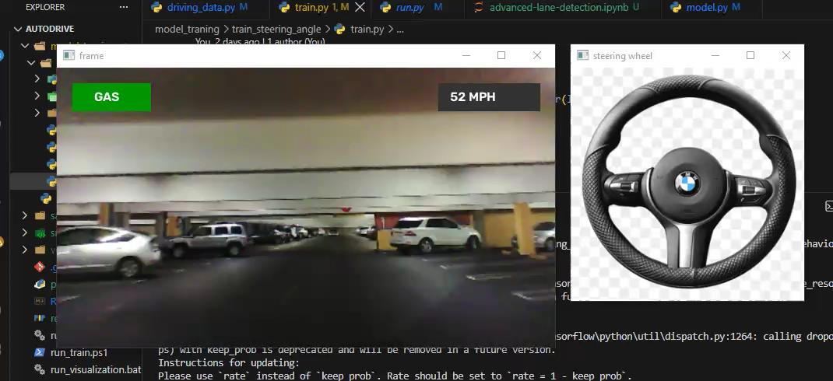
Prototype visualization
Display demonstration only. Speed and pedal indicators do not establish vehicle control.
19
Notes:
PRESENTATION NOTES
This screenshot from our synopsis illustrates the prototype display and steering wheel visualization. The speed and pedal indicators are interface elements. They are not a measured vehicle speed experiment or evidence of autonomous actuation.
SOURCE
Supplied synopsis, page 11. Research paper, Sections XI and XV.
C:/Users/Harsh/Documents/AutoDrive_Research_Paper.pdf

Slide 20
Latency and model footprint
Separate framework timings on a Tesla T4
Timing mode | Detection | Lane | Combined
Batch-16 evaluation | 11.1 ms | 11.8 ms | 22.9 ms
Single-image prediction | 17.0 ms | 14.3 ms | 31.3 ms
Saved weights | 19.2 MB | 20.5 MB | 39.7 MB
32–44 FPS
Projected throughput for the two YOLO modules only
Full pipeline FPS was not measured. Capture, steering, display and control I/O are excluded.
20
Notes:
PRESENTATION NOTES
The combined timings are sums of separately measured modules. They suggest around 32 to 44 FPS for the two perception modules. This is a projection, not an end-to-end benchmark. Steering, frame capture, display and I/O are excluded.
SOURCE
Research paper, Table VIII and Section VIII.
C:/Users/Harsh/Documents/AutoDrive_Research_Paper.pdf

Slide 21
Challenges, applications and next steps
Current limitations
Research applications
01
Steering trails simple constant baselines.
Component benchmarking
Lane annotation experiments
Perception and visualization teaching
02
Lane scores use synthetic masks.
03
Independent-drive and closed-loop tests remain outstanding.
Next steps
Official lane metrics, new driving data and controlled simulator evaluation
21
Notes:
PRESENTATION NOTES
This is useful as an academic research framework. We can compare modules, inspect errors and study annotation conversion. We have not demonstrated lane-keeping control or sensor fusion. Future work includes independent drives, official lane evaluation and closed-loop simulation.
SOURCE
Research paper, Sections IX, XI and XII.
C:/Users/Harsh/Documents/AutoDrive_Research_Paper.pdf

Slide 22
Conclusion and proof of work
01
AutoDrive integrates detection, lane segmentation and steering prediction.
02
Perception results are useful, while steering reliability remains unresolved.
03
The implementation and experiment artifacts support reproducibility.
github.com/HA2345567/Autodrive
Thank you. Questions are welcome.
22
Notes:
PRESENTATION NOTES
To conclude, we built an integrated research prototype and documented its component results. Perception shows useful capabilities, while steering requires further work. Our repository contains the implementation. Thank you. Questions are welcome.
SOURCE
Research paper, Sections XII and XIV. GitHub repository: https://github.com/HA2345567/Autodrive
C:/Users/Harsh/Documents/AutoDrive_Research_Paper.pdf

Slide 23
References
[1] Bojarski et al. End to End Learning for Self-Driving Cars. arXiv:1604.07316, 2016.
[2] Jocher and Qiu. Ultralytics YOLO11. Ultralytics repository, 2024.
[3] TuSimple. TuSimple Lane Detection Benchmark. Dataset and evaluation code, 2017.
[4] Lin et al. Microsoft COCO: Common Objects in Context. ECCV, 2014.
[5] Neven et al. Towards End-to-End Lane Detection: An Instance Segmentation Approach. IV, 2018.
[6] AutoDrive Research Team. AutoDrive research paper and implementation repository.
23
Notes:
PRESENTATION NOTES
These are the principal references used for the model families, datasets and evaluation. The research paper contains the full bibliography. Appendix slides follow for detailed numerical questions.
SOURCE
Research paper references [4], [8], [11], [22], [27], [36].
C:/Users/Harsh/Documents/AutoDrive_Research_Paper.pdf

Slide 24
Appendix A COCO-10 dataset counts
Instances per class. Image split: 8,080 train / 975 validation / 525 test
Class | Train instances | Train share | Val instances | Test instances
person | 24,661 | 43.8% | 2,728 | 1,567
bicycle | 2,887 | 5.1% | 210 | 104
car | 12,443 | 22.1% | 1,276 | 642
motorcycle | 3,054 | 5.4% | 220 | 147
bus | 2,188 | 3.9% | 169 | 114
truck | 2,914 | 5.2% | 267 | 147
traffic light | 4,768 | 8.5% | 403 | 231
stop sign | 1,118 | 2.0% | 53 | 22
dog | 1,221 | 2.2% | 146 | 72
cat | 1,013 | 1.8% | 132 | 70
Total | 56,267 | 100% | 5,604 | 3,116
24
Notes:
PRESENTATION NOTES
Backup slide. These are instance counts, not image counts. Images can contain multiple annotations. The largest-to-smallest training instance ratio is about 24 to 1.
SOURCE
Research paper, Table II(a).
C:/Users/Harsh/Documents/AutoDrive_Research_Paper.pdf

Slide 25
Appendix B Per-class detection results
Held-out test results. Validation AP50–95 is shown for comparison.
Class | Test P | Test R | Test AP50 | Test AP50-95 | Val AP50-95 | Test inst.
person | 0.812 | 0.613 | 0.717 | 0.457 | 0.469 | 1,567
bicycle | 0.686 | 0.399 | 0.498 | 0.270 | 0.311 | 104
car | 0.763 | 0.607 | 0.680 | 0.456 | 0.406 | 642
motorcycle | 0.802 | 0.633 | 0.771 | 0.472 | 0.422 | 147
bus | 0.842 | 0.711 | 0.791 | 0.662 | 0.669 | 114
truck | 0.561 | 0.463 | 0.521 | 0.331 | 0.347 | 147
traffic light | 0.636 | 0.476 | 0.494 | 0.265 | 0.271 | 231
stop sign | 0.488 | 0.607 | 0.619 | 0.556 | 0.736 | 22
dog | 0.651 | 0.806 | 0.771 | 0.596 | 0.558 | 72
cat | 0.882 | 0.829 | 0.861 | 0.645 | 0.667 | 70
25
Notes:
PRESENTATION NOTES
Backup slide. Traffic lights and bicycles have low AP, while buses, cats and dogs score higher. Stop sign estimates are unstable because the test set contains only 22 instances.
SOURCE
Research paper, Table VII.
C:/Users/Harsh/Documents/AutoDrive_Research_Paper.pdf

Slide 26
Appendix C Full perception metrics
Detection uses a held-out test. Lane results use validation only.
Split | Images | Instances | Precision | Recall | mAP50 | mAP50-95 | mAP75
Epoch-1 reference (val) | 975 | 5,604 | 0.575 | 0.498 | 0.510 | 0.331 | –
Validation | 975 | 5,604 | 0.724 | 0.621 | 0.688 | 0.486 | 0.518
Test (held out) | 525 | 3,116 | 0.712 | 0.614 | 0.672 | 0.471 | 0.511
Lane segmentation
Metric | Epoch 1 | Training end | Re-evaluation
Box P | 0.955 | 0.976 | 0.976
Box R | 0.953 | 0.974 | 0.974
Box mAP50 | 0.974 | 0.992 | 0.992
Box mAP50-95 | 0.672 | 0.831 | 0.831
Mask P | 0.744 | 0.918 | 0.925
Mask R | 0.735 | 0.916 | 0.923
Mask mAP50 | 0.595 | 0.877 | 0.890
Mask mAP50-95 | 0.173 | 0.363 | 0.389
26
Notes:
PRESENTATION NOTES
Backup slide. This preserves the full reported perception metrics. End-of-training and standalone lane results differ because evaluation conditions vary. These comparisons are not official TuSimple benchmark scores.
SOURCE
Research paper, Tables VI(a) and VI(b).
C:/Users/Harsh/Documents/AutoDrive_Research_Paper.pdf

Slide 27
Appendix D Complete steering metrics
All four models below use the same 9,082-frame validation partition.
Model | MAE ° | RMSE ° | Bias ° | R² | Pearson r | Within ±5°
Original CNN (RGB) | 23.2570 | 33.6313 | +21.4106 | -0.8067 | 0.0508 | 9.82%
Frozen CNN + Huber | 14.6822 | 26.6395 | +3.1230 | -0.1336 | 0.1682 | 31.35%
Training-mean constant | 12.4793 | 25.0502 | +1.2196 | -0.0024 | Undefined | 42.57%
Training-median constant | 12.6900 | 25.0212 | -0.1859 | -0.0001 | Undefined | 41.62%
Legacy BGR audit: 505 frames sampled every 18 rows
MAE 22.9616° RMSE 33.2350° Bias +20.9977°
R² −0.8769 Pearson r −0.0404 Within ±5° 9.11%
27
Notes:
PRESENTATION NOTES
Backup slide. Keep the 505-frame BGR audit separate from the 9,082-frame RGB and readout comparisons. Pearson correlation is undefined for constant predictions. R-squared remains negative for the selected readout.
SOURCE
Research paper, Tables VI(c), IX and Section XVII.
C:/Users/Harsh/Documents/AutoDrive_Research_Paper.pdf

Slide 28
Appendix E Recorded experimental comparisons
Saved notebook outputs. These are not controlled ablation results.
Comparison | Metric | Reference | Observed | Change
Detection: epoch 1 to 50 | Validation mAP50-95 | 0.331 | 0.482 | +0.151
Lane: epoch 1 to 60 | Box mAP50-95 | 0.672 | 0.831 | +0.159
Lane: epoch 1 to 60 | Mask mAP50-95 | 0.173 | 0.363 | +0.190
Lane: checkpoint re-evaluation | Mask mAP50-95 | 0.363 | 0.389 | +0.026
Detection: validation to test | mAP50-95 | 0.4855 | 0.4711 | -0.0144
Detection: validation to test | mAP50 | 0.6883 | 0.6723 | -0.0160
Deltas use the precision printed in the source notebooks.
28
Notes:
PRESENTATION NOTES
Backup slide. These are actual saved notebook comparisons. They show training progress, re-evaluation variation and the validation-to-test gap. They do not isolate effects of architecture, mosaic or ribbon width.
SOURCE
Research paper, Table V. research_paper/recorded_comparisons.json
C:/Users/Harsh/Documents/AutoDrive_Research_Paper.pdf

Slide 29
Appendix F Training hyperparameters
Original module training configuration from the recorded runs
Parameter | Detection (YOLO11s) | Lane (YOLO11s-seg) | Steering (DAVE-2)
Initial weights | yolo11s.pt (COCO) | yolo11s-seg.pt | Random initialization
Epochs / patience | 50 / 15 | 60 / 20 | 30 / none
Batch size | 16 | 16 | 100
Input size | 640×640 | 640×640 | 66×200
Optimiser | auto | auto | Adam
Loss | CIoU + BCE + DFL | CIoU + BCE + DFL + mask | MSE
LR schedule | cosine, 3 warm-up ep. | linear, 3 warm-up ep. | Fixed 1e-4
Weight decay | 5×10−4 | 5×10−4 | L2 0.001
Mosaic | 1.0 (off last 10 ep.) | 0.0 | -
Flip / scale / translate | 0.5 / 0.5 / 0.1 | 0.5 / 0.4 / 0.1 | None
HSV (h, s, v) | 0.015, 0.7, 0.4 | 0.015, 0.7, 0.4 | -
Rotation / shear / perspective | default | 0 / 0 / 0 | -
mask_ratio | – | 2 | -
Dropout | 0 | 0 | Keep probability 0.5
Seed / deterministic | 0 / yes | 0 / yes | Not set
Mixed precision | yes | yes | No
Training time (T4) | 2.14 h | 2.31 h | Not recorded
29
Notes:
PRESENTATION NOTES
Backup slide. Detection and lane runs use batch 16 and 640-pixel images. Original steering uses a different training setup. The Huber readout experiment follows its own protocol, described on the next backup slide.
SOURCE
Research paper, Table IV.
C:/Users/Harsh/Documents/AutoDrive_Research_Paper.pdf

Slide 30
Appendix G Steering experiment protocol
Development selection stays within the original training partition.
Item | Recorded value
Sampled training rows | 9,081, selecting every fourth row
Inner chronological split | 7,265 fit / 1,816 development
Candidate configurations | 5 squared-error penalties + 4 Huber configurations
Selected readout | Huber threshold 10°, penalty α = 100
Final optimization | 96 L-BFGS-B iterations
Bootstrap | 100-frame blocks, 1,000 replicates, seed 20261021
MAE 95% interval | 11.631° to 18.629°
RMSE 95% interval | 18.241° to 35.675°
Paired MAE reduction interval | 6.849° to 10.250° versus original RGB CNN
30
Notes:
PRESENTATION NOTES
Backup slide. The mean and scale use training features. Development MAE chooses the loss and penalty. Validation labels do not fit the readout. The existing validation partition was inspected previously and backbone training exposure is unknown, so it is not an independent test drive. Training labels range from minus 152.87 to plus 501.78 degrees, with 219 beyond plus or minus 180. Validation has no labels outside that bound. Runtime: Python 3.13.1, TensorFlow 2.20.0, NumPy 2.5.1, SciPy 1.18.0, OpenCV 5.0.0, local Pentium 4415U CPU.
SOURCE
Research paper, Section XVII. output/steering_audit/comparison_summary.json
C:/Users/Harsh/Documents/AutoDrive_Research_Paper.pdf

Slide 31
Appendix H Reference architecture counts
Canonical DAVE-2 reference. The local saved CNN has 1,595,511 parameters.
Layer | Parameters | Output
Input (YUV) | – | 66×200×3
Normalisation | – | 66×200×3
Conv1: 24 filters, 5×5, stride 2 | 1,824 | 31×98×24
Conv2: 36 filters, 5×5, stride 2 | 21,636 | 14×47×36
Conv3: 48 filters, 5×5, stride 2 | 43,248 | 5×22×48
Conv4: 64 filters, 3×3 | 27,712 | 3×20×64
Conv5: 64 filters, 3×3 | 36,928 | 1×18×64
Flatten | – | 1,152
FC 100 | 115,300 | 100
FC 50 | 5,050 | 50
FC 10 | 510 | 10
Output (steering) | 11 | 1
Total DAVE-2 | 252,219
YOLO11s detector (10 classes) | 9,416,670 | 100 layers, 21.4 GFLOPs
YOLO11s-seg lane network (1 class) | 10,067,203 | 113 layers, 32.9 GFLOPs
31
Notes:
PRESENTATION NOTES
Backup slide. The table reproduces the canonical reference layer counts. It is not the exact saved local graph, which includes an additional 1,164-unit dense layer. This distinction explains the difference between 252,219 reference parameters and 1,595,511 actual checkpoint parameters.
SOURCE
Research paper, Table III and Sections IV, XVII.
C:/Users/Harsh/Documents/AutoDrive_Research_Paper.pdf

