Slide 1
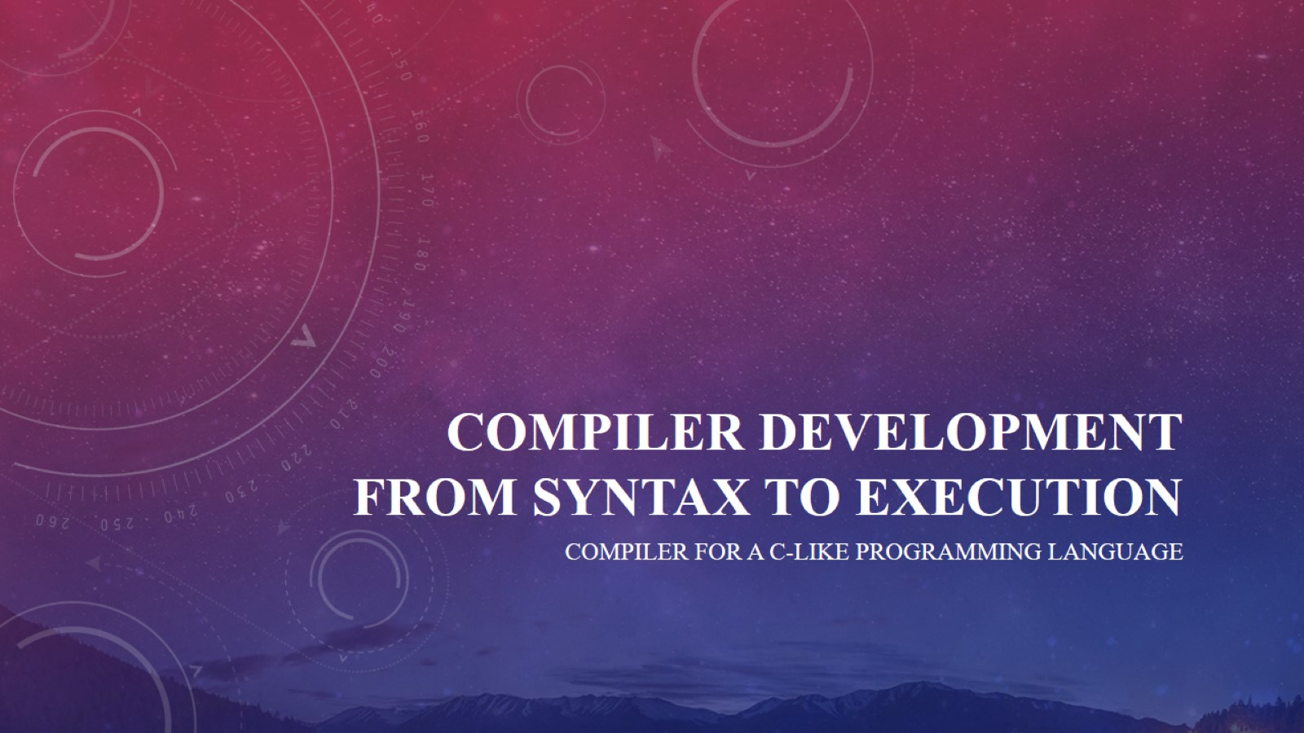
Compiler development from syntax to execution

Slide 2
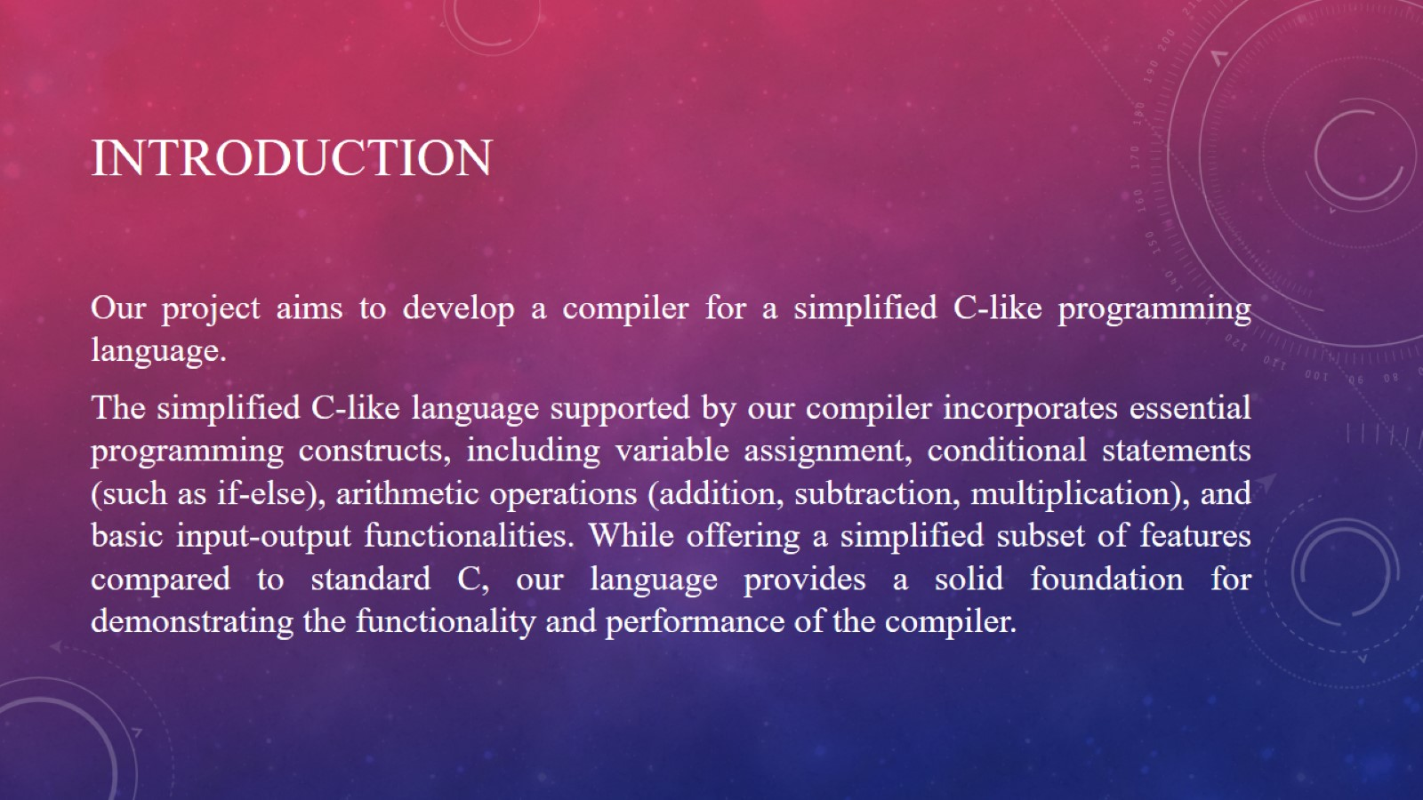
Introduction

Slide 3
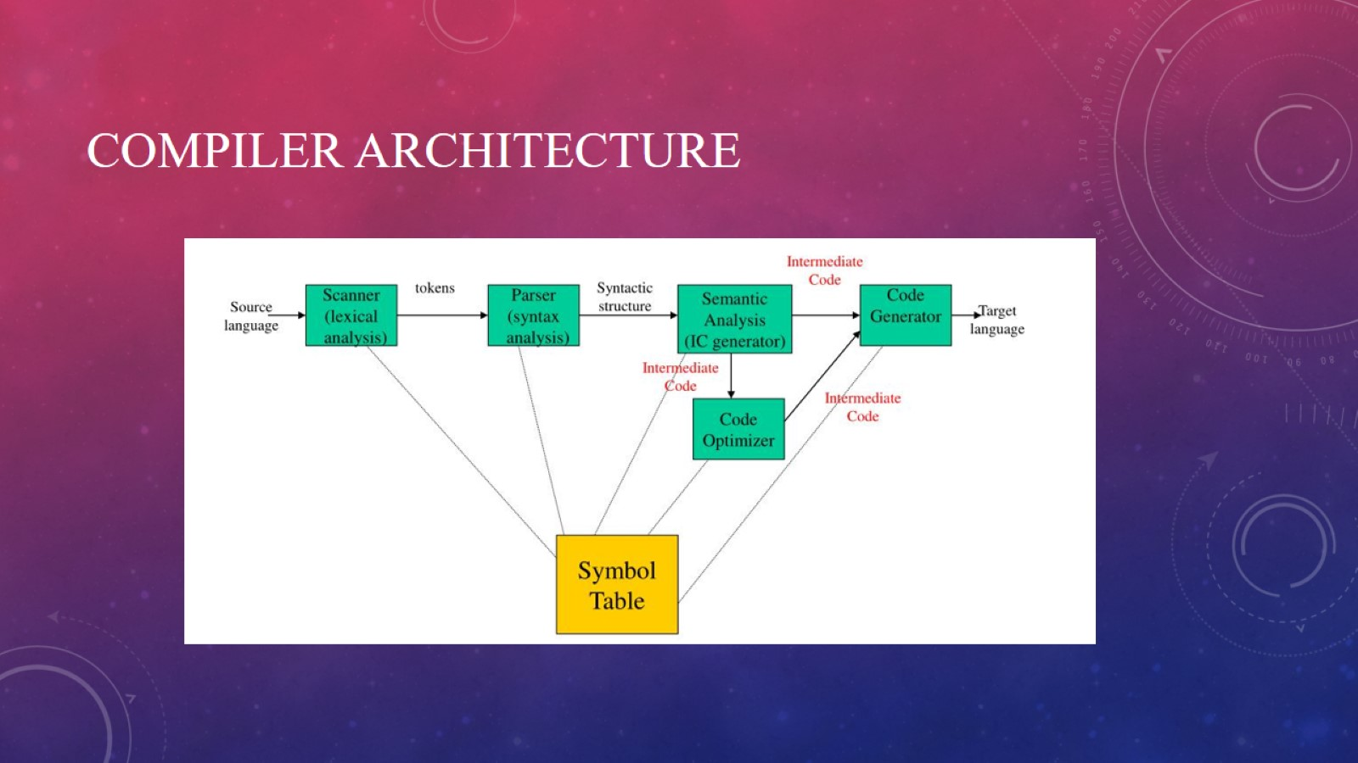
Compiler Architecture

Slide 4
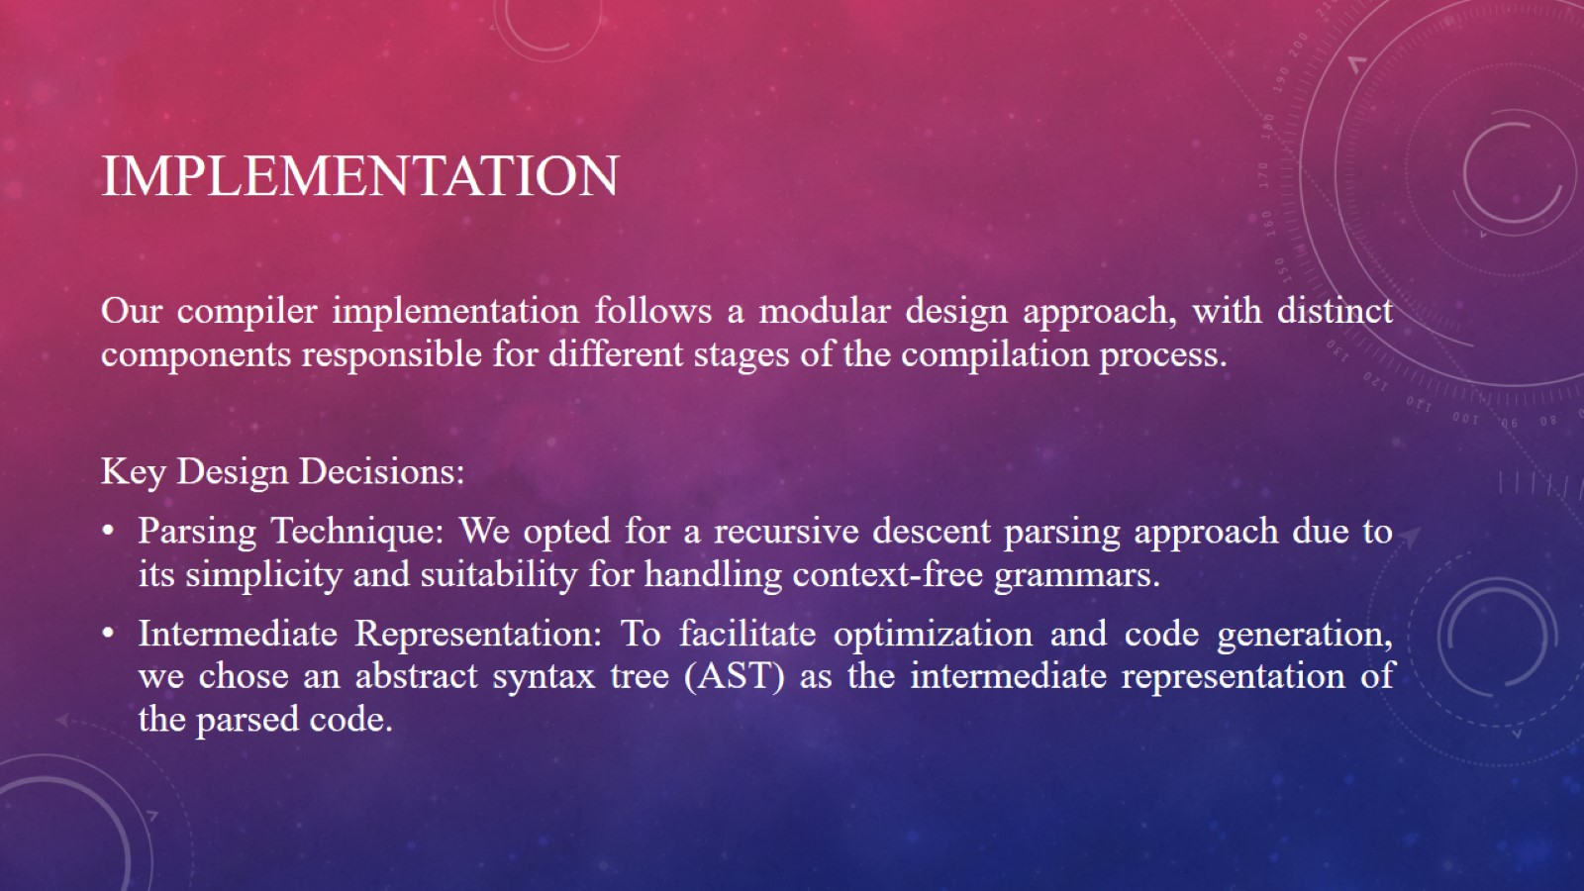
Implementation

Slide 5
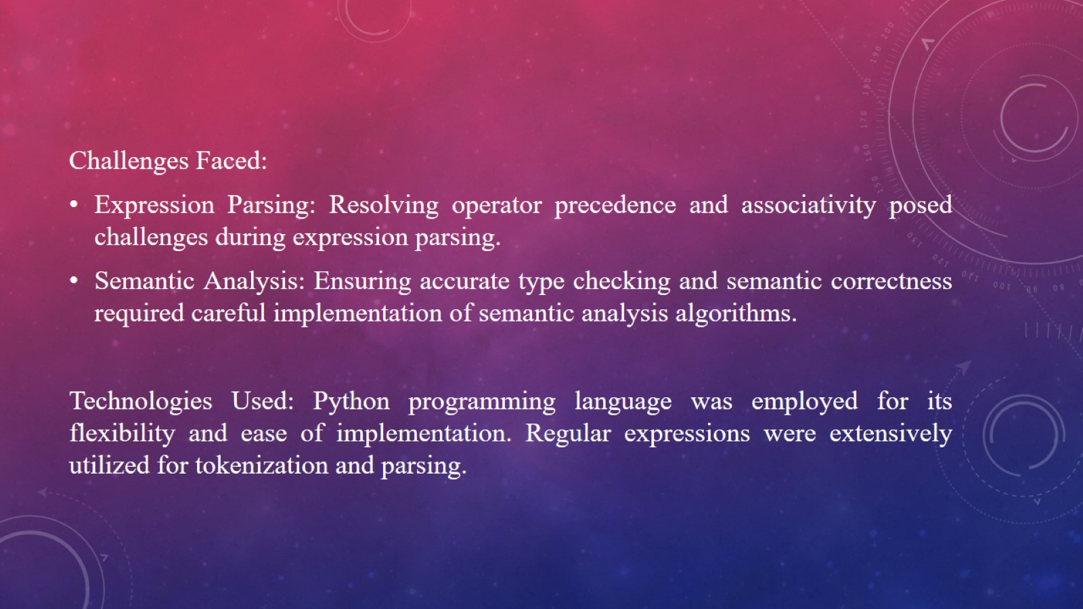

Slide 6
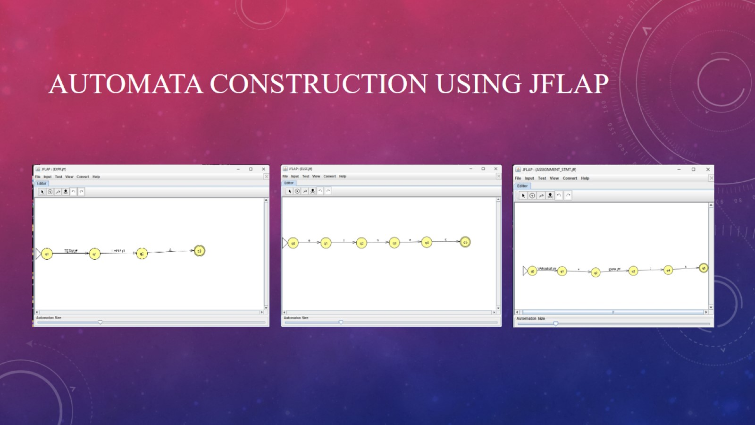
Automata construction using JFLAp

Slide 7
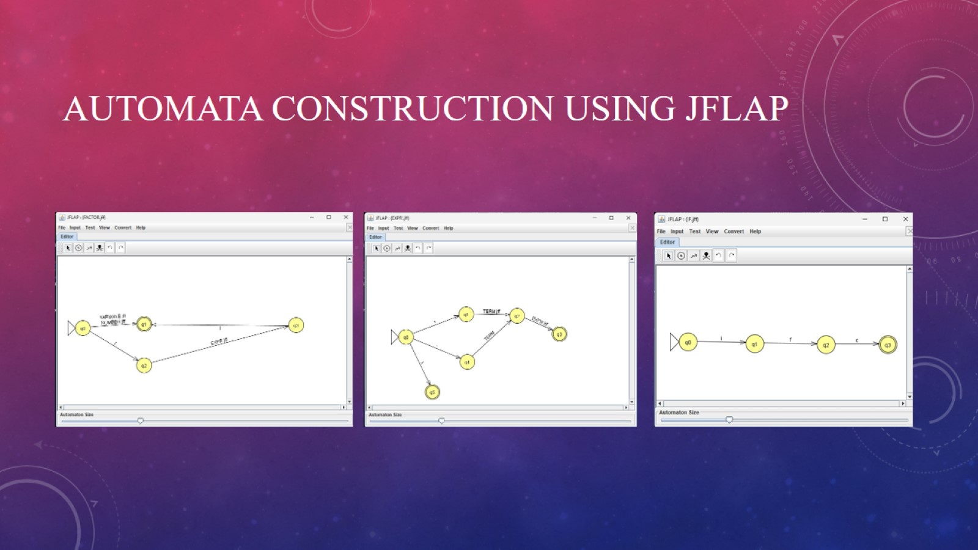
Automata construction using JFLAp

Slide 8
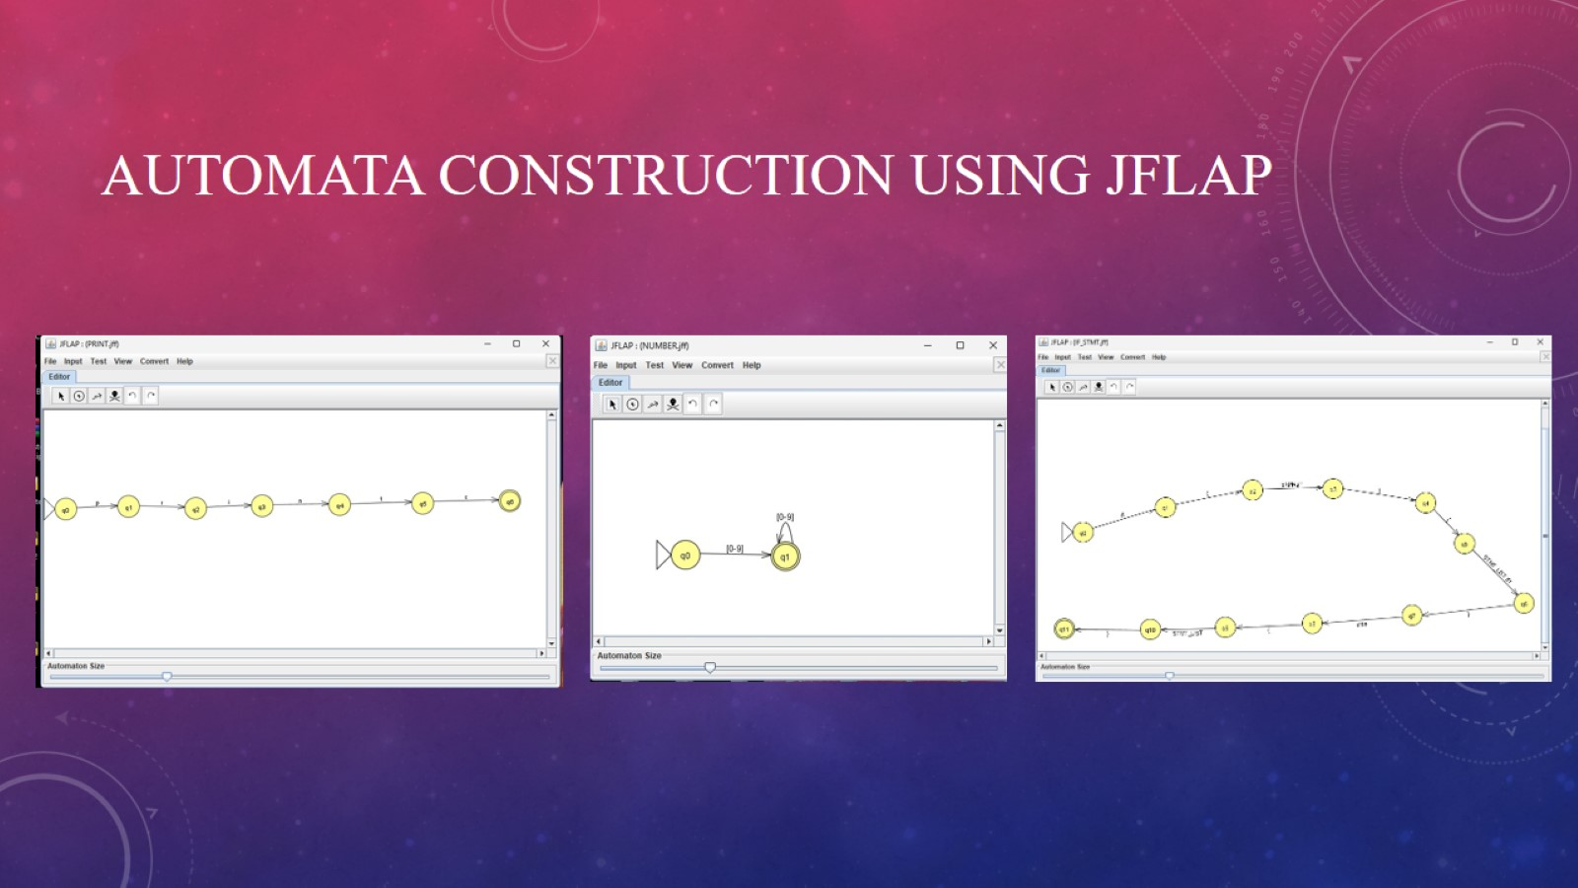
Automata construction using JFLAp

Slide 9
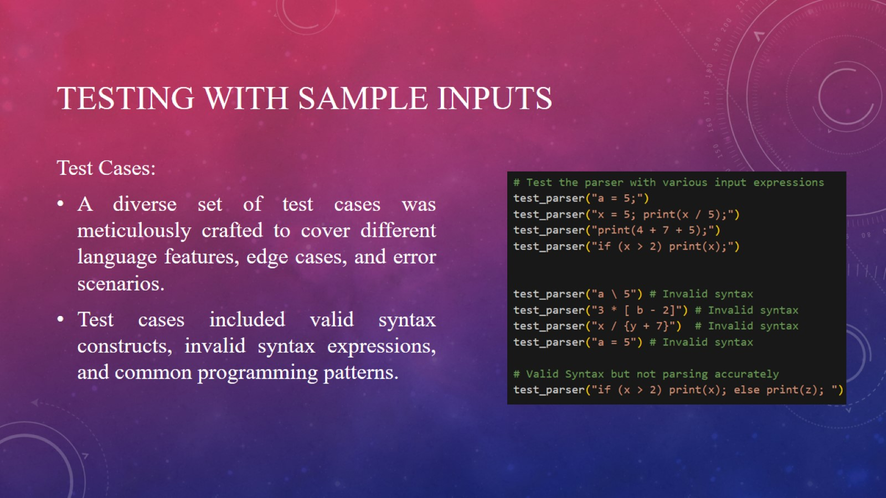
Testing with sample inputs

Slide 10
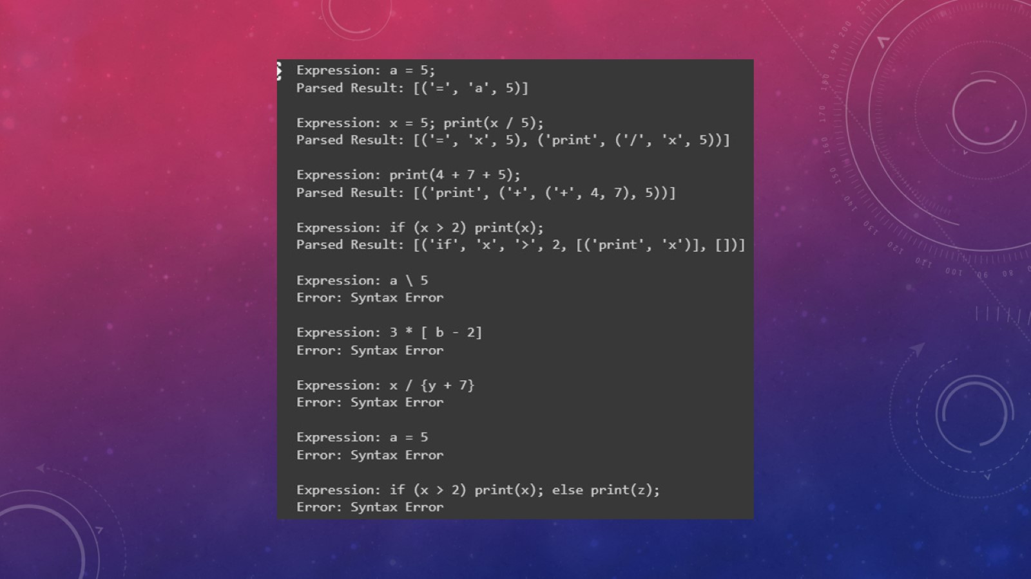

Slide 11

Thank You!

