Slide 1
NON-ORTHOGONAL MULTIPLE ACCESS
(NOMA)
PRESENTED BY

Slide 2

NON ORTHOGONAL MULTIPLE ACCESS
Non-Orthogonal Multiple Access (NOMA) improves spectrum efficiency.
Multiple users share the same time, frequency, and code resources.
Unlike OMA (e.g., TDMA, FDMA), NOMA separates users via power or code domains.
Enables higher efficiency and connectivity.

Slide 3
Why we should replace traditional OMA, TDMA, and FDMA with NOMA?
FEATURE | OMA(TDMA/FDMA) | NOMA
Spectral Efficiency | Low(Unused resources with low demand) | High(Simultaneous resource sharing)
Number of Supported Users | Limited by orthogonal resources | Scalable for massive connectivity
Fairness | Poor for users with weak channel | Ensures fairness via power allocation
Latency | High(Due to scheduling delays) | Low(Simultaneous transmission)
Energy Efficiency | Moderate | High(better resource utilization)

Slide 4
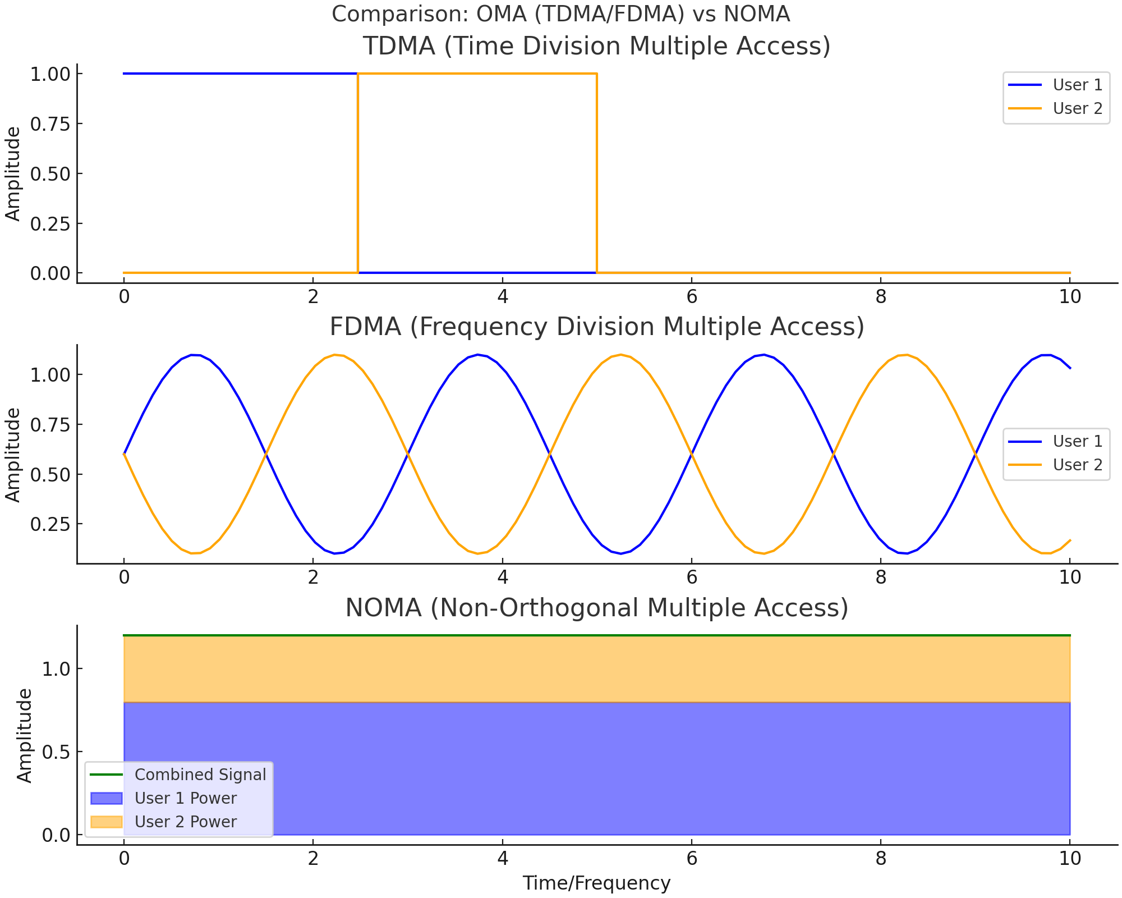

Slide 5

Why Do We Need NOMA?
Enhanced spectral efficiency.
Massive connectivity.
Fair resource allocation.
Improved throughput.
Low latency.
Energy efficiency.
Compatibility with advanced technologies.

Slide 6
MATLAB code for NOMA
% NOMA Simulation Parameters numSymbols = 10^5; % Number of symbols per user Pt = 1; % Total transmit power alpha = 0.8; % User 1 beta = 0.15; % User 2 gamma = 1 - alpha - beta; % User 3 EbN0_dB = 0:2:30; % Eb/N0 range in dB % BPSK Modulation (Symbol Mapping) data1 = randi([0 1], 1, numSymbols); data2 = randi([0 1], 1, numSymbols); data3 = randi([0 1], 1, numSymbols); x1 = 2 * data1 - 1; x2 = 2 * data2 – 1; x3 = 2 * data3 - 1; % Transmitted signal with power allocation s = sqrt(alpha * Pt) * x1 + sqrt(beta * Pt) * x2 + sqrt(gamma * Pt) * x3; % Initialize BER results BER_User1 = zeros(1, length(EbN0_dB)); BER_User2 = zeros(1, length(EbN0_dB)); BER_User3 = zeros(1, length(EbN0_dB)); for idx = 1:length(EbN0_dB) % Noise and Channel EbN0 = 10^(EbN0_dB(idx)/10); N0 = Pt / ( EbN0); % Noise spectral density noise = sqrt(N0/2) * (randn(1, numSymbols) + 1i * randn(1, numSymbols)); h = (randn(1, numSymbols) + 1i * randn(1, numSymbols)) / sqrt(2); % Generation of Received signal y = h .* s + noise; % Channel equalization y_equalized = y ./ h; | % Successive Interference Cancellation (SIC) for User 1 y_User1 = y_equalized / sqrt(alpha * Pt); detected_x1 = real(y_User1) > 0; BER_User1(idx) = sum(detected_x1 ~= data1) / numSymbols; % Remove User 1's signal for User 2 decoding y_User2 = y_equalized - sqrt(alpha * Pt) * x1; y_User2 = y_User2 / sqrt(beta * Pt); detected_x2 = real(y_User2) > 0; BER_User2(idx) = sum(detected_x2 ~= data2) / numSymbols; % Remove User 2's signal for User 3 decoding y_User3 = y_User2 - sqrt(beta * Pt) * x2; y_User3 = y_User3 / sqrt(gamma * Pt); detected_x3 = real(y_User3) > 0; BER_User3(idx) = sum(detected_x3 ~= data3) / numSymbols; end % Plot results figure; semilogy(EbN0_dB, BER_User1, 'b-o', 'LineWidth', 2); semilogy(EbN0_dB, BER_User2, 'r-*', 'LineWidth', 2); semilogy(EbN0_dB, BER_User3, 'g-^', 'LineWidth', 2); % Power Allocation vs Frequency Spectrum Plot frequency = linspace(0, 1, 100); power1 = alpha * ones(size(frequency)); power2 = beta * ones(size(frequency)); power3 = gamma * ones(size(frequency)); figure; hold on; area(frequency, power1, 'FaceColor', 'b', 'DisplayName', 'User 1 Power'); area(frequency,power2, 'FaceColor', 'r', 'DisplayName', 'User 2 Power'); area(frequency, power3, 'FaceColor', 'g', 'DisplayName', 'User 3 Power');

Slide 7
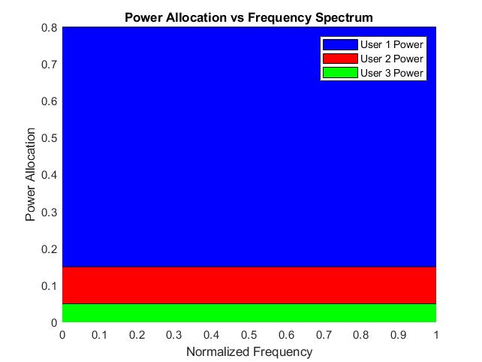
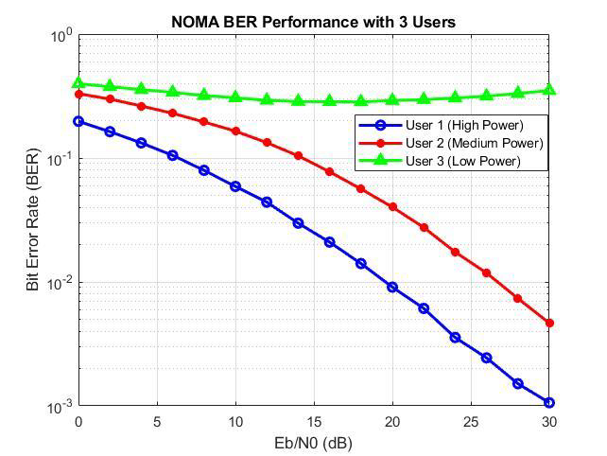
Figure-01: Power Allocation Vs Frequency
Figure-02: Bit Error Rate Performance Vs SNR

Slide 8
Successive Interference Cancellation (SIC) in NOMA
Overview, Mathematical Model, and Applications

Slide 9
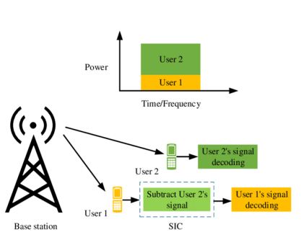
Overview of SIC in NOMA
Technique: Successive Interference Cancellation (SIC) is a signal processing method.
Use in NOMA: Key to separating power-domain superimposed signals.
Goal: Enhances spectral efficiency.
Function: Enables multiple users to share resources simultaneously.
NOMA wireless communication

Slide 10
Working Procedure of SIC
1. Superposition Coding: Signals for multiple users are combined at the transmitter.
2. Signal Reception: Composite signal received by users.
3. Successive Decoding: Stronger signal decoded first and removed. Weaker signal is then decoded.
4. Iterative Interference Cancellation: Process repeats for additional signals.

Slide 11
Mathematical Representation of SIC
Transmitted Signal: x = √P₁s₁ + √P₂s₂
Received Signal: y = h(√P₁s₁ + √P₂s₂) + n
Decoding Stronger Signal: SINR_s₂ = P₂|h|² / (P₁|h|² + σ²)
Subtract Stronger Signal: y' = y - √P₂s₂
Decoding Weaker Signal: SINR_s₁ = P₁|h|² / σ²

Slide 12
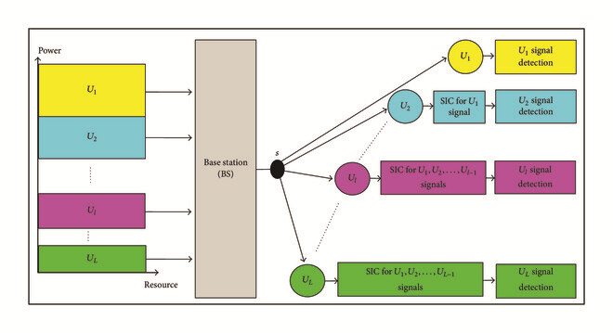
Example Scenario: SIC in Action

Slide 13
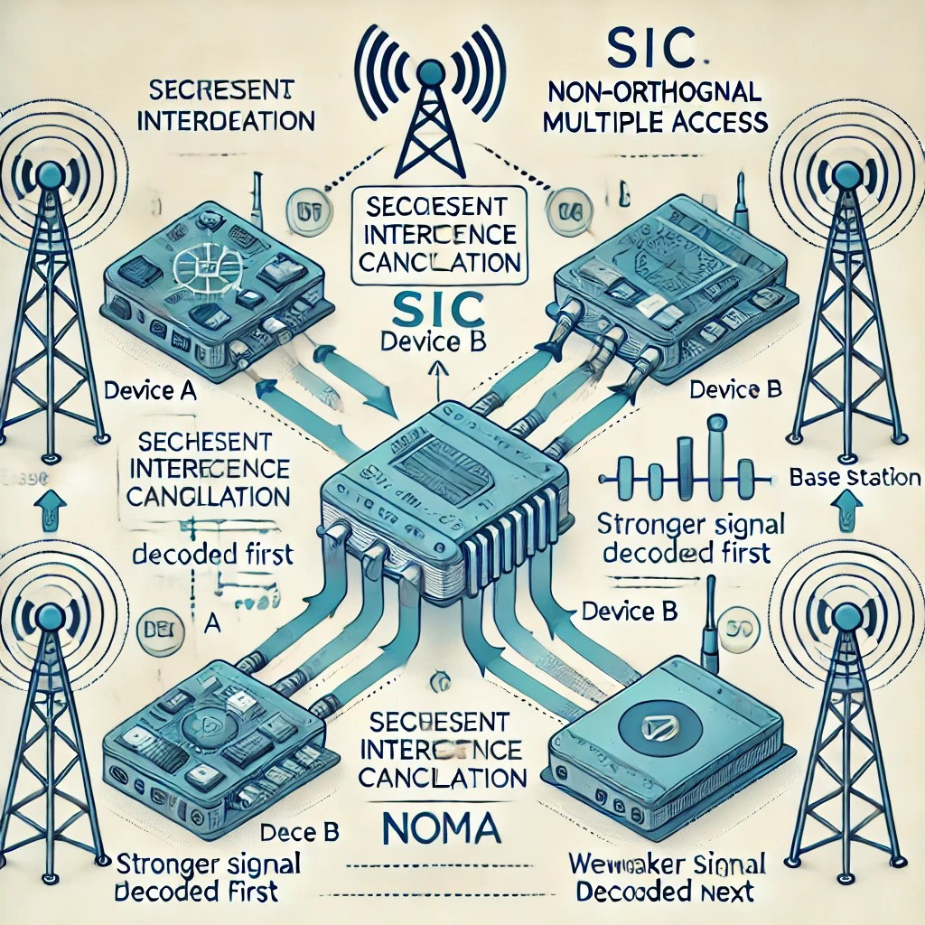
Advantages and Disadvantages of SIC
Advantages:
Efficient spectrum utilization
Enhanced connectivity and throughput
Energy-efficient resource allocation
Disadvantages:
High computational complexity
Error propagation
Dependency on power allocation
Hardware requirements

Slide 14
Applications of SIC in NOMA
5G and beyond for enhanced Mobile Broadband (eMBB) and IoT
Internet of Things (IoT) for massive device connectivity
Satellite communications to manage multiple users
UAV networks for reliable data streams
Machine-to-Machine (M2M) communications in industrial automation

Slide 15
Q & A

Slide 16


