Slide 1

Chapter 16
The World Wide Web

Slide 2
Chapter Goals
Compare and contrast the Internet and the World Wide Web
Describe general Web processing
Write basic HTML documents
Describe several specific HTML tags and their purposes

Slide 3
Chapter Goals
Describe the processing of Java applets and Java server pages
Compare and contrast HTML and XML
Define basic XML documents and their corresponding DTDs
Explain how XML documents are viewed

Slide 4
The World Wide Web
The Web
An infrastructure of information combined and the network software used to access it
Web page
A document that contains or references various kinds of data
Links A connection between one web page and another
What are the links used for?

Slide 5
The World Wide Web
Website
A collection of related web pages
Web browser
A software tool that retrieves and displays eb pages
Web server
A computer set up to respond to requests for web pages

Slide 6
The World Wide Web
Uniform Resource Locator (URL)
A standard way of specifying the location of a Web page, containing the hostname, "/", and a file
What is the relationship between the Internet and the Web?

Slide 7
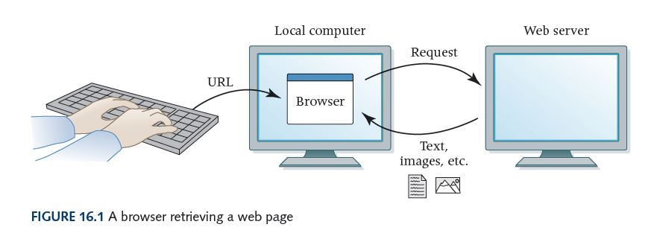
The World Wide Web
Why is the expression
"visiting a website"
confusing?

Slide 8
Search Engines
Search Engine
A website that helps you find other websites
Can you name at least two?
How do they work?

Slide 9
Instant Messaging
Instant messaging (IM)
  Applications that allow people to send short messages
  Similar to texting, but based on username not cellular phone number
  Some applications allow more than two users in a chat room
  If participants run application simultaneously, they can have an interactive conversation
  Most applications use proprietary protocols that dictate the precise format and structure of the messages
  Most instant messages are not secure

Slide 10
Weblogs
Blog or Weblog
An online journal or newsletter that is frequently updated and intended for public consumption
Do you have a blog?
Do you read blogs?

Slide 11
Cookies
Cookie
A small text file that a web server stores on your local computer’s hard disk
  A cookie contains information about your visit to the site
  Cookies can be used
    to determine number of unique visitors to the site
    to customize the site for future visits
    to implement shopping carts that can be maintained from visit to visit
  Cookies are not dangerous

Slide 12
Web Analytics
Web analytics
  Collection and analysis of data regarding website usage
  Typically used by website owners to track the number and behavior of users visiting their sites
  Example: Google Analytics tracks
    Where users are geographically located (based on their ISP)
    Which site referred them
    Which pages within your site they visit
    How long they spend on each page
    Which page they leave your site from
    More

Slide 13
HTML and CSS
Hypertext Markup Language (HTML)
The language used to create or build a web page
Markup language
A language that uses tags to annotate the information in a document
Tag
The syntactic element in a markup language that annotate the information in a document

Slide 14
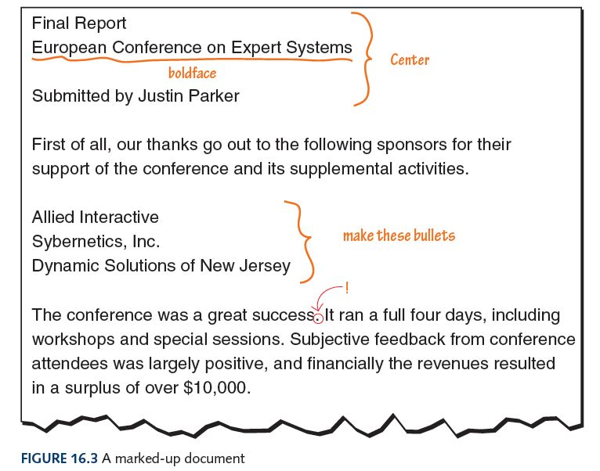
HTML and CSS

Slide 15
HTML and CSS
HTML5
Current version of the HTML standard
Released in 2011
Supported by all major browsers
Doing web development? Focus on HTML5.

Slide 16
HTML and CSS
In a modern, well-designed webpage
HTML tags indicate what the information is
  Paragraph
  Image
  List
  Etc.
CSS style information indicates how information should be displayed
  Alignment
  Borders
  Background colors
  Etc.

Slide 17
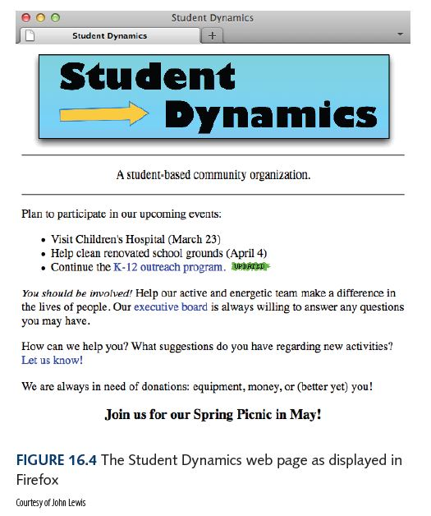
HTML and CSS

Slide 18
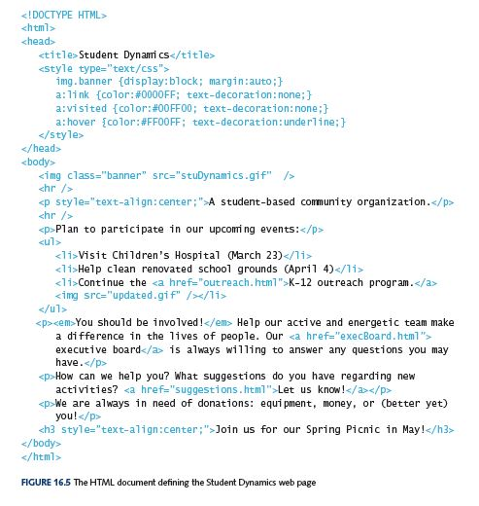
HTML and CSS

Slide 19
HTML and CSS
Tags are enclosed in angle brackets
(<. . . >)
Words such as head, title, and body are called elements and specify the type of the tag
Most elements consist of a start tag such as <body> and a corresponding end tag with a / before the element name, such as </body>

Slide 20
HTML and CSS
HTML Document Structure
Entire document enclosed between <html> and </html>
The head section (within <head> … </head>) contains information about the document itself, such as its title
The body section (within <body> … </body>) contains the information to be displayed

Slide 21
HTML and CSS
The browser
  Uses HTML tags together with CSS style information to determine how page should be displayed
  Ignores the way we format the HTML document using carriage returns, extra spaces, and blank lines
  Takes into account the width and height of the browser window
  Reformats the contents to fit your browser window

Slide 22
Basic HTML Elements
<p> . . . </p> text that should be treated as a separate paragraph
<hr /> horizontal rule across page
<ul>…</ul> unordered list (usually bullets)
<ol>…</ol> ordered list (e.g. numbered)
<li>…</li> list item
<h1>…</h1> level 1 heading
…
<h6>…</h6> level 6 heading

Slide 23
Tag Attributes
Attribute
Part of a tag that provides additional information about the element
Form
attribute-name=value
Examples
CSS style specification | style=“text-align:center”
Image source file | <img src=“myPicture.gif” />
Hyperlink URL | <a href=http://google.com/>Google It!</a>

Slide 24
More About CSS
Cascading
Styles can be specified at multiple levels and overridden at lower levels as needed
In an external file
p {color:#00FF00;}
In the head section of the HTML document:
<head>
…
<style type=“text/css”>
p {color:#00FF00;}
</style>
…
</head>
As an attribute of an HTML element:
<p style=“text-align:center”>This text is centered!<p>

Slide 25
More About CSS
In the Student Dynamics example, the following style tag is used in the head section of the document:
<style type=”text/css”>
img.banner {display:block; margin:auto;}
a:link {color:#0000FF; text-decoration:none;}
a:visited {color:#00FF00; text-decoration:none;}
a:hover {color:#FF00FF; text-decoration:underline;}
</style>
First rule: applies to all img tags that have a class attribute with the value banner. Setting the margins to auto centers the image horizontally
Second rule: An unvisited link is shown in blue text with no underline
Third rule: A visited link is shown in green with no underline
Fourth rule: When the mouse hovers over a link, the link text turns purple with an underline

Slide 26
HTML5
New Tags
<section> to define section of pages
<header> to define the header of a page
<footer> to define the footer of a page
<nav> to define the navigation elements on a page
<article> to define an article or primary content of a page
<aside> to define secondary content that might appear in a sidebar
<figure> to define images that annotate an article

Slide 27
HTML5
Support for dynamic content (e.g. drop down menus)
async attribute – content is loaded asynchronously to improve download speed
Tags supporting form input (e.g. times, dates, ranges, email addresses, URLs)

Slide 28
Java Applets
Java applet
A Java program designed to be embedded into an HTML document, transferred over the Web, and executed in a browser
  <P><APPLET code = "FactByte.class" width=250 height=150></APPLET></P>

Slide 29
Java Applets
Example
Contents of FactByte.htm:
<H1>Factorial with Byte Result</H1>
<P>Enter increasing values beginning with 0 and record the results of the Factorial of your input. At some point, the answer will seem strange. Record what seems strange about the answer and return to the previous page. </P>
<P><HR></P>
<P><APPLET code = "FactByte.class" width=250 height=150></APPLET></P>
FactByte.class
contains the
Java applet

Slide 30
Java Server Pages
JSP Scriptlet
A portion of code embedded in an HTML document designed to dynamically contribute to the content of the web page
Java Server Page
A web page that has a JSP scriptlet interwoven among the HTML content

Slide 31
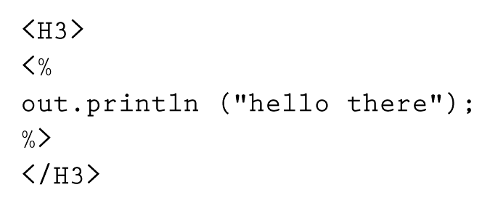
Java Server Pages
A JSP scriptlet is encased in special tags beginning with <% and ending with %>
Imagine JSP scriptlets as having the expressive power of a full programming language

Slide 32
Java Server Pages
JSPs are executed on the server side where the web page resides
By the time it arrives at your computer, all active processing has taken place, producing a static (though dynamically created) web page
JSPs are particularly good for coordinating the interaction between a web page and an underlying database
Compare and contrast Java
applets and JSP scriptlets

Slide 33
XML
Extensible Markup Language (XML)
A language that allows the user to describe the content of a document
  HTML describes how a document should look
  XML describes a document's meaning
Metalanguage
A language for talking about, or defining, other languages
XML is a metalanguage

Slide 34
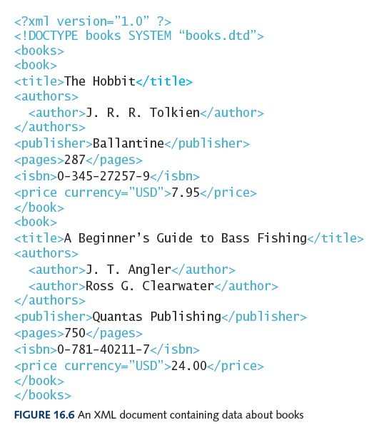
XML
Like HTML, an XML document is made up of tagged data

Slide 35
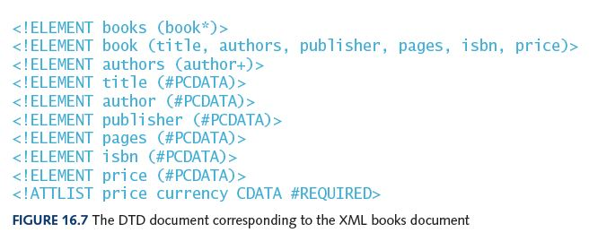
XML
Document Type Definition (DTD)
A specification of the organization of the document
The structure of a particular XML document is described by its corresponding DTD document

Slide 36
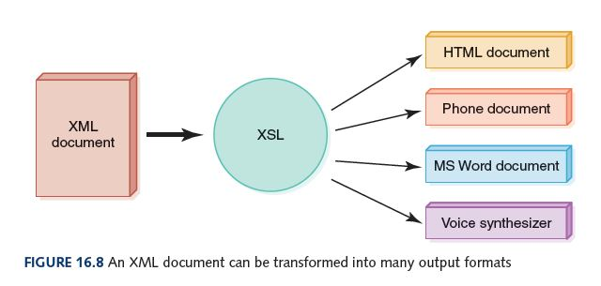
XML
XML represents a standard format for organizing data without tying it to any particular type of output
Extensible Stylesheet Language (or XSL)
A language for defining transformations from XML documents to other output formats

Slide 37
Social Networks
Social Network
An online service that allows people with shared interest to communicate and interact
A few of the many: Facebook, Twitter, LinkedIn, Pinterest, Google+, Tumblr, Instagram
Pre-Facebook history of online social networks includes BBS’s, Classmates.com, SixDegrees.com, MySpace, LinkedIn
Broader social network concept: sociological model of how individuals or organizations interact
  Network can be viewed as map of interactions
  Research began in 1800s (e.g. to model spread of new ideas and practices, diseases, and formation of emotional clusters)
  Stanley Milgram’s study in 1967 showed the chain of social acquaintances to connect any two people to be about six steps, leading to the famous phrase

Slide 38
Ethical Issues
Gambling and the Internet
  When did gambling explode on the Internet?
  Where are most Internet gambling sites hosted?
  Internet sites provide what types of gambling?
  What assurances do gamblers have that sites are run honestly?
  Why is Internet gambling a problem for governments (e.g. states in the USA)?
  What laws apply to online gambling where you live?

Slide 39

Who am I?
Bill Gates
and I
have
something
in common.
Do you
know what
it is?

Slide 40
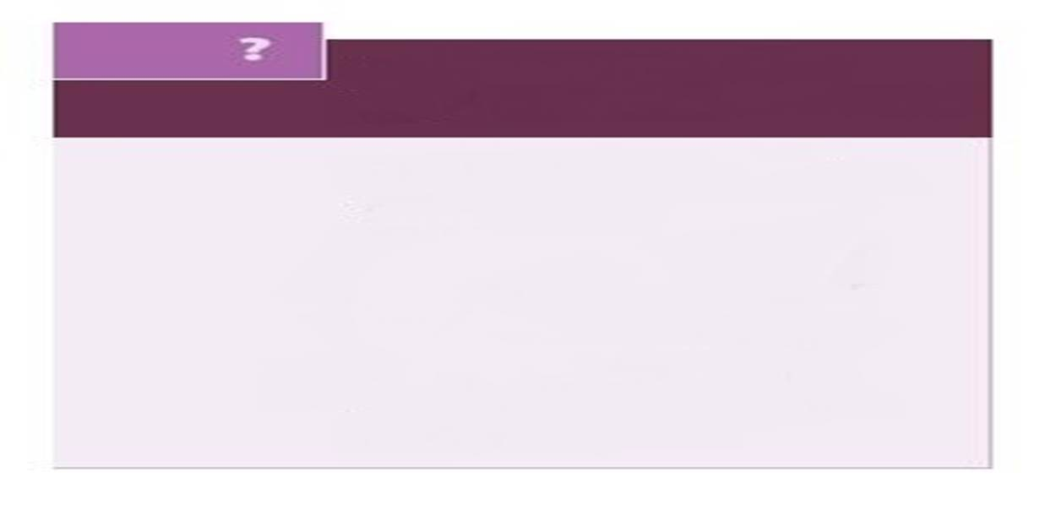
Do you know?
What does the expression "dancing spiders of Google" mean?
What do computers have to do with "going green"?
Why are WiFi standards still evolving?
What change did Facebook make to its
image tagging policy in 2011, and why?
Why can thinking before you tweet can save your job (or job prospects)?

