Slide 1

Javascript
Brendan eich developed javascript, a computer language, in just ten days in may 1995. Initially called mocha, then livescript, it finally became known as javascript. It was designed for the client-side of websites to add dynamic and interactive elements to static HTML pages.

Slide 2
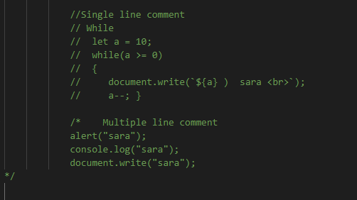
Basic JavaScript Concepts
To print code we use
console.log(“world”);
document.write(“hello”);
alert(“warning”);
Comments
Explanatory notes ignored by the browser.
Single line comment //
Multiple line Comments /* */

Slide 3
Understanding Variables
var
let
Function-scoped, can be re-declared.
Block-scoped, can be updated but not re-declared.
const
Block-scoped, cannot be updated or re-declared.

Slide 4
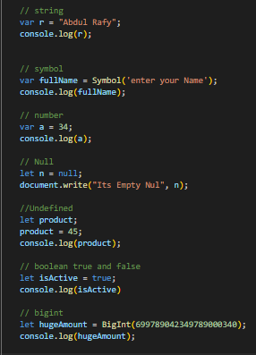
Primitive Data Types (Single data type)
nn, ss , bb ,u
String
Represents Textual data.
Number
Represent numbers.
Absence of any value
Undefined
Variable is declare but not assign
Boolean
Null
Used to create unique identifiers for objects.
Symbol
Hugeamount
Represent true or false
Bignit

Slide 5
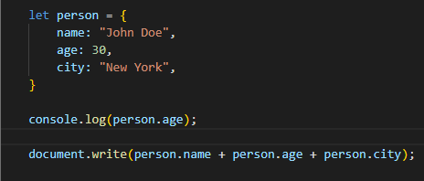
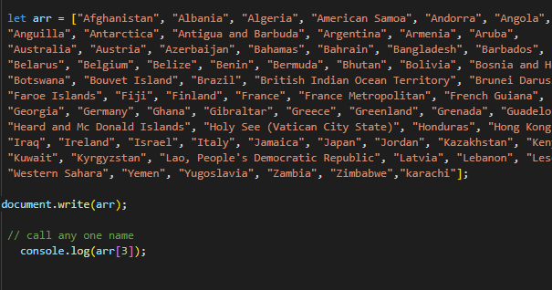
Composite data types (Multiple data type)
Objects {}
Arrays []
Used to store collections of key-value pairs.
Collections of items

Slide 6

Operators
Arithmetic
1
+, -, \* , / , %
Assignment
2
=, +=, -=, \*=, /=
Comparison
==, ===, !=, <, >
3
Ternary
4
condition ? value1 : value2
Logical
5
&&, ||, !

Slide 7
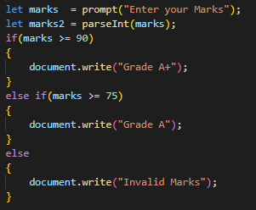
Control F low
If
else
else if
Executes code if condition is true.
Adds more conditions to if.
Executes if condition is false.

Slide 8
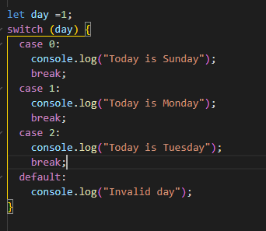
switch
Evaluates expression and matches
it against case values.

Slide 9
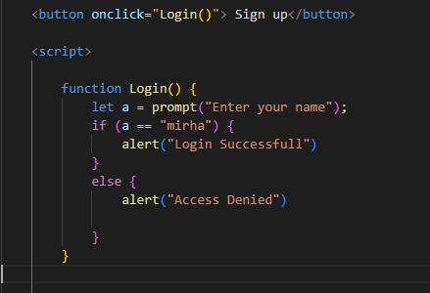
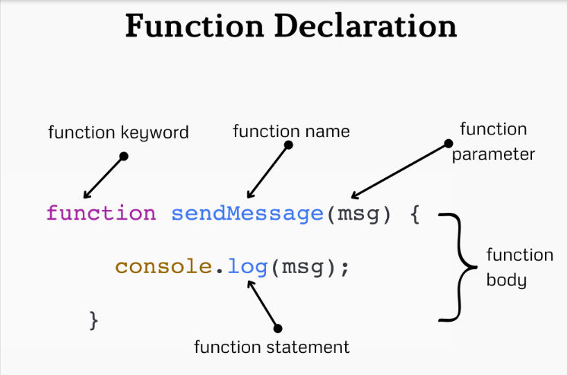
Function
A JavaScript function is executed when "something" invokes it (calls it).

Slide 10
Loop
Loops are used to repeat a block of code multiple times, either for a fixed number of iterations or while a certain condition is true.
for
Save your time.
Loop while a condition is true
do while
Executes the code block at least once before checking the condition
while
Loops through properties of an object
For in

Slide 11
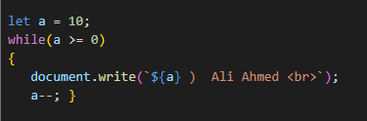

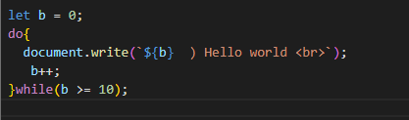
Loops Syntax
While
loop
For
loop
Do while
loop

Slide 12
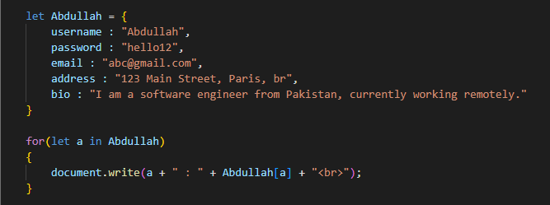
Syntax
For in loop

Slide 13
DOM Manipulation
Document Object Model (DOM) is a programming interface for web documents.It defines how a web page looks and behaves.
Select & Element.
Change Html.
Change CSS.
Event listener

Slide 14

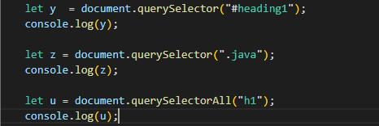
DOM Manipulation
Select & Element
Element by id
Element by TagName
Element by ClassName
Queryselector

Slide 15
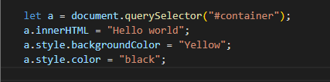
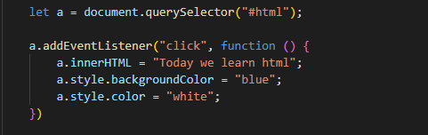
DOM Manipulation
2)Change in Html
innerHTML
3)Change in CSS
style
4)Event listener
addEventListenere

Slide 16
Thank you

