Slide 1


2018 HAWAII ANNUAL CODE CHALLENGE
Equitable Access to Education
Hilary Apana-McKee
Hawaii Department of Education
October 20, 2018
Notes:
Good morning! My name is Hilary Apana-McKee, Administrator for the Learning and Technology Section for the Hawaii Department of Education.

Slide 2
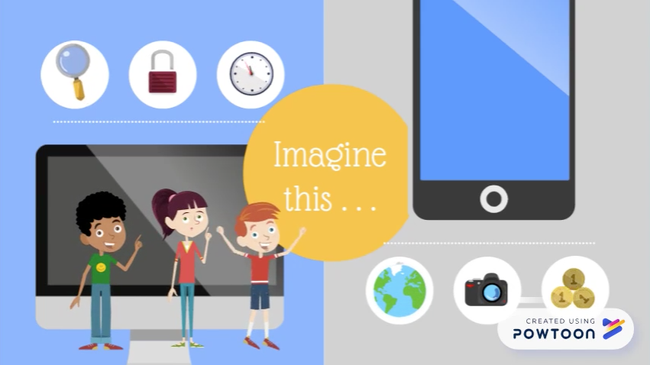
Notes:
Link to video: http://bit.ly/2A8sK2P (Google Drive); https://vimeo.com/294967314 (Vimeo)

Slide 3

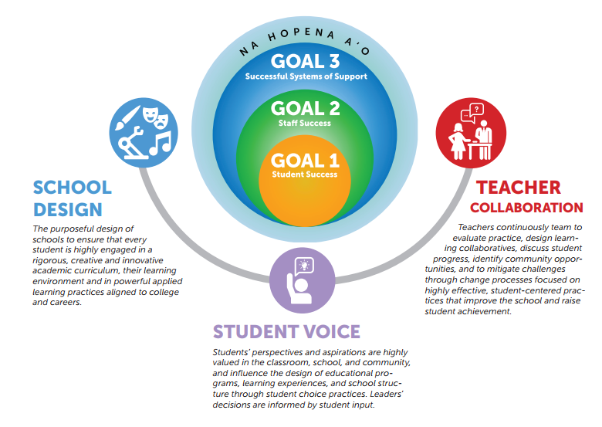
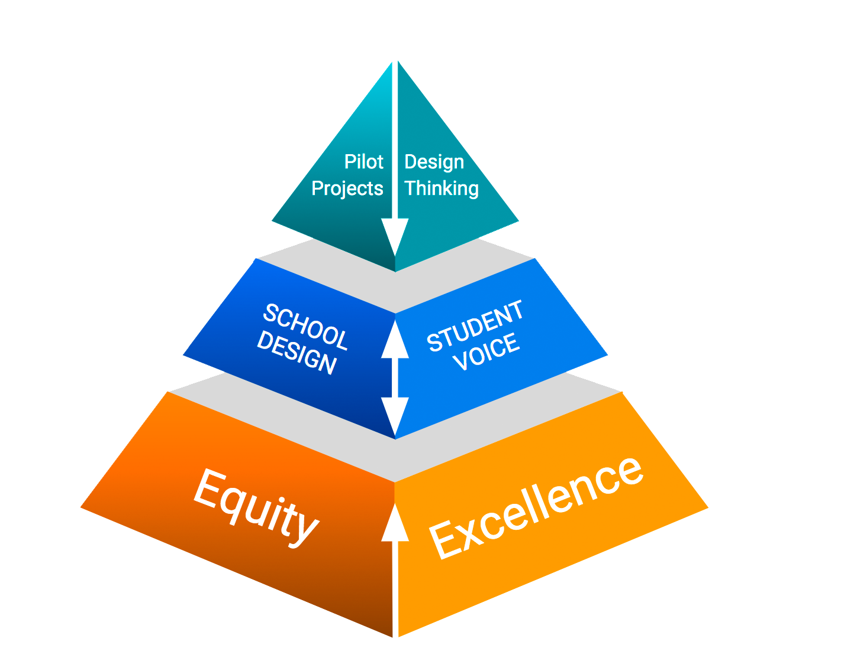
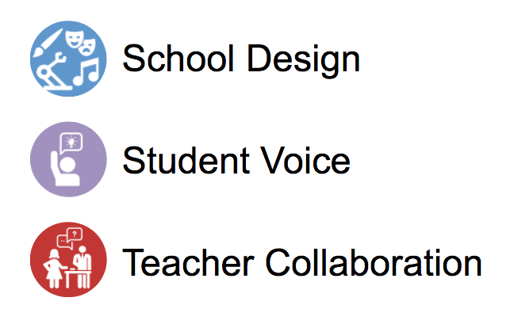
Teacher Match
design thinking lesson ideas for 2nd graders
Virtual Lesson Observation
community partners
STATE
OCID
Action Research
EDUCATOR
Computer Science
Coaching Opportunities
Complex Area
School
Innovation Spaces
resource hub
Prototype Components
Notes:
Link to video: http://bit.ly/27tvRzPg (Google Drive file); https://vimeo.com/295728159 (Vimeo)

Slide 4




Mahalo!

