Slide 1
Nitrogen & Carbon Footprint Data Aggregator
Jillian Cristobal
UH Office of Sustainability - Nitrogen Footprint Fellow
jmc46@hawaii.edu

Slide 2
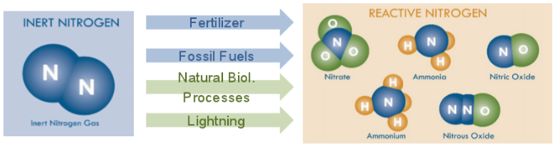
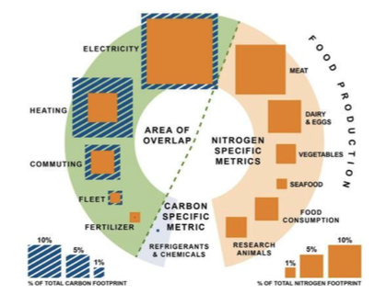
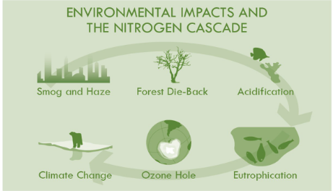
Nitrogen & Carbon Footprints
Quantifies the amount of reactive nitrogen & CO2 released into the environment as a result of an entities resource consumption
Leach et al. 2013
Notes:
Highlight importance

Slide 3
Process Overview
Collect Data
Input data into SIMAP
Export Results
Communicate End Results
Notes:
Insert process diagram chart
Collecting Data---> INput → Export ---> End product

Slide 4
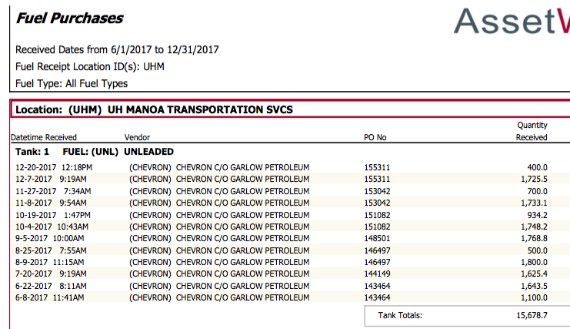
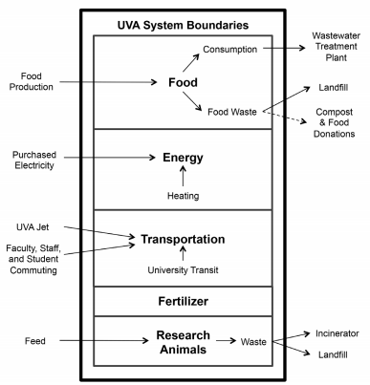
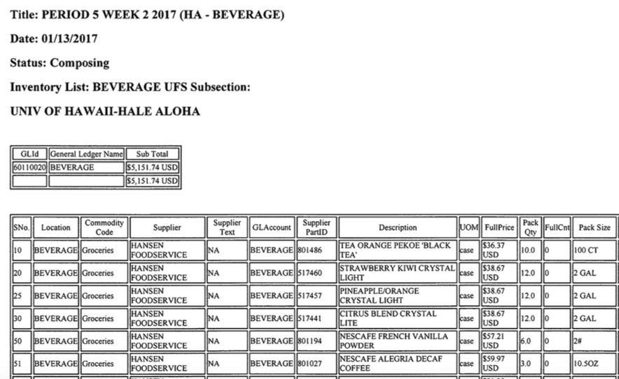
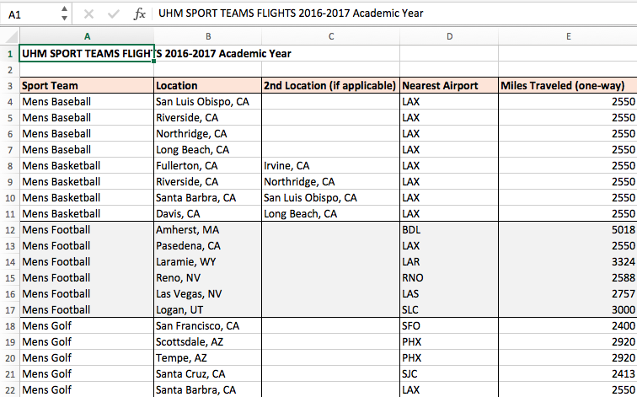
Collecting Data
Notes:
Insert pics of data obtained
Discuss some issues

Slide 5
Process Overview
Collect Data
Input data into SIMAP
Export Results
Communicate End Results
Notes:
Insert process diagram chart
Collecting Data---> INput → Export ---> End product

Slide 6
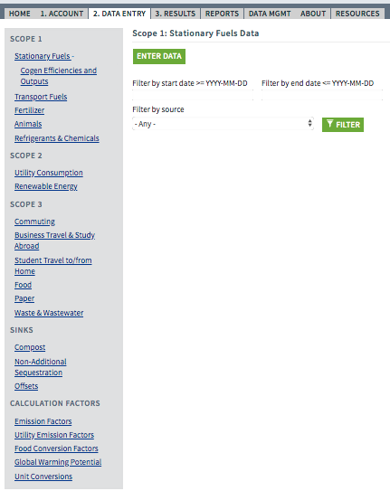


Input Data Into SIMAP
https://unhsimap.org/home
Notes:
SIMAP overview

Slide 7
Process Overview
Collect Data
Input data into SIMAP
Export Results
Communicate End Results
Notes:
Insert process diagram chart
Collecting Data---> INput → Export ---> End product

Slide 8
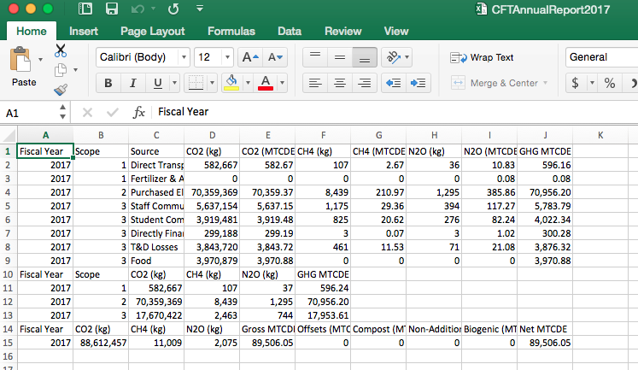
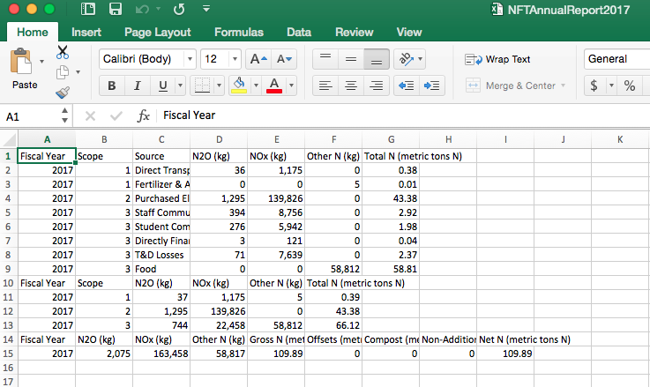
Exported Results
Notes:
Insert pics

Slide 9
Process Overview
Collect Data
Input data into SIMAP
Export Results
Communicate End Results
Notes:
Insert process diagram chart
Collecting Data---> INput → Export ---> End product

Slide 10
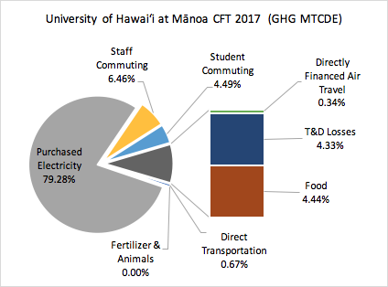
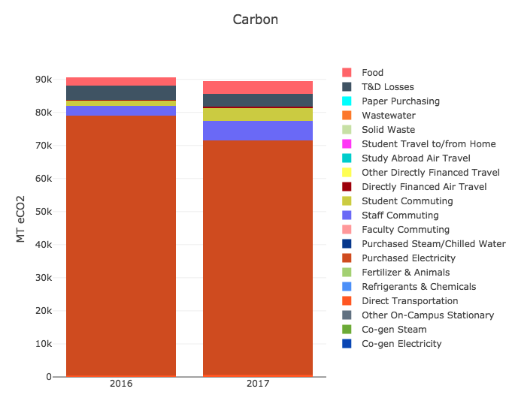
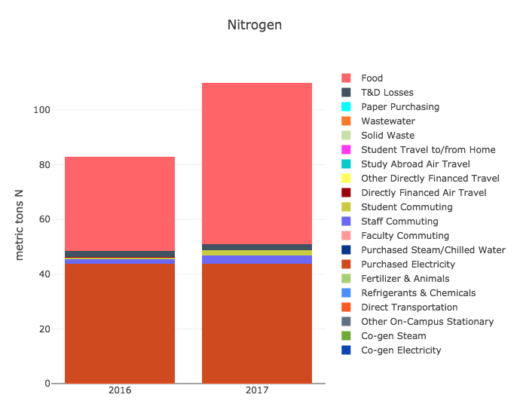
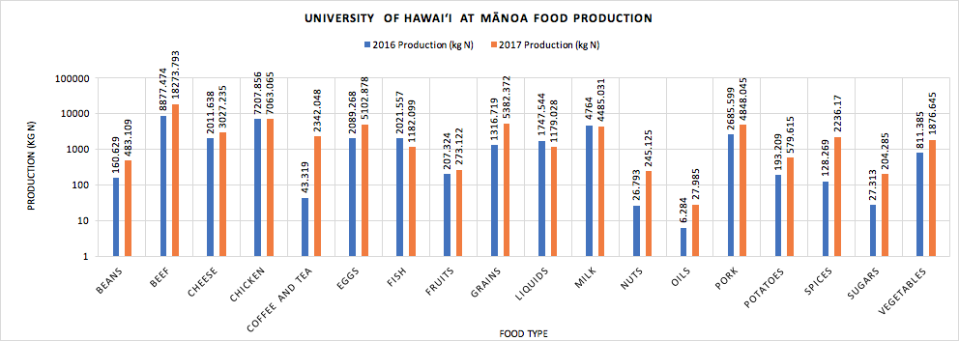
End Product

Slide 11
N&CFT Data Aggregator
Target Audience: Faculty, Administration, Stakeholders, Researchers, Students
Purpose
Streamline the data collection process
Enables consistency
Centralized data archive
Effectively communicate results to a broader audience
Desired Functions
Upload data from stakeholders
Export data (to use in SIMAP)
Import SIMAP results
Communicate results
Notes:
Target Audience: Faculty, Staff, Stakeholders, Students
Something that is user friendly to those with varied backgrounds and experience
Purpose/ why we need it
Streamline the data collection process→ save time, simplify steps for other people to easily get involved/ upload data
Enables consistency → easily repeated and navigable process
Can also act as a… Centralized data archive → one-stop place for data that can be possibly shared amongst stakeholders
Effectively communicate results
Informational while also visually appealing
Desired functions & features
Upload data - stakeholders
Middle Step - data is aggregated and can be easily exported to use in SIMAP (where data is converted to quantify N& CO2)
SIMAP results import
Communicate Results - tracking progress towards goals
Future use/ expansion of what is created

Slide 12
Thank you!
Contact:
Jillian Cristobal
jmc46@hawaii.edu
For more information:
http://www.n-print.org/
https://unhsimap.org/
https://sustainableunh.unh.edu/calculator

