Slide 1
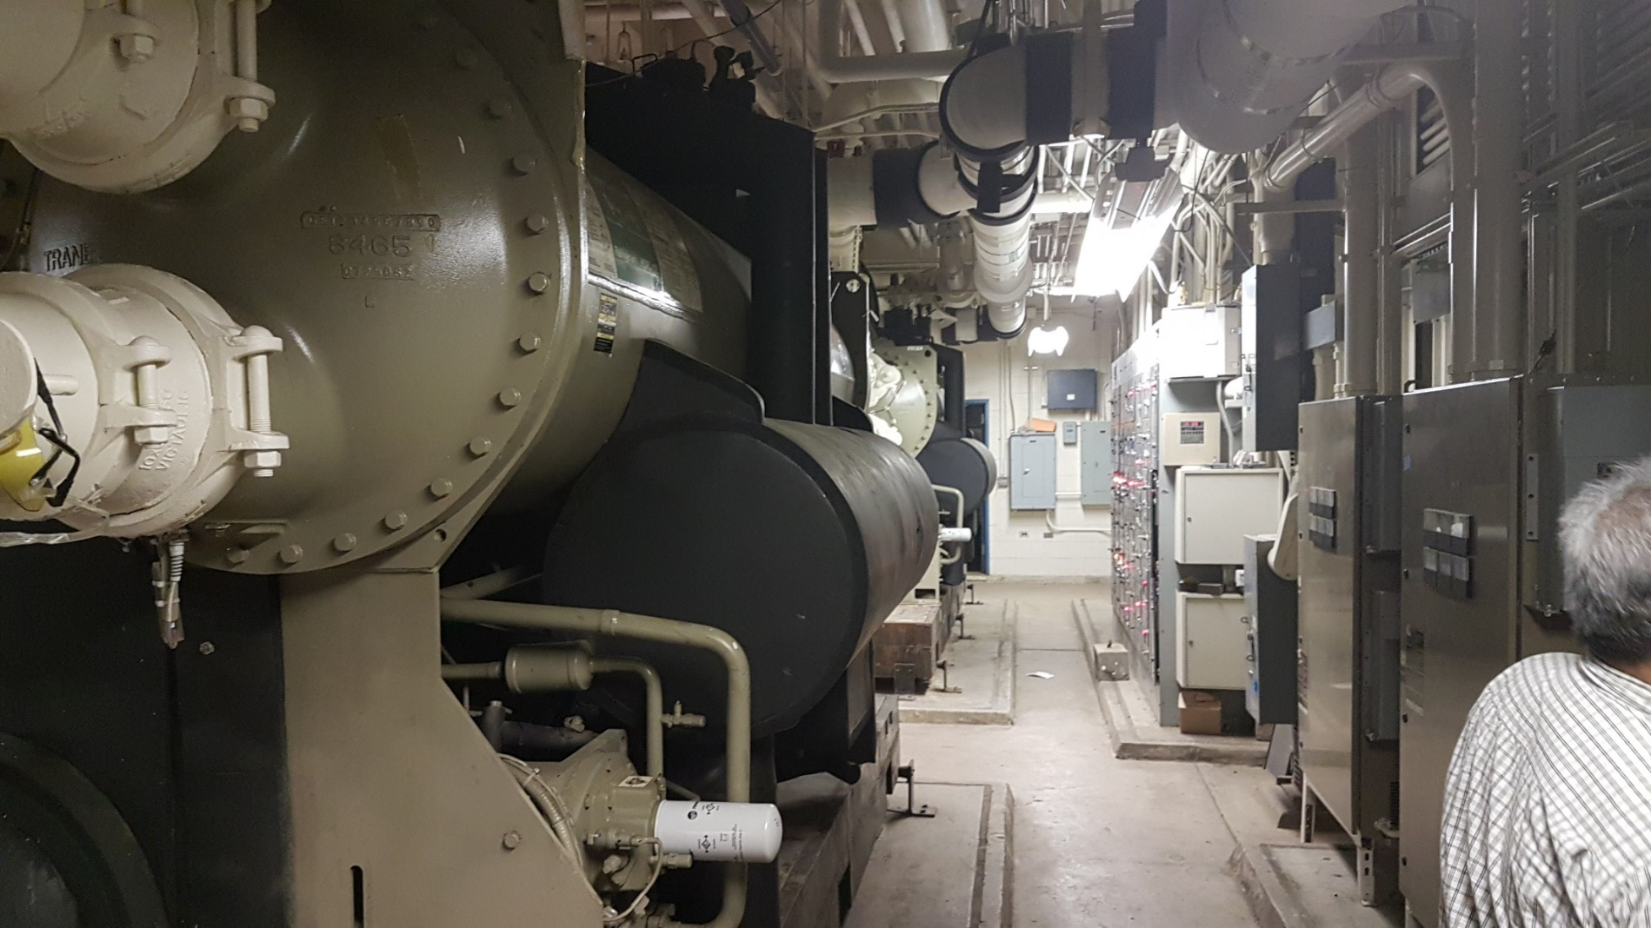
Holmes Hall - Chiller Plant
Chiller
MCC

Slide 2
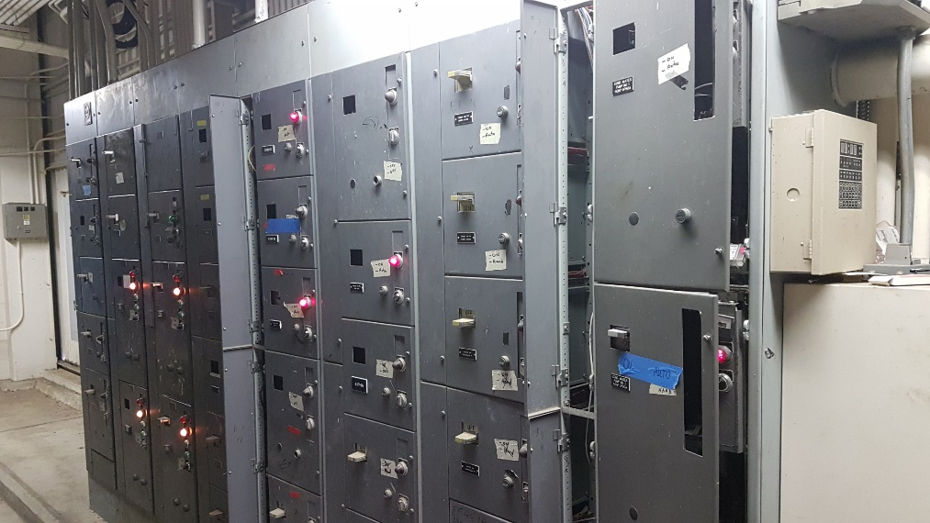
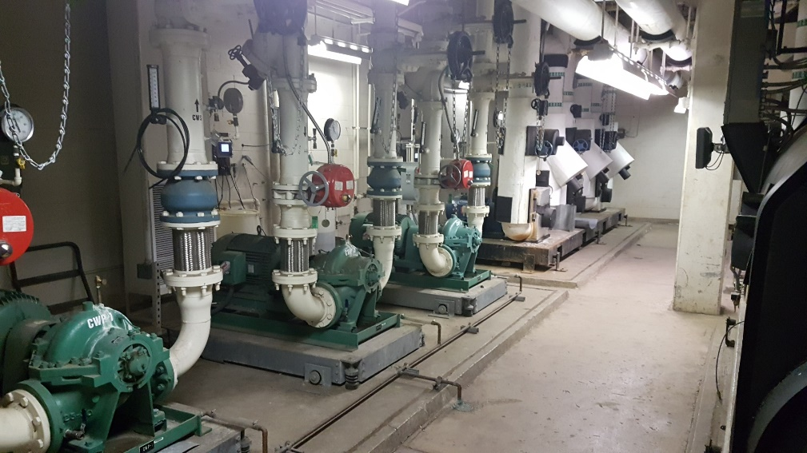
MCC – Motor Control Center
MCC
MCC – like a circuit breaker panel, but for industrial sized Motors
Power
Circuit Breakers
CT cabinet
Pumps (Motors)

Slide 3

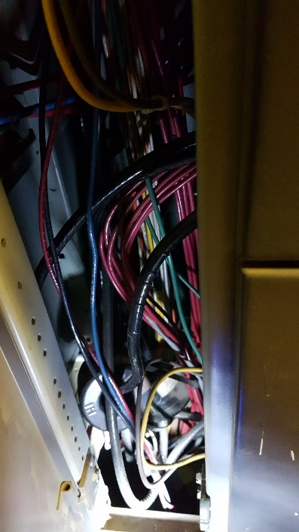
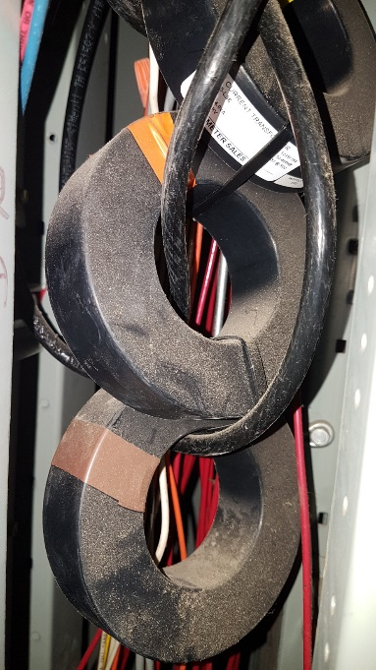
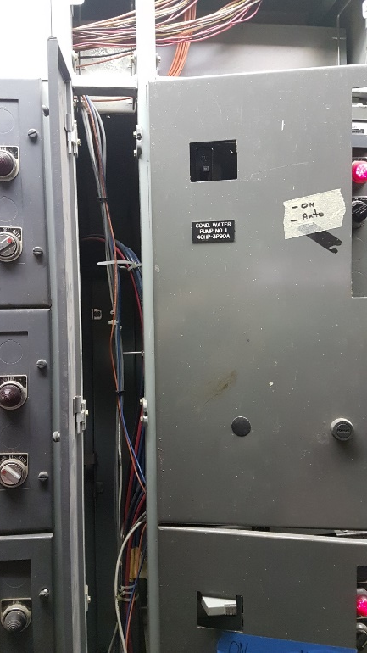
CT – Current Transformer – Measures Current usage
CT cabinet
CTs
MCC
Zoom in 2
Zoom in 1

Slide 4
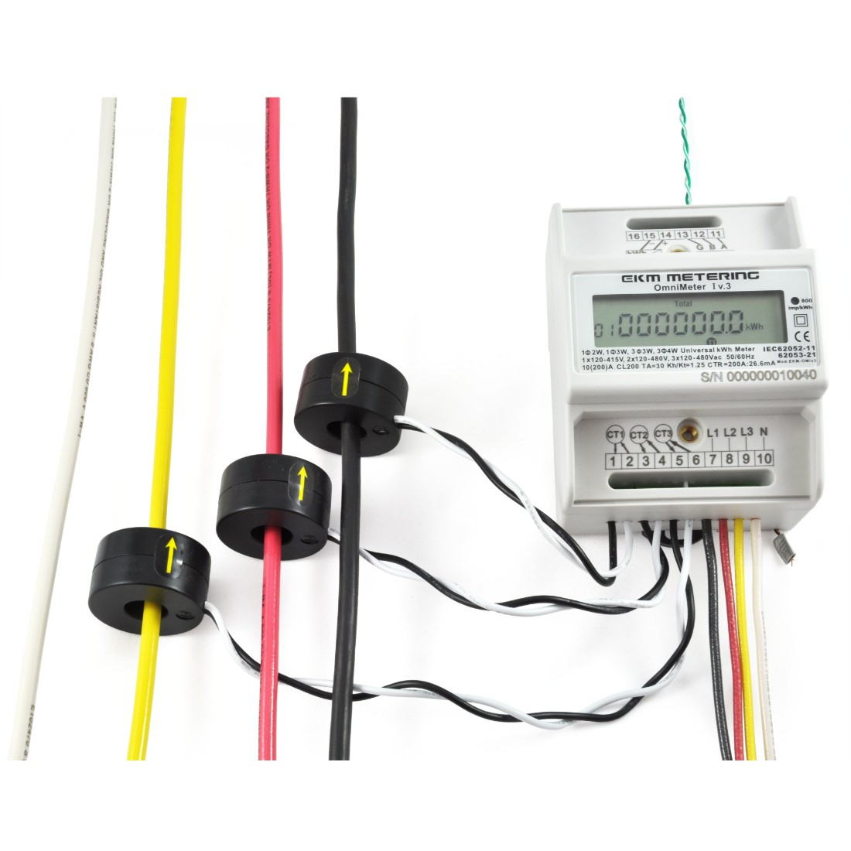
A basic meter
Meters
CTs

Slide 5
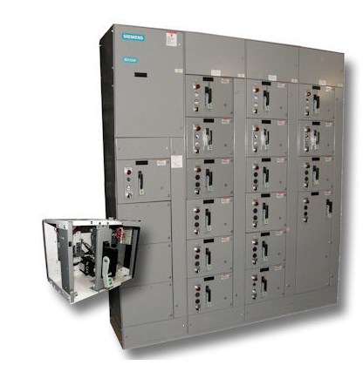
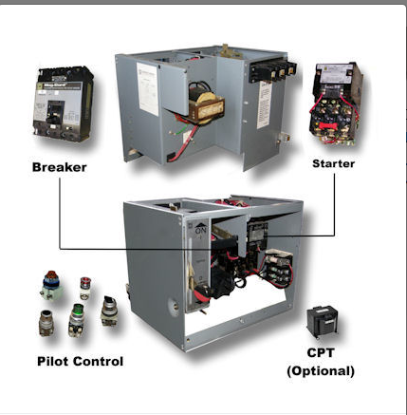
MCC – Motor Controler
MCU
MCU - Motor Controller Unit
MCC – Motor Control Center

Slide 6
