Slide 1


HACC Overflow
High powered solutions for a sustainable Hawaii
Notes:
Introduce ourselves, project motivation, etc.

Slide 2
The Challenge
A Dashboard displaying health of each station
Visualize and analyze key station metrics
Increase availability and usage of Hawaiian Electric fast charging stations

Slide 3
Our Solution
A real time dashboard built with modern tools
A consumer facing web application for finding available stations
Full integration between both components

Slide 4
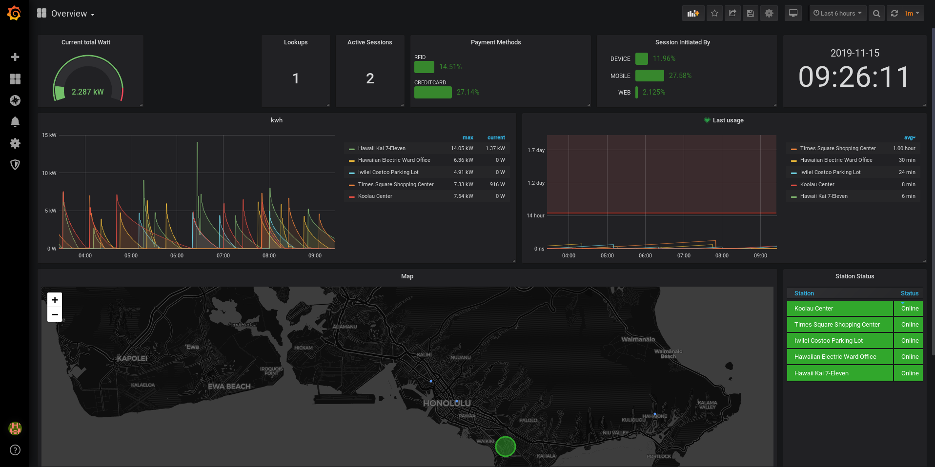

Slide 5
The Dashboard
Real time
Modern stack
Scaleable

Slide 6
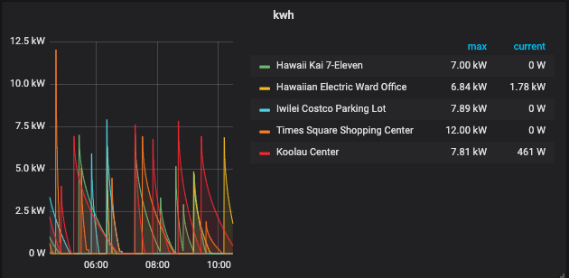
Metrics

Slide 7
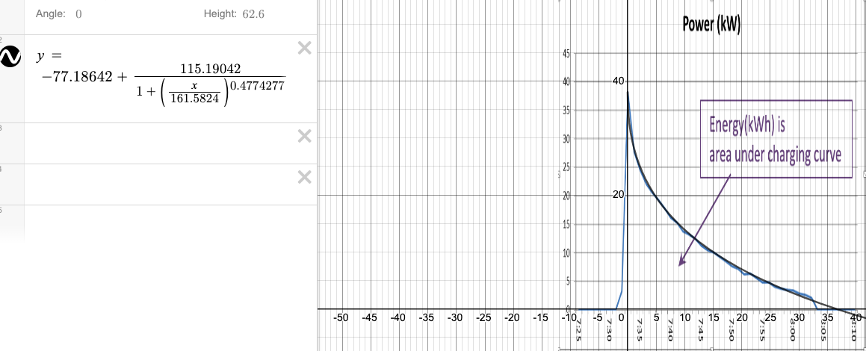
Metrics
www.desmos.com

Slide 8
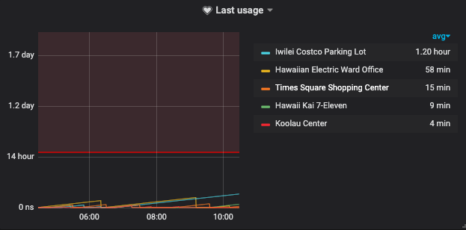
Metrics

Slide 9
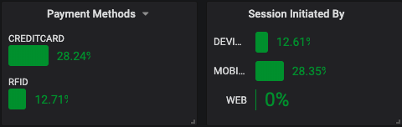
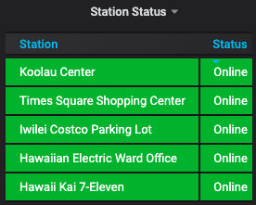
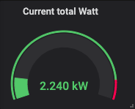
Metrics
Dynamic time window
Deep dive into each metric
Add, alter, query, share.

Slide 10
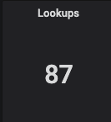
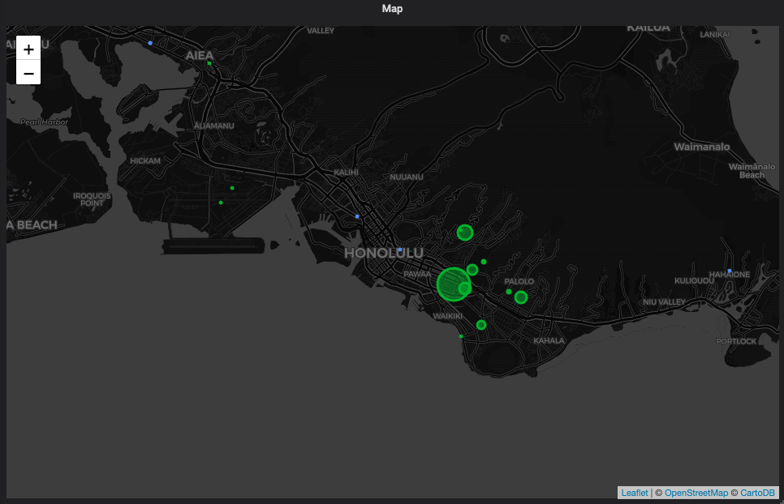
Metrics
Integrates with our consumer facing app

Slide 11
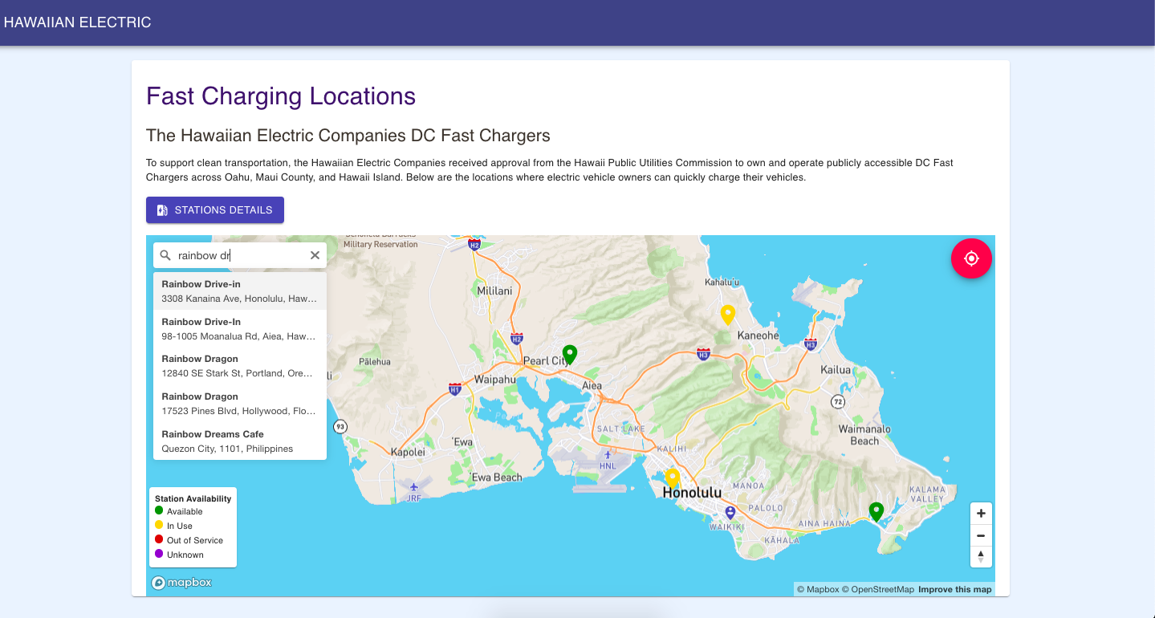
Notes:
pulls data
on or not
able to fetch

Slide 12
Consumer App
Check on stations’ statuses
Searchable
location services
Notifies backend of usage

Slide 13
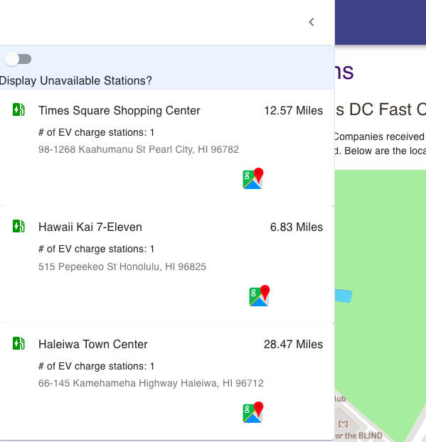
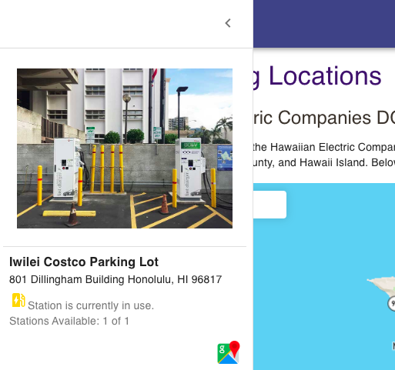
Consumer App

Slide 14
Thank you!
To all the HACC hosts, sponsors and volunteers
Hawaiian Electric Company
Dr. Johnson

Slide 15
Questions?

