Slide 1
Hack #3
Taj-Malik Barrett, Quadir Black, Jonas Caruthers

Slide 2
The Problem?
Students at North Carolina A&T are tired of waiting in long lines for tickets for the homecoming concert every year held at the Greensboro Coliseum.

Slide 3
Our solution
We have created a program that can be used to sell the tickets, keep track of the open seats, and total ticket sales.

Slide 4

Menu Options
User (The admin) enters in prices for the rows
User is taken to main menu to see options
User selects options between 1-4

Slide 5
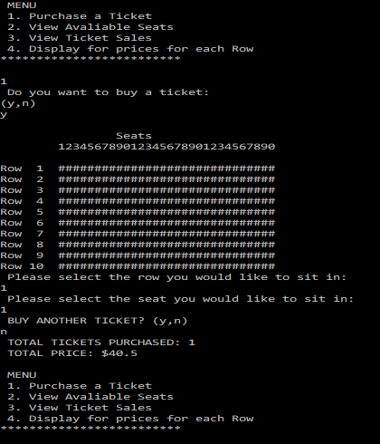
Purchasing of tickets

Slide 6
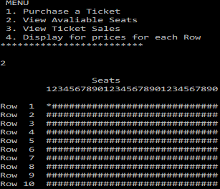
View available seats

Slide 7
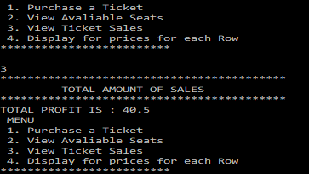
View Ticket Sales

Slide 8
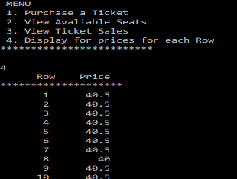
View Ticket prices for each row

