Slide 1
CS 48 Midterm Review

Slide 2
Specifics
Come early to get a decent seat
60 minutes max
Topics
SWE basics: Activities, processes (waterfall, SPIRAL, Iterative)
Practice: Extreme, Scrum
Requirements Specification: Features, FURPS+ (FURPS-REACT)
Domain Analysis (static (UML) and dynamic views)
Design: Architecture (UML), layers, State, Sequences
Implementation and testing: unit, TDD, integration, system
ACM code of Ethics

Slide 3
Topics: SWE Basics
Activities
Requirements specification/planning, domain analysis (problem area), system design (computer solution), implementation, testing/maintenance
Process: waterfall, spiral, & Iterative: unified process and Agile
3-4 pros and cons of each
Practice (Implementation of the Process): Extreme & scrum for Agile
Scrum
Product backlog, sprint backlog
standup
Scrum Meeting is at same time, every day; everyone must participate
Very rigid structure (other options like kanban (workflow visualization/reflection) can be overlayed on existing processes)

Slide 4
Waterfall model
Era (80's)
Shrink wrapped software
Software becoming complex: US Govt. Defense
Computers becoming cheaper & in wider use (home desktops)
No internet
Software SHIPPED VIA SNAIL MAIL
Pros:
easy to partition work, emphasize importance of requirements spec and design, specialized skills/expertise
Cons:
Everything on paper, never back up
build SW like buildings
High risk issues tackled late
No testing/prototyping early
Bad implementations have led to disastrous outcomes: 70% of projects not completed, 50% of projects with 2x cost overruns, 1994=$80B in cancelled projects
Notes:
https://www.unf.edu/~broggio/cen6016/classnotes/How_to_Fail_with_the_RUP.pdf

Slide 5
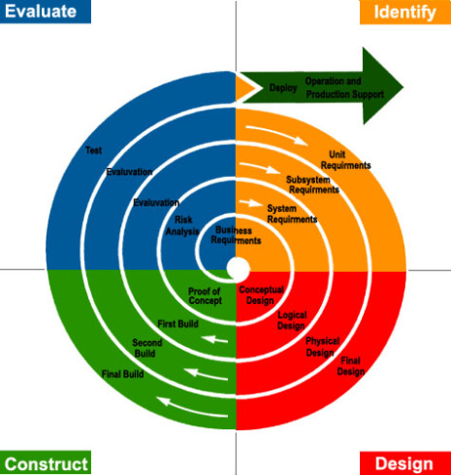
SpIral Model
Includes frequent risk analyses
Frequent reevaluation during an extended planning stage
Pros
Risks are identified early on in the project
Rapid prototyping shows progress, gives users an idea of system/Product
Feedback can be obtained early from these prototypes
Cons
Time is wasted on making too many prototypes
Risk analysis is too time consuming for small projects
It’s a complex process
It can be hard to set milestones and schedule SW releases
It can be never ending if hurdles are not overcome

Slide 6
Incremental / iterative process

Slide 7
Iterating reduces risk overall
Pros: Risk reduction, identify/deal with problems early when they are small, everyone contributes to and becomes expert in all SWE activities, build complex products incrementally
Era (1995+): Software begins to change
Programming languages change (more abstractions, tools, higher-level languages)
Advent of the internet
Browser-based software
Remote services
Software-as-a-service

Slide 8
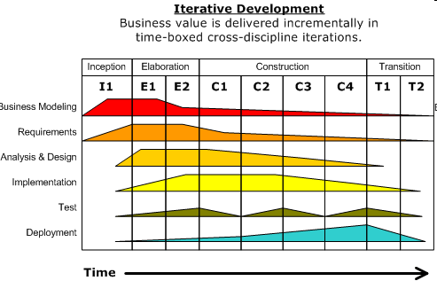
Unified Process (UP) 1999,2000
Iterative and incremental through 4 phases/Workflows/disciplines
Release at end of each timeboxed iteration
Inception – explore feasibility, estimate costs
Elaboration – architecture evaluation and its application
Construction – SW is designed, written, tested
Transition – Released, feedback collected
"like an online mentor that provides guidelines, templates, and examples for program development"
Risk-driven
Use case focused development
Architecture-centric design
UML for dynamic/static views
Cons: too rigid, lots of planning, requires deep "object-oriented" skills
"Owned" by IBM/Rational (RUP=Rational unified process) – to "fix" waterfall

Slide 9
Agile Software Development
Manifesto for Agile Software Development (2001)
available at: http://agilemanifesto.org/
“We are uncovering better ways of developing software by doing it and helping others do it. Through this work we have come to value:
Individuals and interactions over processes and tools
Working software over comprehensive documentation
Customer collaboration over contract negotiation
Responding to change over following a plan
That is, while there is value in the items on the right, we value the items on the left more”

Slide 10
Agile Development
Embrace change; Good if end goal is unknown (Very modern concept 201x); Continuous improvement via customer feedback, collective ownership, favors the simple
Pros:
Can lead to faster, higher quality delivery of software (sw)
Good for Saas, engages developers, continuous delivery, customer focused, Team first
Cons
Hard to pin down a delivery date (hard to plan) b/c of constant reprioritizing; Hard to estimate timings (sprints are fixed in time)
All members of team must be highly skilled in all aspects ($$$)
Requires that members be fully committed and dedicated and willing to make up time when tasks get dragged out
Final Product can be different

Slide 11
Extreme Programming (XP)
See www.extremeprogramming.org
Methodology used to implement an agile process
Software is built iteratively, with frequent releases
Each release implements the set of most valuable features/use-cases/stories that are chosen by the customer
Each release is implemented in a series of iterations, each iteration adds more features/use-cases/stories
Programmers turn the stories into smaller-grained tasks, which they individually accept responsibility for
The programmer turns a task into a set of test cases that will demonstrate that the task is finished
Working as pairs, the programmers make the test cases run, evolving the design in the meantime to maintain the simplest possible design for the system as a whole
Alternatives: kanban (visual workflow reflection), lean (reduce waste), feature driven, scrum (all are minor variations)

Slide 12
Topics: Requirements
Features
Use cases (know the format): name, actors, precondition, flow, alternative paths, postconditions (testable)
User stories
As a [role], I can [feature] so that [reason]
Title: Given [context], When [event], Then [outcome] //acceptance criteria (testable)
Importance of prioritization
How these fit into Scrum & agile development processes
FURPS+ (Furps+ or FURPS-REACT) – nonfunctional requirements

Slide 13
Example Use Case: Online HR System
Use case: Update Benefits
Actors: Employee, Employee Account Database, Healthcare Plan System, Insurance Plan System
Precondition: Employee has logged on to the system and selected “update benefits” option
Flow of Events:
Basic Path:
1. System retrieves employee account from Employee Account Database
2. System asks employee to select medical plan type; uses Update Medical Plan
3. System asks employee to select dental plan type; uses Update Dental Plan
...
Alternative Paths:
If health plan is not available in the Employee’s area the employee is informed and asked to select another plan (exceptional cases that must be handled)
Employee selects cancel, logs out, or leaves page at any point prior to confirming the update (an end-early path)
Postcondition: Employee account plan type has been updated in the Employee Account Database or nothing has changed (end-early paths)

Slide 14
The FURPS+ Model: nonfunctional requirements
Functional
features, capabilities, security
Usability
human factors, help, documentation
Reliability
failure frequency, recoverability, predictability
Performance
response time, throughput, accuracy,...
Supportability
adaptability, maintainability, configurability,...
+ - REACT: reuse, Economics (cost), aesthetics, comprehensibility, technology constraints

Slide 15
Topics: Domain analysis
Static views: static class diagram
UML
Concepts (Classes: concrete and abstract)
Attributes (primitive datatypes that describe concept state)
Associations: dependency, generalization, aggregation

Slide 16
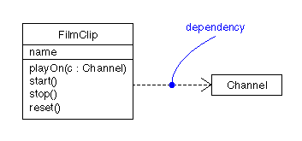
UML: dependency
When a class “uses” or otherwise depends on another class to fulfill a responsibility
Dashed line with arrow in UML

Slide 17
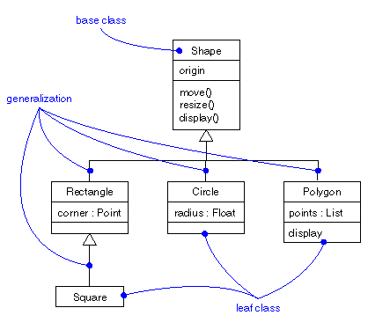
UML: generalization
a.k.a., inheritance – one class is derived from another
In UML, triangle at end of line “points” at parent class

Slide 18
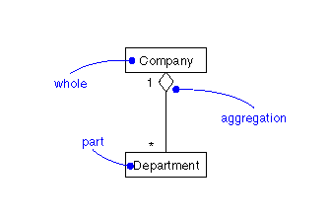
UML: aggregation & multiplicity
many
“Whole” is identified by the diamond shape at that end of the line

Slide 19
Topics: design
Static views -> system architecture (static class diagram via uml)
Layering
Specifying behavior/activity (dynamics)
State Diagrams (FOR COMPLEX OBJECTS)
Sequence diagrams (including communication diagrams)
FOR COMMUNICATION BETWEEN OBJECTS
Sequence diagrams (synchronous messages, asynchronous messages, return values, object creation and deletion; object timelines)
Types of line and arrows, including timeline
Communication diagrams: for complex sequences
Design principles: Expert, coupling, cohesion
Design Patterns: structural, creational, behavioral

Slide 20
layered architectures
Concept – each layer is a base for implementing layers above it
Ideally, knowledge and contact is one-way: down ↓
Lower layers don’t even know upper layers exist
Interaction ONLY with adjacent layer
What are some good reasons to use layers?
Reduce complexity – separate the domain from the implementation as much as possible
Increase modifiability, and reuse potential
Easy to plug in off-the-shelf and 3rd party code
Encapsulation and data hiding

Slide 21
State diagrams
Purpose: to model the changing states of complex objects

Slide 22
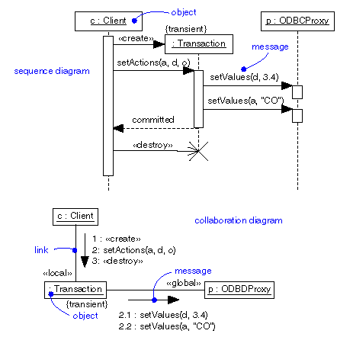
Sequence diagrams
Use for simpler interactions – sequence easily shown as top-to-bottom interactions

Slide 23
Communication diagrams

Slide 24
design patterns: know 3+ from each type, draw their UMl
7 are structural patterns – composition of classes/objects
Adaptor, Bridge, Composite, Decorator, Façade, Flyweight and Proxy
5 are creational patterns – for creating objects
Abstract Factory, Builder, Factory Method, Prototype, Singleton
11 are behavioral patterns – ways classes/objects interact
e.g., Chain of Responsibility, Command, and … 9 more
See http://www.cs.ucsb.edu/~cs48/slides/designdiagrams.pdf
https://sourcemaking.com/design_patterns
Great reference with examples: https://github.com/kamranahmedse/design-patterns-for-humans

Slide 25
Topics: Implementation & testing
Unit testing
Integration Testing
System Testing
Why this order?
TEST PARTS BEFORE THE WHOLE
Test Driven Development
ADD TEST, RUN TEST (FAIL), WRITE CODE, RUN TEST (PASS),..., REPEAT, REFACTOR
REGRESSION TESTING
RUN ALL TESTS ON EVERY COMMIT, WHY?
TEST COVERAGE
TESTING VS DEBUGGING

