Slide 1
Incident Management Process
duration prediction.

Slide 2
What was the problem?
Incident management is an IT service management (ITSM) process area. The first goal of the incident management process is to restore a normal service operation as quickly as possible.
As this digital era we’ve data - a lot of it. , and now we’re moving to make insights from that data and make prediction using that data.
UCI- An online dataset repository has a dataset which contain event logs of Incident management process named “Incident management process enriched event log Data Set”.
This dataset can be used to analyze the impact of different variables which delay a system to recover to its normal state.
That means the dataset can also be used to predict the duration needed to recover a system to its normal state.

Slide 3
Dataset.
The dataset has a total of 36 attributes.
There are 141712 records in dataset.
The prediction variable will be made from two date attributes given in dataset
opened_at : incident user opening date and time;
closed_at : incident user close date and time
duration = closed_at – opened_at
Duration has been initially converted into three variable, days, hours and minutes and for simplicity EDA will be performed by using days only, later for prediction these duration will be combined into days unit, as only numeric value are accepted by the ML algorithms
The null values or unknown values in dataset are denoted by “?”.

Slide 4
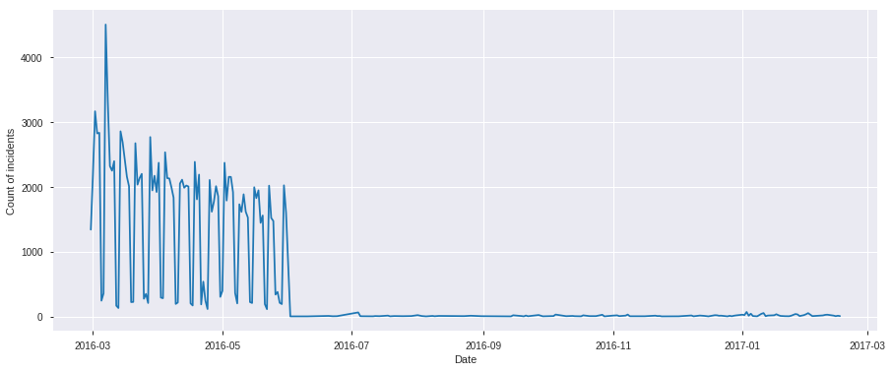
Exploratory Data Analysis (EDA)
This can be clearly seen from the chart that number of incidents opened in first half of 2016 are rising and lowering again and again, but from onwards incidents are in a stable and also lower number.

Slide 5
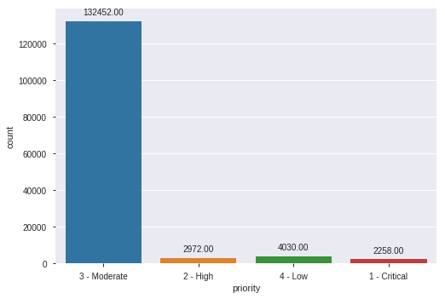
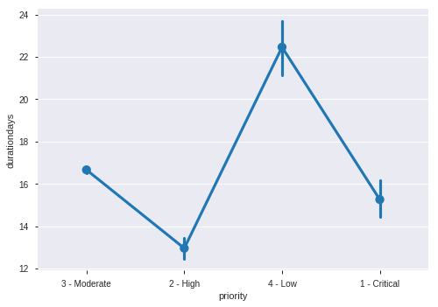
Priority
Bar chart is showing that most of incidents are of moderate priority , and lowest number of incidents are of critical priority, it is shown in point plot that high priority incidents are likely to be solved in less time.

Slide 6
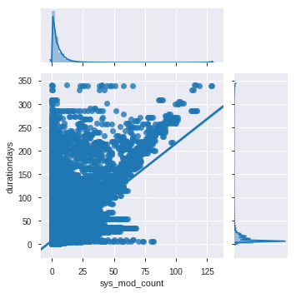
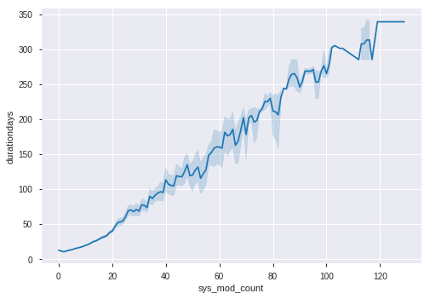
sys_mod_count number of incident updates until that moment;
These graphs shows that, this variable is seem to highly positively correlated with duration days, that means more the times incident is updated in system more the duration it needs to be solved.

Slide 7
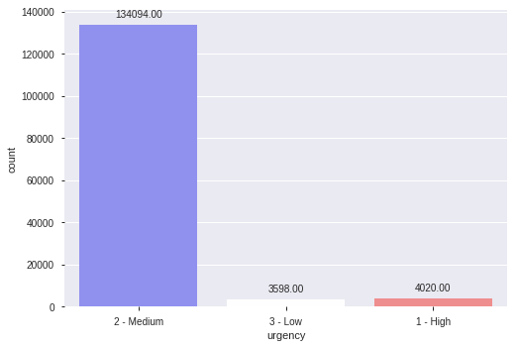
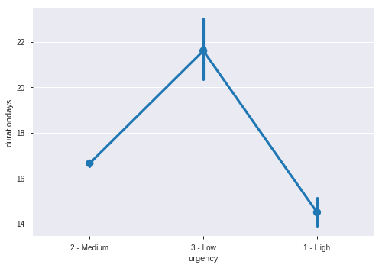
Urgency.
Most of the incidents are of medium urgency, the high urgency incidents indeed are solved in lesser time.

Slide 8
Data Preprocessing & feature engineering.
As described earlier, the unknown or null data in the dataset is denoted by “?”.
We’ve dropped those columns which had higher percentages of this value.
Wherever the percentage was low, it is replaced by “0”, which denotes that it is not known.
All those categorical variables which could be label encoded , are treated as such.
All those categorical where the values were alphanumerical , they’re converted in numeric only.
Dates has been converted into different numeric variables – years, months, days, hours and minutes.

Slide 9
Feature Selection.
Two methods have been applied for feature selection.
Statistical approach:
by looking at the correlations between feature and predictive variable.
Box plots showing relations between the feature and target variable.
RandomForrest Feature importance Chart approach:
On all remaining variable a rough model of RandomForestRegressor has been trained and then by looking at the Feature Importance Chart, the irrelevant features are omitted gradually. The process is repeated several times.

Slide 10
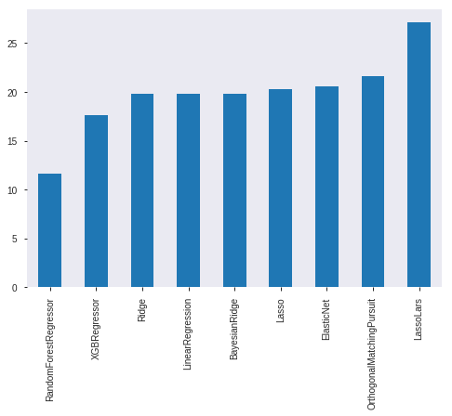
Model Training
After feature selection different ML algorithms are used to train, these include:
Ridge
LinearRegression
Lasso
ElasticNet
LassoLars
OrthogonalMatchingPursuit
BayesianRidge
RandomForestRegressor
XGBRegressor
The graph shows the RMSE (root mean squared error) of each model, the best is RandomForestRegressor..

Slide 11
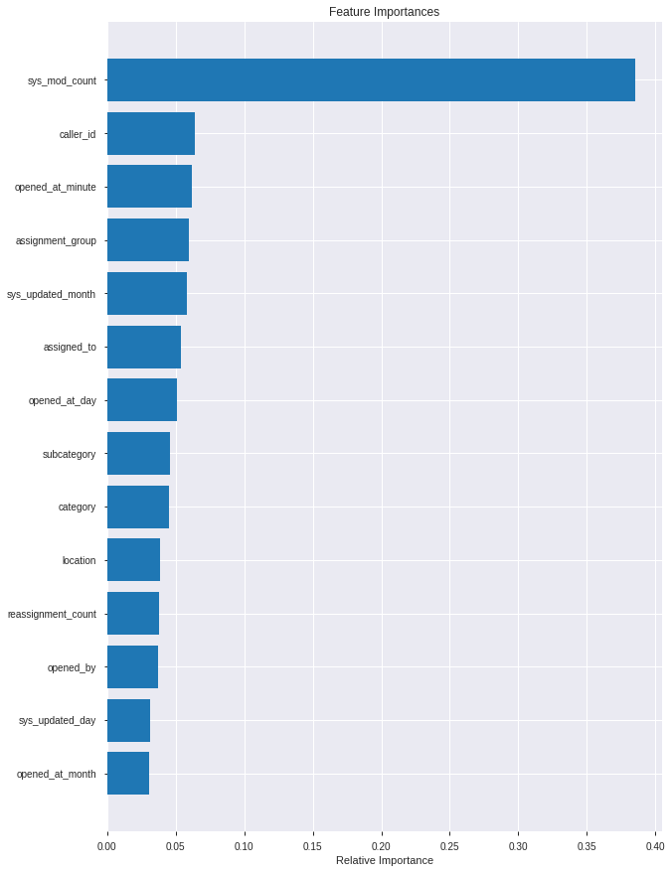
Final (Best) Model refining and pickling.
RandomForrestRegressor is further refined (its hyperparameters are tuned)
The final model is then pickled.
The graph shows finalized features and their importance.

Slide 12
Django-REST-framework.
Django and its REST-framework has been used for model deployment.
A Django-REST API has been made.
Postman software has been used to test the API.

Slide 13
