Slide 1
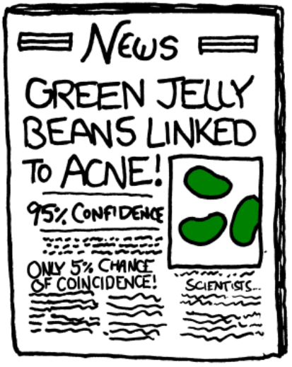
First meeting for the Harper Adams R Users Group
(HARUp!...?)
Ed Harris
2019.10.16
Effect size thinking and power analysis
(Plus some other HARUp! business)

Slide 2
What do we want to accomplish today?
www.operorgenetic.com/wp
Click “HARUp!” tab

Slide 3
What do we want to accomplish today?
- Effect size thinking and power
- Power calculation in R
- Resources and readings; other tools
- Future of HARUp! (topics, attendees, etc.)

Slide 4
Effect size thinking and power
Scientific method
Ask question
Background research,
existing evidence
Hypothesis
Conclusions,
communicate
Analysis
Experiment

Slide 5
Effect size thinking and power
- Sometimes the scientific method does not proceed as planned
- Creativity have a role?
- Wired article

Slide 6
Effect size thinking and power
Does this suggest we only think about analysis AFTER data
Ask question
Background research,
existing evidence
Hypothesis
Conclusions,
communicate
Analysis
Experiment

Slide 7
Effect size thinking and power
Best practice
existing evidence
Effect size
Power analysis
Ask question
Hypothesis
Experiment
Background research
Results, conclusions
Collect data
Statistical analysis plan

Slide 8
Effect size thinking and power
Best practice
existing evidence
Effect size
Power analysis
Ask question
Hypothesis
Experiment
Background research
Results, conclusions
Collect data
Statistical analysis plan

Slide 9
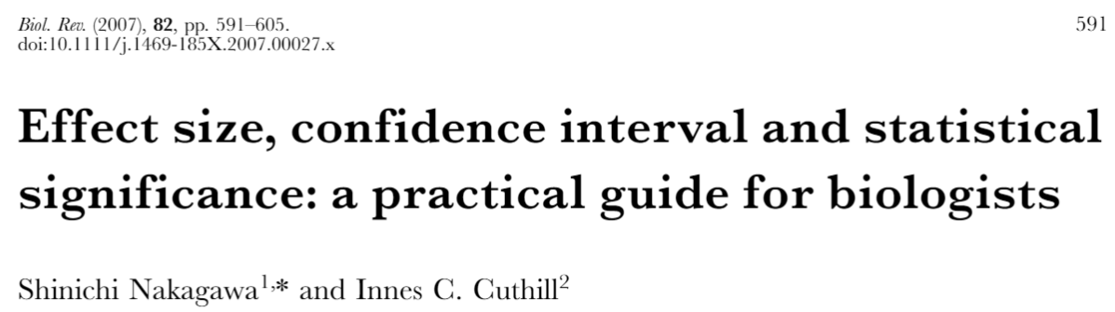
Effect size thinking and power
Null hypothesis testing:
- No prediction for HOW BIG our predicted difference
- No prediction for HOW ACCURATE our predicted difference

Slide 10
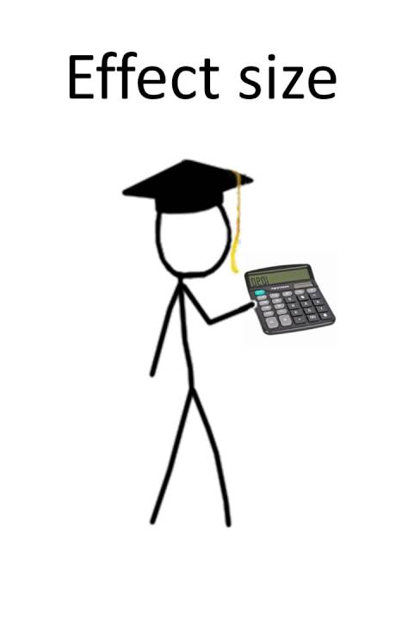
Effect size thinking and power
Components of EFFECT SIZE THINKING
- HOW BIG is the difference?
- HOW ACCURATELY can we estimate the difference?
- Is the expected difference meaningful
(e.g. Biologically, medically, to consumers, etc.)?

Slide 11
Effect size thinking and power
y
--------
variation
--------
difference
X
In general, the bigger the difference, and the smaller the variation (increased accuracy), the more likely our hypothesis is correct

Slide 12
Effect size thinking and power
--------
y
--------
y
--------
--------
X
X
- HOW BIG is the difference?

Slide 13
Effect size thinking and power
y
--------
y
--------
--------
--------
X
X
- HOW ACCURATELY can we estimate the difference?

Slide 14
Effect size thinking and power
y
--------
y
--------
--------
--------
X
X
- Is the expected difference meaningful
(e.g. Biologically, medically, to consumers, etc.)?

Slide 15

Effect size thinking and power
The technical definition of effect size is specific to
The statistical test
For a t-test -> Cohen’s d
Cohen’s d =$\frac{mean1 − mean2}{Pooled std dev}$
y
--------
--------
X

Slide 16
Effect size thinking and power
Best practice is to articulate your hypothesis,
But also to articulate your expected effect size
Let’s discuss how to do this…

Slide 17
Effect size thinking and power
Pilot experiment (best)
existing comparable published evidence
(value varies…, second best)
Educated guess using Cohen’s “rules of thumb” (not bad)
The important part is formally thinking about what you expect:
Make GRAPHS illustrating your hypothesis,
simulate expected data, etc.

Slide 18
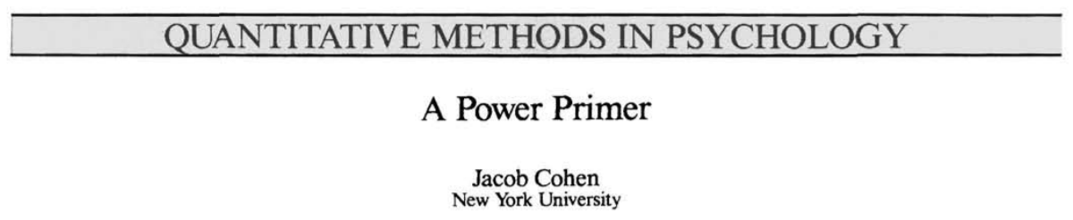
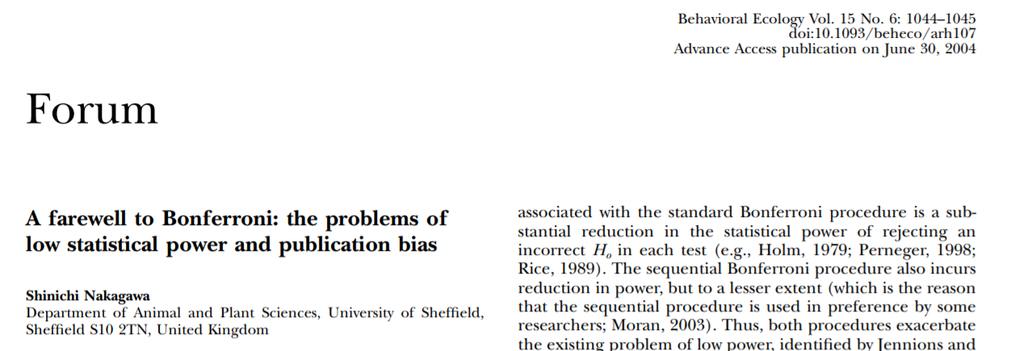
Effect size thinking and power
Statistical power: 2 pretty good papers as an introduction

Slide 19
Effect size thinking and power
How many subjects?
Power analysis is the
justification of your sample size
Notes:
19

Slide 20
Effect size thinking and power
Real World
Null true
Null false
Null true
Correct decision
Type II error
(false negative)
Conclusion of significance test
Type I error
(false positive)
Correct decision
Null false
Notes:
20

Slide 21
Effect size thinking and power
Type I error rate is controlled by the researcher.
It is called the alpha rate and corresponds to the probability cut-off in a significance test (i.e., 0.05).
By convention, researchers use an alpha rate of .05; they will reject the null hypothesis when the observed difference is likely to occur 5% of the time or less by chance (when the null hypothesis is true).
In principle, any probability value could be chosen for making the accept/reject decision. 5% is used by convention.
Notes:
21

Slide 22
Effect size thinking and power
Type II error is also controlled by the researcher.
The Type II error rate is sometimes called beta: the probability of failing to detect a real difference
How can the beta rate be controlled? The only way to control Type II error is to design your experiment to have good statistical power (the good news is that this is easy)
Power is 1 - beta, in other words the probability you will correctly reject the null hypothesis when the null is false
Notes:
22

Slide 23
Why is Ed obsessed with POWER?
Efficiency: Research is expensive and time consuming
Ethics: Minimize required sample subjects and maximize their sacrifice
Practicality: With good reason many grant funding agencies now either require or prefer a formal power analysis
To be blunt, you should probably just go home if you engage in data collection without conducting a power analysis in some form
(20 years ago, you could get away with being ignorant about statistical power, but not today)
Notes:
23
23

Slide 24
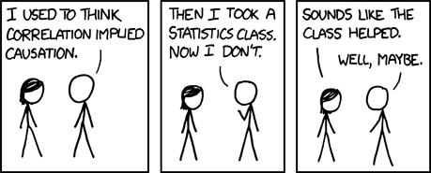
Statistical Power
Statistical power and the correlation
for a correlation test
the effect size == the correlation coefficient, r
Notes:
24

Slide 25
Power and correlation
This graph shows how the power of the significance test for a correlation varies as a function of sample size
Notes:
25

Slide 26
Power and correlation
Notice that when N = 80, there is about an 80% chance of correctly rejecting the null hypothesis (beta = .20).
When N = 45, we only have a ~50% chance of making the correct decision—a coin toss (beta = .50)!!!
Notes:
26

Slide 27
Power and correlation
Take-home message:
If power <= 0.5 you are wasting your time!
Notes:
27

Slide 28
Power and correlation
Power also varies as a function of the size of the correlation.
Notes:
28

Slide 29
Power and correlation
When the population correlation is large (e.g., .80), it requires fewer subjects to correctly reject the null hypothesis
When the population correlation is smaller (e.g., .20), it requires a large number of subjects to correctly reject the null hypothesis
Notes:
29

Slide 30
Low Power Studies
Because correlations in the .2 to .4 range are typically observed in non-experimental research,
one might be wise not trust research based on sample sizes around 50ish...
Notes:
30

Slide 31
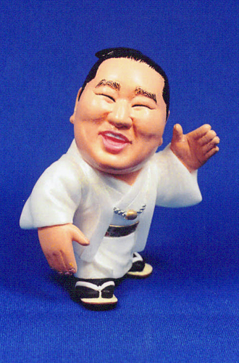
Essential Ingredients for power
To calculate power, you need 3/4 of the following:
1) Your significance level: α (0.05 by convention)
2) Power to detect an effect: 1 – β (the recommended albeit “arbitrary” number is Power = 0.80)
3) Effect size – how big is the change of interest? (from past research, pilot data, rule of thumb, guess)
4) Sample size – a given effect is easier to detect with a larger sample size
Notes:
31
31

Slide 32
Essential Ingredients for power
(Let’s go!)
PS: You also need to know the research design
PPS: That means you need to know what statistical test you plan to use
PPPS: Make sure the statistic can resolve your hypothesis!
Notes:
32
32

Slide 33
Essential Ingredients for power
These you know
1) Significance level: α (0.05 by convention)
2) Power to detect an effect: 1 – β (the recommended, albeit “arbitrary”, value is Power = 0.80)
3) Effect size – how big is the change of interest? (from past research, pilot data, or guess)
4) Sample size – a given effect is easier to detect with a larger sample size
Notes:
33
33

Slide 34
Essential Ingredients for power
1) Significance level: α (0.05 by convention)
2) Power to detect an effect: 1 – β (the recommended, albeit “arbitrary”, value is Power = 0.80)
3) Effect size – how big is the change of interest? (from past research, pilot data, or guess)
4) Sample size – a given effect is easier to detect with a larger sample size
Typically you calculate your own effect size
and solve for the required sample size
Notes:
34
34

Slide 35
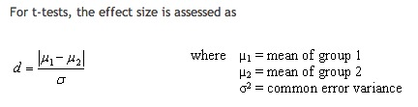

Essential Ingredients for power
Effect size for a t-test is Cohen's d
Where sigma (the denominator) is:
Notes:
35

Slide 36
Essential Ingredients for power
E.g., Cohen suggests “rules of thumb”:
small medium large
t-test for means d .20 .50 .80
Corr r .10 .30 .50
F-test for anova f .10 .25 .40
chi-square w .10 .30 .50
We'll explore this more in R
Notes:
36

Slide 37
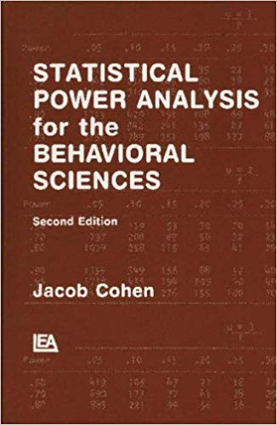
Resources and readings; other tools
Cohen 1988 Statistical power analysis for the behavioural sciences
R package {pwr}, Q*Power
(SPSS & Genstat & Minitab have some functionality too, but are not open and transparent)
Notes:
37

Slide 38
Resources and readings; other tools
Jennions, M. D. and A. P. Moller. 2003. A survey of the statistical power of research in behavioural ecology and animal behaviour. Behavioral Ecology 14:438-445.
Thomas, L. And F. Juanes. 1996. The importance of statistical power analysis: an example from Animal Behaviour. Animal Behaviour 52: 856-859.
I wonder if this has been done (or should be done) in agricultural sciences…?
Notes:
38

Slide 39

Resources and readings; other tools
A particularly good introduction to statistical power can be found in Chapter 7:
Quinn, G. and M. Keough. 2002. Experimental design and data analysis for biologists. Cambridge University Press, Cambridge.
This is probably the best textbook I know of for a general yet comprehensive introduction to “modern” statistical tools for biologists.
Notes:
39

Slide 40
Resources and readings; other tools
Pwr package in R
Quick-R power page
Blomberg 2014 Power analysis using R
Psychstat power page

Slide 41
Power calculation in R

Slide 42
Future of HARUp! (topics, attendees, etc.)
-intro to R programming, basic stats class, adv vs basic
-Reproducible data and research methods, Github
-Graph making
-Generalized linear model, mixed models, etc.

Slide 43
Future of HARUp! (topics, attendees, etc.)
Format of meetings:
-Ed + student presenter? Use Slack? Who can attend?
-Focus on R tools or more general stats stuff?
-Read important papers / books? Focus on activities?
-Your thoughts?

Slide 44

Future of HARUp! (topics, attendees, etc.)
Logo?
HA
Up!

