Slide 1
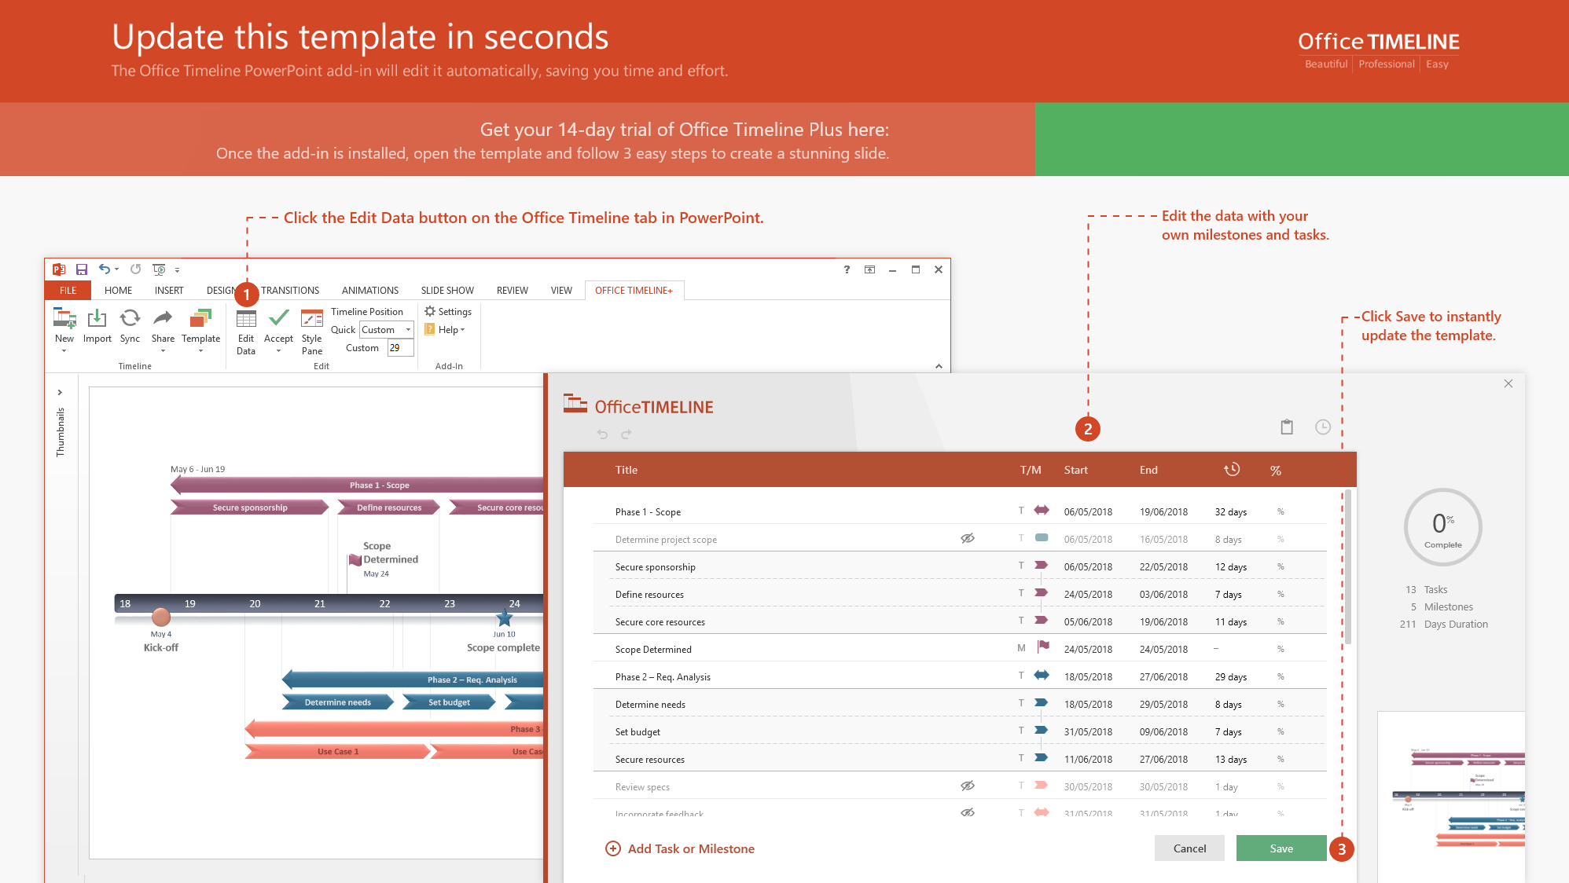
https://www.officetimeline.com/14-days-trial

Slide 2
PowerPoint Gantt Chart
Kick Off
Milestone #2
Milestone #5
Sign Off
May 10
Jul 21
Oct 30
Jan 30
Milestone #1
Checkpoint A
Milestone #3
Checkpoint B
Jun 7
Aug 12
Sep 20
Dec 20
2018
May
Jun
Jul
Aug
Sep
Oct
Nov
Dec
2019
2019
8 days
Preparatory Phase
100%
Jul 25 - Aug 1
Today
24 days
Phase 1 Work Effort
100%
Aug 15 - Sep 7
34 days
Phase 2 Work Effort
80%
Aug 15 - Sep 17
23 days
Phase 3 Work Effort
60%
Sep 8 - Sep 30
35 days
Testing Phase
Oct 4 - Nov 7
31 days
Delivery Phase
Nov 11 - Dec 11

