Slide 1

Project Report: FactSage Simulation Podcast
Influence of Carbon Allotropes on the Melting Point and Eutectic Behavior of the Ni–C Binary System
Presented by: | Hafsa Raza
Presented to: | Prof. Philippe Ouzilleau

Slide 2
Project Overview
Results
Conclusion
Research Context
Research Question
Research Process
Objectives
Methodology

Slide 3
Research Context and Literature Overview
Ni–C system lacks stable carbides, making it ideal for thermodynamic studies.
Nickel enables graphene growth via CVD by absorbing and releasing carbon.
Carbon allotropes (graphite, diamond, graphene) affect phase stability.
Using metastable carbon shifts eutectic temperature and solubility.
Accurate phase modeling is key for carbon-based device fabrication.

Slide 4

Research Question
How do graphite, graphene, and
diamond alter the melting point and
eutectic features in the Ni–C phase binary diagram?

Slide 5
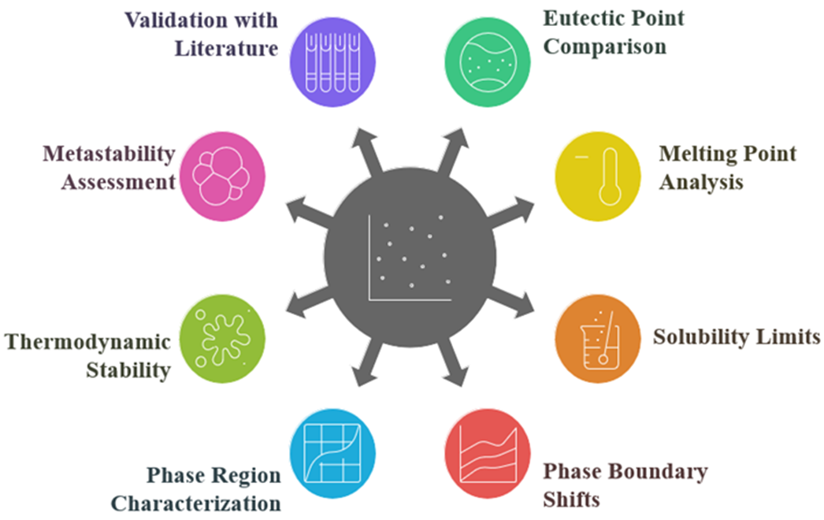
SPECIFIC OBJECTIVES

Slide 6
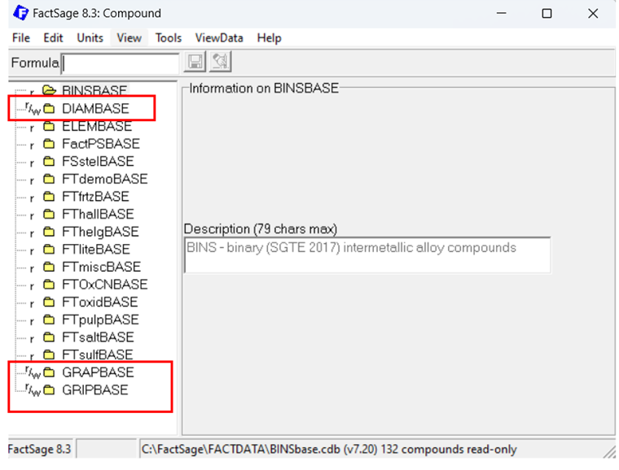
Methodology Step 1:

Slide 7
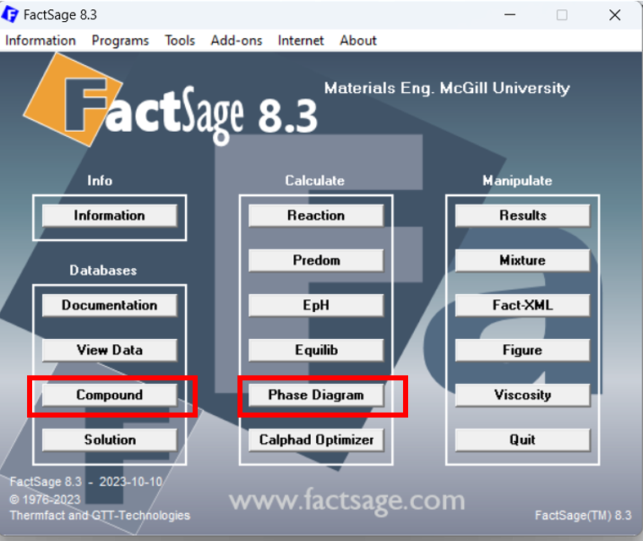
Methodology Step 2:

Slide 8
SGTE Databases
SGTE stands for Scientific Group Thermodata Europe, an international consortium of thermodynamic experts.
It offers experimentally validated and critically assessed thermodynamic data
for solid, liquid, and gaseous phases.
It includes comprehensive data for metals, alloys, and common non-metallic systems.
SGTE does not provide thermodynamic functions for 2D materials like graphene, requiring manual data entry for such phases.

Slide 9
Example
Eutectic point shifted from ~1326 °C (1.9 wt% C) with graphite
To 2.5–3 wt% C, 20–30 °C lower with diamond

Slide 10
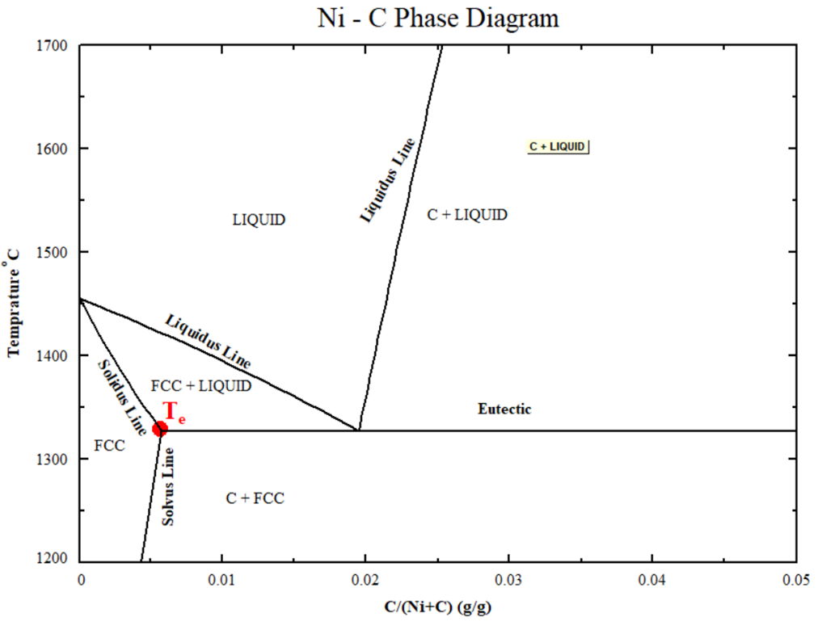
Presentation & Interpretation of Results
Ni-C binary Phase Diagram (Graphite)

Slide 11
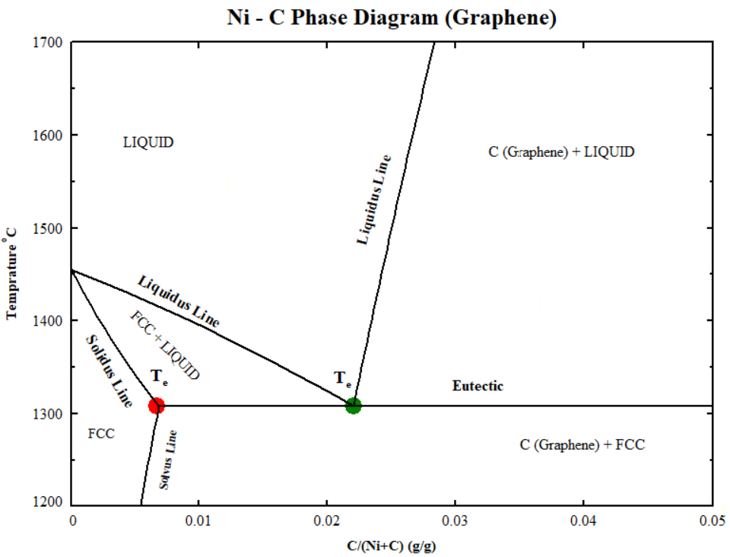
Presentation & Interpretation of Results
Ni-C binary Phase Diagram (Graphene)

Slide 12
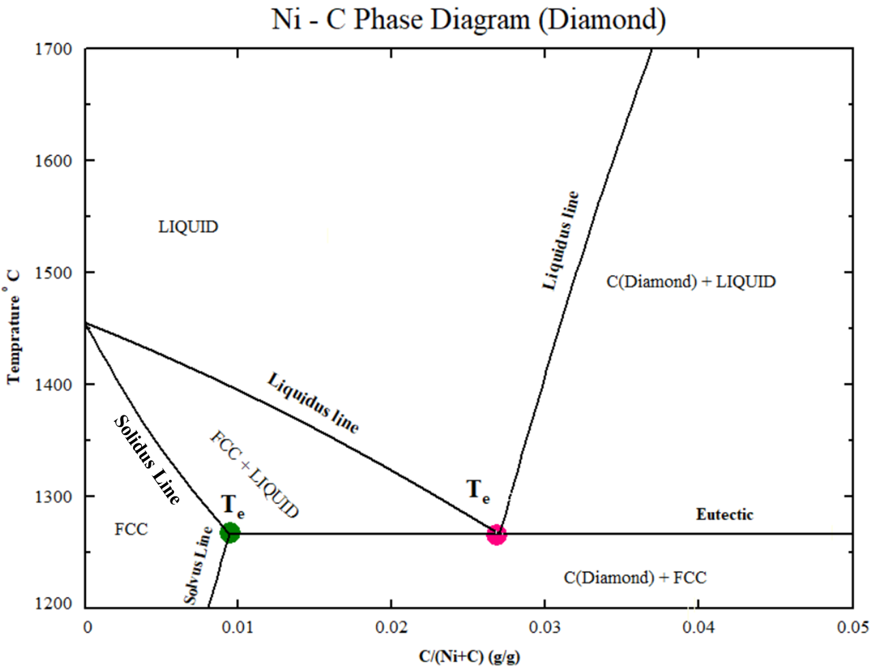
Presentation & Interpretation of Results
Ni-C binary Phase Diagram (Diamond)

Slide 13
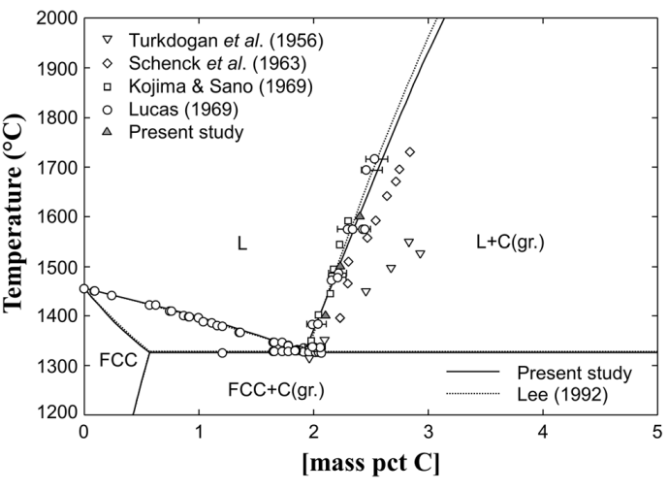
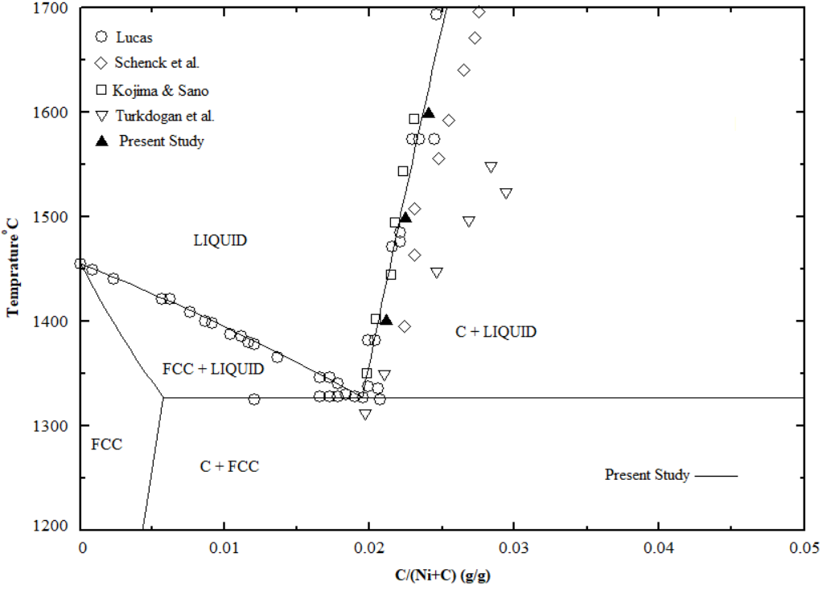
Presentation & Interpretation of Results
Compare with the experimental findings:

Slide 14
Conclusion
The Ni–C system maintains a simple eutectic structure across all carbon allotropes.
Graphite produces the highest eutectic temperature with the lowest carbon content.
Diamond and graphene shift the eutectic to lower temperatures and higher C concentrations.
The stability of the carbon phase critically influences phase equilibria and synthesis outcomes.

