Slide 1
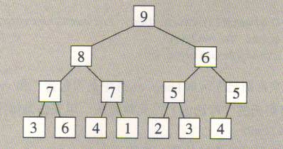
STL 算法 – Heap算法
堆排序算法(heapsort)
make_heap()
push_heap()
pop_heap()
sort_heap()

Slide 2
STL 算法 – 排序算法
sort()
stable_sort()
partial_sort()
partial_sort_copy()
nth_element()
partition()
stable_partition()
make_heap()
push_heap()
pop_heap()
sort_heap()

Slide 3
预定义的函数对象
negate<type>()
plus<type>()
minus<type>()
multiplies<type>()
divides<type>()
modulus<type>()
equal_to<type>()
not_equal_to<type>()
less<type>()
greater<type>()
less_equal<type>()
greater_equal<type>()
logical_not<type>()
logical_and<type>()
logical_or<type>()

Slide 4
预定义的函数适配器
bind1st(op, value)
bind2nd(op, value)
not1(op)
not2(op)
mem_fun_ref(op)
mem_fun(op)
ptr_fun(op)

