Slide 1
Results for Loopless Flux Sampling
Provide a description of the method

Slide 2
NADPH / ATP Ratio
Genotype | Temperature | tpt1 | tpt2
Col0 | 20 | 0.53 | 0.55
Col0 | 4 | 0.48 | 0.47
fum2 | 20 | 0.54 | 0.56
fum2 | 3 | 0.43 | 0.43

Slide 3

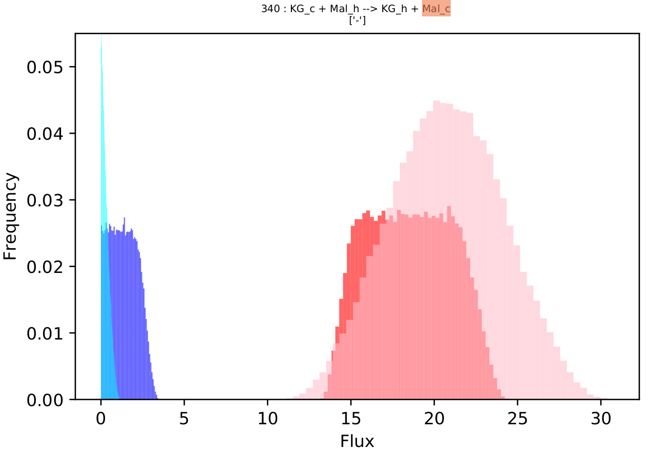
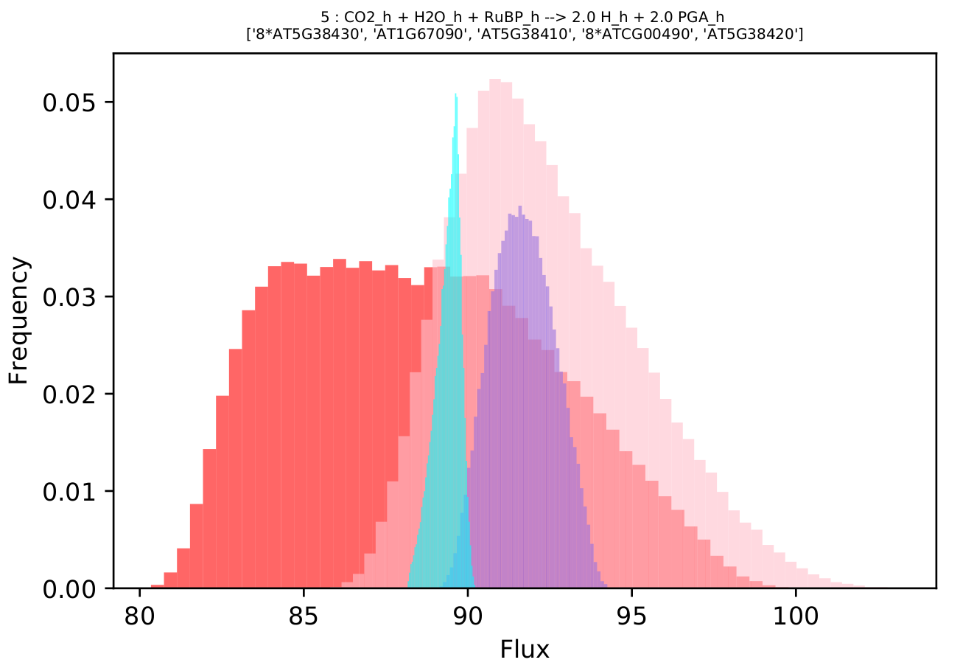
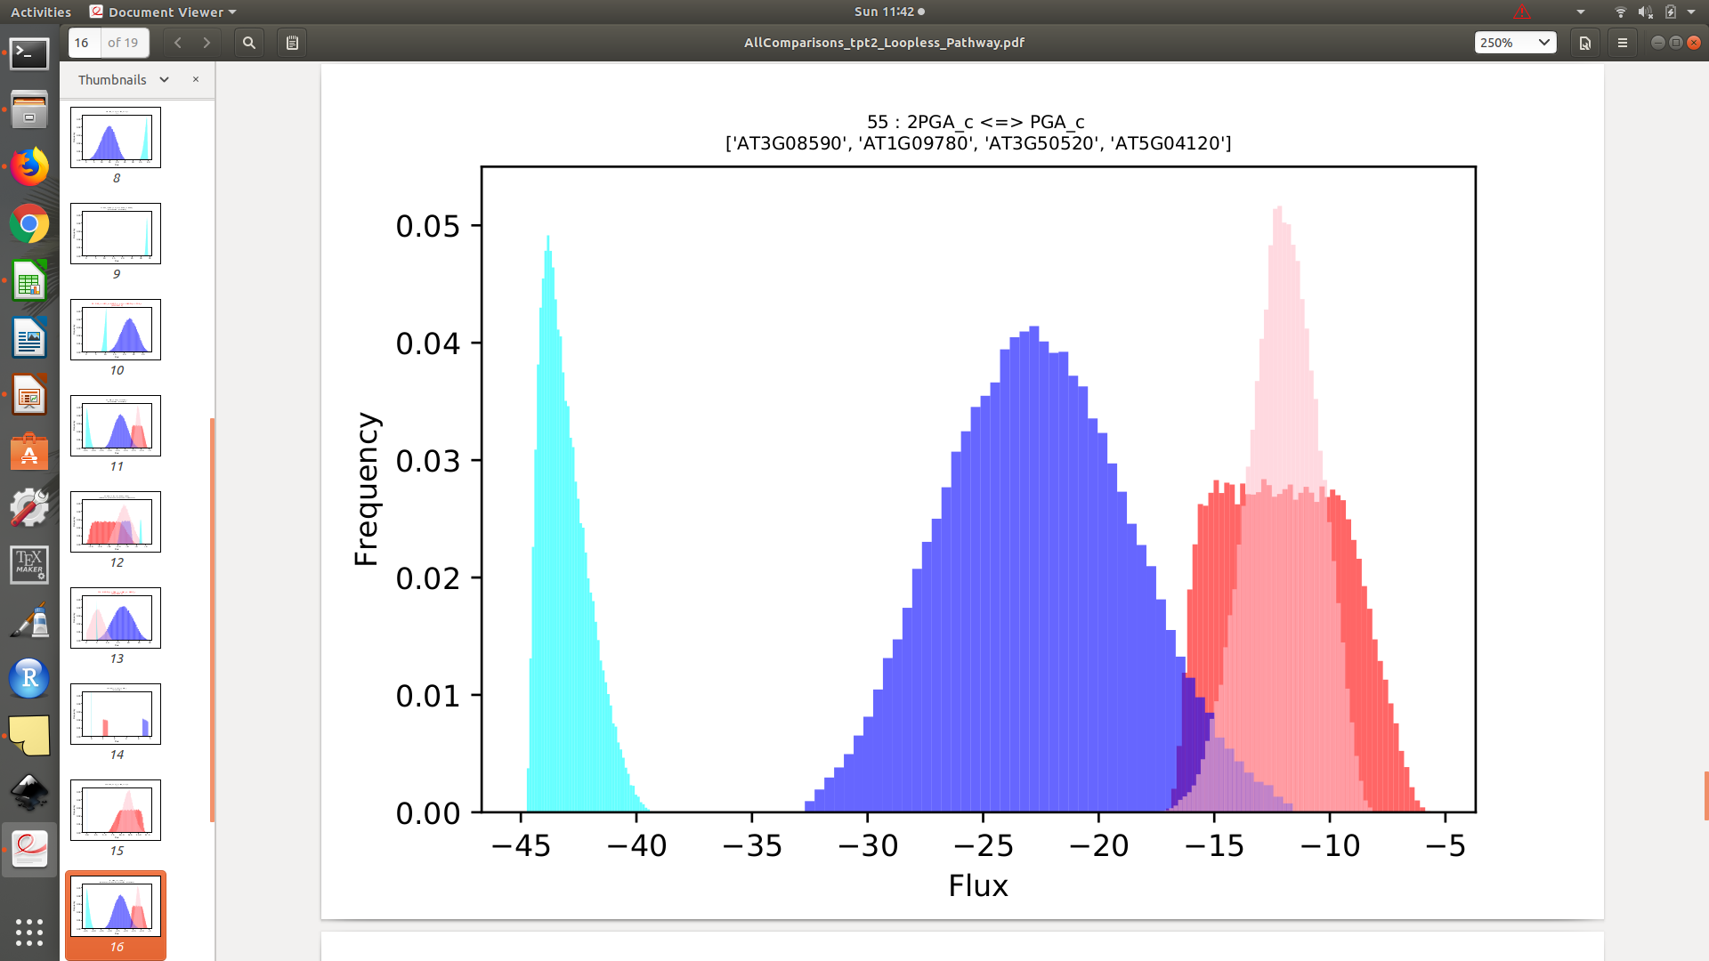

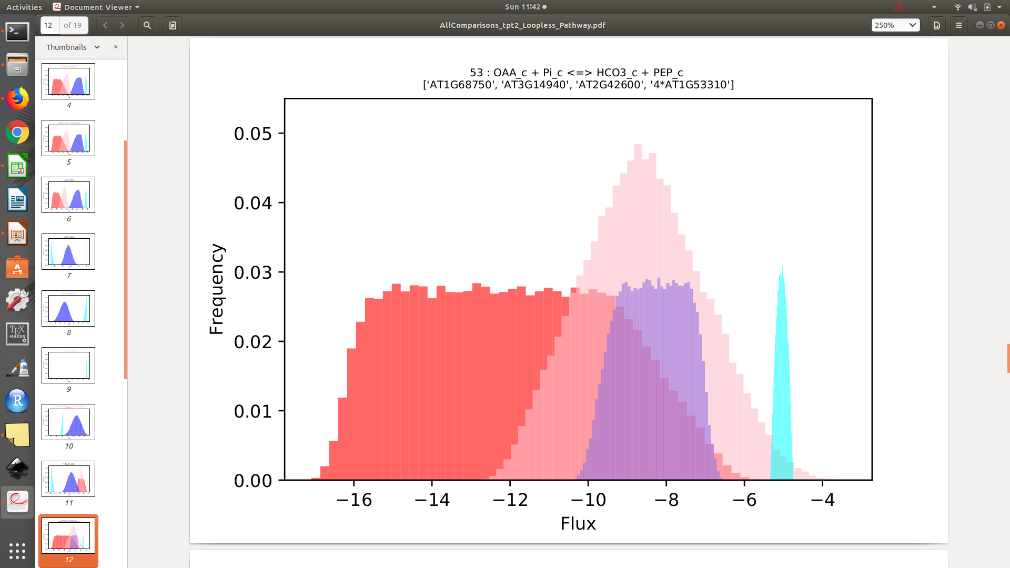
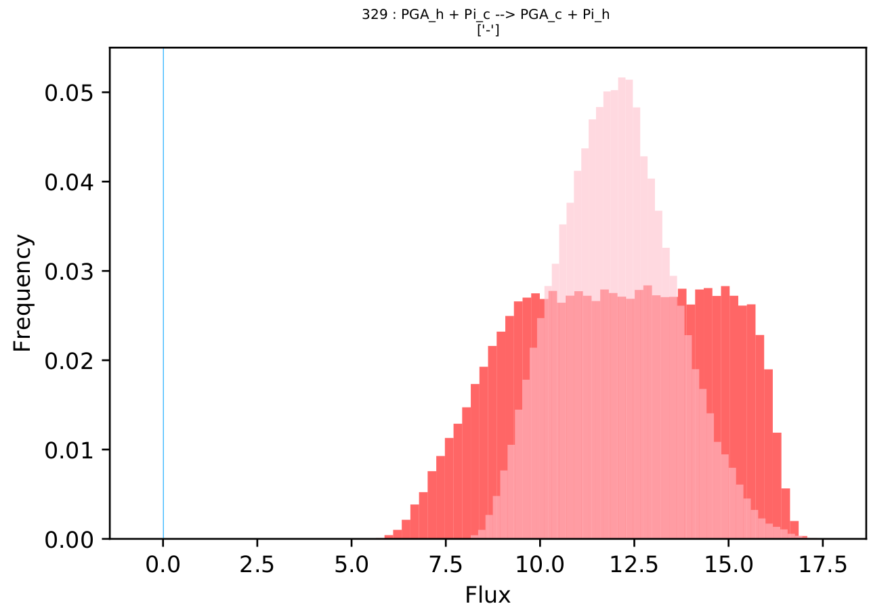
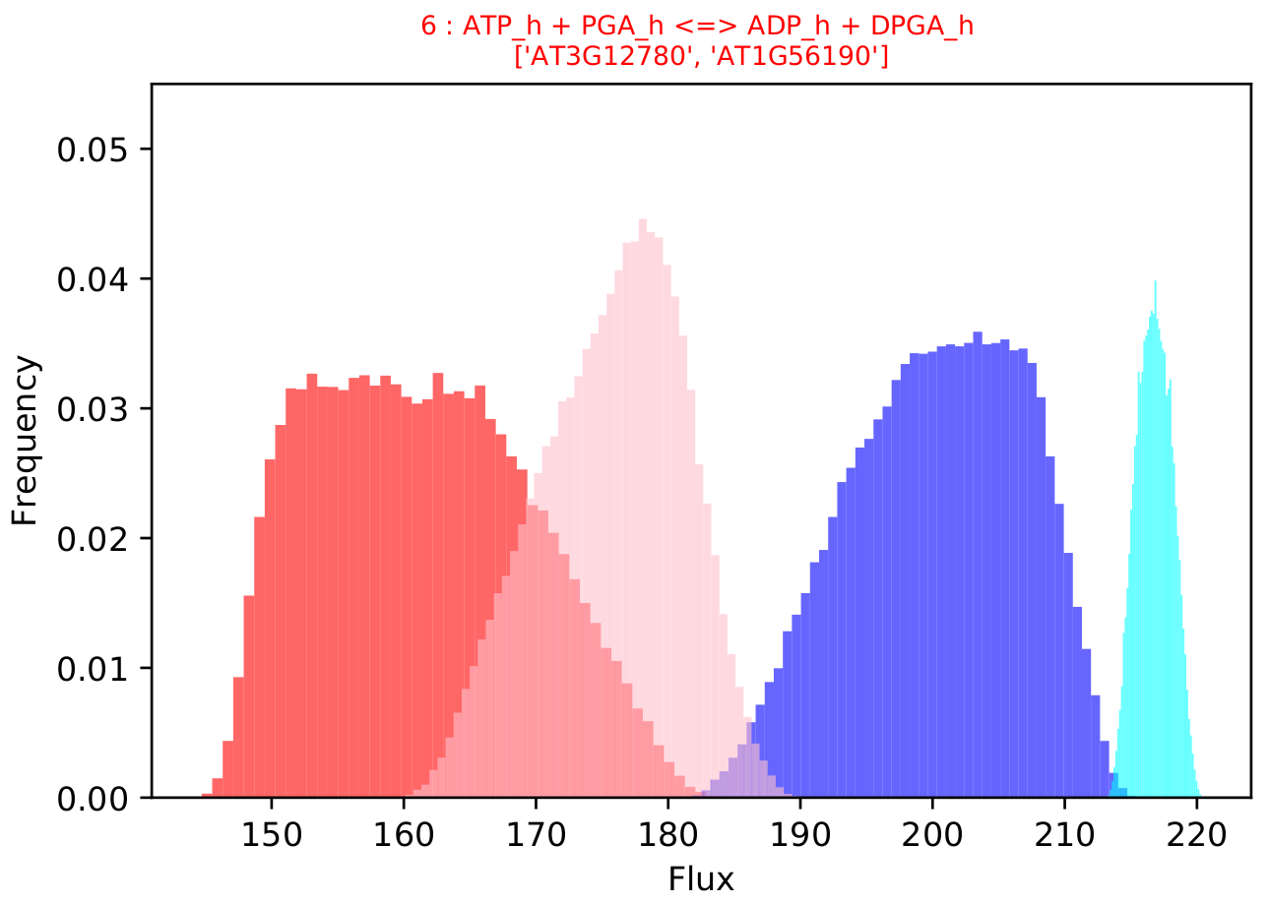
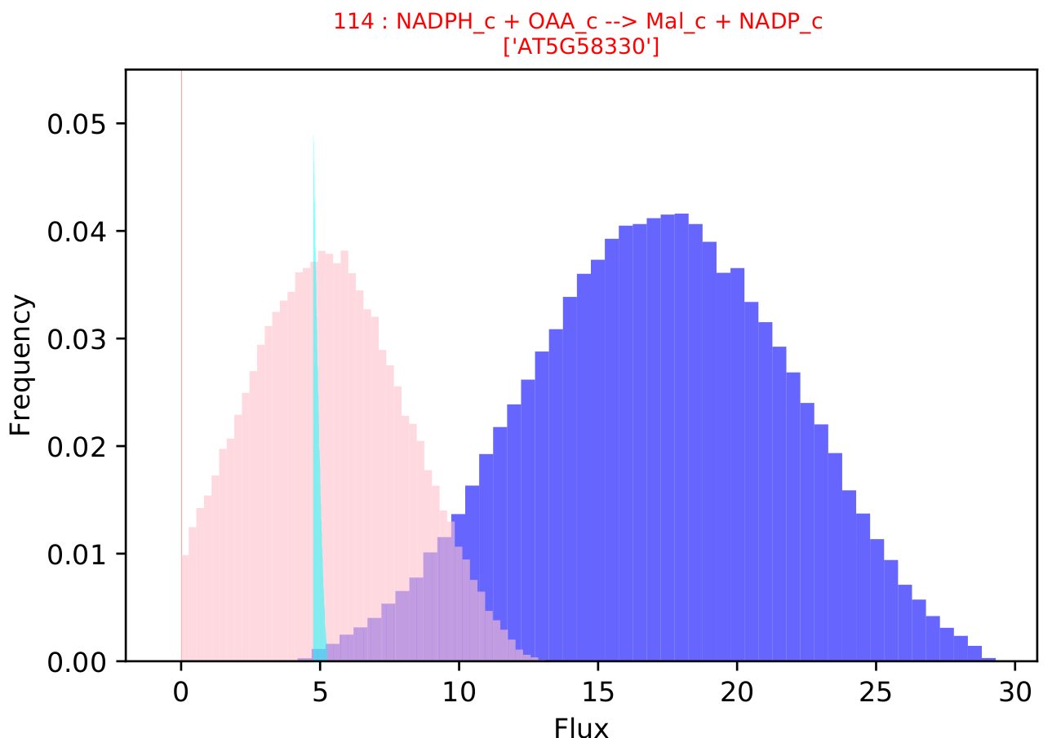
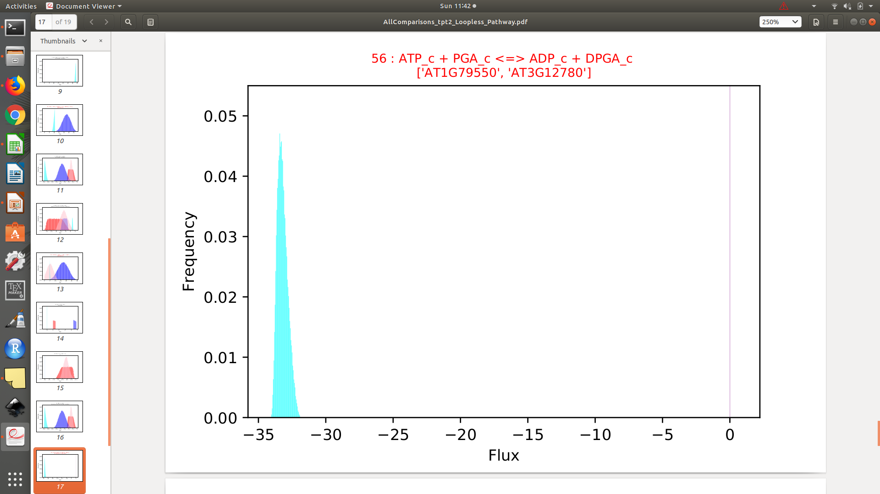
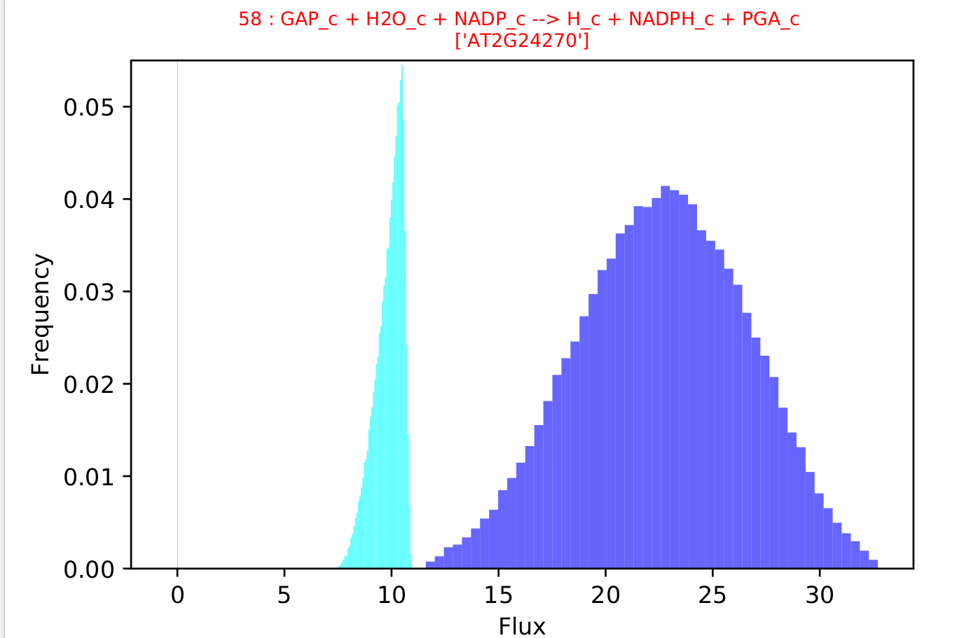
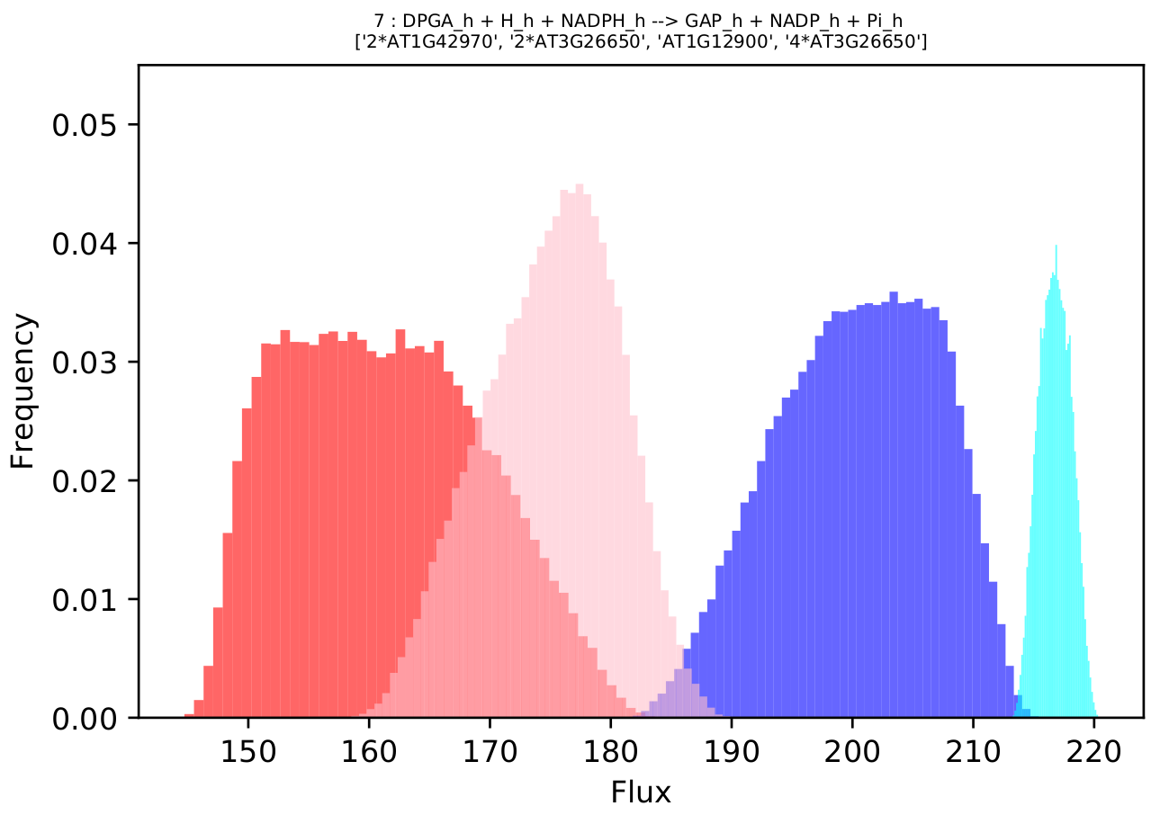
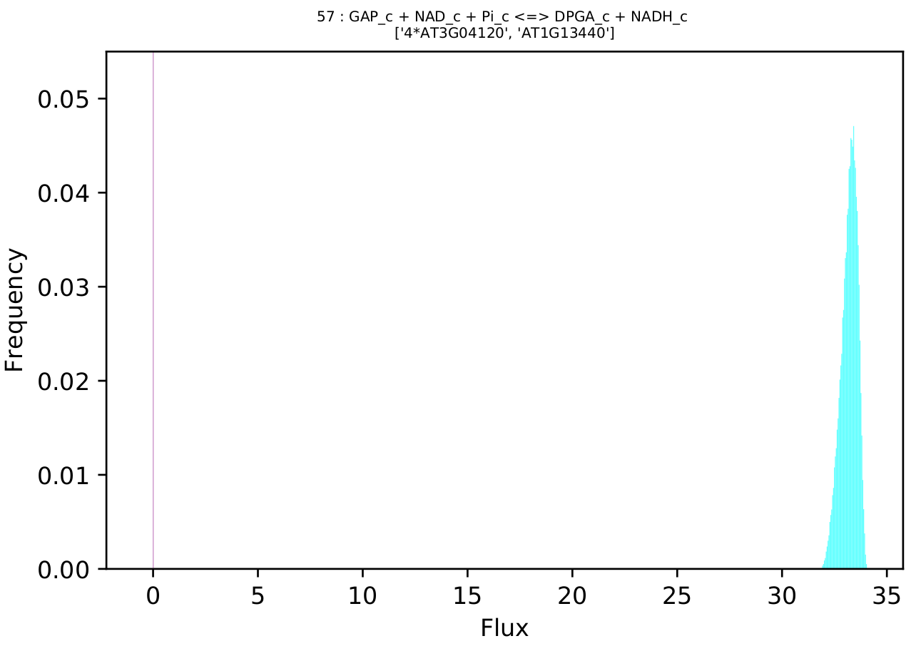
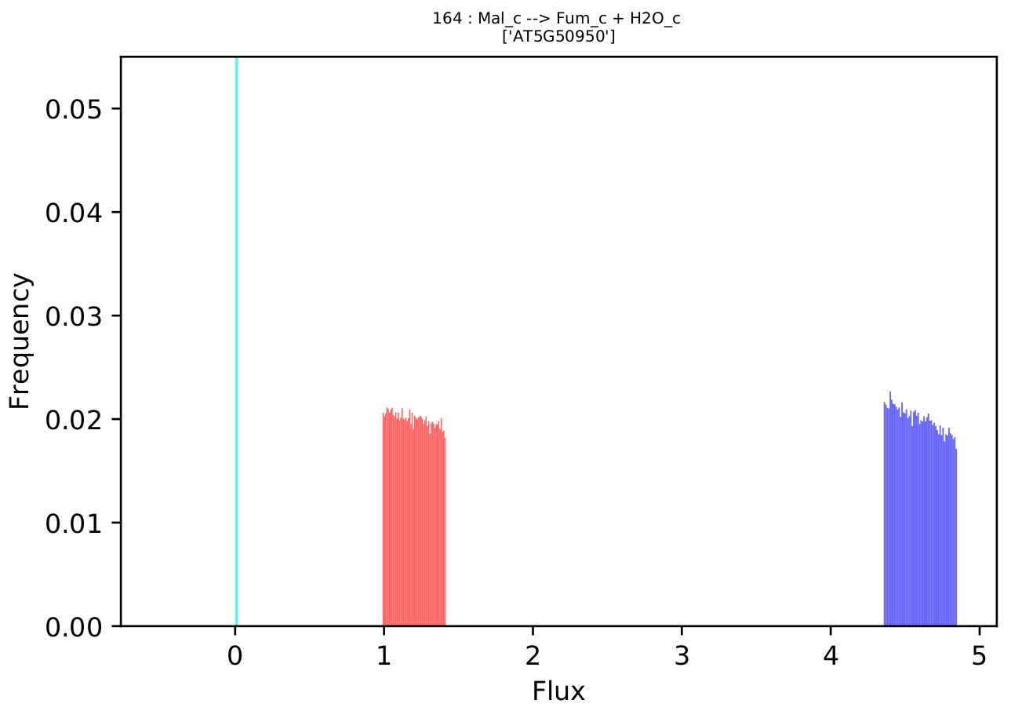
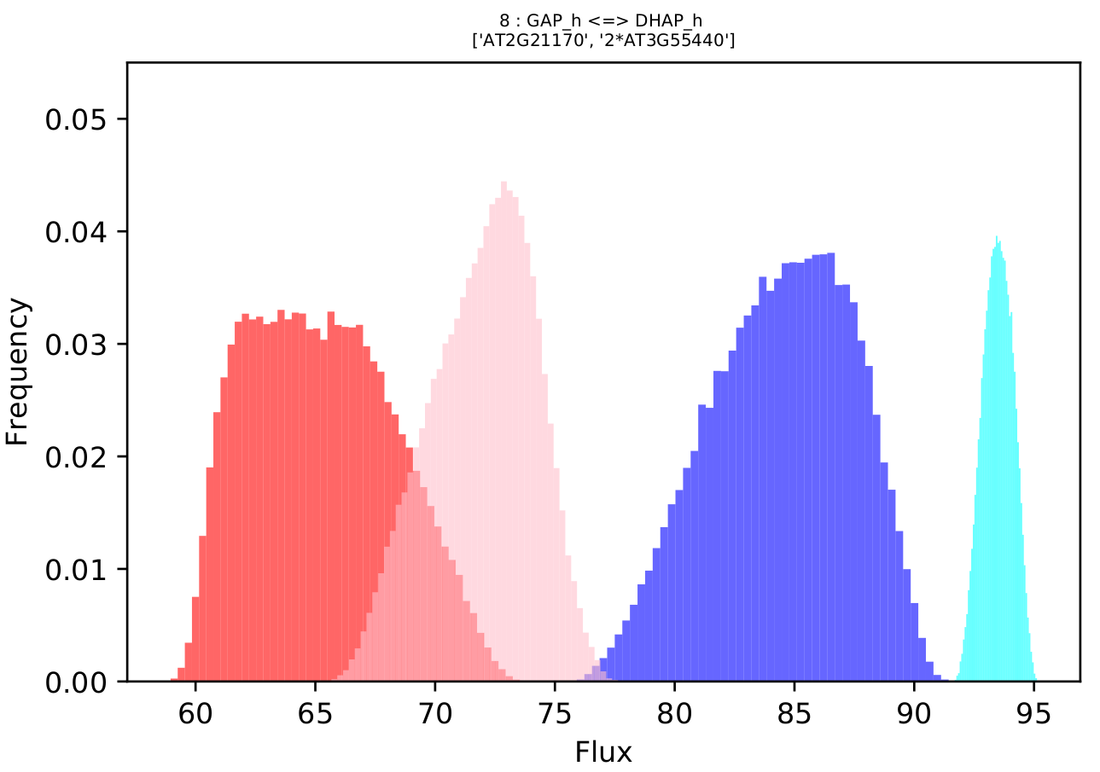
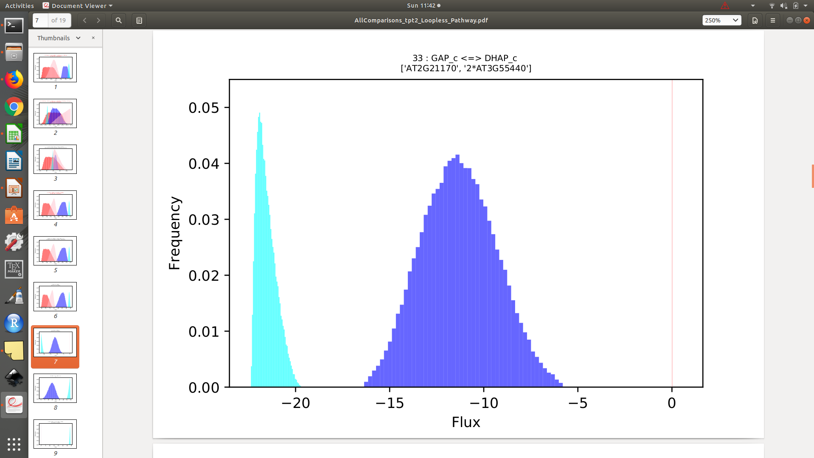
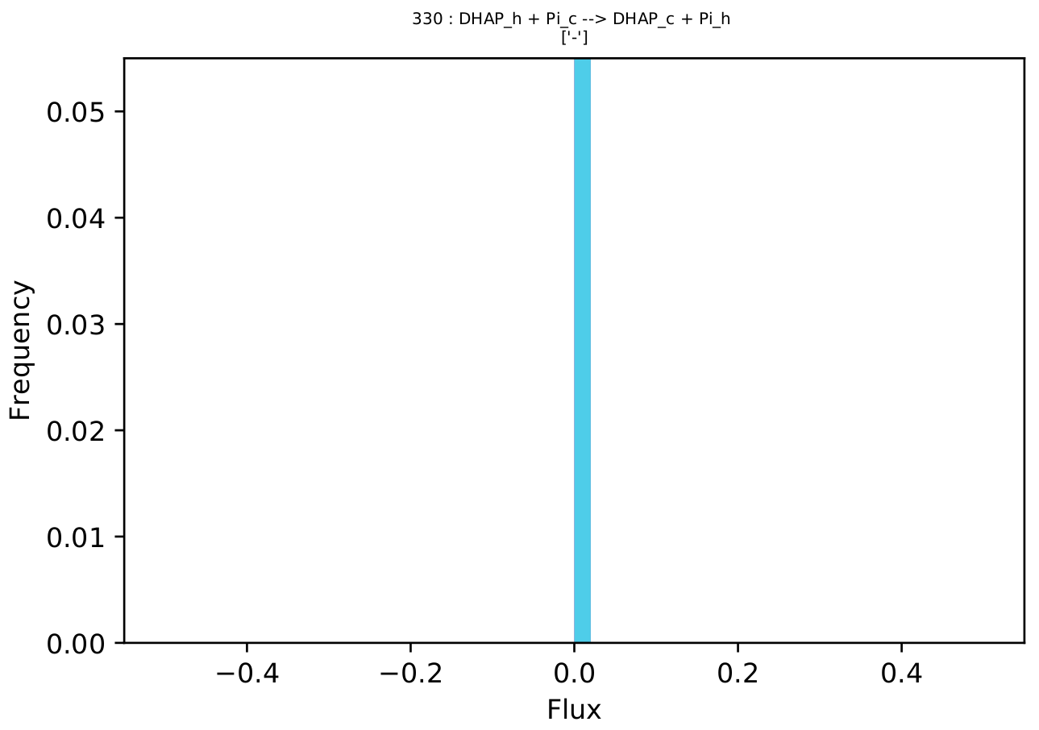
​tpt2
RuBP
Pyr
CO₂
PGA
PGA
2PGA
PEP
OAA
P_{i}
CO₂
P_{i}
ATP
ATP
NADPH
P_{i}
P_{i}
DPGA
DPGA
Mal
NADPH
NADH
P_{i}
GAP
GAP
Fum
P_{i}
DHAP
P_{i}
DHAP

Slide 4

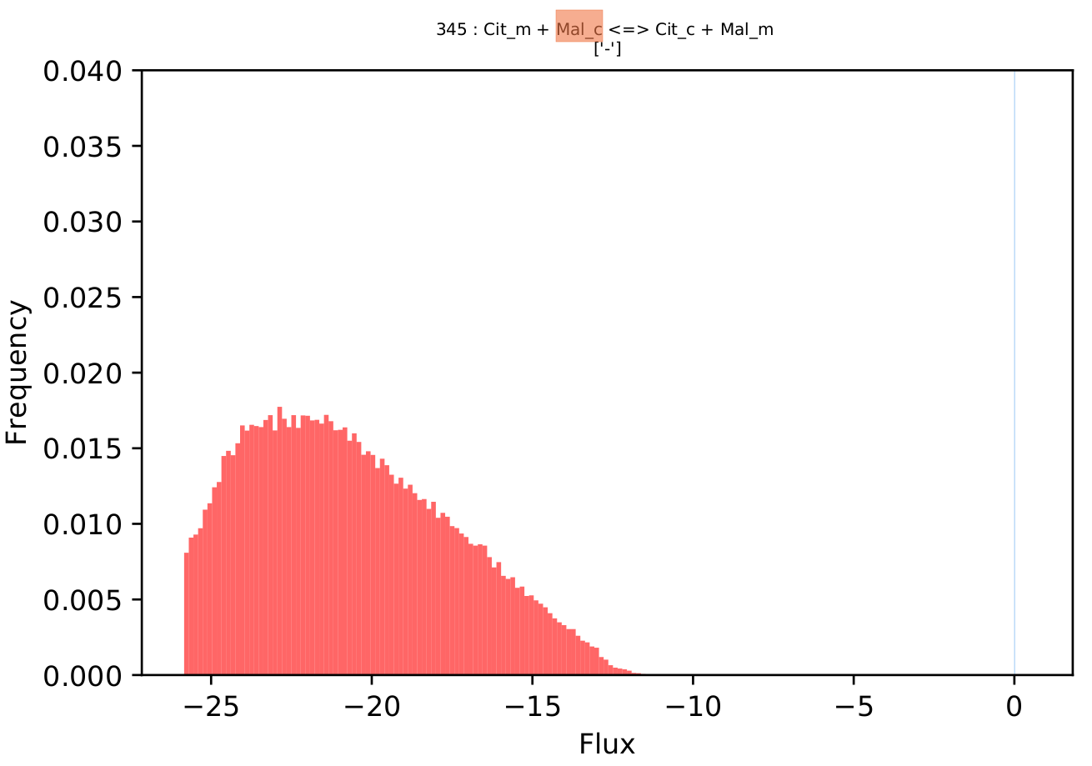
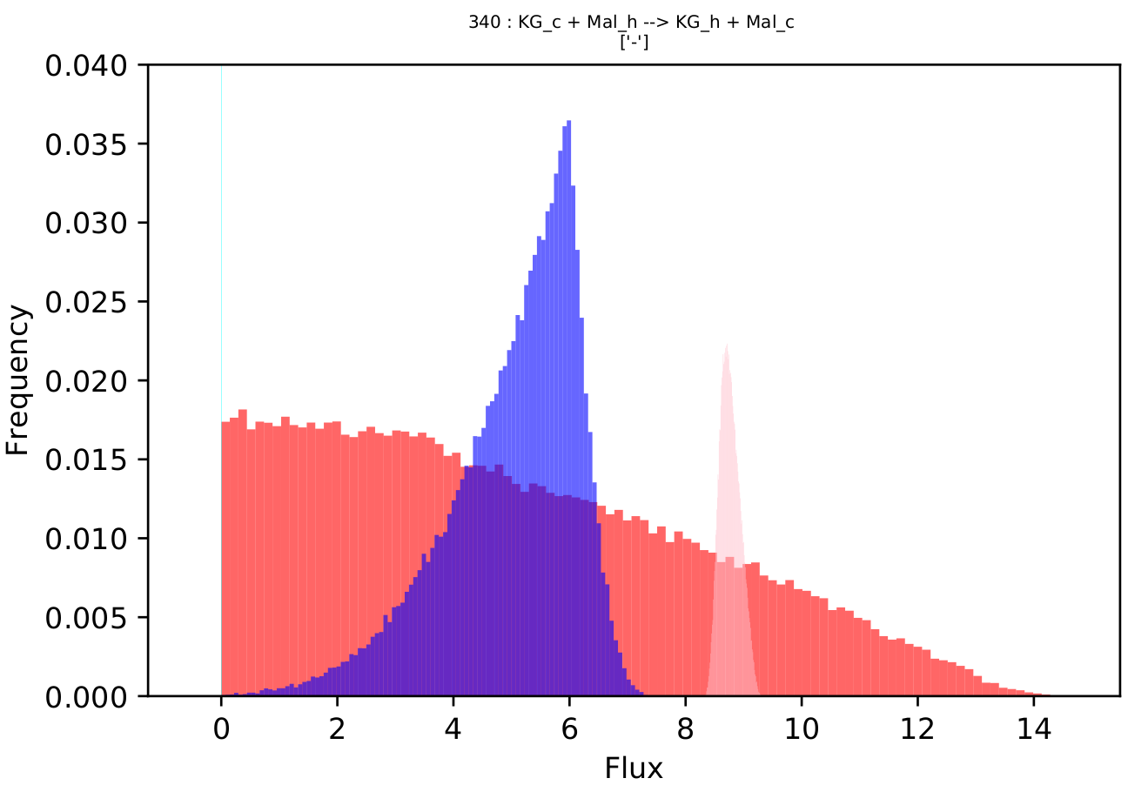
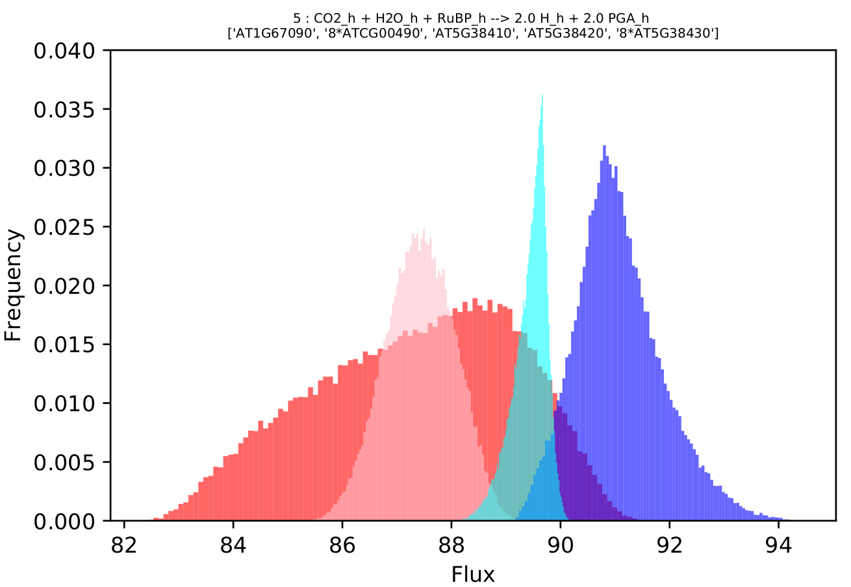
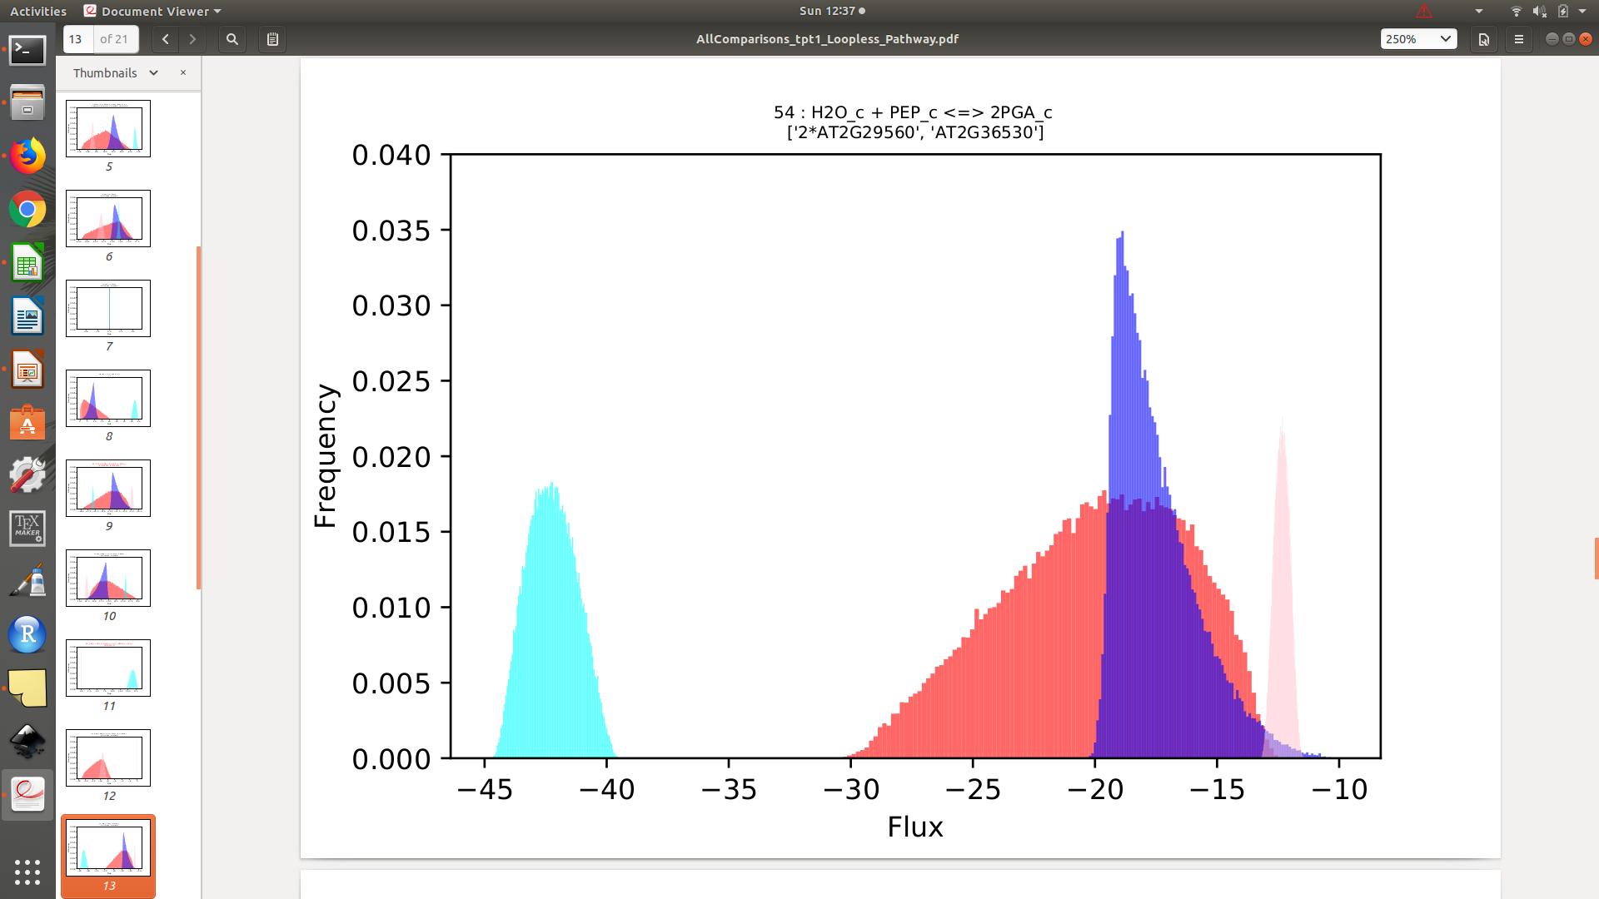
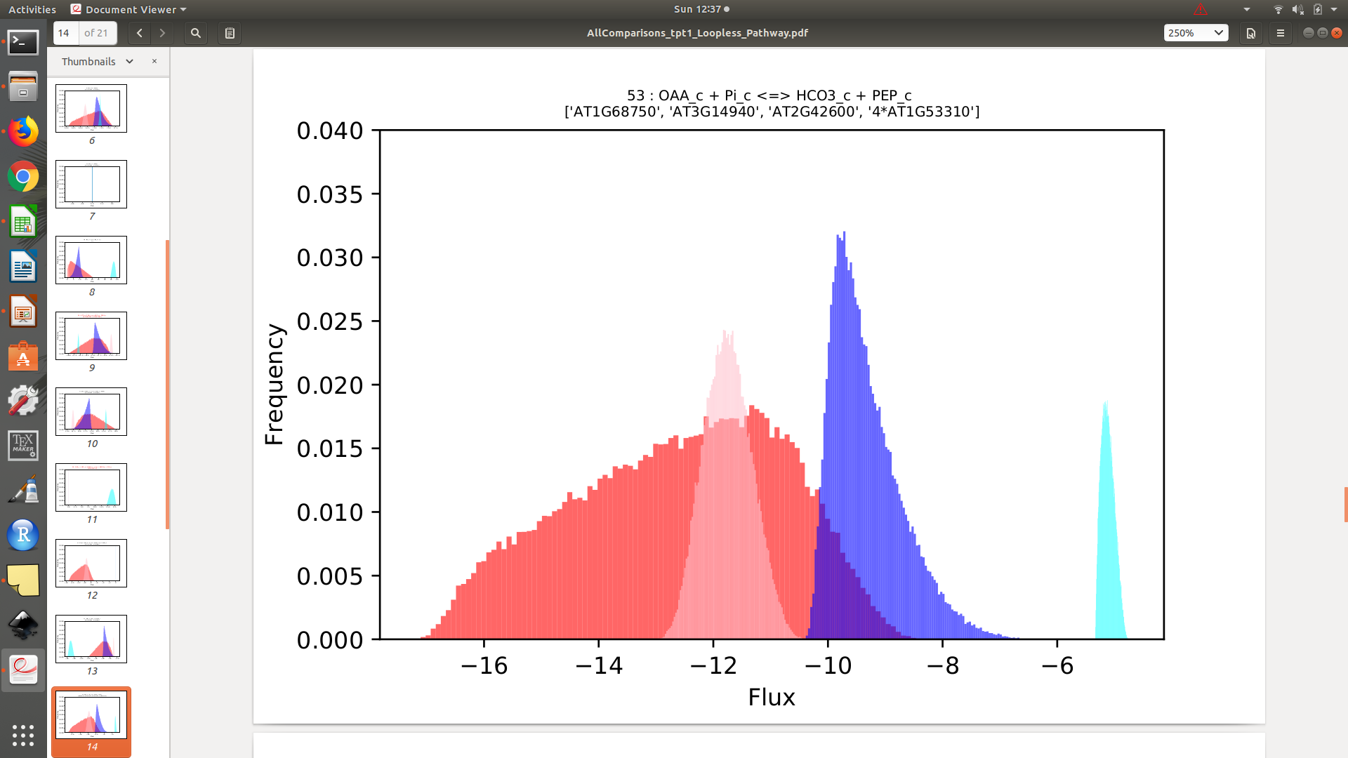
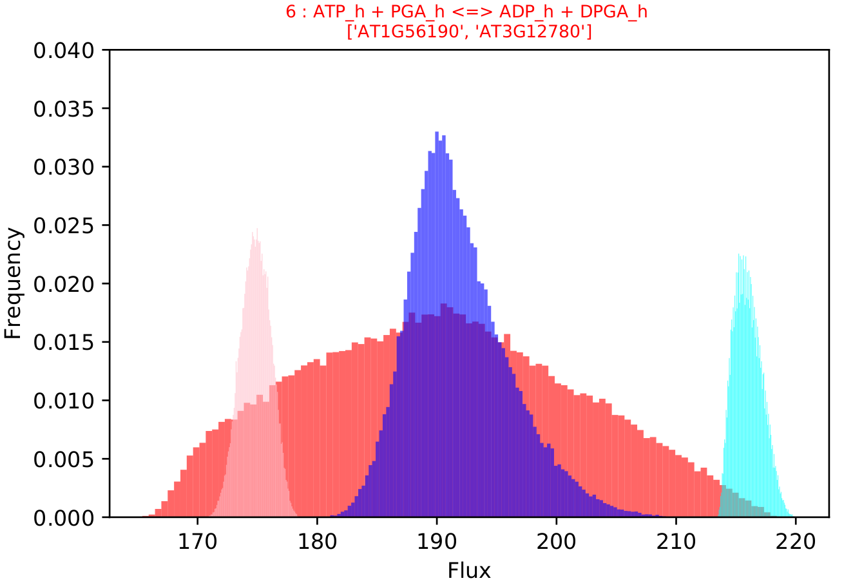
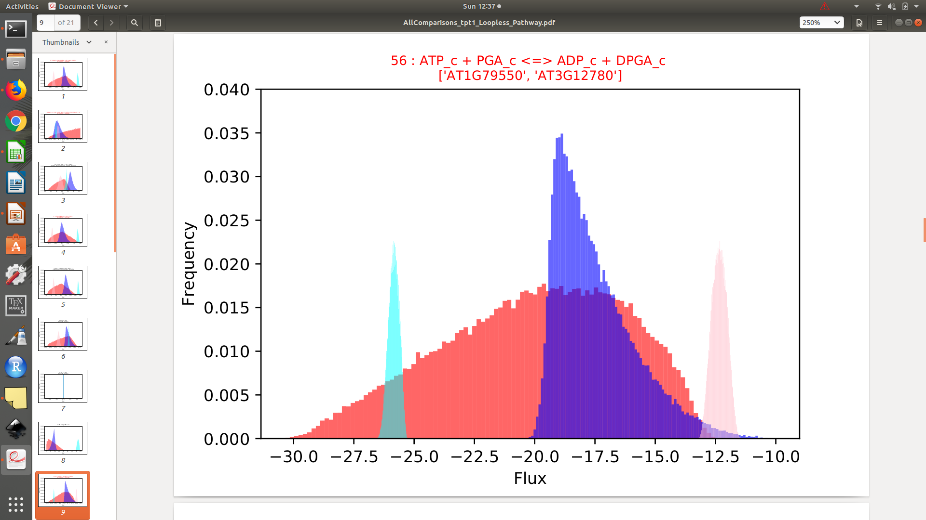
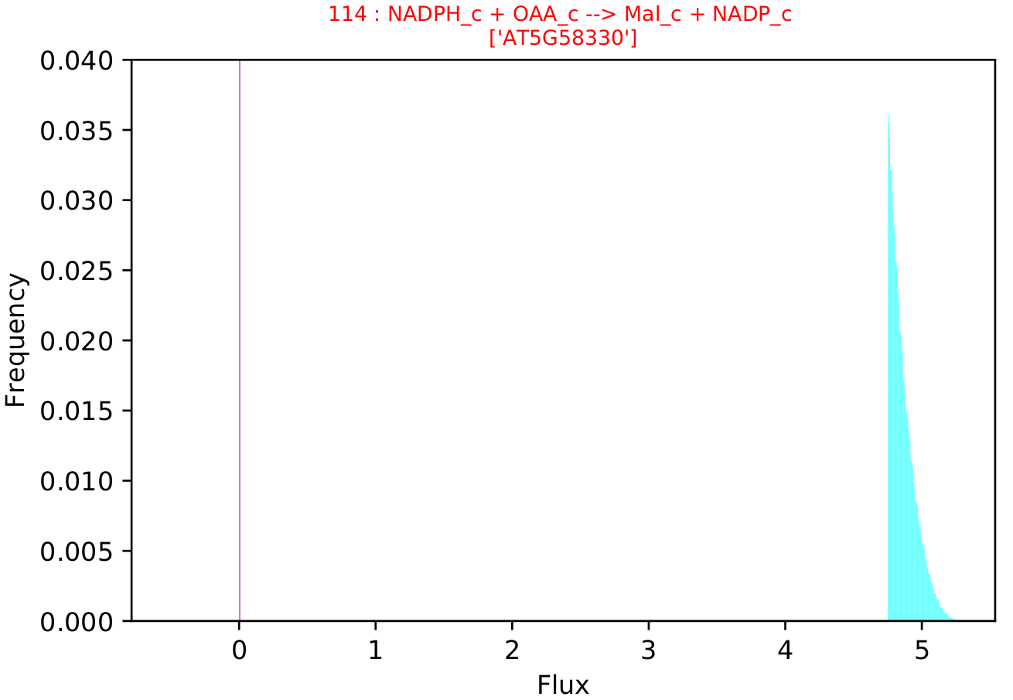
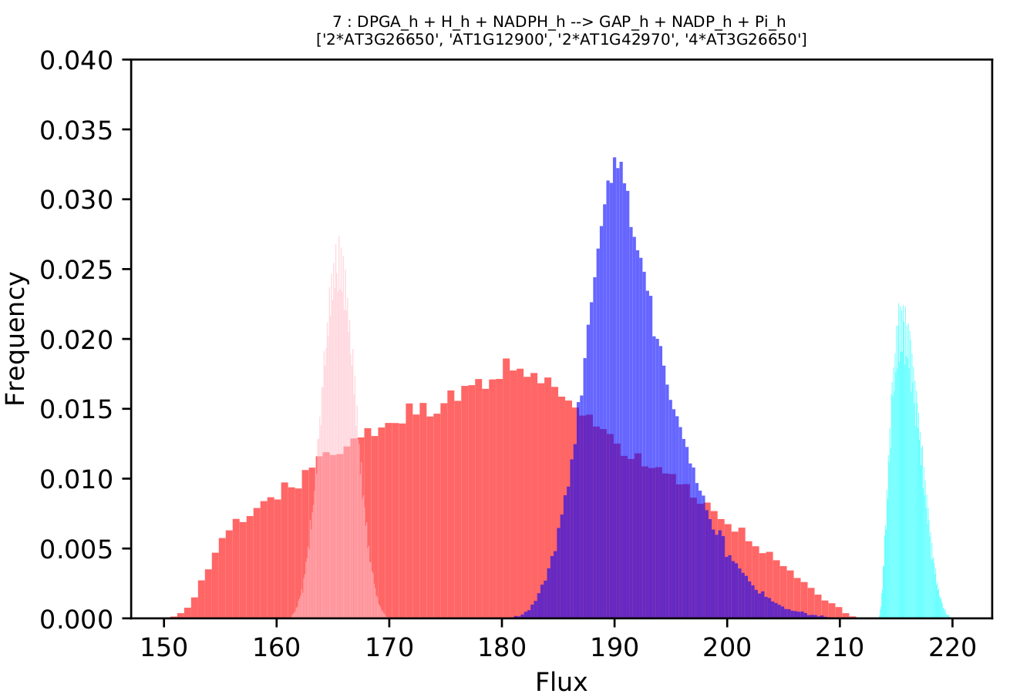
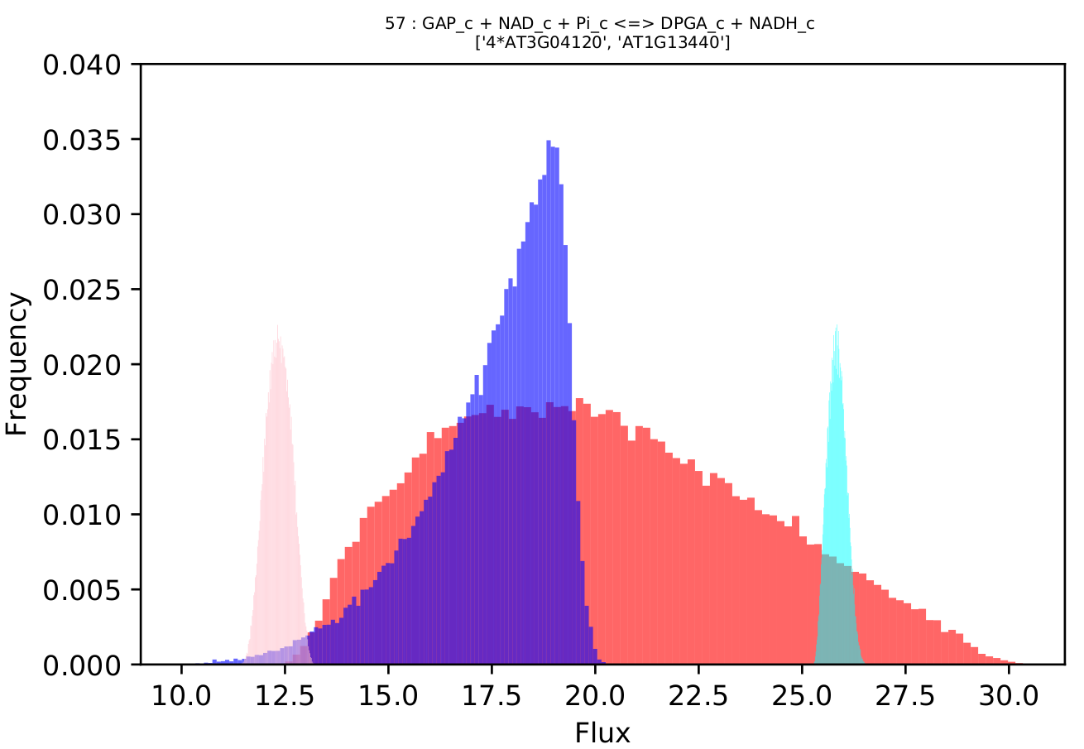
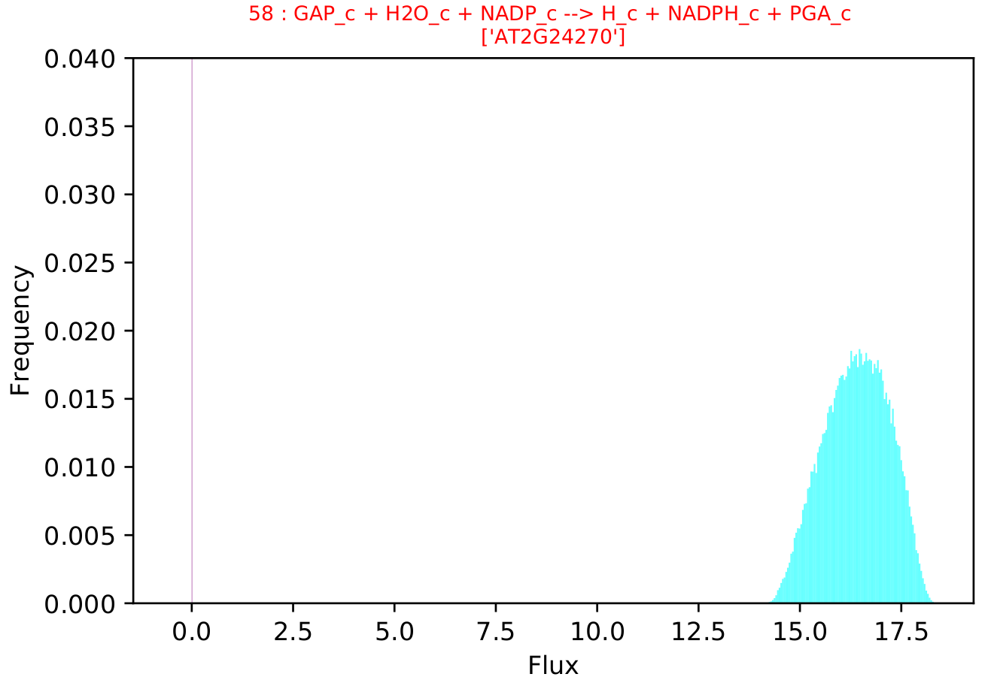
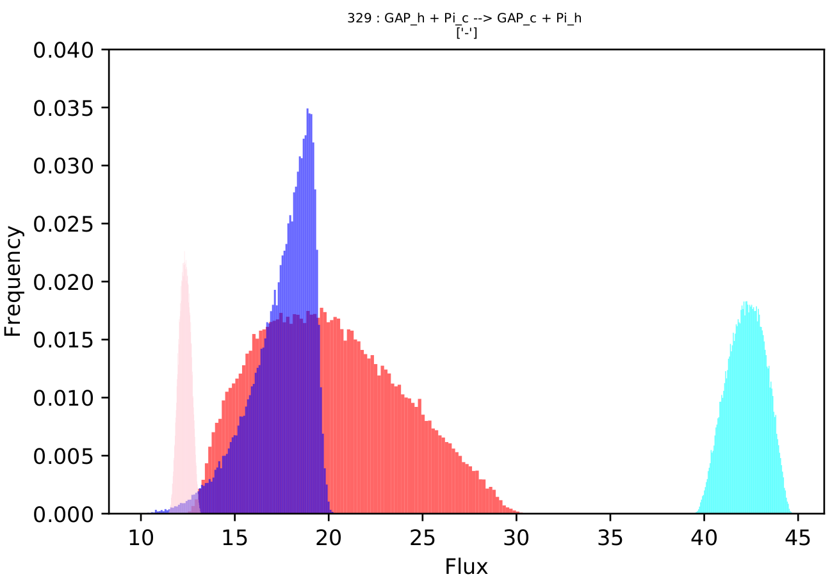
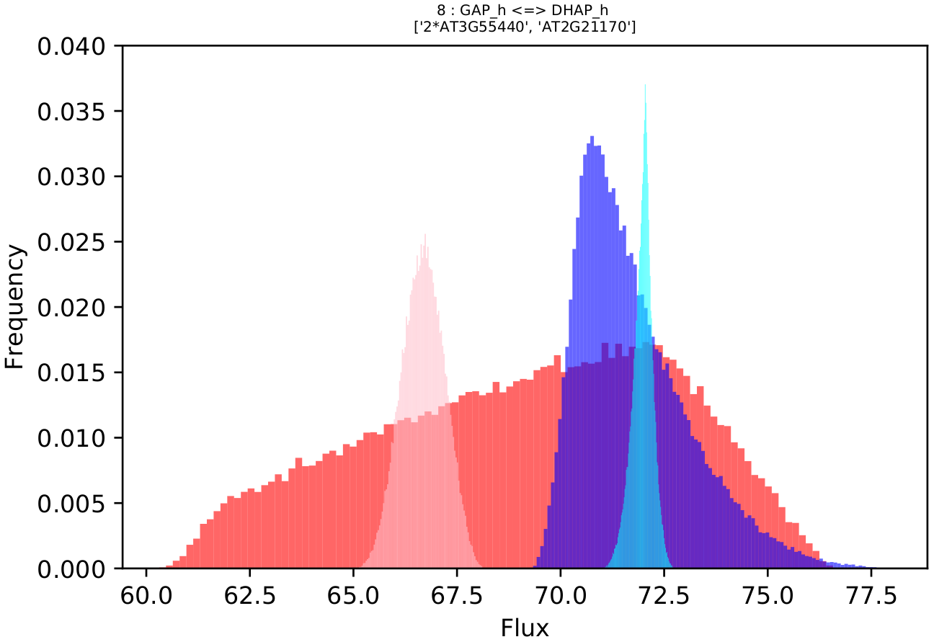
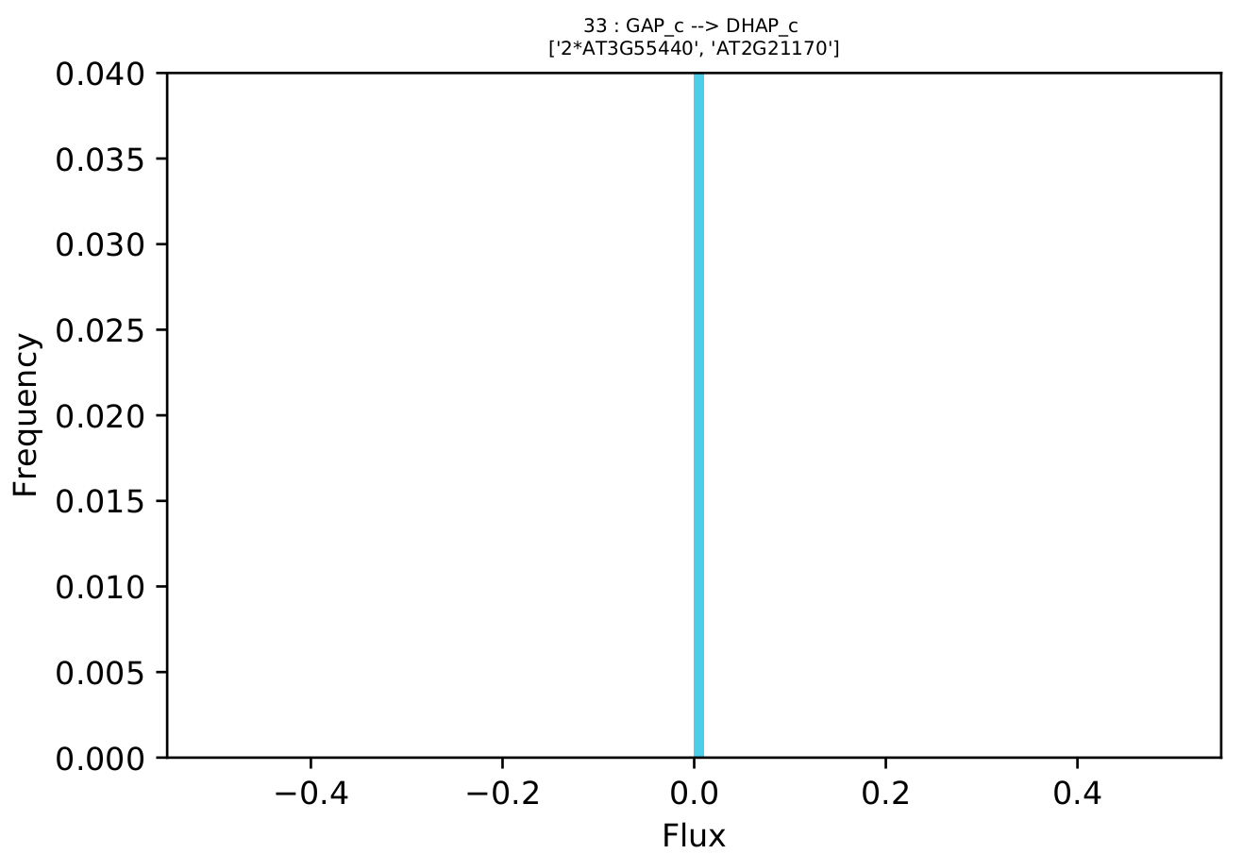
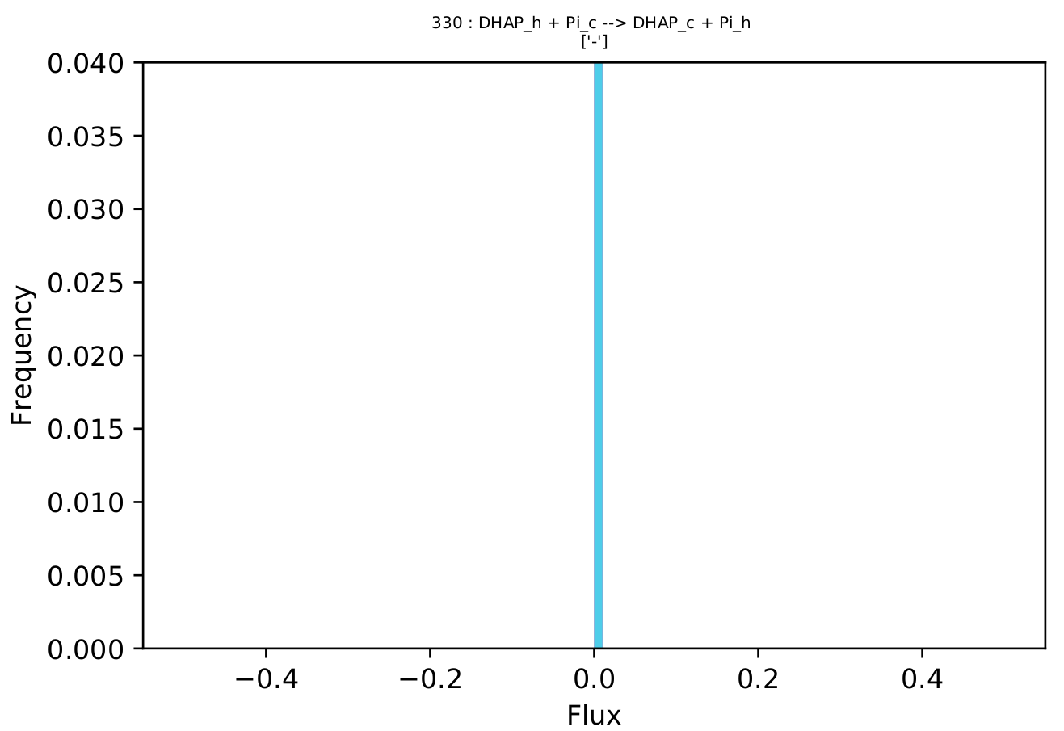
​tpt1
RuBP
Pyr
CO₂
PGA
PGA
2PGA
PEP
OAA
P_{i}
CO₂
P_{i}
ATP
ATP
NADPH
P_{i}
P_{i}
DPGA
DPGA
Mal
NADPH
NADH
P_{i}
GAP
GAP
Fum
P_{i}
DHAP
P_{i}
DHAP

