Slide 1

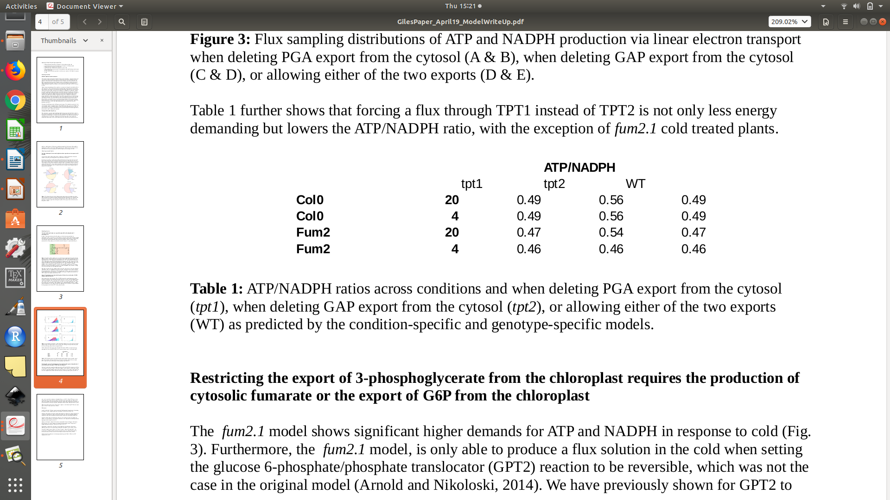


tpt1
tpt2
WT
This is non-loopless sampling

Slide 2
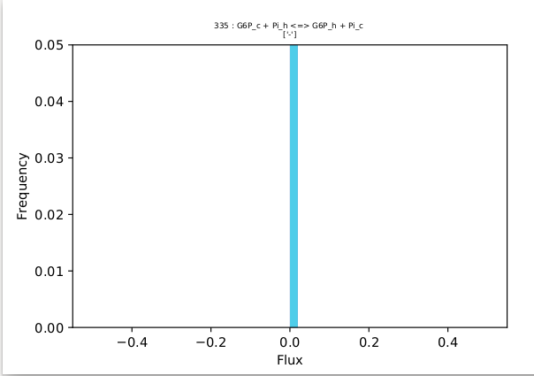
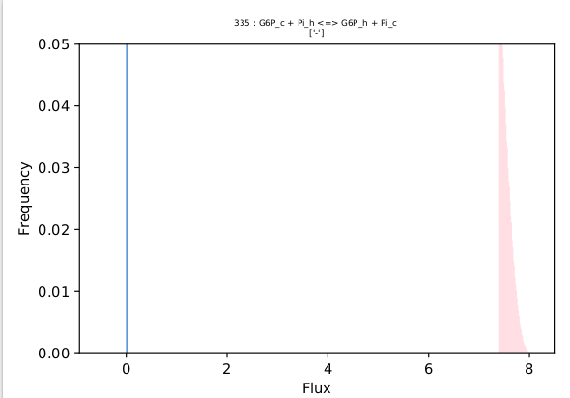
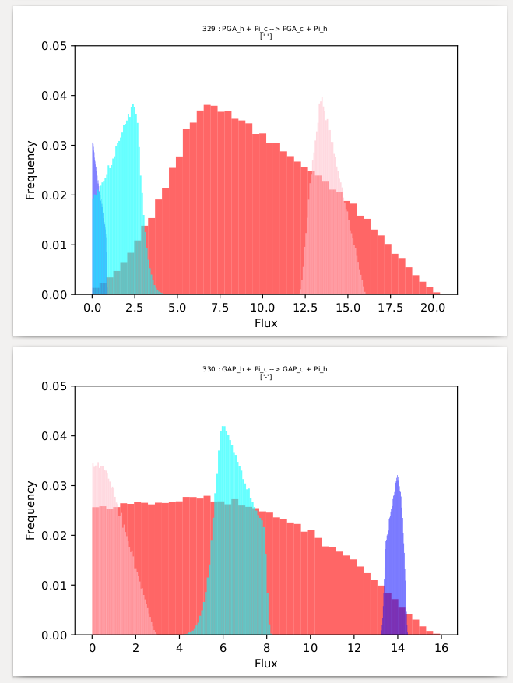
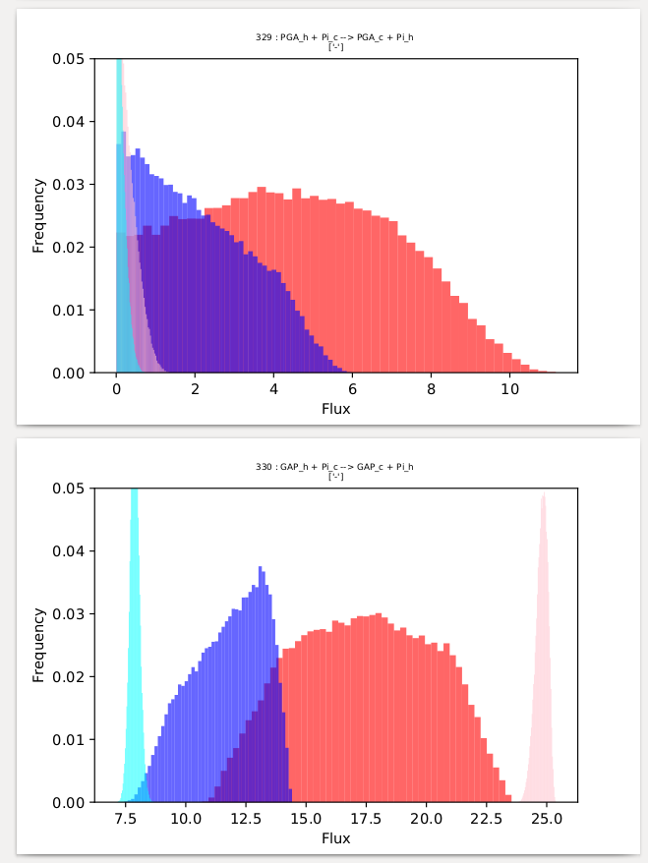
ATP/NADPH = 100/166 = 0.60
ATP/NADPH = 100/213 = 0.47
This is loopless sampling

