Slide 1
Attacks on TCP

Slide 2
Outline
What is TCP protocol?
How the TCP Protocol Works
SYN Flooding Attack
TCP Reset Attack
TCP Session Hijacking Attack

Slide 3
TCP Protocol
Transmission Control Protocol (TCP) is a core protocol of the Internet protocol suite.
Sits on the top of the IP layer; transport layer.
Provide host-to-host communication services for applications.
Two transport Layer protocols
TCP: provides a reliable and ordered communication channel between applications.
UDP: lightweight protocol with lower overhead and can be used for applications that do not require reliability or communication order.

Slide 4
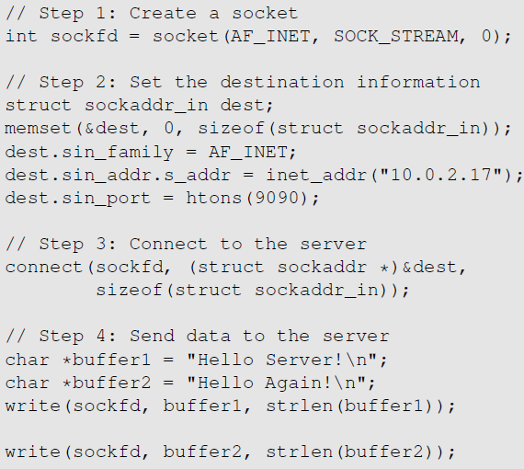
TCP Client Program
Create a socket; specify the type of communication. TCP uses SOCK_STREAM and UDP uses SOCK_DGRAM.
Initiate the TCP connection
Send data

Slide 5
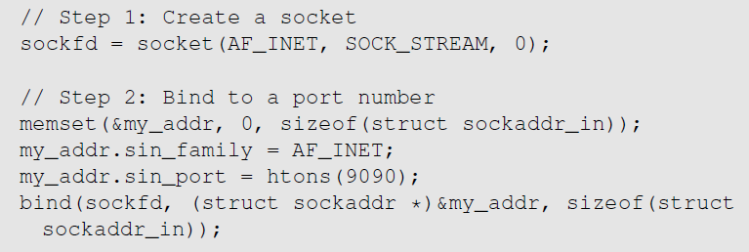
TCP Server Program
Step 1 : Create a socket. Same as Client Program.
Step 2 : Bind to a port number. An application that communicates with others over the network needs to register a port number on its host computer. When the packet arrives, the operating system knows which application is the receiver based on the port number. The server needs to tell the OS which port it is using. This is done via the bind() system call
Notes:
Client programs also need to register a port number. They can use bind() , but it is not necessary as the clients need to reach out to others to know what port the servers are using. Clients can leave the decision to the operating system. So, when they initiate a connection using connect(), operating systems will randomly assign a random port numbre to them.

Slide 6

TCP Server Program
Step 3 : Listen for connections.
After the socket is set up, TCP programs call listen() to wait for connections.
It tells the system that it is ready to receive connection requests.
Once a connection request is received, the operating system will go through the 3-way handshake to establish the connection.
The established connection is placed in the queue, waiting for the application to take it. The second argument gives the number of connection that can be stored in the queue.

Slide 7
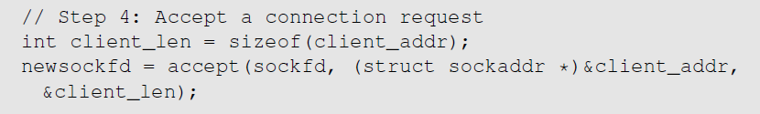
TCP Server Program
Step 4 : Accept a connection request
After the connection is established, an application needs to “accept” the connection before being able to access it. The accept() system call extracts the first connection request from the queue, creates a new socket, and returns the file descriptor referring to the socket.
Step 5 : Send and Receive data
Once a connection is established and accepted, both sides can send and receive data using this new socket.

Slide 8
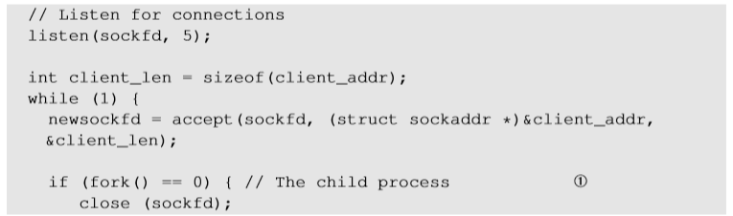
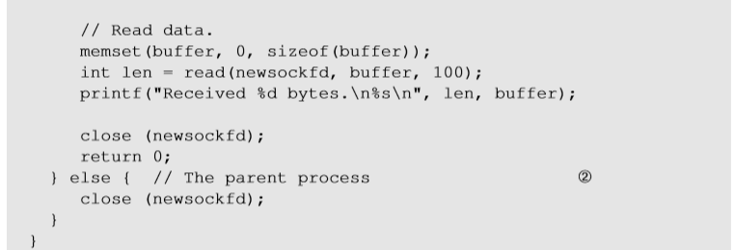
TCP Server Program
To accept multiple connections :
fork() system call creates a new process by duplicating the calling process.
On success, the process ID of the child process is returned in the parent process and 0 in the child process.
Line ① and Line ② executes child and parent process respectively.

Slide 9
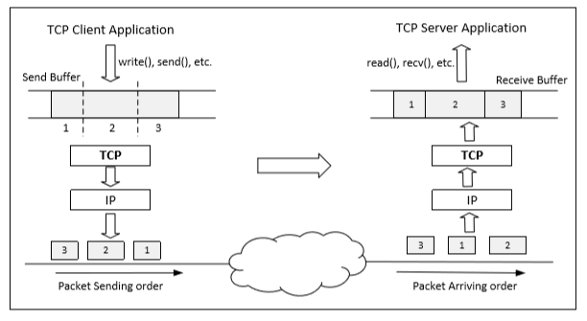
Data Transmission
Once a connection is established, OS allocates two buffers at each end, one for sending data (send buffer) and receiving buffer ( receive buffer).
When an application needs to send data out, it places data into the TCP send buffer.

Slide 10
Data Transmission
Each octet in the send buffer has a sequence number field in the header which indicates the sequence of the packets. At the receiver end, these sequence numbers are used to place data in the right position inside receive buffer.
Once data is placed in the receive buffer, they are merged into a single data stream.
Applications read from the receive buffer. If no data is available, it typically gets blocked. It gets unblocked when there is enough data to read.
The receiver informs the sender about receiving of data using acknowledgement packets

Slide 11
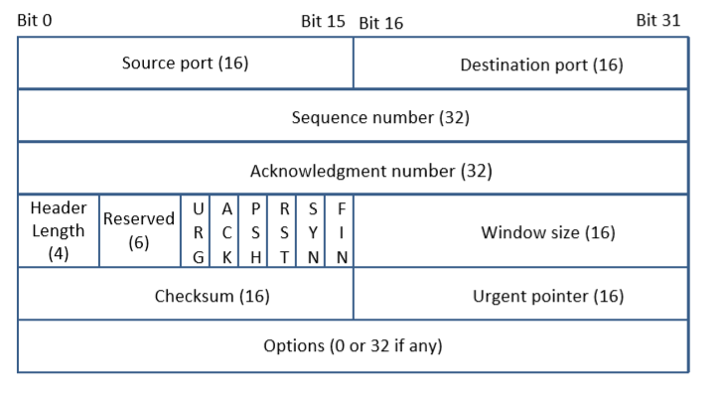
TCP Header
TCP Segment: TCP Header + Data.
Source and Destination port (16 bits each): Specify port numbers of the sender and the receiver.
Sequence number (32 bits) : Specifies the sequence number of the first octet in the TCP segment. If SYN bit is set, it is the initial sequence number.
Acknowledgement number (32 bits): Contains the value of the next sequence number expected by the sender of this segment. Valid only if ACK bit is set.

Slide 12
TCP Header
Header length (4 bits): Length of TCP header is measured by the number of 32-bit words in the header, so we multiply by 4 to get number of octets in the header.
Reserved (6 bits): This field is not used.
Code bits (6 bits): There are six code bits, including SYN,FIN,ACK,RST,PSH and URG.
Window (16 bits): Window advertisement to specify the number of octets that the sender of this TCP segment is willing to accept. The purpose of this field is for flow control.
Notes:
Flow Control : If one end of the connection sends data too fast, it may overwhelm the receive buffer of the other end and cause data being dropped.By putting a smaller window value, the receiver can tell the sender to slow down.

Slide 13
TCP Header
Checksum (16 bits): The checksum is calculated using part of IP header, TCP header and TCP data.
Urgent Pointer (16 bits): If the URG code bit is set, the first part of the data contains urgent data (do not consume sequence numbers). The urgent pointer specifies where the urgent data ends and the normal TCP data starts. Urgent data is for priority purposes as they do not wait in line in the receive buffer, and will be delivered to the applications immediately.
Options (0-320 bits, divisible by 32): TCP segments can carry a variable length of options which provide a way to deal with the limitations of the original header.

Slide 14
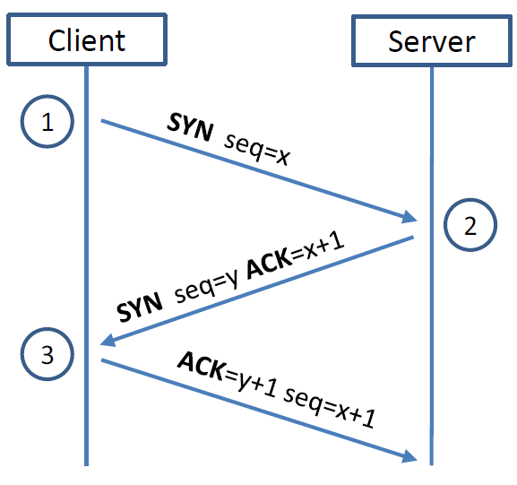
TCP 3-way Handshake Protocol
SYN Packet:
The client sends a special packet called SYN packet to the server using a randomly generated number x as its sequence number.
SYN-ACK Packet:
On receiving it, the server sends a reply packet using its own randomly generated number y as its sequence number.
ACK Packet
Client sends out ACK packet to conclude the handshake

Slide 15
TCP 3-way Handshake Protocol
When the server receives the initial SYN packet, it uses TCB (Transmission Control Block) to store the information about the connection.
This is called half-open connection as only client-server connection is confirmed.
The server stores the TCB in a queue that is only for the half-open connection.
After the server gets ACK packet, it will take this TCB out of the queue and store in a different place.
If ACK doesn’t arrive, the server will resend SYN+ACK packet. The TCB will eventually be discarded after a certain time period.

Slide 16
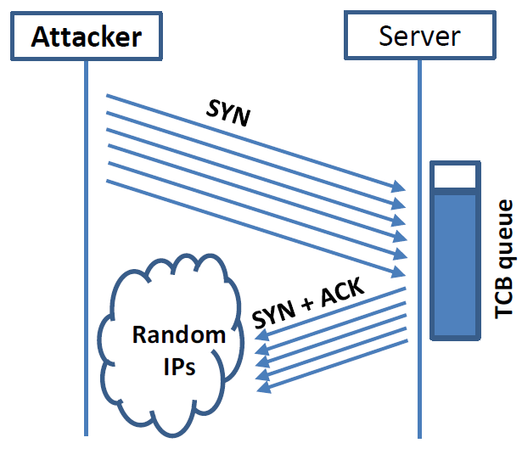
SYN Flooding Attack
Idea : To fill the queue storing the half-open connections so that there will be no space to store TCB for any new half-open connection, basically the server cannot accept any new SYN packets.
Steps to achieve this : Continuously send a lot of SYN packets to the server. This consumes the space in the queue by inserting the TCB record.
Do not finish the 3rd step of handshake as it will dequeue the TCB record.

Slide 17
SYN Flooding Attack
When flooding the server with SYN packets, we need to use random source IP addresses; otherwise the attacks may be blocked by the firewalls.
The SYN+ACK packets sent by the server may be dropped because forged IP address may not be assigned to any machine. If it does reach an existing machine, a RST packet will be sent out, and the TCB will be dequeued.
As the second option is less likely to happen, TCB records will mostly stay in the queue. This causes SYN Flooding Attack.

Slide 18
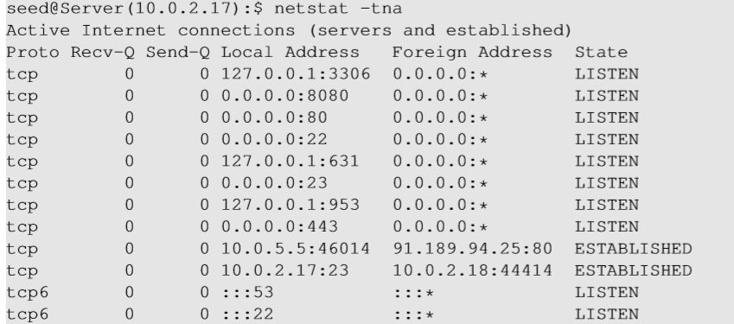
Launching SYN Flooding Attack – Before Attacking
Check the TCP states
TCP States
LISTEN: waiting for TCP connection.
ESTABLISHED: completed 3-way handshake
SYN_RECV: half-open connections

Slide 19
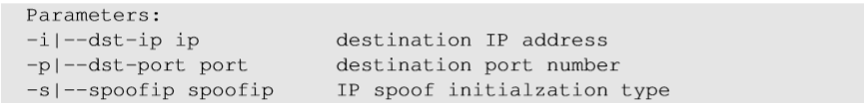
SYN Flooding Attack – Launch the Attack
Turn off the SYN Cookie countermeasure:
$sudo sysctl -w net.ipv4.tcp_syncookies=0
Targeting telnet server
Launch the attack using netwox
Result

Slide 20
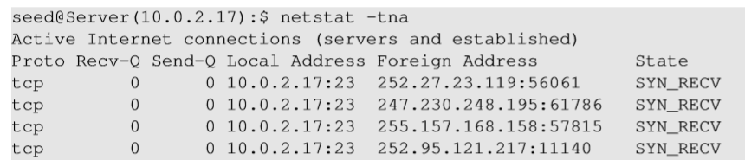
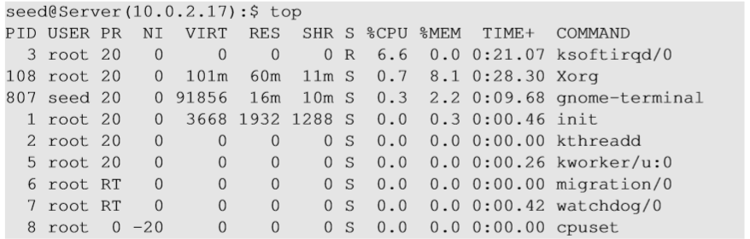
SYN Flooding Attack - Results
Using netstat command, we can see that there are a large number of half-open connections on port 23 with random source IPs.
Using top command, we can see that CPU usage is not high on the server machine. The server is alive and can perform other functions normally, but cannot accept telnet connections only.

Slide 21
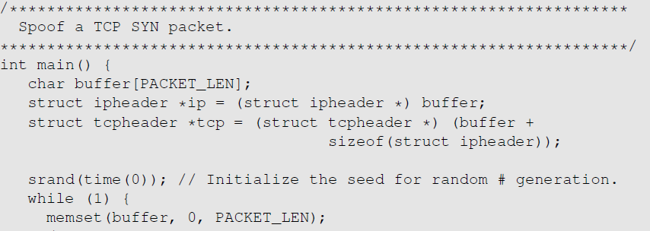
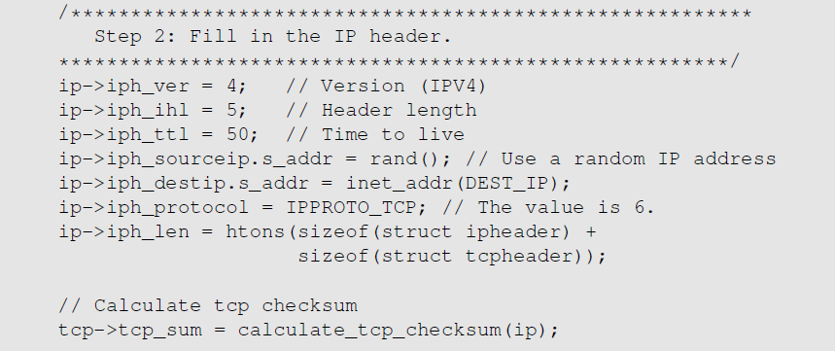
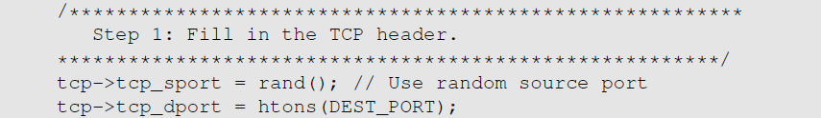

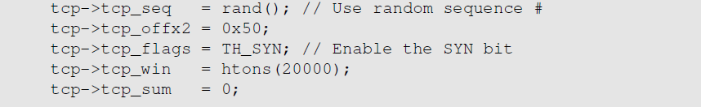
SYN Flooding Attack - Launch with Spoofing Code
We can write our own code to spoof IP SYN packets.

Slide 22
Countermeasures: SYN Cookies
After a server receives a SYN packet, it calculates a keyed hash (H) from the information in the packet using a secret key that is only known to the server.
This hash (H) is sent to the client as the initial sequence number from the server. H is called SYN cookie.
The server will not store the half-open connection in its queue.
If the client is an attacker, H will not reach the attacker.
If the client is not an attacker, it sends H+1 in the acknowledgement field.
The server checks if the number in the acknowledgement field is valid or not by recalculating the cookie.

Slide 23
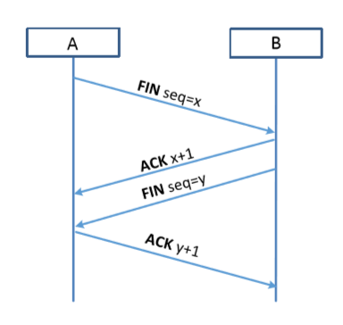
TCP Reset Attack
To disconnect a TCP connection :
A sends out a “FIN” packet to B.
B replies with an “ACK” packet. This closes the A-to-B communication.
Now, B sends a “FIN” packet to A and A replies with “ACK”.
Using Reset flag :
One of the parties sends RST packet to immediately break the connection.
Notes:
There is one more way to disconnec

Slide 24
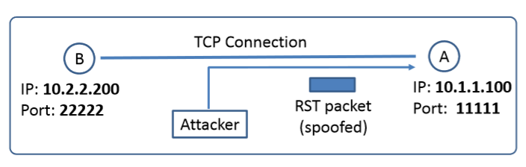
TCP Reset Attack
Goal: To break up a TCP connection between A and B.
Spoofed RST Packet: The following fields need to be set correctly:
Source IP address, Source Port,
Destination IP address, Destination Port
Sequence number (within the receiver’s window)

Slide 25
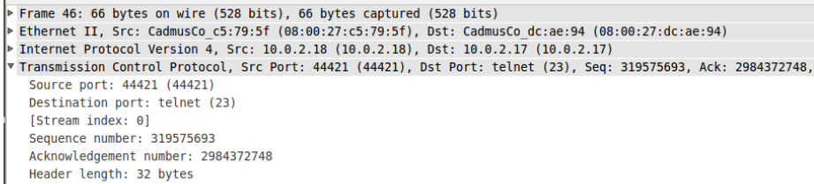
TCP Reset Attack on Telnet Connection
Goal: To break the Telnet connection between User and Server
Setup: User (10.0.2.18) and Server (10.0.2.17)
Steps :
Use Wireshark on attacker machine, to sniff the traffic
Retrieve the destination port (23), Source port number (44421) and sequence number.
Notes:
Uncheck the relative sequence number in the protocol preference option in Wireshark

Slide 26
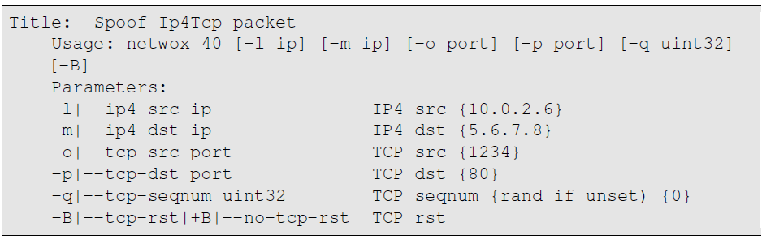
TCP Reset Attack on Telnet Connection
Using netwox tool 40, we can generate a spoofed RST packet to the client or server. If the attack is successful, the other end will see a message “Connection closed by foreign host” indicating that the connection is broken.

Slide 27
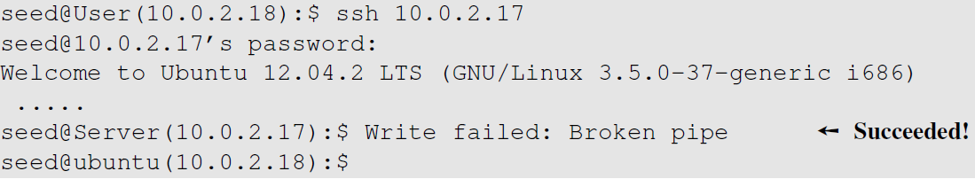
TCP Reset Attack on SSH connections
If the encryption is done at the network layer, the entire TCP packet including the header is encrypted, which makes sniffing or spoofing impossible.
But as SSH conducts encryption at Transport layer, the TCP header remains unencrypted. Hence the attack is successful as only header is required for RST packet.

Slide 28
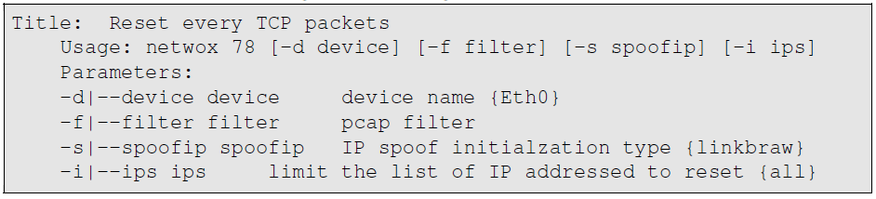
TCP Reset Attack on Video-Streaming Connections
This attack is similar to previous attacks only with the difference in the sequence numbers as in this case, the sequence numbers increase very fast unlike in Telnet attack as we are not typing anything in the terminal.
To achieve this, we use Netwox 78 tool to reset each packet that comes from the user machine (10.0.2.18). If the user is watching a Youtube video, any request from the user machine will be responded with a RST packet.

Slide 29
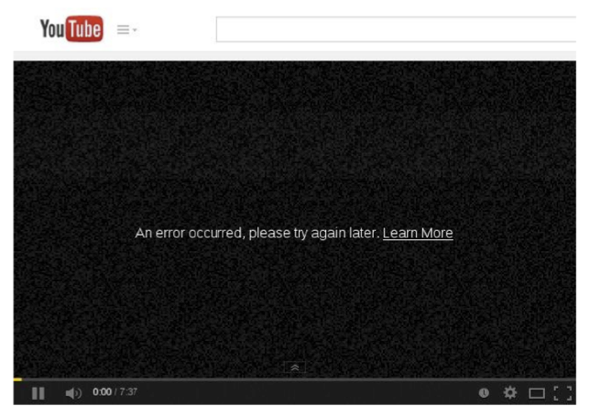
TCP Reset Attack on Video-Streaming Connections
Note: If RST packets are sent continuously to a server, the behavior is suspicious and may trigger some punitive actions taken against the user.

Slide 30
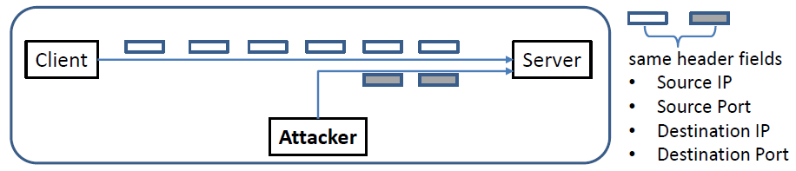
TCP Session Hijacking Attack
Goal: To inject data in an established connection.
Spoofed TCP Packet: The following fields need to be set correctly:
Source IP address, Source Port,
Destination IP address, Destination Port
Sequence number (within the receiver’s window)

Slide 31
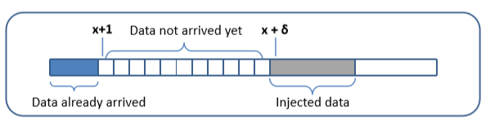
TCP Session Hijacking Attack: Sequence Number
If the receiver has already received some data up to the sequence number x, the next sequence number is x+1. If the spoofed packet uses sequence number as x+𝛿, it becomes out of order.
The data in this packet will be stored in the receiver’s buffer at position x+𝛿, leaving 𝛿 spaces (having no effect). If 𝛿 is large, it may fall out of the boundary.

Slide 32
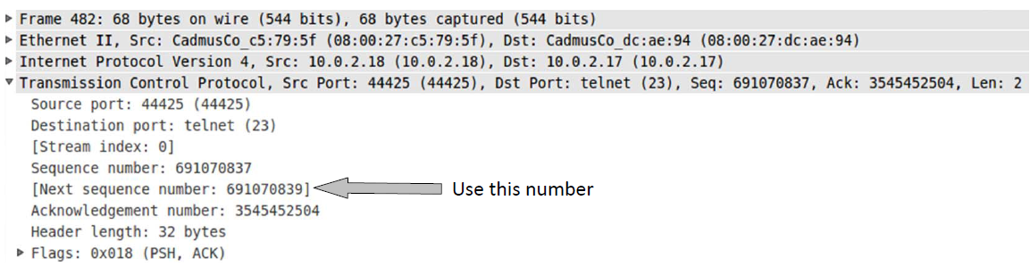
Hijacking a Telnet Connection
Set up: User : 10.0.2.18, Server : 10.0.2.17, Attacker : 10.0.2.16
Steps:
User establishes a telnet connection with the server.
Use Wireshark on attacker machine to sniff the traffic
Retrieve the destination port (23), source port number (44425) and sequence number.
Notes:
There are two sequence numbers : Sequence number and Next Sequence number. The next sequence number is the first sequence number plus the length of the data.If it is an acknowledgement packet, length of data is 0. In this case, the sequence number of the spoofed packet will be 691070839.

Slide 33
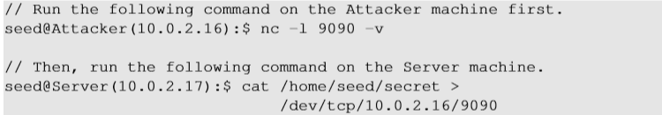
What Command Do We Want to Run
By hijacking a Telnet connection, we can run an arbitrary command on the server, but what command do we want to run?
Consider there is a top-secret file in the user’s account on Server called “secret”. If the attacker uses “cat” command, the results will be displayed on server’s machine, not on the attacker’s machine.
In order to get the secret, we run a TCP server program so that we can send the secret from the server machine to attacker’s machine.

Slide 34
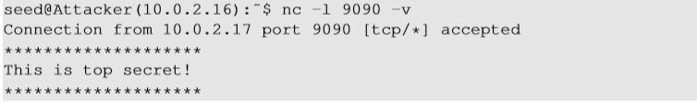
Session Hijacking: Steal a Secret
“cat” command prints out the content of the secret file, but instead of printing it out locally, it redirects the output to a file called /dev/tcp/10.0.2.16/9090 (virtual file in /dev folder which contains device files). This invokes a pseudo device which creates a connection with the TCP server listening on port 9090 of 10.0.2.16 and sends data via the connection.
The listening server on the attacker machine will get the content of the file.

Slide 35
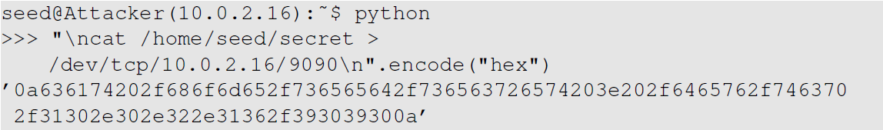
Launch the TCP Session Hijacking Attack
Convert the command string into hex
Netwox tool 40 allows us to set each single field of a TCP packet.

Slide 36
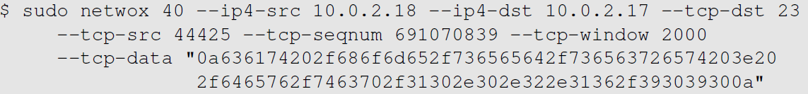
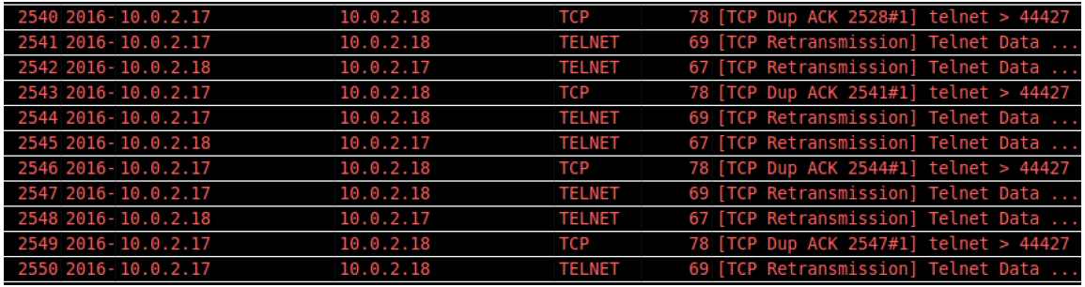
Launch the TCP Session Hijacking Attack
Notes:
0a -> new line.
We use large sequence number so that the attacker gets the secret file after we type some commands on the telnet terminal.As soon as we reach the sequence number, our nc program will immediately print out the secret received indicating the success of the attack.

Slide 37
Creating Reverse shell
The best command to run after having hijacked the connection is to run a reverse shell command.
To run shell program such as /bin/bash on Server and use input/output devices that can be controlled by the attackers.
The shell program uses one end of the TCP connection for its input/output and the other end of the connection is controlled by the attacker machine.
Reverse shell is a shell process running on a remote machine connecting back to the attacker.
It is a very common technique used in hacking.

Slide 38
Create Reverse Shell using Session Hijacking
We have shown how to manually run reverse shell
We leave it to students to figure out how to hijack a Telnet session and then run the reverse shell on the server

Slide 39
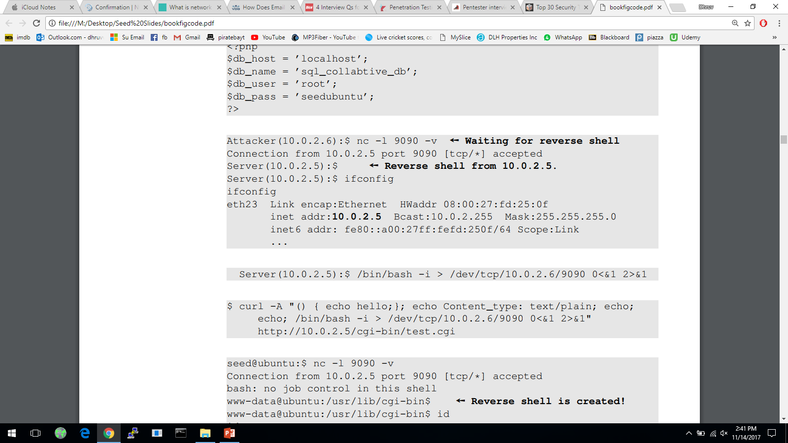
Creating Reverse Shell
1
The option i stands for interactive, meaning that the shell should be interactive.
This causes the output device (stdout) of the shell to be redirected to the TCP connection to 10.0.2.6’s port 9090.
File descriptor 0 represents the standard input device (stdin) and 1 represents the standard output device (stdout). This command tell the system to use the stdout device as the stdin device. Since the stdout is already redirected to the TCP connection, this option basically indicates that the shell program will get its input from the same TCP connection.
File descriptor 2 represents the standard error (stderr). This cases the error output to be redirected to stdout, which is the TCP connection.
Notes:
In summary, the command starts a bash shell on the server machine whose input comes from a TCP connection and the output goes back to the same TCP connection

Slide 40
Defending Against Session Hijacking
Making it difficult for attackers to spoof packets
Randomize source port number
Randomize initial sequence number
Not effective against local attacks
Encrypting payload

Slide 41
Summary
How TCP works
TCP client and server programming
TCP SYN flooding attack
TCP Reset attack
TCP Session Hijacking attack

