Slide 1

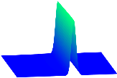

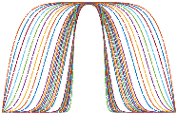

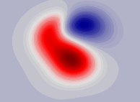
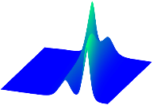
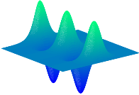
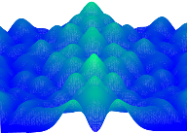















































Canonical PDEs
Dynamics
Data
Results discovered by $S^{3}$d
MSE-STD
FitzHugh-Nagumo
$$U^{512 ×401}:10000$$
$$10000$$
$$u_{t}={1.0023u}_{xx}−1.9910u+{1.2004u}^{2}$$
$$−{1.0031u}^{3}−1.0050w$$
$$w_{t}=0.001999u−0.000993w$$
0.2649%$±$0.2462%
$$u_{t}=u_{xx}−u+u^{2}−u^{3}−w$$
$$w_{t}=0.002u−0.001w$$
$$18000$$
$$27000$$
$$u_{t}={1.0025u}_{xx}−1.9810u+{1.1762u}^{2}$$
$$−{0.9499u}^{3}−0.9920w$$
$$w_{t}=0.001952u−0.001004w$$
1.6795%$±1.669$0%
Klein-Gordon
$$U^{101 ×1001}:1000$$
$$15500$$
$$u_{tt}={0.9994u}_{xx}−0.9995u−0.9998u^{3}$$
0.0426%$±$0.0220%
$$u_{tt}=u_{xx}−u−u^{3}$$
$$u_{tt}={0.9987u}_{xx}−0.9833u−{1.0303u}^{3}$$
1.6100%$±1.4513$%
Fisher’s equation
$$U^{201 ×1000}:10000$$
$$10000$$
$$u_{t}={0.0997u}_{xx}+0.9998u−1.0002u^{2}$$
0.0960%$±$0.1342%
$$u_{t}={0.1u}_{xx}+u−u^{2}$$
$$u_{t}={0.0971u}_{xx}+1.0053u−1.0079u^{2}$$
1.4104%$±1.3007$%
Kuramoto Sivashinsky
$$U^{2048×1001}:14203$$
$$59210$$
$$u_{t}={−1.0000u}_{xx}−1.0000uu_{x}−{1.0000u}_{xxxx}$$
0.0022%$±$0.0010%
$$u_{t}={−u}_{xx}−uu_{x}−u_{xxxx}$$
$$u_{t}={−0.9214u}_{xx}−0.9095uu_{x}−{0.9238u}_{xxxx}$$
8.1781 %$±$0.7678%
Navier Stokes
$$U^{100 ×100×1001}:10000$$
$$20000$$
$$w_{t}=0.01{00w}_{xx}+0.0100w_{yy}−{1.0068uw}_{x}$$
$$−0.9987{vw}_{y}$$
0.3700%$±$0.2305%
$$w_{t}={0.01w}_{xx}+0.01w_{yy}$$
$$−{uw}_{x}−{vw}_{y}$$
$$w_{t}={0.0100w}_{xx}+{0.0097w}_{yy}−{1.0051uw}_{x}$$
$$−{1.0012vw}_{y}$$
0.9447%$±$1.3498%
Korteweg-de Vries
$$U^{256 ×1301}:10000$$
$$18750$$
$$u_{t}={−0.000484uu}_{xx}−0.999247u_{xxx}$$
0.0855%$±$0.0145%
$$u_{t}={−0.000484uu}_{xx}+u_{xxx}$$
$$u_{t}={−0.000483uu}_{xx}−{0.982950u}_{xxx}$$
0.9982%$±$0.9995%
Sine-Gordon equation
$$U^{512 ×256}:10$$
50
$$u_{tt}={0.9999u}_{xx}−0.9987sin⁡(u)$$
0.0706%$±$0.0895%
$$u_{tt}=u_{xx}−sin⁡(u)$$
$$u_{tt}=0.9920u_{xx}−0.9982sin⁡(u)$$
0.4874%$±$0.4407%
Schrödinger equation
$$U^{512 ×501}:10000$$
$$10000$$
$$u_{t}=−3.3333iu+3.3333i{\left|u\right|}^{2}u+0.3000iu_{xx}$$
0.0011%$±$0.0007%
$$u_{t}=\frac{10}{3}iu−\frac{10}{3}i{\left|u\right|}^{2}u$$
$$−0.3iu_{xx}$$
$$u_{t}=−3.3187iu+3.2947i{\left|u\right|}^{2}u+0.3013iu_{xx}$$
0.6775%$±$0.4162%

