Slide 1
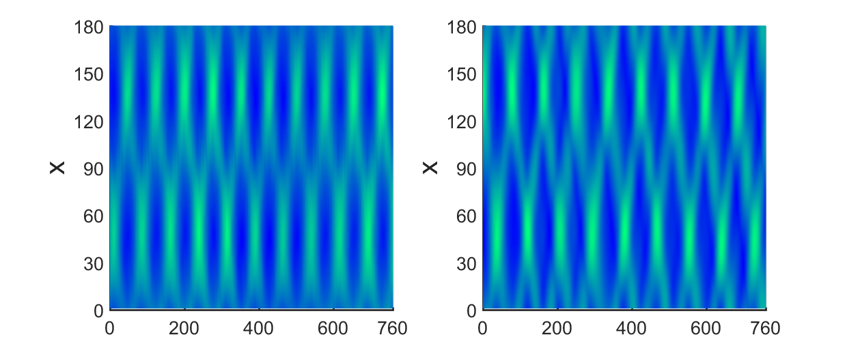
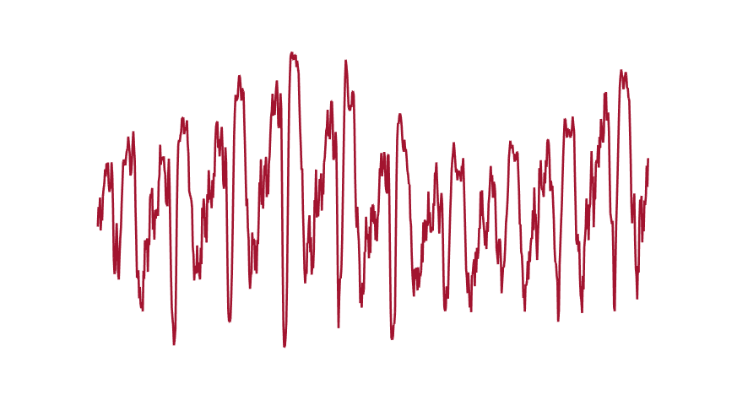































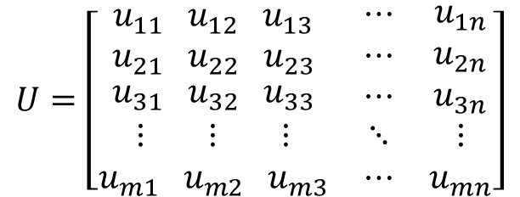

















A
B
Model specification
$$A_{t}(t_{i},x_{j})$$
$$1$$
A$(t_{i},x_{j})$
$$A^{2} (t_{i},x_{j})$$
$$|A|(t_{i},x_{j})$$
$${|A|}^{2}(t_{i},x_{j})$$
$$A_{x}(t_{i},x_{j})$$
$$A_{xx}(t_{i},x_{j})$$
$$A^{3}A_{x}(t_{i},x_{j})$$
$$A^{3}A_{xx}(t_{i},x_{j})$$
B-1
Subsample
Time + space
$$=$$
$$⋯$$
$$Y=Φω$$
$$↓$$
$$CY=CΦω$$
$$=$$
$$⋯$$
$$Φ$$
$$Σ_{r}$$
$$=$$
$$Ψ$$
$$Σ$$
$$Θ^{T}$$
$$Y$$
$$Φ$$
$$ω$$
$$Y=Φω→Ψ^{T}Y=Ψ^{T}Φω$$
B-2
Dimens. reduction
C
Sparse identification
B-1
B-2
$$ω=$$
$$⋯$$
Snapshot matrix
$$Y=Φω$$
optimizing $ω$
$$U=\left[\begin{matrix}\begin{aligned}\begin{aligned}u_{11} u_{12} u_{13} \\ u_{21} u_{22} u_{23}\end{aligned} \\ u_{31} u_{32} u_{33}\end{aligned} & \begin{aligned}⋯ \\ ⋯ \\ ⋯\end{aligned} & \begin{aligned}u_{1n} \\ u_{2n} \\ u_{3n}\end{aligned} \\ ⋮ ⋮ ⋮ & ⋱ & ⋮ \\ u_{m1} u_{m2} u_{m3} & ⋯ & u_{mn}\end{matrix}\right]$$
$$\underset{ω}{arg min}{{∥Y−Φω∥}_{2}^{2}}+λ{∥ω∥}_{1}$$
$$ω_{2}$$
$$ω_{6}$$
$$ω_{8}$$
$$ω_{7}$$
$$ω_{18}$$
$$(0.0054−0.0066i)A(x,t)$$
$$A$$
$$A_{x}$$
$$A{|A|}^{2}$$
$$A_{xx}$$
$${|A}_{R}|^{2}A$$
D
Model Validation
$$A_{t}(x,t)$$
$${(0.5930)A}_{x}(x,t)$$
Experiment
Reconstruction
$$=$$
$$(−2.523−152.7833i)|A_{R}|^{2}A(x,t)$$
$$+$$
Derivative $A_{t}$ from $U$
$${(0.0148−0.6457i)A}_{xx}(x,t)$$
$${(−139.4494−37.6346i)|A|}^{2}A (x,t)$$
$$+$$
VS.
$$+$$
CGLE
$$+$$

