Slide 1

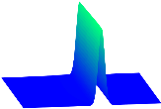

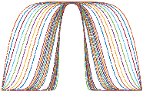

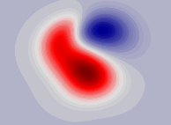
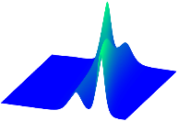
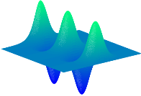
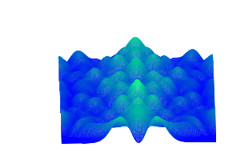
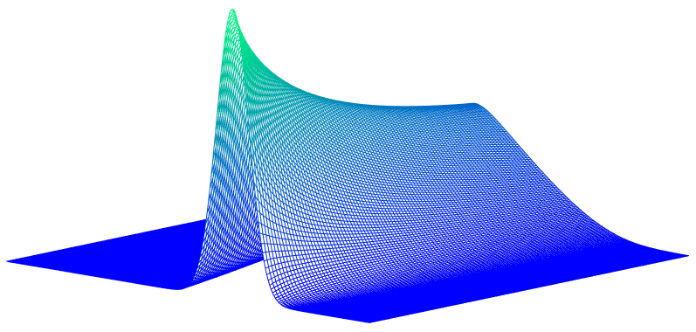
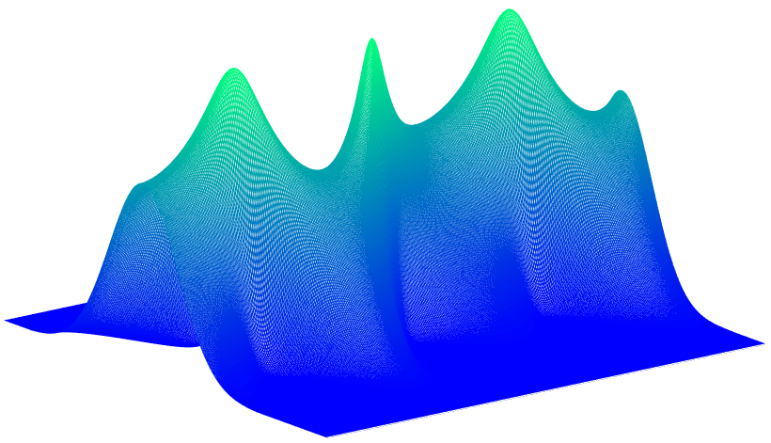


























































Canonical PDEs
Dynamics
Data
Results discovered by $S^{3}$d
MSE-STD
FitzHugh-Nagumo
$$U^{512 ×401}:10000$$
$$10000$$
$$u_{t}={1.0023u}_{xx}−0.1991u+{1.2004u}^{2}$$
$$−{1.0031u}^{3}−1.0005w$$
$$w_{t}=0.001999u−0.000993w$$
0.2649%$±$0.2462%
$$u_{t}=u_{xx}−0.2u+{1.2u}^{2}$$
$−u^{3}−w$
$$w_{t}=0.002u−0.001w$$
$$18000$$
$$27000$$
$$u_{t}={1.0025u}_{xx}−0.1981u+{1.1762u}^{2}$$
$$−{0.9499u}^{3}−0.9920w$$
$$w_{t}=0.001952u−0.001004w$$
1.6795%$±1.669$0%
Klein-Gordon
$$U^{101 ×1001}:10000$$
$$15500$$
$$u_{tt}={0.9994u}_{xx}−0.9995u−0.9998u^{3}$$
0.0426%$±$0.0220%
$$u_{tt}=u_{xx}−u−u^{3}$$
$$u_{tt}={0.9987u}_{xx}−0.9833u−{1.0303u}^{3}$$
1.6100%$±1.4513$%
Fisher’s equation
$$U^{201 ×1000}:10000$$
$$10000$$
$$u_{t}={0.0997u}_{xx}+0.9998u−1.0002u^{2}$$
0.0960%$±$0.1342%
$$u_{t}={0.1u}_{xx}+u−u^{2}$$
$$u_{t}={0.0971u}_{xx}+1.0053u−1.0079u^{2}$$
1.4104%$±1.3007$%
Kuramoto-Sivashinsky
$$U^{2048×1001}:14203$$
$$59210$$
$$u_{t}={−1.0000u}_{xx}−1.0000uu_{x}−{1.0000u}_{xxxx}$$
0.0022%$±$0.0010%
$$u_{t}={−u}_{xx}−uu_{x}−u_{xxxx}$$
$$u_{t}={−0.9214u}_{xx}−0.9095uu_{x}−{0.9238u}_{xxxx}$$
8.1781 %$±$0.7678%
Navier-Stokes
$$U^{100 ×100×1001}:10000$$
$$20000$$
$$w_{t}=0.01{00w}_{xx}+0.0100w_{yy}−{1.0068uw}_{x}$$
$$−0.9987{vw}_{y}$$
0.3700%$±$0.2305%
$$w_{t}={0.01w}_{xx}+0.01w_{yy}$$
$$−{uw}_{x}−{vw}_{y}$$
$$w_{t}={0.0100w}_{xx}+{0.0097w}_{yy}−{1.0051uw}_{x}$$
$$−{1.0013vw}_{y}$$
0.9447%$±$1.3498%
Korteweg-de Vries
$$U^{256 ×1301}:10000$$
$$18750$$
$$u_{t}={−0.000484u}_{xxx}−0.999247uu_{x}$$
0.0855%$±$0.0145%
$$u_{t}={−0.000484u}_{xxx}−{uu}_{x}$$
$$u_{t}={−0.000483u}_{xxx}−{0.982950uu}_{x}$$
0.9982%$±$0.9995%
Sine-Gordon equation
$$U^{512 ×256}:10$$
50
$$u_{tt}={0.9999u}_{xx}−0.9987sin⁡(u)$$
0.0706%$±$0.0895%
$$u_{tt}=u_{xx}−sin⁡(u)$$
$$u_{tt}=0.9920u_{xx}−0.9982sin⁡(u)$$
0.4874%$±$0.4407%
Nonlinear Schrödinger
equation
$$U^{512 ×501}:10000$$
$$10000$$
$$u_{t}=−3.3333iu+3.3333i{\left|u\right|}^{2}u+0.3000iu_{xx}$$
0.0011%$±$0.0007%
$$u_{t}=−\frac{10}{3}iu+\frac{10}{3}i{\left|u\right|}^{2}u$$
$$+0.3iu_{xx}$$
$$u_{t}=−3.3187iu+3.2947i{\left|u\right|}^{2}u+0.3013iu_{xx}$$
0.6775%$±$0.4162%
Burgers’ equation
$$U^{256 ×101}:2000$$
$$5000$$
$$u_{t}={0.1000u}_{xx}−0.9999uu_{x}$$
0.0051%$±$0.0054%
$$u_{t}={0.1u}_{xx}−uu_{x}$$
$$u_{t}={0.1001u}_{xx}−1.0010uu_{x}$$
0.0760%$±$0.0366%
Quantum Harmonic
Oscillator
$$U^{512 ×401}:2000$$
$$2000$$
$$u_{t}=0.5001iu_{xx}−0.9999i{\frac{x^{2}}{2}u}$$
0.0117%$±$0.0055%
$$u_{t}=0.5iu_{xx}−i{\frac{x^{2}}{2}u}$$
$$u_{t}=0.4996iu_{xx}−1.0005i{\frac{x^{2}}{2}u}$$
0.0685%$±$0.0273%

