Slide 1
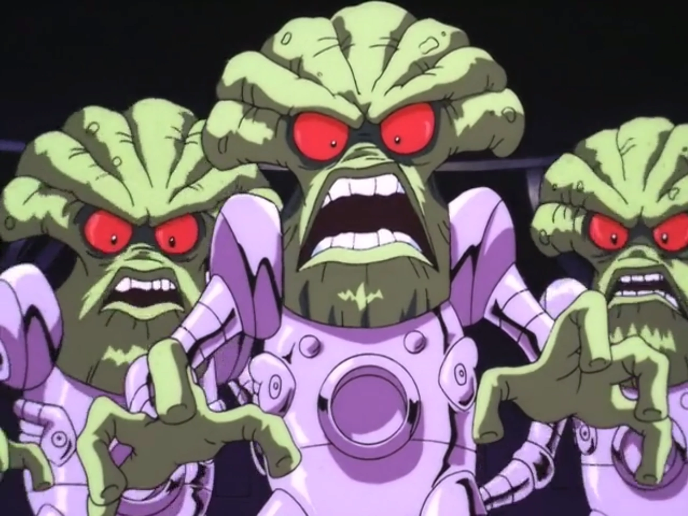
Space Invaders
By: Haider Khan

Slide 2
Vertical Slice Demonstration

Slide 3
Why I chose to develop this project
Made sense with the time given
Perfect to showcase what I have learned about Object Oriented Programming
Fun game!

Slide 4
CTS Modules - Object Oriented Programming 1 & 2
(polymorphism, encapsulation, inheritance)

Slide 5
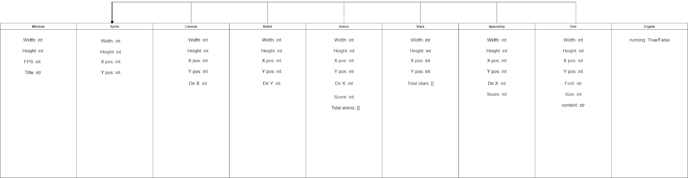
Planning Component - UML Table
Helped a lot when it came to making and organizing my files/classes.
Helped me visualize the order of what I needed to program first

Slide 6
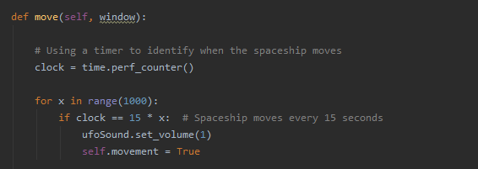
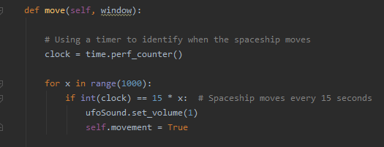
A Challenging Problem
A simple yet frustrating problem!

Slide 7

Some things I would add
Alien bullets
Improve sounds
New mechanics (eg. power ups, types of bullets, boss fight)
New locations/levels

