Slide 1
Evaluate Model Performance
Ordinary Least Squares Estimation, Correlations,
Mean Absolute Error (MAE)
Mean Squared Error (MSE)
R-squared (R²) Score
Root Mean Squared Error (RMSE)

Slide 2
Ordinary Least Squares (OLS)
Ordinary least squares minimizes squared prediction errors.
Regression line explains dependent variable variation clearly.
Estimates coefficients using linear algebraic normal equations.
Assumptions include linearity, independence, homoscedasticity, normality.
Provides best linear unbiased estimators under conditions.
Widely applied in econometrics and statistics.

Slide 3
OLS Mathematics
Equation: y = β₀ + β₁x + ε.
Coefficient formula: β = (XᵀX)⁻¹Xᵀy.
Minimizes sum of squared residuals always.
Produces slope and intercept interpretable statistically.
Explains predictor influence on response variable.
Foundation of linear regression methodologies globally.

Slide 4
OLS Code
Python sklearn library provides LinearRegression model.
Fit model using model.fit(X, y).
Predictions obtained using model.predict(test_data).
Coefficients accessed through model.coef_ attribute.
Intercept retrieved using model.intercept_ property.

Slide 5
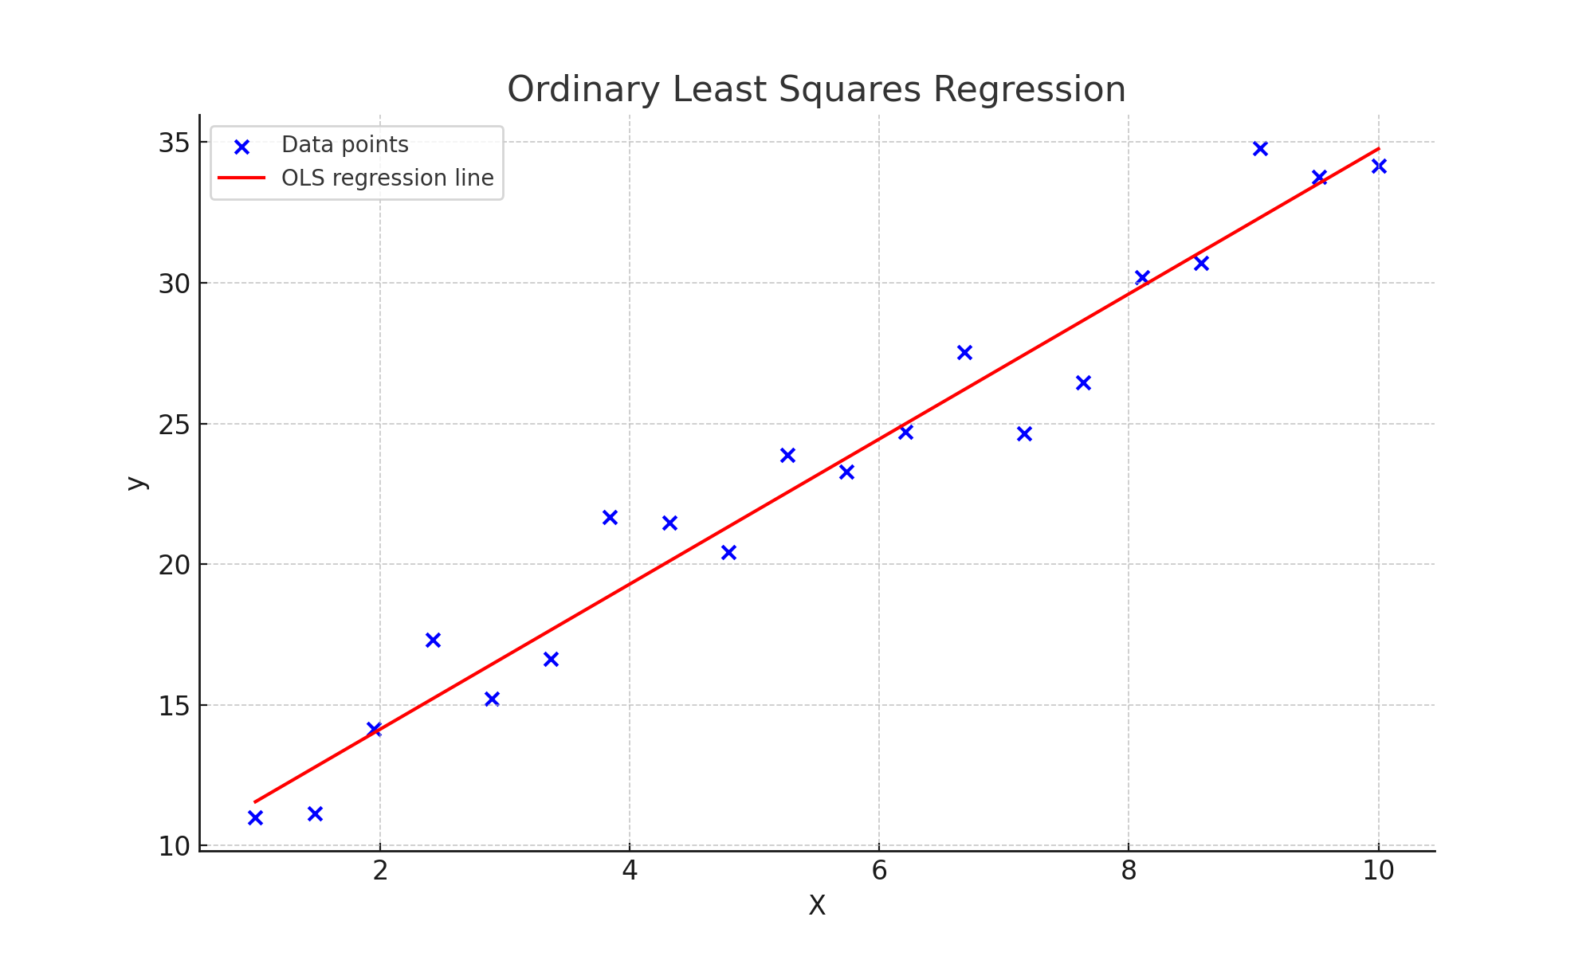
OLS Visualization

Slide 6
Correlation
Correlation measures strength of linear relationships.
Range spans negative one to positive one.
Positive correlation indicates increasing variable trends.
Negative correlation reflects opposite directional movements.
Zero correlation means no linear association.
Key tool in exploratory data analysis.

Slide 7
Correlation Mathematics
Formula: r = cov(X,Y)/(σxσy).
Coefficient values near one indicate strong association.
Negative correlation shows opposite proportional variation.
Scatterplots visually confirm correlation between variables.
Correlation matrices summarize multiple pairwise relationships.
Applied extensively before regression or forecasting tasks.

Slide 8
Correlation Code
Python pandas provides corr() correlation method.
df.corr calculates pairwise variable correlation matrix.
Seaborn heatmap visualizes correlation coefficients visually.
Scatterplots highlight strong positive or negative trends.
Helps detect multicollinearity in regression models.
Enhances data understanding before predictive modeling.

Slide 9
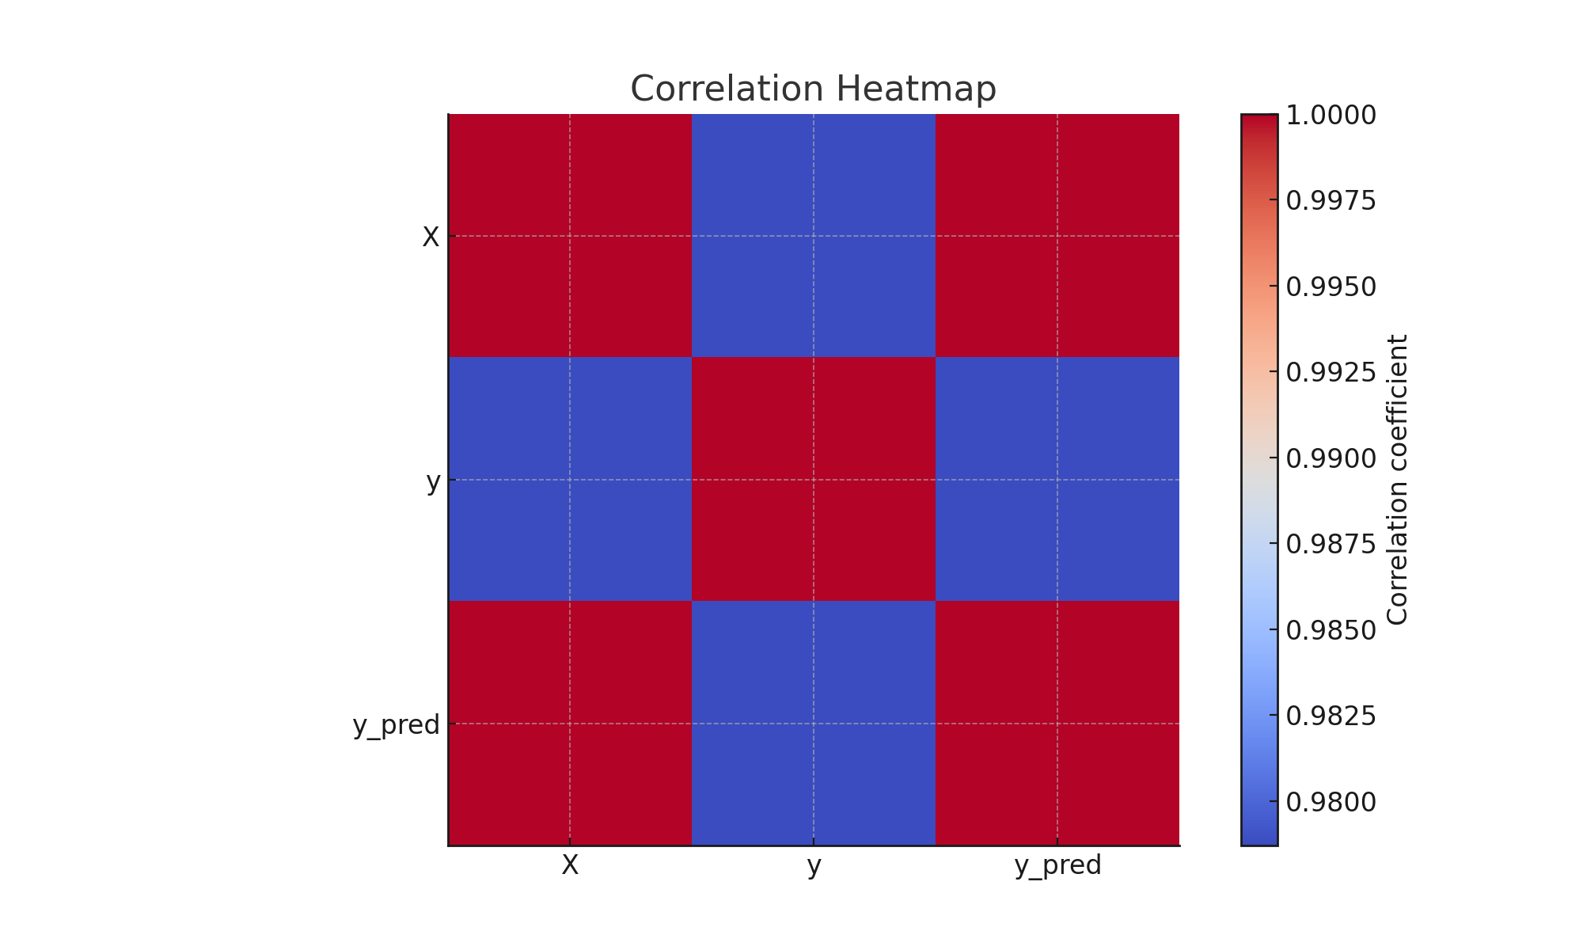
Correlation Visualization

Slide 10
MAE (Mean Absolute Error)
MAE measures mean difference predicted actual.
Expressed in same units as response variable.
Lower values indicate better model accuracy.
Robust to extreme squared error outliers.
Provides interpretable average error magnitude.
Common metric in evaluating regression performance.

Slide 11
MAE Mathematics
Formula: MAE = (Σ|yi - ŷi|)/n.
Summation of absolute residual differences averaged.
Captures magnitude without considering error direction.
Simple measure of model performance accuracy.
Units consistent with dependent variable measurements.
Useful for comparing different regression approaches

Slide 12
MAE Code
Sklearn provides mean_absolute_error(y_true, y_pred).
Returns mean magnitude of prediction errors.
Intuitive metric widely used in practice.
Lower MAE means closer predicted observations.
Complements MSE for robust model analysis.
Valuable during hyperparameter optimization procedures.

Slide 13
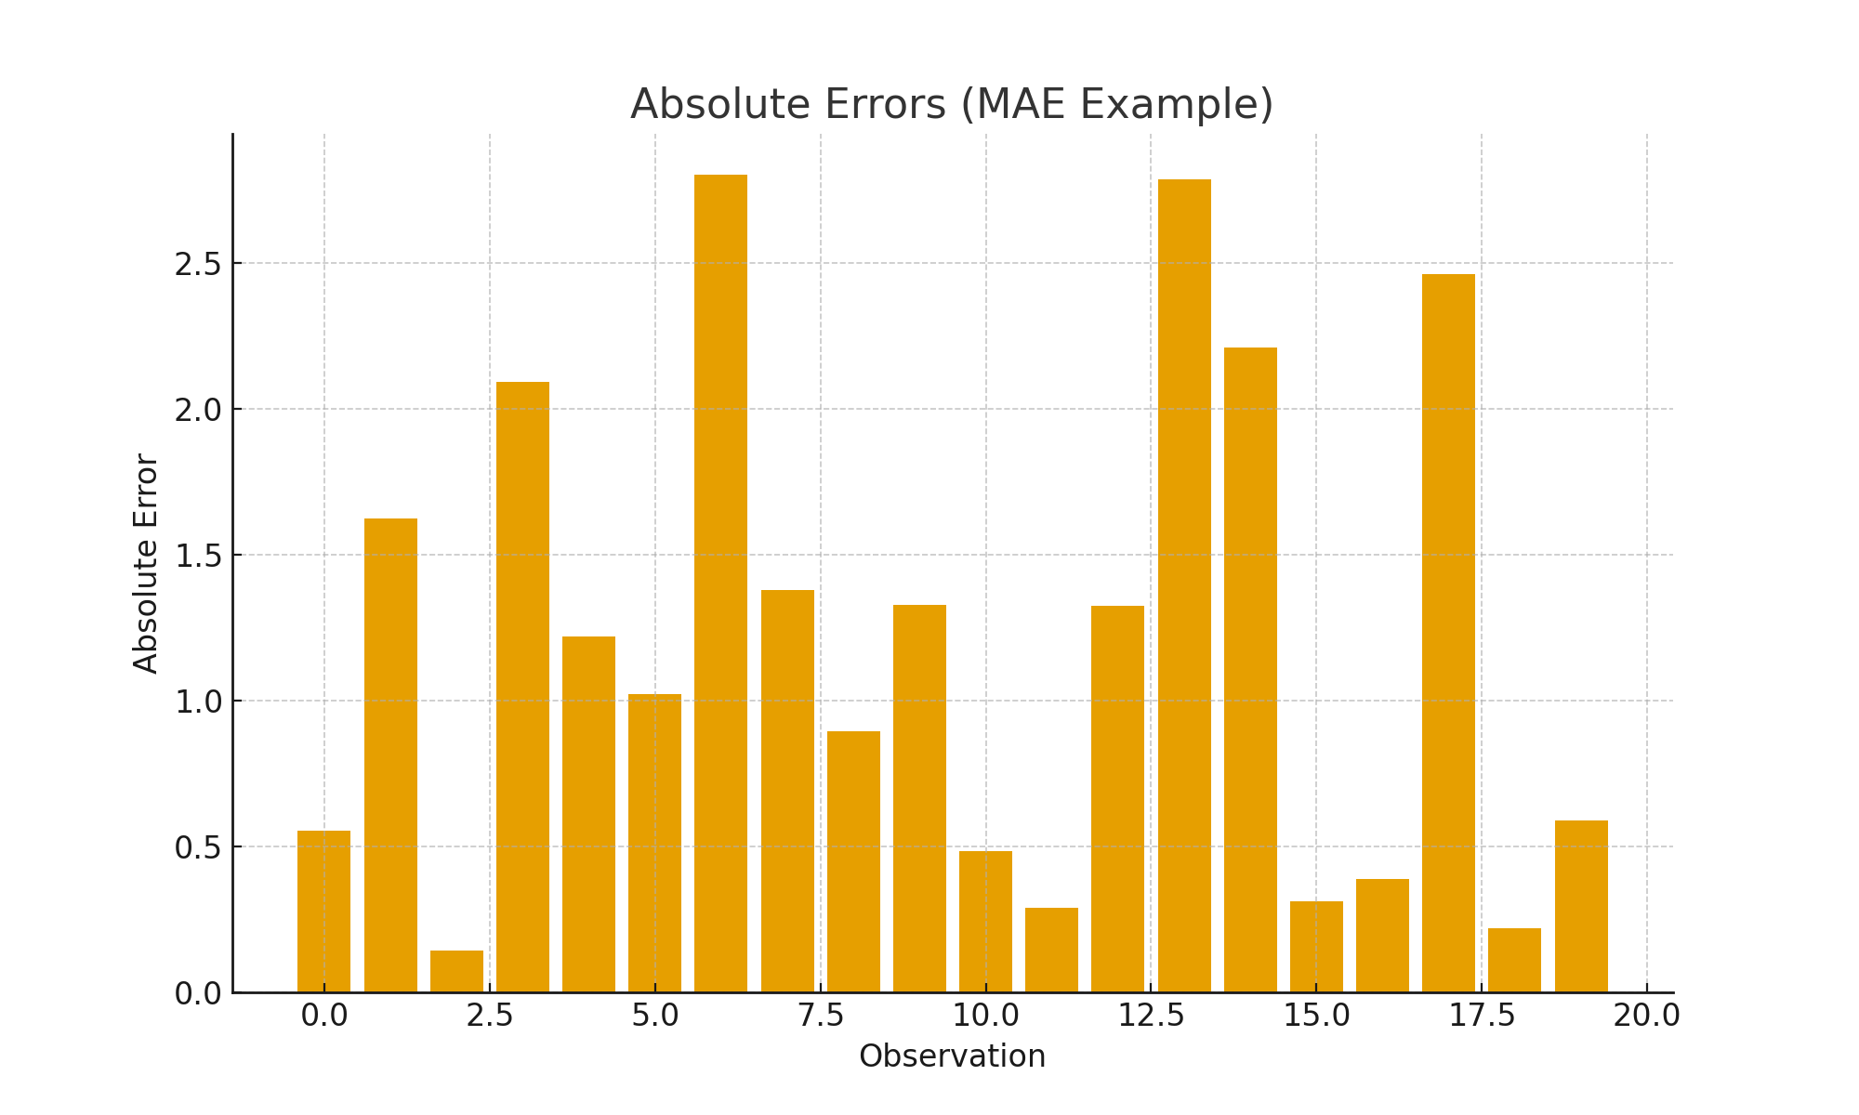
MAE Visualization

Slide 14
Mean Squared Error (MSE)
MSE squares errors before averaging residuals.
Penalizes larger deviations more significantly.
Lower MSE indicates better prediction performance.
Sensitive to dataset outlier values strongly.
Commonly used as optimization objective function.
Central evaluation metric for regression models.

Slide 15
MSE Mathematics
Formula: MSE = Σ(yi - ŷi)² / n.
Represents average squared prediction error magnitude.
Larger deviations receive quadratic penalty weighting.
Derived directly from least squares principle.
Basis for maximum likelihood estimation techniques.
Minimization ensures regression line best fits.

Slide 16
MSE Code
Sklearn mean_squared_error(y_true, y_pred) function.
Returns average squared difference for predictions.
Lower output implies higher model reliability.
Often compared with MAE for robustness.
Useful in supervised learning performance evaluation.
Balances accuracy with sensitivity to outliers.

Slide 17
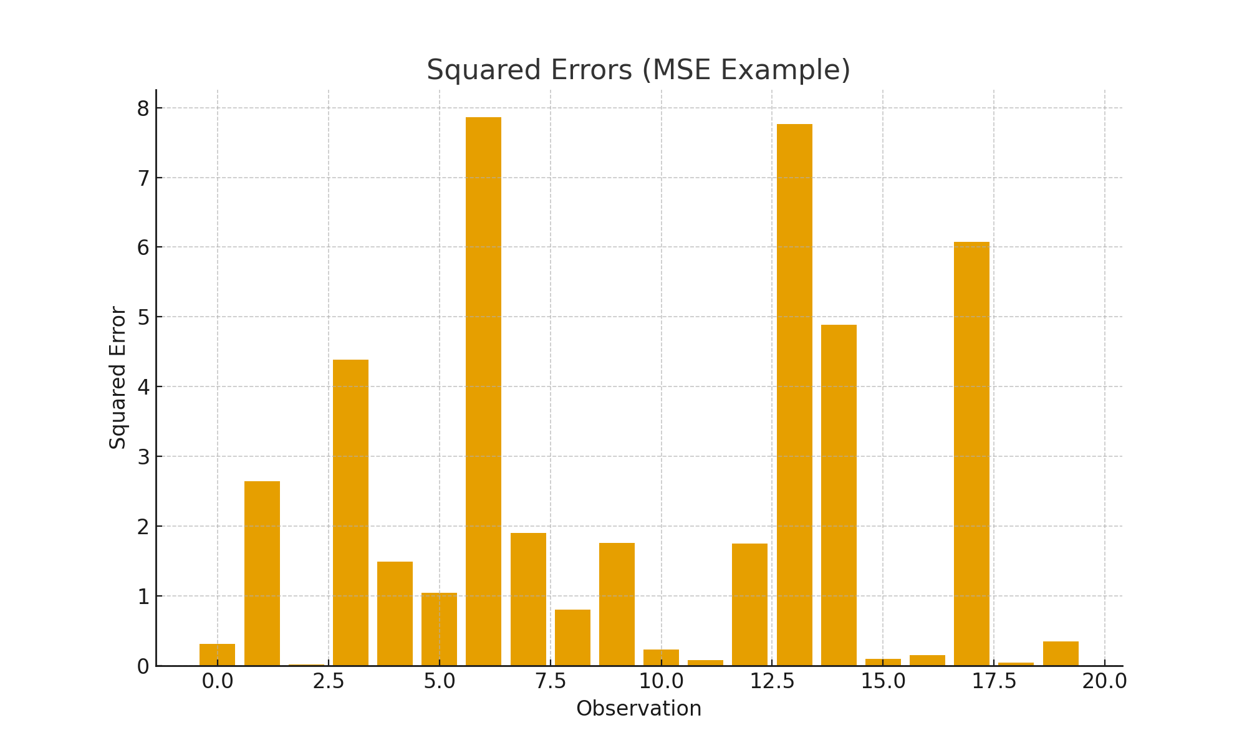
MSE Visualization

Slide 18
R-squared (R²)
R² explains variance captured by regression.
Values range between zero and one.
Higher R² means stronger explanatory power.
Adjusted R² corrects for predictor count.
Negative R² indicates worse than baseline.
Standard metric for regression model quality

Slide 19
R² Mathematics
Formula: R² = 1 - (SSR/SST).
SSR represents residual sum of squares.
SST represents total variation in dataset.
R² gives proportion variance explained accurately.
Higher scores imply strong explanatory regression models.
Helps evaluate overall model prediction strength.

Slide 20
R² Code
Python sklearn provides r2_score(y_true, y_pred).
Returns variance explained by regression predictions.
Higher output closer to one desirable.
Negative score worse than naive baseline.
Used alongside coefficients to explain relationships.
Important complement to MSE and MAE.

Slide 21
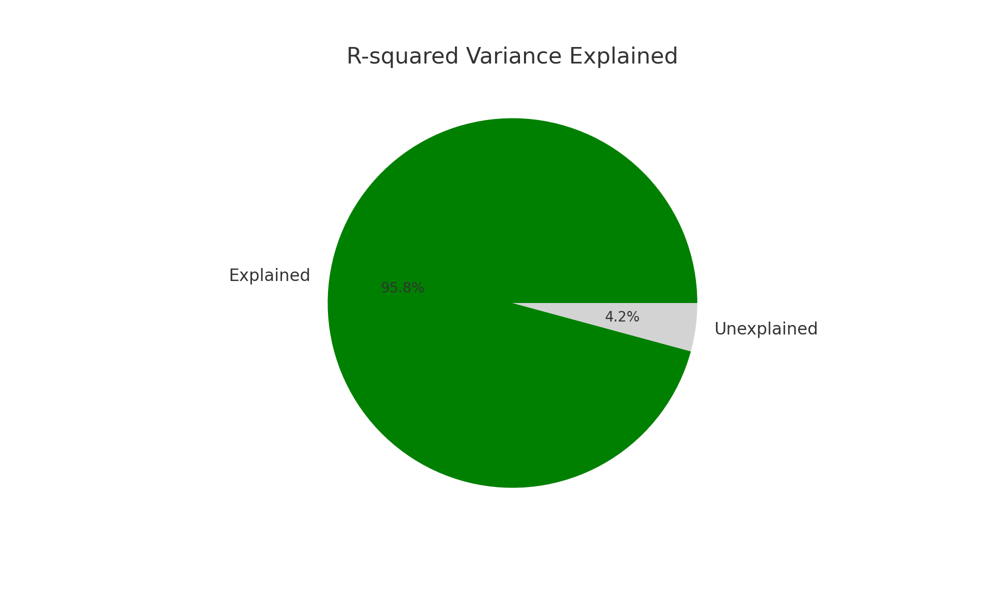
R² Visualization

Slide 22
Root Mean Squared Error (RMSE)
RMSE square root of MSE value.
Expressed in same units as response.
Smaller values indicate stronger predictive performance.
More sensitive towards larger error deviations.
Standard error measure in forecasting studies.
Provides interpretable error magnitude directly.

Slide 23
RMSE Mathematics
Formula: RMSE = √(Σ(yi - ŷi)² / n).
Rooted version of mean squared error metric.
Retains unit consistency for practical interpretation.
Popular across engineering, climate, economic forecasting.
Smaller RMSE means model predicts more reliably.
Complements R² and MAE performance metrics.

Slide 24
RMSE Code
RMSE computed using np.sqrt(MSE).
Combine mean_squared_error with numpy square root.
Provides interpretable error magnitude in units.
Lower RMSE implies higher model precision.
Useful in sensitive regression applications.
Widely reported in forecasting and simulation research.

Slide 25
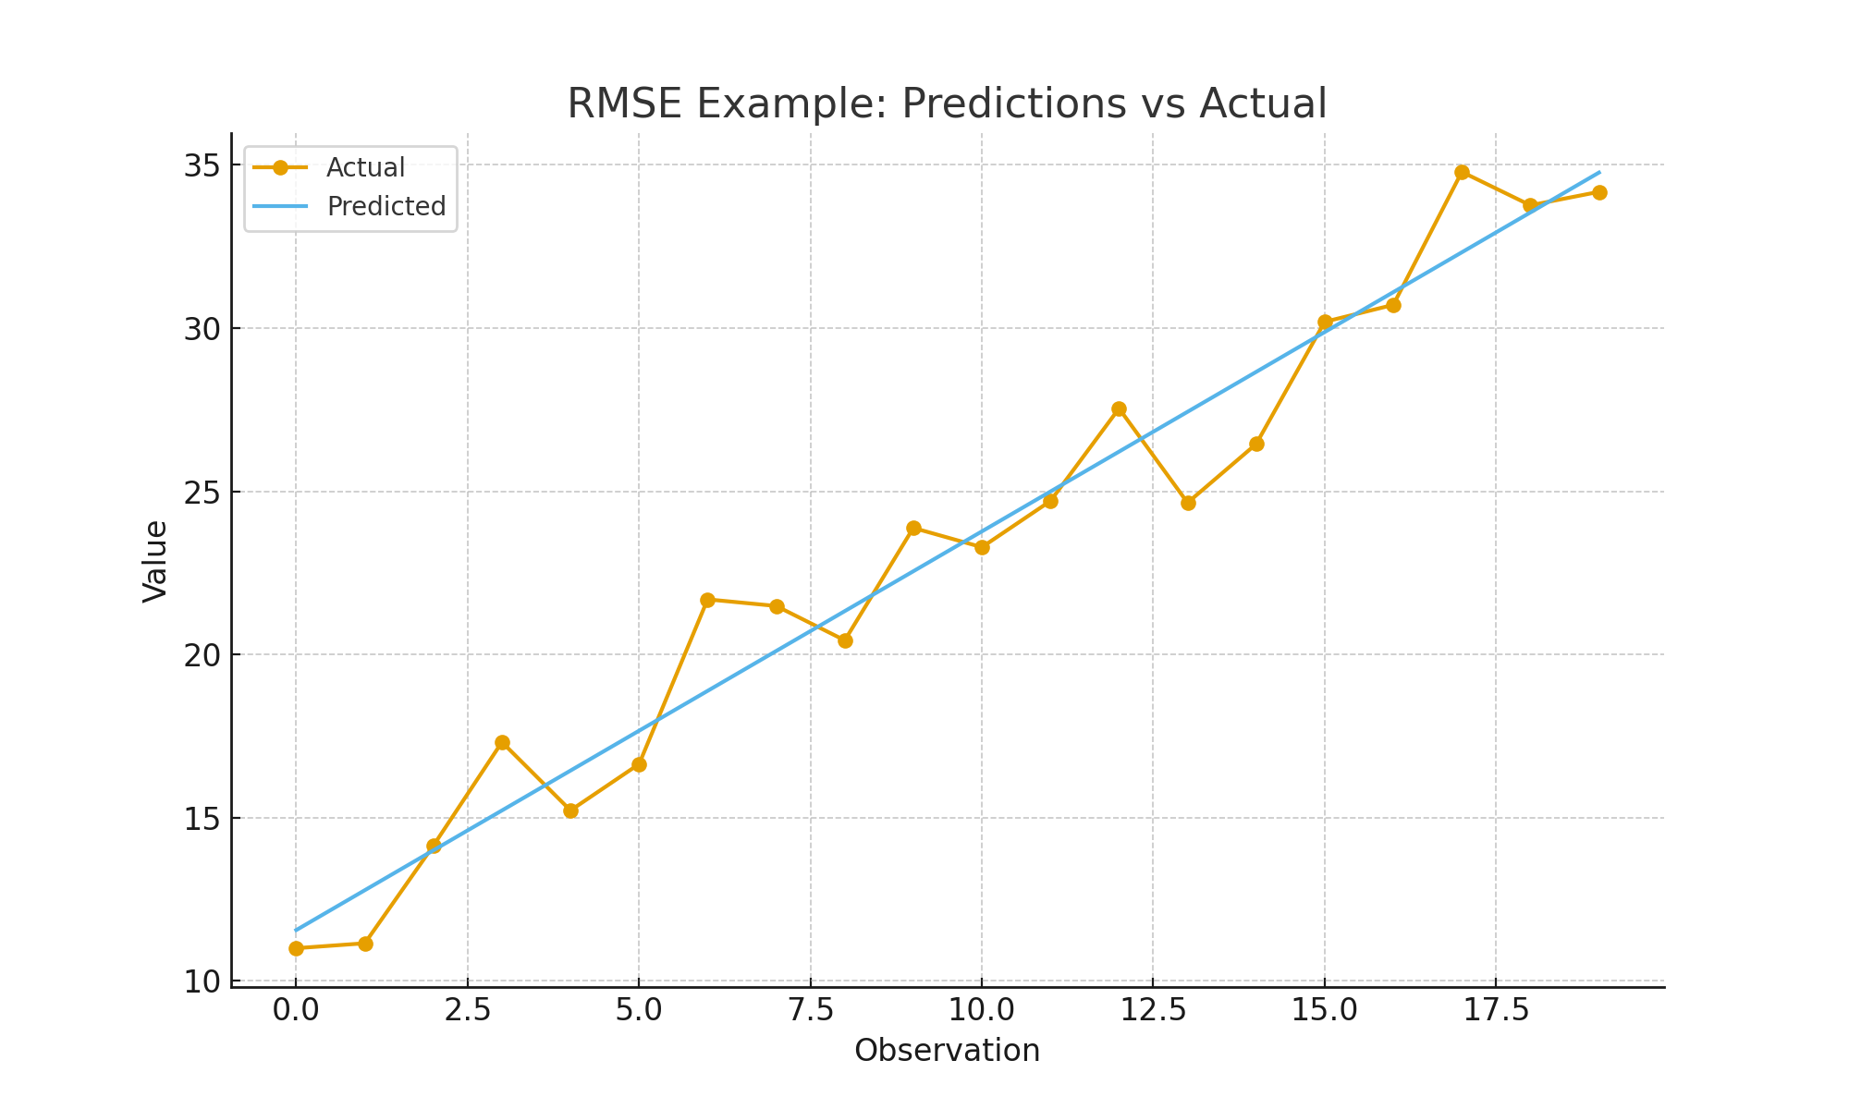
RMSE Visualization

