Slide 1
Regression

Slide 2
Introduction
Regression predicts outcomes using historical data
Identifies relationships between variables for predictions
Dependent variable relies on independent inputs
Independent variables help explain output variations
Regression models minimize prediction error values
Used in economics, biology, social sciences

Slide 3
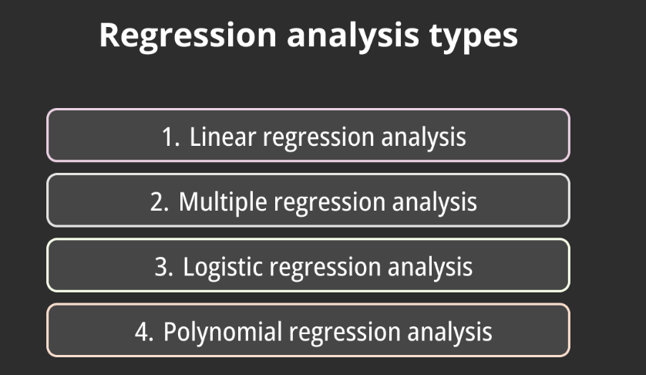
Types

Slide 4
Simple Linear Regression
Examines relationship between two numeric variables
One independent variable influences dependent variable
Represented using straight regression line equation
Slope shows impact, intercept shows baseline
Useful for straightforward, direct predictive modeling
Example: predicting sales based on advertising

Slide 5
Y = mX + b
m = slope
X = independent variable
b = intercept

Slide 6
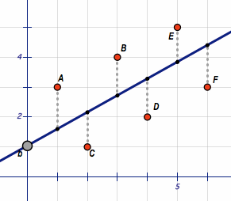

Slide 7
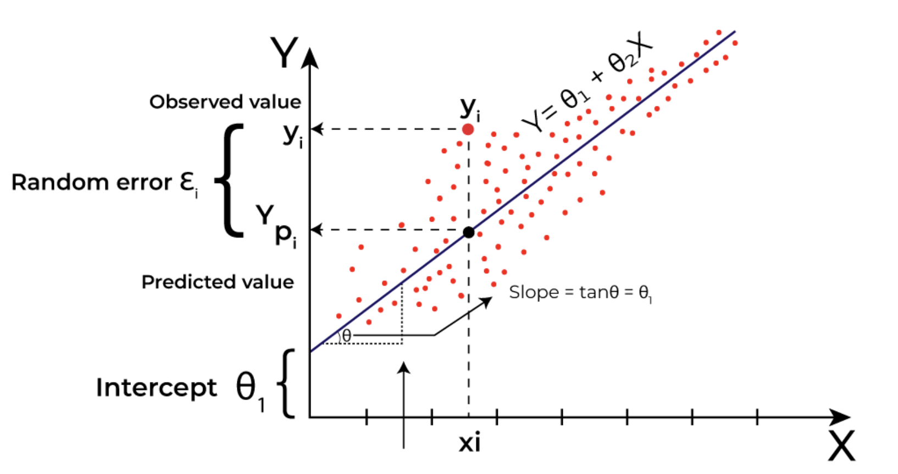

Slide 8
Multiple Linear Regression
Uses multiple predictors for target estimation
Explains dependent variable using several inputs
Equation includes multiple coefficients and intercept
Helps analyze combined effect of predictors
More complex than simple regression analysis
Example: house price prediction using features

Slide 9
Polynomial Regression
Extends regression using higher polynomial terms
Models nonlinear data with curved trends
Still considered linear in model coefficients
Captures more complex variable interaction patterns
Useful when relationship shows quadratic, cubic
Example: population growth following quadratic curve

Slide 10
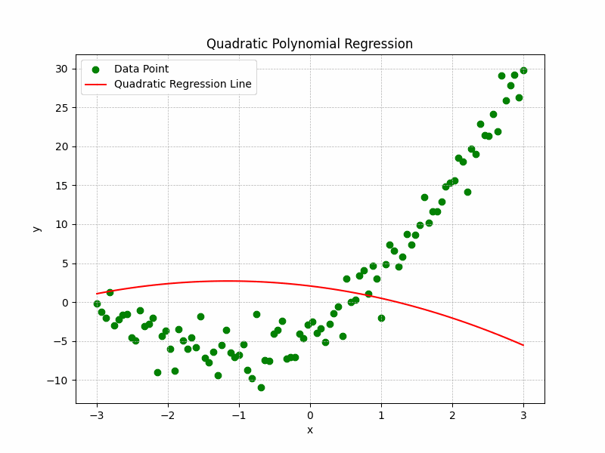

Slide 11
Applications
Widely applied across diverse research fields
Used in finance for stock forecasting
Applied in healthcare predicting disease progression
Marketing uses regression for consumer behavior
Manufacturing predicts quality based on inputs
Environmental science forecasts pollution or weather

Slide 12
Logistic Regression
Logistic regression predicts categorical outcome variables
Extensively used for binary classification tasks
Outputs probability values between zero and one
Uses logistic sigmoid function for transformation
Decision boundary separates different outcome classes
Applied when dependent variable is categorical

Slide 13
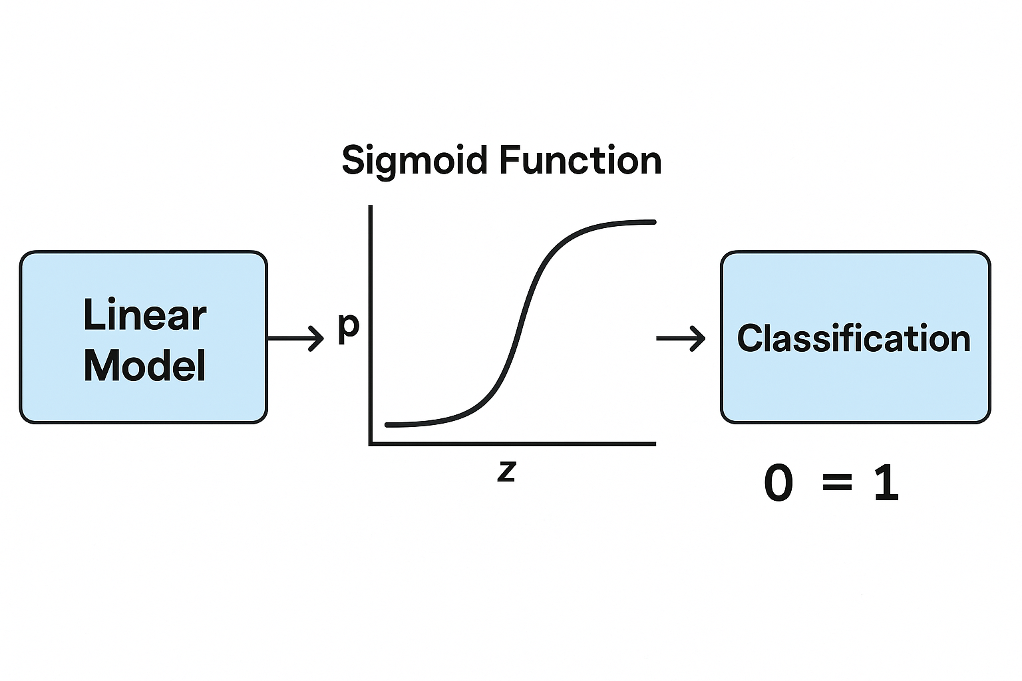

Slide 14
Logistic Function
Logistic function converts inputs into probabilities
Probability curve follows characteristic S-shape
Values always between zero and one
Threshold determines final classification category
Curve ensures output remains bounded values
Provides interpretable probability-based classification outcomes

Slide 15
Linear Regression vs Logistic Regression
Linear regression predicts continuous numeric outcomes
Logistic regression predicts categorical class outcomes
Linear output ranges from negative infinity
Logistic output bounded between zero and one
Linear assumes relationship between variables continuous
Logistic assumes relationship between predictors and logit

Slide 16
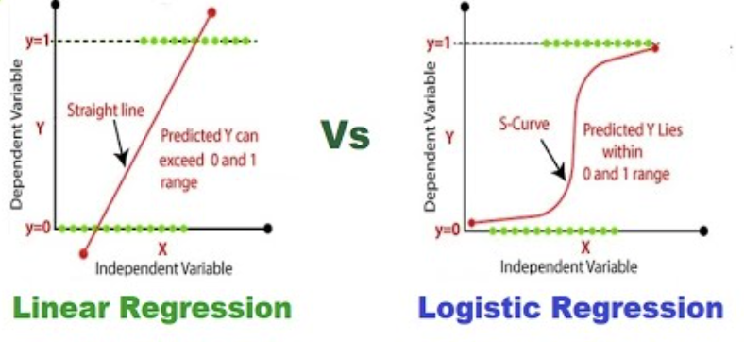

Slide 17
Correlation
Correlation between two variables
Indicates how closely their relationship follows a straight line.
The correlation ranges between -1 and +1.
Extreme values indicate perfect linear relationship
Zero indicates the absence of a linear relationship.

