Slide 1
Radio Fingerprint Recognition with Machine Learning
2019-10-15

Slide 2
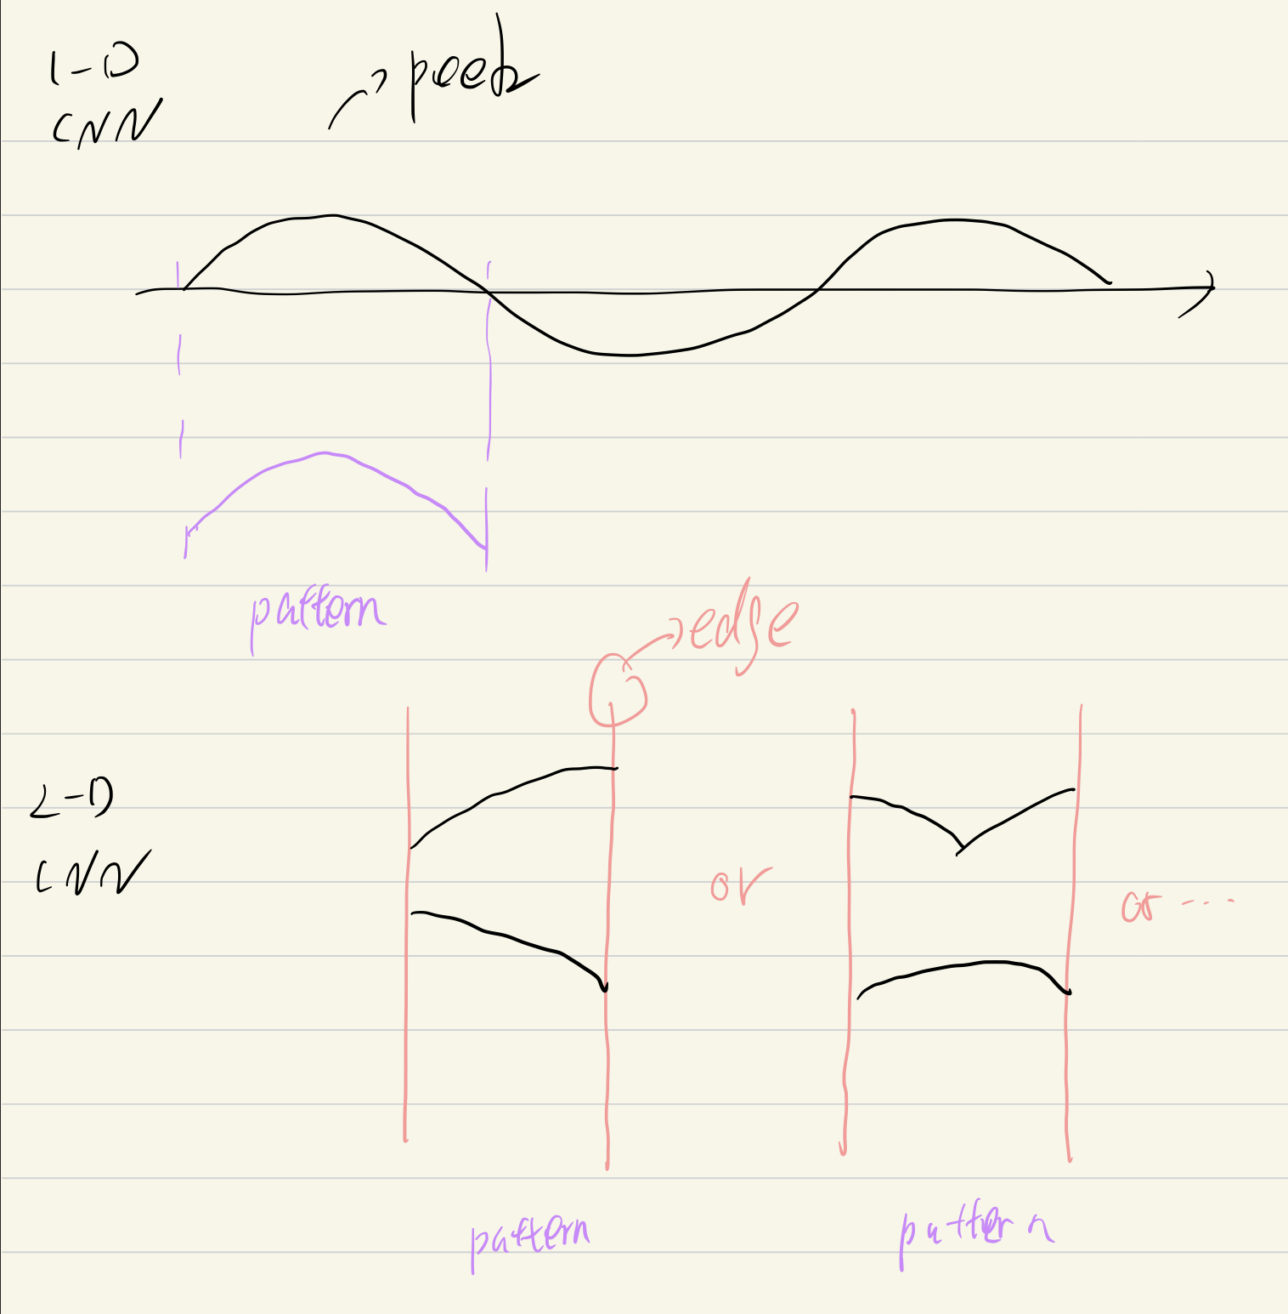
2D Input
More hard to train than 1-D input, can only reach 97 Acc

Slide 3

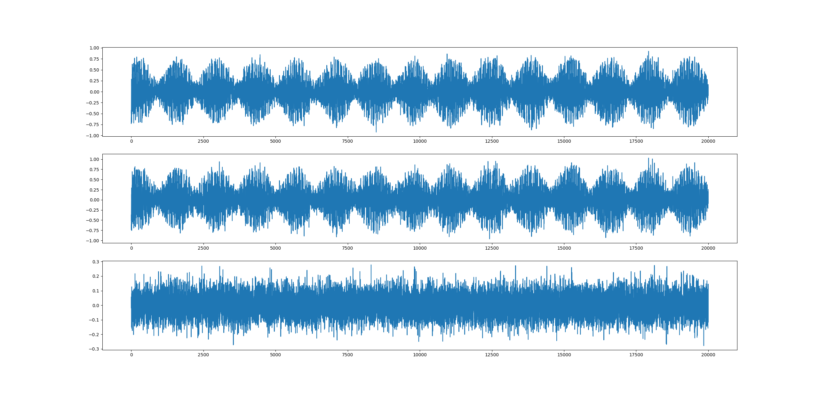
Add Noise

Slide 4
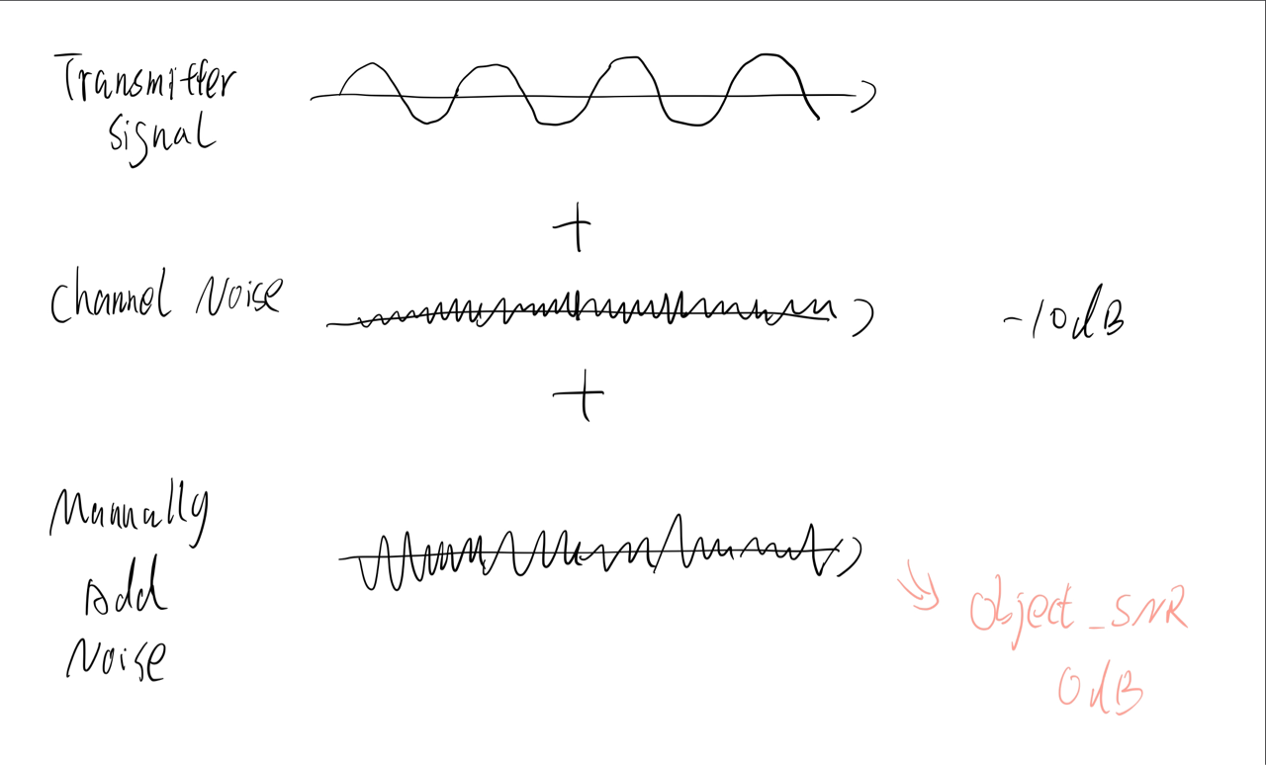
Noise Adding Algorithm

Slide 5
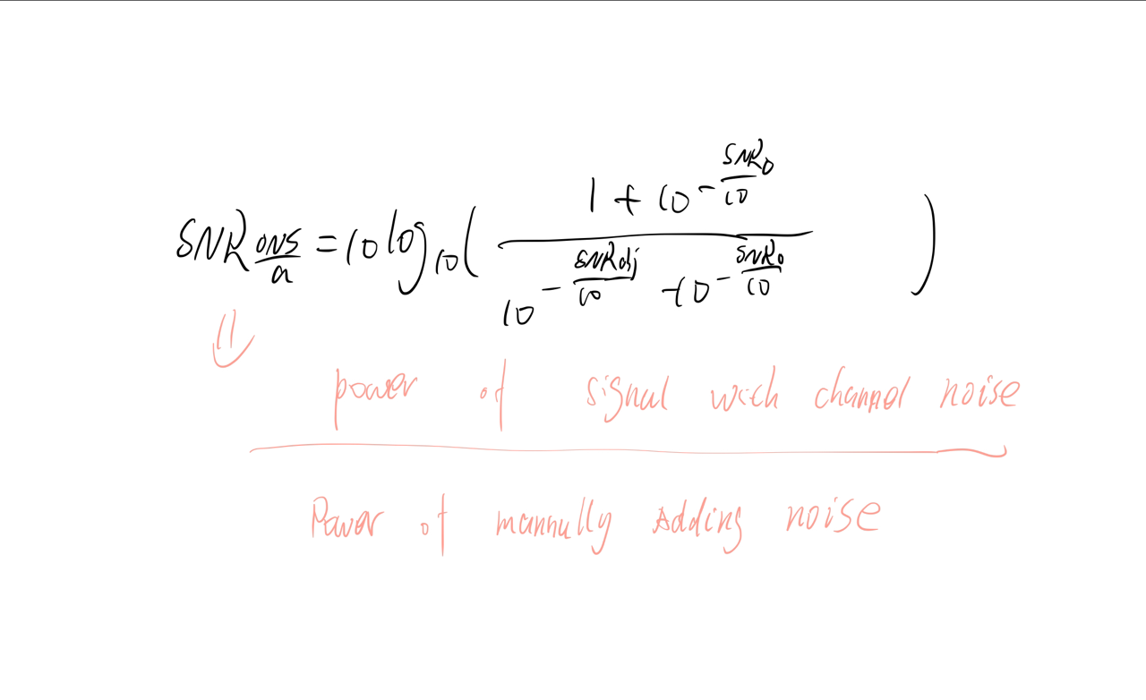
Noise Adding Algorithm

Slide 6
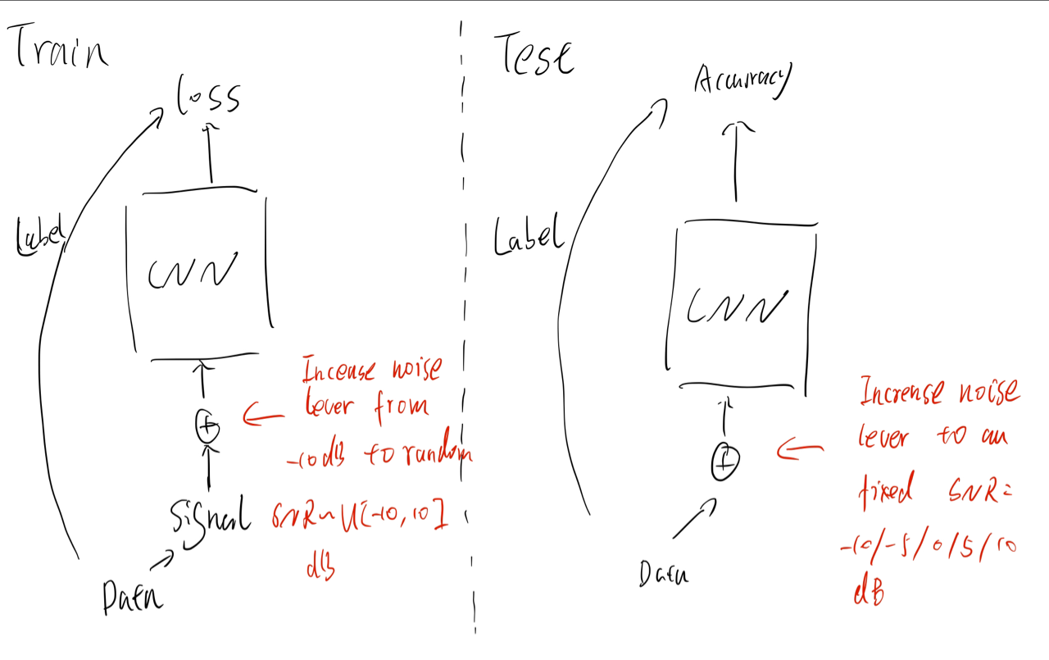
Noise Adding Algorithm

Slide 7
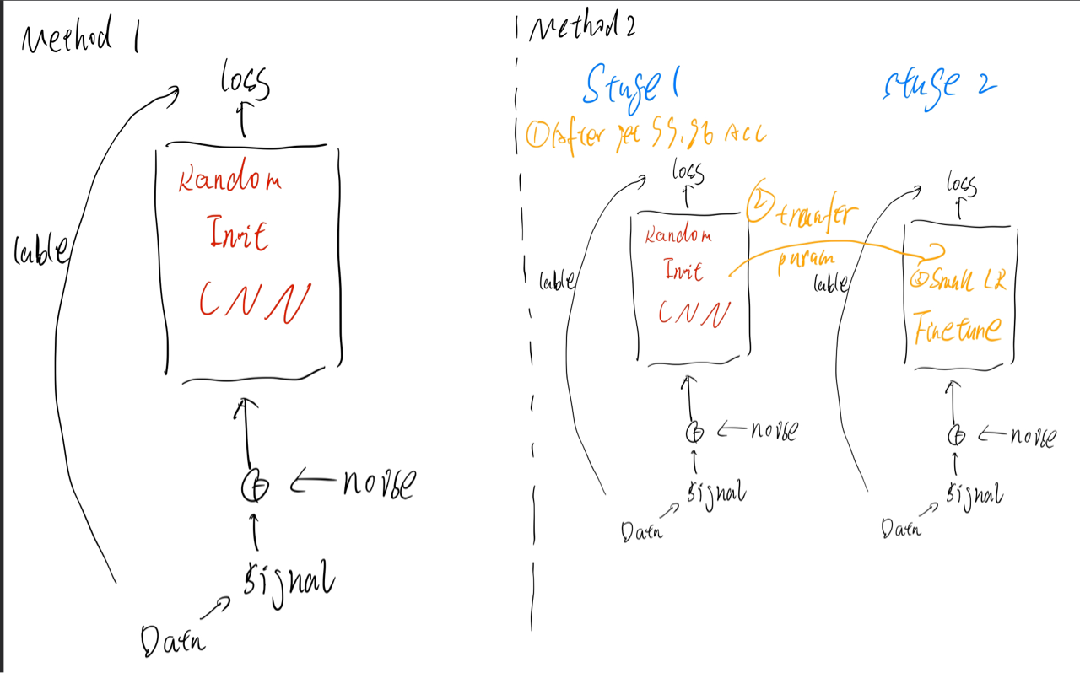
Noise Adding Algorithm

Slide 8
Method 1: Train From Start
SNR | Accuracy
10 db | 99.2%
5 | 96.2%
0 db | 91.2%
-5 db | Waiting for Test
-10 db | 76 %

Slide 9
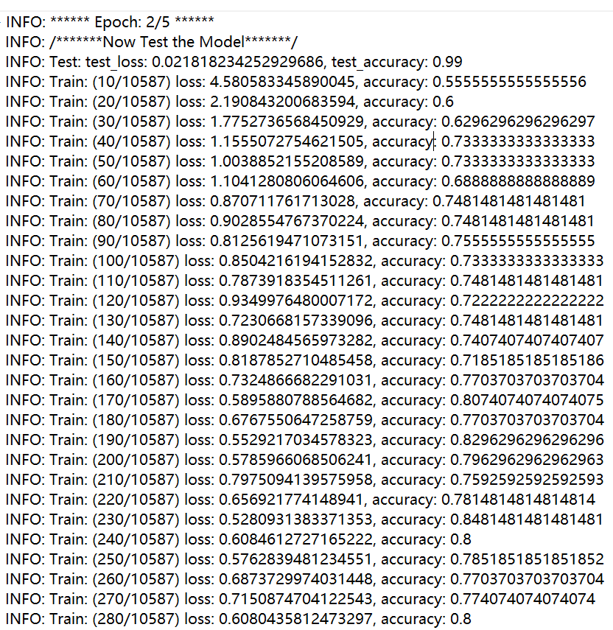
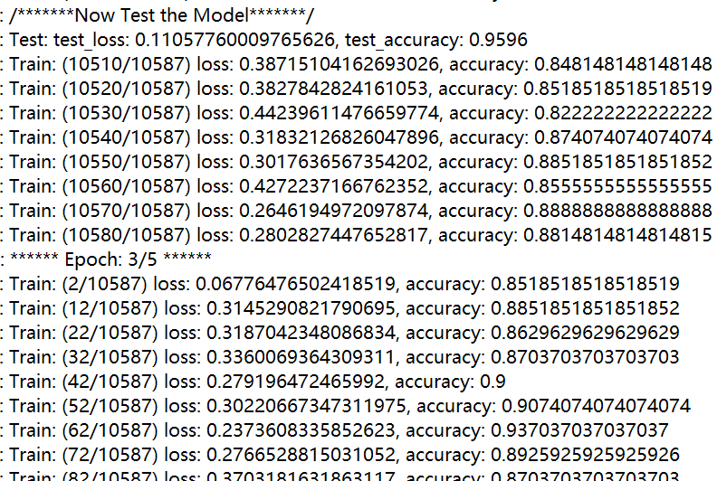
Method 1: Fine Tune

Slide 10
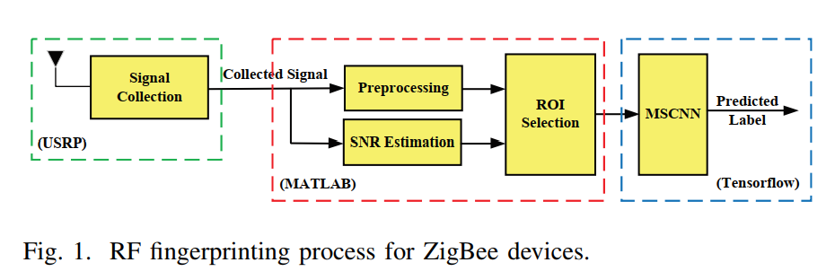
CNN

Slide 11
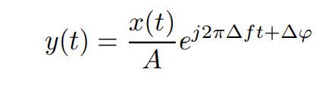
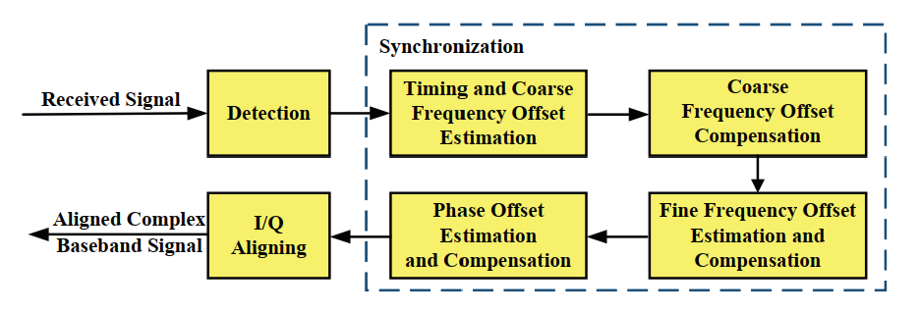
CNN

Slide 12
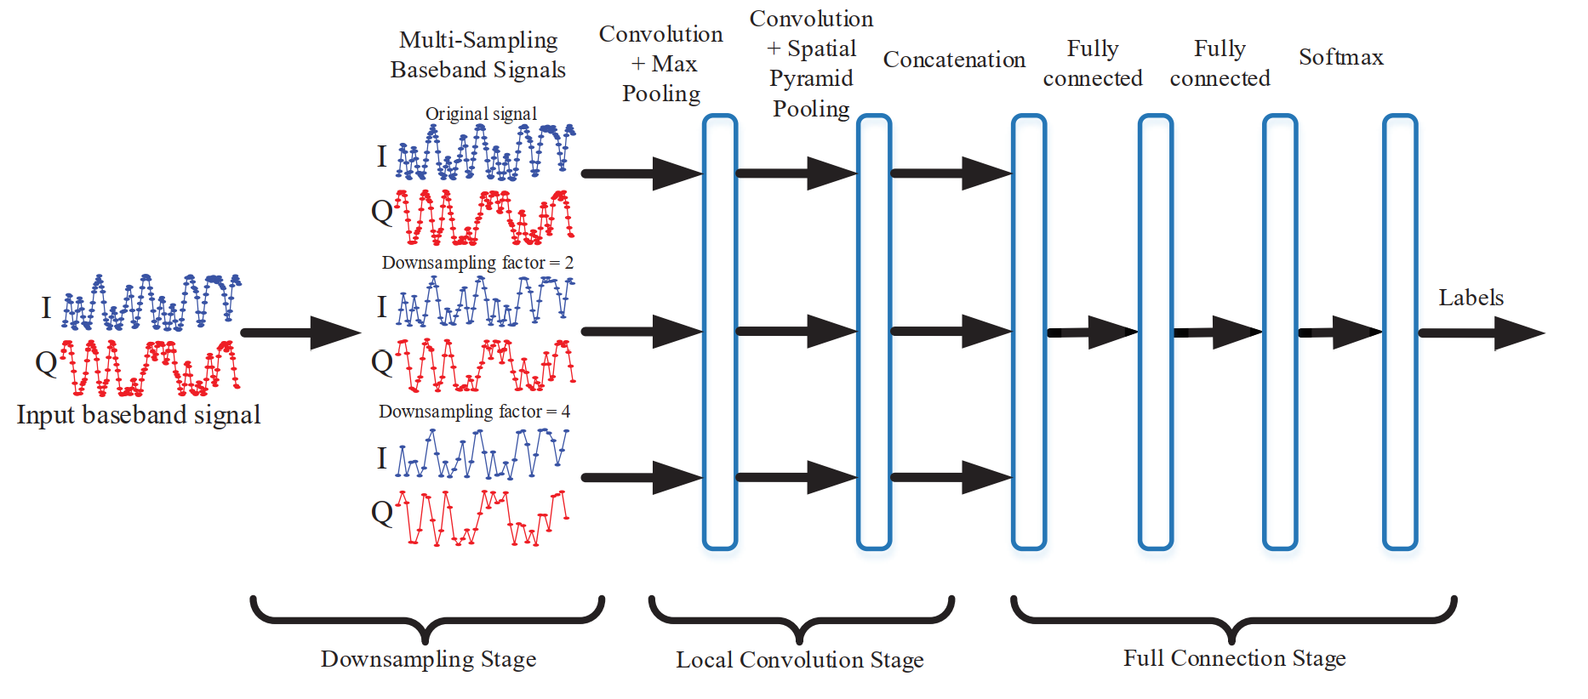
CNN

Slide 13
CNN

Slide 14
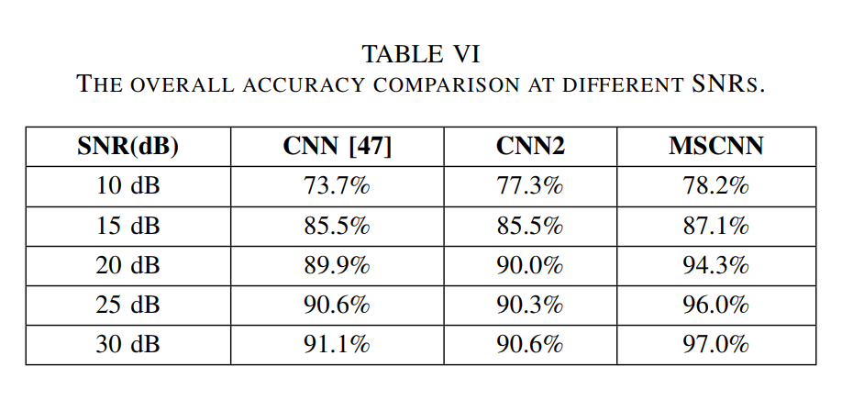
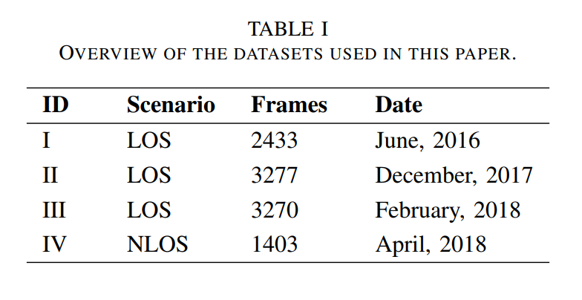
CNN

Slide 15
CNN
54 device

Slide 16
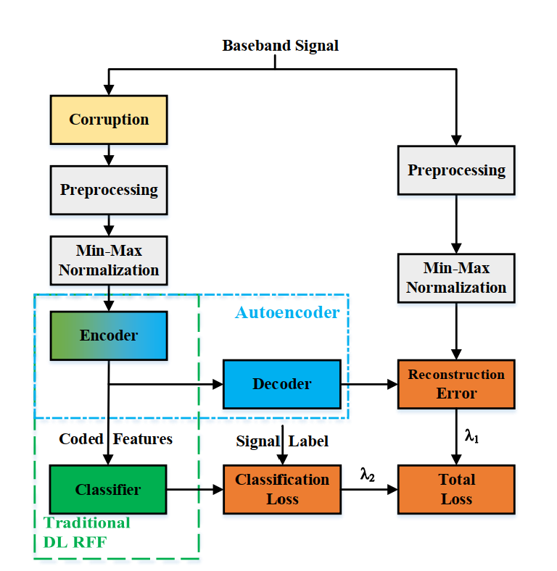
Denoise

Slide 17
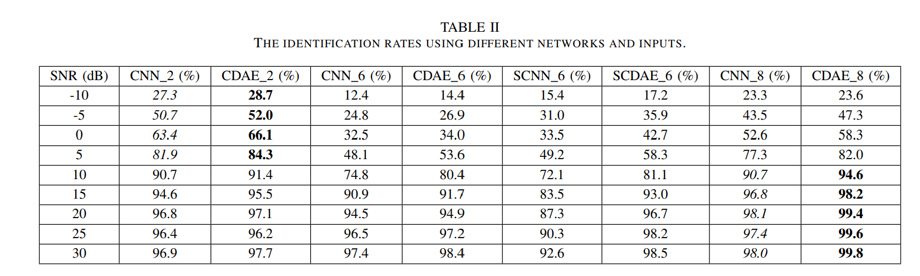
CADE

Slide 18

Thank You
RFML
https://github.com/HAL-42/RFML

