Slide 1
Radio Fingerprint Recognition with Machine Learning
2019-11-23

Slide 2

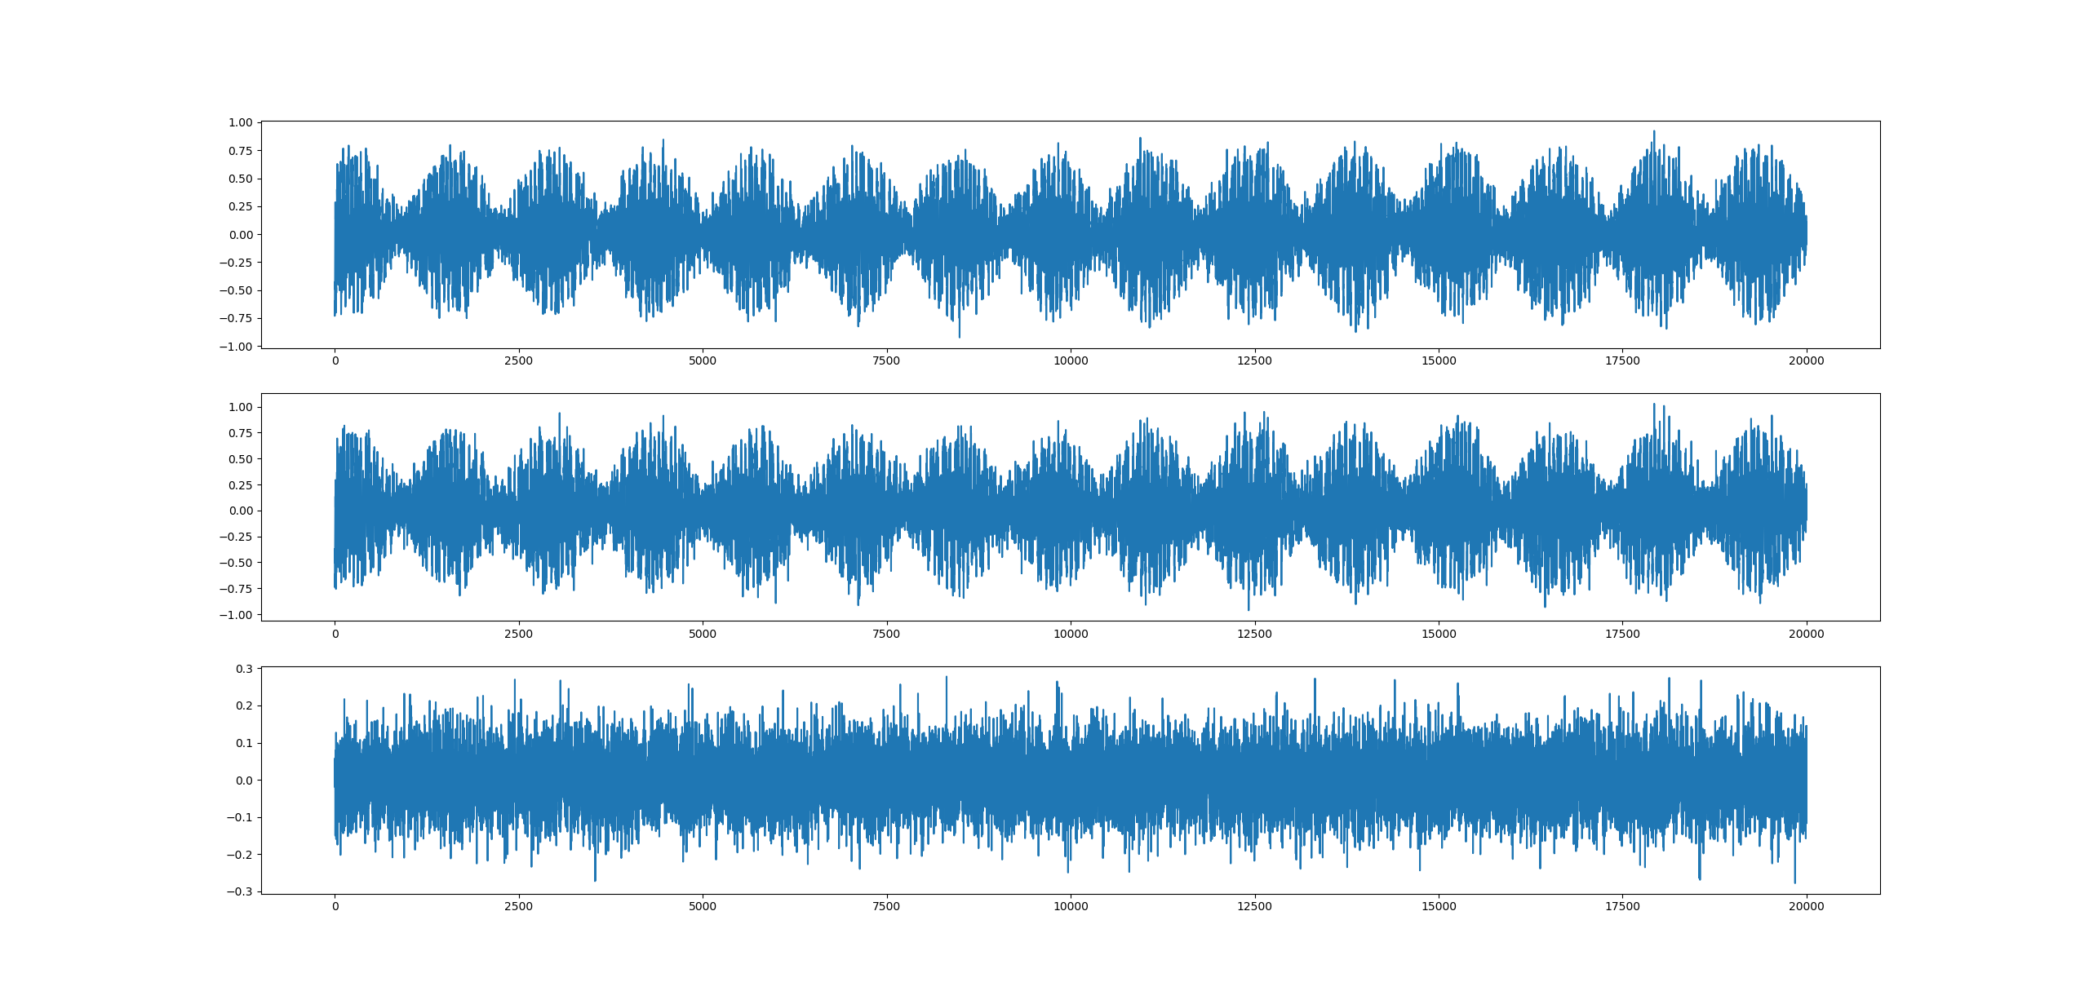
Add Noise

Slide 3
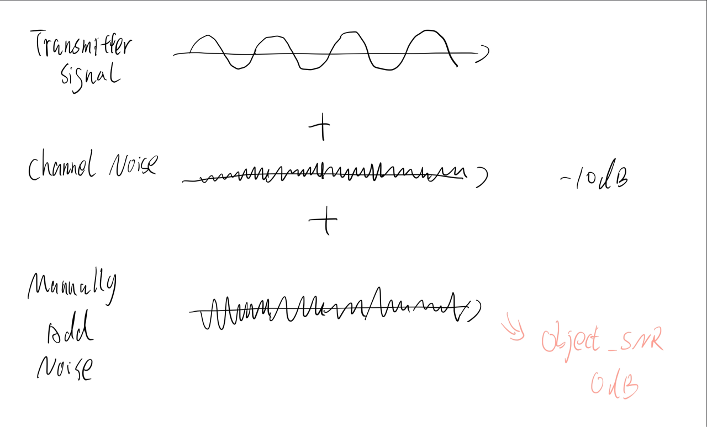
Noise Adding Algorithm

Slide 4
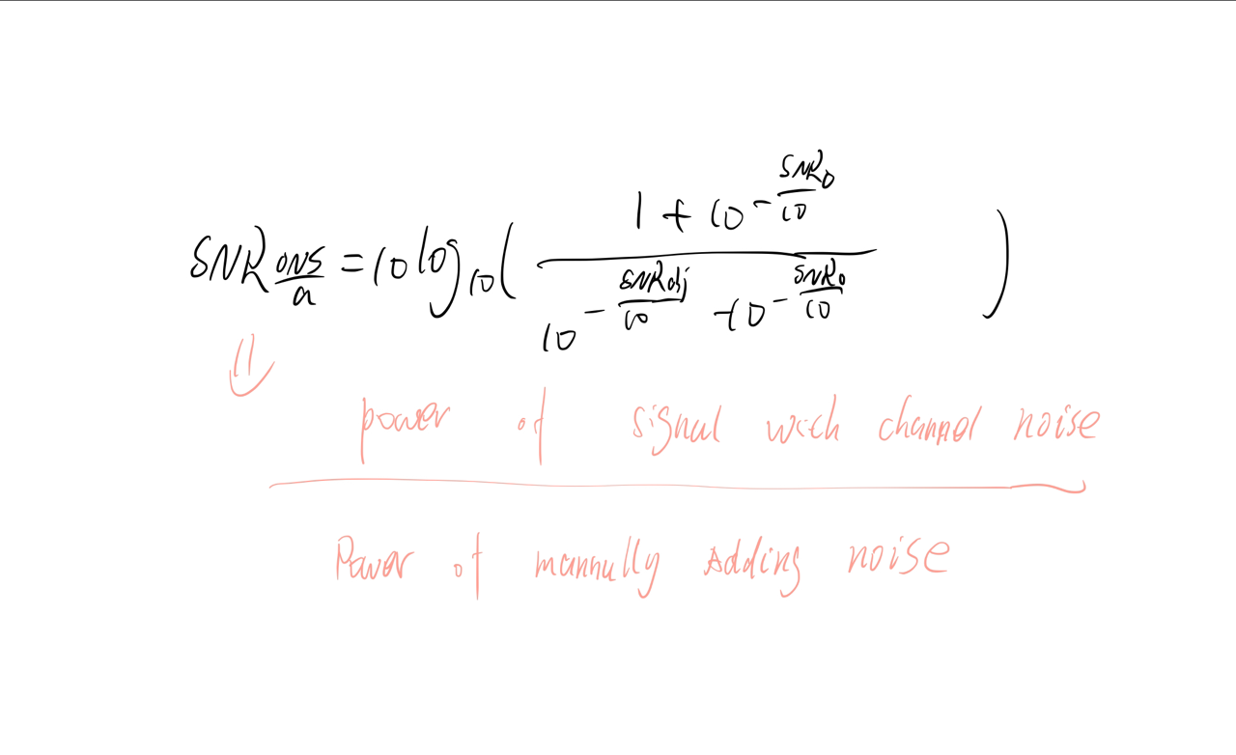
Noise Adding Algorithm

Slide 5
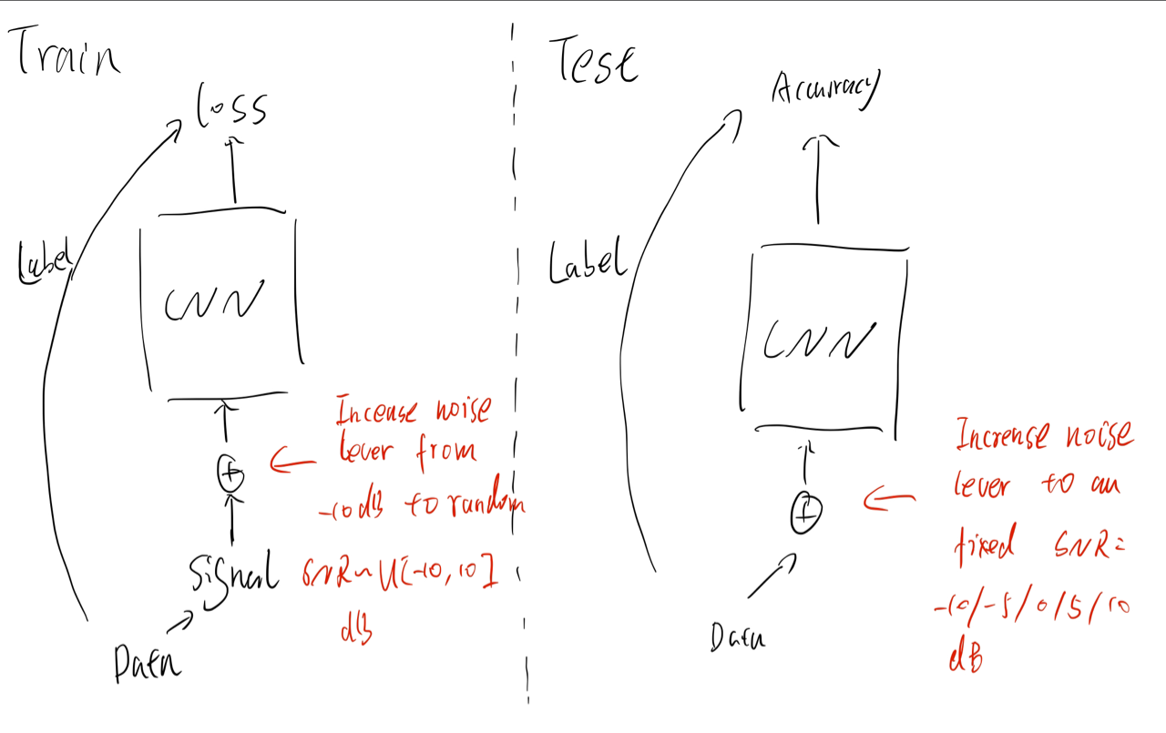
Noise Adding Algorithm

Slide 6
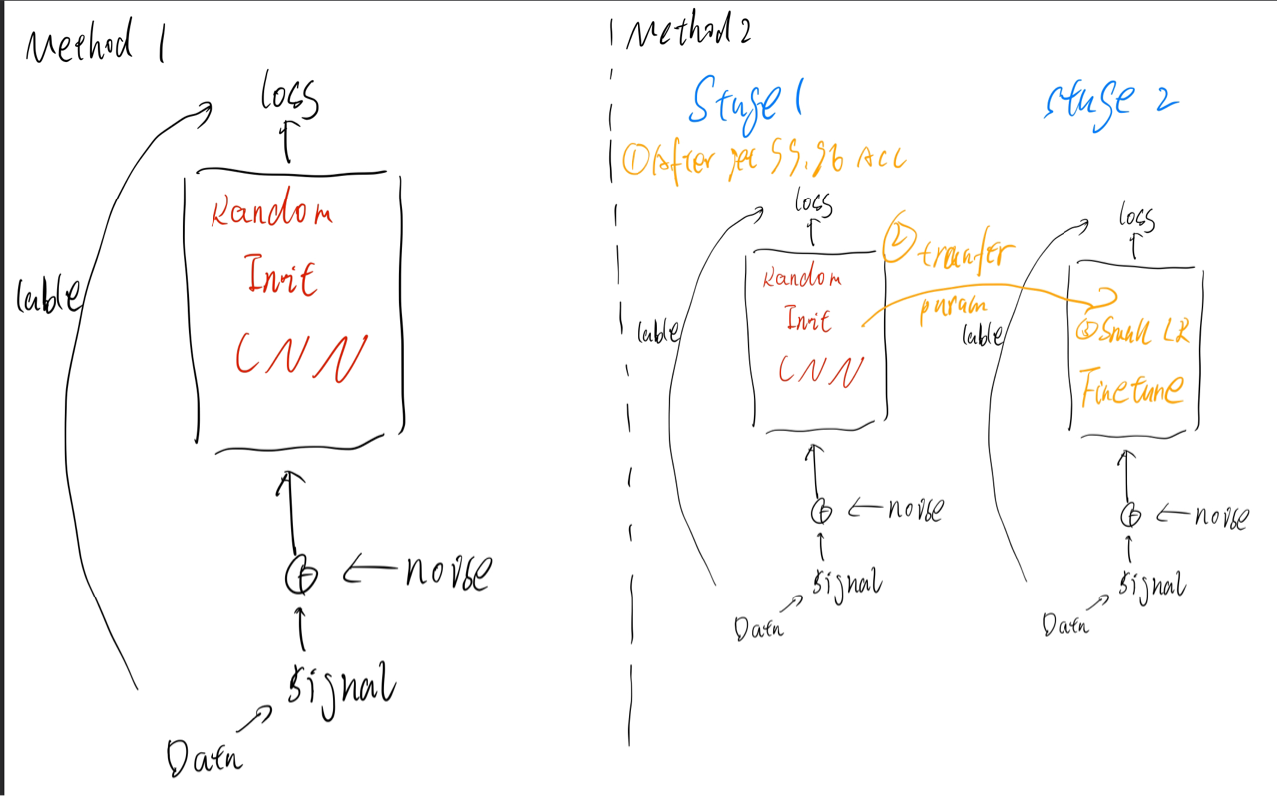
Noise Adding Algorithm

Slide 7
Method 1: Train From Start
SNR | Accuracy
10 db | 96.89%
5 | 96.08%
0 db | 91.29%
-5 db | 87.25%
-10 db | 76.05 %

Slide 8
Method 2: Fine Tune
SNR | Accuracy
10 db | 98.33%
5 | 96.05%
0 db | 91.80%
-5 db | 85.05%
-10 db | 70.27%
99.2%

Slide 9
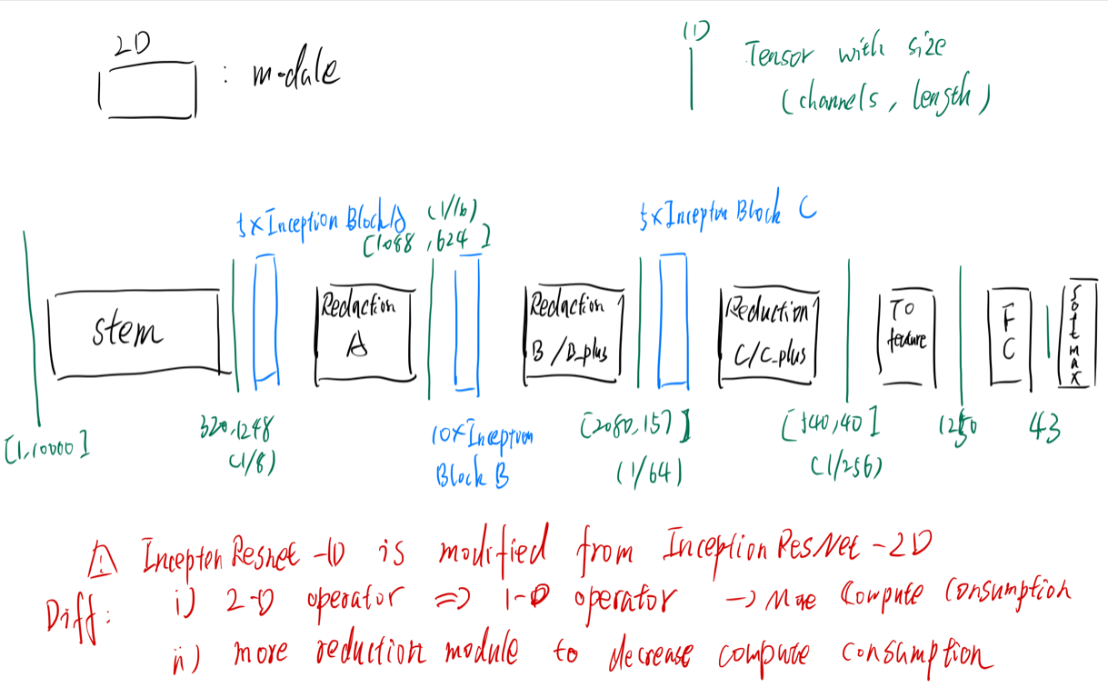

Slide 10
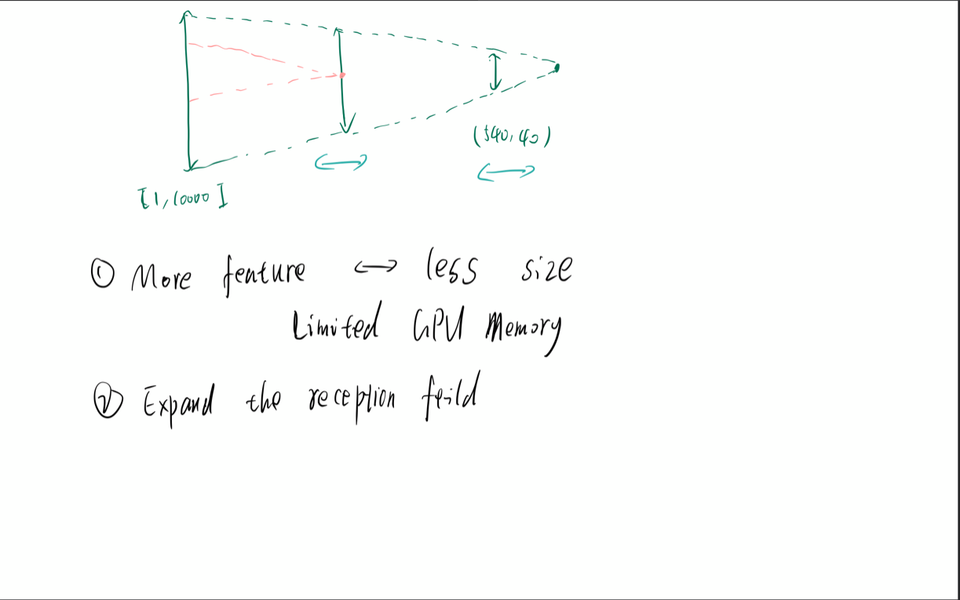

Slide 11
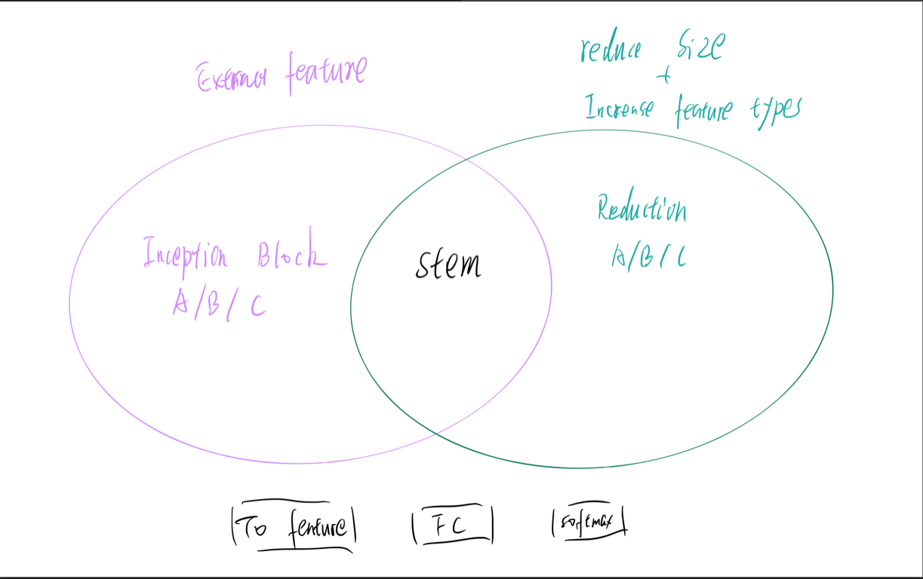

Slide 12
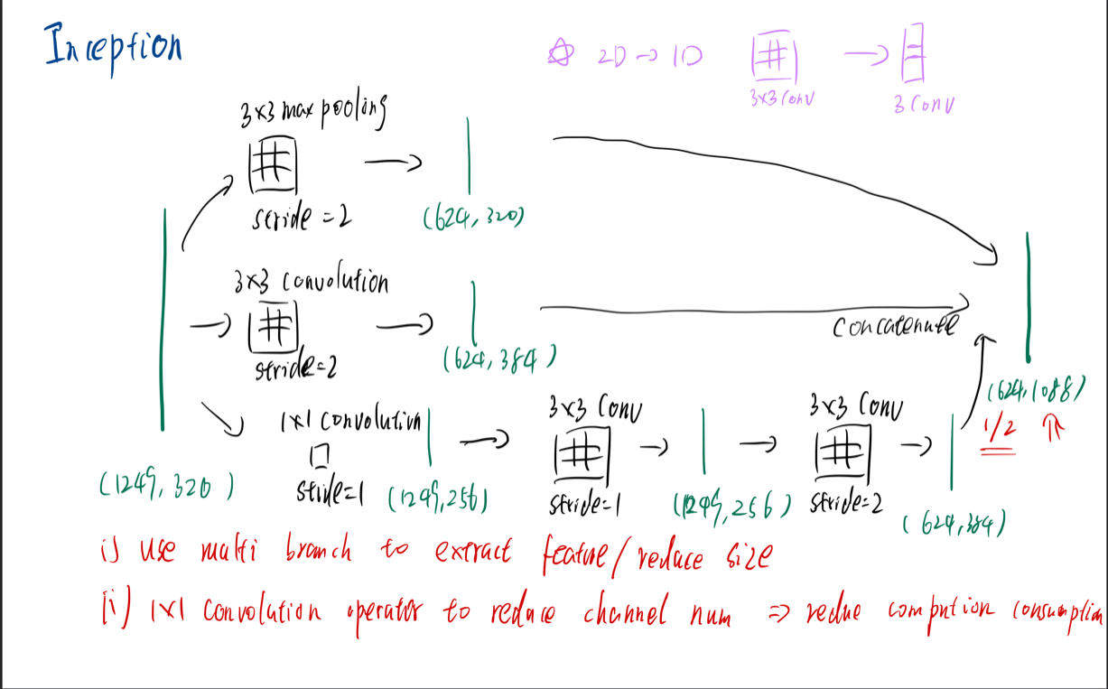

Slide 13
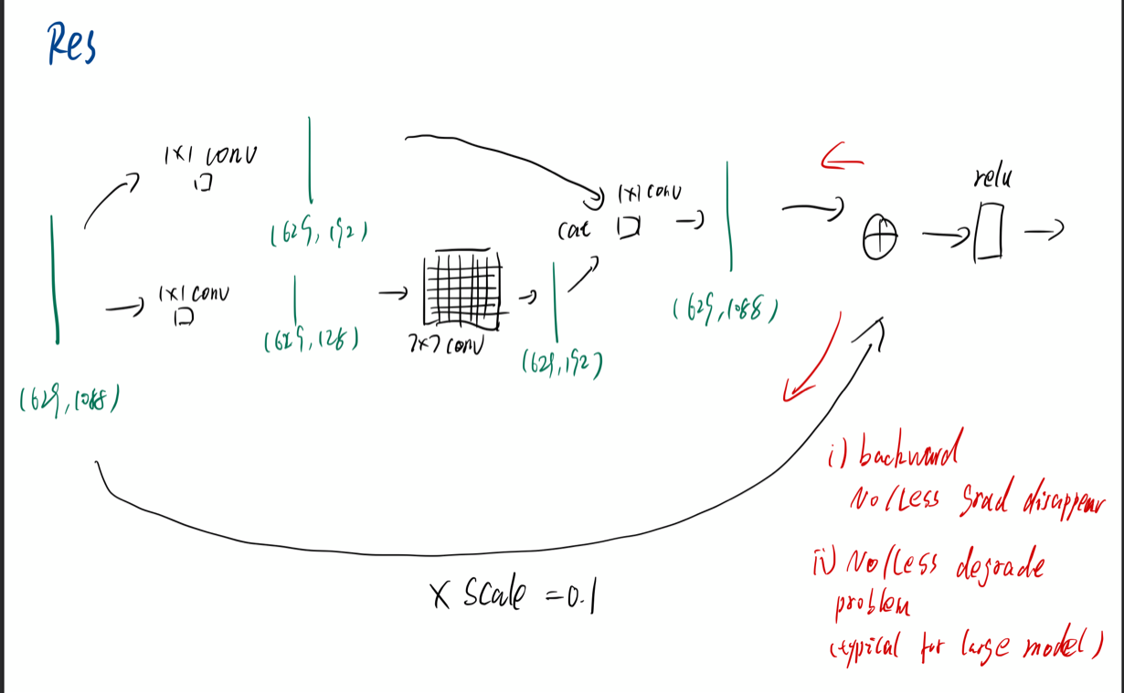

Slide 14
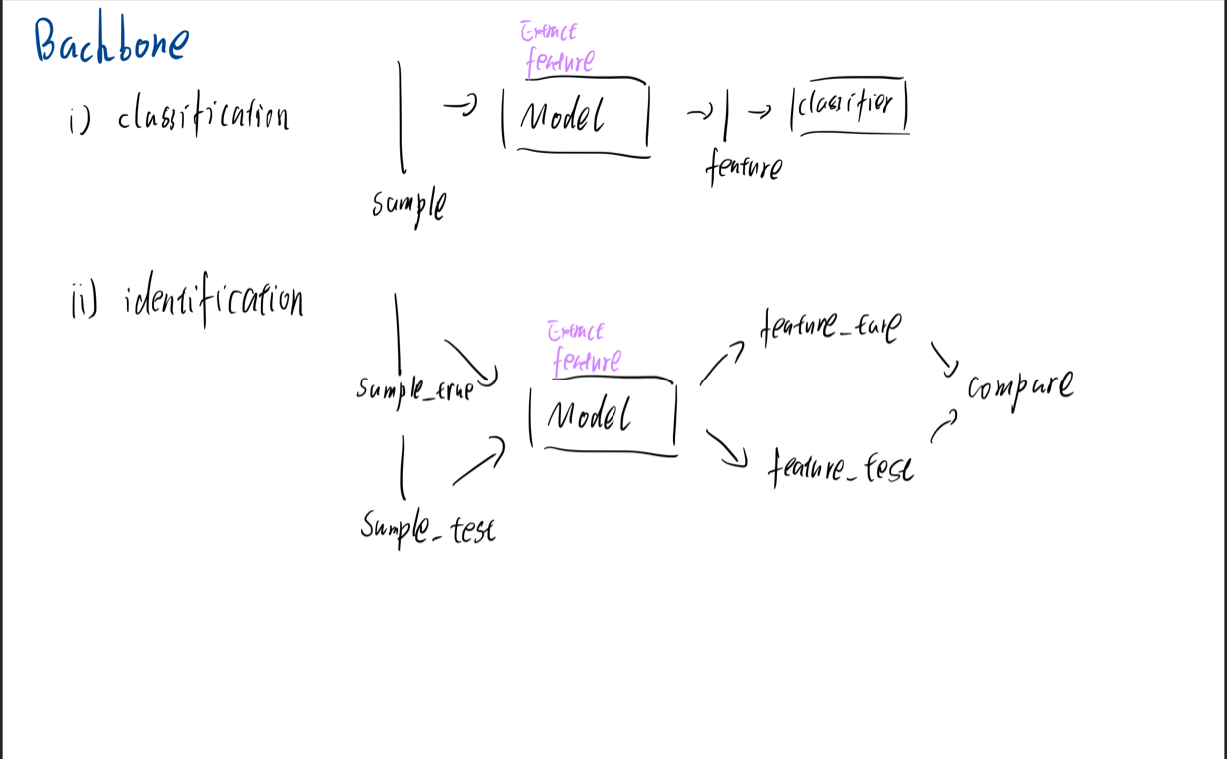

Slide 15
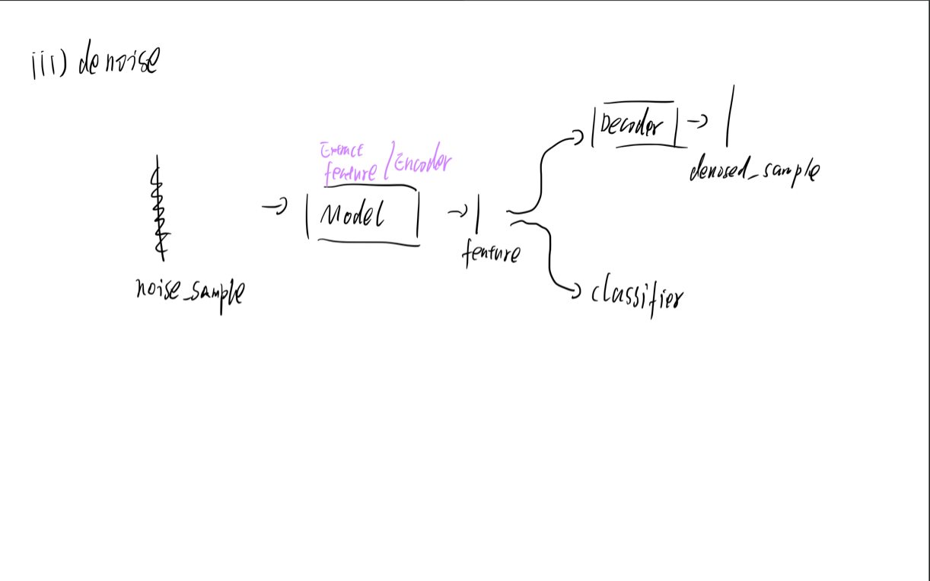

Slide 16
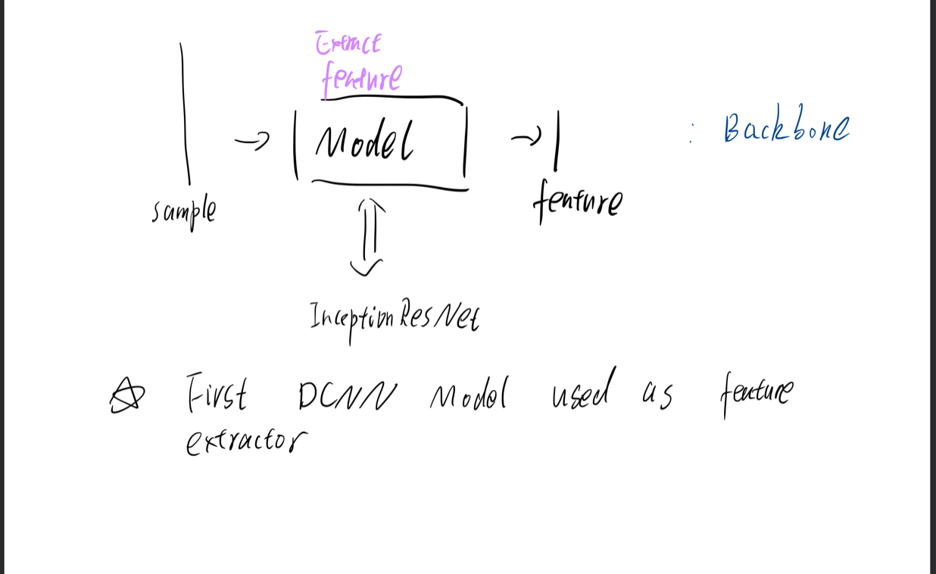

Slide 17

Thank You
RFML
https://github.com/HAL-42/RFML

