Slide 1
Radio Fingerprint Recognition with Machine Learning
2019-11-23

Slide 2

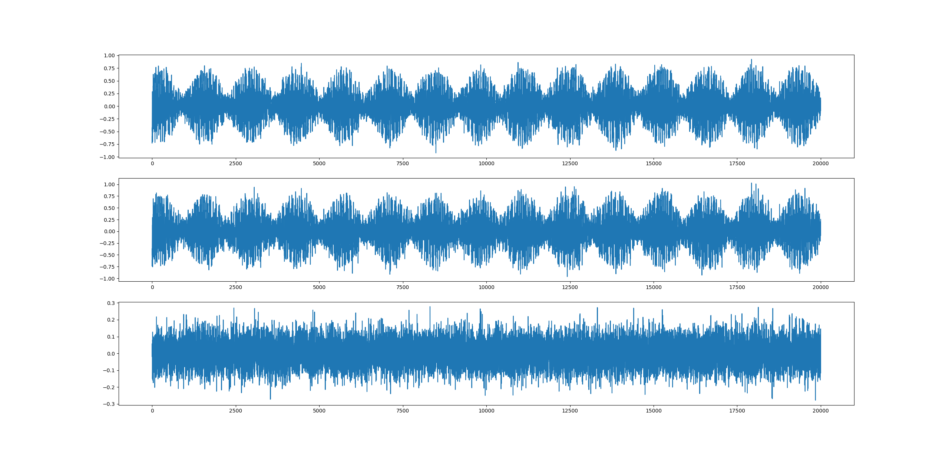
Add Noise

Slide 3
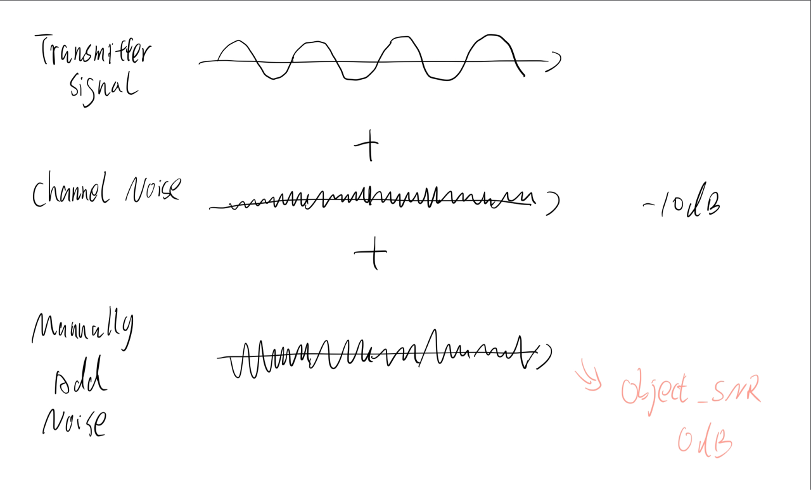
Noise Adding Algorithm

Slide 4
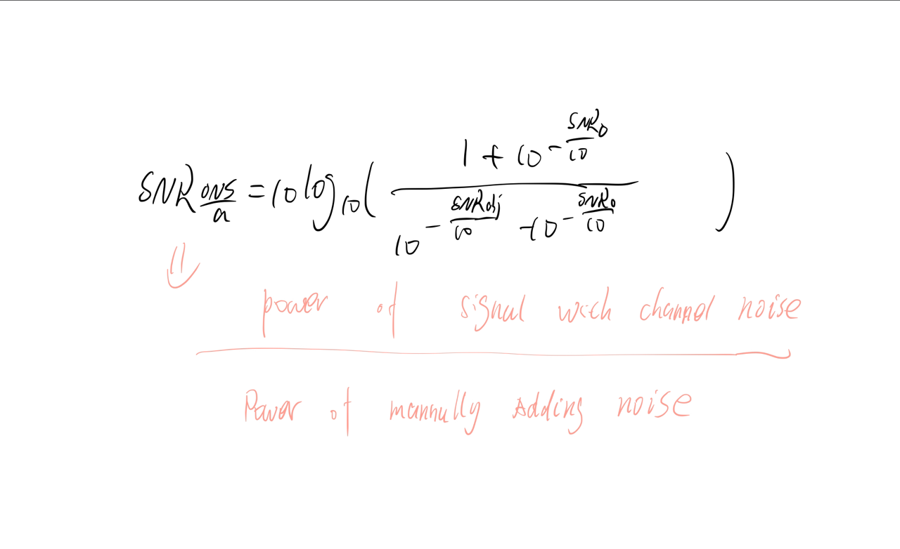
Noise Adding Algorithm

Slide 5
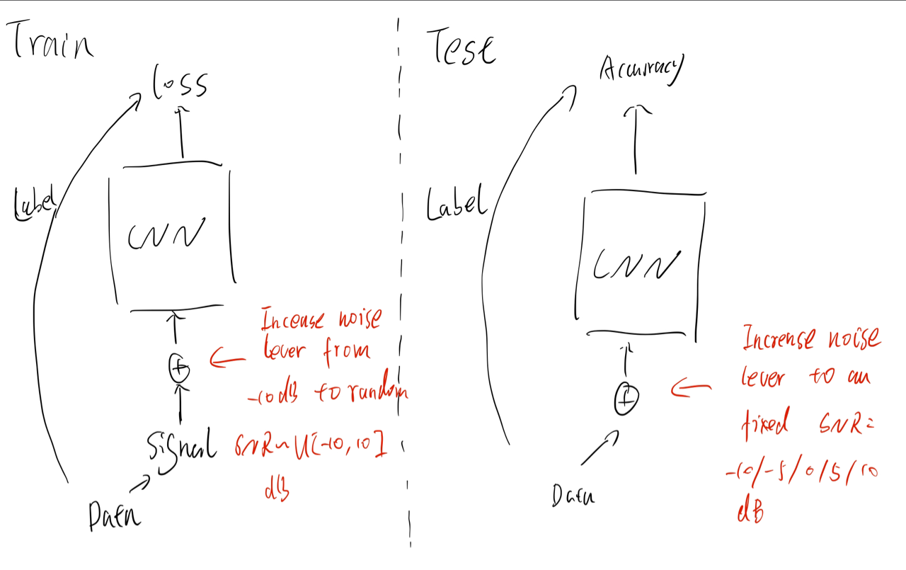
Noise Adding Algorithm

Slide 6
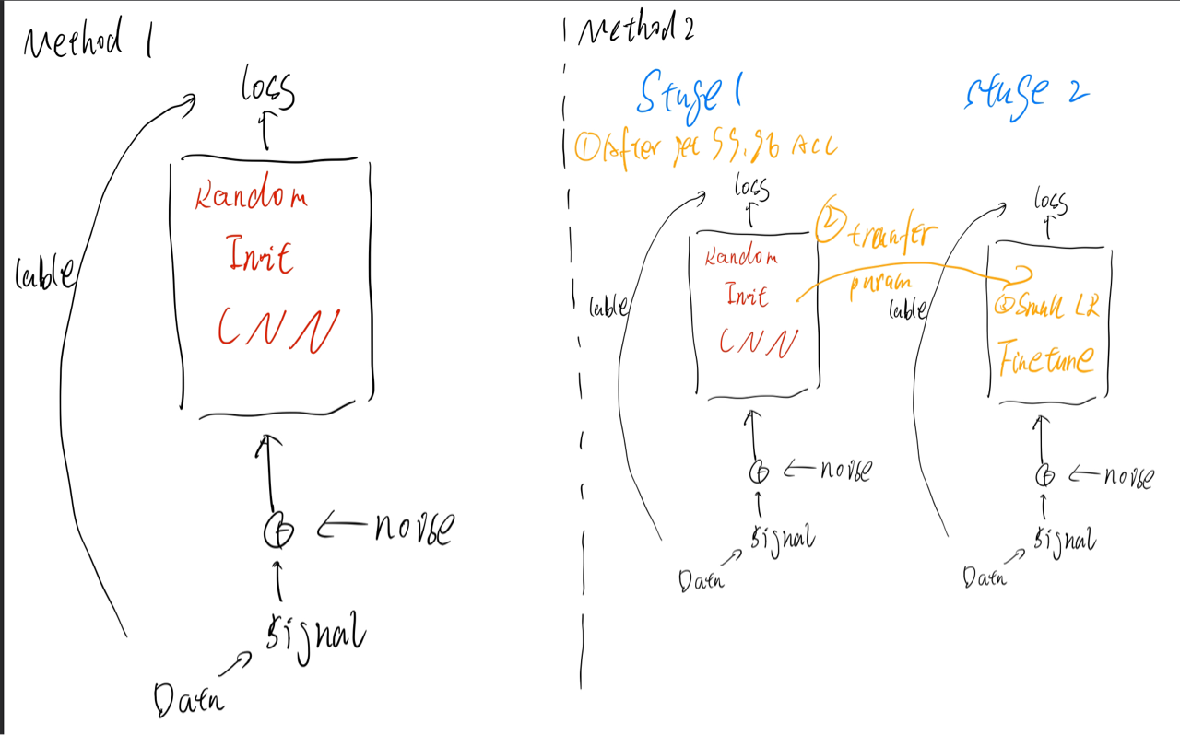
Noise Adding Algorithm

Slide 7
Method 1: Train From Start
SNR | Accuracy
10 db | 96.89%
5 | 96.08%
0 db | 91.29%
-5 db | 87.25%
-10 db | 76.05 %

Slide 8
Method 2: Fine Tune
SNR | Accuracy
10 db
5
0 db
-5 db
-10 db

Slide 9
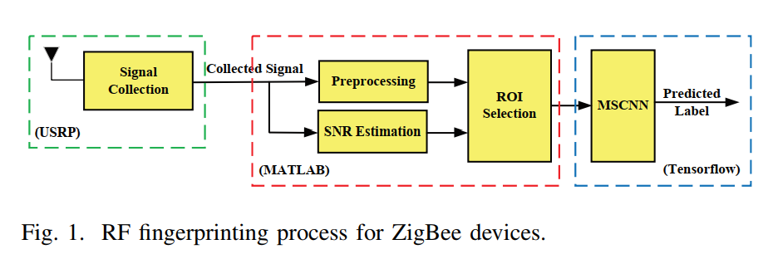
CNN

Slide 10
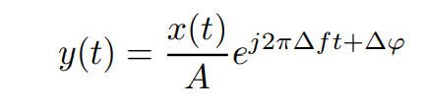
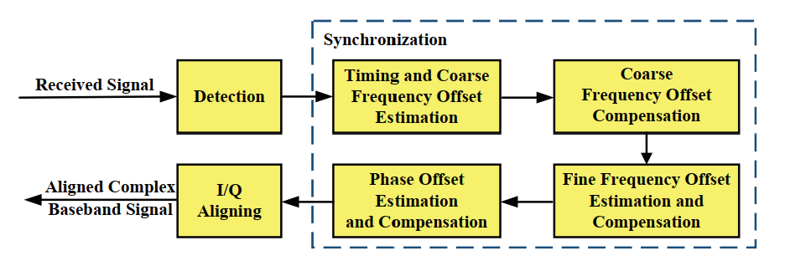
CNN

Slide 11
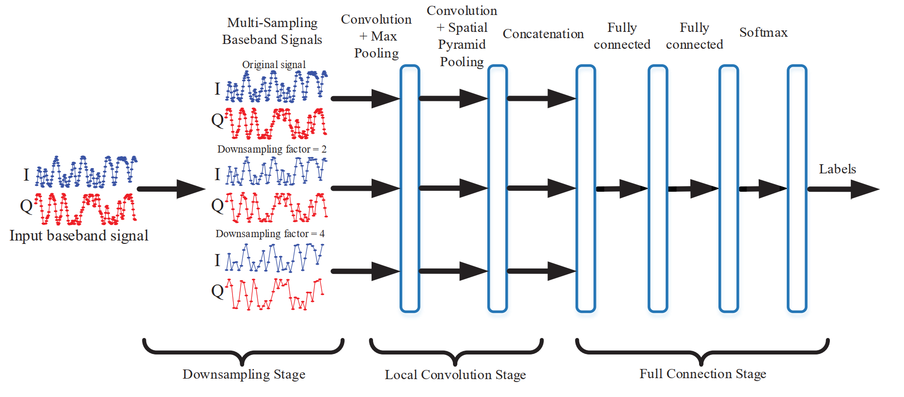
CNN

Slide 12
CNN

Slide 13
Emphasize Model

Slide 14
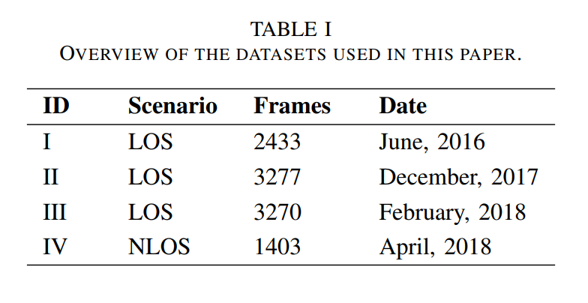
CNN
54 device

Slide 15
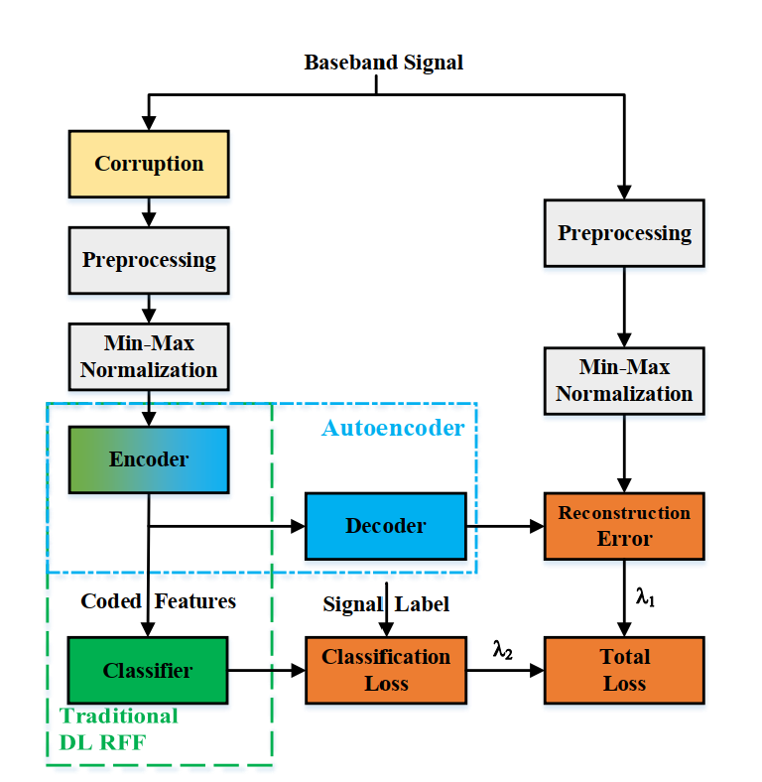
Denoise

Slide 16
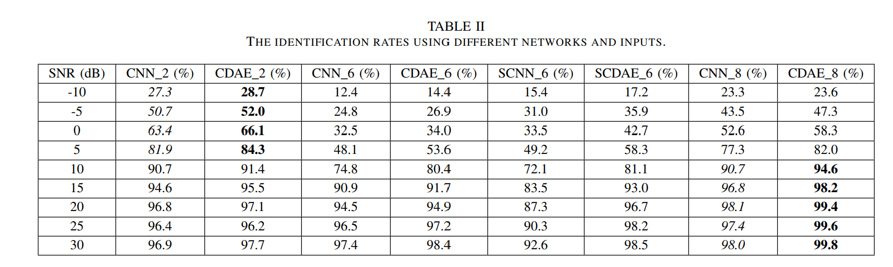
CADE

Slide 17

Thank You
RFML
https://github.com/HAL-42/RFML

