Slide 1




GLOBAL ACADEMY OF TECHNOLOGY
An Autonomous Institute, Affiliated to VTU Belagavi, Approved by AICTE, Accredited by NAAC, ’A’ Grade
Department of Computer Science & Engineering
(Accredited by NBA 2022-2025)
HACK-A-LEAGUE 3.0
#BEYONDINNOVATION
Project Title: [Office Seat Planner]
Team Name: The Clock Cycles
Team Number: Hal 54
Team Members: Abhinandan.S, Bhuvana.GH, Kiran K, Paavana.P
College Name: KSSEM, KSIT, Presidency University

Slide 2

PROBLEM STATEMENT
Office Seat Planner
Problem : Managing seat occupancy across multiple offices is challenging, especially with a planned growth to 3000 employees.
Key Issues | Goal
Inefficient Office Space utilization -> Higher real estate costs Tools to optimize-> Seat Planning Potential-> Scope to monitor | Develop a solution to streamline seat planning and enable cost savings while preparing for future growth.

Slide 3
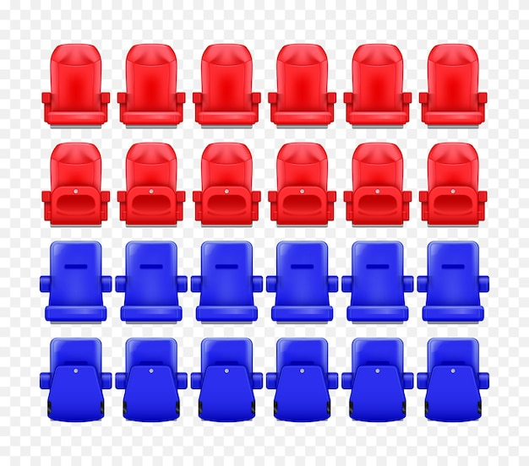
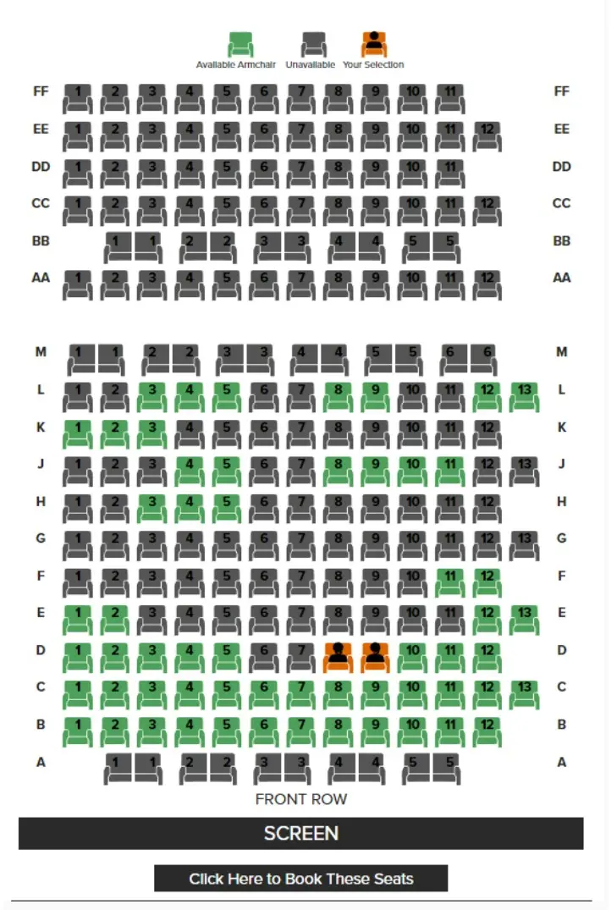
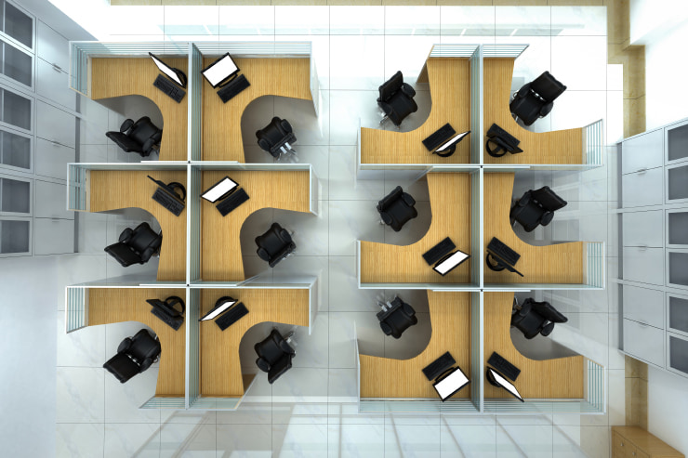
SCOPE
Solution:
Dynamic seat allocation 2.Real Time Tracking 3. Space Optimization
Benefits:
Significant real estate cost savings.
Scalable to meet future growth and its needs.
Integration with systems for seamless management.

Slide 4
SOLUTION REVIEW
Dynamic Allocation
Space Optimization
Automatically assign and manage Analyze layouts, recommend adjustments
Live Seat Tracking, prevent crowding, underutilization Accommodate to 3000+ employees
Reduce real estate and operational expenses
Key Impact: A smarter, scalable, and cost-effective solution for managing office spaces efficiently.
Real-Time Monitoring
Future-Ready Design
Cost Savings

Slide 5
TECHNICAL APPROACH
Technology | Tools | Methodology | Infrastructure
Frontend: React.js for an intuitive user interface. Backend: Node.js with Express for API development. Database: PostgreSQL for scalable and flexible data storage. | Real-Time Tracking: WebSocket, Firebase real-time database, Post for live seat occupancy updates. Integration: REST APIs for syncing with HR and facility systems. Security Measure: Role based access(RBAC), OAuth2.0 Authentication. Scalability: Supporting 3000+ users access. | Agile Development: Iterative approach to incorporate feedback and scale the solution. Data Visualization: Dashboards using google analytics. | Cloud hosting on Render/ Vercel IoT (optional) for advanced power and resource tracking.

Slide 6


IMPACT AND BENEFITS
3000
20%
Headcount
Cost Savings
Support anticipated growth while optimizing space.
[Estimated ]Reduce real estate expenses by optimizing space utilization.
15%
Resource Savings
[estimated ]Optimize energy consumption, reduce chill water usage, and minimize environmental impact.

Slide 7
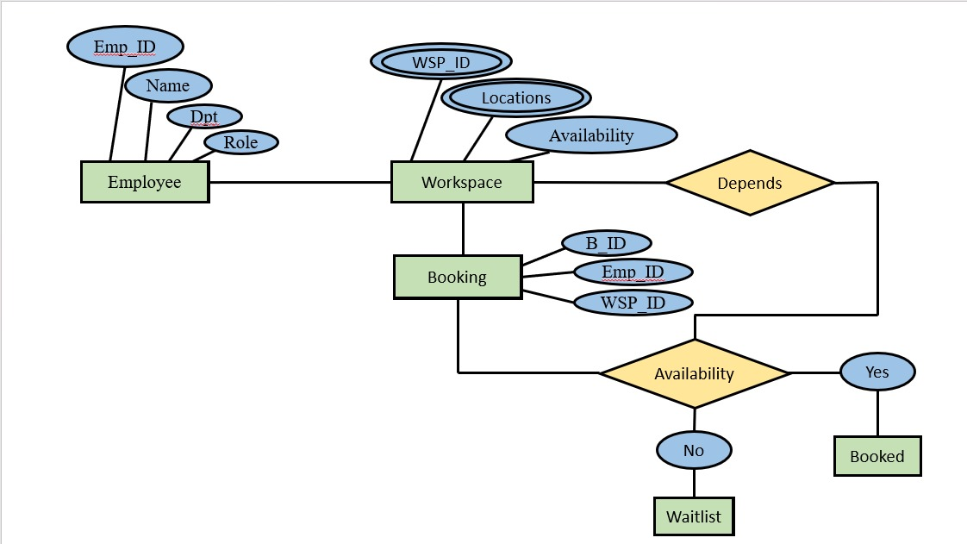
CONCLUSION
Core Problem: Optimizes seat allocation, reducing costs and improving utilization.
Scalability: Handles 3000+ employees across multiple offices.

Slide 8
Thank you

