Slide 1
Where we are, and what we need today
The worst predictions come from a few bad input lines — most of them fixable before the hybrid model
Since 14 Sep
• Etienne's root causes attached to the 100 worst SAM regions, one gallery sorted by cause
• A check that finds the survey that disagrees with the rest of its region, along the bank
• First test of two masks: the RWS side-channel register, and wider buffers around locks and moorings
Today we need
• Luke: the lines that go into the hybrid, both models per region — and the new Rijntakken height data
• Etienne: the cloud share on every SAM line (or re-exports at 0 % and 5 %), and a check of the masks
Next milestone
• Pre-meeting 14 Oct with RWS and Van Oord colleagues outside the core group
Oevererosietool · WOCU weekly 30-09-2026 · 1

Slide 2
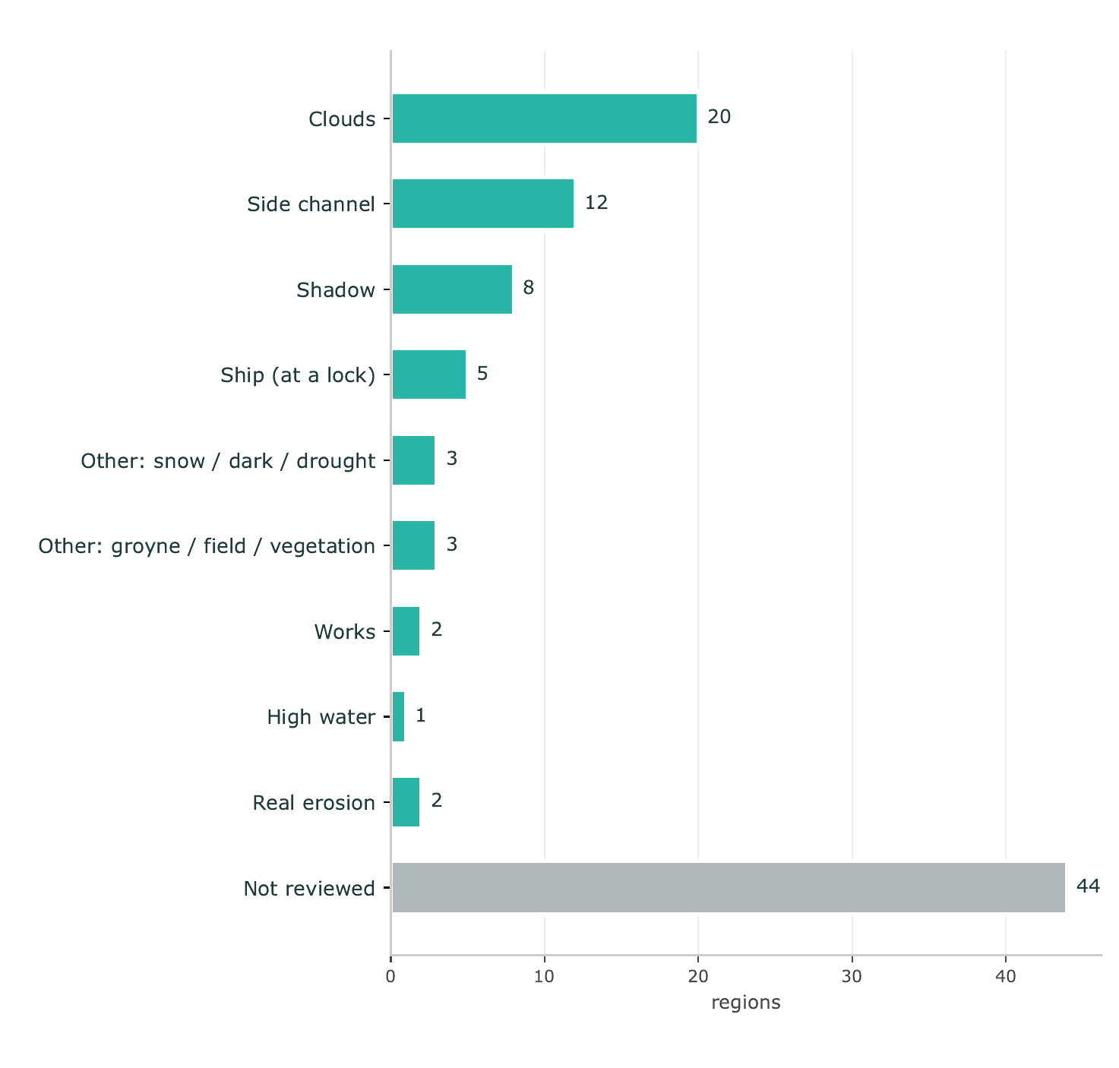
Why the worst regions are wrong
100 worst-predicted SAM regions after our cleaning — Etienne reviewed 56 on the satellite images
• Every one of these got through our current rules: the bad line looks like a normal bank line
• Clouds (20) and shadow (8) are image quality — fixable at the source
• Side channels (12) and moored ships (5) are geometric — fixable with a mask
• 85 of the 100 worst have SAM preference; all won the hybrid's points count, 44 by only 1–2 points
• Two are real erosion the model missed
Oevererosietool · WOCU weekly 30-09-2026 · 2

Slide 3
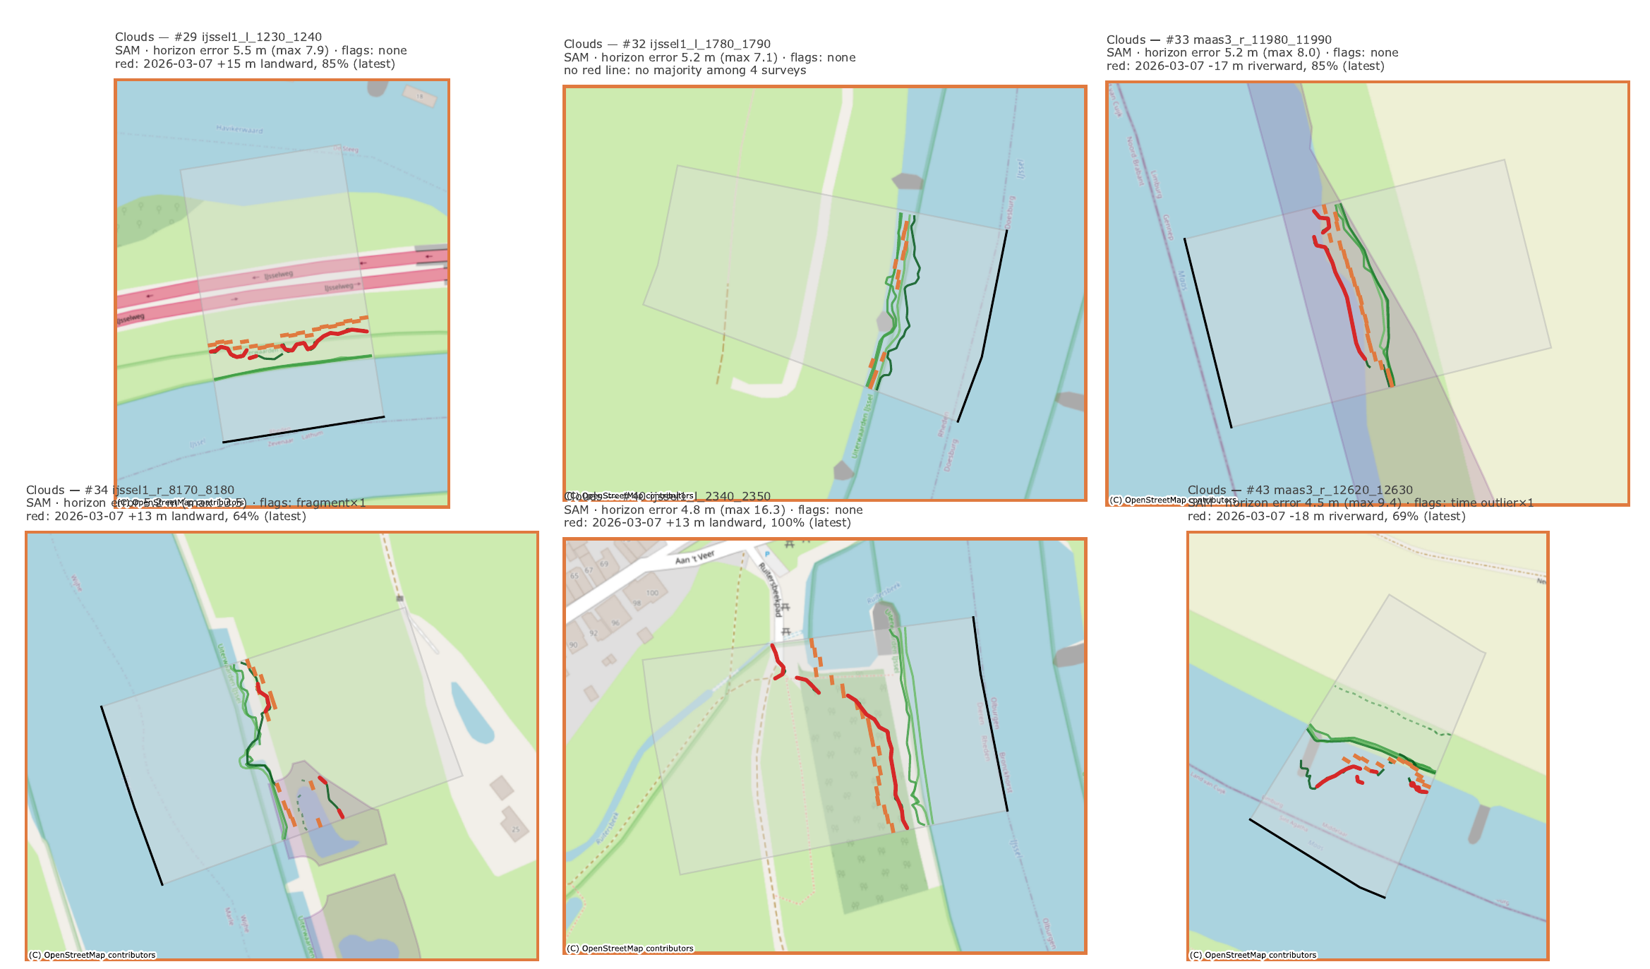
The bad line is usually the newest image
Red = the stretch of a survey that is 8 m or more off the agreeing majority of its region's surveys
• Cloud regions: in 14 of 20 the odd one out is the latest survey (March–April 2026), 12–38 m off
• Shadow: always riverward — a line in the water
• The existing trend rule misses them: they sit under its 15 m threshold
• Limit: real erosion on the latest image looks the same until the next image confirms it
• Hence the ask: the cloud share per line lets us drop these at the source
Oevererosietool · WOCU weekly 30-09-2026 · 3

Slide 4
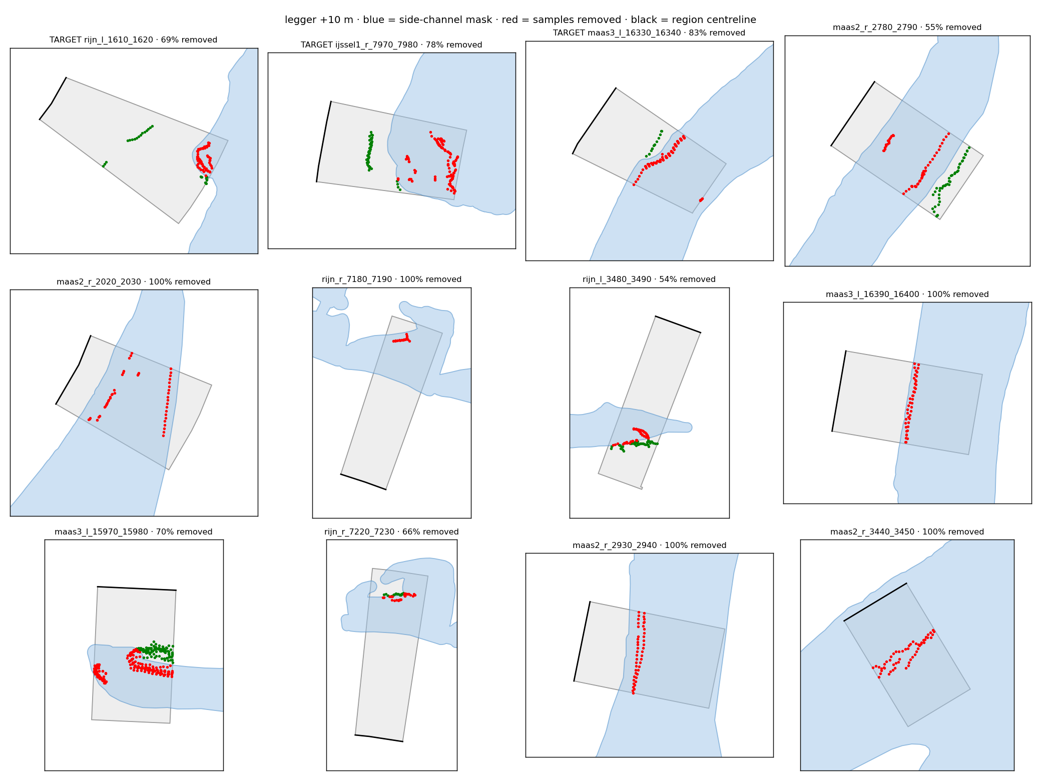
First mask results: side channels yes, ships not yet
Masks applied to the cleaned samples of the current run · not yet run through the model
Side channels — RWS nevengeulen register, +10 m
• Hits 5 of Etienne's 12 side-channel regions, removing 25–83 % of their samples
• Also hits 663 other regions; in a spot check most look like the same failure (the line found along the side channel, far from the river edge) — Etienne to review a sample
• The other 7: strangen and plassen not in the register
Ships — not locks, moored ships
• 4 of 5 ship regions lie 22–125 m from a mooring jetty; locks are 225 m to 4 km away
• A 100 m jetty buffer hits 3 of 5 but also 569 other regions — too blunt; needs a smarter rule
Left: 3 of Etienne's side-channel regions (TARGET) and 9 random other regions the mask hits by ≥ 50 %; red = removed.
Oevererosietool · WOCU weekly 30-09-2026 · 4

Slide 5
What we need from you
Lars, Sytze and Joost are away — Etienne and Luke, can you help?
who | what | why
Luke | The lines that go into the hybrid after your cleaning — both models per region, before the points count | Validate the preference; ~2,200 extra modellable regions. We have the raw inputs, not this set
Luke | New Rijntakken height data: available to us? time to process? in scope for the demo in 5 weeks? | A recent measurement for every Rijntakken region, whichever model wins
Etienne | Cloud share as an attribute on every SAM line (fallback: re-exports at 0 % and 5 %) — can you run Lars's pipeline? | The single biggest fix: 20 of the 56 reviewed failures are clouds
Etienne | Check the masks: right layer for side channels, right width around locks? | Before they change the numbers
Pam | Access to the Claap recordings after 2 Sep | Meeting notes to work from
Oevererosietool · WOCU weekly 30-09-2026 · 5

Slide 6
Towards 14 October
Pre-meeting with RWS and Van Oord colleagues outside the core group — a first outside look
Show
Stretch
To agree today
• Skill on VVR regions — where the tool matters
• The 50 worst VVR regions, with root causes
• Error on height-model vs SAM lines
• Effect of the masks on skill
• Cloud filter, if the attribute arrives
• Rijntakken with the new height data
• Who comes on 14 Oct, and what they expect
• Soft launch date and the asset-manager session
• When our section of the Phase 2 report is due
Oevererosietool · WOCU weekly 30-09-2026 · 6

