Slide 1
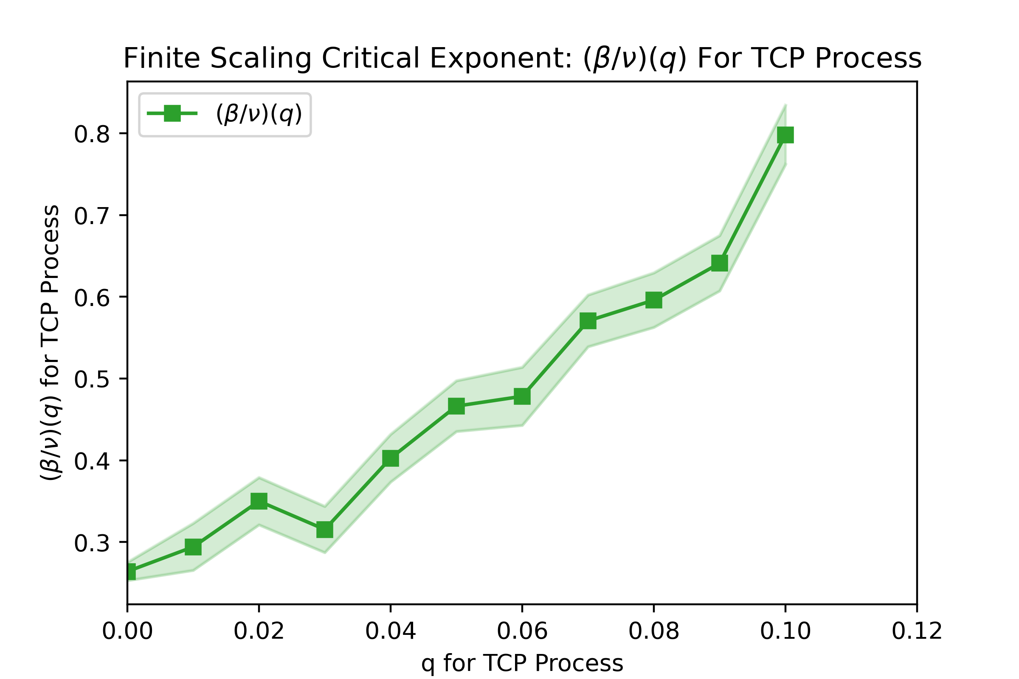
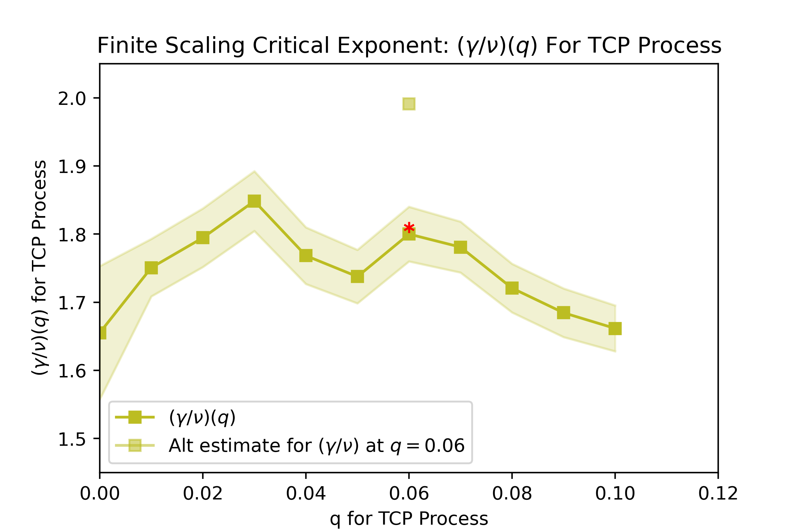
Finite Scaling Critical Exponent: (β/ν)(q) For TCP Process
(a)
(β/ν)(q) For TCP Process
q For TCP Process
Finite Scaling Critical Exponent: (γ/ν)(q) For TCP Process
(b)
(γ/ν)(q) For TCP Process
q For TCP Process

