Slide 1

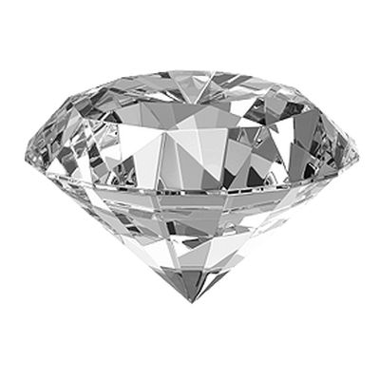
Diamond price predection
2022 - Oct

Slide 2



Create efficient Model
https://www.kaggle.com/competitions/shai-ml

Slide 3
.01
Overview
Info()
No none_values
describe()

Slide 4
.02
Preprocessing
Drop “ Unnamed: 0 ”
Label Encoder( ‘ color ’ , ‘ cut ’ , ‘ clarity ’ )

Slide 5
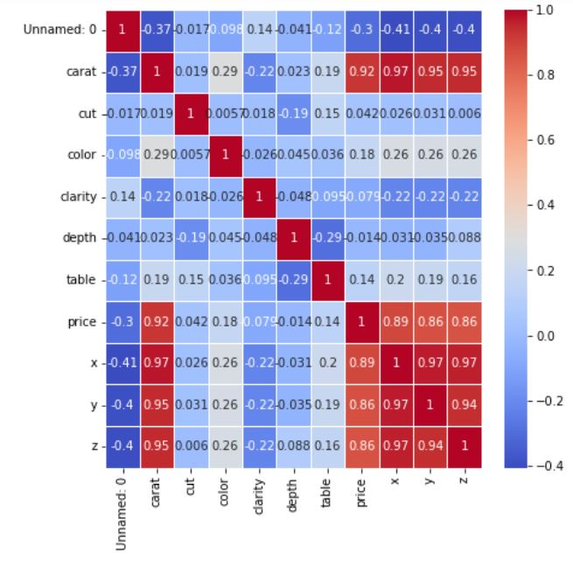
.03
Visualization
Heatmap
Correlation
between ‘ carat ’ & ‘ x ’ , ‘ y ’ , ‘ z ’
Drop ( ‘ x ’ , ‘ y ’ , ‘ z ’)

Slide 6
.04
Split Training Data
Train_data
test size
= 0.3
Training mdel
Test model
Y_train
X_train
X_test
Y_test

Slide 7
.05
Training Model
LinearRegression → accuracy is: 0.882
DecisionTreeRegressor → accuracy is: 0.963
RandomForestRegressor→ accuracy is: 0.979

Slide 8
Revision
Delete rows with the values x | y | z = 0
Vol = x*y*z
Delete the large Outliers
((df0['vol'] < 120 ) & (df0['carat'] > 1 ) & (df0['carat'] < 2 )).sum()
Normalization

Slide 9
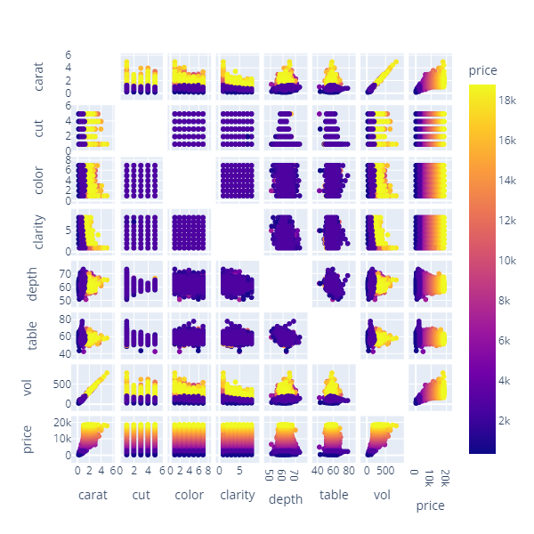
Revision

Slide 10
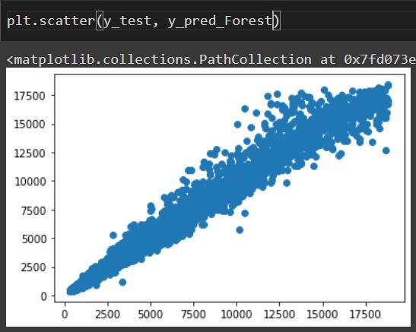
Revision
================================================== RandomForestRegressor Model ======================================================
accuracy is: 0.9828

Slide 11

Thank you For Listening

