Slide 1

DriverPass System Analysis
Submitted by:
Hamna Khalid
ID #: 2902671
Submitted To:
Professor Parul Hirpara
CS-255 Systems Analysis and Design
Southern New Hampshire University
Thursday, October 16, 2025
Notes:
Hello Everyone,
This presentation summarizes the DriverPass system design. I’ll walk through the system requirements, core diagrams, security design, and limitations. The goal is to show how this system helps reduce DMV test failure rates while ensuring efficiency and security for all users.

Slide 2
System Requirements
Functional Requirements
Users can register, log in, and manage their accounts.
Students can schedule, modify, and cancel driving lessons online.
Nonfunctional Requirements
The system must have 99.9% uptime with encrypted HTTPS connections.
Must be accessible through web and mobile devices.
Notes:
The system requirements for DriverPass are divided into functional and nonfunctional types.
Functional requirements describe what the system does. For example, allowing students to book, modify, or cancel lessons ensures flexibility, while progress tracking keeps students and instructors informed of learning outcomes.
Nonfunctional requirements describe how the system performs. For instance, a cloud-based platform with high uptime and strong security guarantees reliability and user trust. These requirements meet DriverPass’s goals of improving DMV test preparation by ensuring that the system is always available, efficient, and secure for students and staff alike.

Slide 3
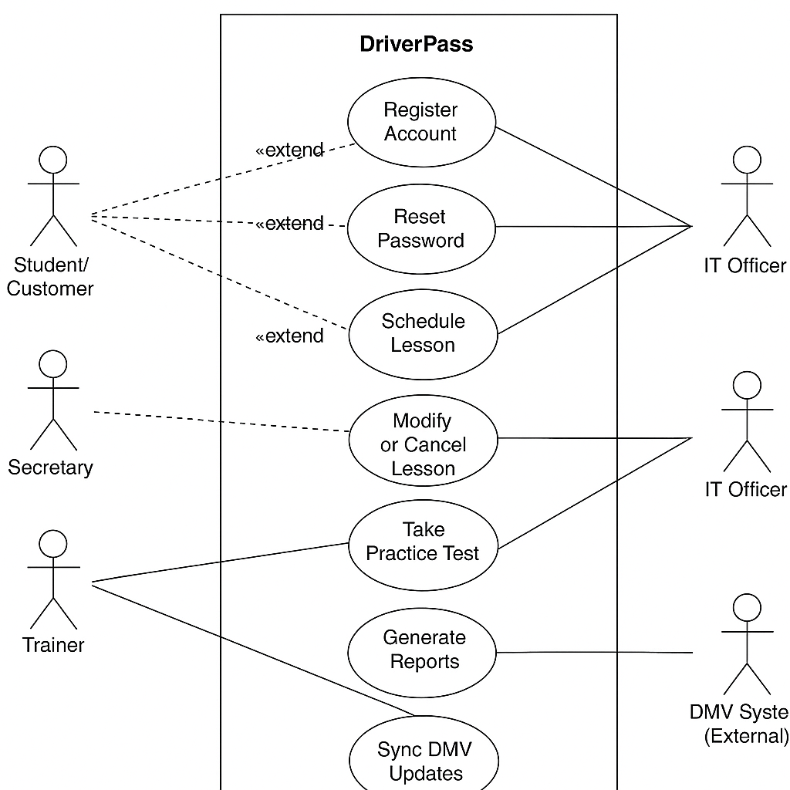
Use Case Diagram
Notes:
This diagram shows how different people and systems interact within DriverPass to make everything work smoothly.
On the left, you have the students who can create an account, log in, schedule lessons, and take practice tests. Secretaries can help manage reservations for students who prefer to book by phone or in person.
Trainers record lesson progress and provide feedback after each session.
On the right side, the IT officer is responsible for managing system access, resetting passwords, and keeping everything running securely.
The DMV system automatically shares updates on new laws, rules, or test questions, so DriverPass always provides the most current information.
This layout ensures that each part of the DriverPass program connects, from booking lessons to staying compliant with DMV standardsso students can focus on learning confidently and passing their tests on the first try.

Slide 4
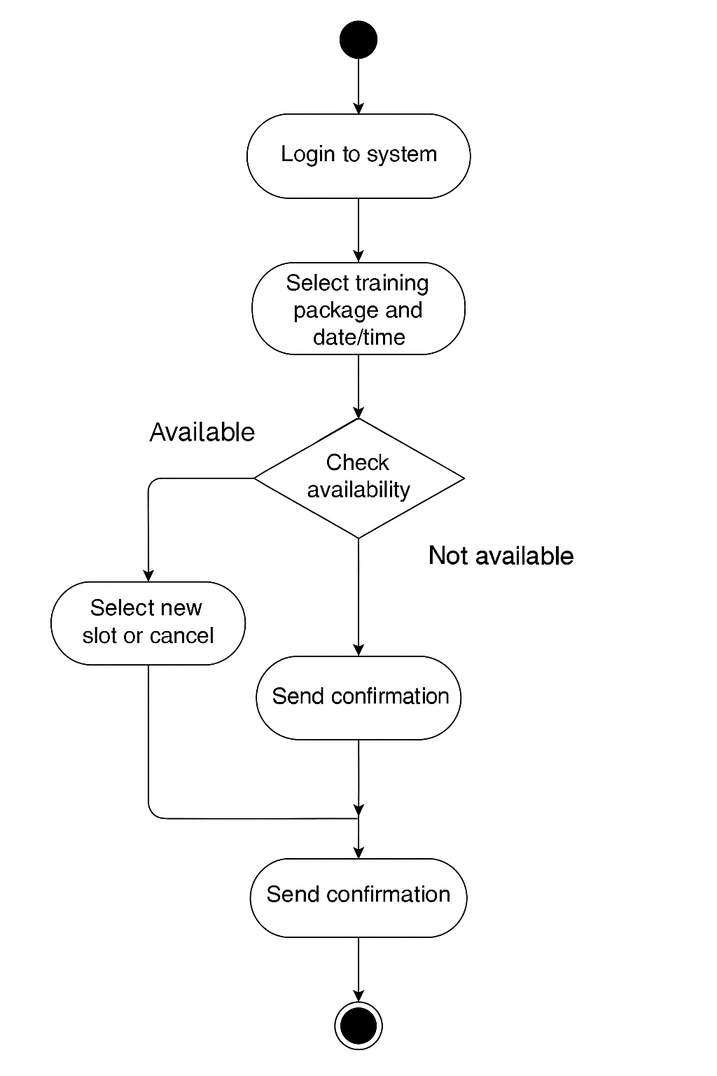
Activity Diagram
Notes:
This diagram shows how a student or secretary books a driving lesson in the DriverPass system.
It starts when the user logs in and chooses a training package along with their preferred date and time. The system automatically checks whether a trainer and a car are available for that slot.
If everything is available, the system confirms the booking and sends a confirmation message to the user. If the chosen time isn’t available, the system lets the user pick another time or cancel the booking.
This process ensures that DriverPass lessons are scheduled smoothly without conflicts, saving time for both students and staff while keeping the booking process simple and reliable.

Slide 5
Security
Secure login with encrypted communication
Role-based permissions for students, trainers, secretaries, and IT staff
Automatic account lock after failed login attempts
Regular activity logging and monitoring
Integration with secure third-party payment services
HTTPS encryption for all online traffic.
Notes:
Security is a top priority for DriverPass because the system manages personal and payment information for students and staff.
The design includes secure logins and encrypted connections so that sensitive data can’t be intercepted online. Each user, whether a student, trainer, or IT officer, has access only to what they need through role-based permissions.
If someone enters the wrong password multiple times, their account is temporarily locked, helping prevent unauthorized access. The system also logs all actions, so administrators can see who made changes or updates if issues arise.
Finally, DriverPass uses secure third-party payment processors instead of storing card data itself, ensuring compliance with industry standards and protecting customer trust.
Altogether, these steps create a safe, transparent environment that allows DriverPass to operate confidently and securely.

Slide 6
System Limitations
Requires a stable internet connection for all users.
Depends on DMV’s timely updates for rules and test materials.
Limited to online and in-office scheduling; no offline access.
Does not include mobile app functionality in the first release.
Relies on third-party services for payments and hosting.
Advanced features (e.g., GPS tracking) may be added later.
Notes:
Like any new system, DriverPass has a few limitations we’ll want to be aware of.
The system relies on a stable internet connection, so users need access to Wi-Fi or data when booking lessons or taking practice tests. It also depends on the DMV providing regular updates, since that’s where new laws and driving test materials come from.
At launch, DriverPass will be available through a web portal only; a mobile app version is planned for future development. Similarly, some advanced options like real-time vehicle tracking or detailed analytics may come later once the system matures.
Lastly, certain parts of the system, such as payment processing and hosting, rely on trusted third-party services. This ensures safety and efficiency but also means some control is shared with external providers.
Despite these small limitations, the overall design still delivers everything DriverPass needs to reduce test failure rates and improve student performance efficiently.

Slide 7
THANK YOU
Notes:
THANK YOU! HOPE YOU HAVE A GREAT DAY! -HAMNA KHALID.

