Slide 1


Final Year Project Proposal
SELF-DESTRUCT MESSENGER
(SDM)
Supervised By: Dr. Jawaid Iqbal
Assistant professor

Slide 2
Project Team
Muhammad Aatif Khan (38587)
Hamza Zawari Khalid (35772)
Syed Abdurrehman (31980)

Slide 3
Table of Content
Opportunities and Stakeholders
Existing Systems
Problem Statement
Proposed Solution
Project Scope
Progress Report Summary
Next Steps
Prototype
References

Slide 4

OPPORTUNITIES AND STAKEHOLDERS

Slide 5
OPPORTUNITIES
Enhanced Security for Sensitive Communications:
Secure platform for confidential communication.
Ideal for legal, medical, and corporate settings.
Features like dynamic encryption and session-based message deletion.
Market Demand for Privacy-Centric Solutions:
Addresses growing concerns over data privacy.[2]
Significant opportunity in the privacy-focused market.[2]
Tailored for industries requiring high security.
Innovation in Secure Messaging:
Advances in secure communication technologies.
Dynamic encryption, anti-screenshot measures, and real-time requirements.
Pioneering features set a new standard in secure messaging.

Slide 6
STAKEHOLDERS
Government Agencies & Law Enforcement: Need secure channels for sensitive data exchange, national security, and investigations
Security Professionals: Require secure tools for discussing vulnerabilities, threat intelligence, and confidential data
Businesses & Corporations: Companies handling sensitive information (e.g., finance, healthcare, legal) need secure communication to comply with data regulations
End Users: Individuals who prioritize privacy, including legal professionals, healthcare providers, and executives

Slide 7
EXISTING SYSTEMS

Slide 8
Existing Systems
Features | Dynamic Encryption | Automatic Message Deletion | Real-Time Communication Requirement | Anti-Screenshot Measures | Google/Email Authentication | Backup on Server
Signal | ✔ | ! | ✘ | ✘ | ✘ | ✔
Telegram | ✔ | ! | ✘ | ✘ | ✘ | ✔
WhatsApp | ✔ | ✘ | ✘ | ✘ | ✘ | ✔
Botim | ✔ | ✘ | ✘ | ✘ | ✔ | ✔
Snapchat | ✔ | ! | ✘ | ✔ | ✔ | ✔
Our system | ✔ | ✔ | ✔ | ✔ | ✔ | ✘
Feature exists
Feature doesn't exists
Feature exists to some extent
✔
✘
!

Slide 9
PROBLEM STATEMENT

Slide 10
PROBLEM STATEMENT
Static Encryption Keys:
Use of a single key for all communications.
Increases vulnerability if the key is compromised.
Persistent Messages:
Long-term message storage can lead to unauthorized access.[2][6]
Poses risks of message recovery by unintended parties.[2][6]
No Real-Time Requirement:
Communication allowed even if one party is offline.
Can lead to potential security compromises.
No Anti-Screenshot Measures:
Lack of screenshot prevention features.[3]
Risks unauthorized sharing of sensitive information.[3]

Slide 11
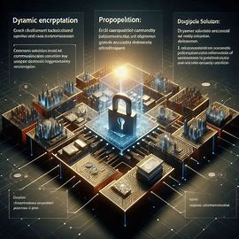
PROPOSED SOLUTION

Slide 12
PROPOSED SOLUTION
Dynamic Encryption:
Constantly changing encryption keys
Enhances data security
Protects even if a key is compromised
Automatic Message Deletion:
Messages self-delete after a set time or event.[1]
Reduces risk of sensitive information exposure.[2]
Real-Time Communication Requirement:
Ensures instant message or data exchange
Crucial for time-sensitive information
Anti-Screenshot Measures:
Prevents or detects unauthorized screenshots.[3]
Protects content from being shared without permission.[3]

Slide 13
PROPOSED ARCHITECTURE

Slide 14
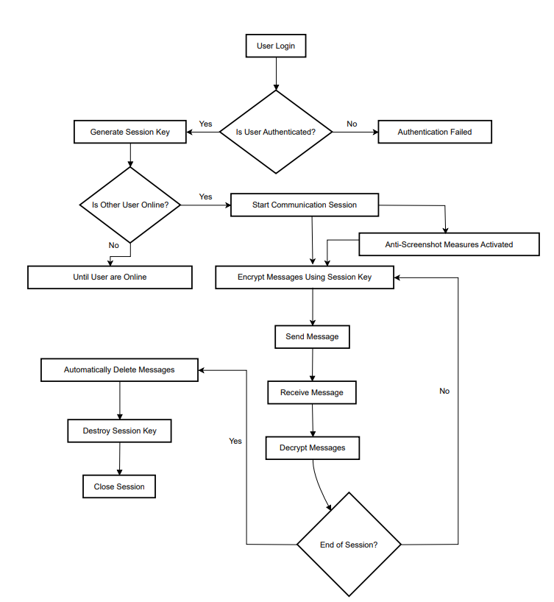
PROPOSED ARCHITECTURE

Slide 15
PROJECT SCOPE

Slide 16
PROJECT SCOPE
User Authentication: Ensures only authorized users can access the system.
Secure Key Exchange: Safely transfers encryption keys between communicating parties.
Dynamic Encryption: Generates unique encryption keys for each session to secure communication.
Real-Time Communication: Enables live, secure exchanges between users in real time.
Automatic Message Deletion: Deletes messages once a session ends or users disconnect.
Anti-Screenshot Measures: Prevents users from capturing screenshots of conversations.
User Interface & Experience: Focuses on creating an intuitive, user-friendly interface.
Chat Interface: Provides a simple and secure space for text-based real-time communication.
Session Status Indicators: Displays real-time information about session activity or user presence.
System Design & Architecture: Blueprint for integrating all components with scalability and security.
Security Testing: Assesses system vulnerabilities through rigorous testing methodologies.
Deployment & Monitoring: Ensures system functionality and security post-launch with continuous
monitoring.

Slide 17

PROGRESS REPORT SUMMARY
Requirements
Software System (Design + Implementation + Testing)
Endeavour (Team + Work + Way of Working)

Slide 18
REQUIREMENTS

Slide 19
REQUIREMENTS
Core Objectives
Ensure secure, real-time communication between users.
Implement ephemeral messaging with automatic deletion.
Employ dynamic encryption to mitigate risks associated with static keys.
Anti-screenshot measures to prevent content capture.
Functional Requirements
Real-time chat accessible only when both parties are online.
Anti-screenshot measures to prevent content capture.
Secure user authentication with robust access control.
Non-Functional Requirements
High performance with minimal latency for real-time messaging.
Scalability to handle an increasing number of users.
Reliable and intuitive user interface for ease of use.

Slide 20
HARDWARE REQUIREMENTS
Development Machine Requirements
Processor: Quad-core or higher.
RAM: Minimum of 8 GB, recommended 16 GB for multitasking
Storage: At least 10 GB
Operating System: Windows, macOS, or Linux
Device Requirements for Testing
Physical Devices:
Android: Version 5.0 (Lollipop) or higher.
iOS: Version 11.0 or higher.
Emulators:
Android Virtual Device (AVD) and iOS Simulator to replicate various environments for compatibility testing.
End-User Device Requirements
Operating System:
• Android: Version 8.0 (Oreo) or higher. • iOS: Version 11.0 or higher.
Hardware:
Processor: Octa-core for Android, A10 chip or higher for iOS.
RAM: Minimum of 3 GB to handle encryption and multitasking.
Storage: 200 MB of free space for app data.
Display: 720p or higher for clear UI.
Connectivity:
Network: Reliable internet connection (Wi-Fi or 4G/5G) for real-time messaging.

Slide 21
SOFTWARE REQUIREMENTS
Development Environment.
Android studio
Visual Studio Code
Code Spell checker
Dart
C++
Flutter
Jira and bitbucket
Material Icon Them
YAML
Firebase
Firebase Realtime Database
Firebase Authentication

Slide 22
Design Summary
User Logged In?
Splash
Screen
LoginScreen
Google Sign-In
Firebase Auth Updates User
HomeScreen
ProfileScreen
ViewProfileScreen
ChatScreen
Logout
Send Message via Firestore
Send Media via Firebase Storage
SignOut from Firebase

Slide 23
Real-Time Communication
Firestore Document Changes?
User Opens Chat Screen
Stream Sends Updated Data
NO
Wait for Changes
YES
Stream Sends Updated Data
UI Updates for All Users
UI Updates with New Messages
Firestore Updates Other Clients
User Sends Message
Message Added to Firestore
Api.sendMessage to Firestore

Slide 24
GOOGLE AUTHORIZATION
Google Sign-In
Start Google Sign-In
Show Progress Bar
Call _signInWithGoogle
Error
Show Error in Snackbar
User Chooses Account
Error
Get Google Authentication Credentials
Navigate to HomeScreen
YES
Check If User Exists
Create GoogleAuth
Provider Credential
Create User in Firebase Database
NO
Sign in with Firebase Authentication

Slide 25
TESTING

Slide 26
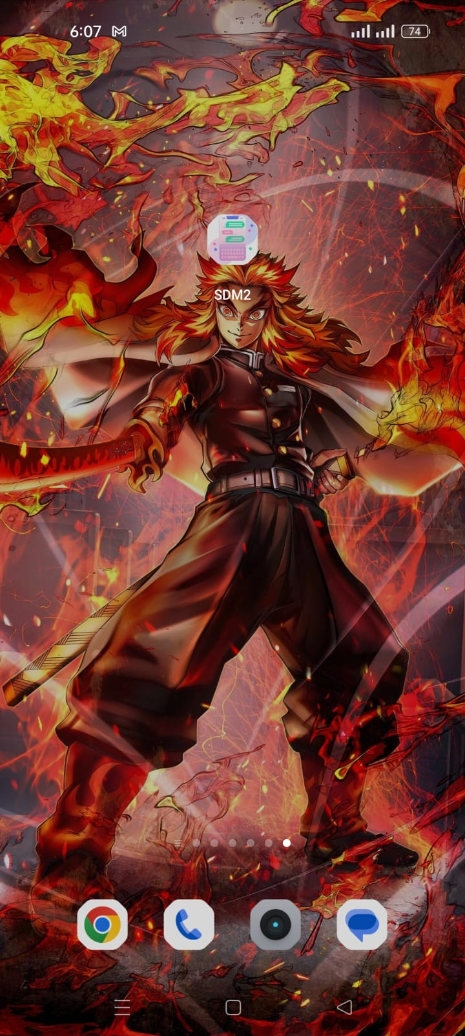
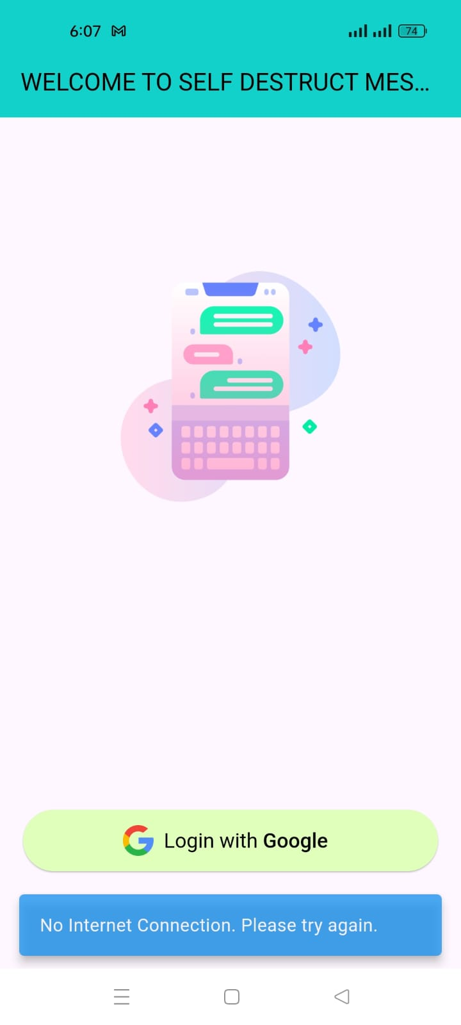
Testing without Internet case 1

Slide 27
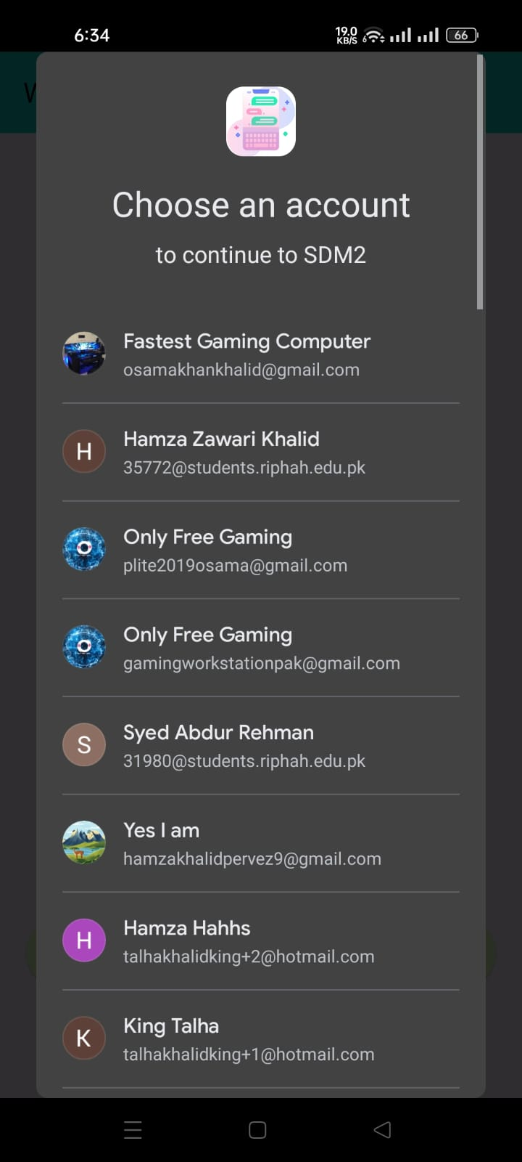
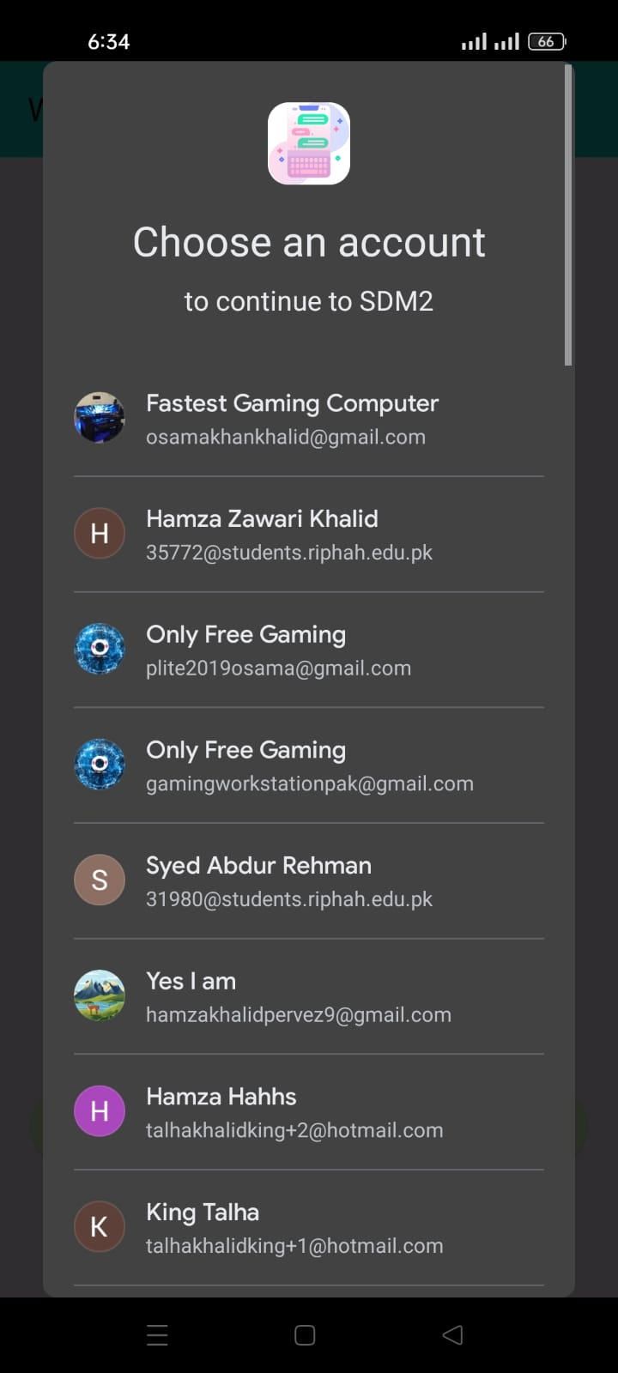
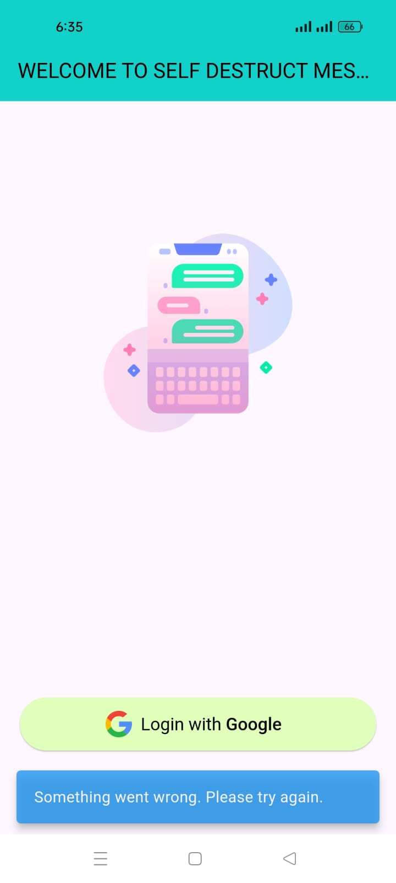
Testing without Internet case 2

Slide 28
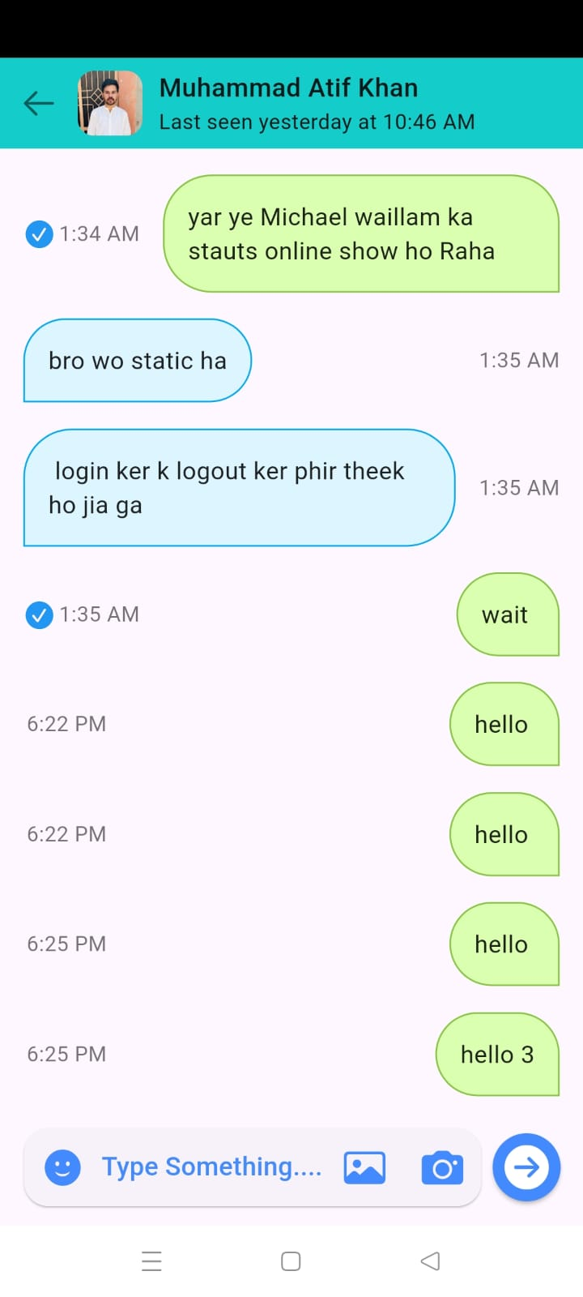
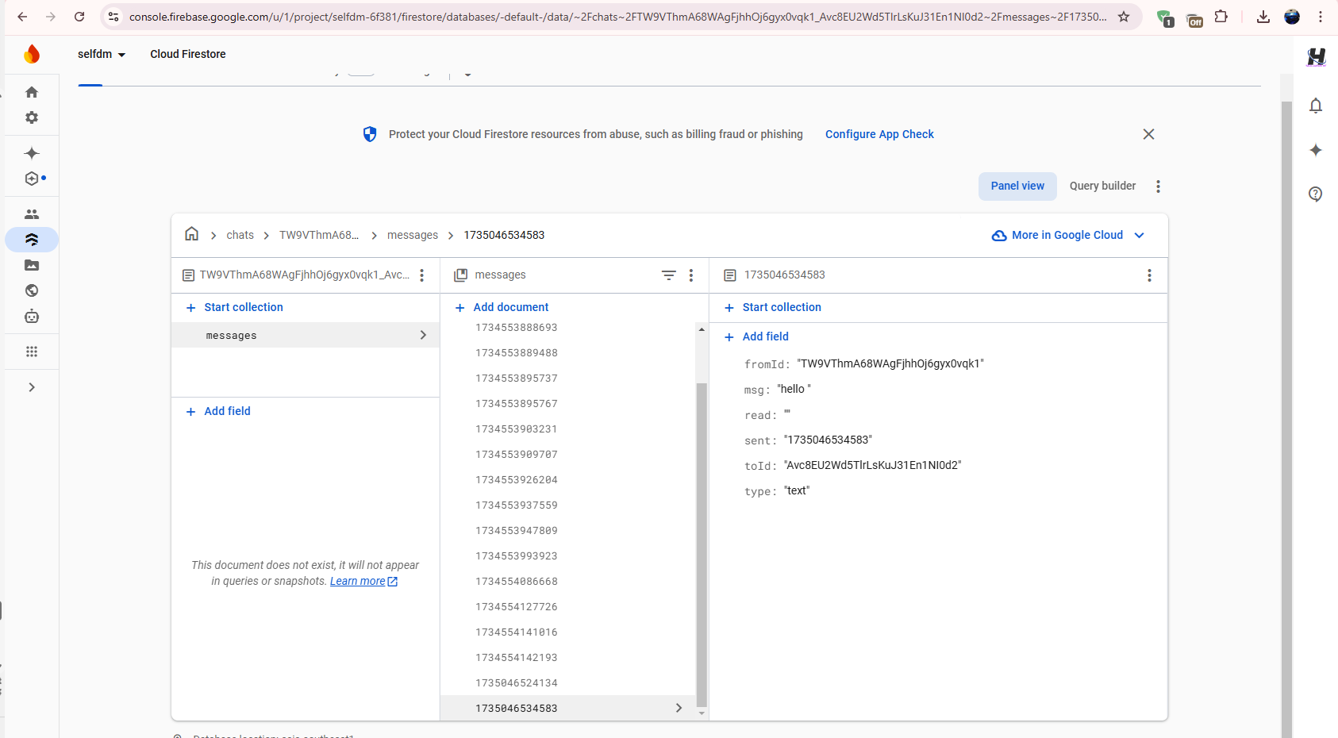
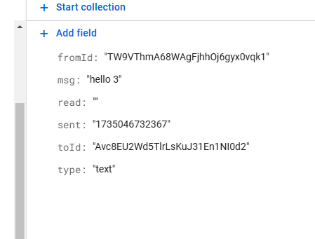
Testing without Internet case 3

Slide 29
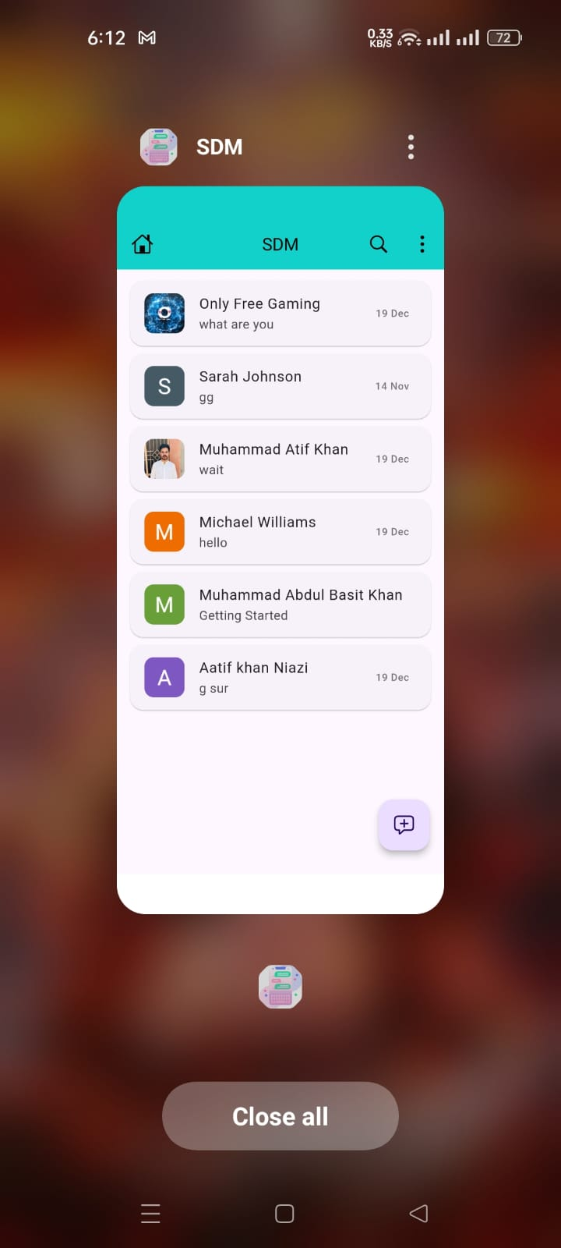
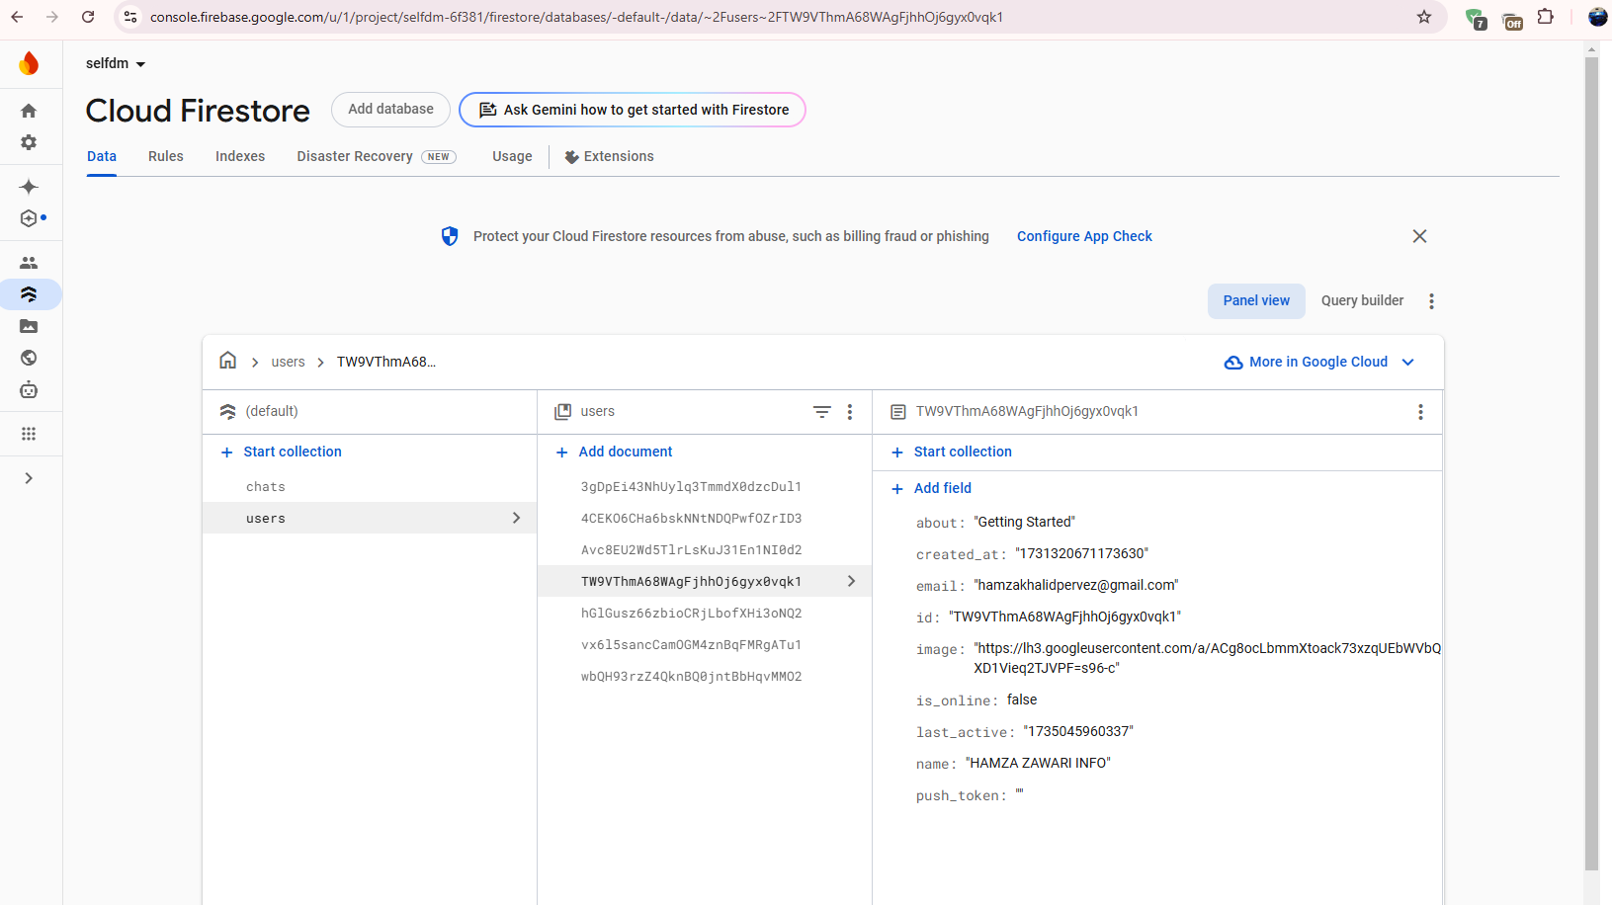
Testing the online/offline status case 1

Slide 30
ENDEAVOUR

Slide 31
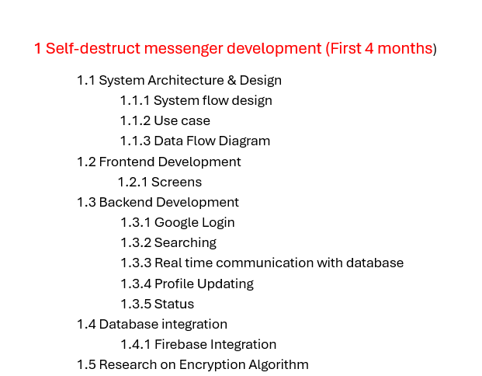
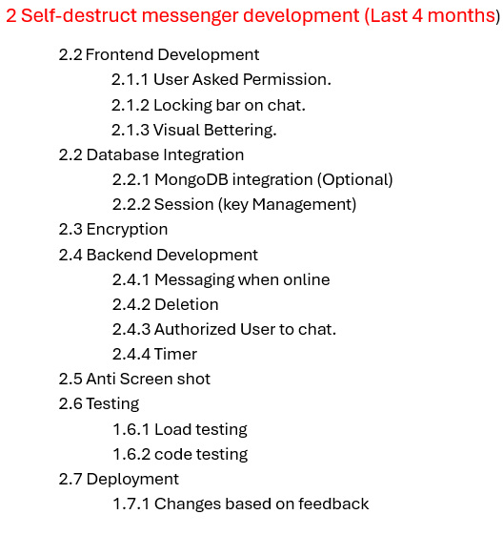

Slide 32
WBS # | WBS Deliverable | Duration | Tools/Technologies | Activity # Description | Responsible Team Member(s) & Roles(s)
1 | System Architecture & Design | 2 weeks | UML, Wireframes, Draw.io | Design architecture, define system flow, UI/UX wireframes, and real-time flow. | Muhammad Aatif Khan, Hamza Zawari Khalid, Syed Abdurrehman
2 | Frontend Development | 4-6 weeks | React.js/Flutter | Build the web and/or mobile app interface, real-time messaging UI. | SyedAbdurrehman Hamza Zawari Khalid,
3 | Backend Development | 6-8 weeks | Dart C++, other | Develop APIs, WebSocket handling, authentication, and encryption features. | Hamza Zawari Khalid, Muhammad Aatif Khan
4 | Real-Time Communication | 3 weeks | WebSocket, Firebase (Optional) | Implement WebSocket connections and real-time updates. | Muhammad Aatif Khan,
5 | Encryption Features | 4 weeks | Crypto, OpenSSL, PyCryptodome | Implement dynamic encryption, RSA/AES for key exchange and secure communication. | Hamza Zawari Khalid,
6 | Anti-Screenshot & Privacy | 2 weeks | Native APIs (Android/iOS) | Develop anti-screenshot features for mobile apps. | Muhammad Aatif Khan,
7 | Database Integration | 3 weeks | MongoDB, Redis more could be added | Set up session management, user metadata, and encryption key storage. | Muhammad Aatif Khan, Hamza Zawari Khalid,
8 | Testing & Security Audits | 4 weeks | OWASP ZAP, Pen Testing Tools | Conduct penetration testing, monitor security protocols, and test vulnerabilities. | Syed Abdurrehman
9 | Deployment | 2 weeks | In Real time Environment | Deploy the app to production environments and ensure security with SSL/TLS. | Syed Abdurrehman
>40% and <60%
>70% and <80%
Done

Slide 33
NEXT STEPS

Slide 34
NEXT STEPS
Implement Dynamic Encryption
Friend List Requirement for Communication
Automatic Message Deletion on User Offline
Implement Anti-Screenshot Feature

Slide 35
PROTOTYPE

Slide 36


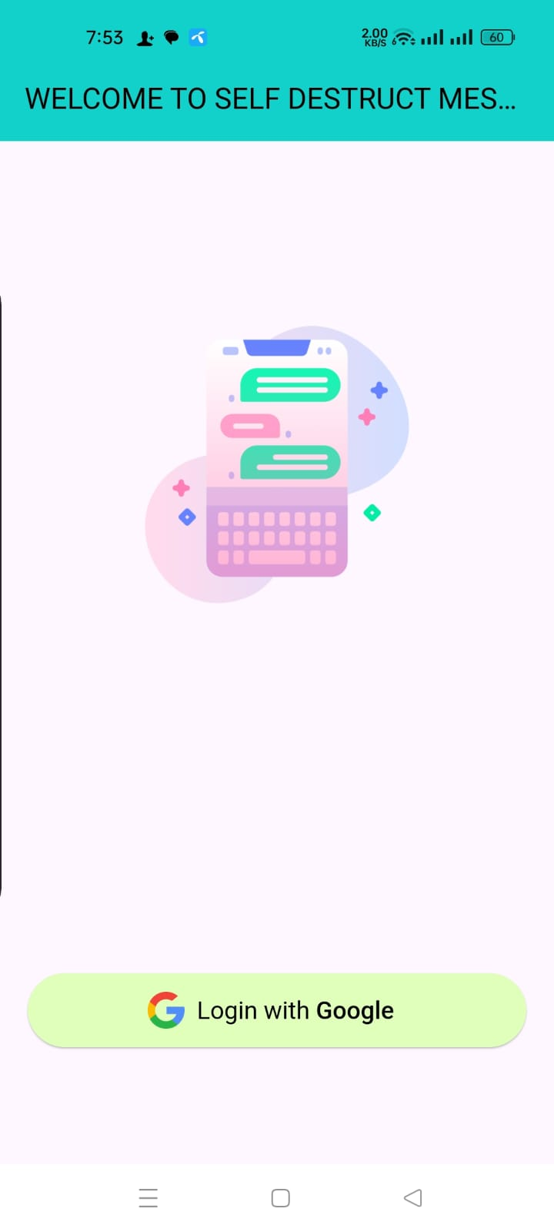
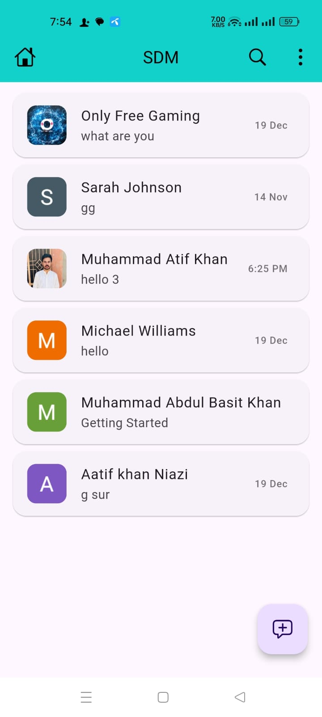
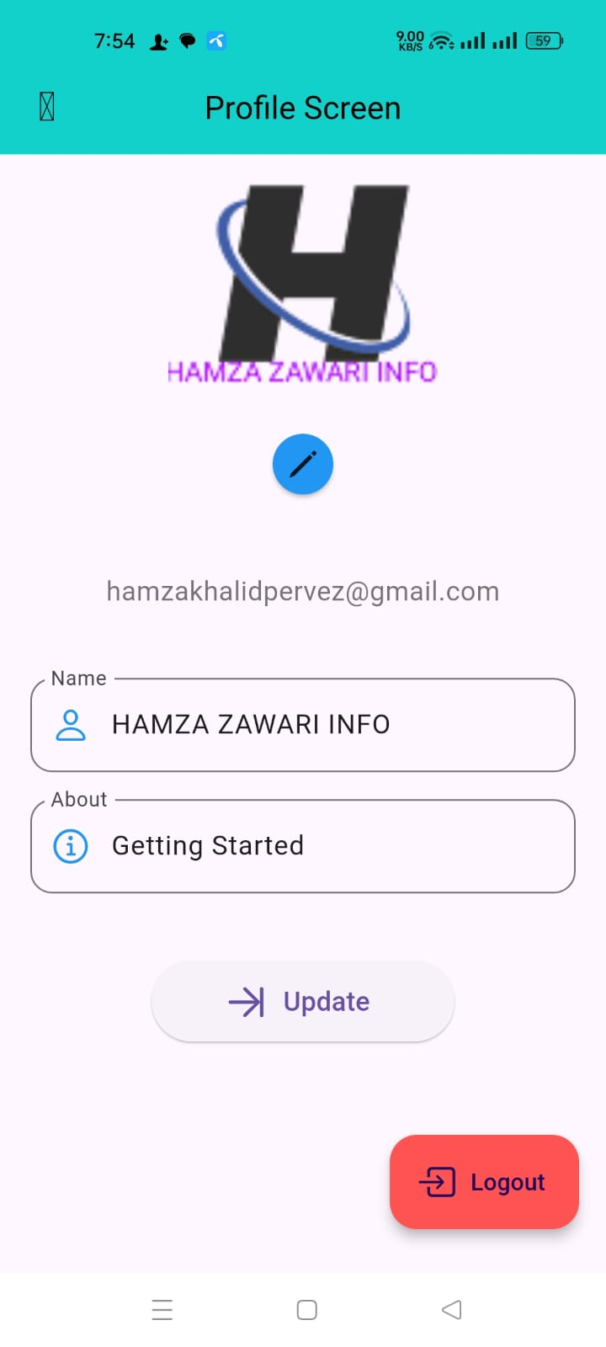
PROTOTYPE

Slide 37

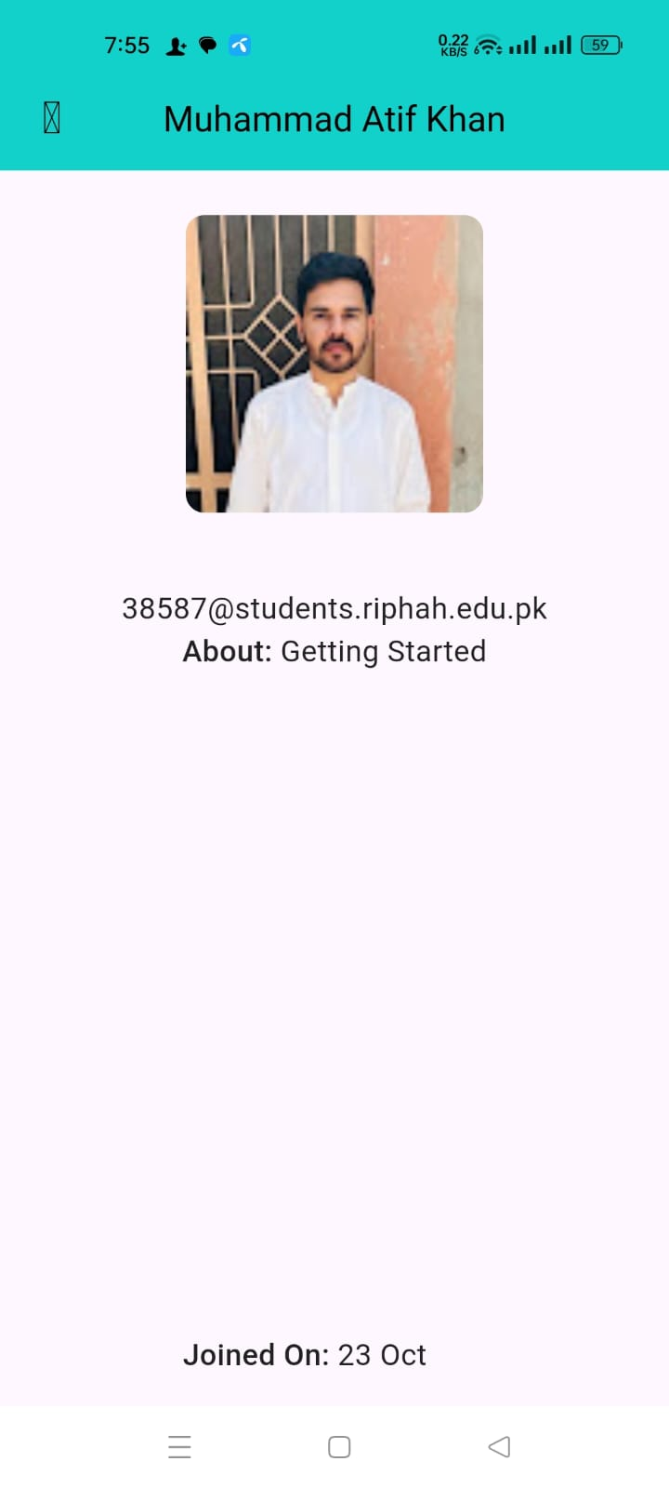
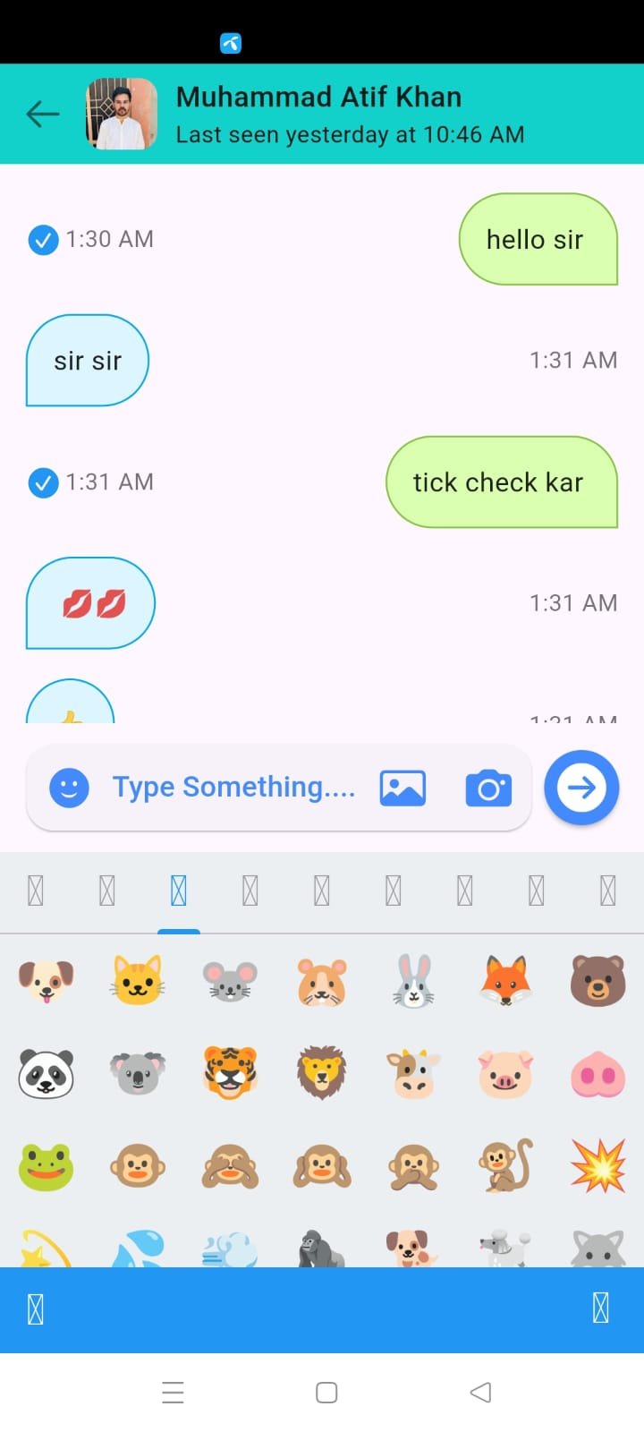
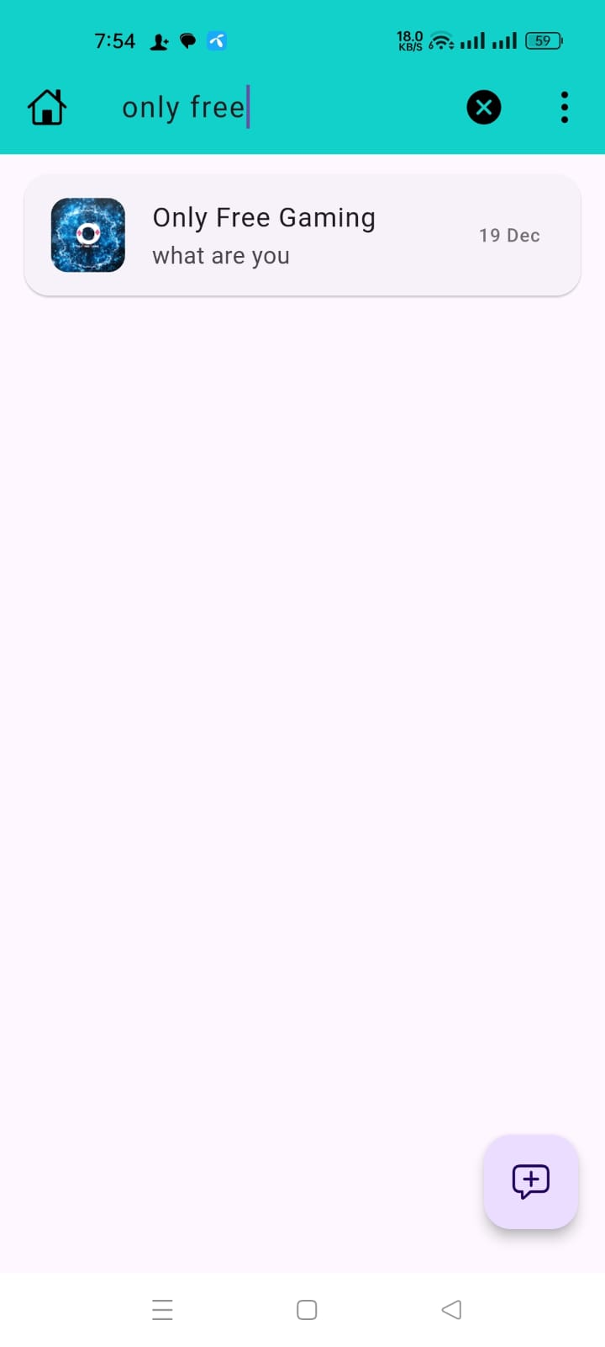
PROTOTYPE

Slide 38
REFERENCES
[1] Schnitzler, Theodor, et al. "Exploring user perceptions of deletion in mobile instant messaging applications." Journal of Cybersecurity 6.1 (2020): tyz016.
[2] Heath, Howard, Áine MacDermott, and Alex Akinbi. "Forensic analysis of ephemeral messaging applications: Disappearing messages or evidential data?." Forensic Science International: Digital Investigation 46 (2023): 301585.
[3] Qiwei, Li, et al. "Feminist Interaction Techniques: Deterring Non-Consensual Screenshots with Interaction Techniques." arXiv preprint arXiv:2404.18867 (2024).
[4] https://www.slashgear.com/769717/snapchat-is-not-private-nor-is-it-safe/

Slide 39
REFERENCES
[5] https://www.whatsapp.com/legal/privacy-policy-eea
[6] https://telegram.org/privacy?setln=fa

Slide 40
THANK YOU!

