Slide 1
Trajectory Prediction for Lower Limb Exoskeleton Robot
Team4
Hyeongwoo Nam
Jaewoong Han
~

Slide 2
Contents

Slide 3
1. Motivation and Backgrounds

Slide 4
2. Goal of project

Slide 5
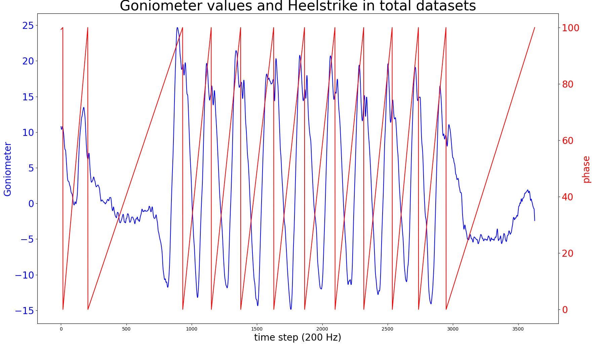
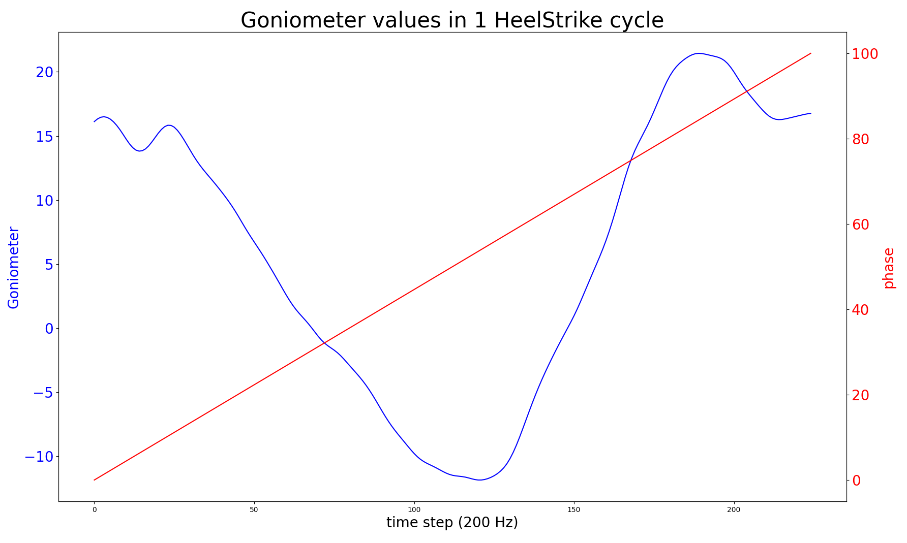
3. Problem statement

Slide 6
3. Problem statement
3.1 Estimation Part

Slide 7
3. Problem statement
3.2 Prediction Part

Slide 8
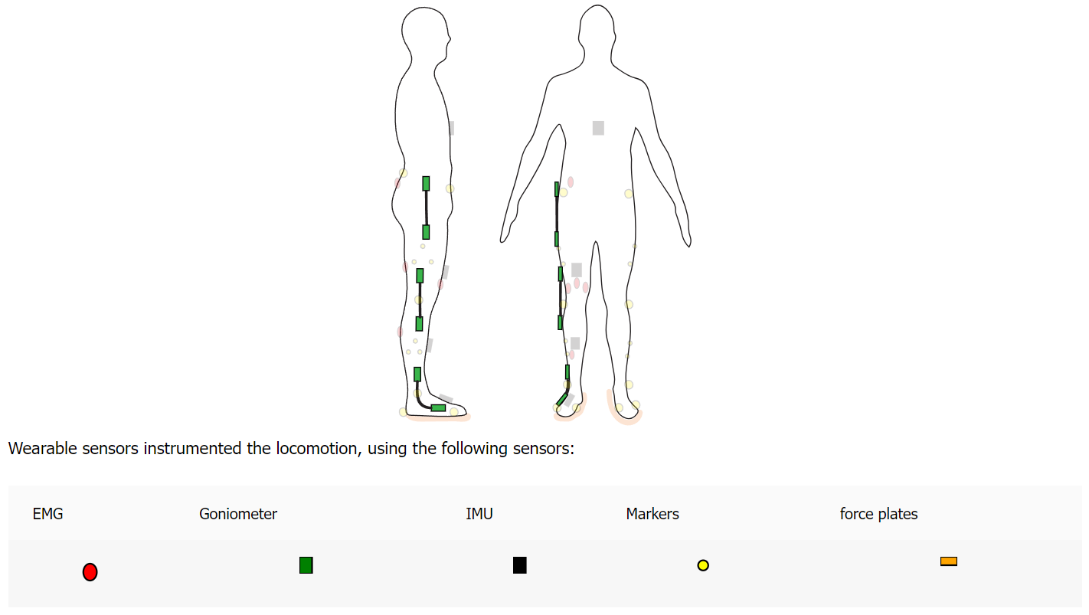
4. Data
4.1 Open datasets
Use open datasets provide by Geogia tech

Slide 9
4. Data
4.2 Input Data
Use open datasets provide by Geogia tech

Slide 10
5. Models
TSAI
TSAI is an open-source deep learning packages built on top of Pytorch & fastai focused on state-of-the-art techniques for time series tasks like regression, forecasting …

Slide 11
6. Expected results

