Slide 1
10월 23일 월요일 진행상황
IPG – RL, IPG – MPC comparison

Slide 2
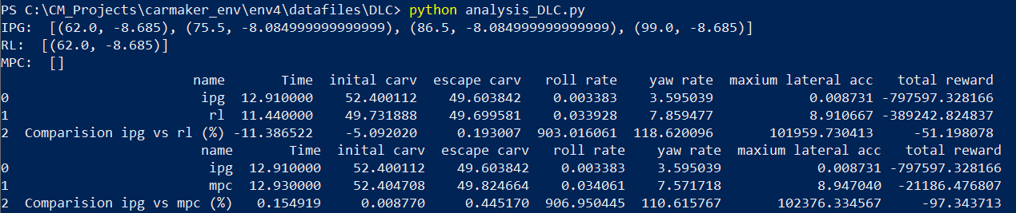
Lane Change (ISO 3888-2) – mpc traj
IPG Setting for RL
Initial car velocity: 50 kph
(0m ~ 52m) Longitudinal Dynamics: IPGDriver, Speed 50 kph
(52m ~ 161m) Longitudinal Dynamics: G/B/C/P 0
Corner cutting Coefficient: 0
IPG Setting for MPC
Longitudinal Dynamics: IPGDriver, Speed 50 kph
Corner cutting Coefficient: 0
Results
IPG Collision: 3
RL Collision: 2
MPC Collision: 0

Slide 3
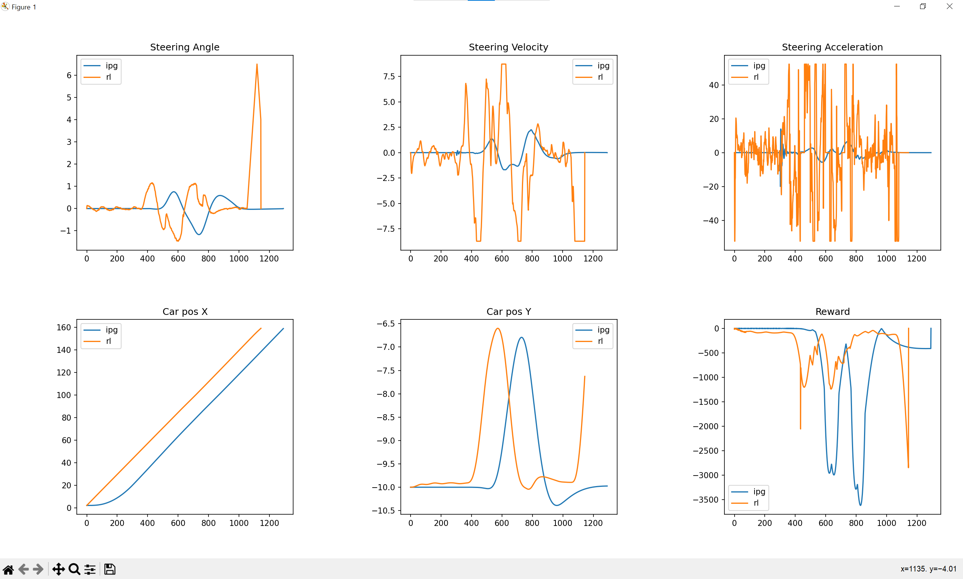
IPG - RL

Slide 4
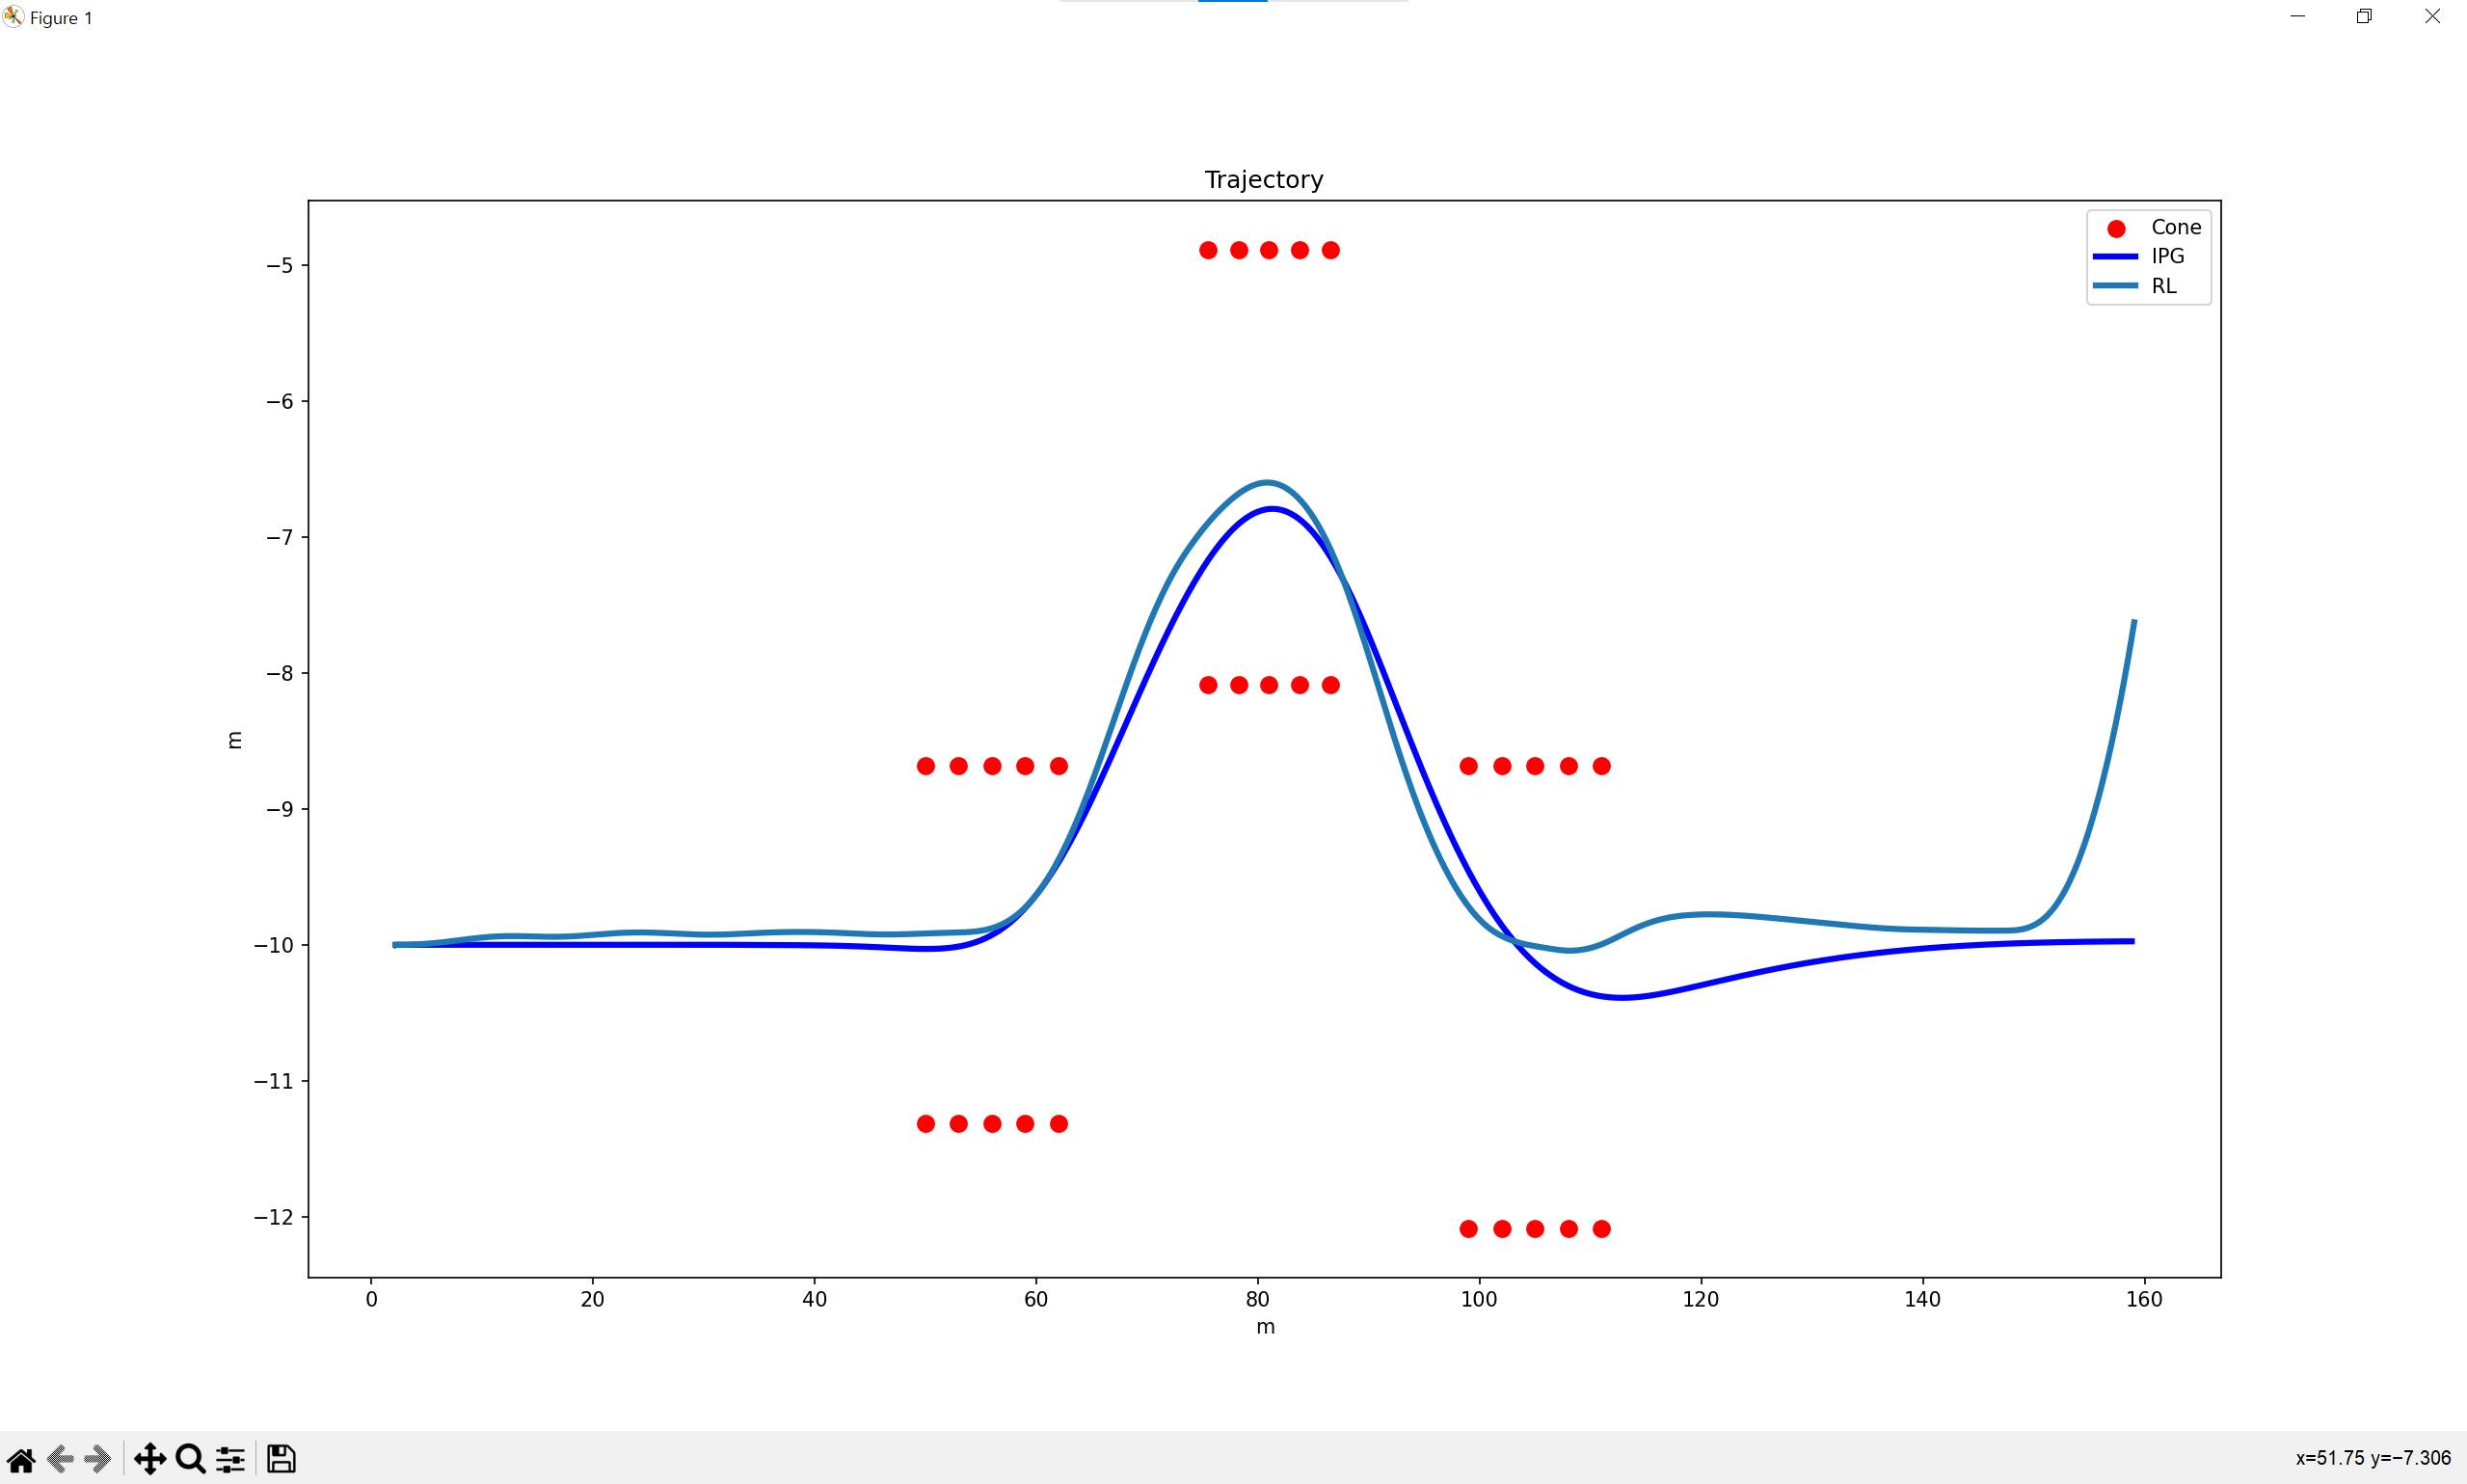
IPG - RL

Slide 5
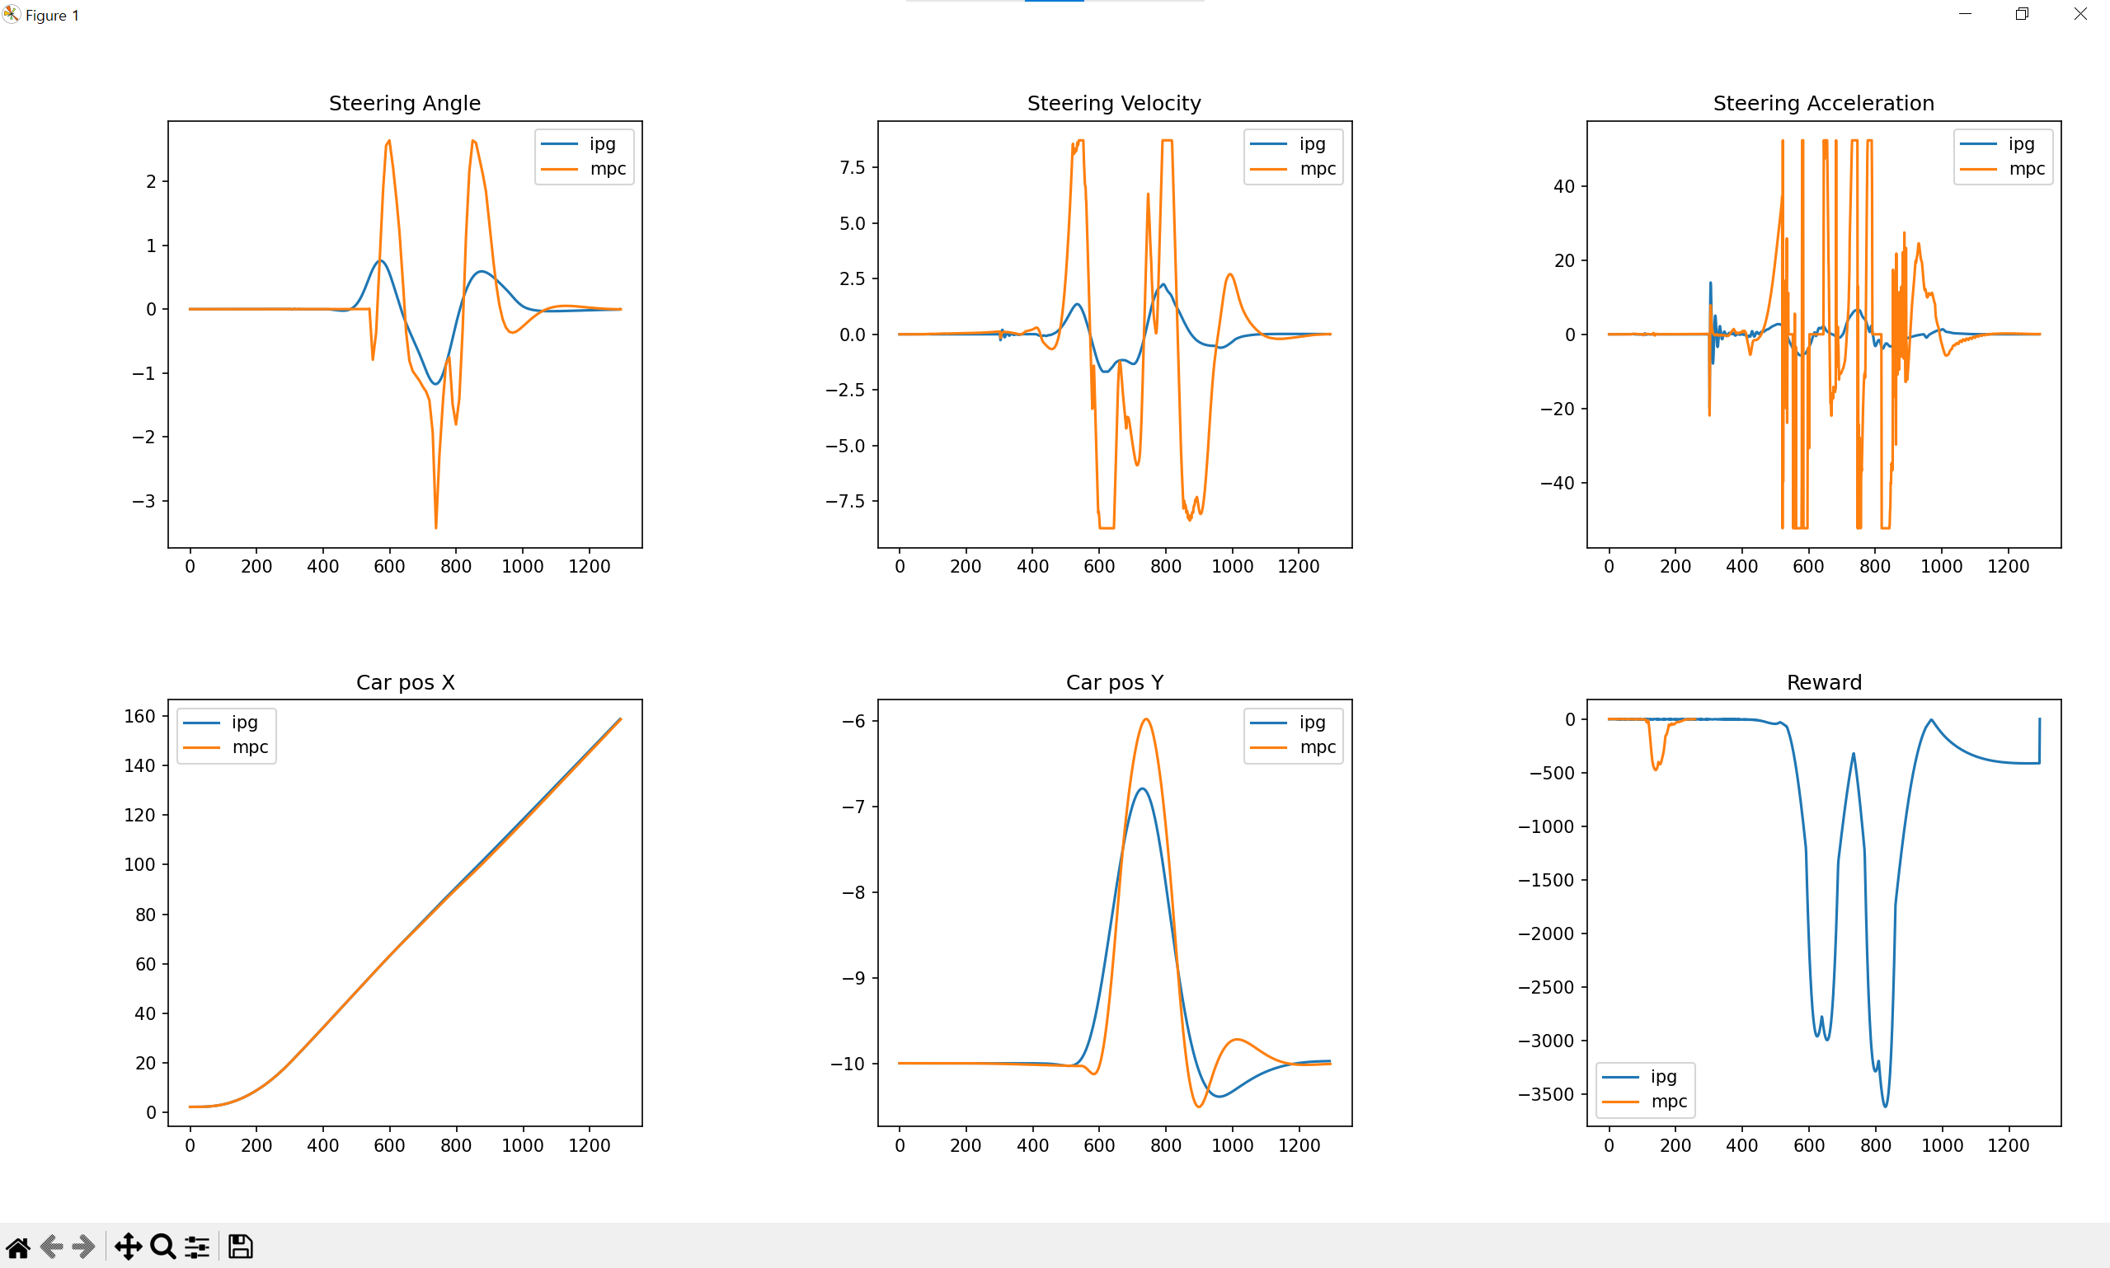
IPG - MPC

Slide 6
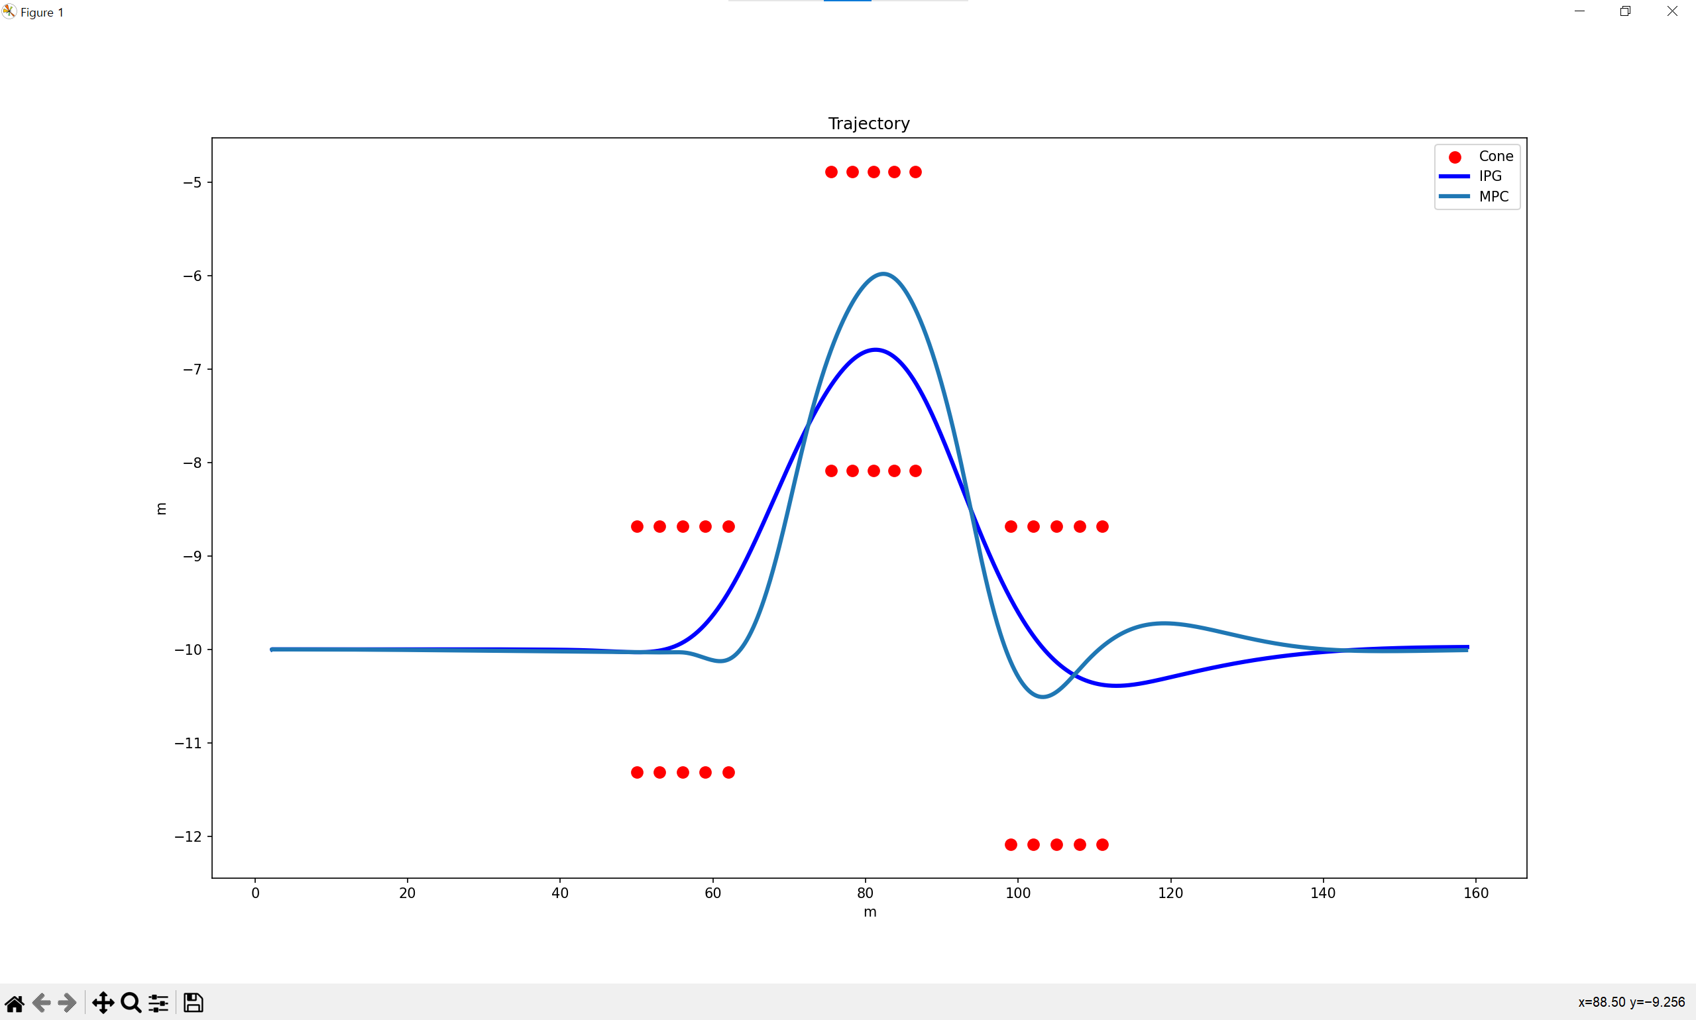
IPG - MPC

Slide 7
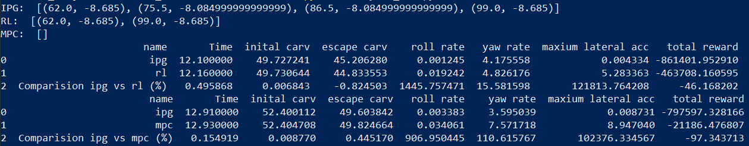
Lane Change (ISO 3888-2) – cutting 0
IPG Setting for RL
Initial car velocity: 50 kph
(0m ~ 52m) Longitudinal Dynamics: IPGDriver, Speed 50 kph
(52m ~ 161m) Longitudinal Dynamics: G/B/C/P 0
Corner cutting Coefficient: 0
IPG Setting for MPC
Longitudinal Dynamics: IPGDriver, Speed 50 kph
Corner cutting Coefficient: 0
Results
IPG Collision: 3
RL Collision: 2
MPC Collision: 0

Slide 8
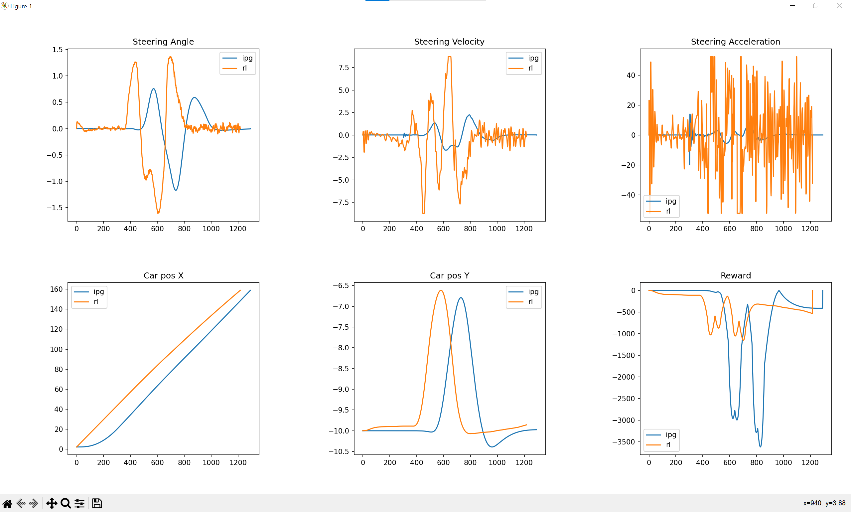
IPG - RL

Slide 9
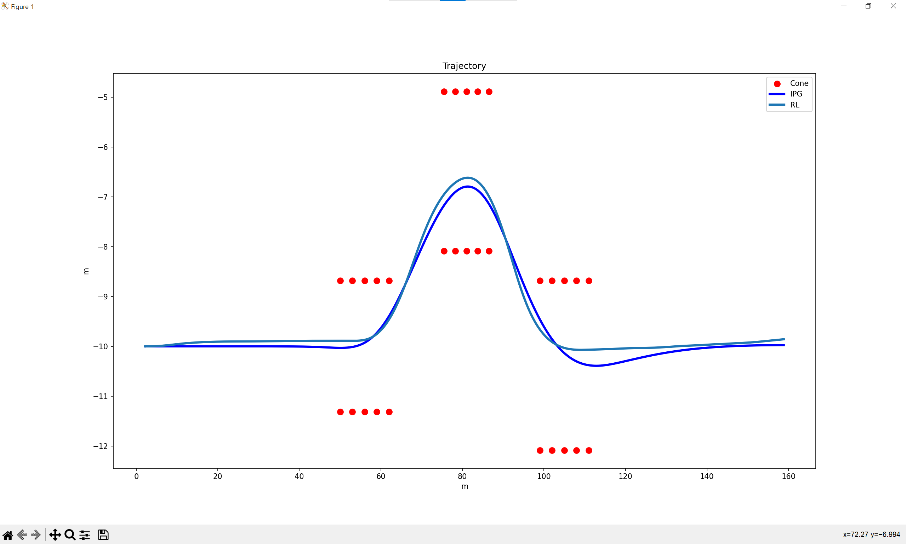
IPG - RL

Slide 10
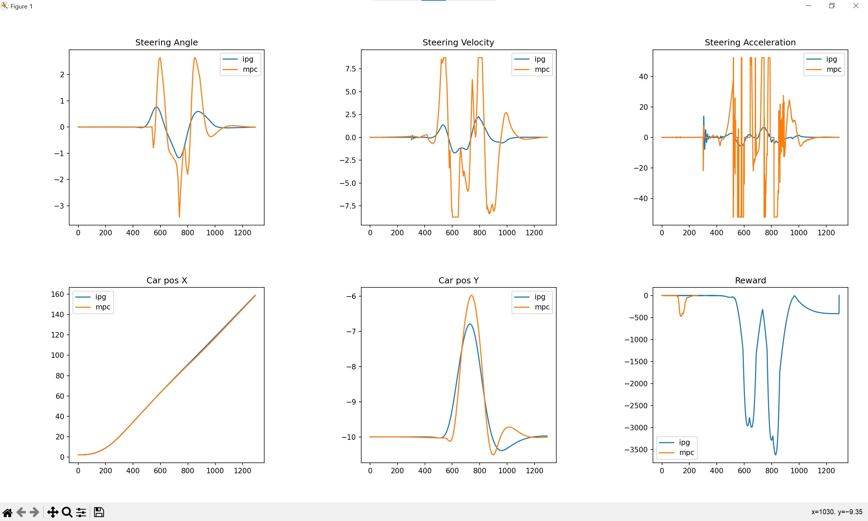
IPG - MPC

Slide 11

IPG - MPC

Slide 12
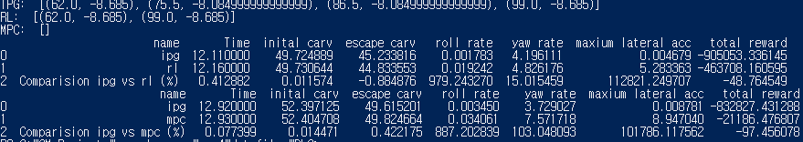
Lane Change (ISO 3888-2) – cutting 1
IPG Setting for RL
Initial car velocity: 50 kph
(0m ~ 52m) Longitudinal Dynamics: IPGDriver, Speed 50 kph
(52m ~ 161m) Longitudinal Dynamics: G/B/C/P 0
Corner cutting Coefficient: 1
IPG Setting for MPC
Longitudinal Dynamics: IPGDriver, Speed 50 kph
Corner cutting Coefficient: 1
Results
IPG Collision: 3
RL Collision: 2
MPC Collision: 0

Slide 13
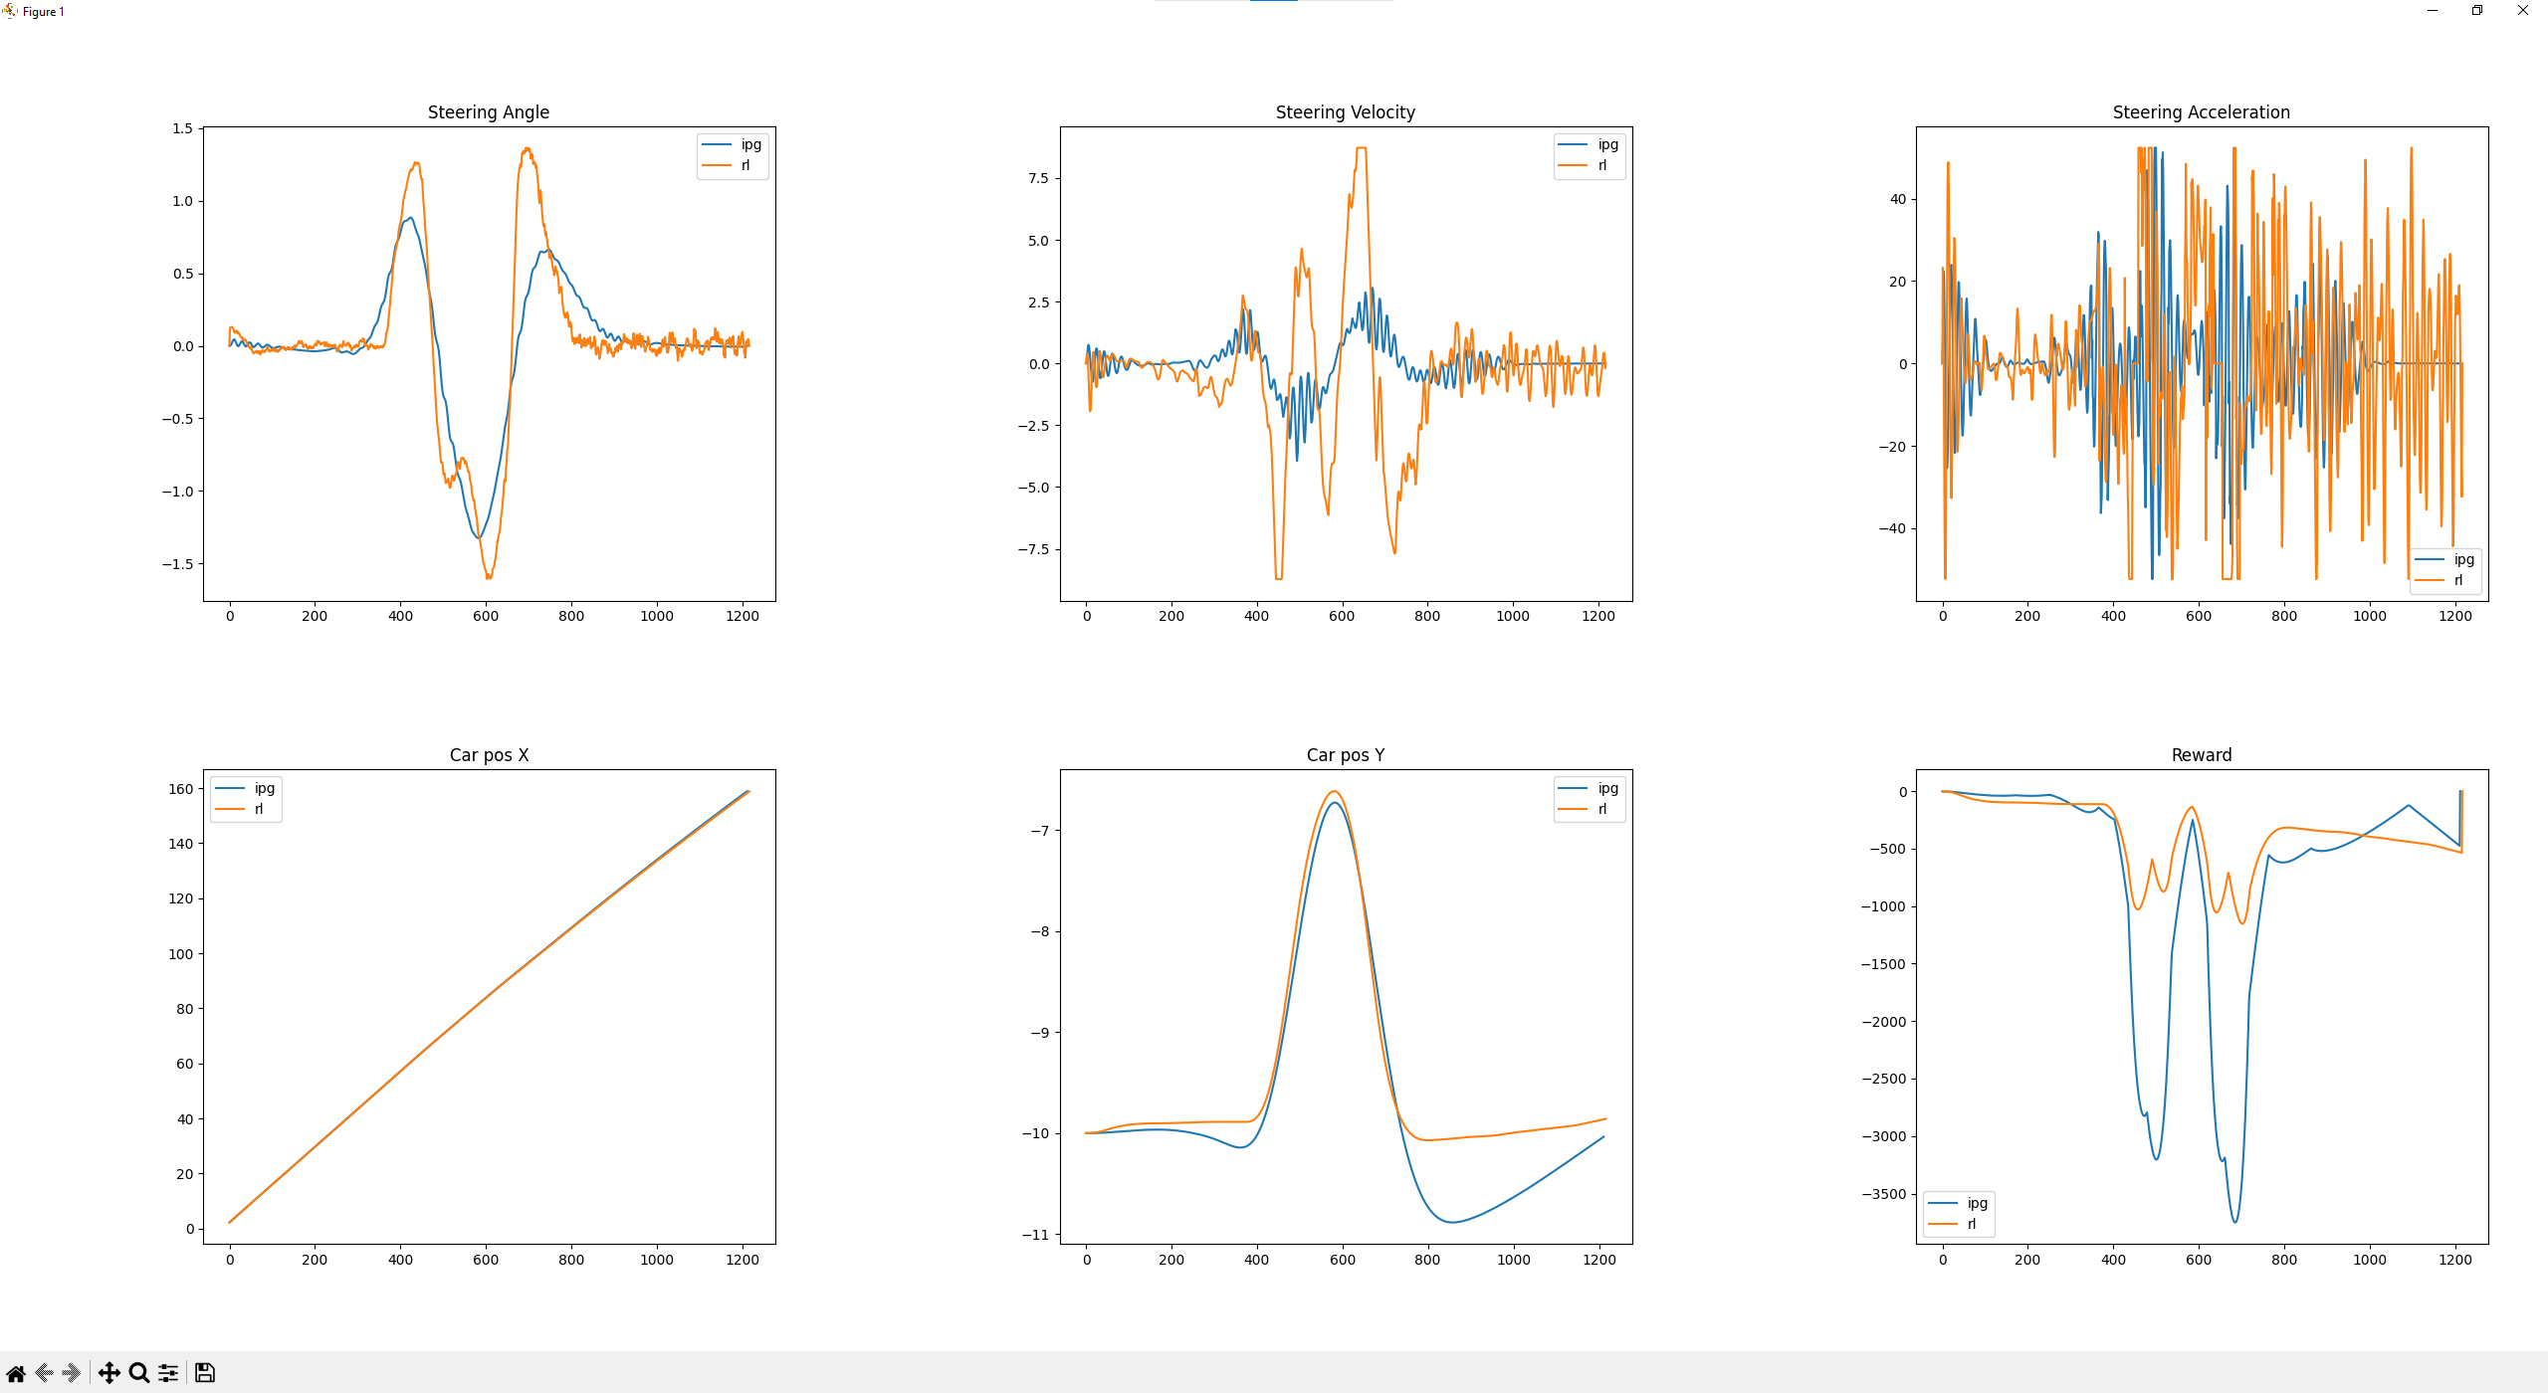
IPG - RL

Slide 14
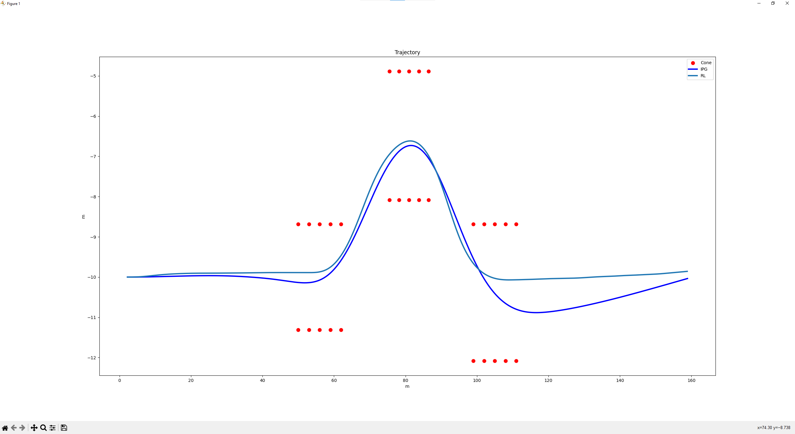
IPG - RL

Slide 15
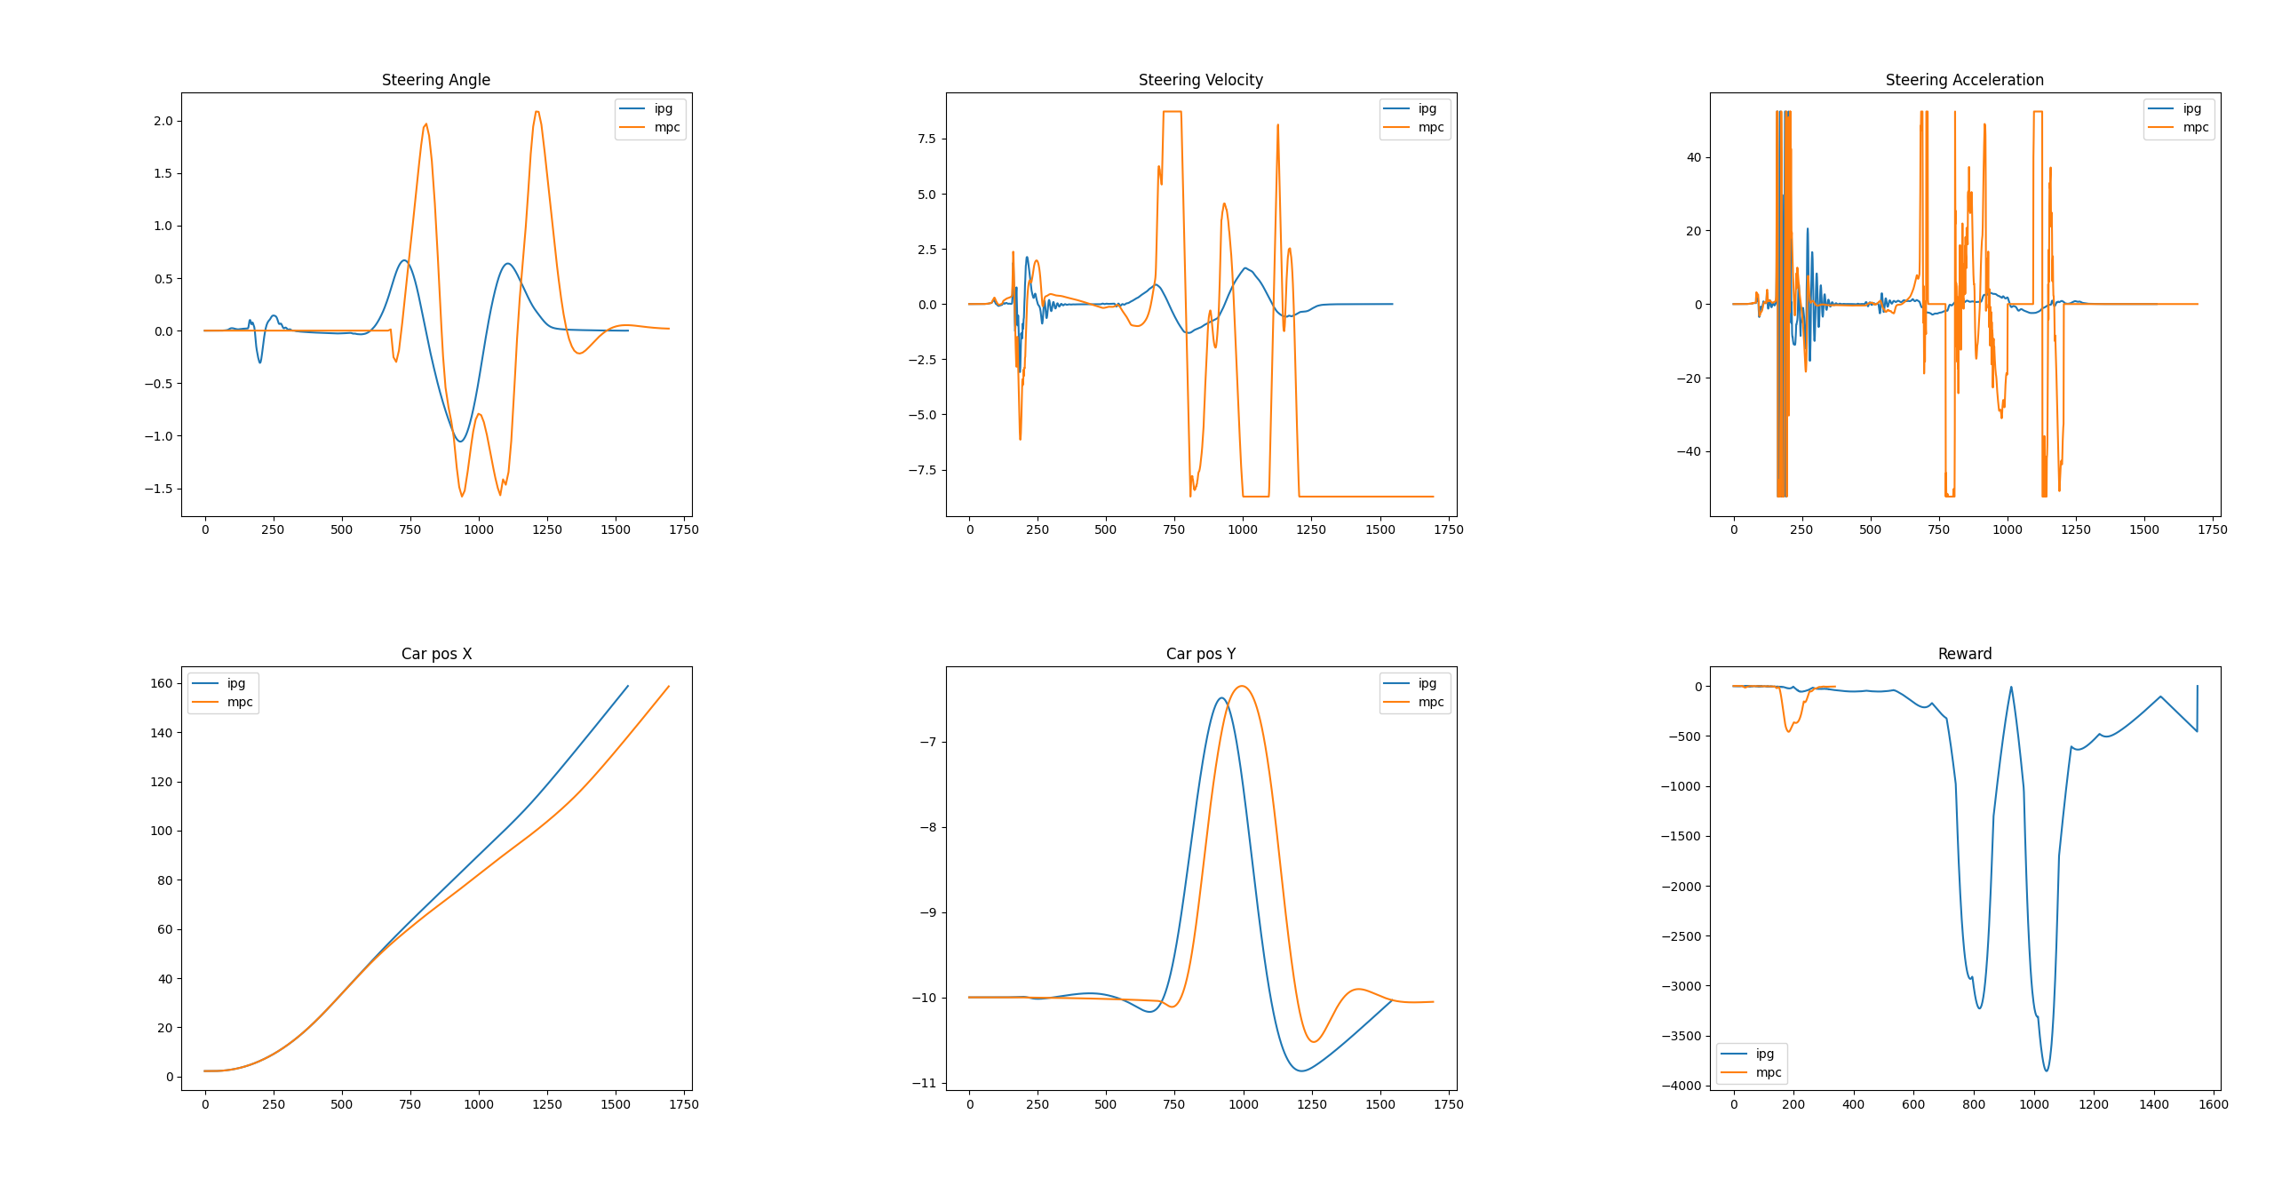
IPG - MPC

Slide 16
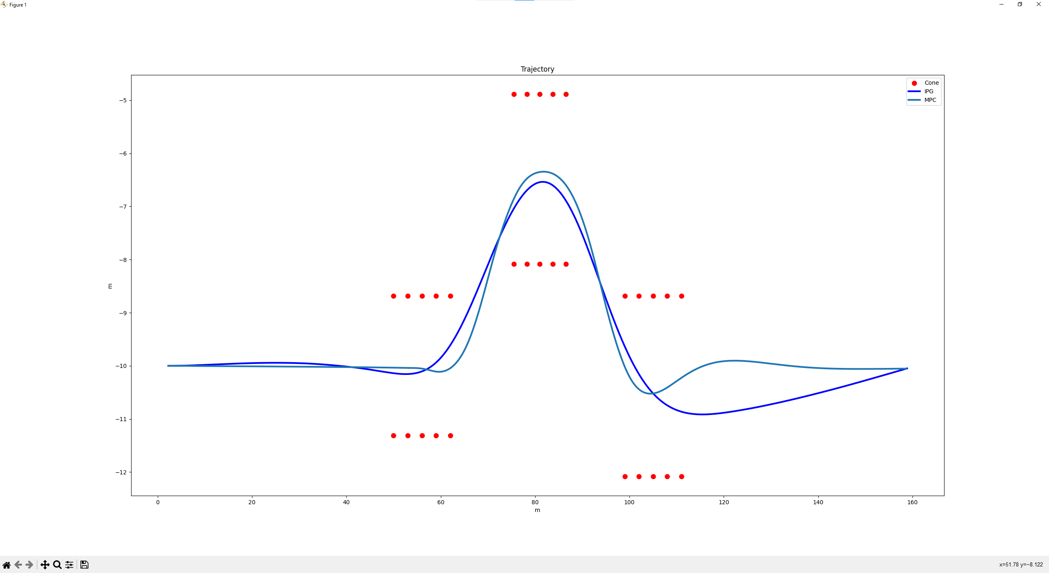
IPG - MPC

Slide 17
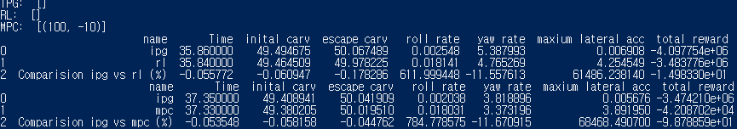
SLALOM
IPG Setting for RL
Initial Velocity: 50 kph
Longitudinal Dynamics: IPG Control, Speed 50 kph
Corner Cutting Coefficient: 0.8
IPG Setting for RL
Initial Velocity: 0
Longitudinal Dynamics: IPG Control, Speed 50 kph
Corner Cutting Coefficient: 0.9 (maximum coefficient while not colliding with cones)
Results

Slide 18
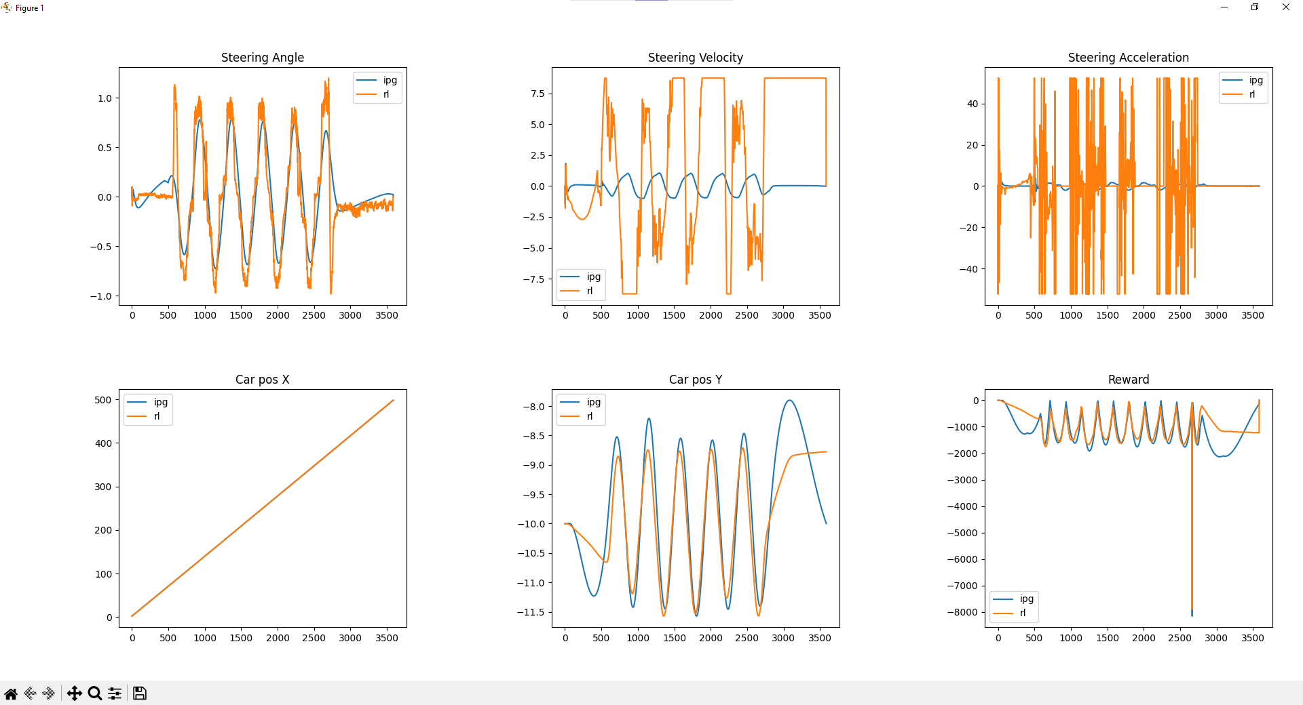
IPG - RL

Slide 19
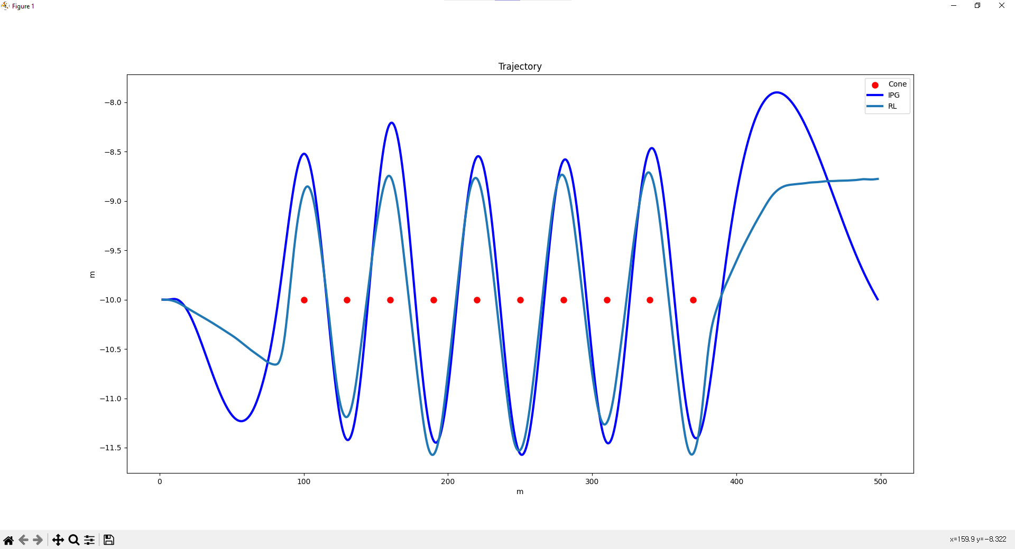
IPG - RL

Slide 20
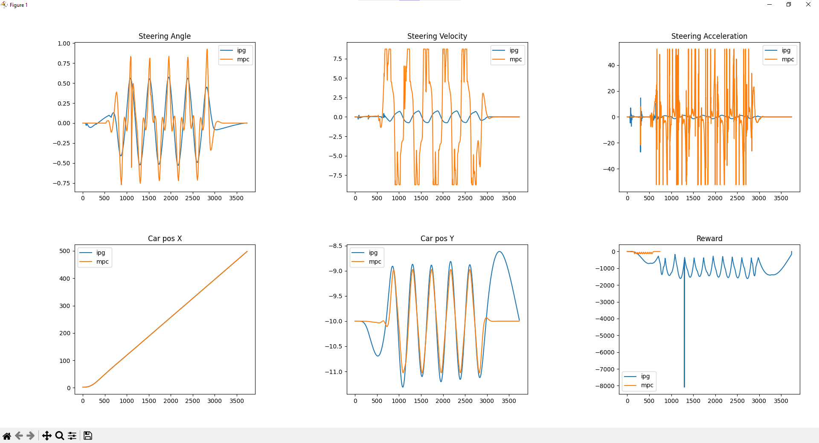
IPG - MPC

Slide 21
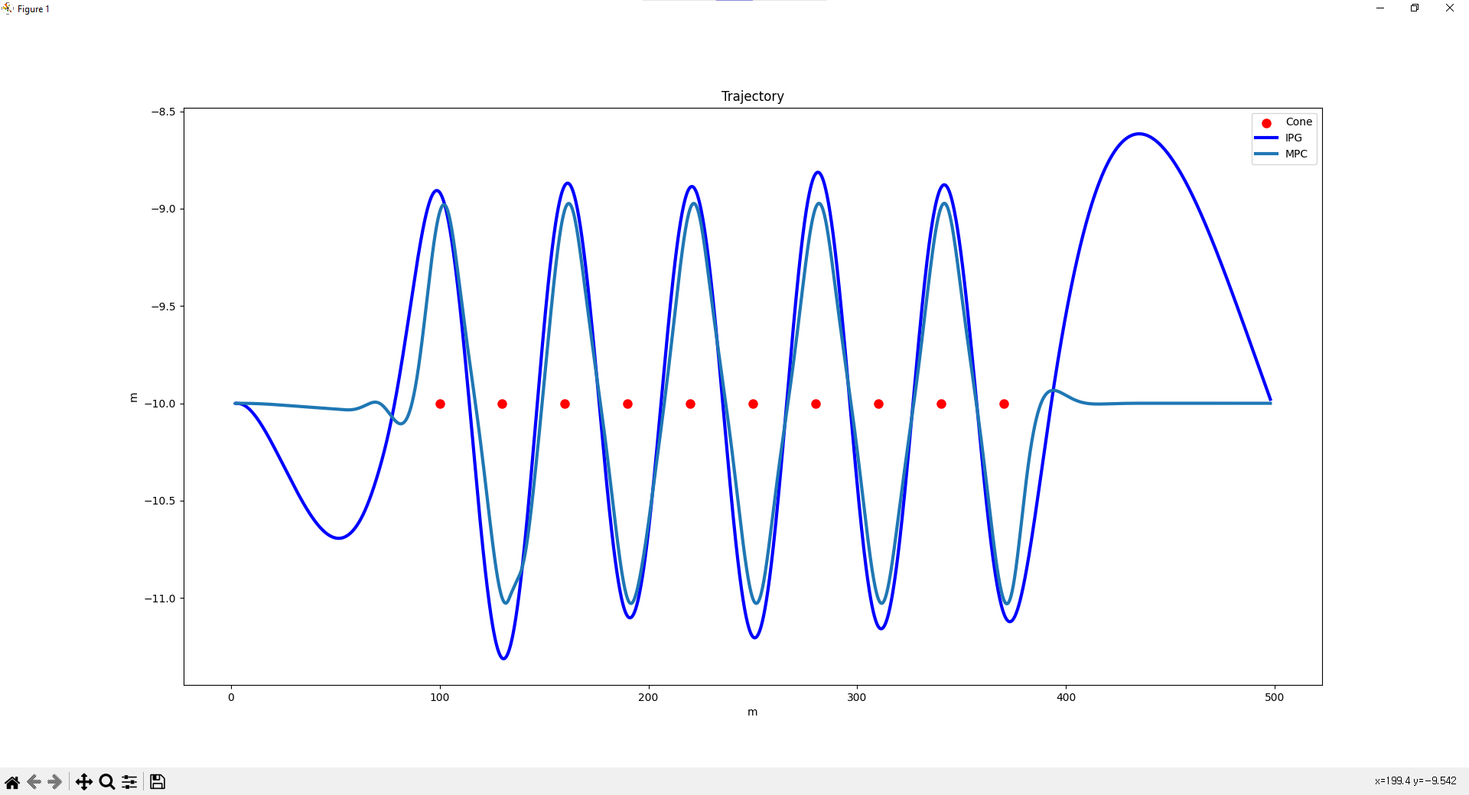
IPG vs MPC

