Slide 1
1219 Report

Slide 2
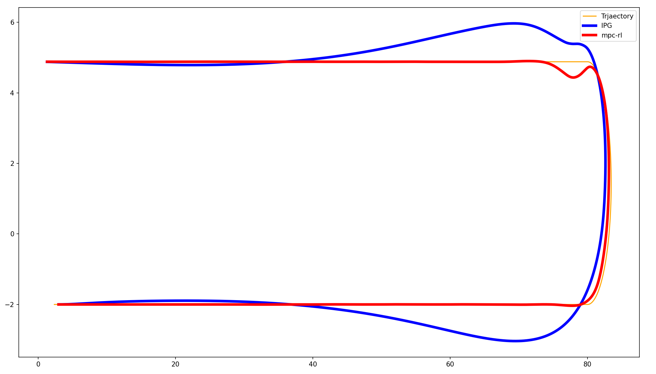
1. 경로

Slide 3
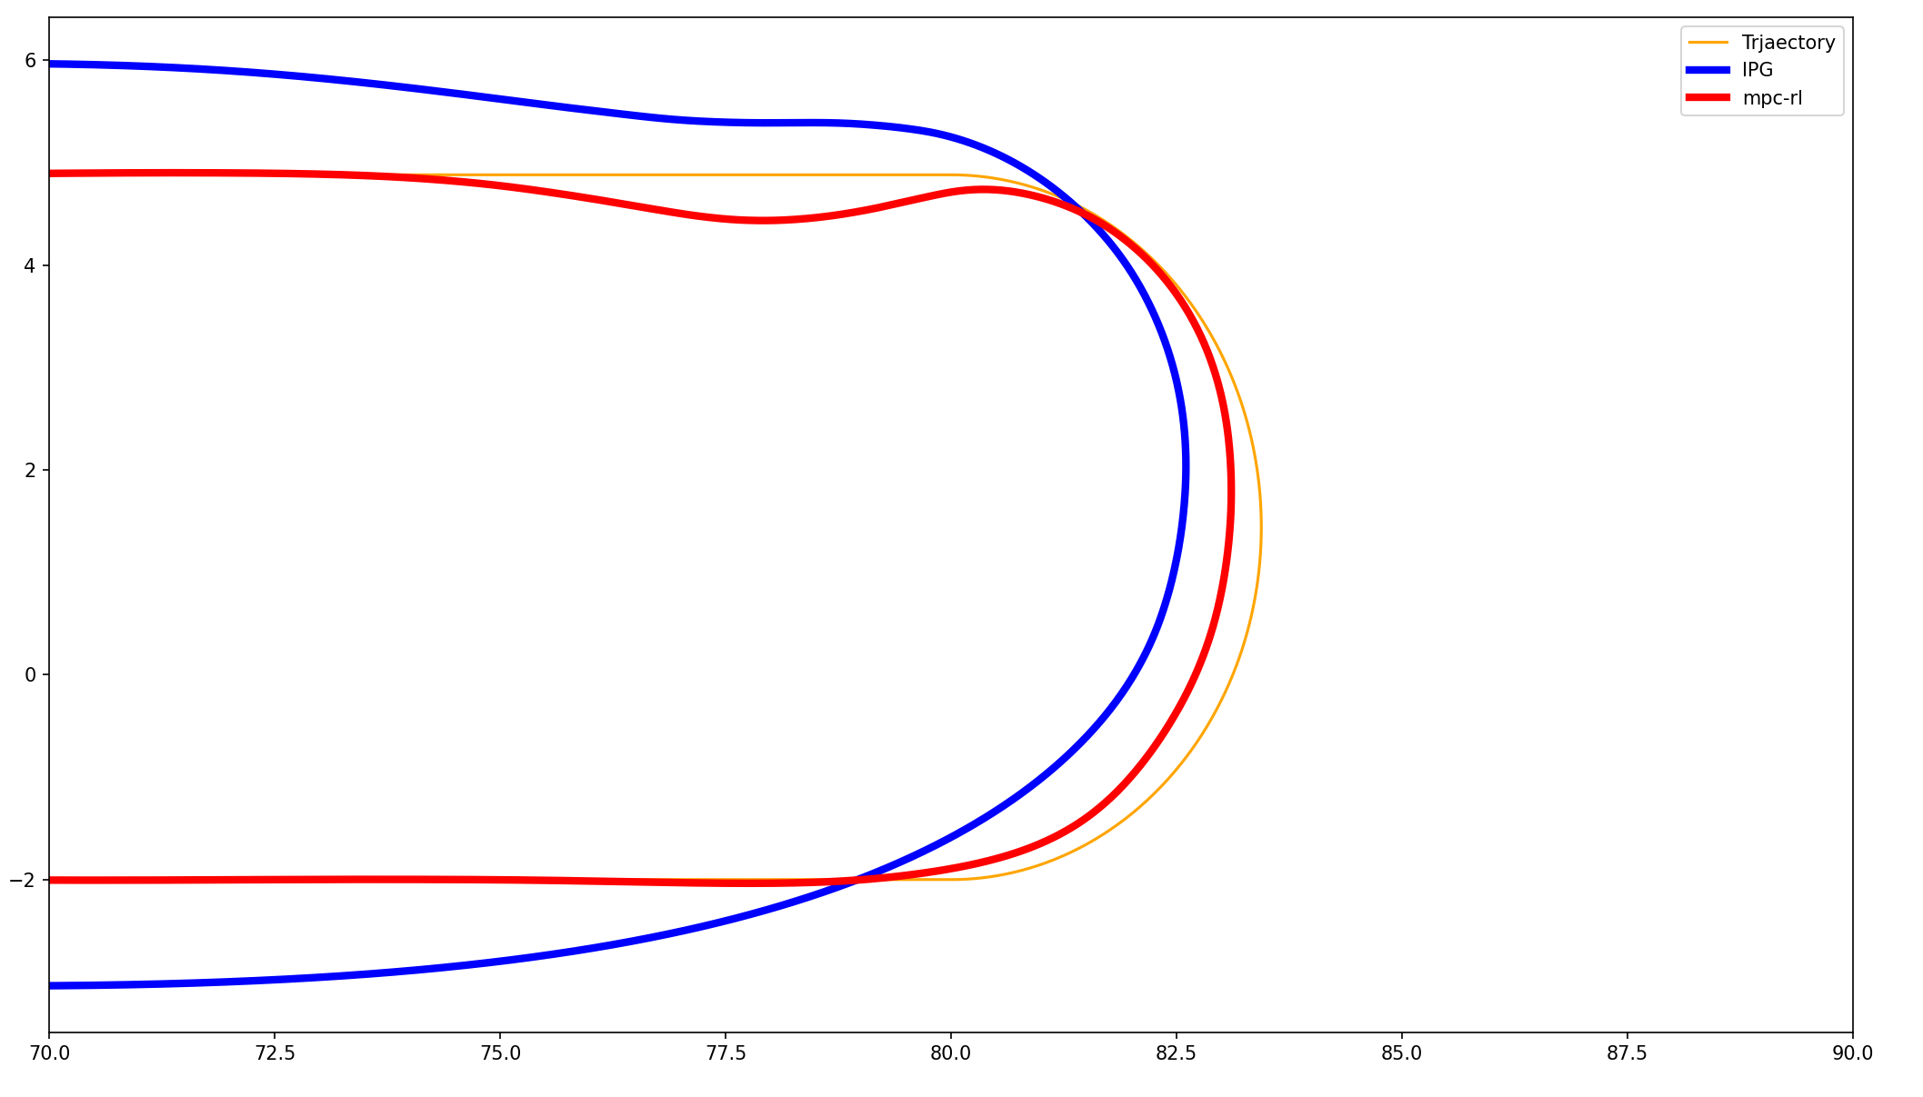

Slide 4
y / x
Ipg | mpc
3.457566 | 2.321792

Slide 5
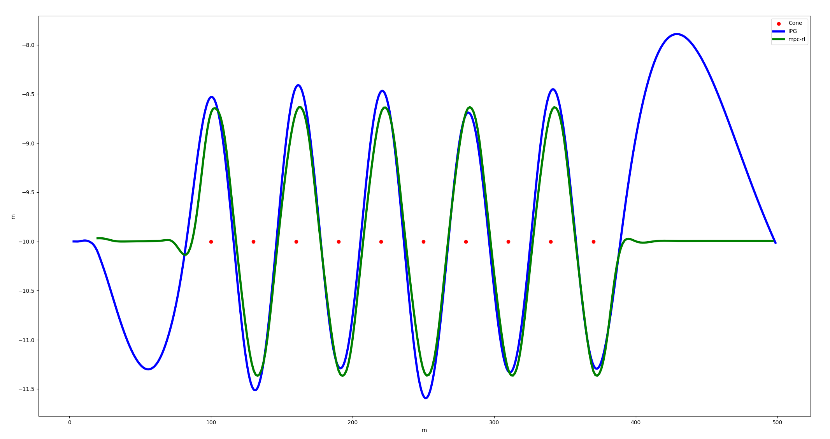
SLALOM
Name | Time (s) | Initial Car velocity (100 m, kph) | Escape Car velocity (370 m, kph) | Roll rate | Yaw rate | Maximum lateral acceleration (m/s^2)
IPG | 36.26 | 48.820820 | 50.081790 | 0.003602 | 0.089964 | 0.006562
MPC-RL | 35.99 | 48.732138 | 50.075539 | 0.019039 | 0.081882 | 0.003566
Comparision | -0.744622 | -0.181647 | -0.012480 | 428.575027 | -8.984283

Slide 6
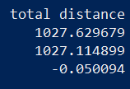
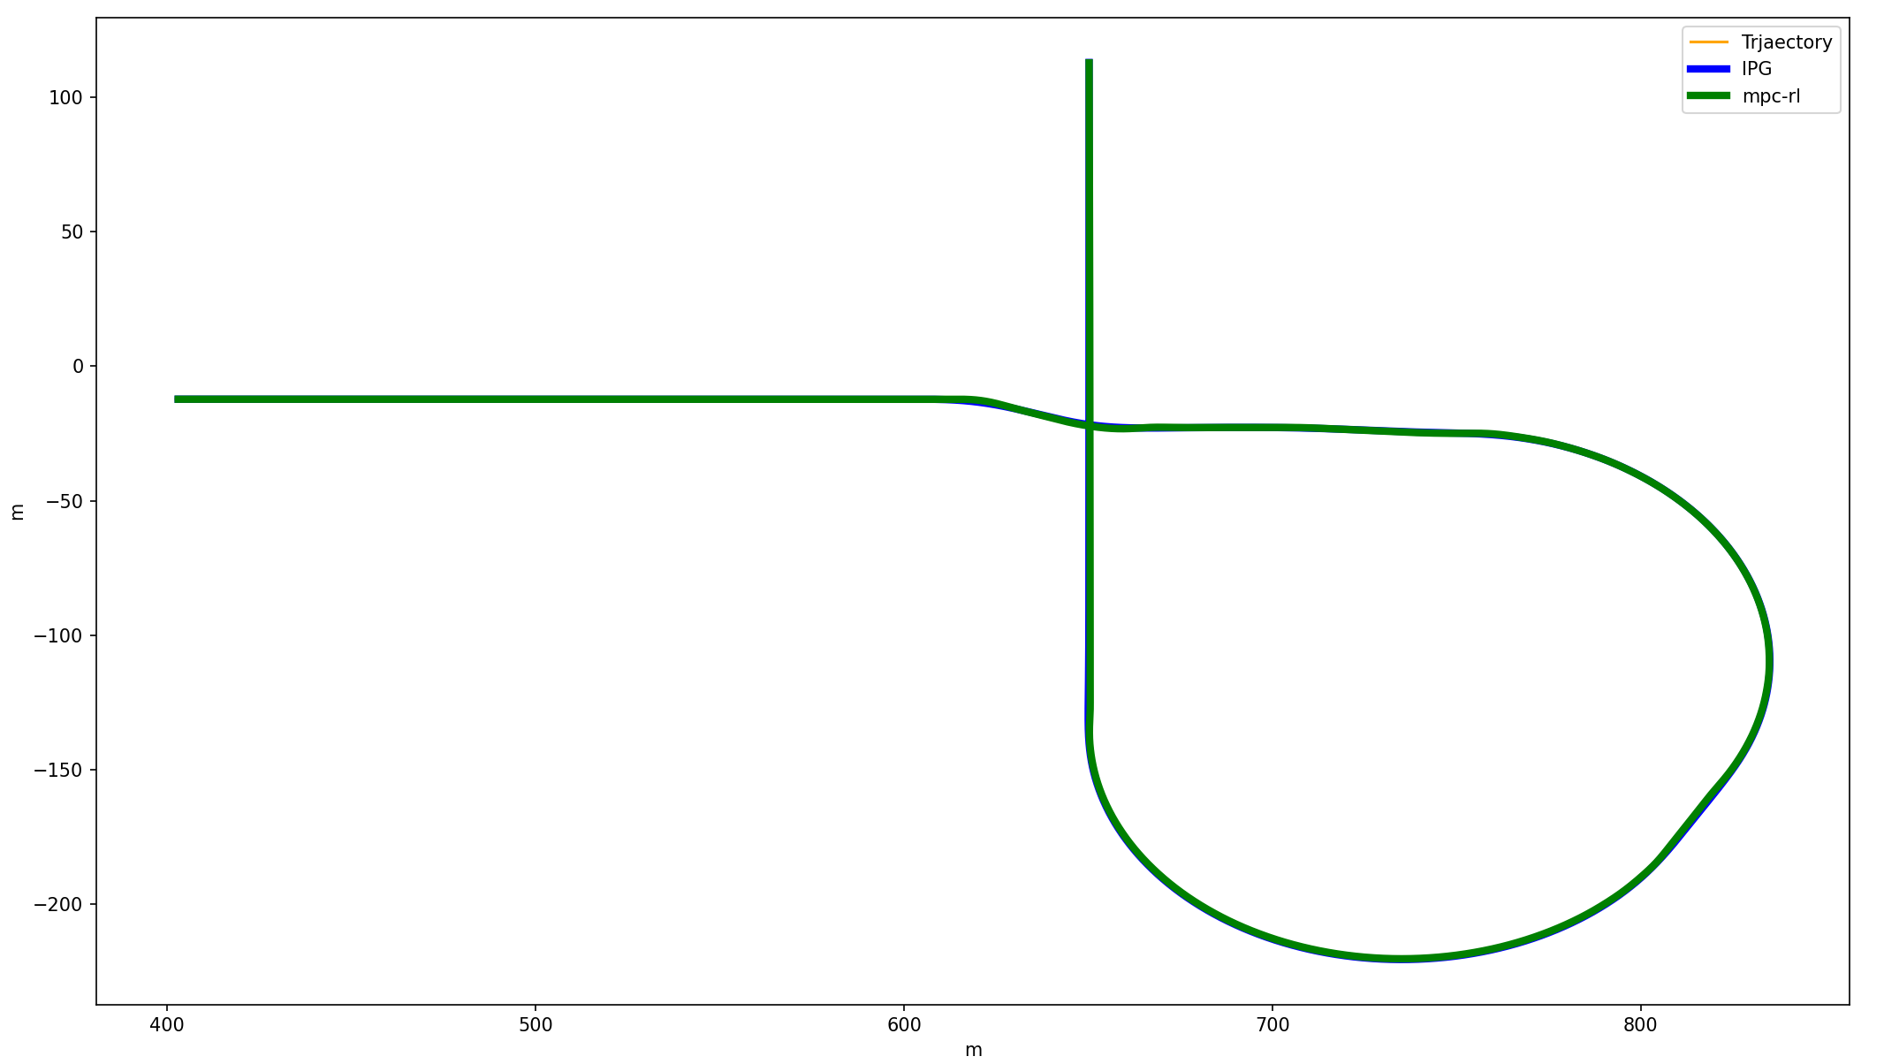
RAMP
Ramp 추가 결과 입니다 ->
Name | Time (s) | Roll rate | Yaw rate | Maximum lateral acceleration (m/s^2) | Total Distance (m)
IPG |  |  |  |  | 1027.629679
MPC- | 74.34 | 0.010547 | 0.081385 | 6.989681 | 1027.114899
Comparison |  |  |  |  | -0.050094

Slide 7
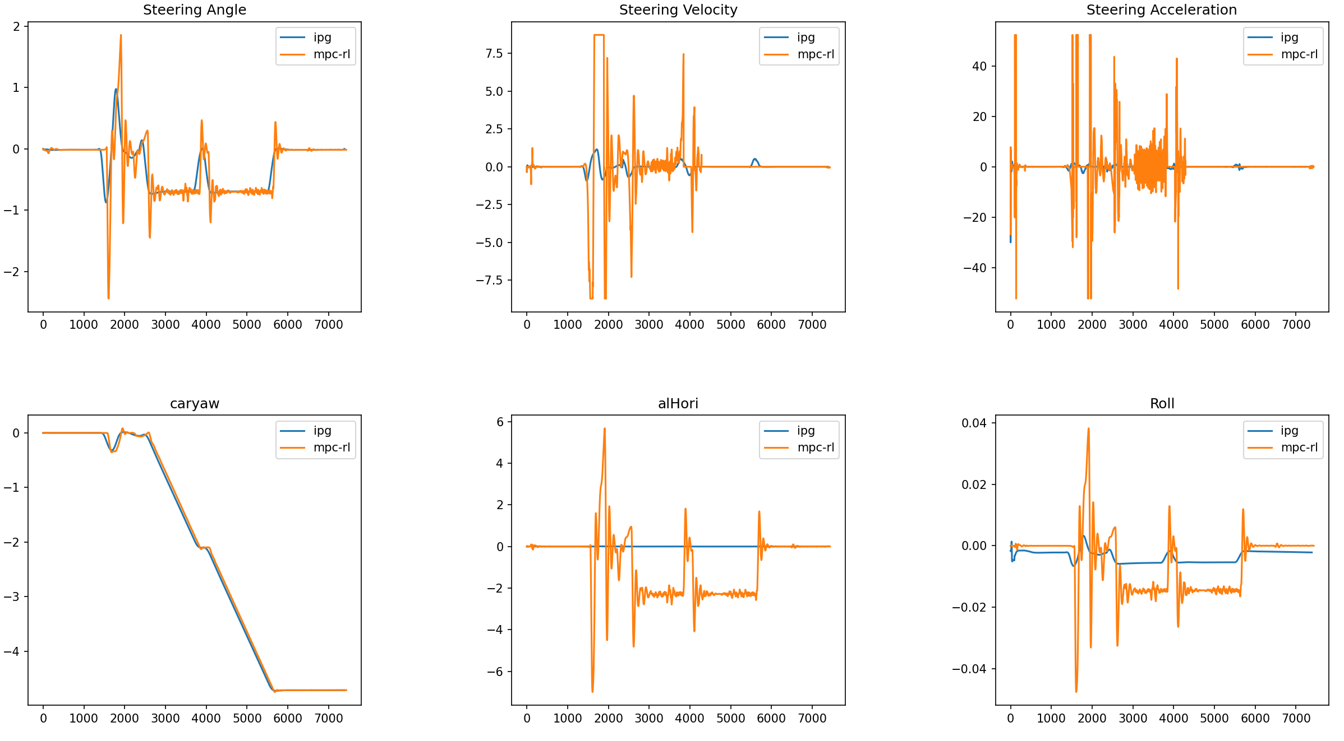
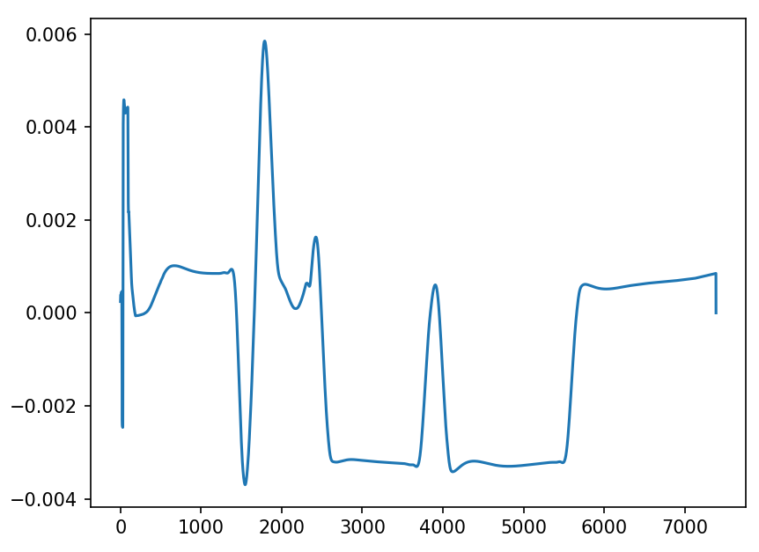

Slide 8
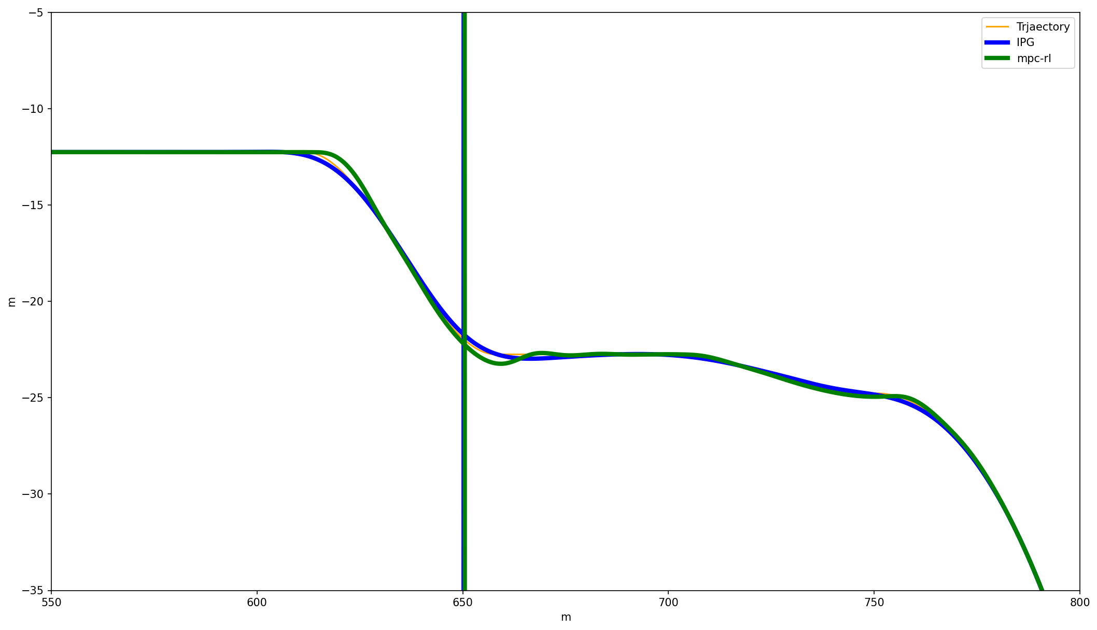

Slide 9
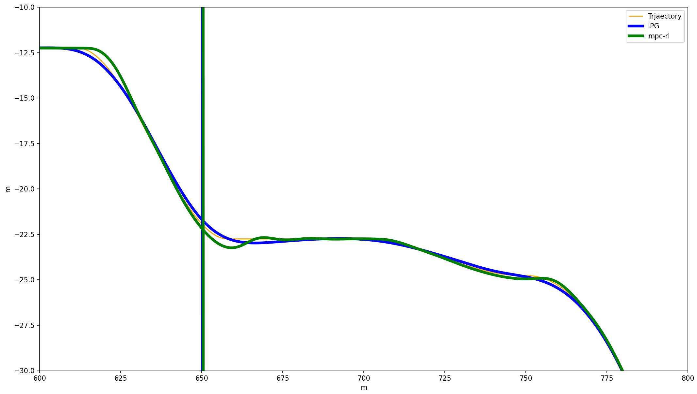

Slide 10
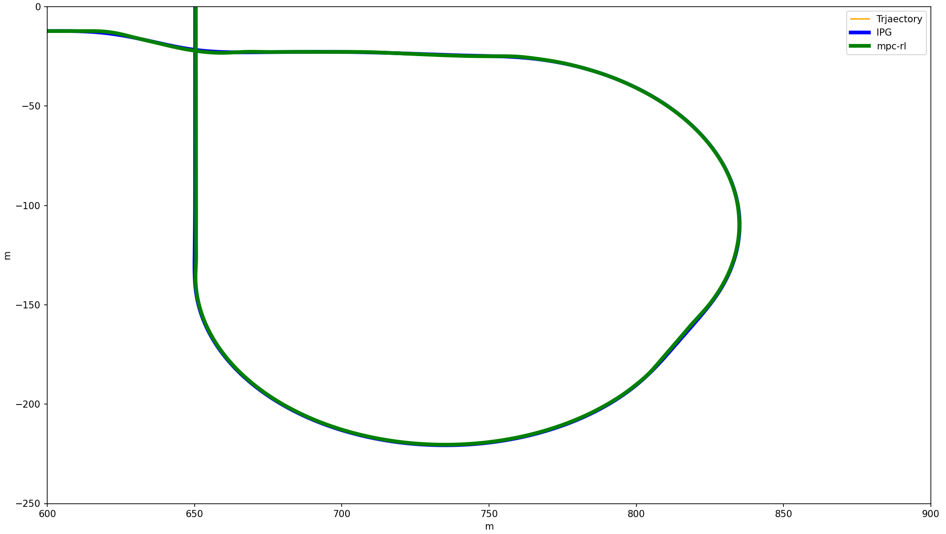

Slide 11
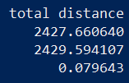
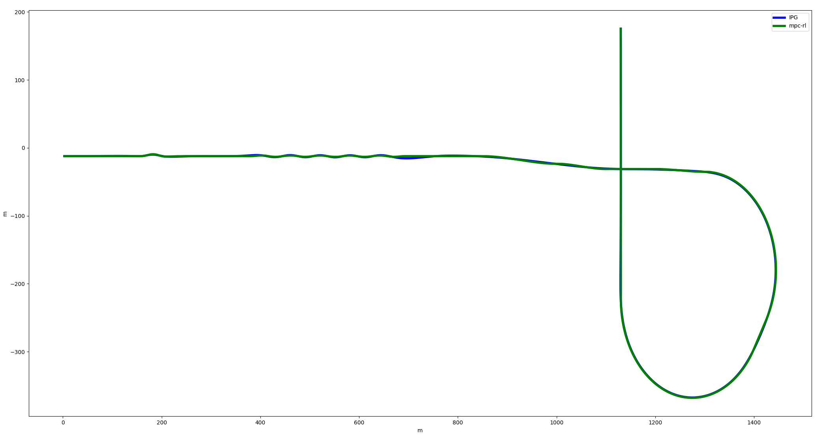
TOTAL
Total 추가 결과 입니다 ->
Name | Time (s) | Roll rate | Yaw rate | Maximum lateral acceleration (m/s^2) | Cone Collision | Total Distance (m)
IPG | 175.13 | 0.000896 | 0.048501 | 0.006107 | 6 | 2427.660640
MPC | 175.27 | 0.001010 | 0.049388 | 0.004830 | 2 | 2429.594107
Comparision | 0.079941 | 102.6989 | 1.828120 | -20.9104 | -4 | 0.079643

Slide 12
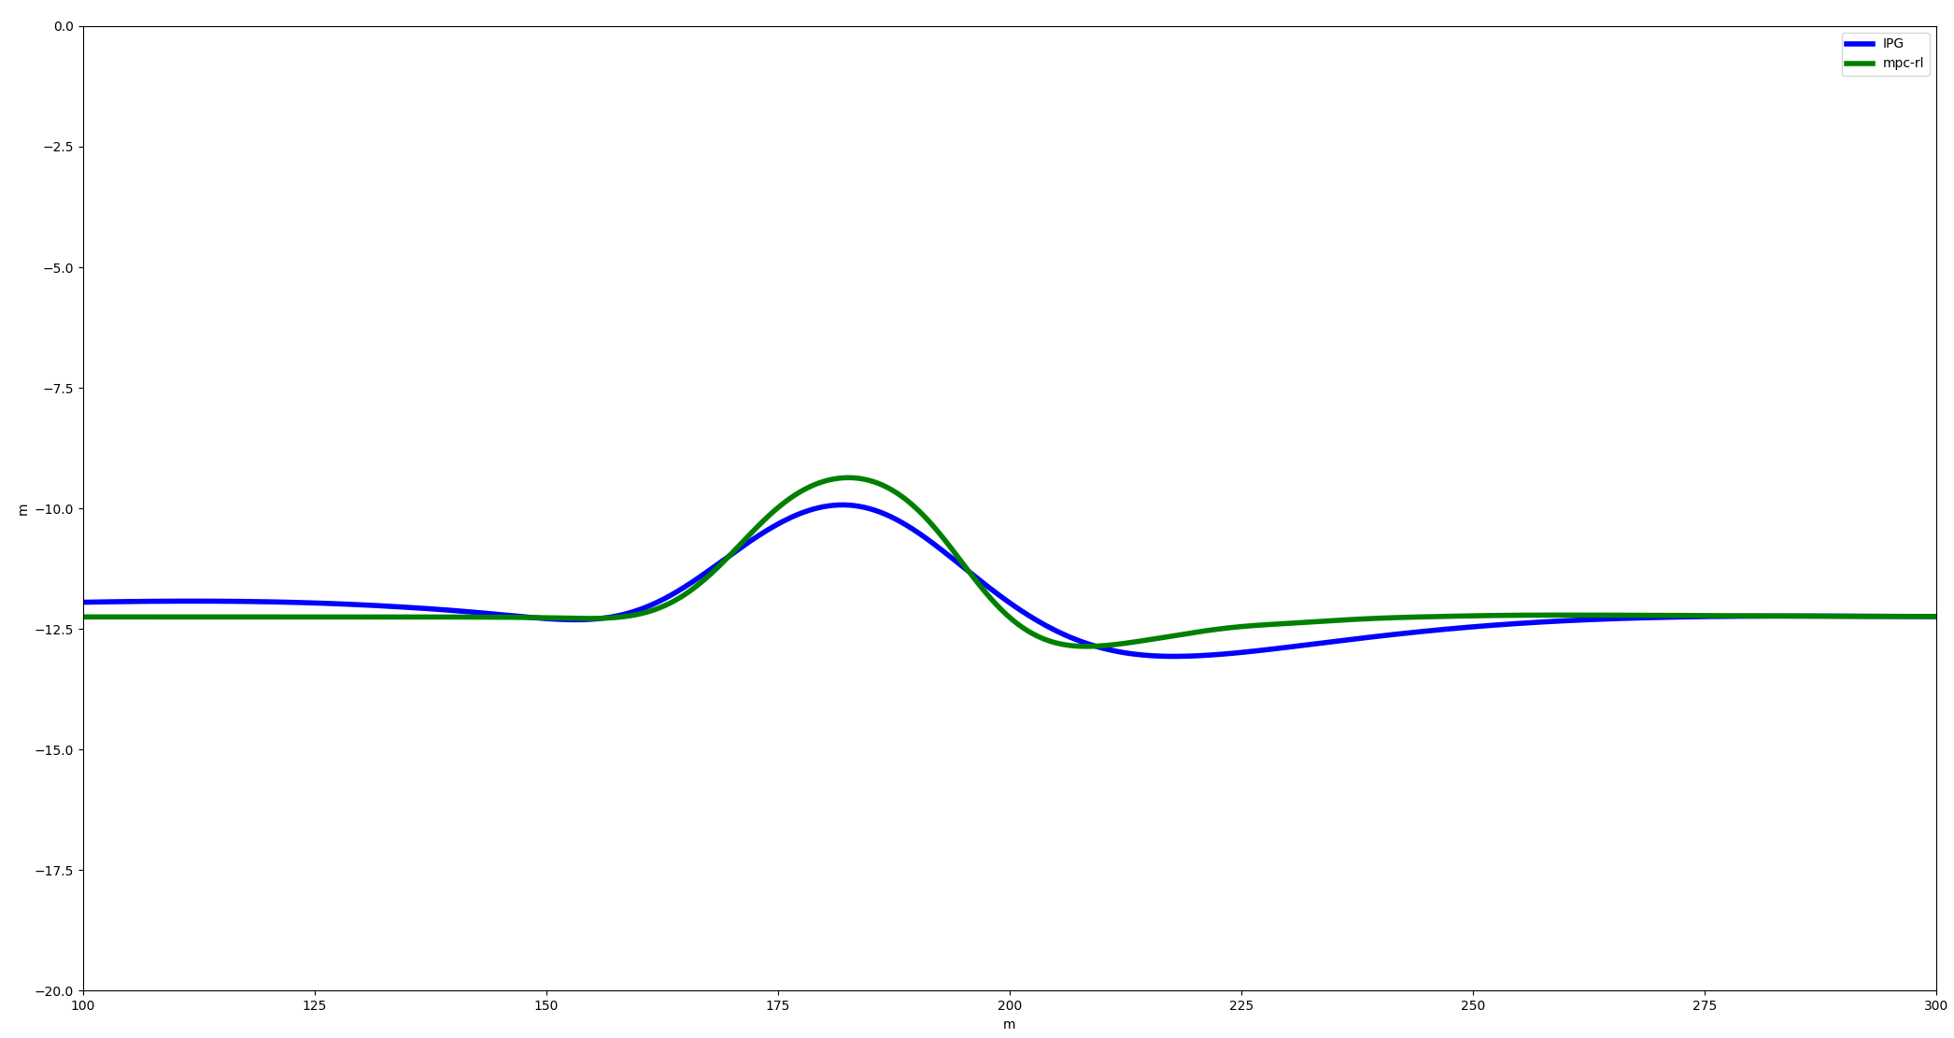

Slide 13
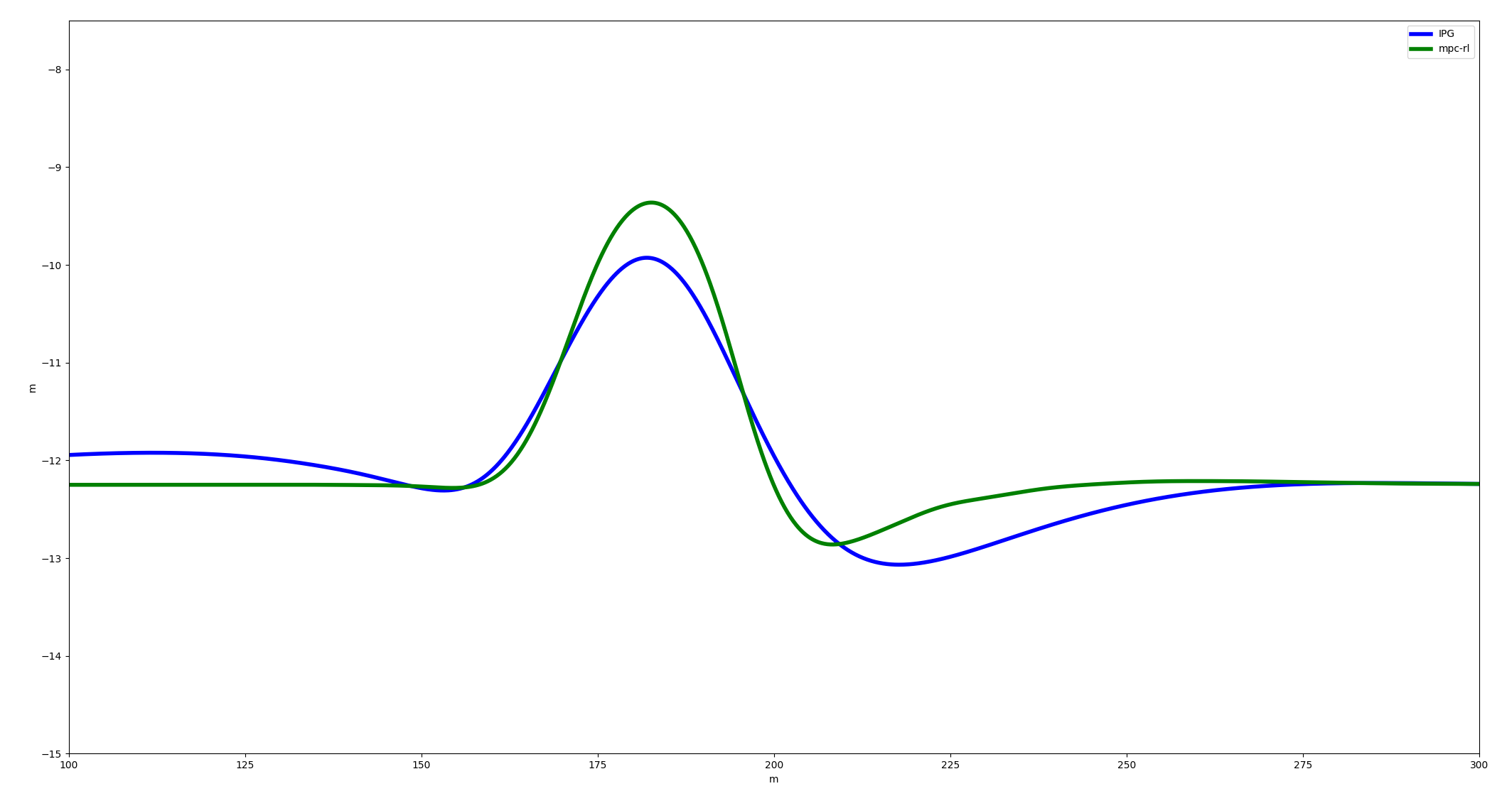

Slide 14
