Slide 1

FINVAUL
Smart Banking Dashboard
Interactive analytics platform to monitor customer financial behavior, assess credit risk, and surface actionable insights for smarter lending and treasury decisions.

Slide 2

Project Snapshot
Overview
Data analytics project:
CSV → PostgreSQL → Python (EDA, feature engineering) → Power BI (Power Query, DAX, Dashboards).
Dataset: 3,000 banking clients (CSV → PostgreSQL)
Tools: PostgreSQL, Python, Power BI
Focus: risk analytics, deposits, loans, KPIs, time-based slicers

Slide 3
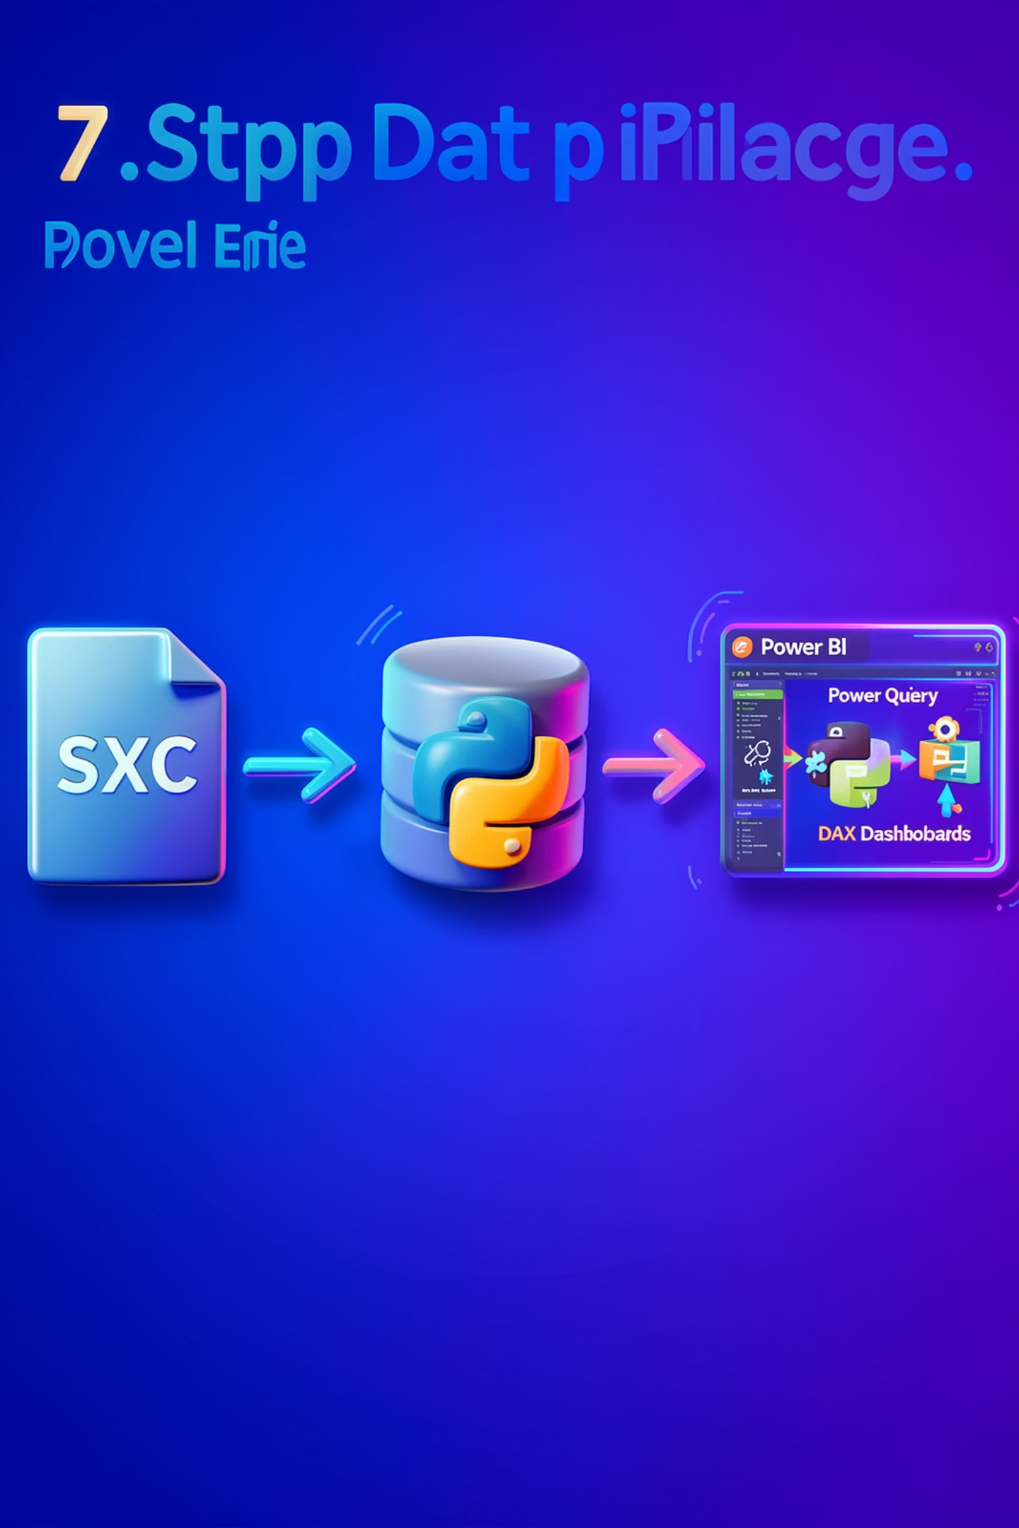
Data Pipeline
Seven-step flow:
1) CSV files → 2) Import to PostgreSQL →
3) Storage → 4) Python cleaning & EDA → 5) Power Query transformations → 6) Power BI data modeling (DAX) → 7) Interactive Power BI dashboards.

Slide 4

Data Cleaning & Feature Engineering
Feature Engineering
Power Query Mapping
Income_band via pd.cut: Low (<100K), Mid (<300K), High (300K+)
Convert ID columns to readable labels (GenderId, BRIId, IAId)
EDA Methods
Pandas, Matplotlib, Seaborn; correlation heatmap and regplots for bivariate checks

Slide 5

Correlation & Bivariate Findings
Strong correlations
Bank Deposits ↔ Checking Accounts (0.84)
Deposits ↔ Savings (0.75) — identifies high-liquidity saver segment.
Loan relationships
Bank Loans ↔ Business Lending (0.42);
Bank Loans ↔ Credit Card Balance (0.37) — debt-layering and SME signals.
Independent signal
Superannuation shows no correlation with banking variables — employer-driven.

Slide 6
Calculated Columns (DAX)
Processing Fees
Income Band
SWITCH('public customer'[Fee Structure],"High",0.05,"Mid",0.03,"Low",0.01,0)
SWITCH(TRUE(),'public customer'[Estimated Income]<100000,"Low", <300000,"Mid","High")
Engagement Days
Year Of Joining
DATEDIFF('public customer'[Joined Bank], TODAY(), DAY)
YEAR('public customer'[Joined Bank])
These columns enable segmentation, time filters, and fee calculations used throughout the dashboard.

Slide 7

Key DAX Measures (Summary)
1
2
3
4
Total Clients
Total Loans
Total Deposit
Total Fees
DISTINCTCOUNT([Client ID]) = 3,000
[Bank Loan] + [Business Lending] + [Credit Card Balance] = $4.38bn
[Bank Deposit]+[Savings]+[Checking]+[Foreign Currency] = $3.77bn
SUMX(customer, [Total Loans] * [Processing Fees]) = $158.19M
Measures recalculate dynamically with slicers and filter context.

Slide 8
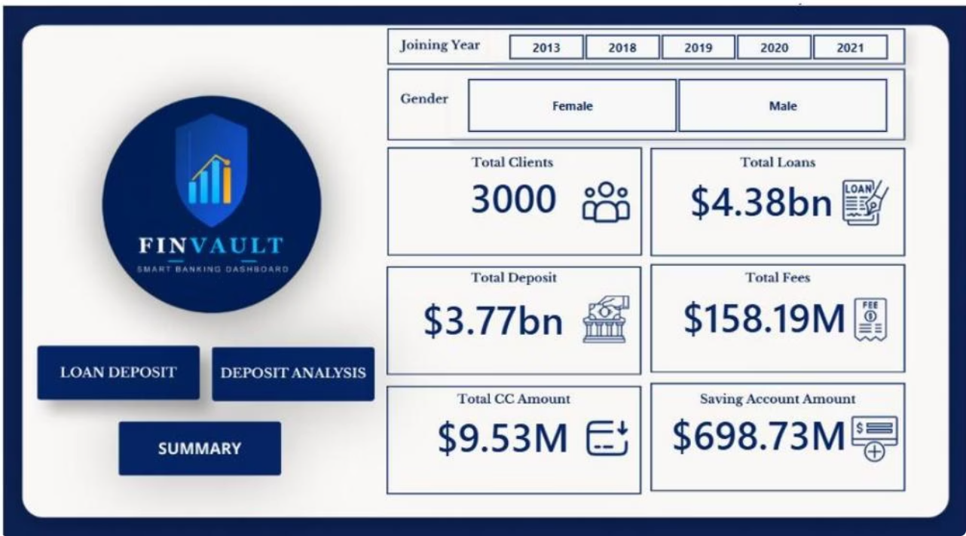
Dashboard Structure & Visuals
Four Pages
Home — 6 KPI cards + slicers (Total Clients, Loans, Deposits, Fees, CC, Savings)
Loan Analysis — loan distributions, income-band donut, treemap by nationality
Deposit Analysis — deposit composition, treemap by income, engagement timeframe bars
Summary — executive 3x4 KPI grid, cross-filters

Slide 9

Key Insights & Risk Observations
Funding Gap
Total Loans $4.38bn vs Deposits $3.77bn → ~ $610M funding gap; external funding reliance and credit/interest risk.
Loan Concentration
Business Lending dominates ($2.6bn); Private Bank clients hold highest balances ($0.81bn) — concentration risk.
Segment Profile
Mid income band = 53% of loans and largest deposit share; long-term clients (>20 yrs) hold highest loans & deposits.
Risk Signals
Loan vs Credit Card correlation (0.37) suggests debt-layering; foreign currency exposure modest ($89.65M) but monitored.

Slide 10
Conclusion & Next Steps
Conclusion
Future Improvements
Metrics to Monitor
FINVAULT delivers a production-grade analytics pipeline and interactive Power BI dashboard that surfaces exposure, deposit behavior, fees, and engagement patterns.
Connect Power BI to PostgreSQL for real-time refresh; build loan default model (scikit-learn / XGBoost); add client-level drill-through and RLS; ingest transaction history for forecasting.
Total Loans $4.38bn
• Total Deposits $3.77bn
• Total Fees $158.19M
• Avg Engagement 15.76 yrs

