Slide 1
Go language
Anand Hariharan
Practice Head, Cloud Technologies Group

Slide 2
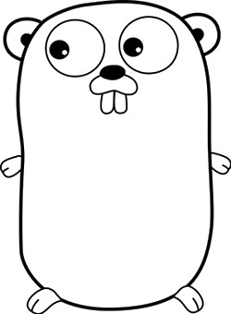
About Go
Developed by Google
By Robert Griesemer, Rob Pike & Ken Thompson
Started in 2007
Current Version 1.5.3, still being actively developed
Compiled, concurrent, garbage-collected, statically typed
Small language – only 25 keywords
Getting started
Download and install Go
https://golang.org/doc/install?download=go1.5.3.windows-amd64.msi
Install LiteIDE
http://sourceforge.net/projects/liteide/

Slide 3
Who uses Go?
Google, of course
Dropbox
Tumblr
Docker
Check below link for comprehensive list for all companies who uses Go! https://github.com/golang/go/wiki/GoUsers

Slide 4
Key concepts

Slide 5
Concurrency
Program structuring technique with multiple threads of control
Concurrency allows programs to be modular
Example: Threads that interacts with users could be distinct from threads that talks to the database.
Difference with parallelism : Parallel programs use multiplicity of computational hardware (e.g. multiple processor cores) in order to perform computation faster
Source: http://cs.stackexchange.com/questions/19987/difference-between-parallel-and-concurrent-programming

Slide 6
Garbage collection
Systematic recovery of pooled computer storage resources that is being used by a program when it is no longer needed
Key principles of garbage collection
Unused memory should be freed
No memory should be freed unless the program will not use it anymore
Source: TechTarget

Slide 7
Statically typed
Statically typed programming languages do type checking, i.e., verification and enforcement of type constraints, at compile-time as opposed to run-time.
E.g. C/C++, Java
Dynamically typed programming languages perform type checking at run time instead of compile time
E.g. Perl, Ruby, Python
Source: StackOverflow

Slide 8
Dependencies in Go
Go defines unused dependencies as compile-time errors
If a package is imported and not used, the program does not compile
This guarantees by construction that the dependency tree for any Go program is precise. No extra code is compiled when building the program and this minimizes compilation time
Source: https://talks.golang.org/2012/splash.article

Slide 9
Naming and visibility
The variable name itself carries information on whether a variable in Public or Private. This is determined by the case of the initial letter of the identifier
If the initial character is in upper case, the identifier is exported as Public, otherwise it is treated as Private:
<Name> is visible to clients of package
<name> (or <_Name>) - this is not visible to clients of the package
Source: https://talks.golang.org/2012/splash.article

Slide 10
Packages, Variables, Constants

Slide 11

Packages
Every Go program is made up of packages.
Programs start running in package main.
It is possible to import remote packages into Go
E.g.
Source: https://talks.golang.org/2012/splash.article

Slide 12
Variables
var statement declares a list of variables
var statement can be at package or function level.
Source: https://golang.org

Slide 13
Short variable declaration
Inside a function, the := short assignment statement can be used in place of a var declaration with implicit type.
Outside a function, every statement begins with a keyword (var, func, and so on) and so the := construct is not available.
Source: https://golang.org

Slide 14
Basic data types
bool, string, int , int8, int16 , int32 , int64
uint uint8 uint16 uint32 uint64 uintptr – denoted unsigned integer
byte // same as uint8
rune // same as int32
float32, float64, complex64, complex128
Source: https://golang.org

Slide 15
Constants
Constants are declared like variables using the const keyword
Constants can be string, character, boolean or numeric
Constants cannot be declared using := syntax.
Source: https://golang.org

Slide 16
Flow control statements

Slide 17
For
Go has only one looping construct - for loop
Loop has three components separated by semicolons:
init statement: executed before first iteration
condition expression: evaluated before every iteration
post statement: executed at end of every iteration
init statement is often a short variable declaration
Variables declared visible only within the for statement
Loop stops iterating once boolean condition evaluates to false
Source: https://golang.org

Slide 18
Switch…case…default
Switch evaluation order
Switch cases evaluate cases from top to bottom, stopping when a case succeeds.
Source: https://golang.org

Slide 19
Defer
Defer statement defers the execution of a function until the surrounding function returns
Deferred call's arguments are evaluated immediately
The function call is not executed until the surrounding function returns
Source: https://golang.org

Slide 20
Arrays, Slices, Maps, Range
Slice is a segment of an array
Like arrays, slices are indexable and have a length
Unlike arrays, length of slices is allowed to change
Maps
Known as hash or dictionary in other languages
Stores key value pairs
A key appears only once in a map
Range
Can be used to iterate over arrays, slices & maps

Slide 21
Methods
Go does not have classes
OOP can be achieved by defining methods on types
Method are functions with special receiver argument
Receiver appears in its own argument list between the func keyword and method name
Declare a method with a receiver whose type is defined in the same package as the method
Method cannot be declared with a receiver whose type is defined in another package. This includes the built-in types such as int
Source: https://golang.org

Slide 22
Interfaces
Interfaces in Go are:
A set of methods
A type

Slide 23
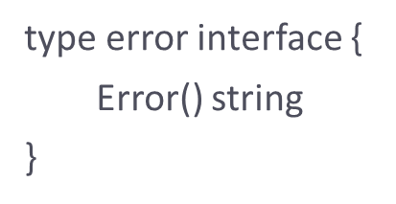
Error handling
Go does not have an exception handling facility
For error handling, Go uses a pre-defined interface type called error
Source: https://golang.org

Slide 24
Concurrency
Implemented using
goroutines
channels
select
goroutine is an independently executing function executed by the “go” statement
Goroutines are multiplexed into a small number of OS threads
They don’t map 1:1 with OS threads
Growable, segmented stacks which startup faster than threads
Go routines communicate via channels
Channel provides a connection between two goroutines allowing them to communicate
See http://tleyden.github.io/blog/2014/10/30/goroutines-vs-threads/ for more info

Slide 25
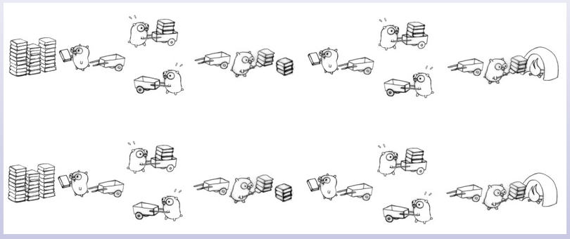
Visualizing concurrency

Slide 26
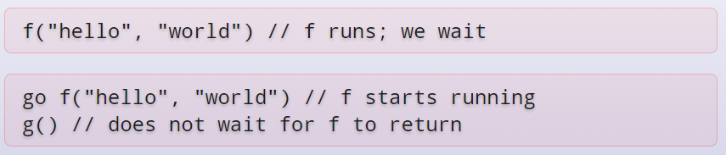
Example
Program execution begins by initializing the main package and then invoking the function main. When that function invocation returns, the program exits. It does not wait for other (non-main) goroutines to complete.

Slide 27
Channels
Use make(chan val-type) to create a new channel
Channels are typed by the values they convey

Slide 28
Tools
gofmt
A formatter for Go code
gofix
Helps in code updates/refactoring (e.g. update of APIs)
Source: https://golang.org

Slide 29
Anand Hariharan
Practice Head
anand.hariharan@wipro.com

