Slide 1
Building apps on Google AppEngine using GO
Anand Hariharan
Practice Head, Cloud Technologies Group

Slide 2
AppEngine SDK
Use AppEngine Go SDK to develop and upload Go applications to Google App Engine
Go SDK includes
a web server application that simulates the App Engine environment,
local version of the datastore
Google Accounts, and
ability to fetch URLs & send email directly from your computer using the App Engine APIs
Source:https://cloud.google.com/appengine/docs/go/gettingstarted/devenvironment

Slide 3
Go AppEngine commands
goapp serve, for running a local development server
goapp deploy, for uploading your app to App Engine
Add the go_appengine directory to your PATH environment variable to simplify development and deployment

Slide 4
Configuring app.yaml
A Go app specifies runtime configuration, including versions and URLs, in a file named app.yaml
Example:
application: myapp version: alpha-001 runtime: go api_version: go1 handlers: - url: /stylesheets static_dir: stylesheets - url: /(.*\.(gif|png|jpg))$ static_files: static/\1 upload: static/.*\.(gif|png|jpg)$ - url: /.* script: _go_app
Source: https://cloud.google.com/appengine/docs/go/config/appconfig

Slide 5
More on app.yaml
Handlers are of two types – they are evaluated top-down:
Script handlers
Static file handlers
Notice that you can specify a handler in either of two ways:
Directly under the handlers: element, as shown above.
Indirectly in .yaml files that are included under the includes: element.
includes: #indirect inclusion of handlers – these files in turn will have handlers defined - cloud_endpoints.yaml - web_interface.yaml - admin_interface.yaml
handlers: - url: /images static_dir: static/images #this is a static file handler - url: /.* script: _go_app #this is a script handler

Slide 6
More on app.yaml
Optional elements
application: <myapp>
version: <version of your app>
For more info, see reference: https://cloud.google.com/appengine/docs/go/config/appconfig#Go_app_yaml_About_app_yaml

Slide 7
Request handling and HTTP
Go runtime for App Engine uses the standard http package as an interface between your Go program and the App Engine servers
When App Engine receives a web request for your application, it invokes the http.Handler associated with the request URL. (The URL must also be specified as a Go handler in the application's app.yaml configuration file.)
App Engine runs multiple instances of your application, each instance has its own web server for handling requests.
Any request can be routed to any instance, so consecutive requests from the same user are not necessarily sent to the same instance.
An instance can handle multiple requests concurrently.
The number of instances can be adjusted automatically as traffic changes.

Slide 8
How applications scale
Instances are the basic building blocks of App Engine, providing all the resources needed to successfully host your application. This includes the language runtime, the App Engine APIs, and your application's code and memory. Each instance includes a security layer to ensure that instances cannot inadvertently affect each other.
Instances are the computing units that App Engine uses to automatically scale your application. At any given time, your application may be running on one instance or many instances, with requests being spread across all of them.

Slide 9
Instances
Instances are resident or dynamic. A dynamic instance starts up and shuts down automatically based on the current needs. A resident instance runs all the time, which can improve your application's performance.
An instance instantiates the code which is included in an App Engine module.
When you configure your app, you specify how its modules scale (the initial number of instances for a module and how new instances are created and stopped in response to traffic), and how much time an instance is allowed to handle a request (its deadline).

Slide 10
Scaling class
The scaling class that you assign to a module determines the kind(s) of instances created:
Manual scaling modules use resident instances
Basic scaling modules use dynamic instances
Auto scaling modules use dynamic instances - but if you specify a number, N, of minimum idle instances, the first N instances will be resident, and additional dynamic instances will be created as necessary.

Slide 11
Scaling dynamic instances
The App Engine scheduler decides whether to serve each new request with an existing instance (either one that is idle or accepts concurrent requests), put the request in a pending request queue, or start a new instance for that request. The decision takes into account the number of available instances, how quickly your application has been serving requests (its latency), and how long it takes to spin up a new instance.
Each instance has its own queue for incoming requests. App Engine monitors the number of requests waiting in each instance's queue. If App Engine detects that queues for an application are getting too long due to increased load, it automatically creates a new instance of the application to handle that load.
You can specify a minimum number of idle instances. Setting an appropriate number of idle instances for your application based on request volume allows your application to serve every request with little latency, unless you are experiencing abnormally high request volume.
Source: https://cloud.google.com/appengine/docs/go/scaling

Slide 12
Go Runtime environment
Go apps run inside a secure "sandbox" environment with a reduced set of libraries
The Go runtime environment uses Go version 1.4. The SDK includes the Go compiler and standard library, so it has no additional dependencies.
The SDK includes an automated build service to compile your app, so you'll never need to invoke the compiler yourself.
Your app will be automatically re-built whenever you change the source.

Slide 13
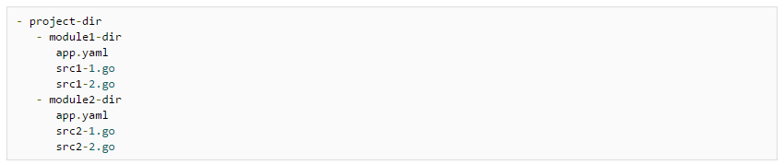
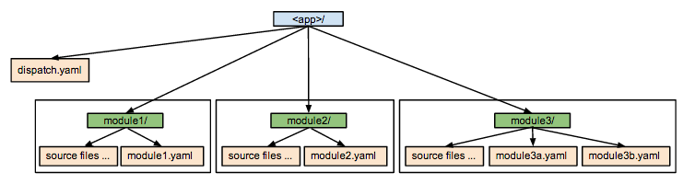
Organizing Go apps
When developing an App Engine app in Go, your code is partitioned into one or more modules; each module is usually contained in its own directory, along with an app.yaml file for the module

Slide 14
Organizing modules – best practices
Create a separate directory in your project for each module.
Each module directory should contain the module's app.yaml file and one or more .go files.
Do not include any subdirectories in a module's directory.
Your .go files should import packages using fully-qualified paths; place all package code beneath src directories that are direct children of the project directory, or not under your project directory at all.

Slide 15
Routing with a dispatch file
HTTP requests from users can reach the appropriate module/version/instance in two ways:
A request with a URL that ends at the domain level can be routed according to App Engine's default address routing rules.
Alternatively, you can include a dispatch file that routes specific URL patterns according to your own rules.

Slide 16
Dispatch.yaml
For certain URLs, you can create a dispatch file that overrides the routing rules. This lets you send incoming requests to a specific module based on the path or hostname in the URL.
To do this you can create a custom routing with a dispatch.yaml file. The file can be placed in your project directory at the top level, or in the directory that defines the default module.

Slide 17
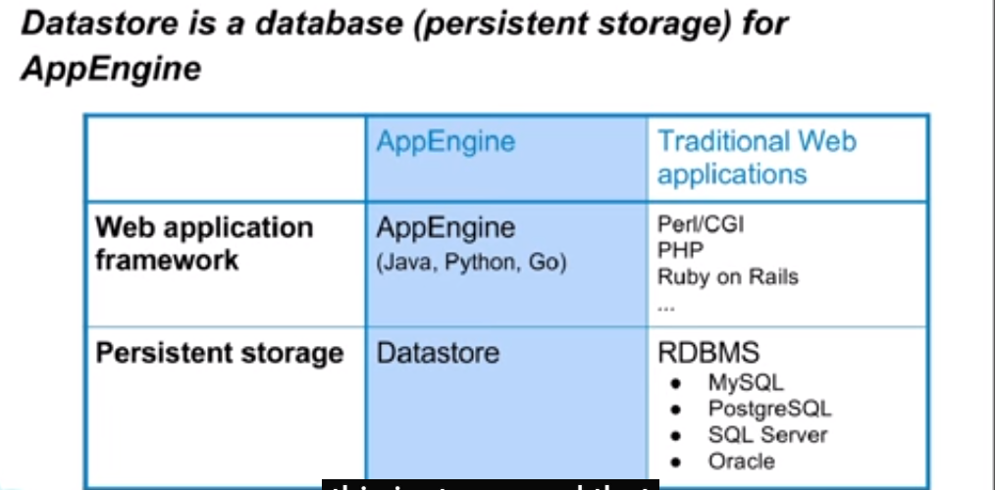
AppEngine DataStore

Slide 18
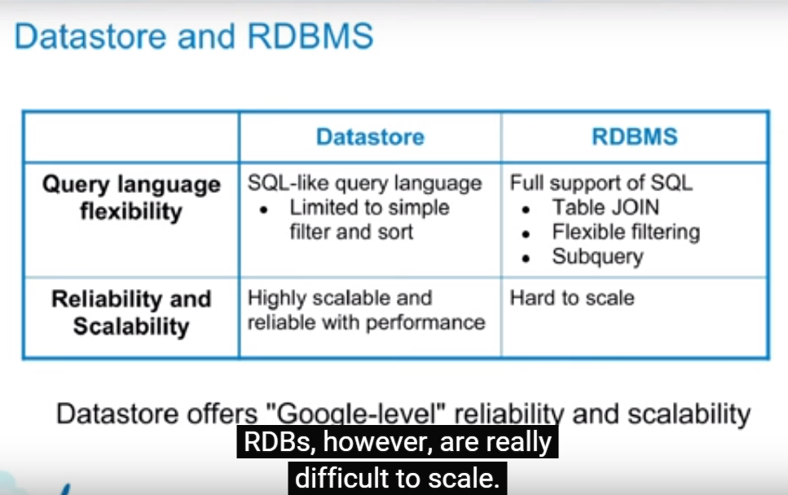
DataStore versus Relational DB

Slide 19
DataStore features
No planned downtime
Atomic transactions
High availability of reads and writes
Strong consistency for reads and ancestor queries
Eventual consistency for all other queries
The Datastore replicates data across multiple datacenters. This provides a high level of availability for reads and writes. Most queries are eventually consistent.
Source: https://cloud.google.com/appengine/docs/go/datastore/

Slide 20
Eventually consistent
Eventual consistency is a consistency model used in distributed computing to achieve high availability that informally guarantees that, if no new updates are made to a given data item, eventually all accesses to that item will return the last updated value.
Source: https://en.wikipedia.org/wiki/Eventual_consistency

Slide 21
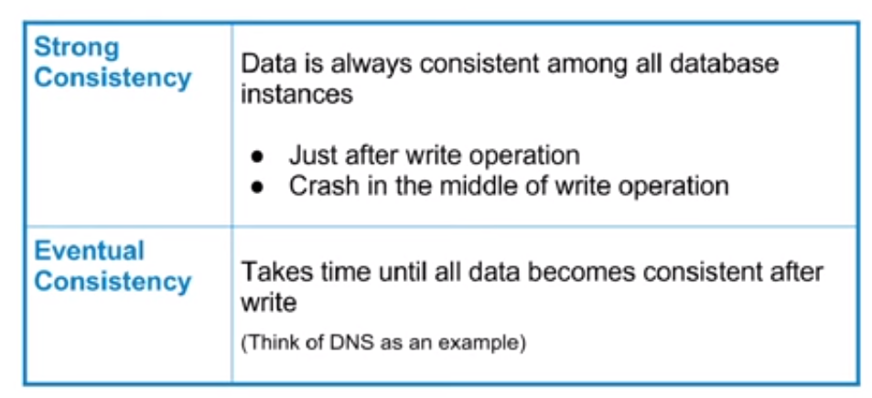
Strong versus Eventual consistency

Slide 22
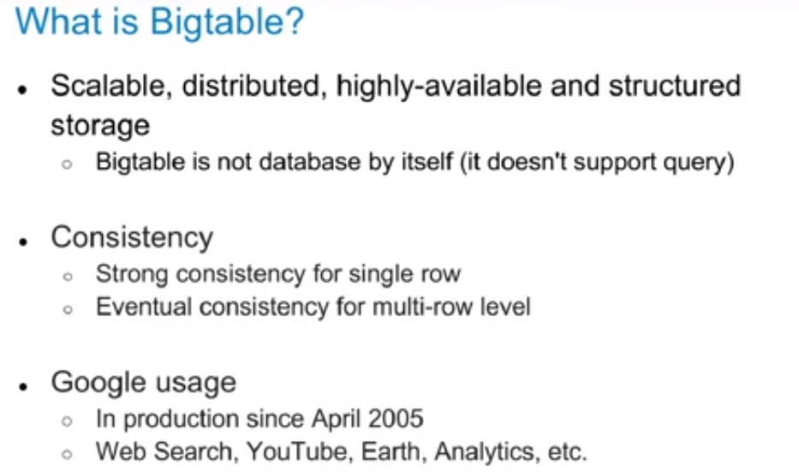
DataStore is based on BigTable

Slide 23
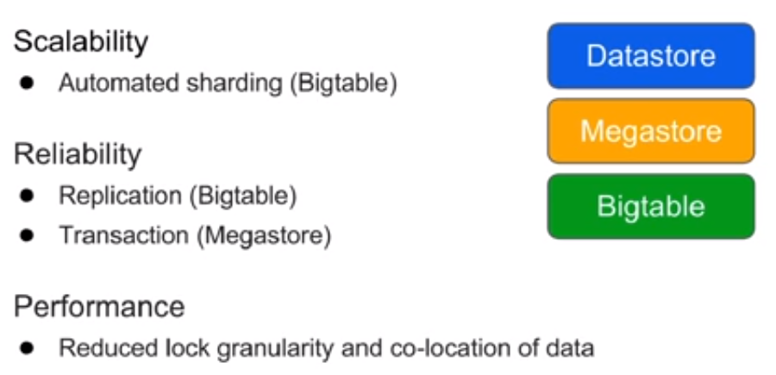
Key components of DataStore

Slide 24
DataStore concepts
The Datastore replicates data across multiple datacenters. This provides a high level of availability for reads and writes.
Most queries are eventually consistent.
The Datastore holds data objects known as entities.
An entity has one or moreproperties, named values of one of several supported data types: for instance, a property can be a string, an integer, or a reference to another entity.
Each entity is identified by itskind, which categorizes the entity for the purpose of queries, and a key that uniquely identifies it within its kind.
The Datastore can execute multiple operations in a singletransaction. By definition, a transaction cannot succeed unless every one of its operations succeeds; if any of the operations fails, the transaction is automatically rolled back. This is especially useful for distributed web applications, where multiple users may be accessing or manipulating the same data at the same time.

Slide 25
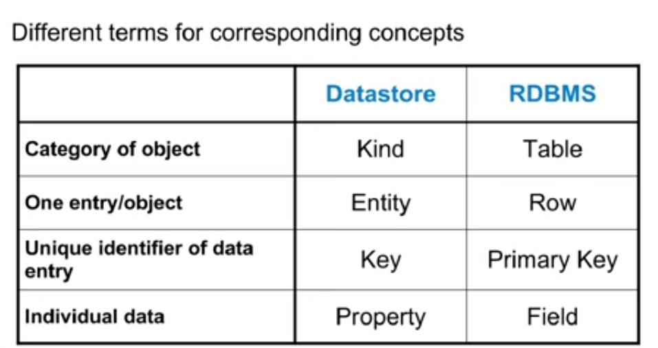
DataStore concepts

Slide 26
Working with DataStores in Go
In Go, Datastore entities are created from struct values.
The structure's fields become the properties of the entity.
To create a new entity, you set up the value you wish to store, create a key, and pass them both to datastore.Put().
Updating an existing entity is a matter of performing another Put() using the same key.
To retrieve an entity from the Datastore, you first set up a value into which the entity will be unmarshalled, then pass a key and a pointer to that value to datastore.Get().

Slide 27
Ancestors & Descendants
An entity can optionally designate another entity as its parent; the first entity is a child of the parent entity.
The entities in the Datastore thus form a hierarchically structured space similar to the directory structure of a file system.
An entity's parent, parent's parent, and so on recursively, are its ancestors; its children, children's children, and so on, are its descendants.
An entity without a parent is a root entity.

Slide 28
Ancestors & Descendants – groups and consistency
Entities descended from a common ancestor are said to belong to the same entity group; the common ancestor's key is the group's parent key, which serves to identify the entire group.
Queries over a single entity group, called ancestor queries, refer to the parent key instead of a specific entity's key. Entity groups are a unit of both consistency and transactionality:
queries over multiple entity groups may return stale, eventually consistent results.
In contrast, queries limited to a single entity group always return up-to-date, strongly consistent results.

Slide 29
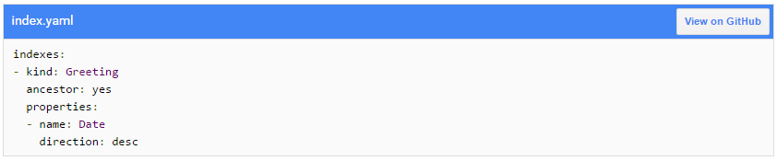
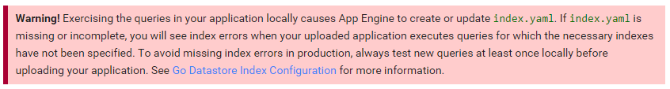
DataStore indexes
Every query in the App Engine Datastore is computed from one or more indexes—tables that map ordered property values to entity keys. This is how App Engine is able to serve results quickly regardless of the size of your application's Datastore.
Many queries can be computed from the builtin indexes, but for queries that are more complex the Datastore requires a custom index. Without a custom index, the Datastore can't execute these queries efficiently.

Slide 30
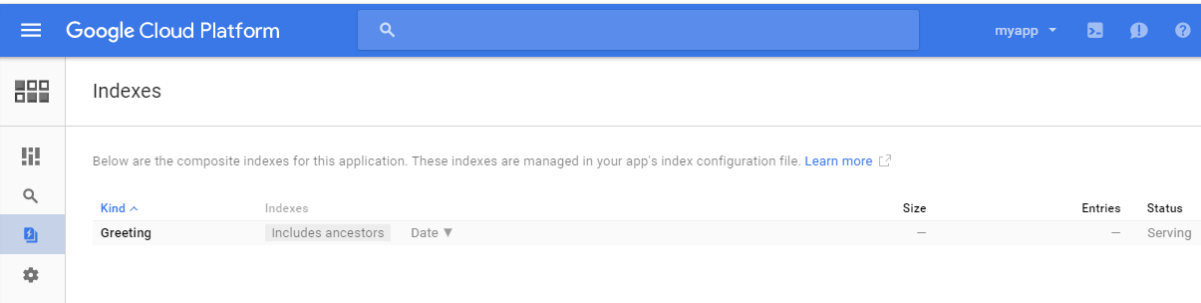
Checking application state
After your application is uploaded, its Datastore Indexes will be automatically generated. This operation may take some time, and any visitors to your site will receive a DatastoreNeedIndexException until the indexes have been built. You can monitor the progress of the operation by visiting the Cloud Platform Console, selecting your application, and then selecting the Storage, Cloud Datastore, Indexes link.

Slide 33
Using Memcache

Slide 34
Join Google Partner Portal
https://connect.googleforwork.com

Slide 35
Anand Hariharan
Practice Head
anand.hariharan@wipro.com

Slide 36

About Go
Developed by Google
By Robert Griesemer, Rob Pike & Ken Thompson
Started in 2007
Current Version 1.5.3, still being actively developed
Compiled, concurrent, garbage-collected, statically typed
Small language – only 25 keywords
Getting started
Download and install Go
https://golang.org/doc/install?download=go1.5.3.windows-amd64.msi
Install LiteIDE
http://sourceforge.net/projects/liteide/

Slide 37
Who uses Go?
Google, of course
Dropbox
Tumblr
Docker
Check below link for comprehensive list for all companies who uses Go! https://github.com/golang/go/wiki/GoUsers

Slide 38
Key concepts

Slide 39
Concurrency
Program structuring technique with multiple threads of control
Concurrency allows programs to be modular
Example: Threads that interacts with users could be distinct from threads that talks to the database.
Difference with parallelism : Parallel programs use multiplicity of computational hardware (e.g. multiple processor cores) in order to perform computation faster
Source: http://cs.stackexchange.com/questions/19987/difference-between-parallel-and-concurrent-programming

Slide 40
Garbage collection
Systematic recovery of pooled computer storage resources that is being used by a program when it is no longer needed
Key principles of garbage collection
Unused memory should be freed
No memory should be freed unless the program will not use it anymore
Source: TechTarget

Slide 41
Statically typed
Statically typed programming languages do type checking, i.e., verification and enforcement of type constraints, at compile-time as opposed to run-time.
E.g. C/C++, Java
Dynamically typed programming languages perform type checking at run time instead of compile time
E.g. Perl, Ruby, Python
Source: StackOverflow

Slide 42
Dependencies in Go
Go defines unused dependencies as compile-time errors
If a package is imported and not used, the program does not compile
This guarantees by construction that the dependency tree for any Go program is precise. No extra code is compiled when building the program and this minimizes compilation time
Source: https://talks.golang.org/2012/splash.article

Slide 43
Naming and visibility
The variable name itself carries information on whether a variable in Public or Private. This is determined by the case of the initial letter of the identifier
If the initial character is in upper case, the identifier is exported as Public, otherwise it is treated as Private:
<Name> is visible to clients of package
<name> (or <_Name>) - this is not visible to clients of the package
Source: https://talks.golang.org/2012/splash.article

Slide 44
Packages, Variables, Constants

Slide 45

Packages
Every Go program is made up of packages.
Programs start running in package main.
It is possible to import remote packages into Go
E.g.
Source: https://talks.golang.org/2012/splash.article

Slide 46
Variables
var statement declares a list of variables
var statement can be at package or function level.
Source: https://golang.org

Slide 47
Short variable declaration
Inside a function, the := short assignment statement can be used in place of a var declaration with implicit type.
Outside a function, every statement begins with a keyword (var, func, and so on) and so the := construct is not available.
Source: https://golang.org

Slide 48
Basic data types
bool, string, int , int8, int16 , int32 , int64
uint uint8 uint16 uint32 uint64 uintptr – denoted unsigned integer
byte // same as uint8
rune // same as int32
float32, float64, complex64, complex128
Source: https://golang.org

Slide 49
Constants
Constants are declared like variables using the const keyword
Constants can be string, character, boolean or numeric
Constants cannot be declared using := syntax.
Source: https://golang.org

Slide 50
Flow control statements

Slide 51
For
Go has only one looping construct - for loop
Loop has three components separated by semicolons:
init statement: executed before first iteration
condition expression: evaluated before every iteration
post statement: executed at end of every iteration
init statement is often a short variable declaration
Variables declared visible only within the for statement
Loop stops iterating once boolean condition evaluates to false
Source: https://golang.org

Slide 52
Switch…case…default
Switch evaluation order
Switch cases evaluate cases from top to bottom, stopping when a case succeeds.
Source: https://golang.org

Slide 53
Defer
Defer statement defers the execution of a function until the surrounding function returns
Deferred call's arguments are evaluated immediately
The function call is not executed until the surrounding function returns
Source: https://golang.org

Slide 54
Methods
Go does not have classes
OOP can be achieved by defining methods on types
Method are functions with special receiver argument
Receiver appears in its own argument list between the func keyword and method name
Declare a method with a receiver whose type is defined in the same package as the method
Method cannot be declared with a receiver whose type is defined in another package. This includes the built-in types such as int
Source: https://golang.org

Slide 55
Arrays, Slices, Maps, Range
Slice is a segment of an array
Like arrays, slices are indexable and have a length
Unlike arrays, length of slices is allowed to change
Maps
Known as hash or dictionary in other languages
Stores key value pairs
A key appears only once in a map
Range
Can be used to iterate over arrays, slices & maps

Slide 56
Interfaces
Interfaces in Go are:
A set of methods
A type

Slide 57
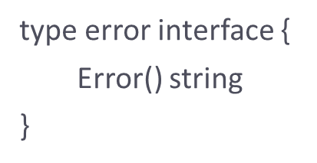
Error handling
Go does not have an exception handling facility
For error handling, Go uses a pre-defined interface type called error
Source: https://golang.org

Slide 58
Concurrency
Implemented using
goroutines
channels
select
goroutine is an independently executing function executed by the “go” statement
Goroutines are multiplexed into a small number of OS threads
They don’t map 1:1 with OS threads
Growable, segmented stacks which startup faster than threads
Go routines communicate via channels
Channel provides a connection between two goroutines allowing them to communicate
See http://tleyden.github.io/blog/2014/10/30/goroutines-vs-threads/ for more info

Slide 59
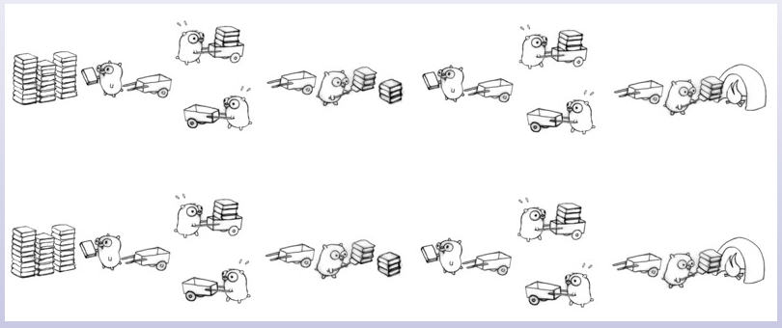
Visualizing concurrency

Slide 60
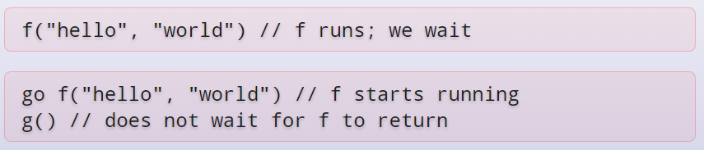
Example
Program execution begins by initializing the main package and then invoking the function main. When that function invocation returns, the program exits. It does not wait for other (non-main) goroutines to complete.

Slide 61
Channels
Use make(chan val-type) to create a new channel
Channels are typed by the values they convey

Slide 62
Tools
gofmt
A formatter for Go code
gofix
Helps in code updates/refactoring (e.g. update of APIs)
Source: https://golang.org

