Slide 1

Note: The data and information in this document is reflective of a hypothetical situation and client. This document is to be used for KPMG Virtual Internship purposes only.
Sprocket Central Pty Ltd
Data analytics approach

Slide 2
Note: The data and information in this document is reflective of a hypothetical situation and client. This document is to be used for KPMG Virtual Internship purposes only.
Agenda
Introduction
Data Exploration
Model Development
Interpretation

Slide 3
Note: The data and information in this document is reflective of a hypothetical situation and client. This document is to be used for KPMG Virtual Internship purposes only.
Introduction
Sprocket Central concentrates on high-quality bikes and cycling accessories.
The marketing team intends to lift business sales by examining provided datasets to recommend which of these 1000 new customers should be targeted to drive the most value for the organisation.
Objective:
Identify and Recommend
Top 1000 Customer to Target from Datasets
Data Analysis’s Content:
Data Preparation (Quality assessment )
Data Exploration
Customer Age Distribution
Customer Gander Distribution
Bike related purchases over the last 3 years
Job industry distributions
Wealth segmentation
Number of cars owned and not owned
3. Model Development &Interpretation

Slide 4
Note: The data and information in this document is reflective of a hypothetical situation and client. This document is to be used for KPMG Virtual Internship purposes only.
Data Preparation (Quality assessment )

Slide 5
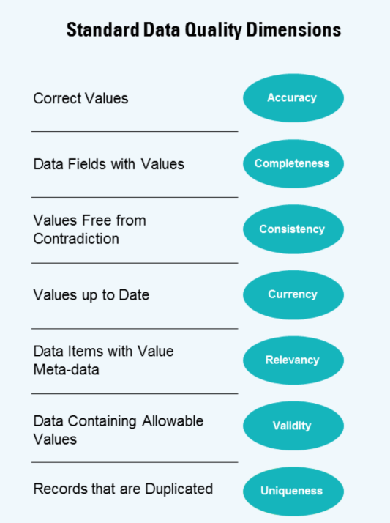
Note: The data and information in this document is reflective of a hypothetical situation and client. This document is to be used for KPMG Virtual Internship purposes only.
Data Preparation (Quality assessment )
The summary table below highlights the key data quality issues :
 | Accuracy | Completeness | Consistency | Currency | Relevancy | Validity | Uniqueness
Customer Demographic | “Default”: values are not correct | Missing data: last_name DOB job_title job_industry_category tenure | Inconsistence Data: Gender | Archive or filter out deceased Customers | incomprehensible information in the « default » column | / | No duplicated values
Customer Address | / | No missing data | Inconsistence Data: States | / | / | / | No duplicated values
Transactions | / | Missing Data: online_order brand product_line product_class product_size standard_cost product_first_sold_date Incomplete Data: Customer id(no transaction for customers between 3501-5033) |  | / | “order_status” is irrelevant for analysis. | Data Type: Product Sold Date: Float>Date | No duplicated values
New Customer List | 5 unamed Columns | Mssing/incomplete Data: Customer id is missing |  | / | / | / | No duplicated values

Slide 6
Note: The data and information in this document is reflective of a hypothetical situation and client. This document is to be used for KPMG Virtual Internship purposes only.
Data Exploration

Slide 7
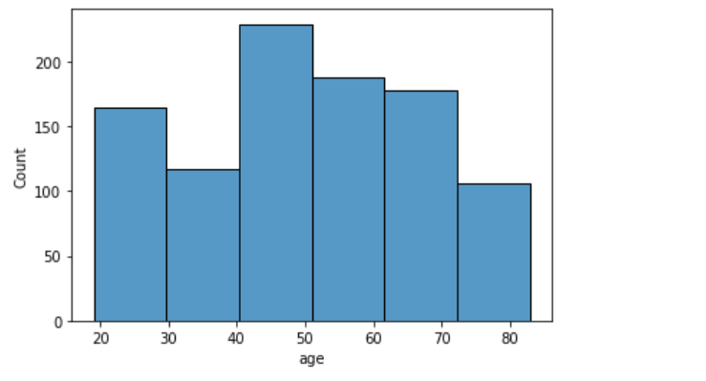
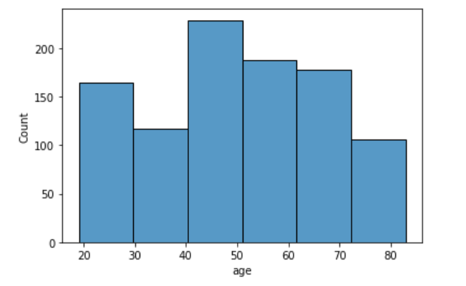
Note: The data and information in this document is reflective of a hypothetical situation and client. This document is to be used for KPMG Virtual Internship purposes only.
2. Data Exploration
Customer Age Distribution:
Most customer are aged between 40-50
(both new customer and the old customers)
For the new customers the lowest age groups are under 20 and uper 80
For the old customers the lowest age groups are under 20 and uper 69
The new customers: age groups 39-49
are most populated(also 50-69).
The old customers:age groups 39-49 are most
populated.

Slide 8
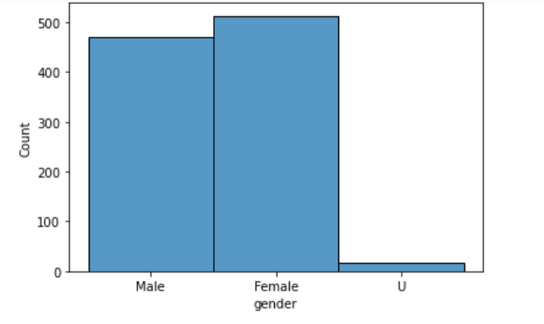
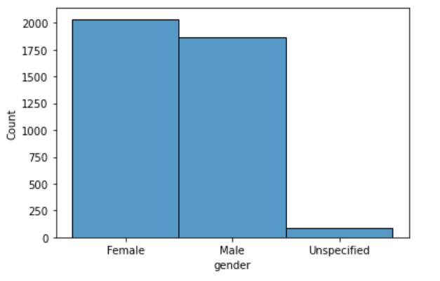
Note: The data and information in this document is reflective of a hypothetical situation and client. This document is to be used for KPMG Virtual Internship purposes only.
2. Data Exploration
Customer Gender Distribution:
For both datasets (old and new customers) most of customer are female
The target audience should be inclined to provide focus on
females more than males cutomers.

Slide 9
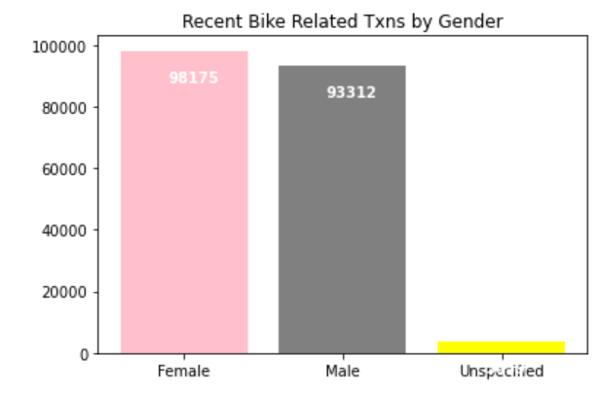
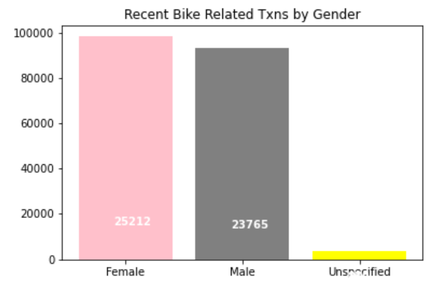
Note: The data and information in this document is reflective of a hypothetical situation and client. This document is to be used for KPMG Virtual Internship purposes only.
2. Data Exploration
Bike related purchases over the last 3 years:
For both old and new customers :
Females make up majority of bike related sales
(25212 bikes for new and 98303bikes purchases )
For Males :23765 bikes for new customers and 93415bikes for old cutomes

Slide 10
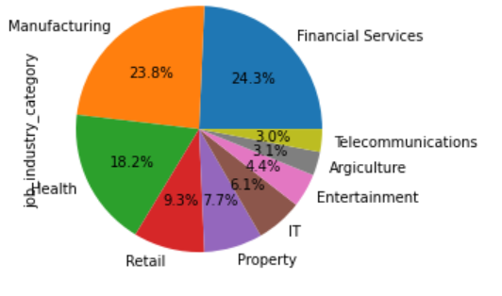
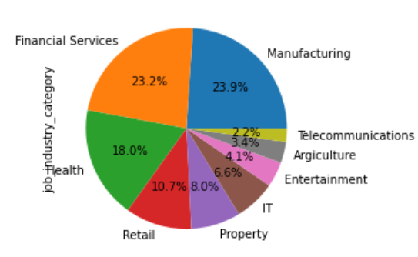
Note: The data and information in this document is reflective of a hypothetical situation and client. This document is to be used for KPMG Virtual Internship purposes only.
2. Data Exploration
Job industry distributions:
For both New and old customers:
Financial Services, Manufacturing, and Health are the top three profit-generating industries,followed by retail and property.
The smallest number of customers are in Agriculture and Telecommunications

Slide 11
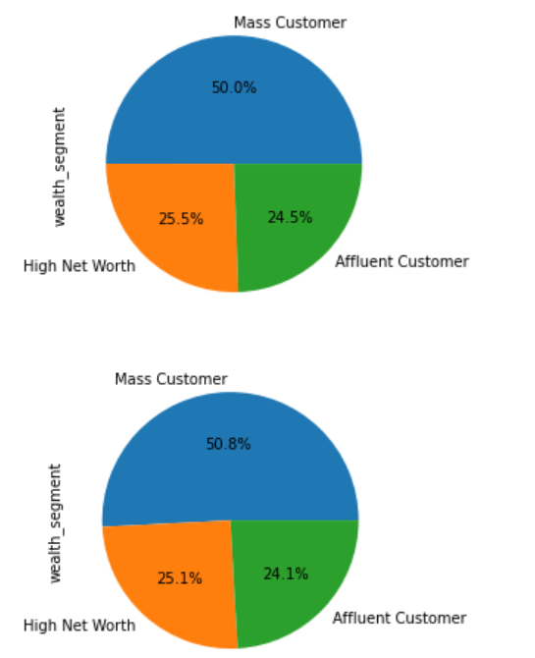
Note: The data and information in this document is reflective of a hypothetical situation and client. This document is to be used for KPMG Virtual Internship purposes only.
2. Data Exploration
Wealth segmentation:
For the social class in both datasets(old nd new customers):
The number of Mass Customers is the highest(we should focus on this class
fellowed by High net customers and then the affluent cutomers)

Slide 12
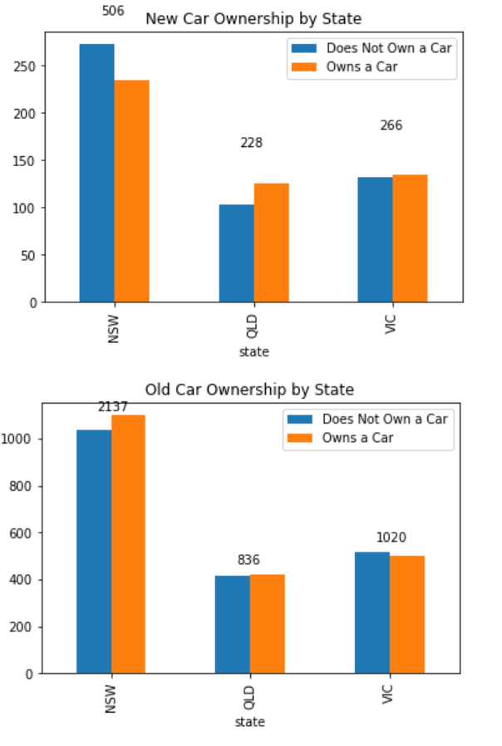
Note: The data and information in this document is reflective of a hypothetical situation and client. This document is to be used for KPMG Virtual Internship purposes only.
2. Data Exploration
Number of cars owned and not owned by state:
For the new customers:
NSW has the largest amount of people that do not own a car.
Victoria is also split quite evenly.
QLD has a relatively high number of customers that own a car.
For old cutomers dataset:
NSW has the largest amount of people that do not own a car.
Victoria and QLD is also split quite evenly.

Slide 13
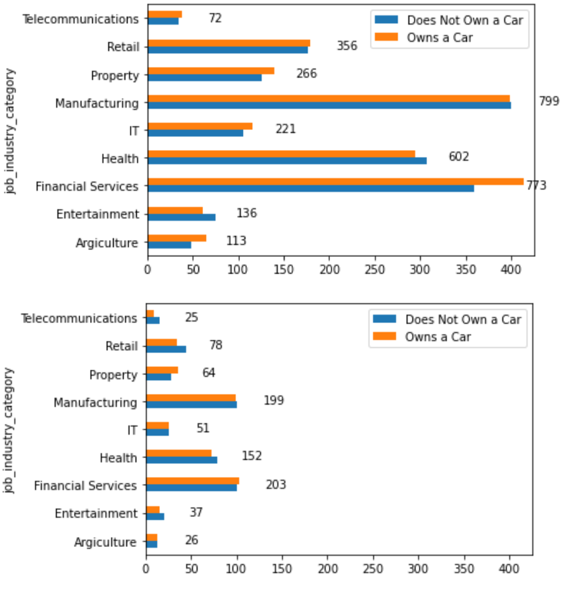
Note: The data and information in this document is reflective of a hypothetical situation and client. This document is to be used for KPMG Virtual Internship purposes only.
2. Data Exploration
Number of cars owned and not owned by job category:
Customers who worked in financial services are most likely to own a car(old cutomers)
Customers who worked in health and entertainmet are most likely to own a car.

Slide 14
Note: The data and information in this document is reflective of a hypothetical situation and client. This document is to be used for KPMG Virtual Internship purposes only.
Model Developement

Slide 15
Note: The data and information in this document is reflective of a hypothetical situation and client. This document is to be used for KPMG Virtual Internship purposes only.
Model Developement
The following are the high-value clients to target from the new list :
Aged between 40 – 50.
Most of the high value customers are female compared to male
Working in Financial Service, Manufacturing and Health.
Who are currently living in New South Wales and Victoria.

