Slide 1

S-Coat
Blinder App
Protecter App
Infrared
Sensor
Vibration motor
Map
Picture
Map
Button
Blue
tooth
Bluetooth
Comm.
SMS
SMS message
Camera
LED
FILE
TextToSpeech
Send
TextMessage
SMS Broadcast receiver
Info.txt
ATmega128
Bluetooth
Service
Google Map API v2
Google Map API v2
WinAVR
Android
Android

Slide 2
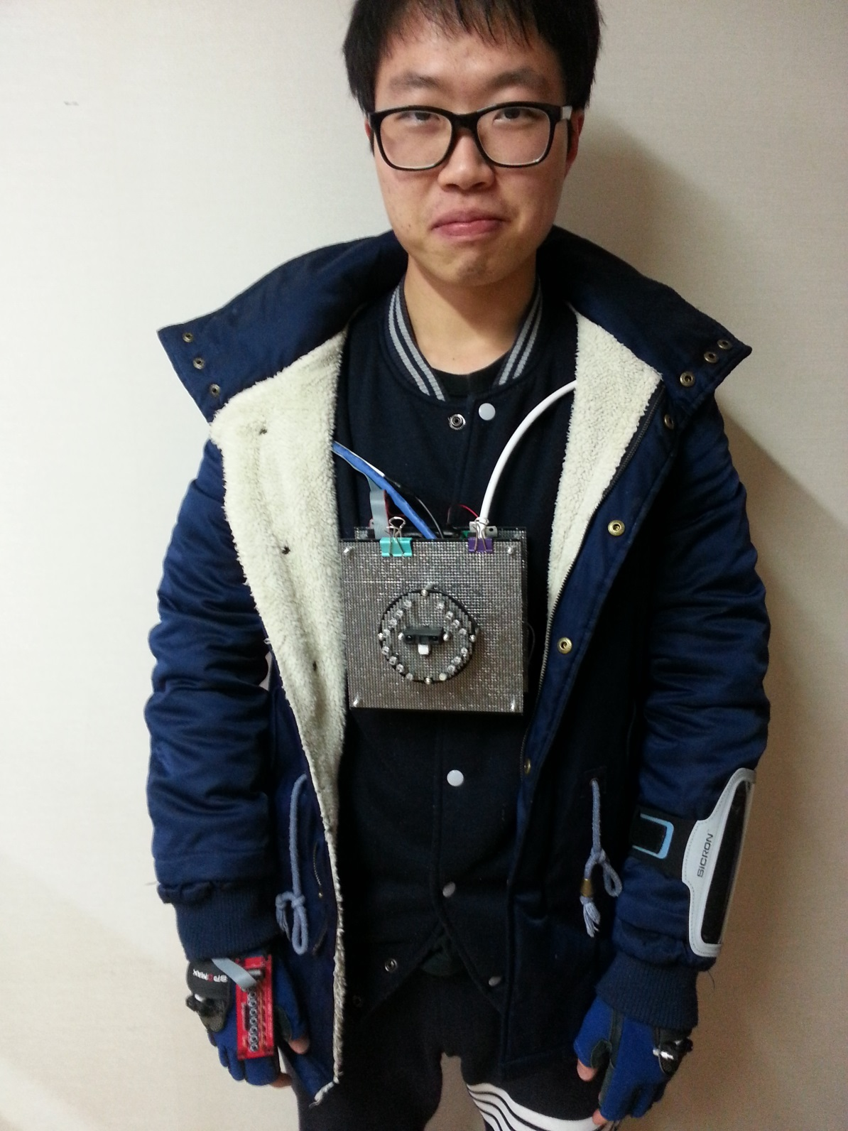

Slide 3

S-Coat
Blinder App
Protecter App
Infrared
Sensor
Vibratemotor
Map
Picture
Map
Button
Blue
tooth
Comm.
SMS
camera
LED
FILE
Info.txt
TextToSpeech
Send
TextMessage
SMS Broadcast receiver
ATmega128
Bluetooth
Service
Google Map API v2
Google Map API v2
WinAVR
Android
Android

Slide 4
MCU
5v
Reg.

Slide 5
Buzzer
(A2)
Vib.
Motor
(A0:A1)
Analog
Signal
Blue
Tooth
(UART1)
MCU
ATmega128
A
D
C
Infrared
Sensor
(F0~F2)
Camera
(UART0)
Button
(B0~B7)

Slide 6
Main()
Init_port();
while(1)
//Camera part
shot, call_size, call_img;
//Sensor part
if(sensor > value)
motor = 1;
//Button part
if(PINB)
printf(“message”);
ISR(UART0)
ISR(UART1)
ISR(Timer1)

Slide 7
Activity
Google Map
.setOnMyLocationEnabled()
MyLocationListener
.Getlatitude()
.getlongitude()
Blinder_val.java
Double latitude;
Double longitude;

Slide 8
Picture_val.java
Byte[] picture_buffer
Activity
ImageView
byteArraytoBitmap();
.setImageBitmap();

Slide 9
MainActivity
Emergency
Button
Intent
blinder_name;
protecter_name;
Protecter_pn;
TextMessage;
SubActivity
Info.txt
Intent
blinder_name;
protecter_name;
Protecter_pn;

Slide 10
BluetoothChatService
ConnectedThread
SendTextMessage();
SendPicturebuffer;
Serial
Comm.
Picture_val.java
Byte[] picture_buffer
S-Coat
(MCU)
Blinder_val.java
Double latitude;
Double longitude;

