Slide 1
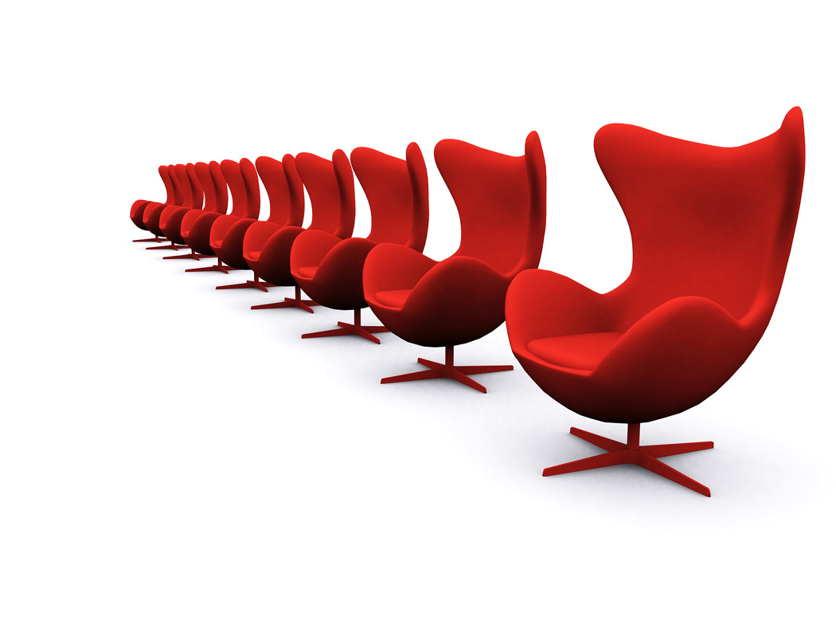

Note Test
음치 교정 어플리케이션
경상대학교
류성현

Slide 2


Motive
Architecture
Explain
Demonstration
1

Slide 3

Motive
1

Slide 4

Motive
하이!
1

Slide 5
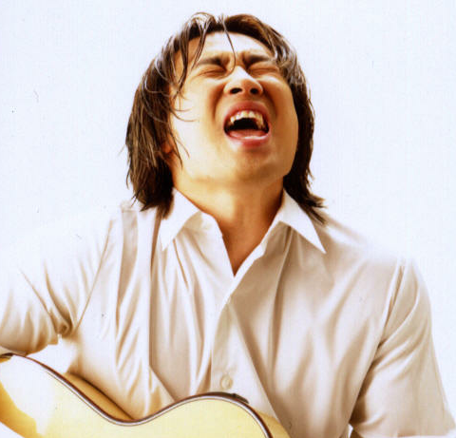
Motive
음치ㅜㅜ
1

Slide 6
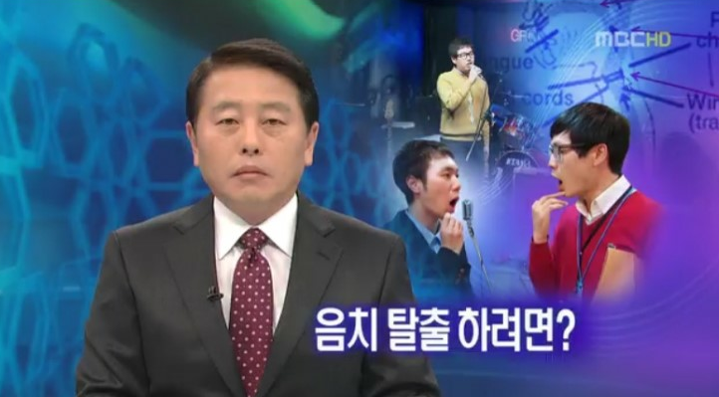
Motive
1

Slide 7
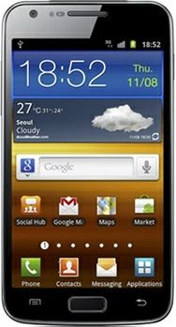




Motive
음치교정
어플리케이션
1

Slide 8
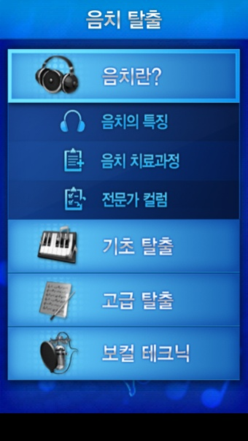
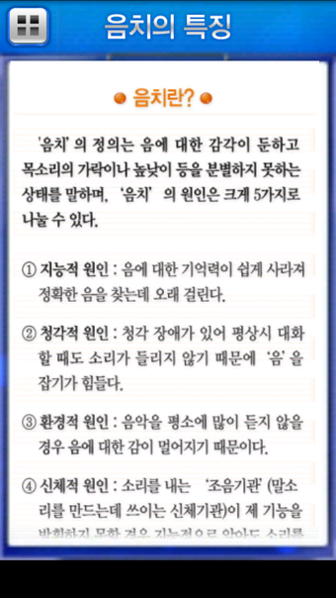
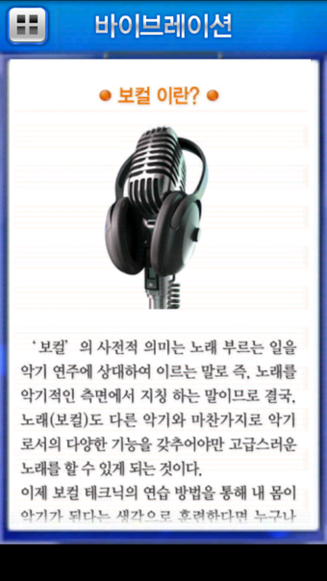
Motive
1

Slide 9
Architecture
1

Slide 10
Architecture - System
Voice
Source Data
Setting
Note
PCM
Play
FFT Library
PCM Record
Pitch Detect
Result
Display
Matching
Android OS
1

Slide 11
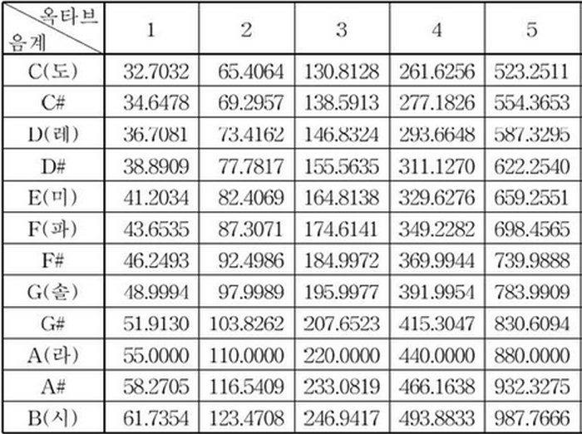
Architecture
Frequency
Data
Voice
Source Data
FFT Library
Pitch Detect
Matching
Compare
CalCul
Comparing
Pitch > Frequency
Frequency = Pitch
Pitch
Frequency
Pitch
Frequency
Data
== Set Note
Measured Notes
1

Slide 12
Architecture
PCM Data
Short Buffer
PCM
Play
Start
Point
PCM Data to play
1

Slide 13
Explain
1

Slide 14
Explain
감각적 요인
발음의 요인
환경적 요인
첫음을 잡아라!
1

Slide 15
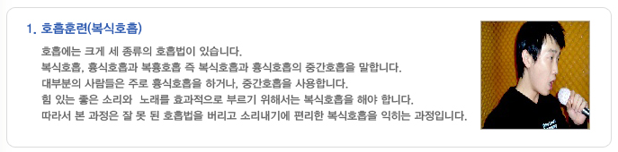
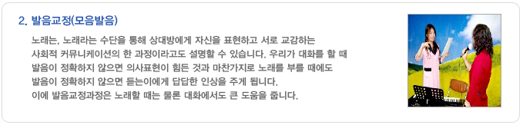
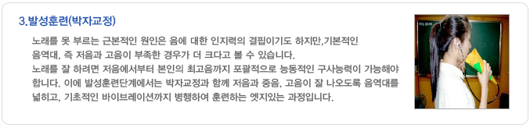
Explain
1

Slide 16




Explain
Note
Test
1

Slide 17
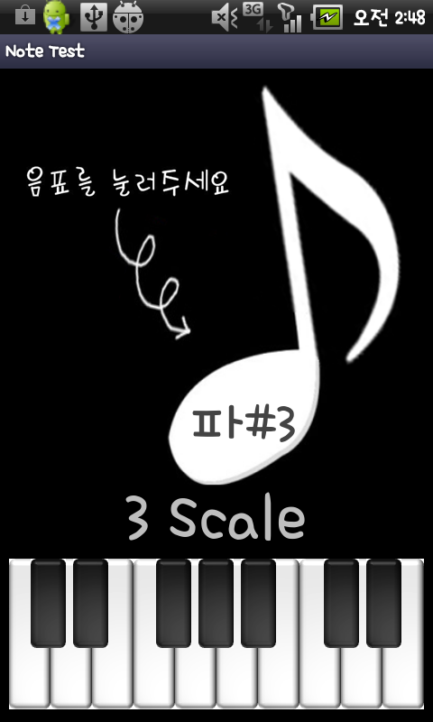
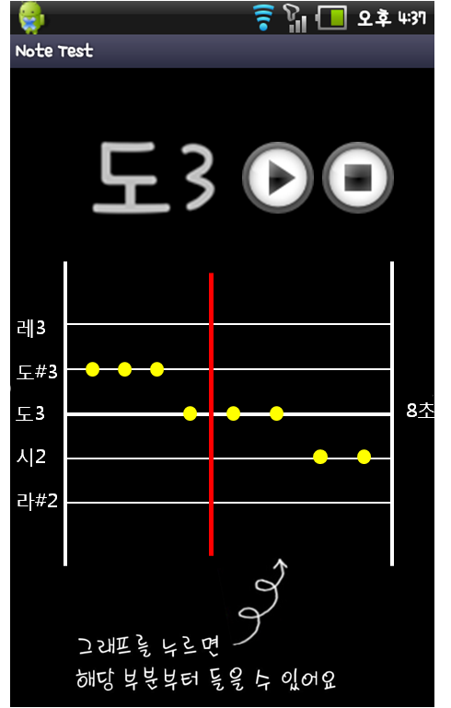
Explain
발성 연습 모드
1

Slide 18
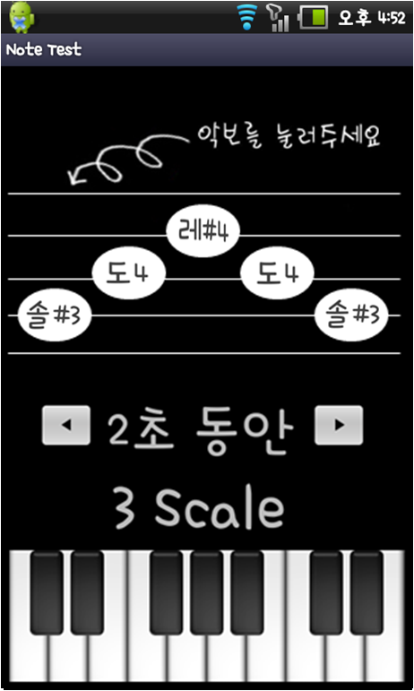
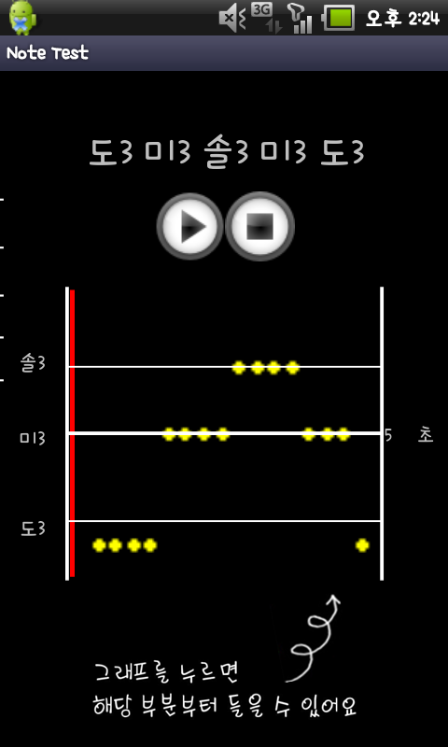
Explain
화음 연습 모드
1

Slide 19
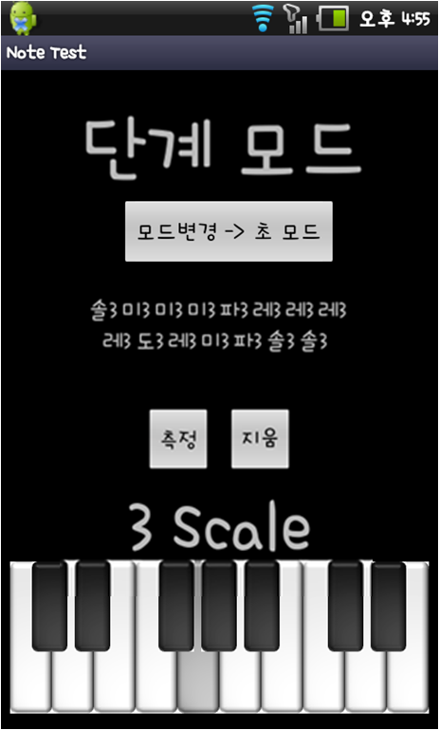
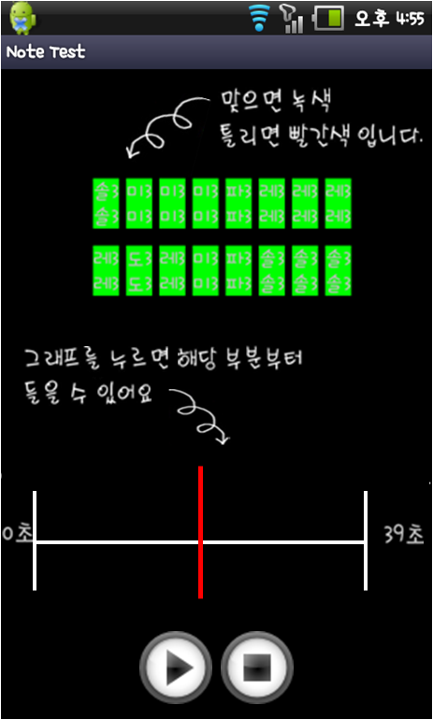
Explain
음정 연습 모드
1

Slide 20
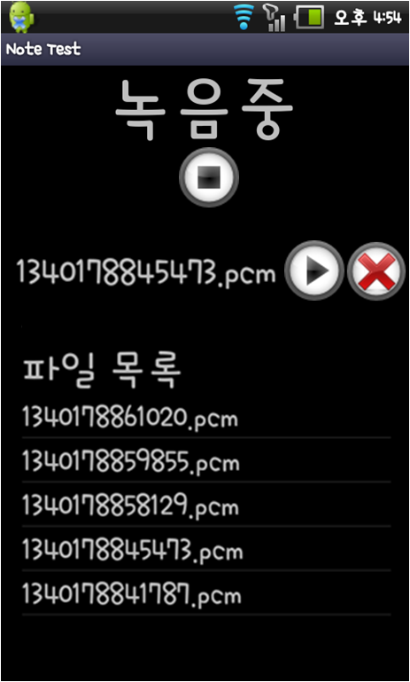
Explain
1

Slide 21
Demonstration
1

Slide 22

1

Slide 23

1

