Slide 1
// YOUTUBE CHANNEL ANALYZER
Subscription Interest Analyzer
Connect your Google account via OAuth and turn subscribed channels into an Interest Score (0–100),
then let Solar LLM interpret your taste — persona, subscription cleanup, and new-channel recommendation.
Flask
Vanilla JS
Google OAuth (GIS)
YouTube Data API v3
Upstage Solar LLM
Algorithm Course — Team Project Presentation

Slide 2
01 · OVERVIEW
Where this project started
The Problem
Our Solution
• Subscriptions pile up to dozens or
hundreds, yet it's hard to tell
which channels you actually watch.
• "Subscribed for years but never
watch" — dormant channels clutter
the whole list.
• YouTube offers no API for your full
comment / watch history (removed 2016).
✓ Weight & sum comments, likes, watch
count, sub age → Interest Score
✓ Zero activity → instant 0 points
✓ Auto-classify into 4 groups 🔥 😊 👋 🌱
✓ Boost accuracy with real watch history (Takeout)
✓ Solar LLM interprets taste & recommends

Slide 3
02 · FEATURES
Core features at a glance
📊 Interest Scoring
🗂️ 4-Group Classification
📥 Takeout Hybrid
Weight & sum comments, likes,
watch & sub age into 0–100
🔥 Top / 😊 Often / 👋 Sometimes /
🌱 Subscribed-only via binary search
Exact comments & watch history
from comments.csv / watch-history
🧬 Viewing-Taste Persona
🧹 Cleanup Coach
✨ New Channel Recommend
Solar LLM turns your channel mix
into one taste report
LLM suggests drop/keep for dormant
& low-interest channels, with reasons
Reverse-trace interest videos to
surface 10 real, existing channels

Slide 4
03 · ARCHITECTURE
System Architecture
Browser (Vanilla JS)
Flask Server (app.py)
External Services
• GIS token client (OAuth)
• Direct YouTube Data API calls
• Takeout file parsing (JS)
• Render · filter · summary
• /api/analyze — score·sort·group
• LRU cache (input-dependent key)
• Heap Sort · Binary Search
• 7 LLM proxy endpoints
• YouTube Data API v3
subscriptions · videos
search · commentThreads
• Upstage Solar (solar-pro2)
→
→
Data Flow
OAuth login → collect subs·likes·comments → (optional) Takeout boost → /api/analyze scoring pipeline → group & sort → render → AI Tools (LLM)

Slide 5
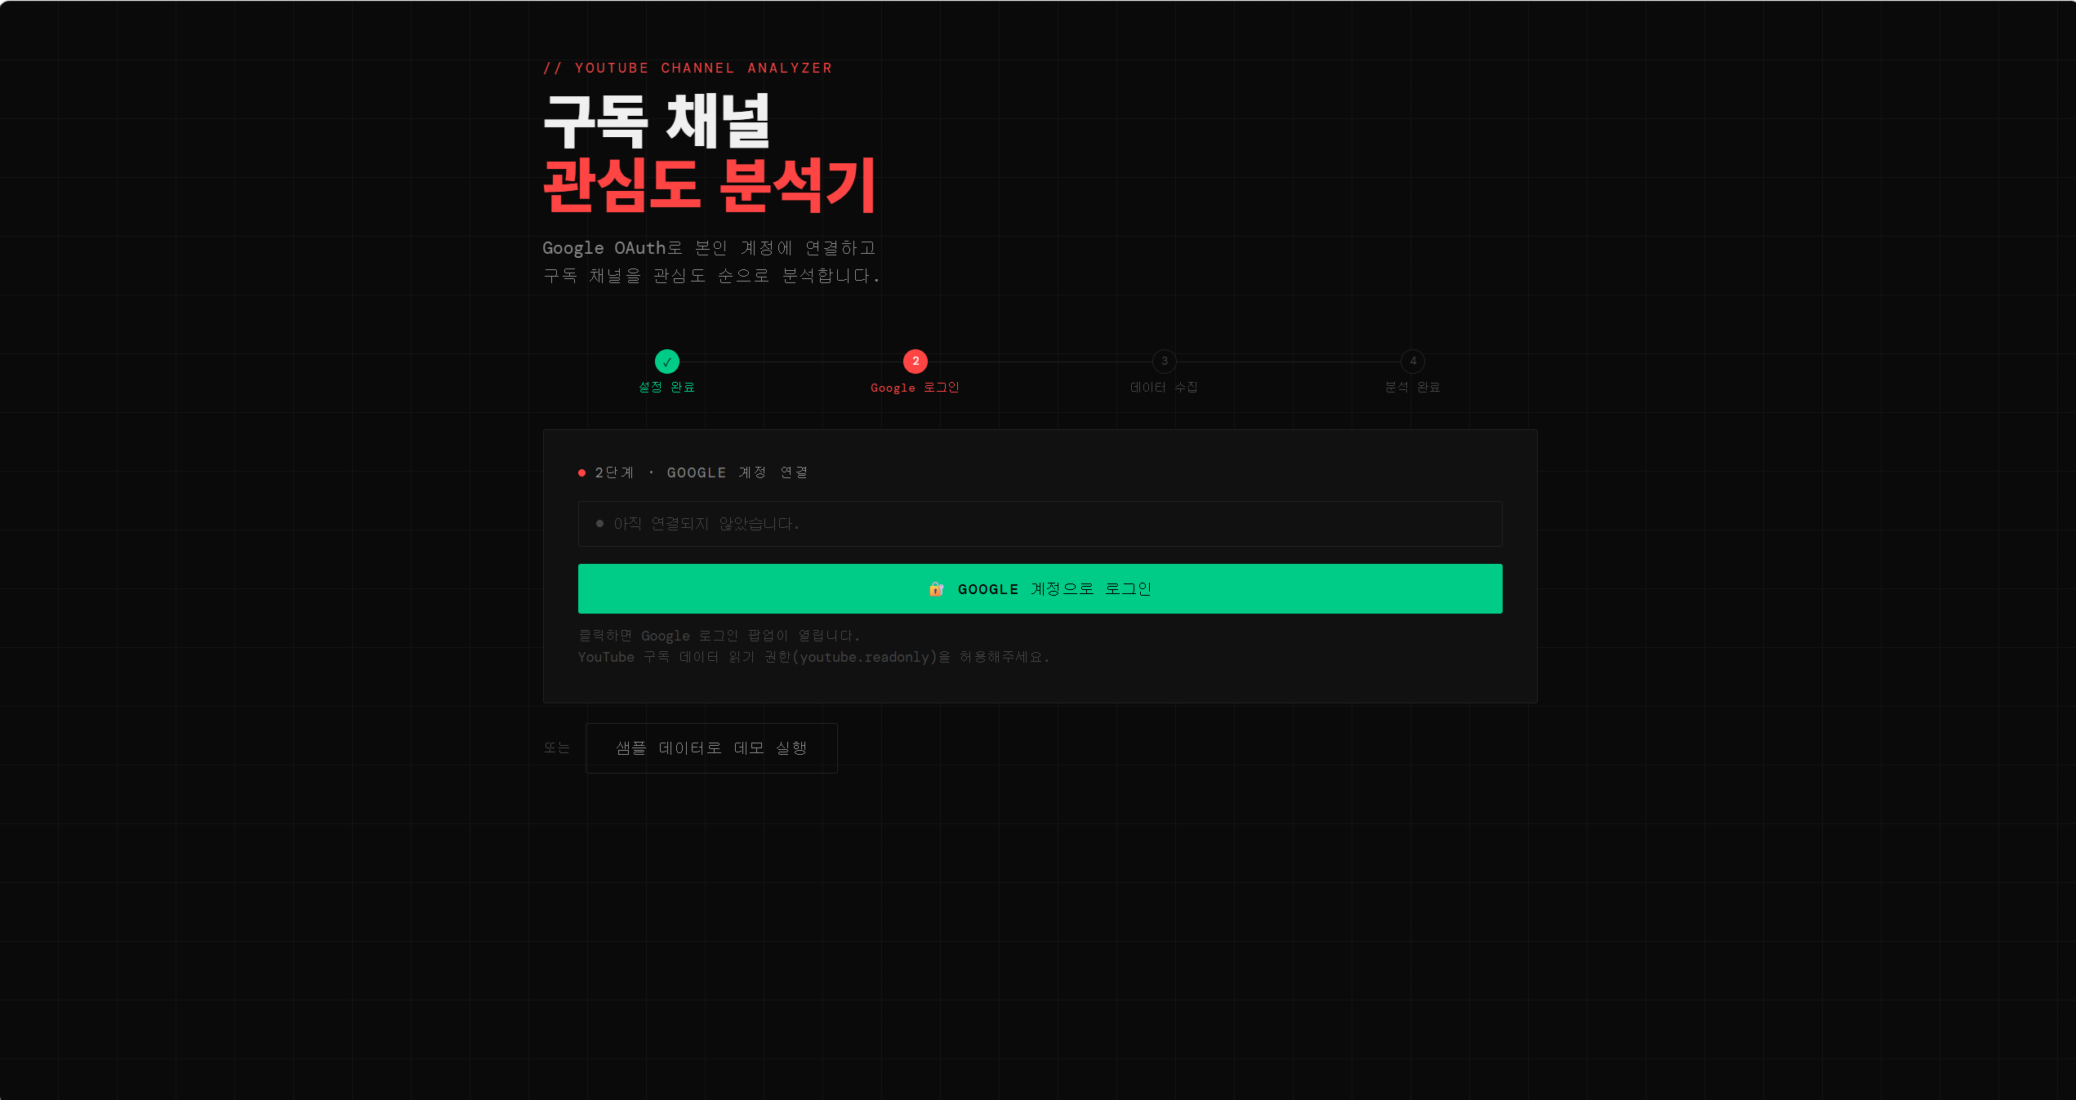
04 · USER FLOW
User Flow — 4 Steps
Google Login → Data Collection → Analysis Done
① Log in with Google (youtube.readonly)

Slide 6
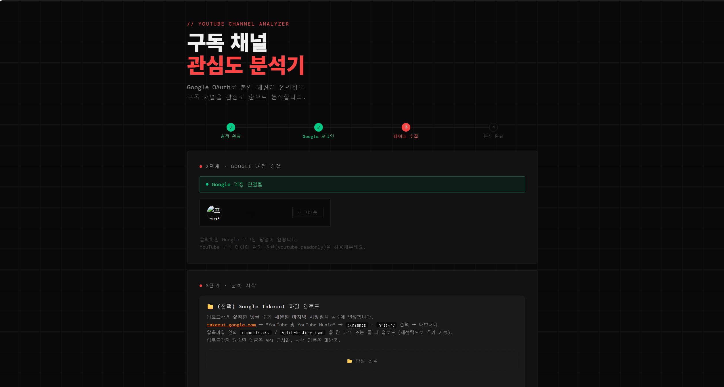
04 · USER FLOW
User Flow — 4 Steps
Google Login → Data Collection → Analysis Done
② (Optional, Recommended) Upload Takeout → exact comments & watch history

Slide 7
05 · ALGORITHM
Scoring — 5-Stage Pipeline
1
2
3
4
5
Weighted Activity
Recency Decay
Min-Max Normalize
Binary Search Group
Heap Sort
comments×5 + watch×3
+ likes×2 + sub bonus(+12)
→
score × e^(−0.005·d)
d = days since last watch
→
(s−min)/(max−min)×100
→ 0–100 relative
→
boundaries [20·50·80]
→ 4 groups O(log k)
→
custom max-heap
descending O(n log n)
Zero activity → 0
Decay stale channels
Within-user compare
🔥 😊 👋 🌱
Ranked output
+ LRU Cache (OrderedDict, input-dependent key)
Cache key = (id, comments, likes, watchCount, subMonths, lastWatchDays) → auto-invalidates on input change; repeat calls hit instantly

Slide 8
05 · ALGORITHM
Why "Zero Activity → 0 Points"
Signal Weights
Verified Results — same input, accurate demotion
Comments
×5
Writing = most active engagement
Channel case
Cmt
Likes
Watch
Score
Watch count
×3
Real watching = strong preference
Watched 150× · 3 days ago
0
0
150
100
Likes
×2
One click, medium signal
Long sub
+0.5/mo
Only if active, 2yr cap (+12)
5yr active (cmt·likes)
20
80
0
60
6mo active
5
20
0
15
Recency Decay e^(−0.005·d)
Dormant 10 years
0
0
0
0
7d
30d
90d
1yr
3yr
Watched 50× · 1000 days ago
0
0
50
0
0.97
0.86
0.64
0.16
≈0
→ Fixes the old trap (10yr-dormant > 6mo-active) via "zero activity → 0"

Slide 9
06 · COURSE CONCEPTS
Algorithms Actually Used in Code
Heap Sort
O(n log n)
Binary Search
O(log k)
recursive heapify, max-heap
boundary-array search
descending score sort
score → 4 groups
LRU Cache
O(1)
Hash Map
O(1) avg
OrderedDict input key
likeMap·commentMap, etc.
score cache · auto-invalidate
multi-channel aggregation
Min-Max Normalize
O(n)
Recency Decay
O(1)
linear scaling
exponential exp(−λ·d)
0–100 scoring
watch-recency weighting
Cursor Pagination
O(n)
Parallel Batch + Backoff
O(n/p)
nextPageToken loop
Promise.all 10 · 429 retry
collect all subs·likes
concurrent API fetch

Slide 10
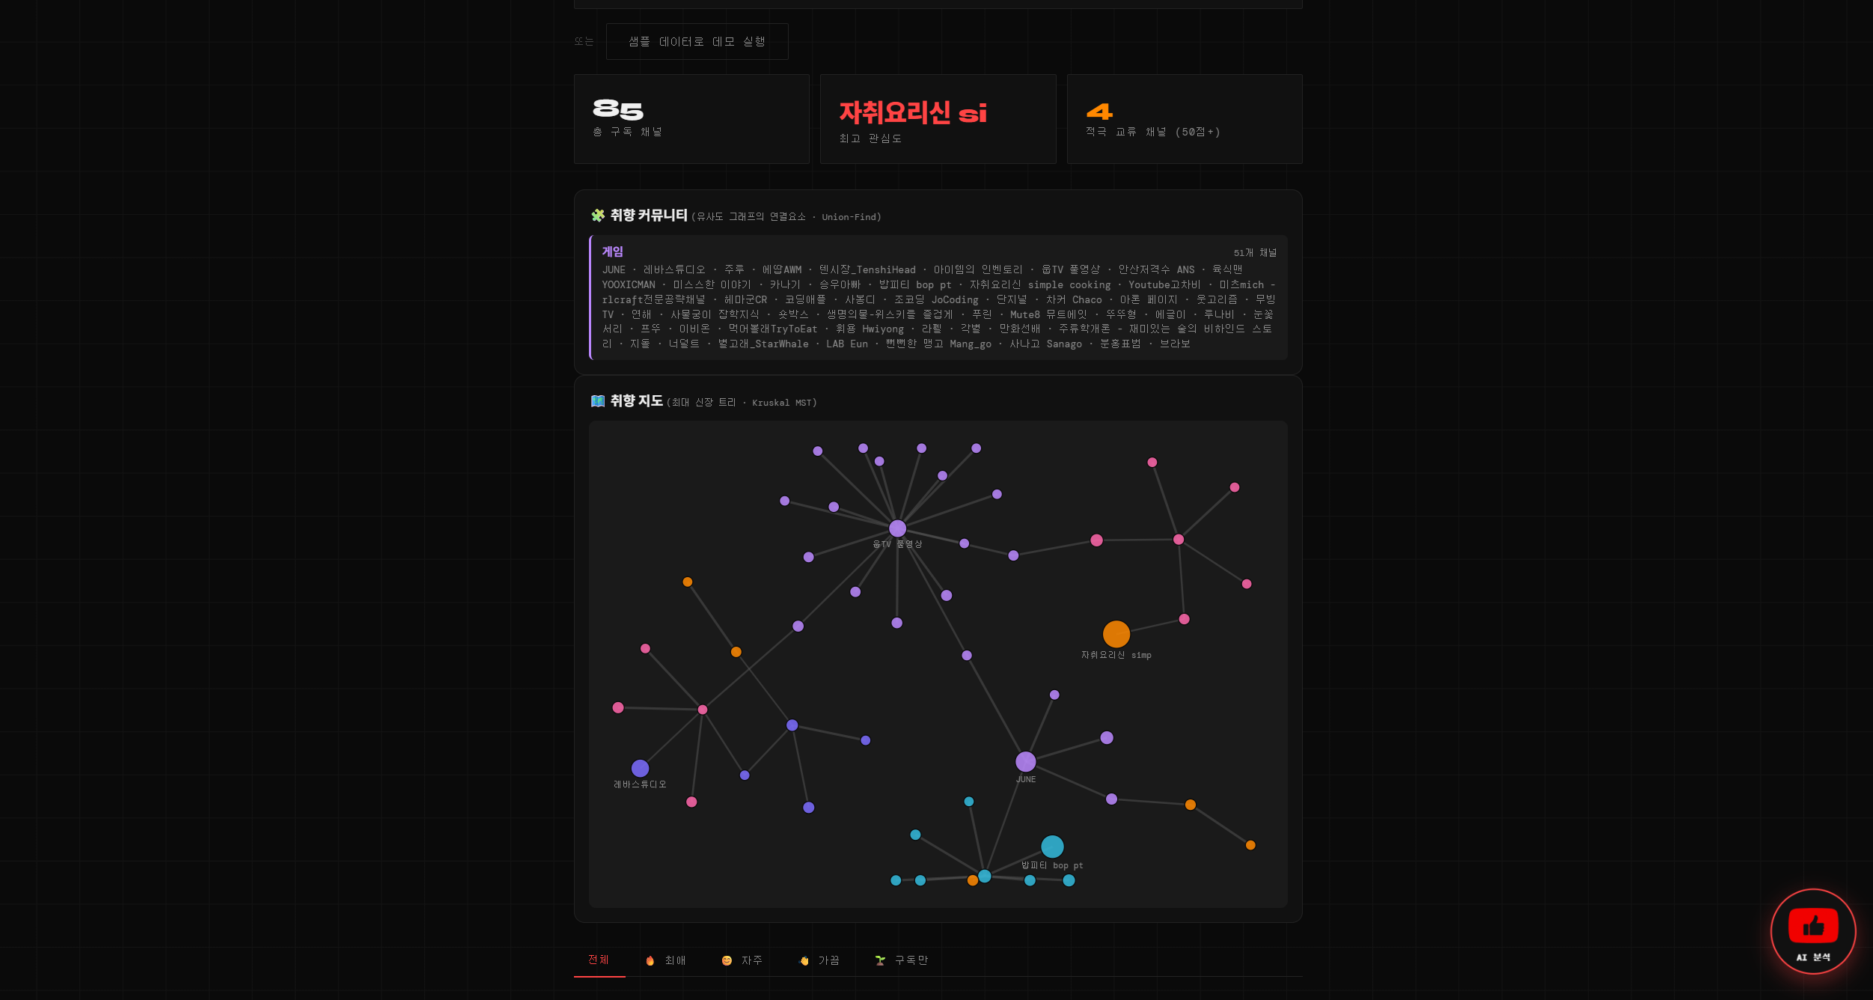
07 · RESULT - Taste Graph
Taste Communities & Map — Union-Find + MST
Build a weighted graph from channels — an edge connects two channels when category cosine similarity ≥ threshold.
🔗 Taste Communities
Union-Find · connected components
• Group channels into taste clusters
• Each community labeled by its
dominant category
🗺️ Taste Map
Kruskal · maximum spanning forest
• Minimal backbone linking your taste
• Rendered as a force-directed SVG
(node size = interest score)
Algorithms Union-Find · Kruskal MST
Reuses categoryScores vectors → 0 extra API

Slide 11
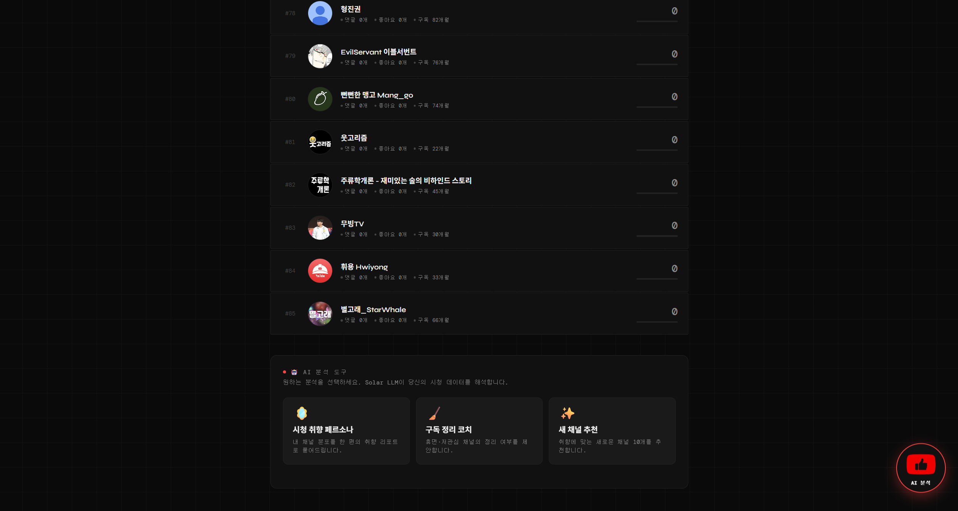
08 · RESULT – Interest Ranking
Result — Interest Ranking + AI Tools
Screen Layout
• Per-channel Interest Score·rank
(#rank · cmt · likes · subs)
• Zero-score channels sorted
to the bottom as dormant
• Bottom 🤖 AI Analysis Tools
— 3 selectable modes
- Viewing-Taste Persona
- Subscription Cleanup Coach
- New Channel Recommendation
• Floating button re-opens
the tools anytime

Slide 12
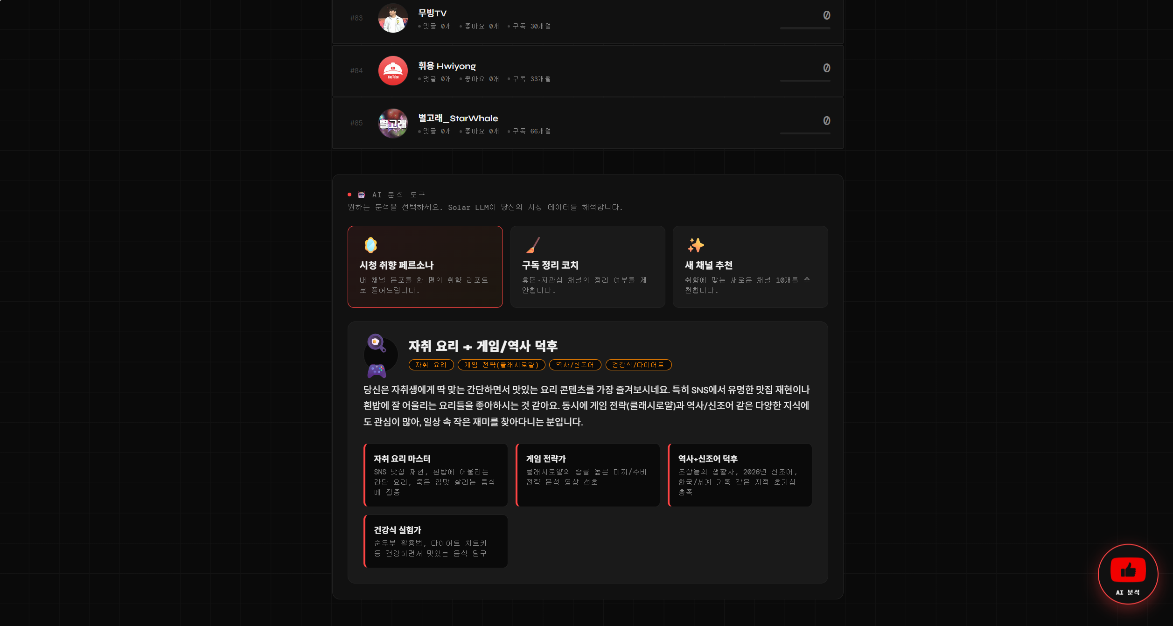
09 · AI TOOL
Viewing-Taste Persona
Solar LLM Interpretation
Takes channel scores &
category distribution, then
writes one taste report
Example result:
"Solo-cooking + Game/
History buff"
• Solo-Cooking Master
• Game Strategist
• History + Slang buff
• Healthy-Food Experimenter
→ tags·subtitles·summary
as structured JSON

Slide 13
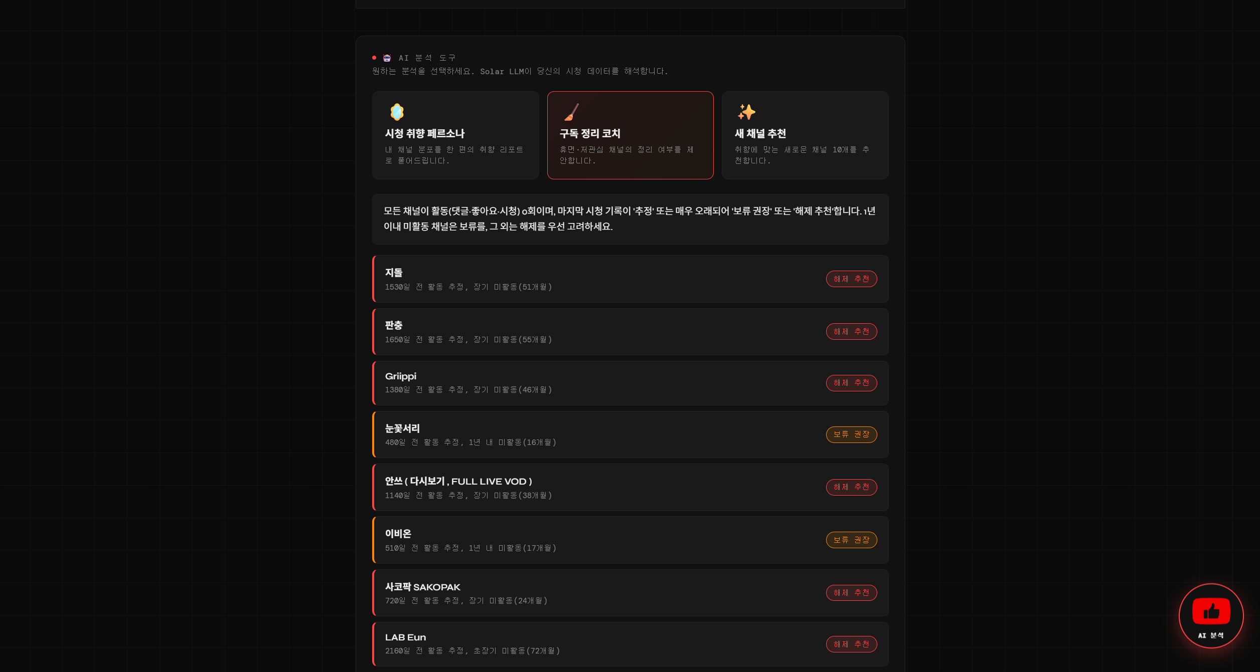
10 · AI TOOL
Subscription Cleanup Coach
Cleanup Logic
LLM judges dormant &
low-interest channels
(score < 20)
🔴 Drop Recommended
long inactivity (2yr+)
🟡 Keep for Now
inactive within 1 year
Each with a stated reason
("active ~1530 days ago,
inactive 51 months")

Slide 14
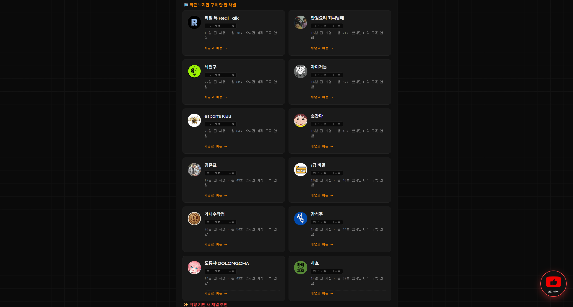
11 · AI TOOL
Channel Recommendation — Video-First Discovery
Anti-hallucination: don't invent
names — reverse-trace real videos
①
Extract interest keywords
top channels + recent titles
②
Search videos per keyword
search.list → collect channelId
③
Aggregate channelId frequency
2+ keywords = real topic
④
Profile candidates
real desc·titles (1 unit)
⑤
LLM curation
rank · reason · fit decision
Costly search(100u) only at ②, deep profiling at 1u → quota saved

Slide 15
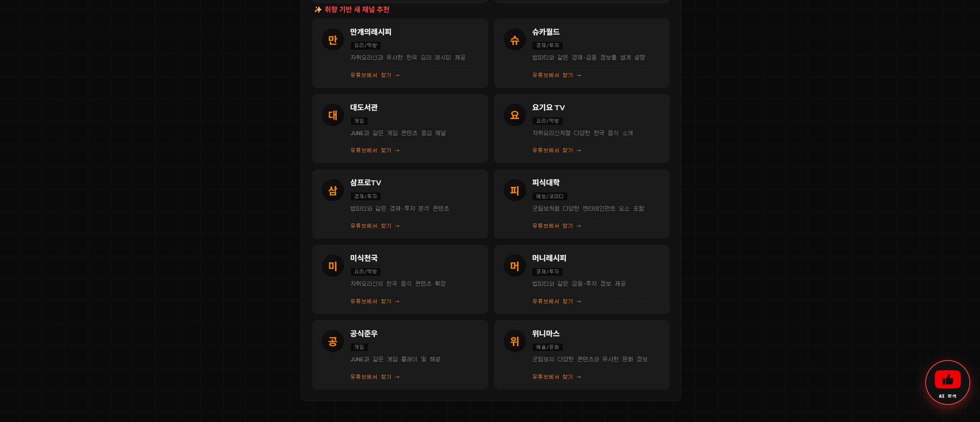
11 · AI TOOL
Channel Recommendation — Video-First Discovery
Anti-hallucination: don't invent
names — reverse-trace real videos
①
Extract interest keywords
top channels + recent titles
②
Search videos per keyword
search.list → collect channelId
③
Aggregate channelId frequency
2+ keywords = real topic
④
Profile candidates
real desc·titles (1 unit)
⑤
LLM curation
rank · reason · fit decision
Costly search(100u) only at ②, deep profiling at 1u → quota saved

Slide 16
DEV · CATEGORY ENGINE
Category Classification System — Deterministic + Cosine Similarity
Added during development — auto-classifies channels into categories, a shared base for recommendation · similar channels · persona. Rule-based core (0 LLM) + optional Solar LLM refinement.
📚 Keyword Lexicon
🏷️ Deterministic Classify
🧭 Cosine Similarity
category_list.yaml
classify_channel
attach_similarity
• 14 top categories + sub-details
• core / general two-tier weights
• Korean = substring match
• English = word-boundary regex
e.g. "ai" won't match "email"
• Match keywords in name + desc
+ recent video titles
• categoryScores vector (top-N,
normalized to sum = 1)
LRU cache (versioned key), cost 0
• Reuse categoryScores vectors
• Representativeness vs taste
centroid (score-weighted)
• Top-K similar channels
vector math only — 0 extra API
Algorithms introduced Cosine Similarity · Weighted Keyword Matching · Vector Normalization · LRU Cache
Accuracy pipeline Rule-based classify → Video-title 2-pass → Solar LLM correction (fills unclassified · fixes mis-tags)
→ This classification directly enables the next step's category diversity in recommendations (≥1 each for cooking·economy·gaming).

Slide 17
DEV · SMART RECOMMENDATION
Recommendation Upgrade — Watch History · Category Diversity
Beyond subscriptions: reflect recent watch history, and recommend evenly across interests instead of one dominant category.
📺 Reflect Watched-but-Unsub
🌱 Taste Seed Expansion
🎯 Category Diversity
• "Recently watched but not
subscribed" channels as a
separate recommendation section
• Noise cut: 2+ times within 90 days
• Rank by frequency × recency
→ always an 'addition', not 'replace'
• Feed video titles of watched-
unsubscribed channels into
discovery keywords
• Based on what you actually watch
• Titles embedded → zero API cost
→ broader discovery
• Derive interest categories from
subscription classification
• Balanced keyword extraction
(round-robin)
• Guarantee ≥1 per category
→ fixes "cooking-only" skew
Result screen
📺 Recently watched, not subscribed + ✨ Taste-based new channels shown together (LLM-name fallback if discovery fails / not logged in)

Slide 18
12 · DATA STRATEGY
Takeout Hybrid — Cost vs Accuracy
YouTube API can't fetch your full comment/watch history → take Google Takeout files as auxiliary input to boost accuracy
Mode
User Effort
API Cost
Accuracy
Neither uploaded
none
commentThreads × #channels
approx comments · no watch
comments.csv only
1 upload
videos.list × #videos/50
exact comments · no watch
watch-history.json only
1 upload
0 units (channelId in subtitles)
exact watch · approx comments
Both ⭐
2 uploads
comment video-resolve only
all exact
Auto file detection: filename (watch/comment) + first 4KB content (titleUrl·subtitles patterns) auto-routes the type
watch-history.json embeds channelId in subtitles[0].url → 0 API calls to extract watch count & last-watch date

Slide 19
13 · LIMITS & NEXT
Limitations & Future Work
Current Limits
Future Work
• YouTube API daily quota 10,000 units
single GCP project shared by all
• OAuth access_token expires in 1h
no refresh logic (one-shot token)
• Comment API approx: scans only
last 100 per channel → use Takeout
• Score is relative — not cross-user
✓ Refresh Token → long-running analysis
✓ Save results · compare trends over time
✓ One-click subscribe to recommendations
✓ Category clustering visualization (charts)
✓ Publish OAuth consent screen
→ lift 100 test-user limit

