Slide 1
[23-winter vacation] Sharing-Knowledge Meeting
project ‘E-Easy’
: decode EEG signal using Python
Jeong, Jiyeon & Lee, Hansol

Slide 2
Table of Contents
Identify the condition of each trials
Decode EEG signal using cross validation
Decode EEG signal across experimental condition

Slide 3
Do what you can

Slide 4
Identify the condition of each trials

Slide 5
Identify the condition of each trials
load information of each trials stored in .mat file
nd_dsgn_path = os.path.join('_', 'sub-02_decode_behavior_without-dist_dsgn.mat')
d_dsgn_path = os.path.join('_', 'sub-02_decode_behavior_with-dist_dsgn.mat')
nd_dsgn = scipy.io.loadmat(nd_dsgn_path)
d_dsgn = scipy.io.loadmat(d_dsgn_path)
nd_resp_path = os.path.join('_', 'sub-02_decode_behavior_without-dist_wmr.mat')
d_resp_path = os.path.join('_', 'sub-02_decode_behavior_with-dist_wmr.mat')
nd_resp = scipy.io.loadmat(nd_resp_path)
d_resp = scipy.io.loadmat(d_resp_path)
load .mat file

Slide 6
Identify the condition of each trials
make information as one DataFrame
dum_2 = np.zeros((200,1))
dum_4 = np.zeros((400,1))
tot_nd = np.hstack((nd_dsgn['dsgn'], dum_2, nd_resp['WM_R']))
tot_d = np.hstack((d_dsgn['dsgn'], dum_4, d_resp['WM_R']))
combine arrays horizontally
idx = ['sequence', 'dist', 'target cat', 'wm_test', 'dum', 'resp', 'RT']
tot_nd = pd.DataFrame(tot_nd, columns=idx)
tot_d = pd.DataFrame(tot_d, columns=idx)
make numpy array into pandas dataframe
DataFrame(data, index, columns, dtype, copy)
data: data to be contained in dataframe → ndarray, iterable, dict, dataframe
index: the name of rows
columns: the name of columns
Notes:
DataFrame: https://pandas.pydata.org/docs/reference/api/pandas.DataFrame.html

Slide 7
Identify the condition of each trials
check the conditions of each trial and make them as DataFrame
ne_base = np.array(range(len(tot_nd['resp'])))[:,None]
e_base = np.array(range(len(tot_d['resp'])))[:,None] + len(tot_nd['resp'])
get the information of sequential position
ne_seq = np.zeros((len(ne_base),2))
seq_OS = tot_nd[(tot_nd['sequence'] == 1)].index.values
seq_SO = tot_nd[(tot_nd['sequence'] == 2)].index.values
ne_seq[seq_OS,:] = [1, 2]
ne_seq[seq_SO,:] = [2, 1]
e_seq = np.zeros((len(e_base),2))
seq_OS = tot_d[(tot_d['sequence'] == 1)].index.values
seq_SO = tot_d[(tot_d['sequence'] == 2)].index.values
e_seq[seq_OS,:] = [1, 2]
e_seq[seq_SO,:] = [2, 1]
get the information of target at that sequence

Slide 8
Identify the condition of each trials
check the conditions of each trial and make them as DataFrame
ne_cue = np.zeros((len(ne_base),1))
cue_O = tot_nd[(tot_nd['target cat'] == 1)].index.values
cue_S = tot_nd[(tot_nd['target cat'] == 2)].index.values
ne_cue[cue_O] = 1
ne_cue[cue_S] = 2
e_cue = np.zeros((len(e_base),1))
cue_O = tot_d[(tot_d['target cat'] == 1)].index.values
cue_S = tot_d[(tot_d['target cat'] == 2)].index.values
e_cue[cue_O] = 1
e_cue[cue_S] = 2
get the information of cued category

Slide 9
Identify the condition of each trials
check the conditions of each trial and make them as DataFrame
ne_po = np.zeros((len(ne_base),1))
for i in range(len(ne_po)):
if (nd_dsgn['dsgn'][i,0] == 1):
if (nd_dsgn['dsgn'][i,2] == 1):
ne_po[i] = 1
elif (nd_dsgn['dsgn'][i,2] == 2):
ne_po[i] = 2
elif (nd_dsgn['dsgn'][i,0] == 2):
if (nd_dsgn['dsgn'][i,2] == 1):
ne_po[i] = 2
elif (nd_dsgn['dsgn'][i,2] == 2):
ne_po[i] = 1
e_po = np.zeros((len(e_base),1))
for i in range(len(e_po)):
if (d_dsgn['dsgn'][i,0] == 1):
if (d_dsgn['dsgn'][i,2] == 1):
e_po[i] = 1
elif (d_dsgn['dsgn'][i,2] == 2):
e_po[i] = 2
elif (d_dsgn['dsgn'][i,0] == 2):
if (d_dsgn['dsgn'][i,2] == 1):
e_po[i] = 2
elif (d_dsgn['dsgn'][i,2] == 2):
e_po[i] = 1
get the information of cued sequence

Slide 10
Identify the condition of each trials
check the conditions of each trial and make them as DataFrame
ne_ans = np.zeros((len(ne_base),1))
ans_C = tot_nd[(tot_nd['wm_test'] == tot_nd['resp'])].index.values
ne_ans[ans_C] = 1
e_ans = np.zeros((len(e_base),1))
ans_C = tot_d[(tot_d['wm_test'] == tot_d['resp'])].index.values
e_ans[ans_C] = 1
get the information of response
ne_rt = np.array(tot_nd['RT'])[:,None]
e_rt = np.array(tot_d['RT'])[:,None]
get the information of response time

Slide 11
Identify the condition of each trials
check the conditions of each trial and make them as DataFrame
dum = np.zeros((len(ne_base),1))
e_dist = np.zeros((len(e_base),1))
nd_pos = tot_d[(tot_d['dist'] == 1)].index.values
d_pos = tot_d[(tot_d['dist'] == 2)].index.values
e_dist[nd_pos] = 1
e_dist[d_pos] = 2
get the information of distraction
ne_nan = np.zeros((len(ne_base),1))
nan_t = tot_nd[np.isnan(tot_nd['resp'])].index.values
ne_nan[nan_t] = 1
e_nan = np.zeros((len(e_base),1))
nan_t = tot_d[np.isnan(tot_d['resp'])].index.values
e_nan[nan_t] = 1
get the information of answer

Slide 12
Identify the condition of each trials
integrate information about condition
ne_np = np.hstack((ne_base, ne_seq, ne_cue, ne_po, ne_ans, ne_rt, dum, ne_nan))
e_np = np.hstack((e_base, e_seq, e_cue, e_po, e_ans, e_rt, e_dist, e_nan))
combine information of trials at each blocks
tot_np = np.vstack((ne_np, e_np))
combine arrays vertically
combine information of each blocks into one numpy array
tot_df = pd.DataFrame(tot_np, columns=['posit', 'first_t', 'second_t', 'cue_C', 'cue_S',
'corr', 'rt', 'dist', 'nan'])
make information array into pandas DataFrame

Slide 13

Identify the condition of each trials
get sequential information of each condition
first target present
…
second target present
…
cue present
…
600 trials (total)
200 trials (no-expectation)
400 trials (expectation)
200 trials (distractor-present)
200 trials (distractor-absent)

Slide 14
Identify the condition of each trials
get sequential information of each condition
ne_trials = tot_df[(tot_df['posit'] < 200) & (tot_df['nan'] == 0)]['posit']
e_trials = tot_df[(tot_df['posit'] > 199) & (tot_df['nan'] == 0)]['posit']
e_nd_trials = tot_df[(tot_df['posit'] > 199) & (tot_df['nan'] == 0)
& (tot_df['dist'] == 1)]['posit']
e_d_trials = tot_df[(tot_df['posit'] > 199) & (tot_df['nan'] == 0)
& (tot_df['dist'] == 2)]['posit']
translate float data into integer
ne_trials = np.array(ne_trials).astype(int)
e_trials = np.array(e_trials).astype(int)
e_nd_trials = np.array(e_nd_trials).astype(int)
e_d_trials = np.array(e_d_trials).astype(int)

Slide 15
Identify the condition of each trials
select epochs
NE_FT_trial = fir_tar_epochs[ne_trials]
NE_ST_trial = sec_tar_epochs[ne_trials]
NE_C_trial = cue_epochs[ne_trials]
select trials assigned to no-expectation condition
E_FT_trial = fir_tar_epochs[e_trials]
E_ST_trial = sec_tar_epochs[e_trials]
E_C_trial = cue_epochs[e_trials]
select trials assigned to expectation condition
E_ND_FT_trial = fir_tar_epochs[e_nd_trials]
E_ND_ST_trial = sec_tar_epochs[e_nd_trials]
E_ND_C_trial = cue_epochs[e_nd_trials]
select trials assigned to distractor-absent condition
E_D_FT_trial = fir_tar_epochs[e_d_trials]
E_D_ST_trial = sec_tar_epochs[e_d_trials]
E_D_C_trial = cue_epochs[e_d_trials]
select trials assigned to distractor-present condition

Slide 16
Decode EEG signal using cross validation

Slide 17
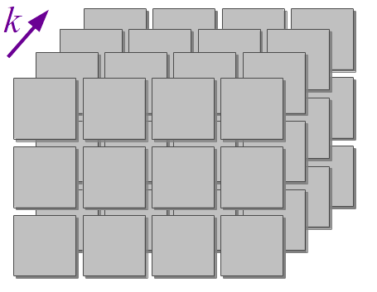
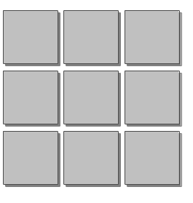
Decode EEG signal
the structure of data used in signal decoding
X = epochs.get_data()
y = epochs.events[:, 2]
X: information of EEG signal (epoch×channel×timepoint)
y: information of trial
epochs
time point
start
time
trigger
channel
Notes:
images from Programming Idioms
3D) https://programming-idioms.org/idiom/27/create-a-3-dimensional-array/1675/lua
2D) https://programming-idioms.org/idiom/26/create-a-2-dimensional-array/448/rust

Slide 18
Decode EEG signal
the structure of data used in signal decoding
ne_FT_X = NE_FT_trial.get_data()
ne_FT_y = tot_df.iloc[ne_trials]['first_t']
get signal data
[‘column name’]
.iloc[array]

Slide 19
Decode EEG signal using cross validation
make pipeline for analysis
clf_pipe = make_pipeline(Scaler(NE_FT_trial.info), Vectorizer(),
LogisticRegression(solver='liblinear'))
make estimator
make_pipeline(steps, memory, verbose): construct pipeline from given estimators
Scalar: standardize data based on channel scale
Vectorizer: transform data from MNE(n-dimention) to scikit-learn(2-dimention)
LogisticRegression: logistic regression classifier
→ ‘lbfgs’, ‘liblinear’, ‘newton-cg’, ‘newton-cholesky’, ‘sag’, ‘saga’
Notes:
make_pipeline: https://scikit-learn.org/stable/modules/generated/sklearn.pipeline.make_pipeline.html#sklearn.pipeline.make_pipeline
Scalar: https://mne.tools/stable/generated/mne.decoding.Scaler.html#
Vectorizer: https://mne.tools/stable/generated/mne.decoding.Vectorizer.html#
LogisticRegression: https://scikit-learn.org/stable/modules/generated/sklearn.linear_model.LogisticRegression.html#sklearn.linear_model.LogisticRegression

Slide 20
Decode EEG signal using cross validation
organize decoder of each time point
time_decod = mne.decoding.SlidingEstimator(clf_pipe, n_jobs=None,
scoring='roc_auc', verbose=True)
organize search light
SlidingEstimator(base_estimator, scoring, n_jobs, position, verbose): fit, predict and score defined model
base_estimator: base estimator to fit on dataset
scoring: score function → automatically determine the predict method
Notes:
https://mne.tools/stable/generated/mne.decoding.SlidingEstimator.html

Slide 21
Decode EEG signal using cross validation
evaluate performance of decoder using cross validation
ne_FT_scores = mne.decoding.cross_val_multiscore(time_decod, ne_FT_X, ne_FT_y,
cv=None, n_jobs=None)
automatically conduct cross validation
ne_FT_score = np.mean(ne_FT_scores, axis=0)
cross_val_multiscore(estimator, X, y, groups, scoring, cv, n_jobs, verbose, fit_params, predispatch)
estimator: object to use in fitting data
X: data for training decoder
y: data to predict → supervised learning
cv: identify the number of pieces of data to divide → k-fold
n_jobs:the number of jobs to run in parallel → None, integer, -1
Notes:
https://mne.tools/stable/generated/mne.decoding.cross_val_multiscore.html

Slide 22
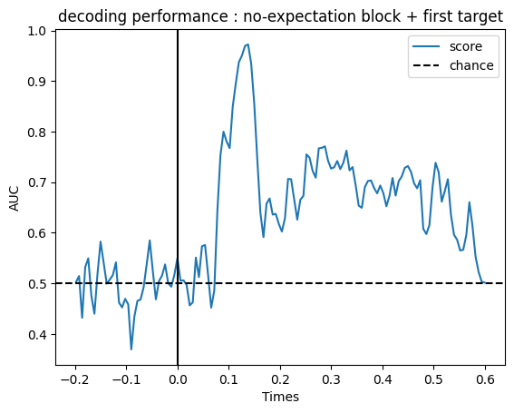
Decode EEG signal using cross validation
visualize the performance of decoder
fig, ax = plt.subplots()
ax.plot(NE_FT_trial.times, ne_FT_score, label='score')
ax.axhline(.5, color='k', linestyle='--', label='chance')
ax.set_xlabel('Times')
ax.set_ylabel('AUC') # Area Under the Curve
ax.legend()
ax.axvline(.0, color='k', linestyle='-')
ax.set_title('decoding performance : no-expectation block + first target')

Slide 23
Decode EEG signal using cross validation
organize decoder of each time point
clf_pipe = make_pipeline(Scaler(NE_FT_trial.info), Vectorizer(),
LogisticRegression(solver='liblinear'))
time_gen = mne.decoding.GeneralizingEstimator(clf_pipe, n_jobs=None,
scoring='roc_auc', verbose=True)
organize search light
GeneralizingEstimator(base_estimator, scoring, n_jobs, position, verbose): use search light across time
evaluate performance of decoder using cross validation
ne_FT_tgs = mne.decoding.cross_val_multiscore(time_ gen, ne_FT_X, ne_FT_y,
cv=None, n_jobs=5)
ne_FT_tg = np.mean(ne_FT_tgs, axis=0)
Notes:
https://mne.tools/stable/generated/mne.decoding.GeneralizingEstimator.html
n_jobs = None → run one analysis at once
n_jobs = integer → run integer analysis at once
n_jobs = -1 → run the number of CPU core analysis at once

Slide 24
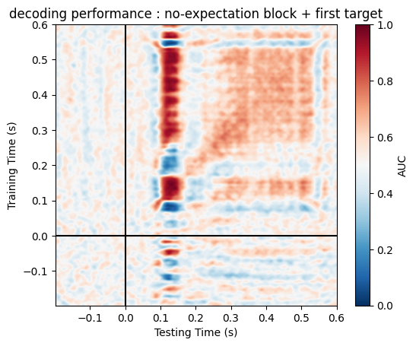
Decode EEG signal using cross validation
visualize the performance of decoder
fig, ax = plt.subplots()
im = ax.imshow(ne_FT_tg, interpolation='lanczos', origin='lower',
cmap='RdBu_r', extent=NE_FT_trial.times[[0, -1, 0, -1]],
vmin=0., vmax=1.)
ax.set_xlabel('Testing Time (s)')
ax.set_ylabel('Training Time (s)')
ax.set_title('decoding performance : no-expectation block + first target')
ax.axvline(0, color='k')
ax.axhline(0, color='k')
cbar = plt.colorbar(im, ax=ax)
cbar.set_label('AUC')

Slide 25
Decode EEG signal using for-loop

Slide 26


Decode EEG signal using for-loop
fit
signal
DECODER
vs
A / B
predict
fit
New
signal
A
signal
predict
DECODER
DECODER
A / B
predict
B

Slide 27
Decode EEG signal using for-loop
model.fit(X, y): fit model to data
X: training data including EEG signal
y: target information
train decoder
model.predict(X): predict targets of given data
conduct decoding
X: data for predict
Notes:
fit: https://scikit-learn.org/stable/modules/generated/sklearn.cross_decomposition.PLSRegression.html#sklearn.cross_decomposition.PLSRegression.fit
predict: https://scikit-learn.org/stable/modules/generated/sklearn.cross_decomposition.PLSRegression.html#sklearn.cross_decomposition.PLSRegression.predict

Slide 28
Decode EEG signal using for-loop
make pipeline for analysis
clf_pipe = make_pipeline(Scaler(NE_FT_trial.info), Vectorizer(),
LogisticRegression(solver='liblinear'))
make a variable for storing the result of decoding
ne_pred_FtoS = []

Slide 29
Decode EEG signal using for-loop
fit and predict data
decode signal time-by-time
for i in range(len(ne_FT_X[0][0])):
FT_pipe.fit(ne_FT_X[:,:,i], ne_FT_y)
temp_pred_FtoS = np.array([2])
for j in range(len(ne_ST_X[0][0])):
pred = FT_pipe.predict(ne_ST_X[:,:,j])
temp = np.array([2])
for k in range(len(pred)):
if (pred[k] == ne_ST_y[k]):
temp = np.hstack((temp, 1))
elif (pred[k] != ne_ST_y[k]):
temp = np.hstack((temp, 0))
temp = np.delete(temp, 0)
temp_pred_FtoS = np.hstack((temp_pred_FtoS, np.mean(temp)))
temp_pred_FtoS = np.delete(temp_pred_FtoS, 0)
if (i == 0):
ne_pred_FtoS = temp_pred_FtoS[None,:]
else:
ne_pred_FtoS = np.vstack((pred_FtoS, temp_pred_FtoS[None,:]))
train model
decode signal and save the result
check decoding result of each trial
store the result of decoding
at that time point
store the result of decoding
at each progress

Slide 30
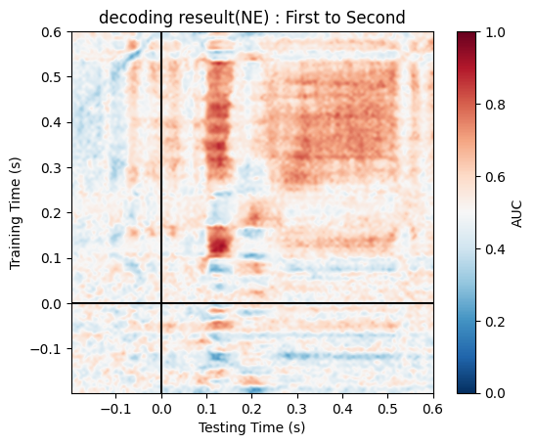
Decode EEG signal using for-loop
visualize the result of decoding
fig, ax = plt.subplots()
im = ax.imshow(ne_pred_FtoS, interpolation='lanczos', origin='lower', cmap='RdBu_r',
extent=NE_ST_trial.times[[0, -1, 0, -1]], vmin=0., vmax=1.)
ax.set_xlabel('Testing Time (s)')
ax.set_ylabel('Training Time (s)')
ax.set_title('decoding reseult(NE) : First to Second')
ax.axvline(0, color='k')
ax.axhline(0, color='k')
cbar = plt.colorbar(im, ax=ax)
cbar.set_label('AUC')

Slide 31
Decode EEG signal using for-loop
observe whether the decoder is doing its work sincerely
print('Start decoding : First to Second’)
for i in range(len(ne_FT_X[0][0])):
[decoding part]
if ((i+1)%10 == 0):
print('progress : '+str(i+1)+'/'+str(len(ne_FT_X[0][0]))+'time points')
print('DONE!')
announce the beginning of decoding
update the progress of decoding every 10 trainings
announce the end of decoding

Slide 32
Decode EEG signal using for-loop
decode two set of signal at once
make two variables
for storing result
ne_pred_FtoS = []
ne_pred_FtoC = []
for i in range(len(ne_FT_X[0][0])):
FT_pipe.fit(ne_FT_X[:,:,i], ne_FT_y)
temp_pred = np.array([2, 2])
for j in range(len(ne_ST_X[0][0])):
pred_S = FT_pipe.predict(ne_ST_X[:,:,j])
pred_C = FT_pipe.predict(ne_C_X[:,:,j])
temp = np.array([2, 2])
t_temp = np.array([2, 2])[None,:]
for k in range(len(pred_S)):
if (pred_S[k] == ne_ST_y[k]):
temp[0] = 1
elif (pred_S[k] != ne_ST_y[k]):
temp[0] = 0
if (pred_C[k] == ne_C_y[k]):
temp[1] = 1
elif (pred_C[k] != ne_C_y[k]):
temp[1] = 0
t_temp = np.vstack((t_temp, temp))
decode signal time-by-time
handle two results at once
[0]: second target / [1]: cue
store the results of decoding
at that predict time point

Slide 33
Decode EEG signal using for-loop
decode two set of signal at once
store the result of decoding
at that train time point
t_temp = np.delete(t_temp, 0, axis=0)
temp_pred = np.vstack((temp_pred, np.mean(t_temp, axis=0)))
temp_pred = np.delete(temp_pred, 0, axis=0)
if (i == 0):
ne_pred_FtoS = temp_pred[:,0][None,:]
ne_pred_FtoC = temp_pred[:,1][None,:]
else:
ne_pred_FtoS = np.vstack((ne_pred_FtoS, temp_pred[:,0][None,:]))
ne_pred_FtoC = np.vstack((ne_pred_FtoC, temp_pred[:,1][None,:]))
store the result of decoding
at each progress

Slide 34
Decode EEG signal using for-loop
visualize the result of decoding
fig, ax = plt.subplots()
im = ax.imshow(ne_pred_FtoS, interpolation='lanczos', origin='lower', cmap='RdBu_r',
extent=NE_ST_trial.times[[0, -1, 0, -1]], vmin=0., vmax=1.)
ax.set_xlabel('Testing Time (s)')
ax.set_ylabel('Training Time (s)')
ax.set_title('decoding reseult(NE) : First to Second')
ax.axvline(0, color='k')
ax.axhline(0, color='k')
cbar = plt.colorbar(im, ax=ax)
cbar.set_label('AUC')

Slide 35
Decode EEG signal using for-loop
decode signal by making the process as a function
def cross_condition_dec(fit_trial, fit_X, fit_y, predict_X, predict_y, cond):
predict_y = np.array(predict_y)
train_pipe = make_pipeline(Scaler(fit_trial.info), Vectorizer(),
LogisticRegression(solver='liblinear'))
[decoding part]
return decoding_result
return the result of decoding
fit_trial: the epoch that used in training
fit_X: data for fitting defined model
fit_y: the target information at fitting
predict_X: data for predicting trained model
predict_y: correct information at predicting
cond: information for announcing the progress of decoding

Slide 36




Decode EEG signal using for-loop
decode signal by making the process as a function
ne_pred_FtoS = cross_condition_dec(NE_FT_trial, ne_FT_X, ne_FT_y,
ne_ST_X, ne_ST_y, 'First to Second')
ne_pred_StoC = cross_condition_dec(NE_ST_trial, ne_ST_X, ne_ST_y,
ne_C_X, ne_C_y, 'Second to Cue')

Slide 37
Decode EEG signal using for-loop
visualize the result of decoding
fig, ax = plt.subplots()
im = ax.imshow(ne_pred_FtoS, interpolation='lanczos', origin='lower', cmap='RdBu_r',
extent=NE_ST_trial.times[[0, -1, 0, -1]], vmin=0., vmax=1.)
ax.set_xlabel('Testing Time (s)')
ax.set_ylabel('Training Time (s)')
ax.set_title('decoding reseult(NE) : First to Second')
ax.axvline(0, color='k')
ax.axhline(0, color='k')
cbar = plt.colorbar(im, ax=ax)
cbar.set_label('AUC')

Slide 38
Decode EEG signal using for-loop
compare the results of each methods for cross-conditional decoding
use each of for-loops
use one for-loop
use one function

Slide 39
[23-winter vacation] Sharing-Knowledge Meeting
Thank
You
Jeong, Jiyeon & Lee, Hansol

