Slide 1
[23-winter vacation] Sharing-Knowledge Meeting
project ‘E-Easy’
: preprocess EEG signal using Python
Jeong, Jiyeon & Lee, Hansol

Slide 2
Table of Contents
Complete environment setting for EEG data analysis based on Python
Preprocess EEG signal using Python
Check the performance of different decoders on the applied model
package list: mne, numpy, pandas, scipy, sklearn, matplotlib

Slide 3

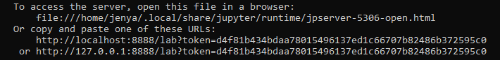
Complete environment for EEG data analysis based on Python
make virtual environment using ‘conda’ for this project
conda create -n (environment name) python=(3.8)
conda activate (environment name)
install jupyter lab in virtual environment
conda install -c conda-forge jupyterlab
Notes:
가상환경 이름은 원하는 대로 설정
python version은.. 지금까지 큰 문제 없었기 때문에 3.8로 설정해서 설치 (참고로 내 ubuntu에 깔려있는 pytho은 3.9,,)
명령어 입력하고 좌라락 나온다음에 [y]로 되어있는거 확인하고 엔터하면 가상환경 설치 완료!

Slide 4
Complete environment for EEG data analysis based on Python
install packages in virtual environment
install ‘mne’
pip install mne
install ‘numpy’
conda install numpy
install ‘pandas’
conda install pandas
install ‘matplotlib’
conda install matplotlib
install ‘scipy’
conda install scipy
install ‘sklearn’
pip3 install -U scikit-learn
Notes:
mne
https://mne.tools/stable/install/index.html
numpy
https://numpy.org/install/
pandas
https://pandas.pydata.org/pandas-docs/stable/getting_started/install.html
matplotlib
https://matplotlib.org/stable/users/installing/index.html
scipy
https://scipy.org/install/
sklearn
https://scikit-learn.org/stable/install.html

Slide 5
Preprocess EEG signal using Python
import packages
import os
import warnings, sys, os
if not sys.warnoptions:
warnings.simplefilter("ignore")
import mne
import numpy as np
import pandas as pd
import matplotlib.pyplot as plt
from sklearn.pipeline import make_pipeline
from sklearn.preprocessing import StandardScaler
from sklearn.linear_model import LogisticRegression
from sklearn.svm import SVC
import scipy.io
packages for data handling
package for signal visualizing
packages for signal decoding

Slide 6
Preprocess EEG signal using Python
load raw EEG signal
user_path = os.path.expanduser('~')
vhdr_path = os.path.join('_','sub-01_decoder-nback.vhdr')
raw = mne.io.read_raw_brainvision(vhdr_path,eog=('HEOG','HEOG1','VEOG'))
use header file for reading signal
use function for data collected by brainvision
read_raw_brainvision(vhdr_fname, eog, misc, scale, preload, verbose)
vhdr_fname: name of header file
eog: define eog channels by entering eog channel name
preload: choose preloading → preloading data can make data processing faster but needs more memory
Notes:
https://mne.tools/stable/generated/mne.io.read_raw_brainvision.html

Slide 7
Preprocess EEG signal using Python
load raw EEG signal
apply pass-filter
raw.load_data().filter(0.5, 40)
events = mne.events_from_annotations(raw)
event_id = {'object': 101, 'scene': 102}
define trigger
events_from_annotations(raw, events_id, regexp, use_rounding, chunk_duration, verbose)
raw: raw data for defining annotation
event_id: can be set by hand or as ‘auto’ → in brainvision, read integer from trigger code(S___)
Notes:
the pass-filter and reference is set based on below paper
Takacs, A., Mückschel, M., Roessner, V., & Beste, C. (2020). Decoding stimulus–response representations and their stability using EEG-based multivariate pattern analysis. Cerebral Cortex Communications, 1(1)
https://mne.tools/stable/generated/mne.events_from_annotations.html

Slide 8
Preprocess EEG signal using Python
load raw EEG signal
re-reference signal
raw.set_eeg_reference('average', projection=True)
set_eeg_reference(inst, ref_channels, copy, projection, ch_type, forward, joint, verbose)
inst: raw file or epochs
ref_channel: can be identified as channel name, channel name list, ‘ average’, ‘REST’, or empty
projection: identify only when the ref_channel is ‘average’
ch_type: channel type that the reference is applied to → ‘auto’, ‘eeg’, ‘ecog’, ‘seeg’, ‘dbs’
Notes:
the pass-filter and reference is set based on below paper
Takacs, A., Mückschel, M., Roessner, V., & Beste, C. (2020). Decoding stimulus–response representations and their stability using EEG-based multivariate pattern analysis. Cerebral Cortex Communications, 1(1)
https://mne.tools/stable/generated/mne.set_eeg_reference.html

Slide 9
Preprocess EEG signal using Python
handle eye movement signal : reject blinked trial
reload raw file🌟
load_raw(REJ_raw)
eog_events = mne.preprocessing.find_eog_events(REJ_raw)
find eye blink using signal from EOG channels
mne.preprocessing.find_eog_events(raw, event_id, l_freq, h_freq, filter_length, ch_name, tstart,
reject_by_annotation, thresh, verbose)
event_id: event ID assigned to blink event
l_freq/h_freq: low/high cut-off frequency of EOG channel (Hz)
tstart: time point to start finding eye blink signal
Notes:
https://mne.tools/stable/generated/mne.preprocessing.find_eog_events.html

Slide 10
Preprocess EEG signal using Python
handle eye movement signal : reject blinked trial
onsets = eog_events[:, 0] / REJ_raw.info['sfreq'] - 0.25
durations = [0.5] * len(eog_events)
descriptions = ['bad blink'] * len(eog_events)
blink_annot = mne.Annotations(onsets, durations, descriptions,
orig_time=REJ_raw.info['meas_date'])
REJ_raw.set_annotations(blink_annot)
make annotation about blink
add annotation in data
mne.Annotations(onset, duration, description, orig_time, ch_names)
duration: duration of annotation(sec) → array, float
descriptions: description for annotation → it should start with ‘bad’ for epoch rejection
mne.Raw.set_annotations(annotations, emit_warning, on_missing, verbose)
annotations: annotation to set in raw file
Notes:
onset: 왜 저렇게 계산하는지 잘 모르겠음… 앞의 find_eog_events의 첫 번째 column이 시작 시점이 아닌가봄..
.info[‘sfreq’]: sample frequency -> 뭔지 모르겠음
durations, descriptions 모두 blink event 개수 만큼 앞의 것을 반복한 것임.. 어떻게 가능한 것인지는 모르겠음..
mne.Annotations: https://mne.tools/stable/generated/mne.Annotations.html
duration: 그냥 float로 설정해도 됐을 것 같은데 왜 굳이 array 만든지 모르겠음
raw.set_annotations: https://mne.tools/stable/generated/mne.io.Raw.html#mne.io.Raw.set_annotations
annotation 설정하는 순간 trial drop,,

Slide 11
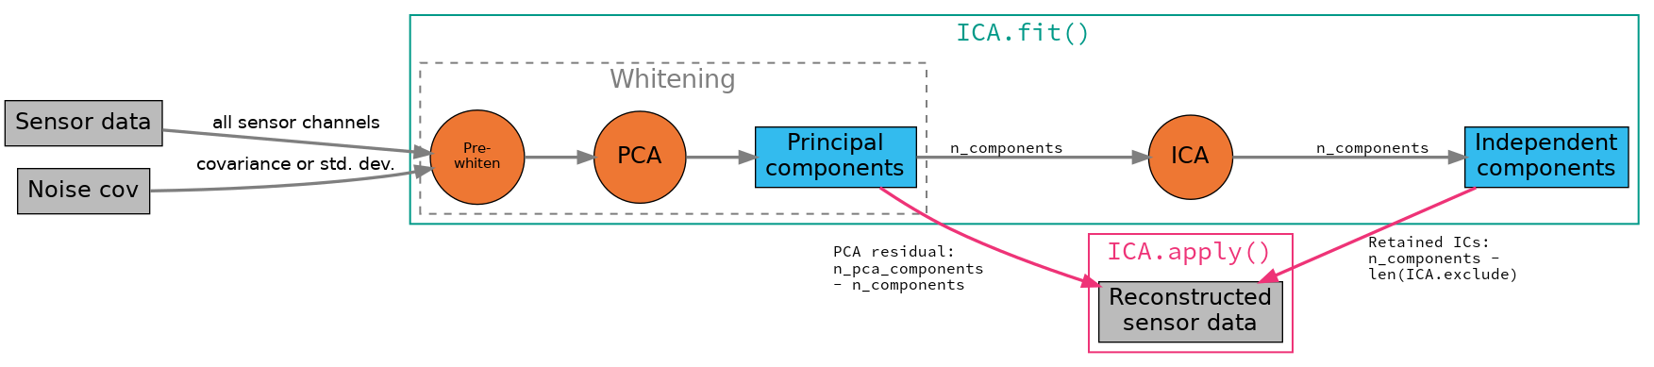
Preprocess EEG signal using Python
handle eye movement signal : Independent Components Analysis(ICA)
estimate independent source signals from a set of recordings
search for linear transformation that minimizes the statistical dependence between components
prerequisite about source signal for separation
- statistically independent
- non-gaussian distribution
Notes:
wiki-pedia: https://ko.wikipedia.org/wiki/%EB%8F%85%EB%A6%BD_%EC%84%B1%EB%B6%84_%EB%B6%84%EC%84%9D
paper: Comon, Pierre. (1994). "Independent Component Analysis: a new concept?“. Signal Processing, 36(3), 287–314. http://mlsp.cs.cmu.edu/courses/fall2012/lectures/ICA.pdf

Slide 12
Preprocess EEG signal using Python
handle eye movement signal : Independent Components Analysis(ICA)
reload raw file🌟
load_raw(ICA_raw)
create epochs possessing eye blink
eog_evoked = mne.preprocessing.create_eog_epochs(ICA_raw).average()
eog_evoked.apply_baseline(baseline=(None, -0.2))
set baseline on created epochs
mne.preprocessing.create_eog_epochs(raw, ch_name, event_id, picks, tmin, tmax, l_freq, h_freq, reject, flat,
baseline, preload, reject_by_annotation, thresh, decim, verbose)
ch_name: name of channels used in making epochs → ‘None’: use channels identified as EOG
picks: channels to include → ‘None’: use all channels
tmin/tmax: start/end time point of event
mne.EvokedArray.apply_baseline(baseline, verbose)
baseline: time interval for baseline correction
Notes:
create_eog_epochs: https://mne.tools/stable/generated/mne.preprocessing.create_eog_epochs.html#
read EOG channel data -> find eye blink using ‘mne.preprocessing.find_eog_events’ -> create epochs of eye blink
picks: 아마도.. epoch을 만들어서 나중에 그거를 쓰는거니까 PCA를 돌릴 때 사용할 signal을 가지고 있는 channel의 type이나 이름을 넣으라고 하는 것인 듯
apply_baseline: https://mne.tools/stable/generated/mne.EvokedArray.html#mne.EvokedArray.apply_baseline

Slide 13
Preprocess EEG signal using Python
handle eye movement signal : Independent Components Analysis(ICA)
prepare ICA decomposition
ica = mne.preprocessing.ICA(n_components=15, max_iter='auto’,
random_state=97)
ica.fit(ICA_raw)
run ICA decomposition
mne.preprocessing.ICA(n_components, noise_cov, random_state, method, fit_params,
max_iter, allow_ref_meg, verbose)
n_components: the number of principal component → PCA
method: ICA method for fitting → ‘fastica’, ‘infomax’, ‘picard’
fit_params: additionap parameters for ICA estimator, specified by method
max_iter: the maximum number of iteration during fit → ‘auto’: 1,000(fastica) / 500(infomax, picard)
mne.preprocessing.ICA.fit(inst, picks, start, stop, decim, reject, flat, tstep, reject_by_annotation, verbose)
inst: data for decomposing
pics: name of channels to include
tstep: length of data chunk (sec)
Notes:
ICA: https://mne.tools/stable/generated/mne.preprocessing.ICA.html#
fastica: https://scikit-learn.org/stable/modules/generated/sklearn.decomposition.FastICA.html#
infomax: https://mne.tools/stable/generated/mne.preprocessing.infomax.html#
picard: https://pierreablin.github.io/picard/generated/picard.picard.html#
fit: https://mne.tools/stable/generated/mne.preprocessing.ICA.html#mne.preprocessing.ICA.fit

Slide 14
Preprocess EEG signal using Python
handle eye movement signal : Independent Components Analysis(ICA)
eog_indices, eog_scores = ica.find_bads_eog(ICA_raw)
ica.exclude = eog_indices
find IC correlated with EOG signal
ica.exclude = [0]
ica.apply(ICA_raw)
choose components for removing noise
remove selected components
mne.preprocessing.ICA.find_bads_eog(inst, ch_name, threshold, start, stop, l_freq, h_freq,
reject_by_annotation, measure, verbose)
ch_name: name of channel used in EOG peak detection
threshold: value for identifying outlier → ‘auto’: 3.0(zscore) / 0.9(correlation)
measure: method for finding outliers → ‘zscore’, ‘correlation’
mne.preprocessing.ICA.apply(inst, include, exclude, n_pca_components, start, stop,
on_baseline, verbose)
include/exclude: components to be kept in/zeroed out
n_pca_components: the number of PC to be kept
Notes:
find_bads_eog: https://mne.tools/stable/generated/mne.preprocessing.ICA.html#mne.preprocessing.ICA.find_bads_eog
use correlation
component index와 correlation score를 반환

Slide 15
Preprocess EEG signal using Python
handle eye movement signal : Signal-Space Projection(SSP)
reload raw file🌟
load_raw(SSP_raw)
blink_proj = mne.preprocessing.compute_proj_eog(SSP_raw, tmax=1.5, n_mag=0,
ch_name=['HEOG','HEOG1','VEOG'])
make SSP vector based on EOG signal
SSP_raw.add_proj(blink_proj[0])
add SSP to raw data file
mne.preprocessing.compute_proj_eog(raw, raw_event, tmin, tmax, n_grad, n_mag, n_eeg, l_freq, h_freq,
average, filter_length, n_jobs, reject, flat, bads, avg_ref, no_proj, event_id,
eog_l_freq, eog_h_freq, tstart, filter_method, iir_params, ch_name, copy,
return_drop_log, meg, verbose)
n_grad/n_mag/n_eeg: the number of SSP vectors for gradiometers/magnetometers/EEG
ch_name: add name of EOG channels
Notes:
https://mne.tools/stable/generated/mne.preprocessing.compute_proj_eog.html

Slide 16
Preprocess EEG signal using Python
epoching signal
tmin, tmax = -0.200, 1.500
epochs = mne.Epochs(_, events[0], event_id, tmin, tmax, _,
picks='eeg', baseline=(-0.2, 0.0), preload=True,
reject=None, decim=3, verbose='error')
separate signal into epochs
mne.Epochs(raw, events, event_id, tmin, tmax, baseline, picks, preload, reject, flat, proj,
.(decim, reject_tmin, reject_tmax, detrend, on_missing, reject_by_annotation,
.(metadata, event_repeated, verbose)
events: event array → C1 contains timing of events and C3 contains event trigger
event_id: information about needed epochs
tmin, tmax: decide the length of epochs
baseline: baseline time interval → ‘baseline correction’
picks: channels to include → channel name or channel type
proj: applying SSP projector
Notes:
https://mne.tools/stable/generated/mne.Epochs.html

Slide 17
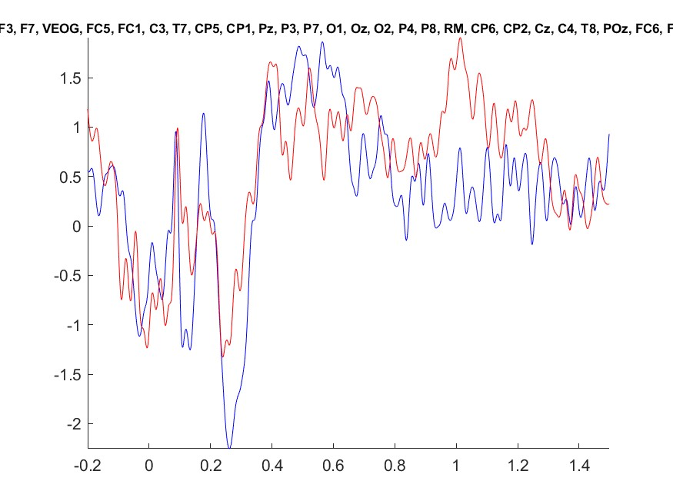
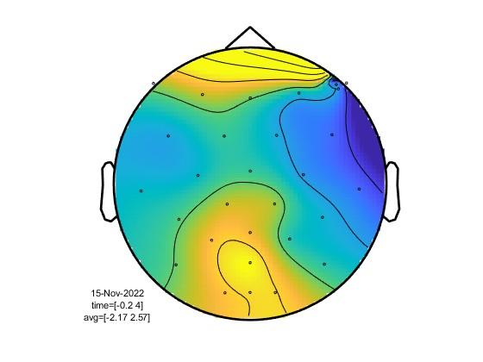
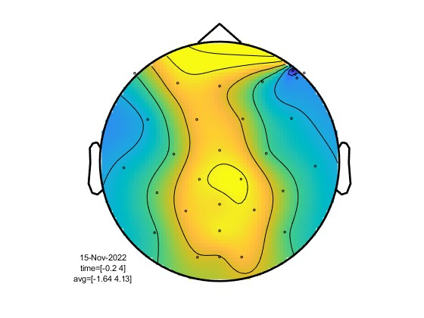
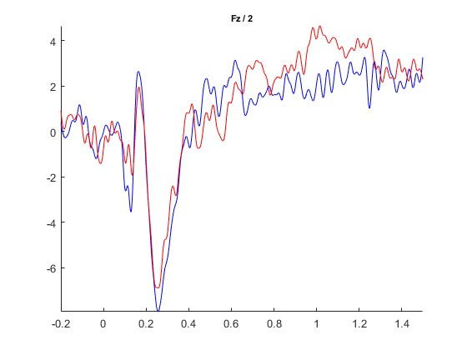
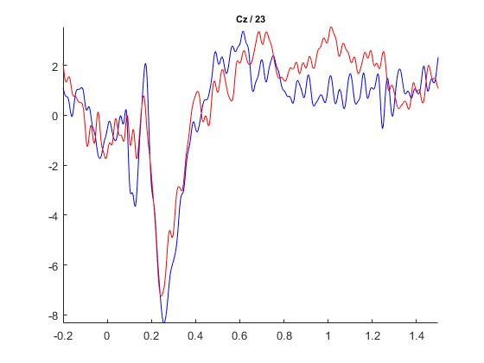
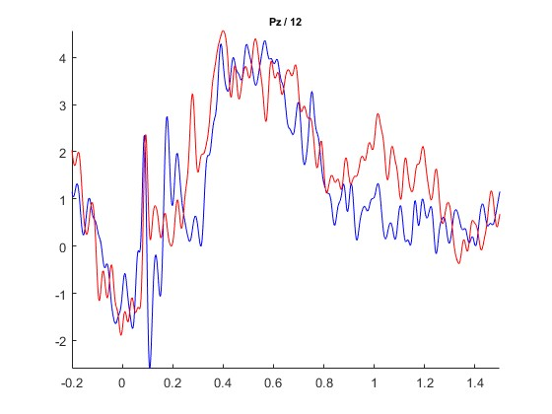
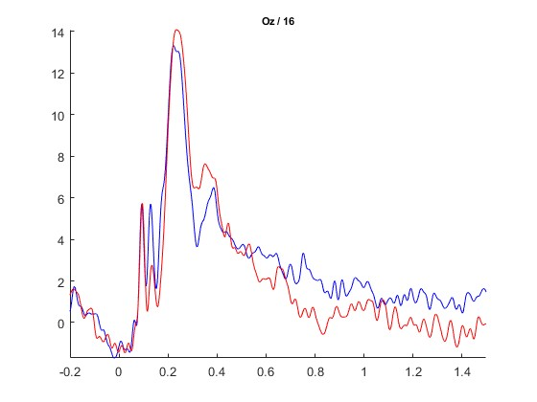
Check the performance of different decoders on the applied model
check event-related potential(ERP) : re-visit ‘fieldtrip’
object
scene
Fz
Cz
Pz
Oz
Notes:
maybe) blue = object / red = scene

Slide 18
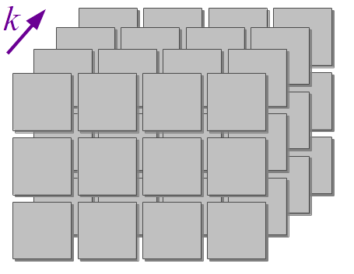
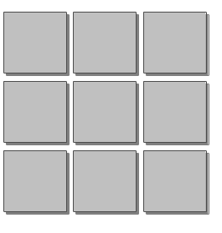
Check the performance of different decoders on the applied model
check decoding performance using different models
X = epochs.get_data()
y = epochs.events[:, 2]
X: information of EEG signal (epoch×channel×timepoint)
y: information of trial
epochs
time point
start
time
trigger
channel
Notes:
images from Programming Idioms
3D) https://programming-idioms.org/idiom/27/create-a-3-dimensional-array/1675/lua
2D) https://programming-idioms.org/idiom/26/create-a-2-dimensional-array/448/rust

Slide 19
Check the performance of different decoders on the applied model
check decoding performance using different models : regression model
make estimator
lin_pipe = make_pipeline(Scaler(train_epochs.info),
Vectorizer(), LogisticRegression(solver='liblinear'))
make_pipeline(steps, memory, verbose): construct pipeline from given estimators
Scalar: standardize data based on channel scale
Vectorizer: transform data from MNE(n-dimention) to scikit-learn(2-dimention)
LogisticRegression: logistic regression classifier
→ ‘lbfgs’, ‘liblinear’, ‘newton-cg’, ‘newton-cholesky’, ‘sag’, ‘saga’
Notes:
make_pipeline: https://scikit-learn.org/stable/modules/generated/sklearn.pipeline.make_pipeline.html#sklearn.pipeline.make_pipeline
Scalar: https://mne.tools/stable/generated/mne.decoding.Scaler.html#
Vectorizer: https://mne.tools/stable/generated/mne.decoding.Vectorizer.html#
LogisticRegression: https://scikit-learn.org/stable/modules/generated/sklearn.linear_model.LogisticRegression.html#sklearn.linear_model.LogisticRegression

Slide 20
Check the performance of different decoders on the applied model
check decoding performance using different models : regression model
lin_scores = cross_val_multiscore(lin_pipe, X, y, cv=5, n_jobs=None)
lin_score = np.mean(lin_scores, axis=0)
conduct cross-validation
cross_val_multiscore(estimator, X, y, groups, scoring, cv, n_jobs, verbose, fit_params, pre_dispatch)
estimator: object used in fitting data → pipeline
X: data to fit → n_sample×n_dimension_of_feature
y: target data to predict → n_sample×n_target
cv: cross-validation splitting strategy → k-fold
n_jobs: the number of jobs to run in parallel → integer, None, -1 (the number of CPU cores)
Notes:
https://mne.tools/stable/generated/mne.decoding.cross_val_multiscore.html#

Slide 21
Check the performance of different decoders on the applied model
check decoding performance using different models : support vector machine(SVM)
svm_pipe = make_pipeline(Scaler(train_epochs.info), Vectorizer(),
SVC(decision_function_shape='ovo'))
svm_scores = cross_val_multiscore(svm_pipe, X, y, cv=5, n_jobs=None)
svm_score = np.mean(svm_scores, axis=0)
SVC: C-Support Vector Classification
→ ‘ovo’(one-vs-one decision), ‘ovr’(one-vs-rest decision)
Notes:
https://scikit-learn.org/stable/modules/generated/sklearn.svm.SVC.html#sklearn.svm.SVC

Slide 22
[23-winter vacation] Sharing-Knowledge Meeting
Thank You
see ya!
Jeong, Jiyeon & Lee, Hansol

