Slide 1
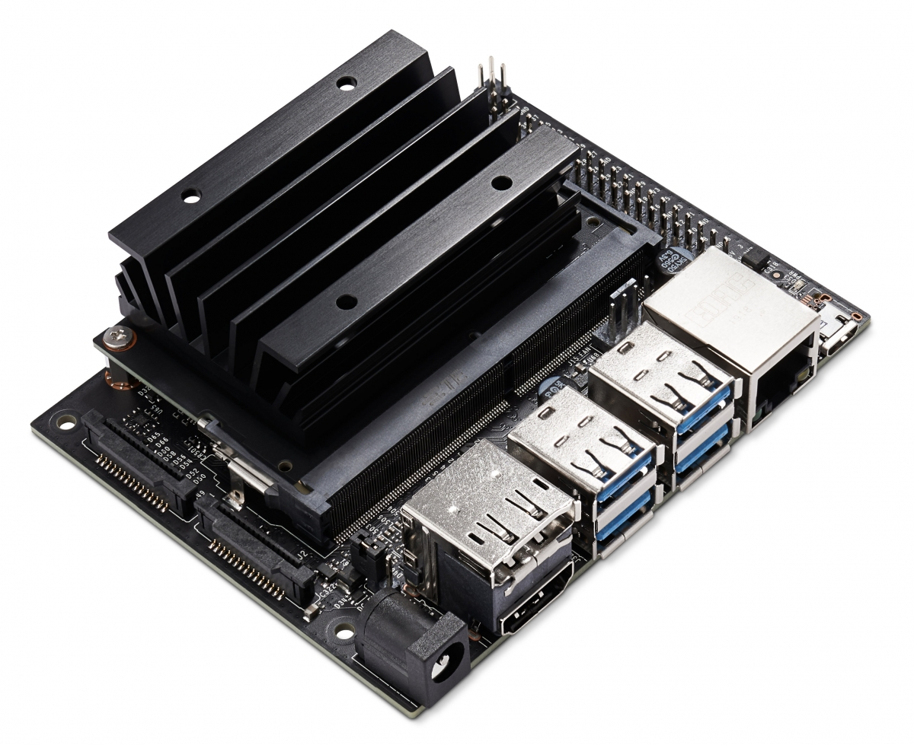
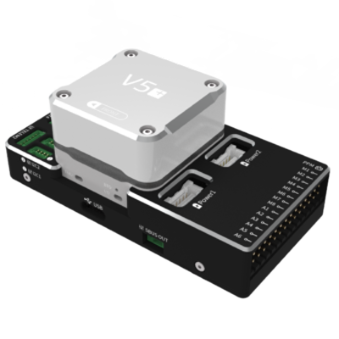
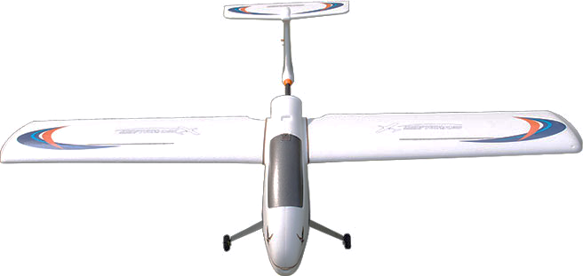
HOST COMPUTER
FIXED_WING_FORMATION_CONTROL
NODE1
MAVROS
NODE2
attitude setpoint
plane states
ATTITUIDE INNER LOOP
SALVE COMPUTER
actuator
plane states
UAV DYNAMAIC
PLATFORM

Slide 2
ROS
PX4 on SITL
MAVLINK
UDP
FIXED_WING_FORMATION_CONTROL
mavlink_main.cpp
NODE1
NODE2
UDP
port 14540
MAVROS
port 14580
port 14550
QGC Ground Station
UDP
port 14570
Gazebo Simulator
UDP
random port
simulator_mavlink.cpp
TCP 4560

